Slide 1

WORK IN SKINS
Archaeology of Work in Skins Exercise
Adapted from Teaching eHRAF Exercise 2.4 “Hide Working and Tanning Leather” by Christiane Cunnar

Slide 2

In this assignment, you will be
Leather cover of German book published in 1789. Oryct. Carniolica. Public Domain Image.
conducting research on strategies
for work in skins, and synthesizing this data by extrapolating the sorts of marks, traces, and indications that hide working practices might leave in the archaeological record.
WORK IN SKINS

Slide 3
EXERCISE DETAILS
TIME: 45 minutes
MATERIALS REQUIRED:
➤
HRAF Access
Worksheet and pen or other materials for recording answers
➤
STUDENT LEARNING OUTCOMES:
At the end of this Exercise, students will be able to:
➤
describe the material traces left by hide working practices.
explain the social context of hide working practices in multiple Native North American societies
demonstrate an understanding of secondary data collection and analysis techniques that archaeologists use to ethnographically and historically situate material evidence at given sites
construct eﬀective and eﬃcient search strategies in eHRAF in order to retrieve data relevant to a specific topic/assignment.
➤
➤
➤

Slide 4

LEATHER GOODS
Practices of processing animal hide for human use are commonly referred to work in skins, hide working, tanning, or skin dressing.
In the United States, and in many other societies, leather is an integral part of fashion and household living.
PRADA Leather iPhone Case in Taipei Taiwan. By Luke Ma 2012.CC-by-2.0 via Wikimedia Commons
This Teaching Exercise is provided by the Human Relations Area Files at Yale University in New Haven, CT

Slide 5
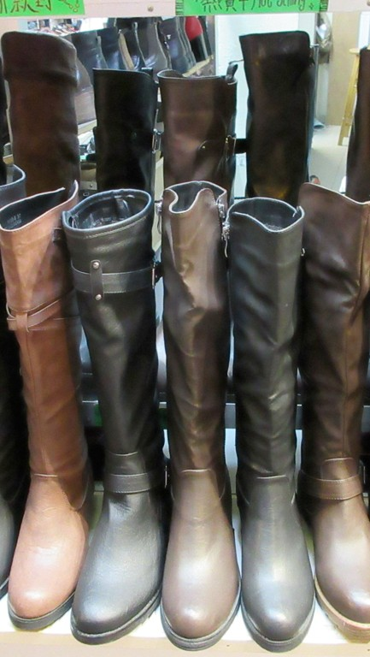
Shop in 皇后⼤道西, Queen's Road West, Sai YIng Pun, Hong Kong. SsunaHram. CC 4.0
For example, in North America many people own shoes or belts made out of leather, and some have leather journals, jackets, chairs, or sofas.
LEATHER GOODS

Slide 6

INDUSTRIALIZATION OF WORK IN SKINS IN USA
This Teaching Exercise is provided by the Human Relations Area Files at Yale University in New Haven, CT
➤
For most parts, hide working in the USA was usually an industrialized process in the 20th century, with artisanal exceptions.
Old English Tannery. Photo by Mike Quinn. CC-BY-2.0 via Wikimedia Commons

Slide 7
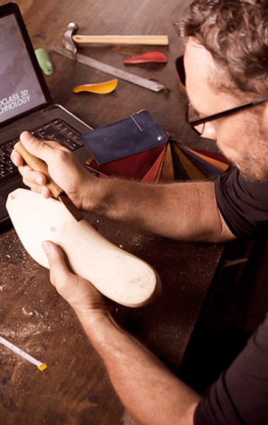
HAND-TANNING METHODS PERSIST
➤
By 2010, with the economic growth of handmade creative markets,
“diy” (do-it-yourself) craftspersons and organic leather studios found broader exposure for ‘traditional’ methods of hide working that rely on natural ingredients and individual craftsmanship.
“The Finest Handmade Bespoke Shoes from Canada” 2016 by Veritas Bespoke. CC-BY-4.0 via Wikimedia Commons
This Teaching Exercise is provided by the Human Relations Area Files at Yale University in New Haven, CT

Slide 8
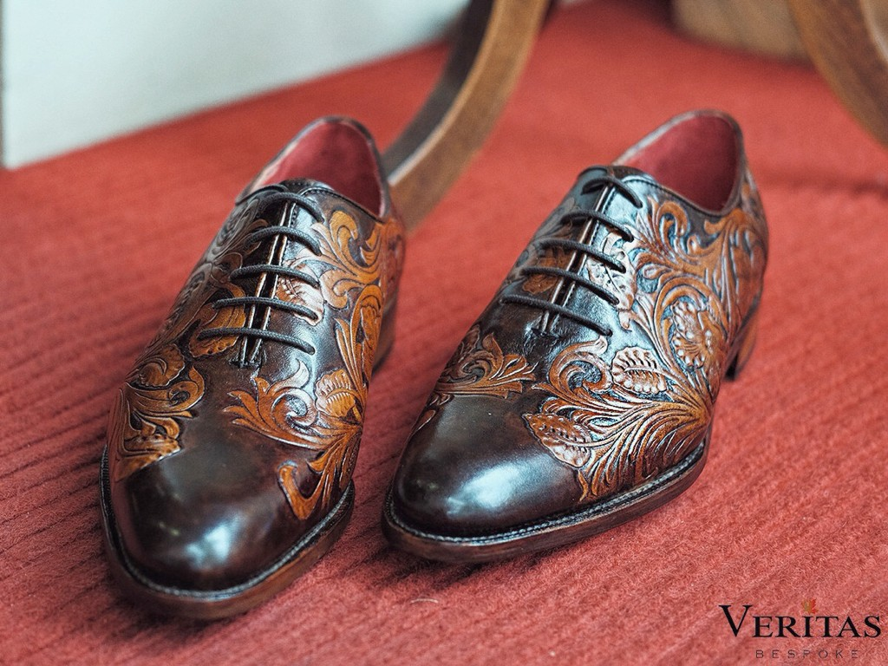
These methods of hide working are connected to older, pre- industrial practices that have been kept alive by communities of craftspersons around the world.
“The Finest Handmade Bespoke Shoes from Canada” 2016 by Veritas Bespoke. CC-BY-4.0 via Wikimedia Commons
This Teaching Exercise is provided by the Human Relations Area Files at Yale University in New Haven, CT
This Teaching Exercise is provided by the Human Relations Area Files at Yale University in New Haven, CT

Slide 9
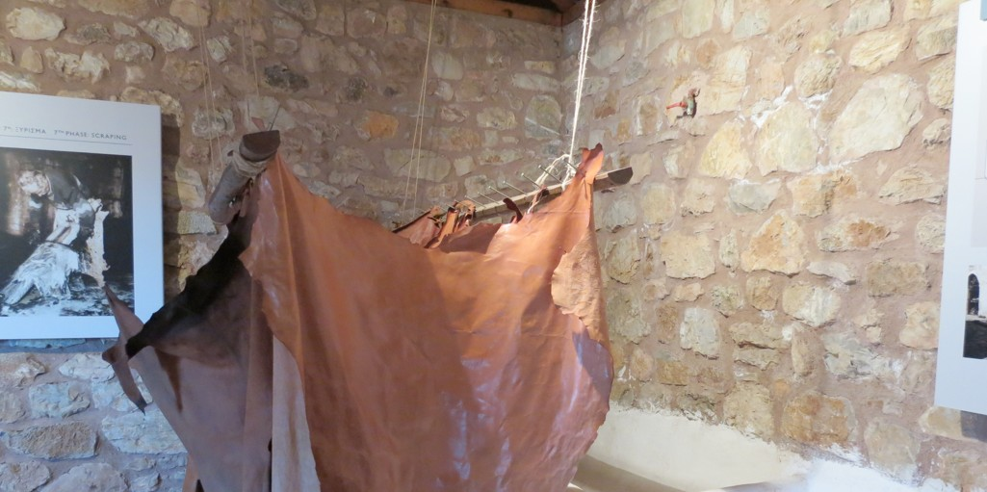
Compared to industrial processes, these small-scale methods of hide-working are long and labor-intensive involving several discrete stages—such as the removal of hair, the preparation of ingredients, soaking of skins, and kneading and conditioning.
Leather tanning part of the open air museum for hydro power at Dimitsana, Arkadia, Greece. 29 December 2013. Dkoukoul. CC- BY-3.0 via Wikimedia Commons
This Teaching Exercise is provided by the Human Relations Area Files at Yale University in New Haven, CT
This Teaching Exercise is provided by the Human Relations Area Files at Yale University in New Haven, CT

Slide 10
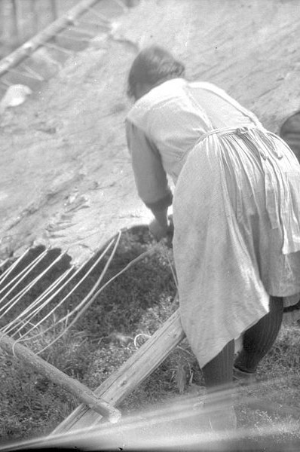
GENDER STRATIFICATION
Looking to the ethnographic record, it appears that this multi- step, processually-complex and chemically-precise work was more often than not performed by women and girls
Cree women working on a large moose hide - Waterhen River area, Northern Saskatchewan. Provincial Archives of Alberta
@ Flickr Commons. Public Domain Image.
This Teaching Exercise is provided by the Human Relations Area Files at Yale University in New Haven, CT

Slide 11
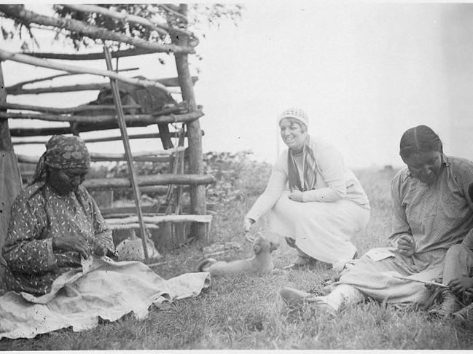
This Teaching Exercise is provided by the Human Relations Area Files at Yale University in New Haven, CT
In this assignment, you will imagine that you are an archaeology student assisting in the excavation of a faunal assemblage at a historic site in the North American plains region. You find evidence for hide working, and decide to consult the ethnographic literature to learn more about hide working processes.
ASSIGNMENT
Indian women tanning hides. 1932. NARA’s Central Plains Region (Kansas City) (NREA). Public Domain Image

Slide 12
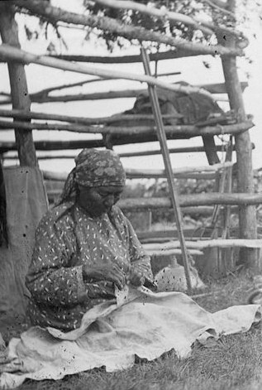
ASSIGNMENT PART 1
Use sources in eHRAF World Cultures to compare and contrast the hide working methods employed by three Native North American groups.
First, choose three Native American societies from the following page for comparing hide working methods (1-2 minutes).
Indian women (Cree?) Tanning Hides. 1932. NARA’s Central Plains Region (Kansas City) (NREA). Public Domain Image
This Teaching Exercise is provided by the Human Relations Area Files at Yale University in New Haven, CT

Slide 13
NATIVE AMERICAN SOCIETIES THAT WORK IN HIDES
Culture Name
Kaska Pawnee
Western Apache
Haida
Blackfoot
Ojibwa
Western Woods
Cree
Nuu-chah-nulth
Comanche
Nuxalk
Gros Ventre
Havasupai
Cherokee
Pomo
Klamath
Hopi
Navajo
Crow Aleut
Maricopa
Creek
Quinault
Omaha
Delaware
Tlingit
Osage
Mescalero Apache
Fox
Northern Paiute
Tubatulabal
Stoney
Alutiiq
Iroquois
Mi'kmaq Seminole
Winnebago/Ho- Chunk
Chinookans of the Lower Columbia River
Yokuts
Cajuns
O'odham
Chipewyans
Tewa Pueblos
Yuki
Chicanos
Copper Inuit
Ute
Yurok
Sea Islanders
Ingalik
Zia Pueblo
Assiniboine
Eastern Apache
Innu
Zuni

Slide 14
Fill in the following information for each society using Advanced Search in eHRAF World Cultures
To conduct an Advanced Search for paragraphs on hide working, add all three of your chosen societies in the "Add Cultures" box, then add in the subject category “work in skins” and execute the search.
For a brief step-by-step video guide to conducting an Advanced Search in eHRAF, click here.
Society A Society B Society C
Division of Labor: (If there is a division of labor for hide working, how is work allocated?)
Length of Time/Persons (Roughly how long and how many people does it take to process hides?)
Tools and Materials (What tools and materials are used? )
ASSIGNMENT PART 1

Slide 15
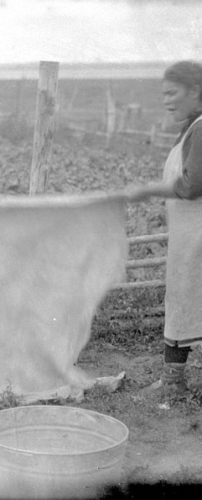
ASSIGNMENT PART 2
After you have answered the above questions using ethnographic data, choose one of the two societies as a case study and answer the following questions:
Based on the sorts of work in skins you explored:
What evidence of working in skins would you expect to find in the archaeological record of this society? (5 minutes)
Where would you look for it? (5 minutes)
And how would you distinguish it from other zoological evidence or other practices? (5 minutes)
Cree women working on a large moose hide - Waterhen River area, Northern (NREA). Public Domain Image via Wikimedia Commons
This Teaching Exercise is provided by the Human Relations Area Files at Yale University in New Haven, CT

Slide 16
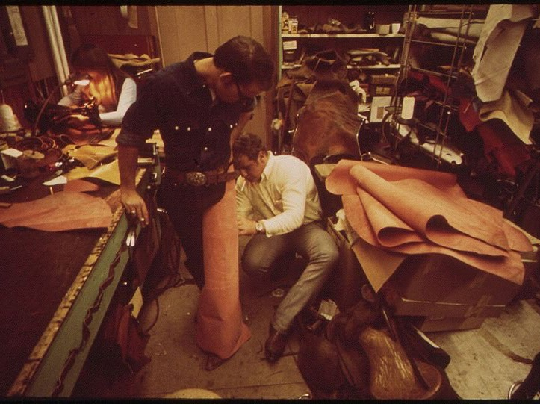
This Teaching Exercise is provided by the Human Relations Area Files at Yale University in New Haven, CT
RESOURCES
Assignment Rubric, Tips, References
Young Cowboy Is Being Fitted for Chaps at the Rifle Leather Shop, 10/1972 David Hisler. The U.S. National Archives @ Flickr Commons

Slide 17
RUBRIC
➤
The following rubric is suggested for evaluating responses:
Unsatisfactory (0%) |  | Needs Improvement (25%) | Satisfactory (75%) | Outstanding (100%)
Assignment | Unsatisfactory ➤ Table for hide working across societies is absent | Needs Improvement ➤ Tables for hide working across societies is sparsely filled in with information from only 1-2 societies. | Satisfactory ➤ Table for hide working includes several societies with detailed information | Outstanding ➤ Table for hide working is robust across multiple societies with detailed information on gender division, length of time, and tools/materials
Part 1:
Data
Collection
Assignment | Unsatisfactory ➤ Major points are not clear. ➤ Specific examples are not used. | Needs Improvement ➤ Commentary on research findings is not comprehensive and /or persuasive. ➤ Major points are addressed, but not well supported. ➤ Responses are inadequate or do not address topic or response to the questions ➤ Specific examples do not support topic or response to the questions. | Satisfactory ➤ Evaluation and analysis of research findings is accurate. Major points are stated. ➤ Responses are adequate and address the question at hand. ➤ Content is accurate ➤ A specific example from the research is used. | Outstanding ➤ Evaluation and analysis of research findings is accurate and persuasive. ➤ Major points are stated clearly and are well supported. ➤ Responses are excellent and address questions ➤ Content is clear. ➤ Several specific examples from the research are used.
Part 2:
Questions
1-3

Slide 18
FURTHER READING
➤
For more exercises and teaching resources related to human societies past and present, explore Teaching eHRAF.
For a more detailed version of this particular exercise with additional questions and activities check out Exercise 2.4 Hide Working by Christiane Cunnar.
Check out the Advanced Search Tutorial for detailed instructions on conducting searches in eHRAF World Cultures.
For information on hide working practices in the archaeological record, check out eHRAF Archaeology.
➤
➤
➤

