Slide 1

ALTERED STATES OF CONSCIOUSNESS
Trance Styles Exercise
Adapted from eHRAF Teaching Exercises 1.26 Altered States of Consciousness by Jack Dunnington, Carol R. Ember, and Erik Ringen.

Slide 2

TRANCE STYLES
In this exercise, you will read, compare, and contrast ethnographic work on Middle America and Caribbean trance practices.
Tibetan Rope Incense. By GrammarFascist CC BY-SA 4.0 via Wikimedia Commons
This Teaching Exercise is provided by the Human Relations Area Files at Yale University in New Haven, CT

Slide 3
EXERCISE DETAILS
EXERCISE DETAILS
TIME: 35 minutes
MATERIALS REQUIRED:
➤
HRAF Access
Worksheet and pen or other materials for recording answers
➤
STUDENT LEARNING OUTCOMES:
At the end of this Exercise, students will be able to:
➤
describe and explain diﬀerences in possession and trance phenomena
demonstrate knowledge of how these diﬀerences have been organized into types by anthropologists
use the possession typology to categorize trance and possession phenomena in the ethnographic records of multiple societies.
construct eﬀective and eﬃcient search strategies in eHRAF in order to retrieve data relevant to a specific topic/assignment.
➤
➤
➤
This Teaching Exercise is provided by the Human Relations Area Files at Yale University in New Haven, CT

Slide 4
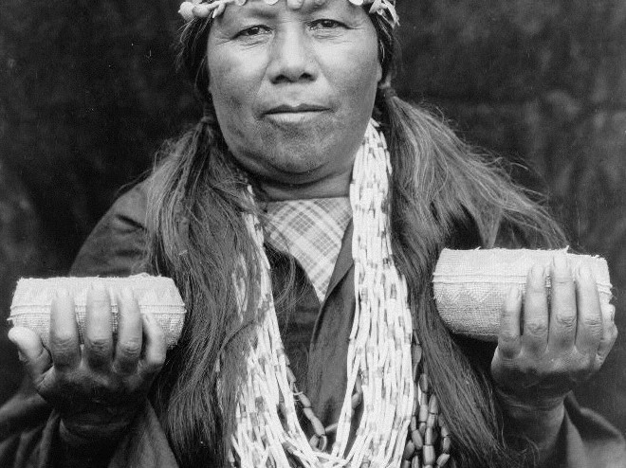
This Teaching Exercise is provided by the Human Relations Area Files at Yale University in New H
Trance and other altered states of consciousness are strongly associated with healing practices of shamans, a subset of magico-
religious healers.
Hupa Female Shaman. Photo by Edward S. Curtis. Public Domain Image, via Wikimedia Commons.
This Teaching Exercise is provided by the Human Relations Area Files at Yale University in New Haven, CT

Slide 5
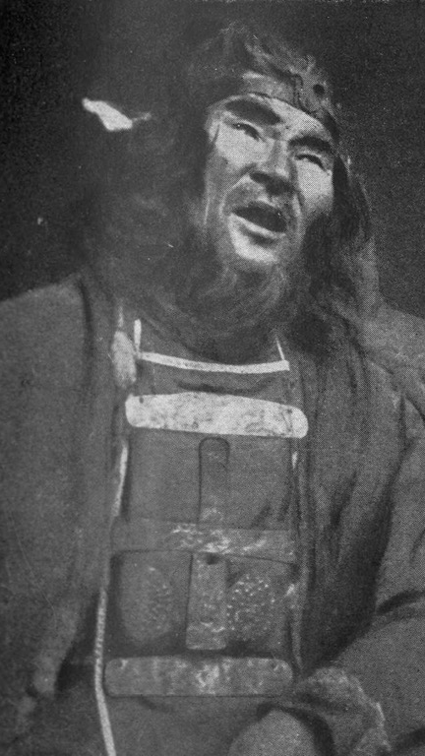
Among shamans, trances are usually induced by mechanisms such as singing, chanting, drumming, or dancing, after which the shaman in training or practice collapses and becomes unconscious and has intense visual experiences.
TRANCE AND SHAMANISM
Shaman of the Yenisei-Ostiaks (Sumarokova, Sept. 16th)”. 1914. Nansen Fridtjof Wedel-Jarlsberg. Public Domain Image.
This Teaching Exercise is provided by the Human Relations Area Files at Yale University in New Haven, CT

Slide 6
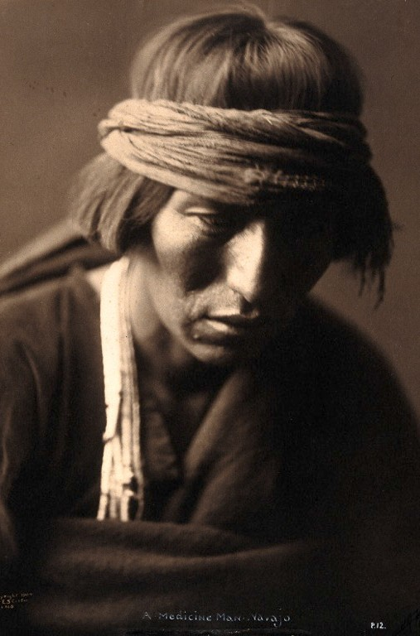
TRANCE STATES
These experiences presumably induce a state of relaxation that replaces fast brain activity in the front areas of the brain with slow wave activity representing more emotional information (Winkelman 1986)
Portrait of a medicine man, Navajo, in trance. Edward S Curtis. Wellcome Images CC BY 4.0. via Wikimedia Commons
This Teaching Exercise is provided by the Human Relations Area Files at Yale University in New Haven, CT

Slide 7
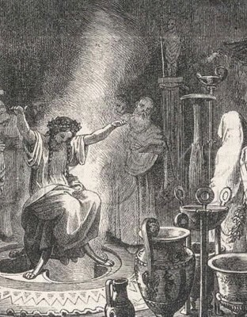
Institutionalized trances are generally divided into experiences in which the soul is believed to leave the body, we will call those Type A…
TYPE A
The Pythia, or high priestess who held court at Pytho, would channel prophecies from Apollo in a dreamlike trance seated above medicinal smokes. Oracle of Delphi Entranced. Detail of Etching by Heinrich Leutemann.
Public Domain Image.
This Teaching Exercise is provided by the Human Relations Area Files at Yale University in New Haven,
CT

Slide 8
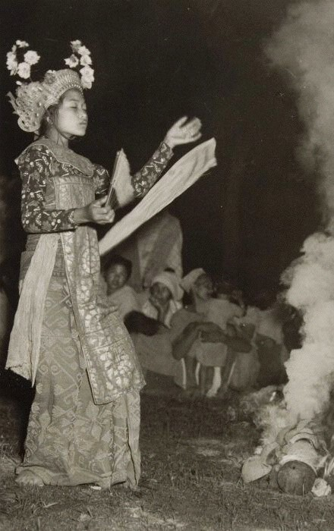
The Sanghyang dance is a sacred dance performed by two young girls. During this dance, it is believed that a force enters the body of an entranced performer and takes over her movements. Photo of Sang Hyang Dans by Tropenmuseum, part of the National Museum of World Cultures CC BY-SA 3.0 via Wikimedia Commons
…and experiences in which a person’s body is possessed or taken over by a spirit, we will call those “Type B”…
TYPE B
This Teaching Exercise is provided by the Human Relations Area Files at Yale University in New Haven, CT

Slide 9
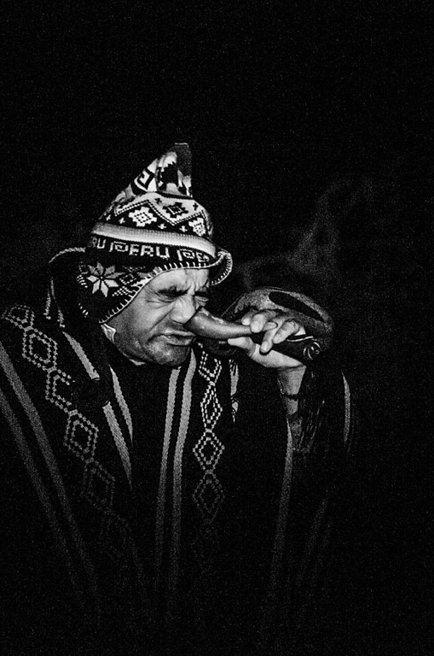
METHODS OF INDUCTION
Diﬀerent methods are used to induce trances cross- culturally. These methods can require excessive physical movement (including shamanic drumming and dancing mentioned above), but may also involve sleep deprivation, fasting, sleep, and psychoactive drugs.
A shaman in Huancambamba, Peru imbibes tobacco and other medicines in the midst of a ritual for healing a sick patient. Image: Curandero Singando Por La Fosa Nasal Izquierda en Huancabamba, Piura, Peru. Sebastián Castañeda Vita CC-by-4.0
This Teaching Exercise is provided by the Human Relations Area Files at Yale University in New Haven, CT

Slide 10
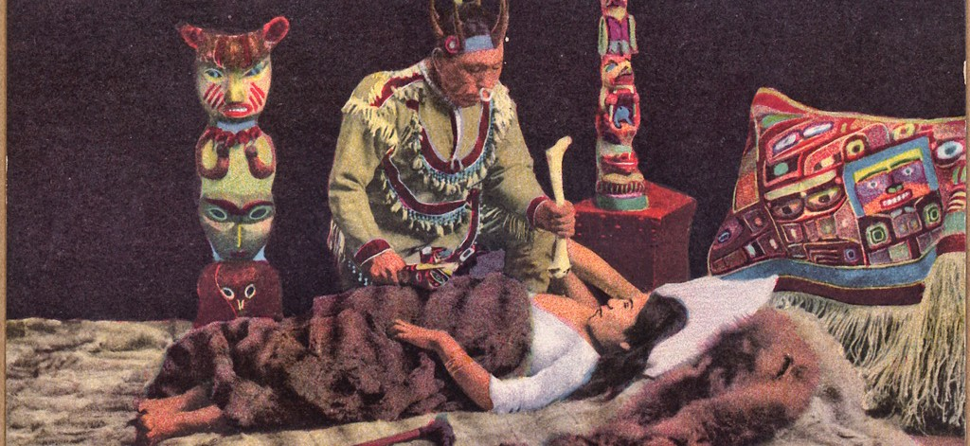
CORRELATIONS IN TRANCE INDUCTION METHODS
These types of behaviors are not haphazard; if sleep deprivation is present, fasting and social isolation are often also present, such as when a young person goes alone into the forest on a quest for a guardian spirit. Moreover, these types of induction methods rarely are associated with possession trance (Winkelman 1986)
Dramaticized image of Indian shaman healing a sick patient, distributed as a novelty item on a postcard. Henry Solomon Wellcome. held by NARA Pacific Alaska Region. Public Domain Image via Wikimedia Commons.
This Teaching Exercise is provided by the Human Relations Area Files at Yale University in New Haven, CT
This Teaching Exercise is provided by the Human Relations Area Files at Yale University in New Haven, CT

Slide 11
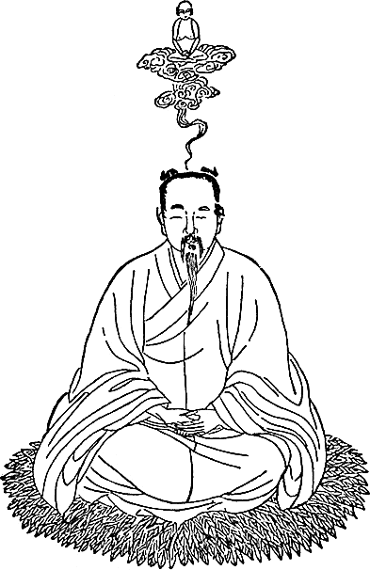
SLEEP TRANCE
If sleeping is the induction method, trance usually involves a non-possession trance such as a soul journey. Possession trances, on the other hand, are associated with subsequent amnesia, convulsions, and spontaneous onset of trances (Winkelman 1986).
A Tao priest enters deep meditative trance during which his spirit embarks upon a journey. Illustration from Richard Wilhelm “The Secret of the Golden Flower”. Public Domain Image via Wikimedia Commons
This Teaching Exercise is provided by the Human Relations Area Files at Yale University in New Haven, CT

Slide 12
ASSIGNMENT PART 1
➤
Using “ADVANCED Search” in eHRAF, search for the subject altered states of consciousness (trances) using its corresponding OCM code (Ecstatic Religious Practices, 786 OR Revelation and Divination, 787) in conjunction with the word trance*.
Narrow your search to include only cultures within the Middle America and Caribbean subregion.
Browse through the search results of these 5 cultures: Garifuna (Gonzalez document), Haitians (Laguerre document), Huichol (Myerhoff document), Kuna (Chapin document), and Miskito (Conzemius document). Look for examples of each type (A or B) of institutionalized trance and note them.
➤
➤
This Teaching Exercise is provided by the Human Relations Area Files at Yale University in New Haven, CT

Slide 13
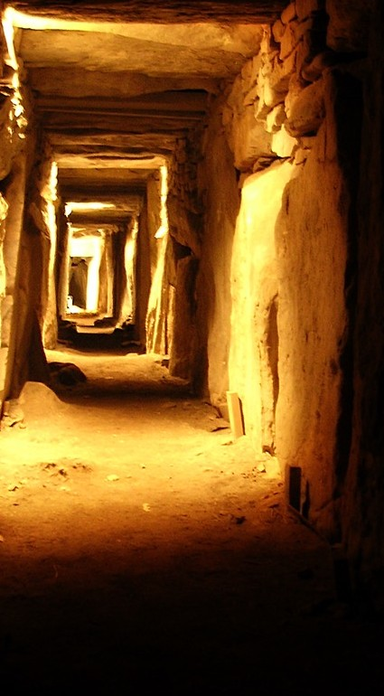
ASSIGNMENT PART 2
Question 3: How many examples of each type (A & B) did you find? (5 minutes)
Question 2: What criteria did you use to identify them? (5 minutes)
Image of Eastern Passage, Knowth, Ireland, where cavernous hallways and rooms are thought to have been used by ancient people’s to induce altered states of consciousness. Photo By Przemysław Sakrajda CC BY- SA 3.0 via Wikimedia Commons
This Teaching Exercise is provided by the Human Relations Area Files at Yale University in New Haven, CT

Slide 14
ASSIGNMENT PART 3
Question 3: How does the definition of “types” in anthropology, such as types of ritual behavior as we discussed here, become useful for ethnographic or anthropological research? (5 minutes)
Question 4: Are there limits to the value of “types” and “models” for grouping and explaining human variation? If so, please describe. (5 minutes)?
Question 5: How should anthropologists balance the benefits of “typologies” with the limits of typological models? (5 minutes)
This Teaching Exercise is provided by the Human Relations Area Files at Yale University in New Haven, CT

Slide 15
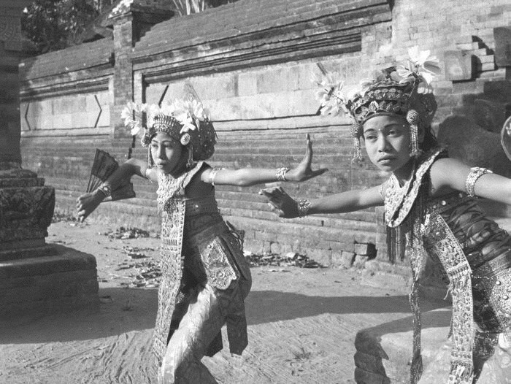
This Teaching Exercise is provided by the Human Relations Area Files at Yale University in New Haven,
RESOURCES
Assignment Rubric, Tips, References
Balinese Legong Dancers 1953.P. (Paul) Spies . TropenMuseum, part of the National Museum of World Cultures. CC by SA 3.0 via Wikimedia Commons

Slide 16
RUBRIC
➤
The following rubric is suggested for evaluating responses:
Unsatisfactory (0%) |  | Needs Improvement (25%) | Satisfactory (75% | Outstanding (100%)
Assignment Part 1: Questions 1-2 | Unsatisfactory ➤ Answers are absent or mostly incomplete | Needs Improvement ➤ Answers are only partially completed and/or inaccurate | Satisfactory ➤ Answers are paritally complete and accurate | Outstanding ➤ Answers are complete and accurate
Assignment Part 3: Questions 3-5 | Unsatisfactory ➤ Major points are not clear. ➤ Specific examples are not used. | Needs Improvement ➤ Commentary on research findings is not comprehensive and /or persuasive. ➤ Major points are addressed, but not well supported. ➤ Responses are inadequate or do not address topic or response to the questions ➤ Specific examples do not support topic or response to the questions. | Satisfactory ➤ Evaluation and analysis of research findings is accurate. Major points are stated. ➤ Responses are adequate and address the question at hand. ➤ Content is accurate ➤ A specific example from the research is used. | Outstanding ➤ Evaluation and analysis of research findings is accurate and persuasive. ➤ Major points are stated clearly and are well supported. ➤ Responses are excellent and address questions ➤ Content is clear. ➤ Several specific examples from the research are used.
This Teaching Exercise is provided by the Human Relations Area Files at Yale University in New Haven, CT

Slide 17
FURTHER READING
➤
For more information on altered states of consciousness across time, space, and society check out the Altered States of Consciousness module by Carol Ember and Christina Carolous in HRAF’s Explaining Human Culture database.
For a more detailed version of this particular exercise with additional questions and activities check out eHRAF Teaching Exercises 1.26 Altered States of Consciousness by Jack Dunnington, Carol R. Ember, and Erik Ringen.
Check out the Advanced Search Tutorial for detailed instructions on conducting searches in eHRAF World Cultures.
For more exercises and teaching resources related to human societies past and present, explore Teaching eHRAF
➤
➤
➤
This Teaching Exercise is provided by the Human Relations Area Files at Yale University in New Haven, CT

Slide 18
REFERENCES
➤
Winkelman, Michael. 1986. “Trance States: A Theoretical Model and Cross- Cultural Analysis.” Ethos 14 (2): 174–203. doi:10.1525/eth.
1986.14.2.02a00040
Winkelman, Michael. 2006. “Cross-Cultural Assessments of Shamanism as a Biogenetic Foundation for Religion.” In The Psychology of Religious Experience, edited by Patrick McNamara. Vol. 3. Where God and Science Meet. Westport, Ct.: Prager Publishers.
➤
This Teaching Exercise is provided by the Human Relations Area Files at Yale University in New Haven, CT

