Slide 1

ETHNOBOTANY
Ethnobotanical Medicines Exercise
Adapted from Teaching eHRAF Exercise 3.1: Topics in Medical Anthropology, Section 5: Ethnobotany and its Medical Uses by Christiane Cunnar

Slide 2
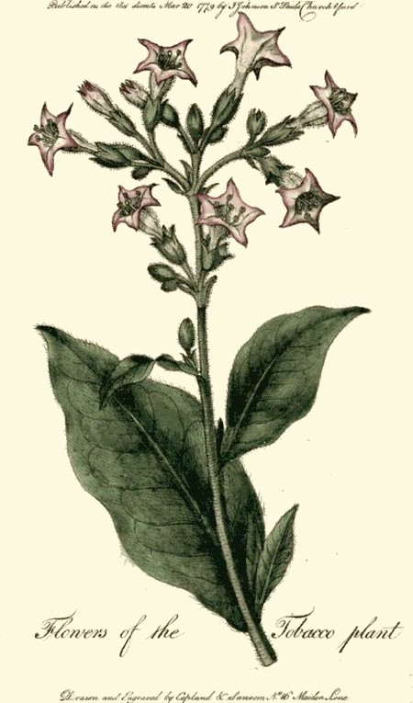
This exercise asks you to explore ethnobotanical practices across several societies.
Tobacco plant botanical drawing drawn and engraved by Copland & Samsun 1789. Public Domain Image
ETHNOBOTANICAL
MEDICINE

Slide 3
EXERCISE DETAILS
TIME: 30 minutes
MATERIALS REQUIRED:
HRAF Access
Worksheet and pen or other materials for recording answers
➤
➤
STUDENT LEARNING OUTCOMES:
At the end of this assignment, you will be able to:
➤
compare and contrast the cultural views regarding medicinal properties of common plants, herbs, and fruits.
construct eﬀective and eﬃcient search strategies in eHRAF in order to retrieve data relevant to a specific topic/assignment.
appreciate the cultural diversity of medicinal knowledge across the globe
➤
➤

Slide 4
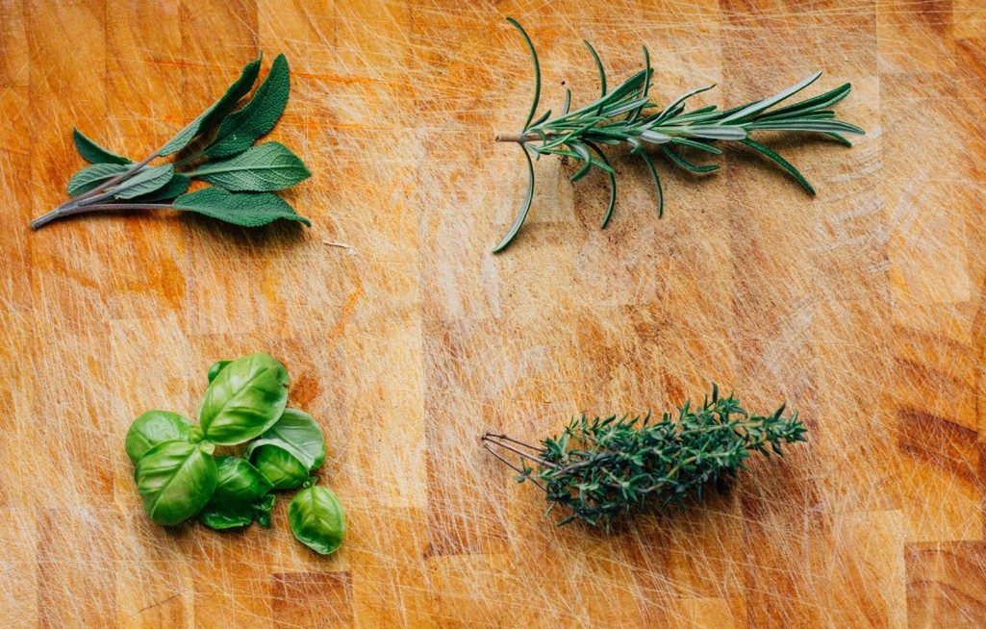
In many traditional medical practices, plants, herbs, and fruits are used for their healing properties.
Assembled herbs. Jonas Weckschmied on Flickr. Public Domain Image
This Teaching Exercise is provided by the Human Relations Area Files at Yale University in New Haven, CT

Slide 5
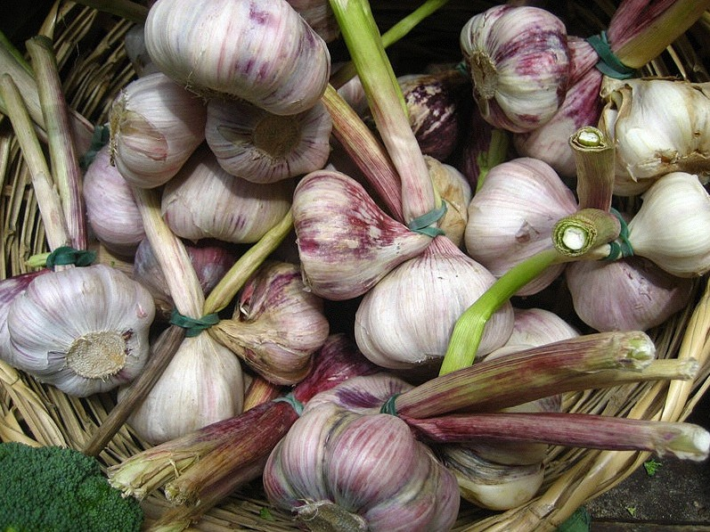
For example, the antiseptic properties of garlic are known to a great number of societies. Garlic has been used to cure everything from bites, colds, boils, and furuncles, to wounds and fevers.
A basket of garlic cloves from the farmer’s market. By Jeremy Keith from Brighton & Hove, United Kingdom [CC BY 2.0 (http:// creativecommons.org/licenses/by/2.0)], via Wikimedia Commons
This Teaching Exercise is provided by the Human Relations Area Files at Yale University in New Haven, CT

Slide 6
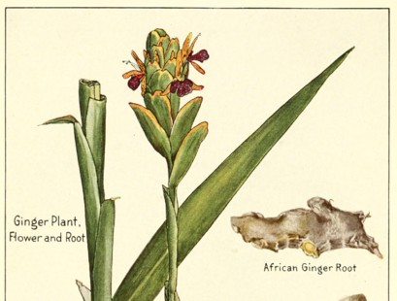
This Teaching Exercise is provided by the Human Relations Area Files at Yale University in New Haven, CT
Ginger is also widespread as a remedy. It is not only used for treating eye inflammations, stomach-aches, fevers and colds, but it is also used for childbirth.
Ginger and its Varieties. McCormick and company [Public domain], via Wikimedia Commons

Slide 7
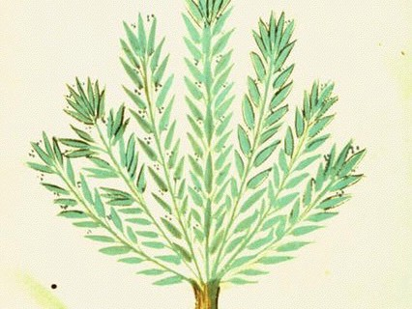
Rosemary is a good “general” herbal medication and will cure everything from headaches to toothaches.
Rosemary sketch. By Unknown artist from Italy [Public domain], via Wikimedia Commons
This Teaching Exercise is provided by the Human Relations Area Files at Yale University in New Haven, CT

Slide 8
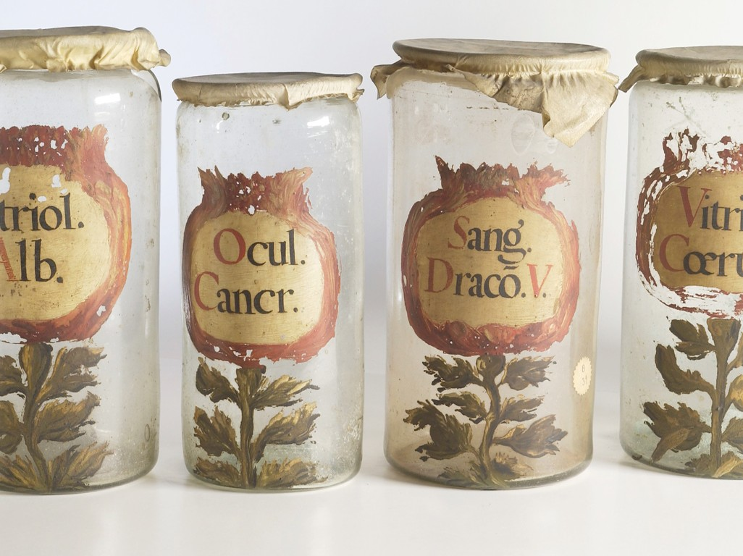
In this exercise, you will explore the medicinal uses of a specific
plant, herb, or fruit across a number of societies and world regions in order to better grasp variations in traditional
medicinal practices.
ASSIGNMENT
Selection of Apothecary Jars. Wellcome Images. UK CC 4.0 via Wikimedia.
This Teaching Exercise is provided by the Human Relations Area Files at Yale University in New Haven, CT

Slide 9
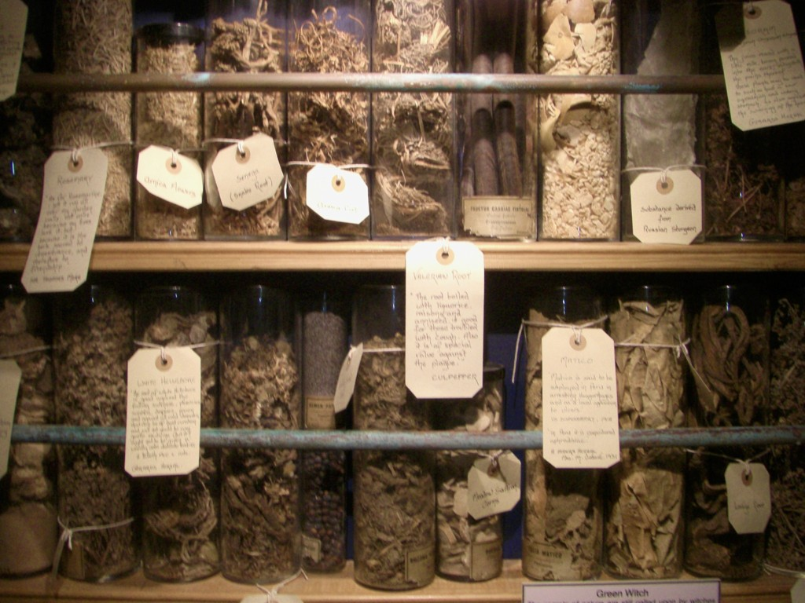
ASSIGNMENT PART 1
A selection of jars containing herbs and other ingredients used by Cunning folk in Britain. Museum of Witchcraft. Photo by Midnightblueowl. CC 1.0
Choose a plant, herb, or fruit from the following list
➤
➤
➤
➤
➤
Garlic Basil Ginger Ginseng Juniper
➤
➤
➤
➤
Mint Parsley Rosemary Sage
This Teaching Exercise is provided by the Human Relations Area Files at Yale University in New Haven, CT

Slide 10
ASSIGNMENT PART 1
Now, create a table of your chosen plant & medicinal uses across the world.
➤
Perform an advanced search in eHRAF.
Combine the name of your plant (as a keyword) with medicinally-related OCM identifiers across world regions.
➤
Tip: Use OCM subjects such as bodily injuries, mental and magical therapy, medical therapy, pharmaceuticals, child birth, post-natal care, and more.
Example Table:
Culture Name | Bodily Injuries | Magical Therapy | Childbirth
Cultural A | Basil leaves and stems crushed and applied as a poultice to open wounds and burns | Basil leaves crumbled and spread at doorways to ward oﬀ evil energies | No
Culture B | Basil root applied to skin over sprains | No | Basil stems chewed by mother, burned as incense in room
This Teaching Exercise is provided by the Human Relations Area Files at Yale University in New Haven, CT

Slide 11
ASSIGNMENT PART 2
Across societies in your table, are there similar symptoms that this plant is used to treat—or similar eﬀects that it is used to produce? List the symptoms/syndromes and societies. (5 minutes)
Do any of societies explain the eﬀects of your chosen plant (or the illness the plant is used to treat) in identical (or nearly identical) ways? Explain. (5 minutes)
This Teaching Exercise is provided by the Human Relations Area Files at Yale University in New Haven, CT

Slide 12
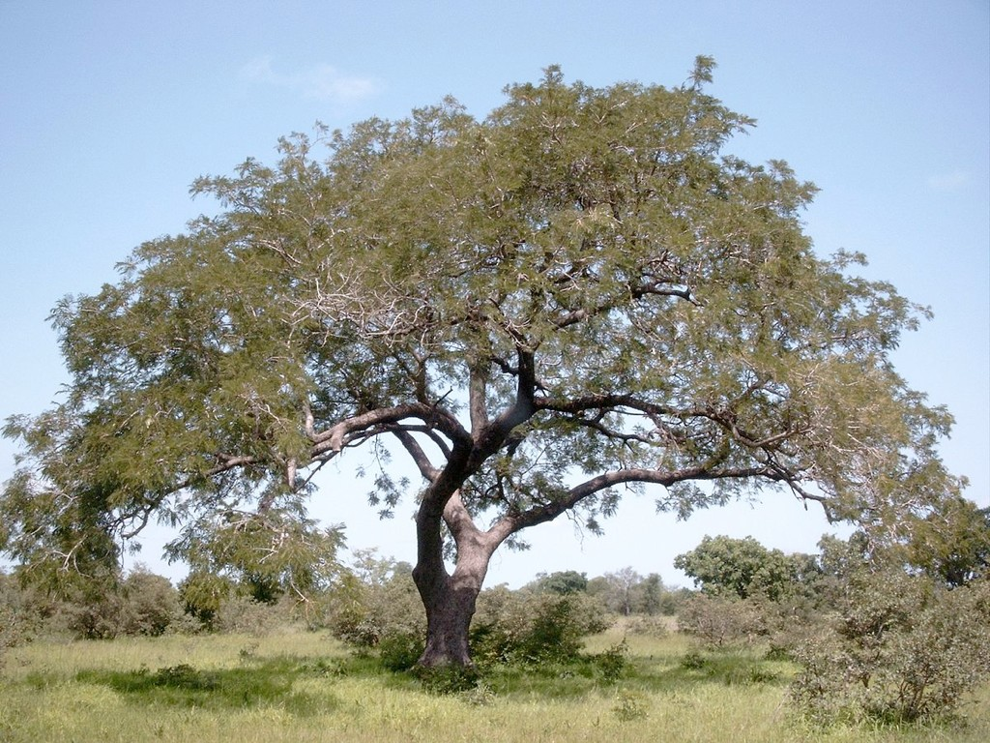
This Teaching Exercise is provided by the Human Relations Area Files at Yale University in New Haven, CT
RESOURCES
Assignment Rubric, Tips, References
A selection of jars containing herbs and other ingredients used by Cunning folk in Britain. Museum of Witchcraft. Photo by Midnightblueowl. CC 1.0

Slide 13
RUBRIC
➤
The following rubric is suggested for evaluating responses:
_{Unsatisfactory} Needs Improvement Satisfactory Outstanding (0%) (25%) (75% (100%)
Assignment | ➤ | Unsatisfactory Table for plant use in eHRAF is absent | ➤ | Needs Improvement Tables for plant use is sparsely filled in with very few societies. | ➤ | Satisfactory Table for plant use include smultiple societies across several subjects | Outstanding ➤ Table for plant use includes multiple societies across diverse subjects and include citations.
Part 1:
Data
Collection
Assignment |  | Unsatisfactory Major points are not clear. Specific examples are not used. | ➤ | Needs Improvement Commentary on research findings is not comprehensive and /or persuasive. Major points are addressed, but not well supported. Responses are inadequate or do not address topic or response to the questions Specific examples do not support topic or response to the questions. | ➤ | Satisfactory Evaluation and analysis of research findings is accurate. Major points are stated. Responses are adequate and address the question at hand. Content is accurate A specific example from the research is used. | Outstanding ➤ Evaluation and analysis of research findings is accurate and persuasive. ➤ Major points are stated clearly and are well supported. ➤ Responses are excellent and address questions ➤ Content is clear. ➤ Several specific examples from the research are used.
Part 2: |  |  | ➤
 | ➤
Questions
 | ➤ |  | ➤ |  | ➤
1-2 |  |  |  |  | ➤
 |  |  | ➤ |  | ➤

Slide 14
REFERENCES
Check out the Advanced Search Tutorial for detailed instructions on conducting searches in eHRAF World Cultures.
For information on ethnobotanical practices in the archaeological record, check out eHRAF Archaeology.
For more exercises and teaching resources related to human societies past and present, explore Teaching eHRAF.
For a more detailed version of this particular exercise with additional questions and activities check out Teaching eHRAF Exercise 3.1: Topics in Medical Anthropology, Section 5: Ethnobotany and its Medical Uses by Christiane Cunnar
➤
➤
➤
➤

