Slide 1

SEXUALITY
Marital Choice Exercise
Adapted from Teaching eHRAF Exercise 1.21, Exercise VII. Marriage by Carol Ember

Slide 2
EXERCISE DETAILS
TIME: 45 minutes
MATERIALS REQUIRED:
➤
HRAF Access
Worksheet and pen or other materials for recording answers
➤
STUDENT LEARNING OUTCOMES:
At the end of this Exercise, students will be able to:
➤
describe marital partner choice in the context of multiple societies across the world.
construct eﬀective and eﬃcient search strategies in eHRAF in order to retrieve data relevant to a specific topic/ assignment.
➤

Slide 3
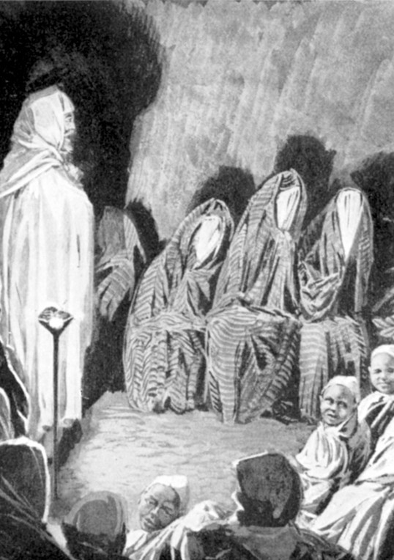
A Berber Wedding.1912. By permission of Sir
H. H. Johnston, G. C. M. G. Public Domain Image
MARRIAGE CHOICES
In this exercise, students will read and analyze the concept of marital choice among a variety of societies across the globe.

Slide 4
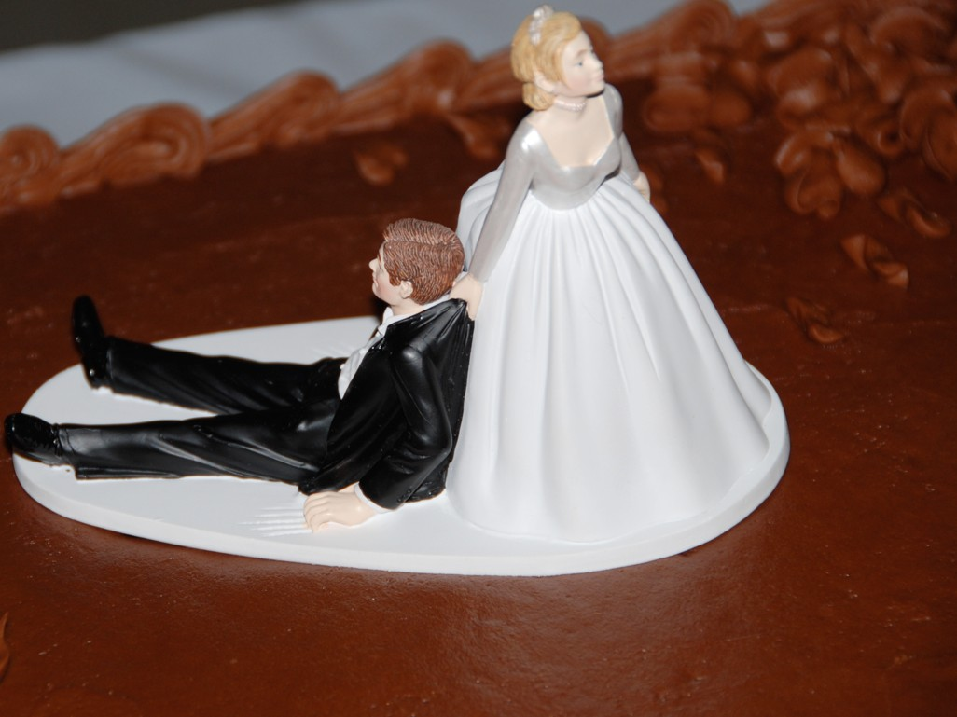
RESEARCH EXERCISE
For the following questions, locate answers by conducting by conducting an eHRAF World Cultures Advanced Search. Most answers can be located by searching for the Culture Name in combination with the OCM subject category “Arranging a Marriage” in the Add Subjects column of the Advanced Search Form. For further help, click here for a video guide to Advanced Searches in eHRAF World Cultures.

Slide 5
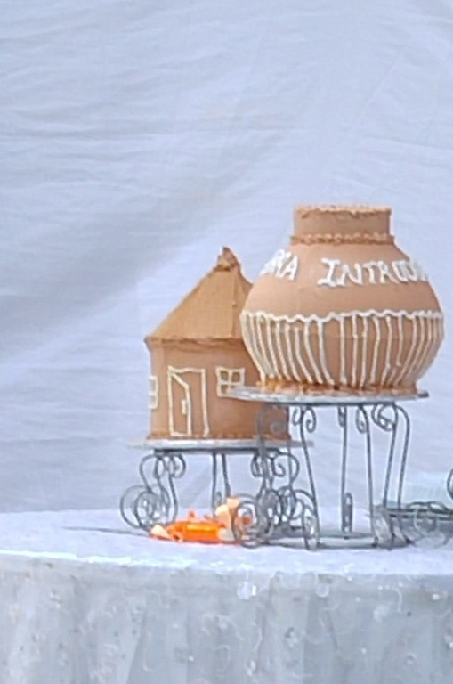
ARRANGING MARRIAGE WITH GANDA AND DOGON
Question 1: The Ganda and Dogon diﬀer in how much freedom males and females have in choosing a spouse. Briefly compare their freedom of choice. (10 minutes)
Buganda wedding cakes in the shape of pots and homes. 2012. Emmanuel Adiba. CC 3.0
This Teaching Exercise is provided by the Human Relations Area Files at Yale University in New Haven, CT

Slide 6
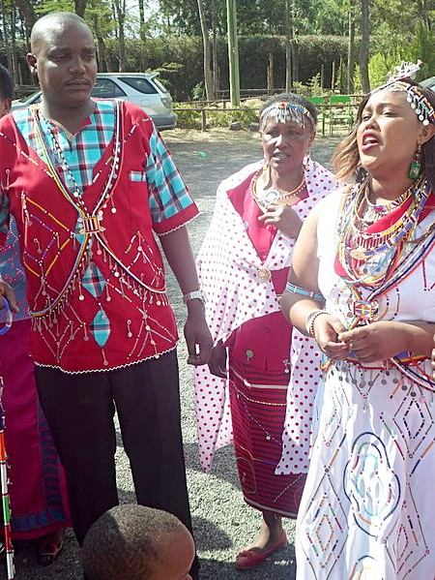
ARRANGING MARRIAGE WITH MAASAI
Question 2: Technically, a Maasai male has free choice in choosing a spouse, but that “choice” is considerably diﬀerent from what most people expect by “free choice.”
➤
How do Maasai males choose?
What is the situation for females? (10 minutes)
➤
Colourful dressing during a traditional Maasai wedding. 19 September 2015.
Looremeta92. CC 4.0
This Teaching Exercise is provided by the Human Relations Area Files at Yale University in New Haven, CT

Slide 7

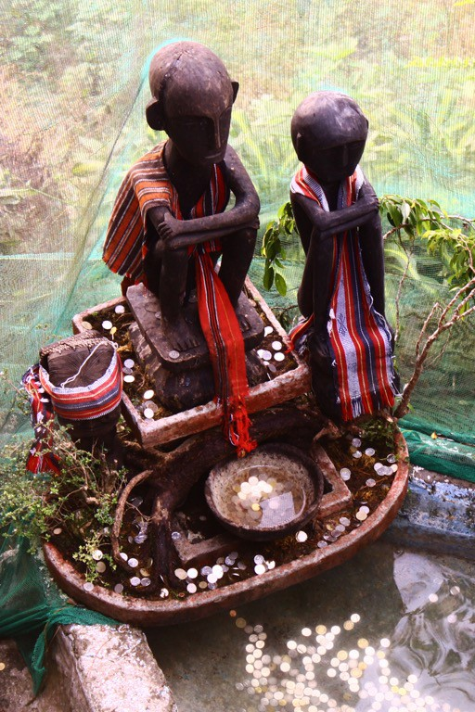
ARRANGING MARRIAGE WITH GARO AND IFUGAO
Question 3: How does wealth diﬀerence aﬀect marriage among the Garo and Ifugao? (10 minutes)
Bulol fertility couple looking out and protecting the rice field in an Ifugao community. 5 April 2012 Adriann Caldozo. CC 3.0
This Teaching Exercise is provided by the Human Relations Area Files at Yale University in New Haven, CT

Slide 8
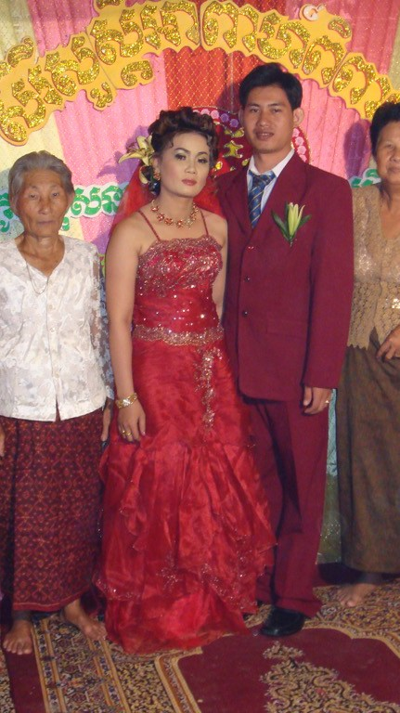
ARRANGING MARRIAGE
WITH TAIWAN HOKKEIN
Question 4: How have marriage arrangements changed over time for the Taiwan Hokkien? Use Diamond
source to answer questions (10 minutes)
Like the Taiwan Hokkien, Khmer Hokkien
wedding dresses are red. 2009. Khmer Hokkien wedding in Kampong Thom. Engsamnang CC 3.0
This Teaching Exercise is provided by the Human Relations Area Files at Yale University in New Haven, CT

Slide 9
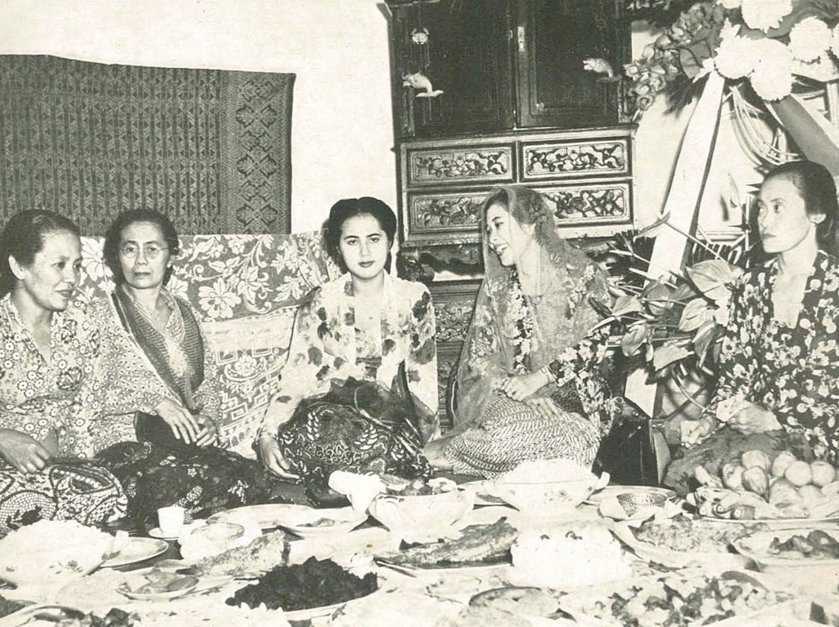
This Teaching Exercise is provided by the Human Relations Area Files at Yale University in New Haven, CT
RESOURCES
Assignment Rubric, Tips, References
Wedding in Indonesia. 1953. Wanita di Indonesia / Women in Indonesia. Djakarta, Chailan Sjamsoe. Public Domain Image

Slide 10
RUBRIC
➤
The following rubric is suggested for evaluating responses:
Unsatisfactory
Needs Improvement (25%)
Satisfactory (75%
Outstanding (100%)
(0%)
Assignment Part 2: Questions 1-4
Unsatisfactory
➤ Major points are not clear.
➤ Specific examples are not used.
Needs Improvement
Satisfactory
➤ Major points are addressed, and well supported.
➤ Responses are adequate and address the question at hand.
➤ Content is accurate
➤ A specific example from the research is used.
Outstanding
➤ Major points are addressed, but not well supported.
➤ Responses are inadequate or do not address topic or response to the questions
➤ Specific examples do not support topic or response to the questions.
➤ Major points are stated clearly and are well supported.
➤ Responses are excellent and address questions
➤ Content is clear.
➤ Several specific examples from the research are used.

Slide 11
FURTHER READING
➤
For more exercises and teaching resources related to human societies past and present, explore Teaching eHRAF.
For a more detailed version of this particular exercise with additional questions and activities check out Teaching eHRAF Exercise 1.21, Exercise VII. Marriage by Carol Ember
Check out the Advanced Search Tutorial for detailed instructions on conducting searches in eHRAF World Cultures.
➤
➤

