Slide 1
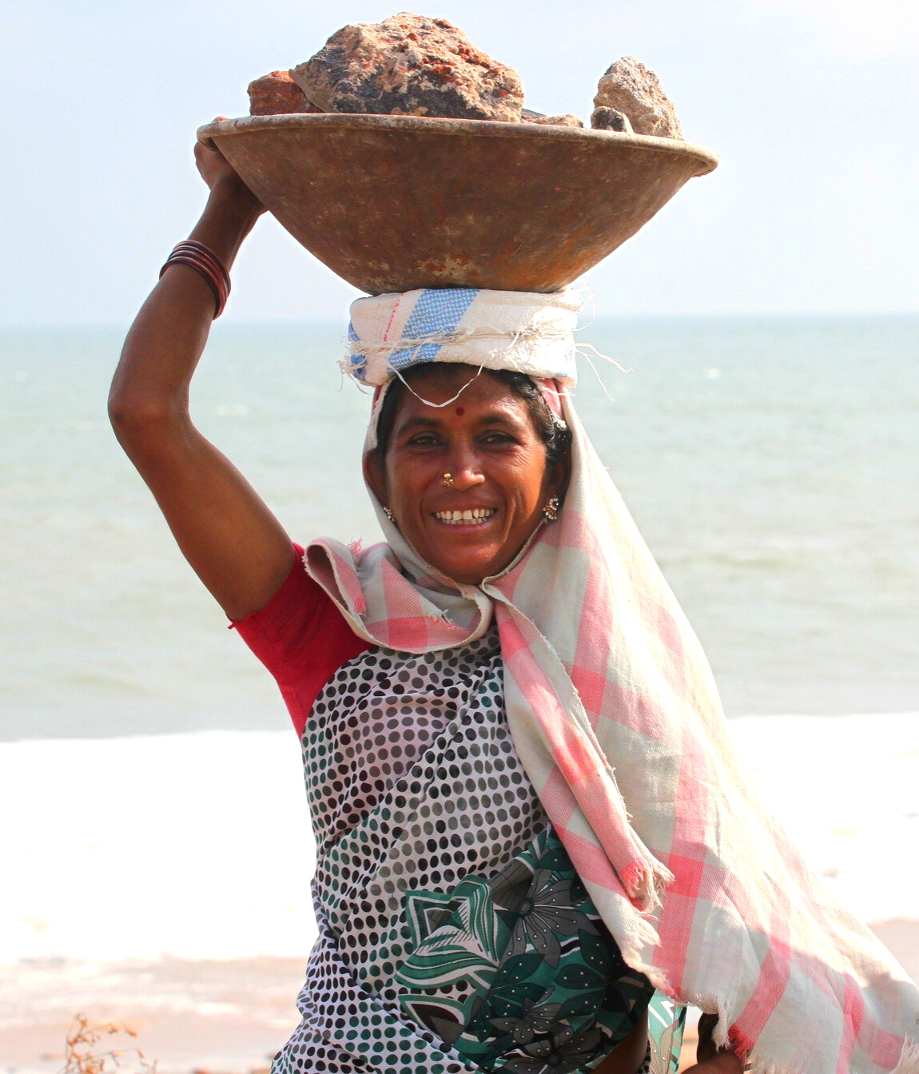
An eHRAF Workbook Activity
Division of Labor by Gender
in eHRAF World Cultures
Human Relations Area Files
at Yale University

Slide 2
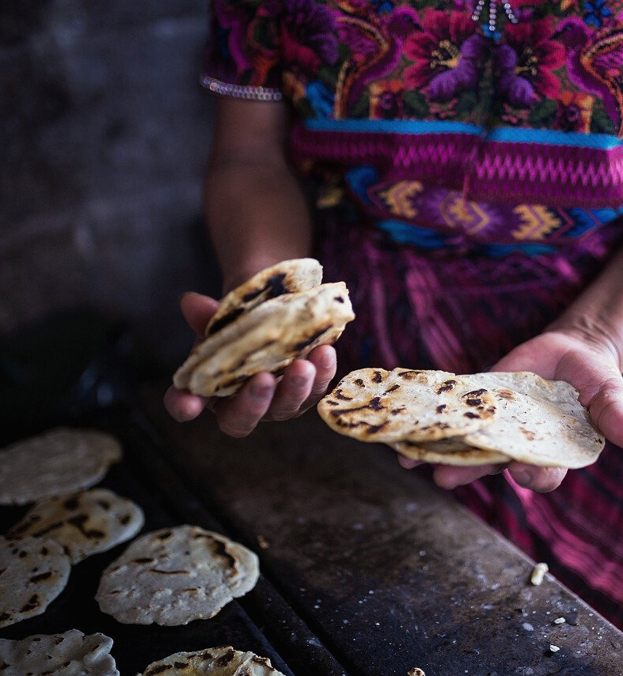
In this activity
Do all societies have a division of labor roles by gender?
Which labor tasks are typically divided by gender?
How does subsistence type affect division of labor?
Read and interpret ethnographic data in eHRAF World Cultures
Topics We'll Cover

Slide 3
DIVISION OF LABOR
BY GENDER

Slide 4
This workbook is based on the Explaining Human Culture (EHC) summary on Gender
by
Carol R. Ember, Milagro Escobar, Noah Rossen,
and Abbe McCarter
https://hraf.yale.edu/ehc/summaries/gender
You may wish to read the EHC summary to learn more about gender categories, variations in gender concepts, division of labor, and the relative status of men and women before you begin.

Slide 5
Labor and Gender
Nearly every society in the anthropological record divides labor activities relating to subsistence, food processing, various economic activities, and household chores, unequally based on gender.
Despite the frequent occurrence of this division, there tends to be certain cross-cultural trends and themes that differentiate labor roles between the genders.
Did you know?

Slide 6
eHRAF Workbook
activity
gender, labor, and subsistence

Slide 7
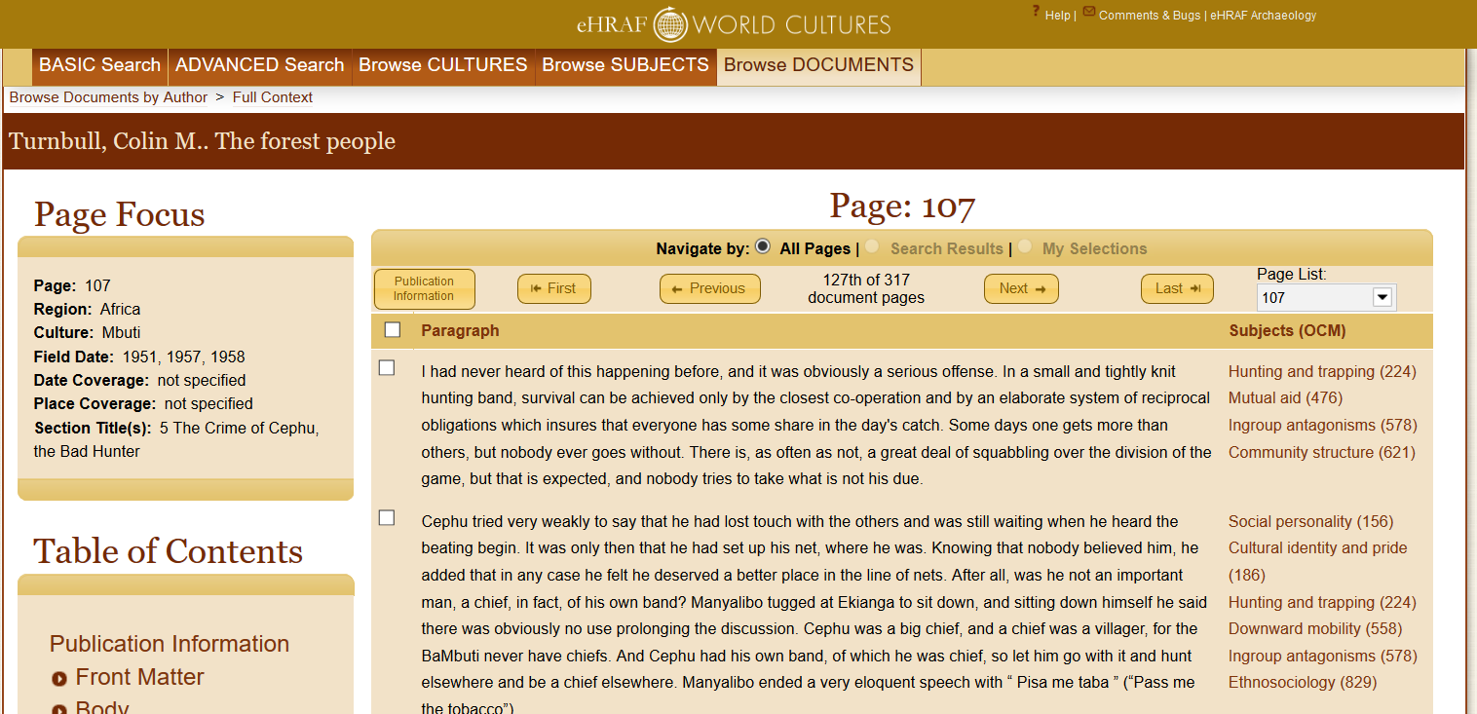
To read pages in eHRAF:
INSTRUCTIONS
First, follow the permalinks provided in the activities below to get to the relevant documents.
For example:
🌐 https://ehrafworldcultures.yale.edu/document?id=fo04-003
Then, use the Page List dropdown menu to navigate to the required page(s).

Slide 8
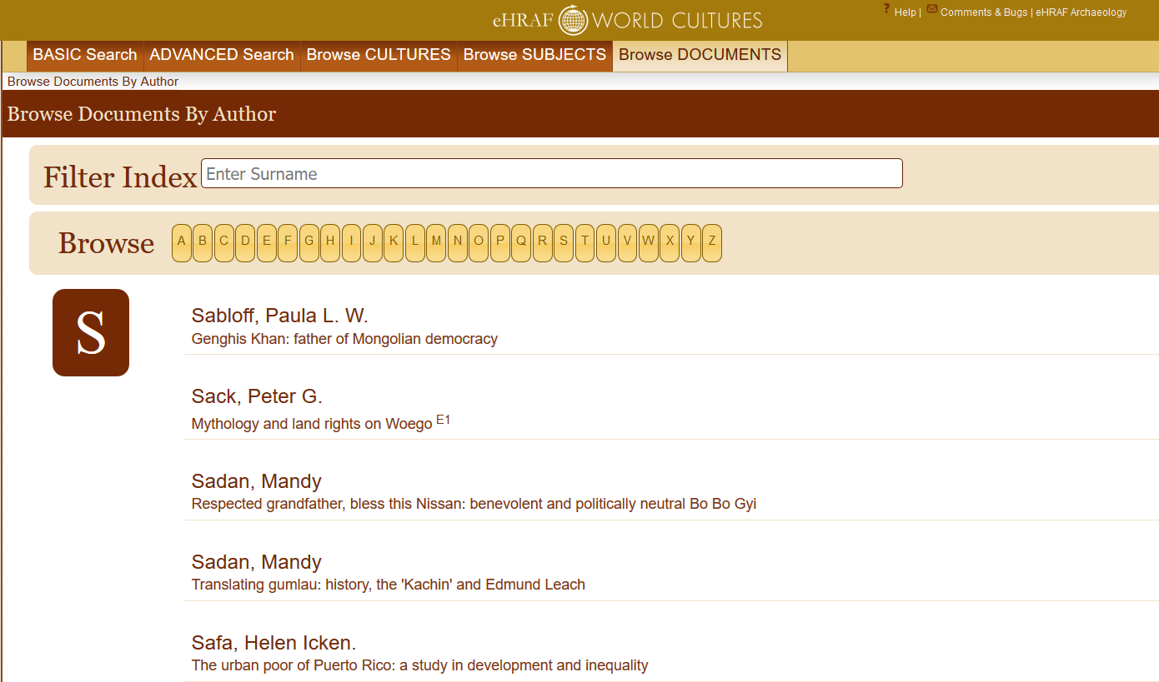
Finding pages without permalinks
INSTRUCTIONS
Follow these steps if you are having trouble with permalinks from off campus while using a proxy or VPN service, or if you have been provided with a HRAF-issued username and password.
Sign in via your library proxy or VPN, or using the HRAF-issued credentials.
Go to the Browse Documents tab.
Enter the author's last name into the Filter Index box.
Click on the required title to access the document, then select the page number from the Page List dropdown menu as shown above.

Slide 9
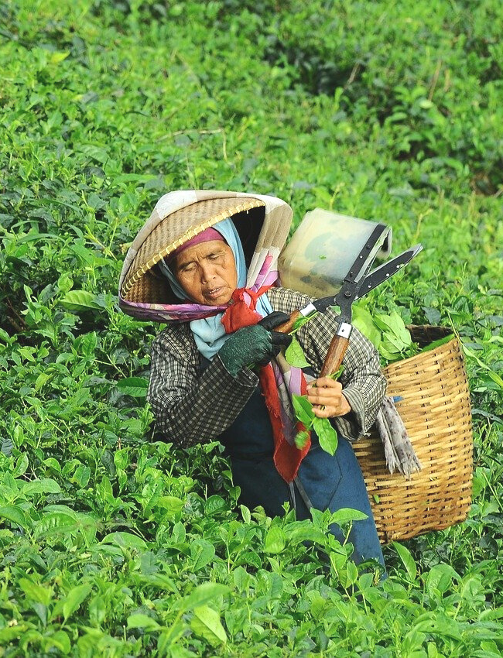
DIVISION OF LABOR
Which roles typically fall to different genders, and why you think that is the case?
Referring to the list below, select one culture from each subsistence type for a total of four cultures.
Read the excerpts provided in eHRAF World Cultures to learn more about division of labor for each culture.
Fill in the table to keep track of your findings.

Slide 10
SUBSISTENCE TYPES
Select one culture from each category:
Hunter-gatherers
Ojibwa (NG06)
Tlingit (NA12)
Pastoralists
Libyan Bedouin (MT09)
Saami (EP04)
Horticulturalists
Azande (FO07)
Kuna (SB05)
Intensive agriculturalists
Central Thai (AO07)
Hopi (NT09)

Slide 11
HUNTER-GATHERERS
Ojibwa (NG06)
R. Dunning: Social And Economic Change Among The Northern Ojibwa - page 64
🌐 https://ehrafworldcultures.yale.edu/document?id=ng06-022
Tlingit (NA12)
F. De Laguna: “Under Mount Saint Elias: the History and Culture of the Yakutat Tlingit" - pages 391-c, 416-b, 421-b
🌐 https://ehrafworldcultures.yale.edu/document?id=na12-020
R. Olson: “Social Structure And Social Life Of The Tlingit In Alaska” - pages 11-b, 38-a
🌐 https://ehrafworldcultures.yale.edu/document?id=na12-019
K. Tollefson: “Culture Summary: Tlingit” - page 3
🌐 https://ehrafworldcultures.yale.edu/document?id=na12-000

Slide 12
PASTORALISTS
Libyan Bedouin (MT09)
L. Abu-Lughod: Veiled Sentiments: Honor and Poetry in a Bedouin Society - page 72
🌐 https://ehrafworldcultures.yale.edu/document?id=mt09-010
D. Cole: "Culture Summary: Libyan Bedouin" - page 6
🌐 https://ehrafworldcultures.yale.edu/document?id=mt09-000
Saami (EP04)
T. Ingold: "Skolt Lapps Today" - pages 155-156
🌐 https://ehrafworldcultures.yale.edu/document?id=ep04-021
Beach and Anderson: "Culture Summary: Saami" - page 4
🌐 https://ehrafworldcultures.yale.edu/document?id=ep04-000

Slide 13
HORTICULTURALISTS
Azande (FO07)
Baxter and Butt: "The Azande, and Related Peoples of the Anglo-Egyptian Sudan and Belgian Congo" - page 46
🌐 https://ehrafworldcultures.yale.edu/document?id=fo07-056
G. Culwick: Dietary Survey Among the Zande of the South-Western Sudan - page 29
🌐 https://ehrafworldcultures.yale.edu/document?id=fo07-061
Kuna (SB05)
J. Sherzer: Kuna Ways of Speaking: An Ethnographic Perspective - page 155
🌐 https://ehrafworldcultures.yale.edu/document?id=sb05-039
R. Holloman: Developmental Change in San Blas - pages 110, 129-130
🌐 https://ehrafworldcultures.yale.edu/document?id=sb05-042

Slide 14
INTENSIVE AGRICULTURALISTS
Central Thai (AO07)
Baxter and Butt: "The Azande, and Related Peoples of the Anglo-Egyptian Sudan and Belgian Congo" - page 46
🌐 https://ehrafworldcultures.yale.edu/document?id=fo07-056
G. Culwick: Dietary Survey Among the Zande of the South-Western Sudan - page 29
🌐 https://ehrafworldcultures.yale.edu/document?id=fo07-061
Hopi (NT09)
A. Schlegel: "Culture Summary: Hopi" - page 8
🌐 https://ehrafworldcultures.yale.edu/document?id=nt09-000
A. Schlegel: "Fathers, Daughters, And Kachina Dolls" - page 46
🌐 https://ehrafworldcultures.yale.edu/document?id=nt09-059

Slide 15
RECORD FINDINGS

Slide 16
As you read through each excerpt for your selected cultures, identify the tasks that are specifically divided along gender lines and record them in the table below.

Slide 17
REFLECT & DISCUSS

Slide 18
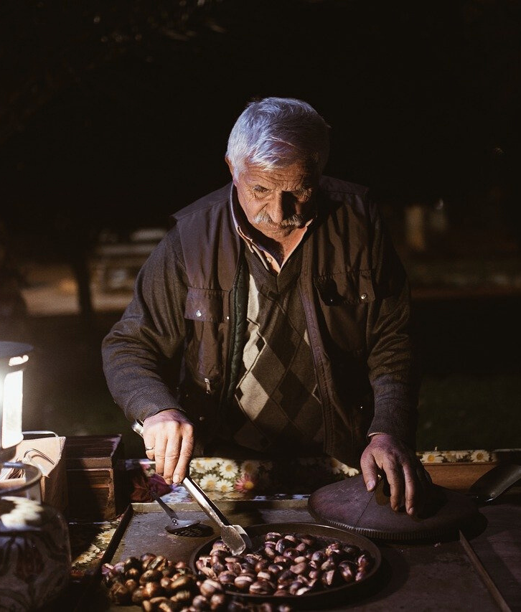
After you have completed the table, read the "What Explains Division of Labor" section of the EHC Gender module.
Which roles typically fall to different genders?
Why you think that is the case?
Are your findings consistent with the trends you read about in the module?
Did any of them surprise you?

Slide 19
1. This activity was adapted in part from Gender (Explaining Human Culture), by Carol R. Ember, Milagro Escobar, Noah Rossen, and Abbe McCarter. http://hraf.yale.edu/ehc/summaries/gender
2. Abu-Lughod, Lila. 1986. “Veiled Sentiments: Honor And Poetry In A Bedouin Society.” Berkeley: University of California Press. https://ehrafworldcultures.yale.edu/document?id=mt09-010.
3. Anderson, Myrdene, and Hugh Beach. 1996. “Culture Summary: Saami.” New Haven, Conn.: HRAF. https://ehrafworldcultures.yale.edu/document?id=ep04-000.
References
4. Baxter, P. T. W., and Audrey Butt. 1953. “Azande, And Related
Peoples Of The Anglo-Egyptian Sudan And Belgian Congo.” Ethnographic
Survey Of Africa, East Central Africa. London: International African
Institute. https://ehrafworldcultures.yale.edu/document?id=fo07-056.
5. Cole, Donald P. 1999. “Culture Summary: Libyan Bedouin.” New
Haven, Conn.: HRAF. https://ehrafworldcultures.yale.edu/document?id=mt09-000.
6. Culwick, Mrs., G. M. 1950. “Dietary Survey Among The Zande Of
The South-Western Sudan.” Khartoum: Agricultural Publications Committee,
Ministry of Agriculture, Sudan Govt. https://ehrafworldcultures.yale.edu/document?id=fo07-061.

Slide 20
7. Dunning, Robert William. 1959. “Social And Economic Change Among The Northern Ojibwa.” Toronto: University of Toronto Press. https://ehrafworldcultures.yale.edu/document?id=ng06-022.
8. Hanks, Jane Richardson. 1963. “Maternity And Its Ritual In Bang Chan.” Data Paper. Ithaca, N.Y.: Cornell University, Department of Asian Studies, Southeast Asia Program. https://ehrafworldcultures.yale.edu/document?id=ao07-001.
9. Holloman, Regina. 1997. “Developmental Change In San Blas.” Ann Arbor, Michigan: University Microfilms International. https://ehrafworldcultures.yale.edu/document?id=sb05-042.
References
10. Ingold, Tim. 1976. “Skolt Lapps Today.” Changing Cultures. London: Cambridge University Press. https://ehrafworldcultures.yale.edu/document?id=ep04-021.
11. Laguna, Frederica De. 1972. “Under Mount Saint Elias: The History And Culture Of The Yakutat Tlingit.” Smithsonian Contributions To Anthropology. Washington, D.C.: Smithsonian Institution Press. https://ehrafworldcultures.yale.edu/document?id=na12-020.
12. Martin, M. Marlene. 2000. “Culture Summary: Central Thai.” New Haven, Conn.: HRAF. https://ehrafworldcultures.yale.edu/document?id=ao07-000.

Slide 21
13. Olson, Ronald L. (Ronald LeRoy). 1967. “Social Structure And Social Life Of The Tlingit In Alaska.” Anthropological Records. Berkeley: University of California Press. https://ehrafworldcultures.yale.edu/document?id=na12-019.
14. Schlegel, Alice. 2000. “Culture Summary: Hopi.” New Haven, Conn.: HRAF. https://ehrafworldcultures.yale.edu/document?id=nt09-000.
15. Schlegel, Alice. 1989. “Fathers, Daughters, And Kachina Dolls.” European Review Of Native American Studies 3 (1): 7–10. https://ehrafworldcultures.yale.edu/document?id=nt09-059.
References
16. Sherzer, Joel. 1983. “Kuna Ways Of Speaking: An Ethnographic Perspective.” Texas Linguistic Series. Austin: University of Texas Press. https://ehrafworldcultures.yale.edu/document?id=sb05-039.
17. Tollefson, Kenneth D. 1997. “Culture Summary: Tlingit.” New Haven, Conn.: HRAF. https://ehrafworldcultures.yale.edu/document?id=na12-000.

Slide 22
Division of Labor by Gender
in eHRAF World Cultures
Produced by
Human Relations Area Files
at Yale University
An eHRAF Workbook Activity
hraf.yale.edu

