Slide 1
An eHRAF Workbook Activity
Reciprocity
&
Exchange
in eHRAF World Cultures
Human Relations Area Files
at Yale University

Slide 2
In this activity
Learn about three modes of reciprocity
Explore gift exchange among Trobriand Islanders
Conduct research in eHRAF World Cultures
Read and interpret ethnographic data
Topics We'll Cover

Slide 3
ECONOMIC ANTHROPOLOGY

Slide 4
All societies in the world have some kind of economic system.
Broadly speaking, economic anthropology is concerned with the ways in which humans "make a living" in different societies or cultures.
By focusing on the circulation of objects in both market and non-market economies, economic anthropologists address questions such as:
Did you know?

Slide 5
Why are some people farmers or shopkeepers, while others are stockbrokers or bankers?
What items have "value" and how is that worth determined?
Do concepts like altruism or self-interest exist in all societies?
Tracing the meaning of objects through their production, distribution, exchange, and consumption enables us to evaluate how people make decisions and build interpersonal relationships through transactions.

Slide 6
RECIPROCITY & EXCHANGE

Slide 7
Types of Reciprocity
In his book Stone Age Economics (1972), anthropologist Marshall Sahlins identified three modes of reciprocity:
modes of exchange in non-market economies
1. Generalized Reciprocity
2. Balanced Reciprocity
3. Negative Reciprocity

Slide 8
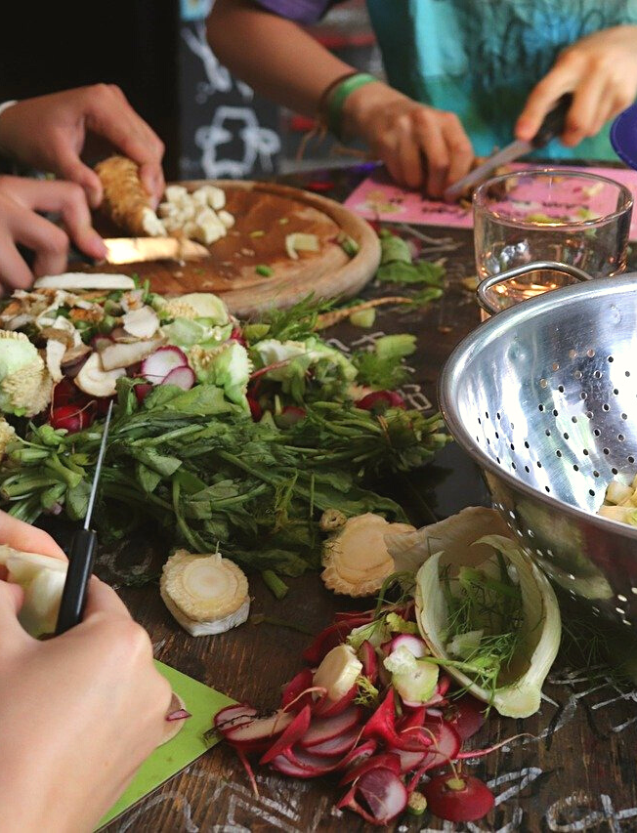
GENERALIZED RECIPROCITY
Generalized reciprocity refers to a type of exchange of goods and/or services where the giver and the recipient do not keep an exact ledger of value or stipulate the amount or duration of return.
It is expected that the exchange will balance itself over time. Examples include kinship, friendship and close neighborly relationships where gifts, tokens, hospitality, or other helpful actions are exchanged back and forth over time when desired or necessary.
Similarly, a "pure gift", to quote anthropologist Malinowski, would be one where the giver expects nothing in return and to request it would be considered socially unacceptable; for example, charitable donations.

Slide 9
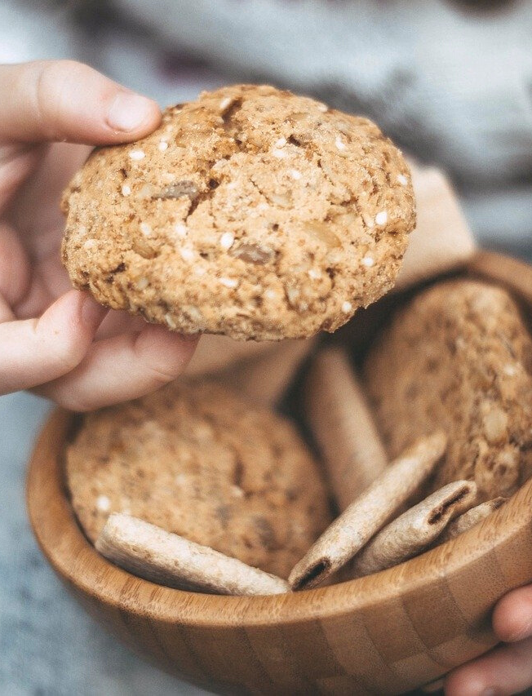
GENERALIZED RECIPROCITY
Examples of generalized reciprocity:
You buy a coffee for a friend one day, with the expectation that at some point in the future, they will do the same for you. Or, perhaps instead they decide to buy you dinner or help you move in to your new home.
Placing a tray of freshly baked cookies in a communal area at school or work for anyone to enjoy.
A hunter-gatherer sharing their meat with the entire camp.
These small tokens are indicators that both parties wish to have a prolonged relationship.

Slide 10
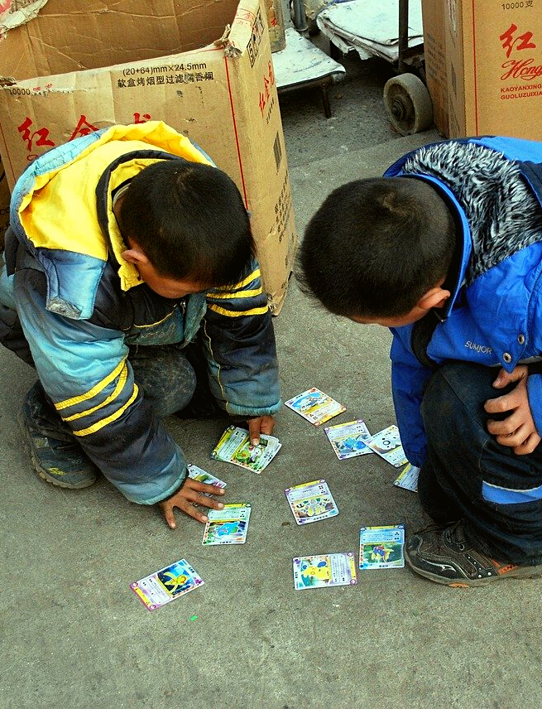
BALANCED RECIPROCITY
Balanced reciprocity obligates the recipient to return, within a specific time limit, items understood to be of equal value. Most gift exchanges, as well as simple barter transactions in lieu of currency - such as trading food in exchange for labor - exemplify this model.
To illustrate, if you purchased a carefully selected Christmas present for a friend, but received something of much lesser value in return, this would likely result in hurt feelings. Additional examples of balanced reciprocity include trading goods at a "swap meet"; working as a crew member to cover the cost of ones passage on a ship; or when parents take turns carpooling the kids to school.

Slide 11
NEGATIVE RECIPROCITY
Negative reciprocity refers to exchanges where one or both participants act entirely in their own self-interest in pursuit of material advantage or profit. If generalized reciprocity tips the balance in favor of selfless giving without expectation of immediate receipt, then negative reciprocity does the opposite. It is an attempt to "get something for nothing".
Sahlins refers to this type of reciprocity as the "unsociable extreme" (1972: 195) because it occurs most often between strangers rather than friends or kin. It includes commercial barter, haggling, stealing, looting, raiding, or price-gouging. An example would be a banker who promises to invest your money, but steals it instead.

Slide 12
eHRAF Workbook
ACTIVITY
The Kula Ring

Slide 13
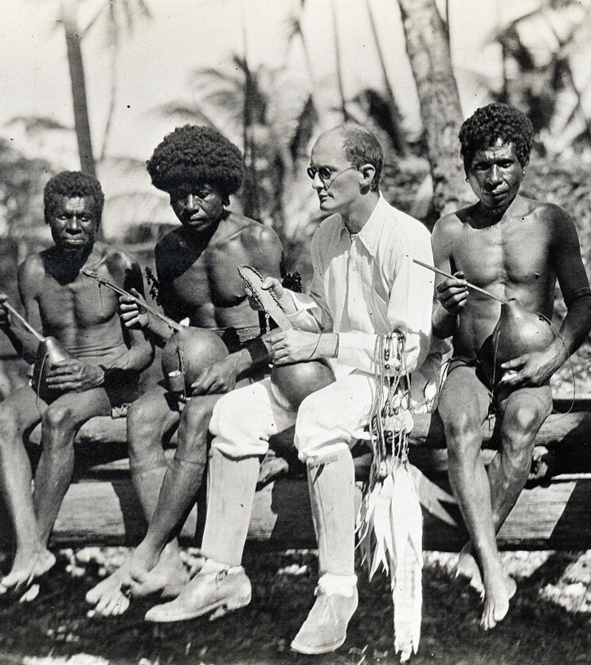
TROBRIAND ISLANDS
Melanesia
The Trobriand Islanders of Melanesia make a distinction between the practices of ceremonial gift exchange and bartering for commodities.
Anthropologist Bronisław Malinowski famously detailed these two types of exchange in Trobriand society. In this activity, you will compare and contrast two Trobriand practices of reciprocity.

Slide 14
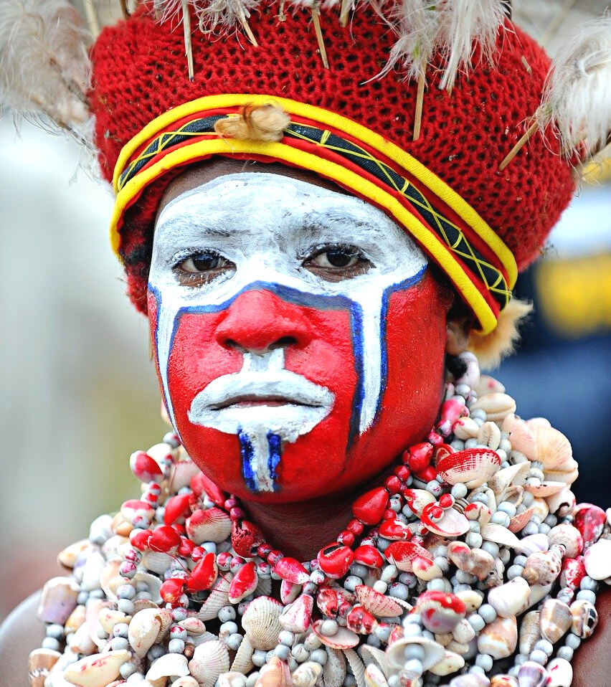
Trobriand Islanders (OL06)
PART 1
Begin by learning more about the Trobriand Islanders. First, read the eHRAF Culture Summary:
🌐
https://ehrafworldcultures.yale.edu/document?id=ol06-000
Then, write a brief description of the Trobriands indicating any significant cultural elements that stand out to you.

Slide 15
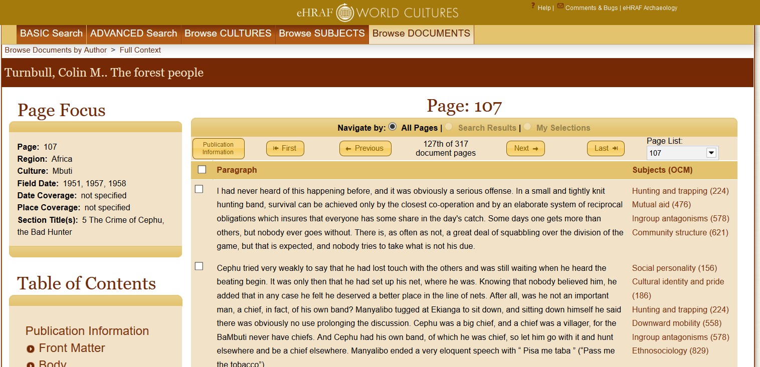
To read documents or pages in eHRAF:
INSTRUCTIONS
First, follow the permalinks provided in the activities below to get to the relevant documents.
For example:
🌐
https://ehrafworldcultures.yale.edu/document?id=fo04-003
Then, use the Page List dropdown menu to navigate to the required page(s).

Slide 16
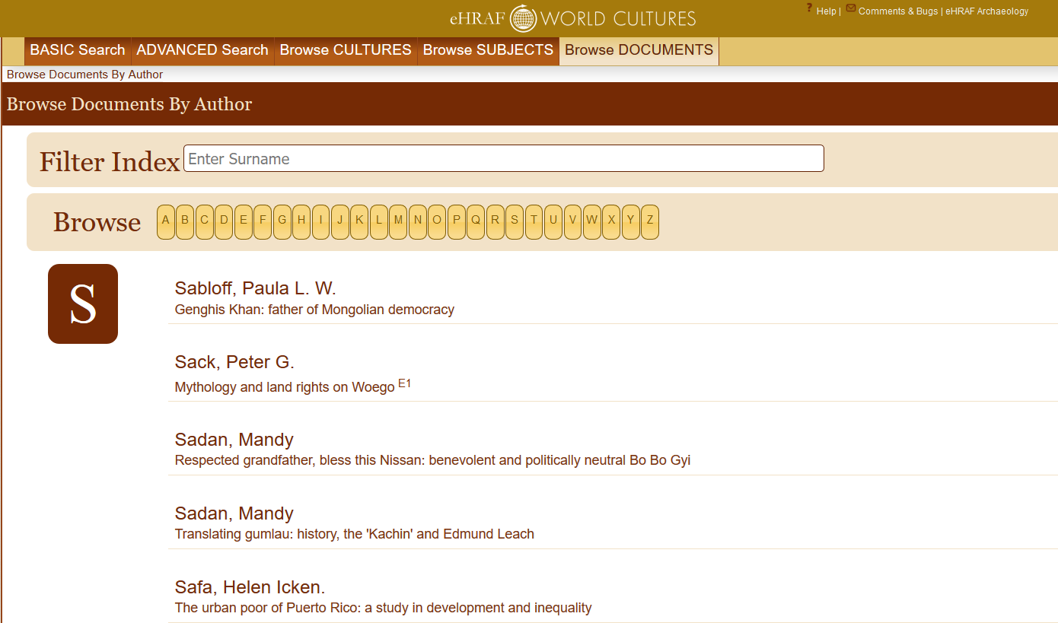
Finding documents without permalinks
INSTRUCTIONS
Follow these steps if you are having trouble with permalinks from off campus while using a proxy or VPN service, or if you have been provided with a HRAF-issued username and password.
Sign in via your library proxy or VPN, or using the HRAF-issued credentials.
Go to the Browse Documents tab.
Enter the author's last name into the Filter Index box.
Click on the required title to access the document, then select the page number from the Page List dropdown menu as shown above.

Slide 17
PART 2
KULA vs. GIMWALI
Read the following selected passages from Malinowski’s ethnography, Argonauts of the Western Pacific (1922).
Then, answer the questions about the different types of exchange.
🌐
https://ehrafworldcultures.yale.edu/document?id=ol06-001
For Kula, read pages: 81, 85-89, 93, 95-96
For Gimwali, read pages: 95, 98, 361-363

Slide 18
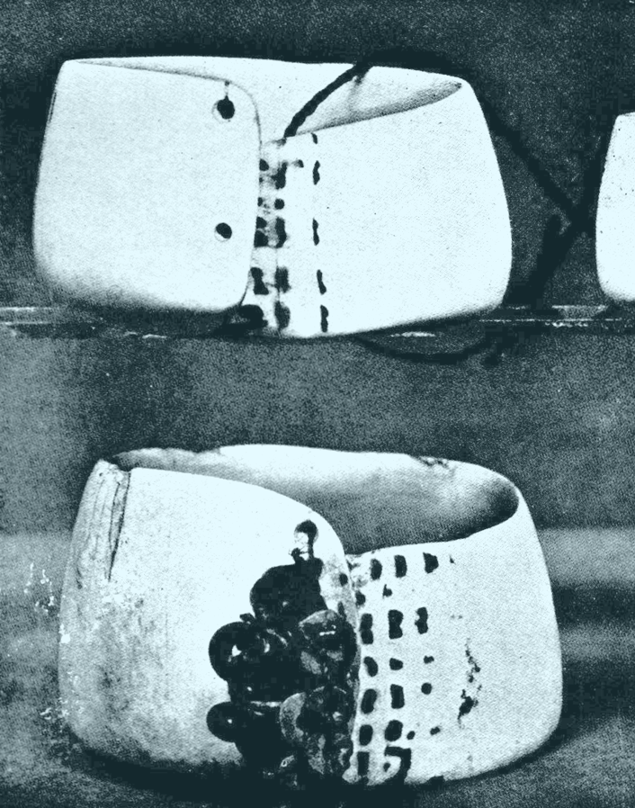
Read about kula, then describe the Kula Ring.
QUESTIONS
Who takes part in kula?
What are the "rules" of the exchange?
What type of reciprocity does kula represent?
What items are exchanged and what type of value/significance do they have?
Do Trobriand men materially profit from their kula exchanges?
What other important functions does the Kula Ring serve in Trobriand society?

Slide 19
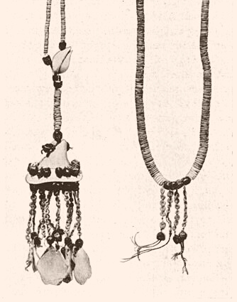
QUESTIONS
Read the passages provided, then describe gimwali.
Who takes part in gimwali?
How and when is it practiced?
What types of things are exchanged, and what value do they have?
What type of reciprocity does gimwali represent?
Do Trobriand men materially profit from their gimwali exchanges?
How does it compare to kula?

Slide 20
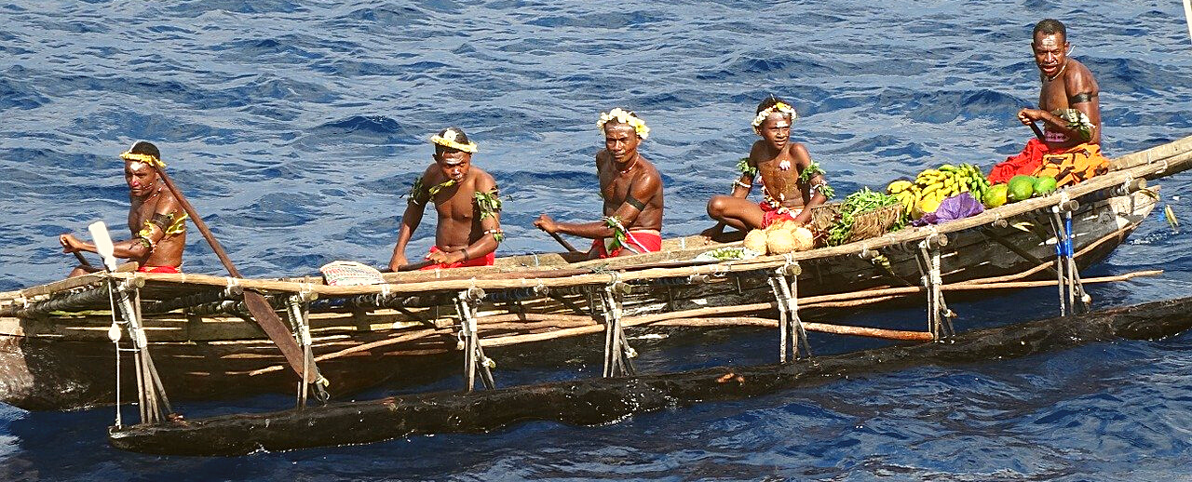
Find out more
Optional: If you need more information to answer the questions, or if you would like to dig deeper into this topic, you may conduct an Advanced Search in eHRAF World Cultures to read sources by other authors in addition to the assigned reading from Malinowski.
A sample search appears below:

Slide 21
SAMPLE ADVANCED SEARCH
Add 3 subjects:
Gift giving (431),
Exchange transactions (437) Mutual aid (476)
Add culture:
Trobriands (OL06)
Click "search"

Slide 22
GENDER, CULTURE & EXCHANGE

Slide 23
PART 3
Societies are continually changing.
Sometimes, ethnographers studying in the same location at different times can shed light on aspects of a culture that have changed or might have been overlooked by previous researchers.
Read the following passages from the two documents by anthropologist Annette Weiner, then answer the questions.

Slide 24
PART 3
1976. Women of Value, Men of Renown: New Perspectives in Trobriand Exchange.
🌐
https://ehrafworldcultures.yale.edu/document?id=ol06-025
Pages:
12 & 14, on the overlooked role of Trobriand women
230-233, on the socioeconomic power of Trobriand women vs. men
1988. The Trobrianders of Papua New Guinea.
🌐
https://ehrafworldcultures.yale.edu/document?id=ol06-026
Pages:
27-30,"An Extraordinary Discovery"
136-138, on women's wealth and matrilineal identity.

Slide 25
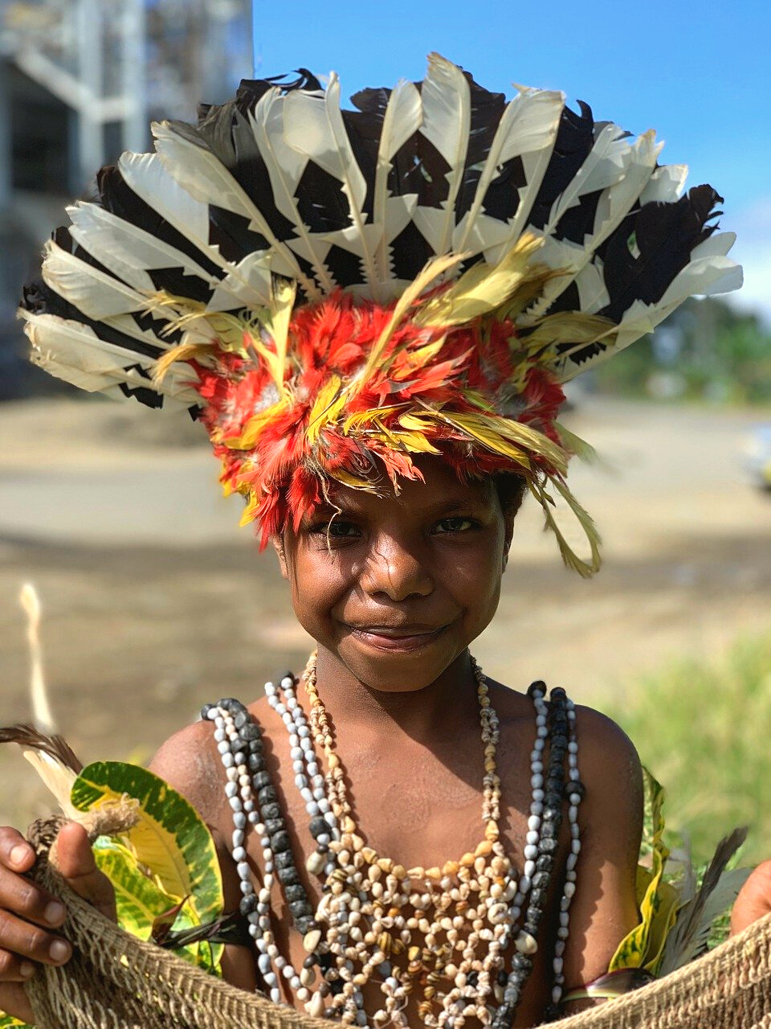
Questions:
What does Weiner's analysis add to Malinowski's previous description of economic exchange in Trobriand society?
What roles does gender play in Trobriand economic life?
Why might this have been overlooked by previous ethnographers?

Slide 26
RECIPROCITY
ACROSS CULTURES

Slide 27
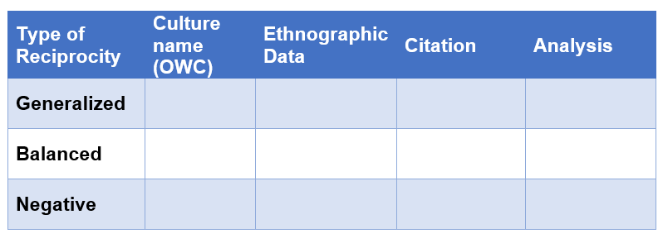
PART 4
Advanced Search
In eHRAF World Cultures, find at least one example of each type of reciprocity described in Part 1 from different cultures around the world. Then, create a table like the one below.

Slide 28
After you have found your examples:
Copy and paste the paragraph(s) from eHRAF illustrating your examples from each culture into the Ethnographic Data column.
Remember to cite the author's name, date, and page for each source.
Describe why you believe the type of exchange is generalized, balanced, or negative reciprocity in the Analysis column.
You may add additional rows for each type of reciprocity to compare more culture findings.

Slide 29
Is reciprocity a human universal?
How does purchasing an object with money differ from trading or gift-giving?
Can you think of examples of generalized, balanced, or negative reciprocity in your everyday life?
How does the closeness of one's relationship to others (e.g. family, friends, acquaintances, or strangers) affect the types of reciprocity that they are willing to engage in?
DISCUSS

Slide 30
1. This activity is based on Reciprocity & Exchange: The Kula Ring, by Francine Barone, in Teaching eHRAF. https://hraf.yale.edu/teach-ehraf/reciprocity-exchange-the-kula-ring/
2. Malinowski, B. 1922. Argonauts of the Western Pacific: An Account of Native Enterprise and Adventure in the Archipelagoes of Melanesian New Guinea. London: George Routledge & Sons, Ltd. https://ehrafworldcultures.yale.edu/document?id=ol06-001.
References
3. Sahlins, M. 1972. Stone Age Economics. London: Routledge.
4. Weiner, A. 1976. Women of Value, Men of Renown: New Perspectives in Trobriand Exchange. Austin, Tex.: University of Texas Press. https://ehrafworldcultures.yale.edu/document?id=ol06-025.
5. Weiner, A. 1988. “The Trobrianders of Papua New Guinea.” In Case Studies in Cultural Anthropology, xx, 184. New York: Holt, Rinehart and Winston, Inc. https://ehrafworldcultures.yale.edu/document?id=ol06-026.
6. Weiner, A. and J. Beierle. 1995. “Culture Summary: Trobriands”. New Haven, Conn.: HRAF. https://ehrafworldcultures.yale.edu/document?id=ol06-000.

Slide 31
Reciprocity
&
Exchange
in eHRAF World Cultures
Produced by
Human Relations Area Files
at Yale University
An eHRAF Workbook Activity
hraf.yale.edu

