Slide 1
An eHRAF Workbook Activity
Class vs. Caste
in eHRAF World Cultures
Human Relations Area Files
at Yale University

Slide 2
In this activity
Learn about social stratification
Define achieved vs. ascribed status
Identify class vs. caste societies and upward or downward social mobility
Conduct research using eHRAF World Cultures
Topics We'll Cover

Slide 3
SOCIAL STRATIFICATION
Societies with social stratification have groups of people with different degrees of access to economic resources, power, and prestige.

Slide 4
Social Status
ACHIEVED STATUS
The status people acquire over the course of their lifetimes. Related to the concepts of merit; meritocracy.
ASCRIBED STATUS
The status people have by virtue of birth. Things about ourselves which we cannot change.

Slide 5
Social Mobility
SOCIAL MOBILITY
The ability of people to change their social position within their society.
UPWARD MOBILITY
Moving up the ladder of the social hierarchy.
DOWNWARD MOBILITY
Moving down the ladder of the social hierarchy.

Slide 6
Class vs. Caste
There are two main types of stratified societies: class societies and caste societies. These differ in the degree of social mobility.
CLASS SOCIETIES
Characterized by achieved status and some degree of social mobility. Members of a social class share similar lifestyles and levels of wealth, education, power, and prestige.
CASTE SOCIETIES
A rigid form of social stratification in which membership is determined by birth (ascribed status) and social mobility is practically nonexistent.

Slide 7
CASE STUDY
INDIA & AMERICA

Slide 8
CASE STUDY
In the mid-20th century, social scientists observed a fascinating phenomenon:
The Indian caste system was becoming more like the American class system, with increasing social mobility.
Conversely, the American class system had developed features which resemble a caste system, with rigid social structures (such as socially exclusive private clubs) favoring a White Anglo-Saxon Protestant (WASP) elite.
Fittingly, some members of the American upper crust were referred to as "Boston Brahmins", borrowing their name from the Brahmins at the top of the Indian caste system.

Slide 9
CASE STUDY
HINDU CASTE SYSTEM
The best-known example of a caste system is the Hindu caste system in India.
VARNAS
The sacred Sanskrit texts of Hinduism rank all people into four categories, called varnas. Each varna is associated with certain occupations.

Slide 10
CASE STUDY
HINDU MYTH OF ORIGIN
The four major varnas originated from the body of primeval man:
Brahmins (priests & scholars) – from his mouth
Kshatriyas (warriors) – from his arms
Vaishyas (tradesmen) – from his thighs
Shudras (cultivators & servants) – from his feet
A fifth cast is below these four:
Dalit (outcasts) – derogatorily referred to as “untouchables"

Slide 11
CASE STUDY
THE AMERICAN DREAM
American idealism is exemplified by the concept of "life, liberty, and the pursuit of happiness". America is often described as the "Land of Opportunity" where people follow their dreams.
Unlike a rigid caste system, the United States is typically seen as having a class system, where people may experience both upward and downward mobility.

Slide 12
CASE STUDY
THE WASP ELITE
Despite the purported ideal of equality of opportunity, sociologist E. Digby Baltzell observed that a caste-like WASP elite had formed in America. His acroynm WASP stands for White, Anglo-Saxon, Protestant and refers to "old money".
Some institutions (e.g., country clubs) have maintained caste-like exclusivity through "members only" discrimination based on ethnicity, race, and religion.

Slide 13
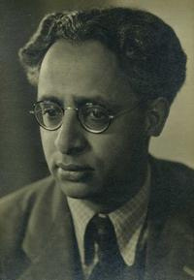
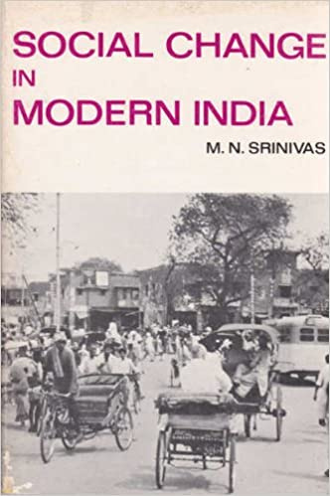
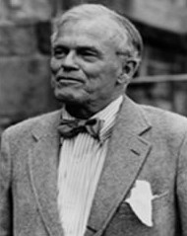
CASE STUDY
Sociologists M. N. Srinivas (1916–1999) and E. D. Baltzell (1915–1996) were contempories. Srinivas taught at Oxford University. Baltzell taught at the University of Pennsylvania. Both authored influential books on the subject of class and caste in their respective societies.

Slide 14
CASE STUDY: INDIA
Srinivas described a process called Sanskritization or Brahminization: a form of upward social mobility in India whereby people born into lower castes can achieve higher status by taking on some of the behaviors and practices of the highest (Brahmin) caste, such as vegetarianism, giving large dowries for their daughters, and wearing sacred clothing associated with Brahmins. People accomplish this type of upward mobility by acquiring considerable wealth and education, migrating to other parts of the country, or becoming political activists (Kolenda 1978, in Ferraro and Andreatta 2010).

Slide 15
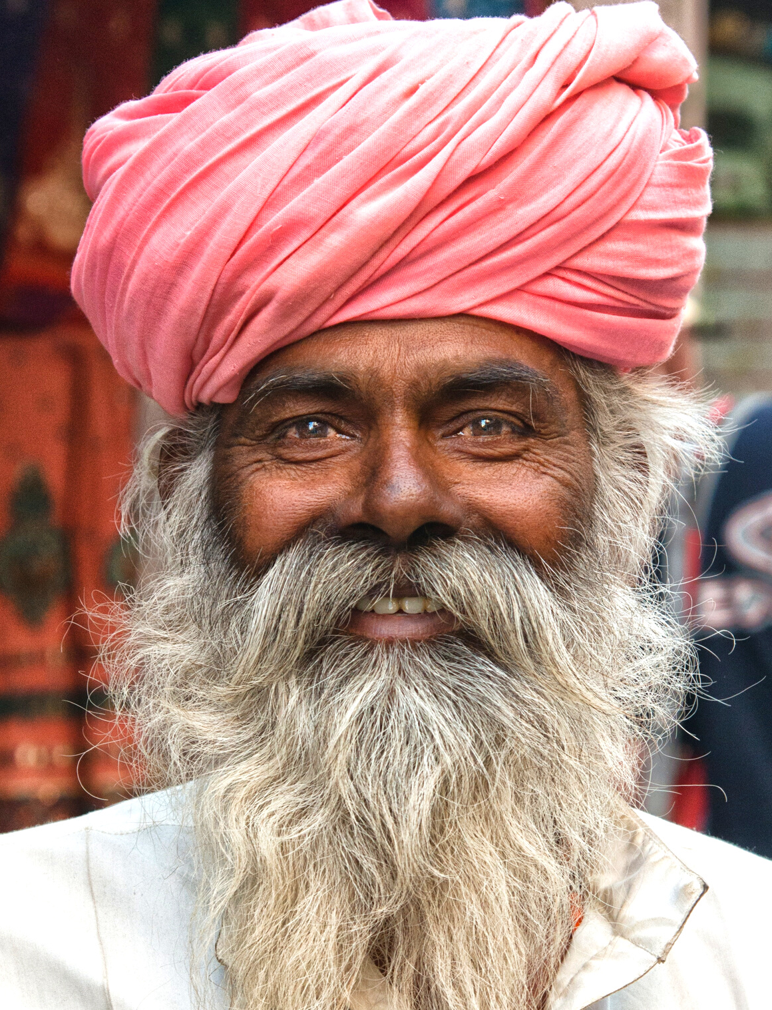
CASE STUDY: INDIA
"Sanskritization was (and is) the emulation of the life style of a higher caste as a way of legitimatizing social rank by claiming a higher state of being in the divine scheme of the universe. The models that an upwardly mobile caste might emulate varied according to the styles of the dominant caste or castes in its locality. Thus, Sanskritization sometimes meant adopting the manners of warrior-princes, of merchants, or of peasant land owners, but Srinivas claims that the most influential models were puritanical Brahmin castes" (Leslie 1967: 420).

Slide 16
CASE STUDY: USA
Baltzell observed a process similar to Brahminization which he called aristocratic assimilation. He described his book The Protestant Establishment as "an analysis of the conflict between the divisive forces of caste, on the one hand, which seek to maintain a WASP monopoly of upper-class institutions, and the cohesive forces of aristocracy which ideally call for gradually evolving upper-class institutions that constantly assimilate new men of talent and power, regardless of ethnic or racial origins" (Baltzell 1987[1964]: 24). American boarding schools and Ivy League universities, once primarily bastions of WASP exclusivity, are among the institutions for aristocratic assimilation. Baltzell hoped that a new heterogeneous multiethic establishment would emerge, while retaining some of the better WASP cultural values such as noblesse oblige.

Slide 17
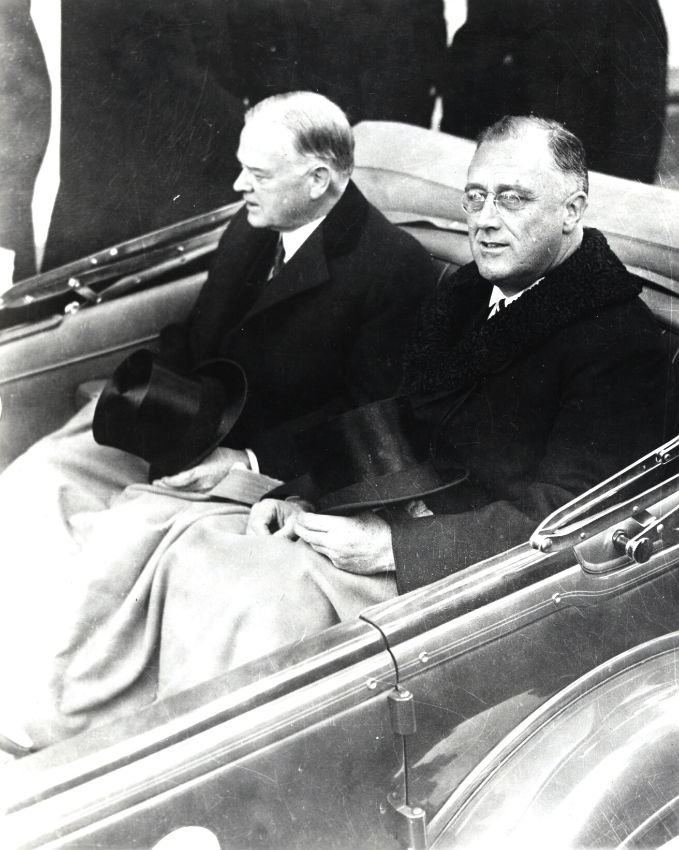
CASE STUDY: USA
"In a conservative and stable democracy such as ours, the establishment must, over the long run, reflect the composition and aspirations of the whole people. Thus the significance of the so‐called Roosevelt revolution was that it produced a kind of schizophrenia within the ranks of the establishment. Those who believed in the aristocratic idea of assimilation and service to the whole people responded to the threat of violent revolution by supporting the reforms of the New Deal. Those who clung to the idea of caste protection and the pursuit of individual success were more likely to have become a part of a rich and resentful opposition" (The New York Times 1964: 4).

Slide 18
eHRAF Workbook
ACTIVITY
Class vs. Caste
In this activity, you will ual relations across the globe.

Slide 19
The eHRAF World Cultures database is primarily about cultural anthropology: cultural and social life in the recent present.
It also contains ethnographic information about social stratification, social mobility, class and caste, ascribed and achieved status in societies around the globe.

Slide 20
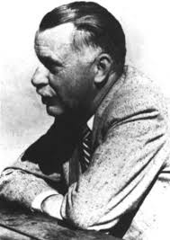
Outline of Cultural Material (OCM)
The Outline of Cultural Materials (OCM) is a vast subject index designed to cover all aspects of cultural and social life.
It was first developed in the 1930s by George Peter Murdock and colleagues at Yale's Institute of Human Relations and has been revised ever since.

Slide 21
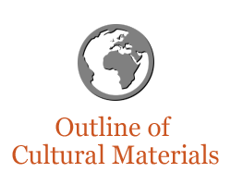
Outline of Cultural Materials (OCM)
The OCM is an ethnographic classification system on human behavior, social life and customs, and material culture.
In the eHRAF databases, these subjects categories have been use to index each and every paragraph.
This tagging system means that you can search across all of our collections to find the exact paragraph-level content you need.

Slide 22
OCM SUBJECTS
On the following slides, you will find some suggested OCM subjects which may be helpful when searching for information related to class and caste.

Slide 23
550 INDIVIDUATION AND MOBILITY
554 Status, Role, and Prestige
556 Accumulation of Wealth
558 Downward Mobility
560 SOCIAL STRATIFICATION
564 Castes
565 Classes
OCM IDENTIFIERS

Slide 24
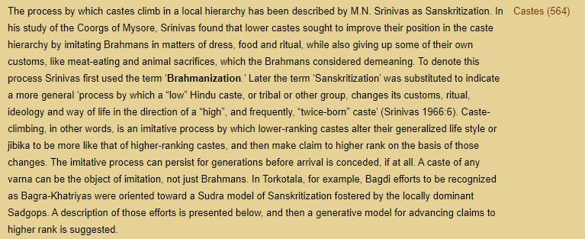
This screenshot shows how a paragraph from Davis (1983: 135) on Bengali (AW69) appears in eHRAF World Cultures. Read the text to discover a perspective about upward moblity through Brahmanization in Indian society.

Slide 25
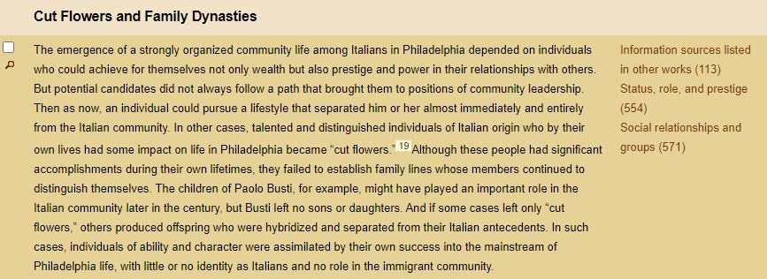
This screenshot shows how a paragraph from Juliani (1998: 264) on Italian Americans (N010) appears in eHRAF World Cultures. Read the text to discover a perspective about upward moblity through cultural assimilation in American society.

Slide 26
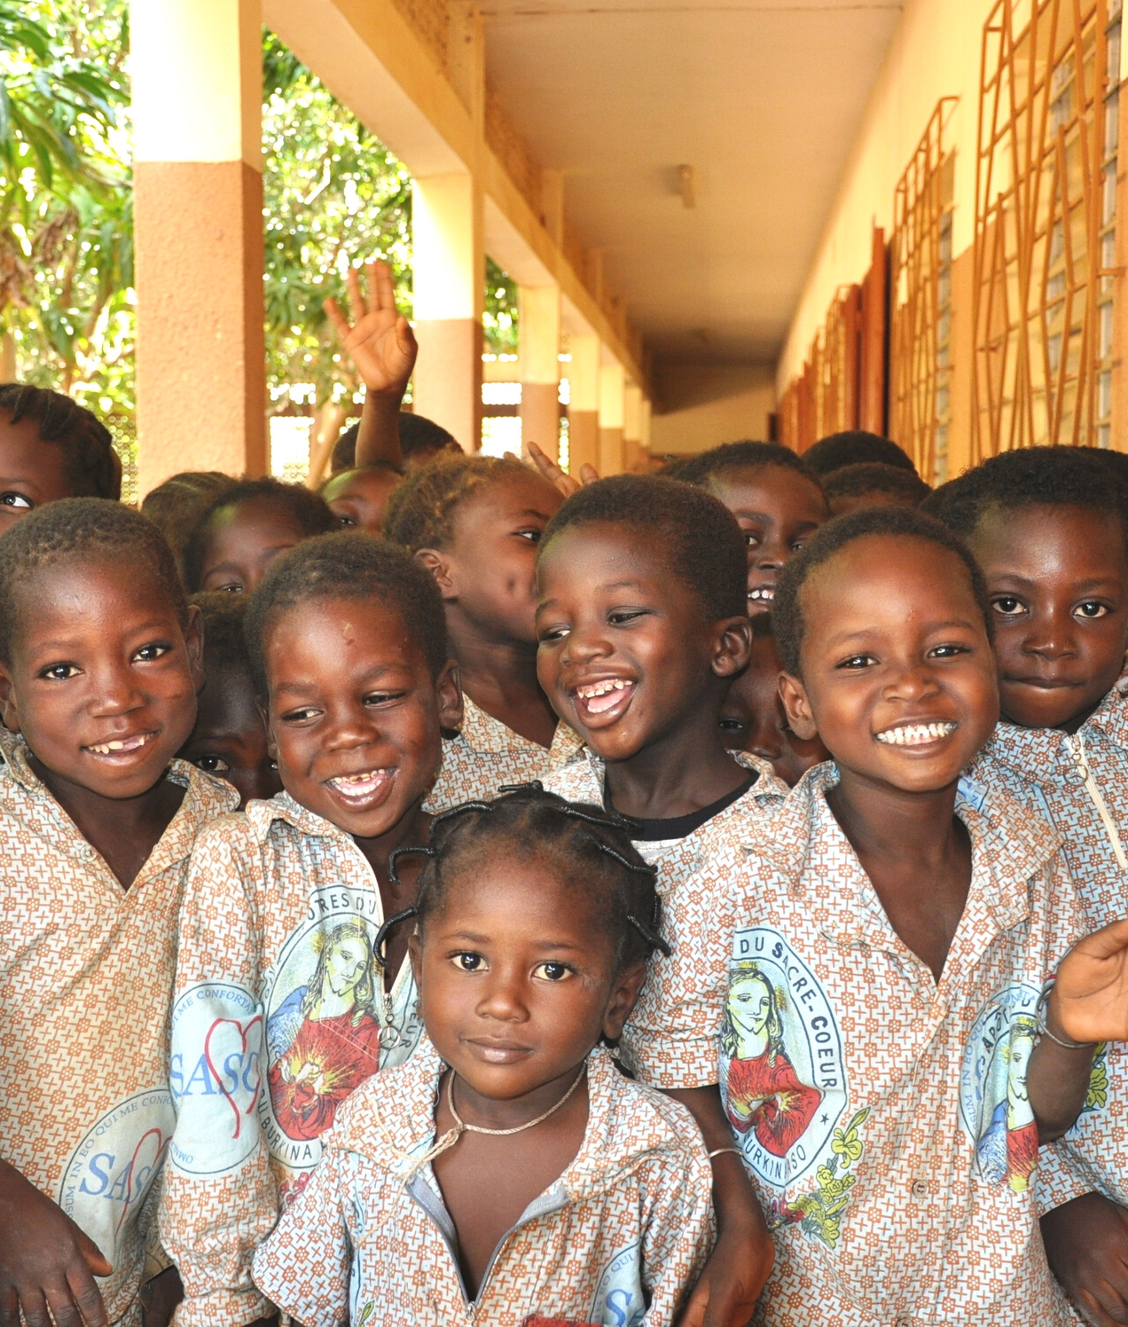
eHRAF Research
Use eHRAF to research two (2) cultures that are of interest to you.
Specifically look for information which pertains to class, caste, and social mobility.
Make sure to keep track of the sources you find.

Slide 27
Essay Assignment
Write a short paper (2-4 pages) in which you discuss your findings.
Does social stratification in the cultures you studied appear to be indicative of a class society or a caste society?
What examples upward or downward social mobility did you find?
How is cultural assimilation related to social mobility in each society?

Slide 28
Baltzell, E. D. 1987. The Protestant Establishment: Aristocracy & Caste in America. Yale University Press.
Ferraro, Gary, and Susan Andreatta. 2010. Cultural Anthropology: An Applied Perspective. Eighth Edition. Wadsworth Cengage Learning.
Kolenda, Pauline. 1978. Caste in Contemporary India: Beyond organic solidarity. Menlo Park, CA: Benjamin/Cummings.
References
Leslie, C. 1967. "Social Change in Modern India. M. N. Srinivas." American Anthropologist, 69: 420-421. doi:10.1525/aa.1967.69.3-4.02a0056
Srinivas, M. N. 1995. Social Change in Modern India. Orient Blackswan.
The New York Times. 1964. "Old Elite, New Reality; The Protestant Establishment." The New York Times Book Review. November 15, 1964, Section BR, Page 4.

Slide 29
Class vs. Caste
in eHRAF World Cultures
Produced by
Human Relations Area Files
at Yale University
An eHRAF Workbook Activity
hraf.yale.edu

