Slide 1
An eHRAF Workbook Activity
Egalitarian vs. Rank Societies
in eHRAF World Cultures
Human Relations Area Files
at Yale University

Slide 2
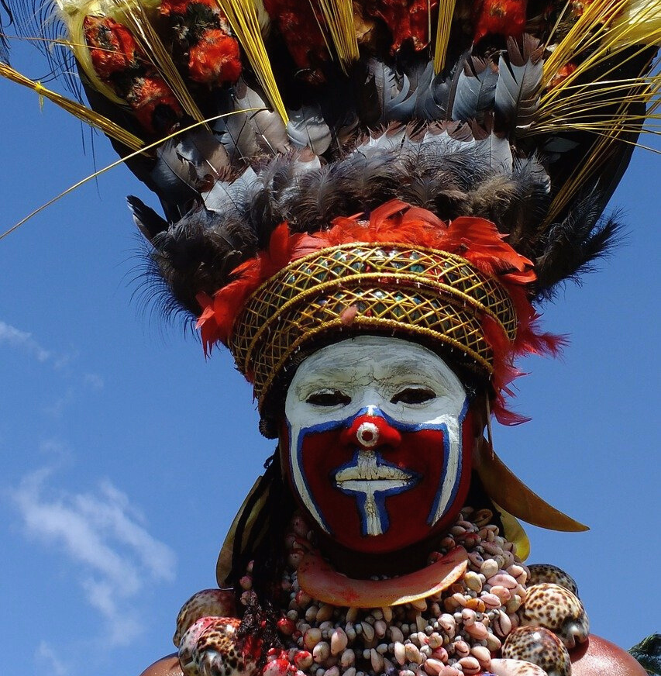
In this activity
Define wealth, power, and prestige
Understand the differences between egalitarian, rank, and stratified societies
Conduct research using eHRAF World Cultures
Topics We'll Cover

Slide 3
DIMENSIONS OF SOCIAL INEQUALITY
According to Max Weber (1946), there are three dimensions of social inequality: wealth, power, and prestige.

Slide 4
Social Inequality
WEALTH
The accumulation of material objects that have
value in a society.
POWER
The ability to achieve one’s goals and objectives even against the will of others.
PRESTIGE
Social honor, or respect, within a society.

Slide 5
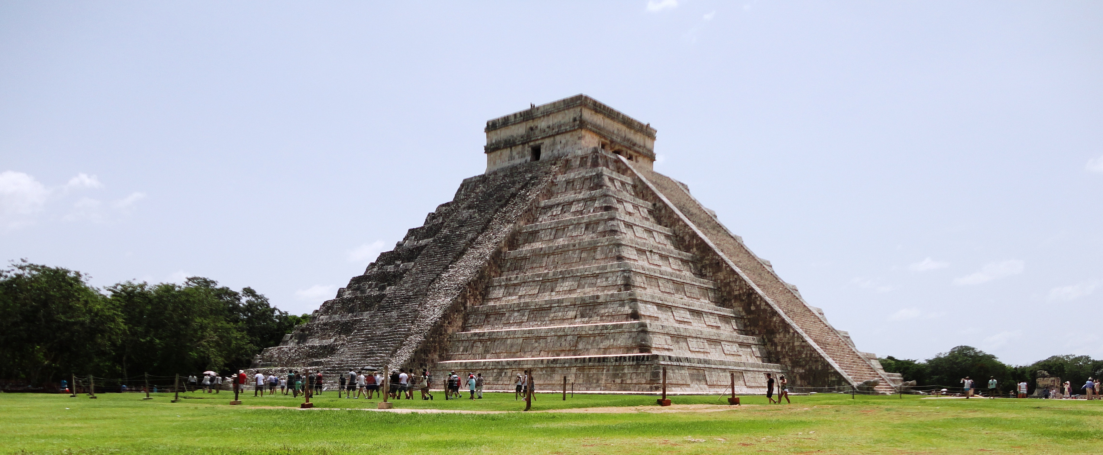
TYPES OF SOCIETIES
According to Morton Fried (1967), there are three types of societies based on levels of social inequality: egalitarian, rank, and stratified.

Slide 6
SOCIAL INEQUALITY CONTINUUM
Least Inequality
Most Inequality
Egalitarian Societies
Rank Societies
Stratified Societies

Slide 7
Egalitarian Societies
LEVEL OF INEQUALITY
no social group has appreciably more wealth, power, or prestige than any other
ECONOMICS
typically hunters and gatherers with economies based on reciprocity
POLITICS
have little or no political role specialization

Slide 8
Rank Societies
LEVEL OF INEQUALITY
certain groups enjoy higher prestige, even though power and wealth are equally distributed
ECONOMICS
economies based on redistribution
POLITICS
usually found among chiefdoms with limited political role specialization

Slide 9
Stratified Societies
LEVEL OF INEQUALITY
the greatest degree of social inequality in all three (wealth, power, and prestige) categories
ECONOMICS
found in industrialized societies with market economies
POLITICS
associated with state systems of government

Slide 10
EGALITARIAN SOCIETIES
Contains no social group with greater or lesser access to economic resources, power, or prestige. Examples: !Kung, Mbuti, Australian aborigines, Inuit, Ache, Yanomano (Ember and Ember 2019: 136).
RANK SOCIETIES
Do not have very unequal access to economic resources or to power, but they do contain social groups with unequal access to prestige. Examples: Samoans, Tahiti, Trobriand Islands, Ifaluk (Ember and Ember 2019: 136).

Slide 11
EGALITARIAN SOCIETIES
Found most readily among geographically mobile food collectors.
Egalitarian societies featured in eHRAF World Cultures include:
Aranda (OI08)
Copper Inuit (ND08)
Hadza (FN11)
Mbuti (FO04)
San or !Kung (FX10)

Slide 12
RANK SOCIETIES
Found most readily among chiefdoms.
Rank societies featured in eHRAF World Cultures include:
Nuu-chah-nulth or Nootka (NE11)
Samoans (OU08)
Tikopia (OT11)
Trobriands (OL06)
Woleai Region including Ifaluk (OR21)

Slide 13
CULTURAL COMPARISON

Slide 14
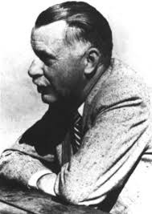
Outline of Cultural Materials (OCM)
The Outline of Cultural Materials (OCM) is a vast subject index designed to cover all aspects of cultural and social life.
It was first developed in the 1930s by George Peter Murdock and colleagues at Yale's Institute of Human Relations and has been revised ever since.

Slide 15
Outline of Cultural Materials (OCM)
The OCM is an ethnographic classification system on human behavior, social life and customs, and material culture.
In the eHRAF databases, these subjects categories have been use to index each and every paragraph.
This tagging system means that you can search across all of our collections to find the exact paragraph-level content you need.

Slide 16
OCM SUBJECTS
On the following slides, you will find some suggested OCM subjects which may be helpful when searching for information related to egalitarian and rank societies.

Slide 17
554
STATUS, ROLE, AND PRESTIGE
565
CLASSES
OCM IDENTIFIERS

Slide 18
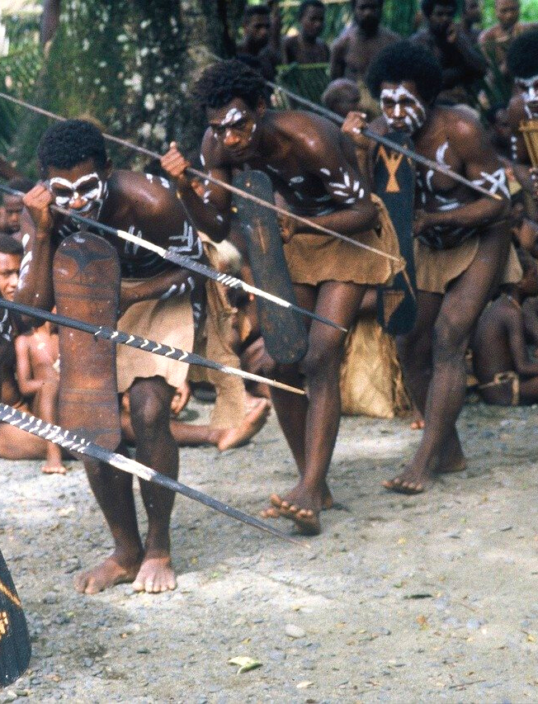
CULTURAL COMPARISON
Examine an egalitarian society: San (FX10) of Africa.
Examine a rank society:
Tikopia (OT11) of Polynesia.

Slide 19
Culture Summaries
A brief overview for societies in eHRAF World Cultures is provided in the form of Culture Summaries.
The format, general outline, and headings are the same for each summary. You will find a basic overview about the culture, such as its economy, history, environment, and sociopolitical organization.
eHRAF
World
Cultures
To find a culture summary, go to the Browse Cultures tab and enter the culture name into the box, then click on Culture Summary below the culture name to read it.

Slide 20
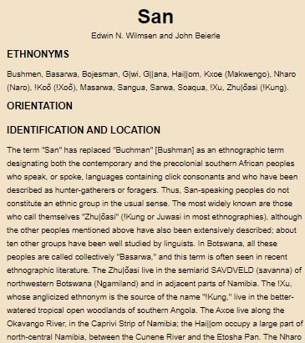
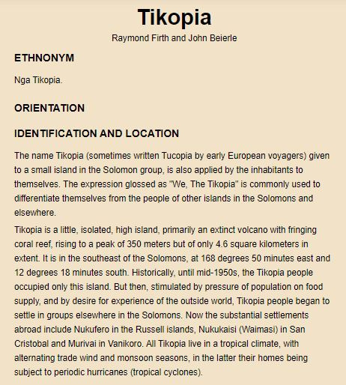
Read the culture summaries for:
San (FX10) and Tikopia (OT11)

Slide 21
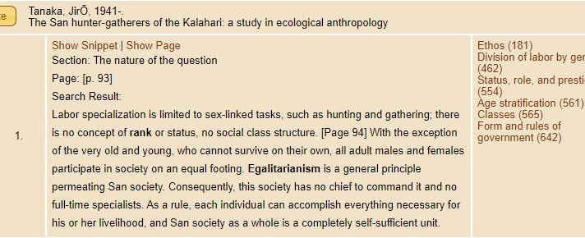
This screenshot shows how a paragraph from Tanaka (1980: 93) on San (FX10) appears in eHRAF World Cultures. Read the text to learn about how the San are an egalitarian society with no concept of rank or status, and no social class structure.

Slide 22
This screenshot shows how a paragraph from Marshall (1976: 303) on San (FX10) appears in eHRAF World Cultures. Marshall describes how shell necklaces given to the San as parting gifts would later be taken apart and the shells were redistributed among the people. This story illustrates the principle of egalitarianism among the San.

Slide 23
This screenshot shows how a paragraph from Firth (1970: 212) on Tikopia (OT11) appears in eHRAF World Cultures. Firth describes how the bowing of the head by commoners as a sign of respect for chiefs is symbolic of Tikopia as a rank society.

Slide 24
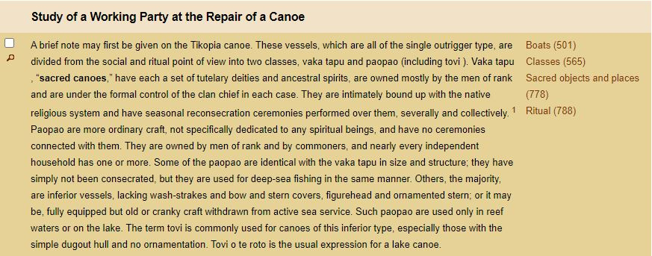
This screenshot shows how a paragraph from Firth (1939: 117) on Tikopia (OT11) appears in eHRAF World Cultures. Firth describes how canoes used by the Tikopia are differentiated between chiefs and commoners, which symbolizes a rank society.

Slide 25
In this activity, you will ual relations across the globe.
eHRAF Workbook
ACTIVITY

Slide 26
eHRAF Research
Use eHRAF to find ethnographies describing another egalitarian society and another rank society.
Refers to the societies listed in slides 11 and 12 for suggestions.
Read the Culture Summaries for the societies you select.
Find relevant passages which describe social stratification.

Slide 27
Essay Assignment
Write a short paper (2-4 pages) in which you discuss your findings.
What do people in the egalitarian society do to maintain social equality?
What do people in the rank society do which indicates a social hierarchy?
How do these societies compare to your own society? Does your society have social inequality, economic inequality, or both?

Slide 28
1. Ember, Carol R., and Melvin Ember. 2019. Cultural Anthropology, Fifteenth Edition. New York, NY: Pearson.
2. Firth, Raymond. 1939. Primitive Polynesian Economy. London, England: George Routledge & Sons, Ltd.
3. Firth, Raymond. 1970. Rank and Religion in Tikopia: A Study in Paganism and Conversion to Christianity. Boston, Mass.: Beacon Press
References
4. Fried, Morton. 1967. The Evolution of Political Society: An Essay in Political Anthropology. New York, NY: Random House.
5. Marshall, Lorna. 1976. The !Kung of Nyae Nyae. Cambridge, Massachusetts: Harvard University Press.
6. Tanaka, JirŌ, and David W. Hughes. 1980. The San Hunter-Gatherers of the Kalahari: A Study in Ecological Anthropology. Tokyo: University of Tokyo Press.
7. Weber, Max. 1946. From Max Weber: Essays in Sociology (Hans Girth and C. Wright Mills, trans. and eds.). New York, NY: Oxford University Press.

Slide 29
Egalitarian vs. Rank Societies
in eHRAF World Cultures
Produced by
Human Relations Area Files
at Yale University
An eHRAF Workbook Activity
hraf.yale.edu

