Slide 1
Quantitative and Qualitative Approaches to Health in Anthropology
Ben Gonzalez

Slide 2
Outline
Introduction
What is medical anthropology?
Why is health of interest to anthropologists?
Quantitative methods
Disparities in Context
Qualitative methods
Producing the Qualified
Comparing and contrasting methods
Moving forward with methods in health

Slide 3
Health in anthropology
Medical anthropology
Incorporates social, cultural, biological, and linguistic anthropology
Factors which influence what we know as “health”
Why health?
Medicinal practices/beliefs
Idea of the body
Sociocultural norms
Human health institutions
Social construction of knowledge and politics of science

Slide 4
Disparities in Context- Quantitative Research
Completed in Summer 2019 at University of Texas at Austin
Part of independent NSF REU program
Dealt with insurance coverage rates of Latino vs. white respondents in Texas
Secondary data analysis
Used existing data
Research Questions:
How are disparities in health insurance coverage distributed differently across public and private insurance types?
How much of the disparity is related to socioeconomic status?

Slide 5
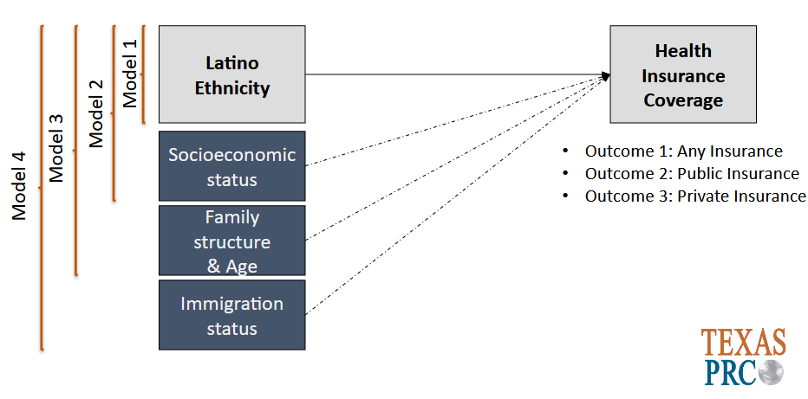
Disparities in Context- Methodology
Data
ACS 2017: Nationally representative sample by Census Bureau
Individual-level data
Texas residents ages 18-45
n=76,842
Methods
Logistic regression
3 Outcome variables: whether or not respondent has any, public or private insurance
Controlled for socioeconomic status, family structure and age, and immigration status
Odds-ratios for Latino coverage vs. white

Slide 6
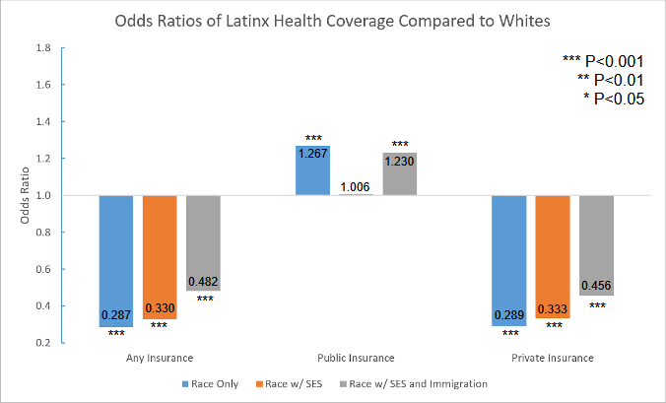
Disparities in Context- Results
Findings
After controlling for socioeconomic status (SES), still a large disparity in coverage
Controlling for immigration status largely reduced the disparity
These trends hold true across different types of insurance (but especially private)
Implications
There is more to health insurance disparities than class
System avoidance
Could inform how institutions approach different populations
Benefits of quantitative study

Slide 7
Producing the Qualified- Qualitative Research
Green and Healthy Homes (GHH)
Lead-based paint removal and renovation program for San Antonio
Families must meet specific requirements
Income level
Age of home
Age of children in home (focus of study)
Families must live in house for 5 years after renovation, or pay back cost
Research questions
How do environmental hazards constitute a public health threat, and how do public institutions systematize responses to that threat?
How do requirements for public health programs inform our understanding and prioritization of public health itself?

Slide 8
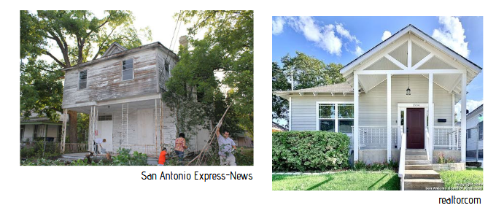
Producing the Qualified- Methodology
Community Data
Interviews with 4 GHH residents
Observational data on 30 homes
Outreach events between city & community
City Data
10 interviews with various city officials
Lead inspection
Outreach events between city & community
Qualitative Data and Analysis:
Required IRB approval
Informants (anonymous) found through mix of city data, word of mouth, referrals
Transcriptions and analysis
Theoretical focus and development changed over time

Slide 9
Producing the Qualified- Results
Focus on child’s measurable health
Blood Lead Levels (BLLs)
Requirements for qualification
Methods of recruitment
“Clients” and “Collective investments”
Residents not simple beneficiary, but entering into a contract
5-year covenant protects “investment” by city
Success conditions of GHH programs
Implications
Neoliberal structure of state-funded aid
Public health’s focus on protecting bodies
Benefits of qualitative analysis
Research questions
How do environmental hazards constitute a public health threat, and how do public institutions systematize responses to that threat?
How do requirements for public health programs inform our understanding and prioritization of public health itself?

Slide 10
Comparing and Contrasting Methods
Quantitative
More easily generalizable
Can speak to broader trends across larger scope
Can directly build off previous data
More rigid structure
Often less resource-intensive
Qualitative
More focused
Speaks in-depth but to a narrower scope
Not as easily summarizable
Looser, fluid theoretical structure
Often more resource-intensive

Slide 11
Methods and Health in Anthropology
Both method categories offer unique aspects to the study of health
Measurable outcomes vs. the power of a narrative
Future research
Quantitative:
Human health outcomes affected by climate change
Medicare-for-all and its societal implications
Qualitative:
LGBTQ+ health identities and how bodies are conceptualized
COVID-19 and social responsibility

Slide 12
Thank you! Any Questions?
Ben Gonzalez
bencruzgonzalez@gmail.com

Slide 13
Image credits
Photos of Dignowity Hill:
https://www.realtor.com/realestateandhomes-search/Dignowity-Hill_San-Antonio_TX
https://www.sanantonio.gov/historic/scoutsa/HistoricDistricts/Dignowity-Hill
All other images are researcher’s own, or retrieved from pixabay.com under “free for commercial or non-commercial use license”

