Slide 1
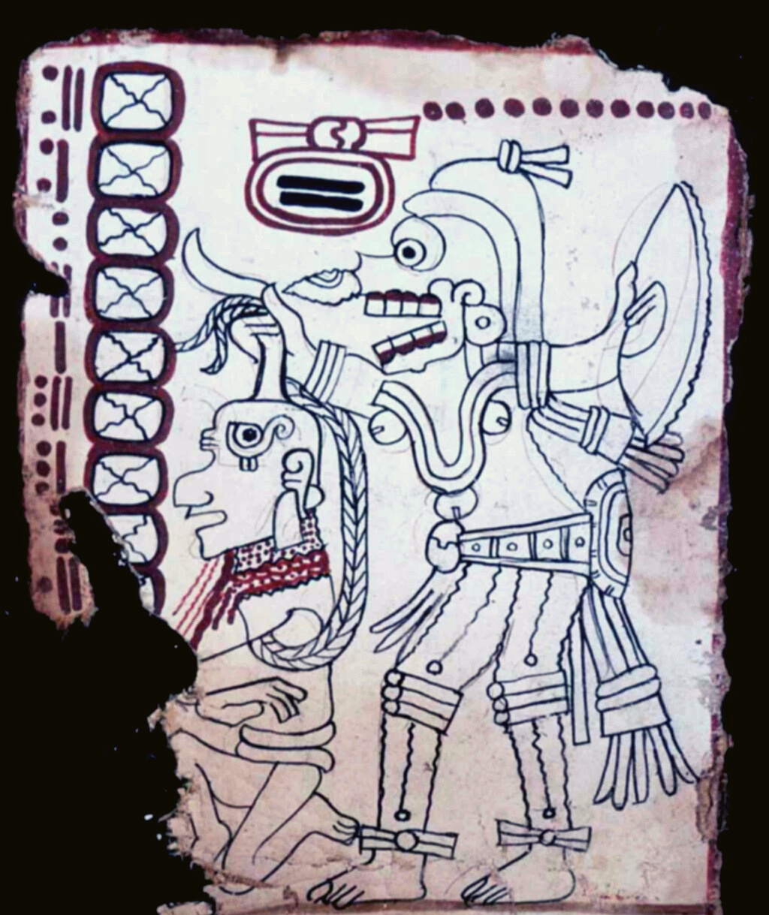

An eHRAF Workbook Activity
Great Discoveries:
Maya Codices
Human Relations Area Files
at Yale University

Slide 2
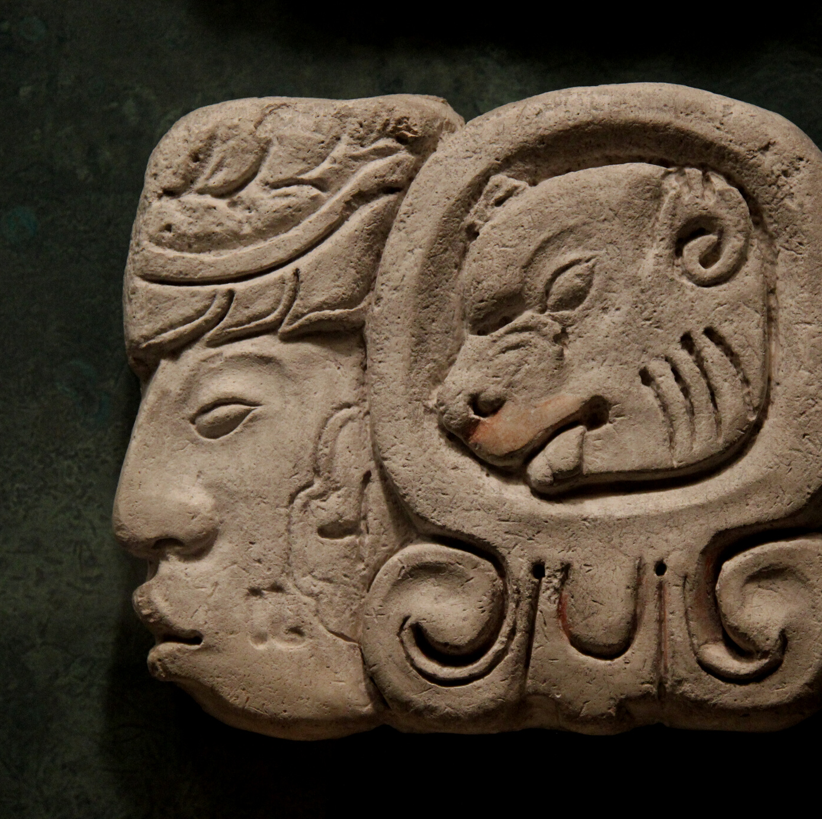
In this activity
Learn about the Maya Codices
Read passages in eHRAF Archaeology
Answer questions about this archaeological discovery
Find out what makes the Maya Codices a "Great Discovery"
Topics We'll Cover

Slide 3
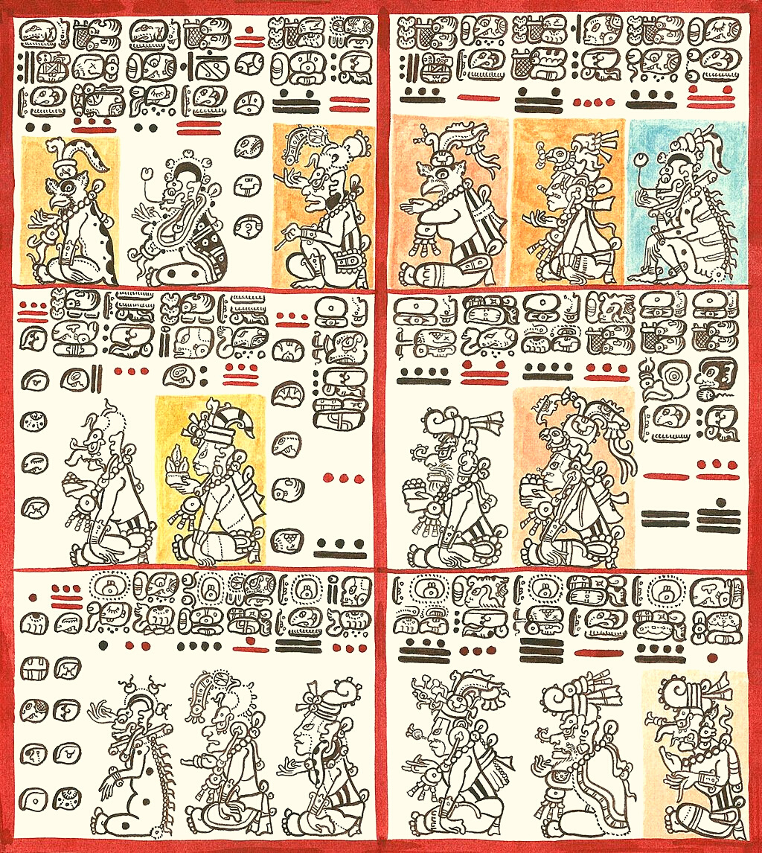
MAYA CODICES

Slide 4
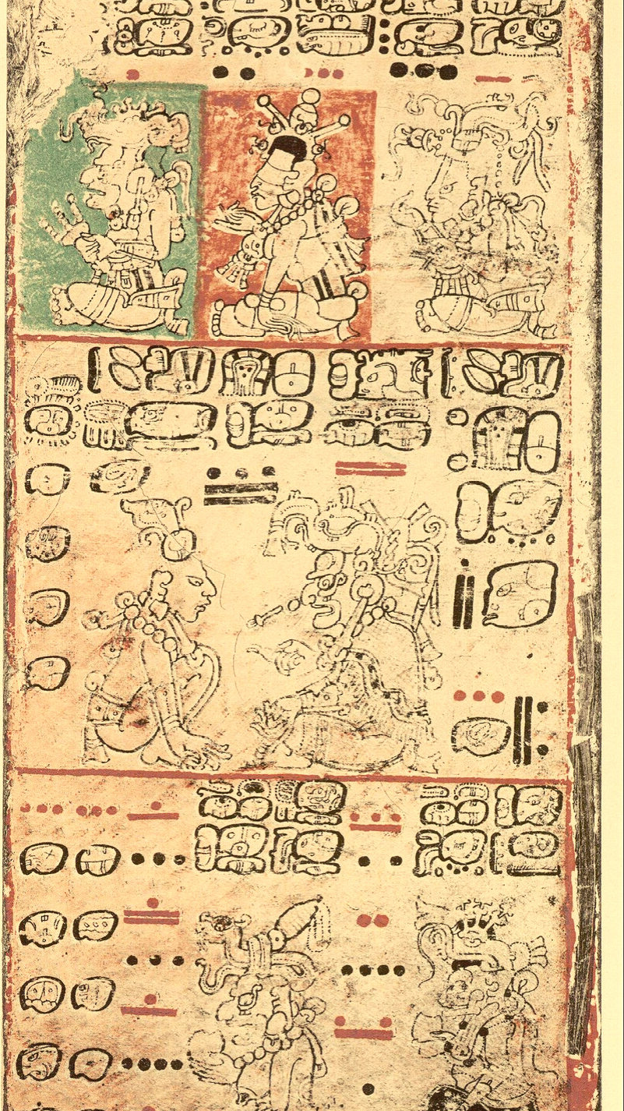
The Maya civilization was an ancient Mesoamerican civilization noted for its architecture, art, astronomy, calendar, mathematics, and logosyllabic script—the most sophisticated writing system in the pre-Columbian Americas.
Maya codices (singular codex) are folding books written by professional scribes in hieroglyphic script on bark paper. Spanish conquistadors and Catholic priests destroyed most of the codices in the 16th century. The few remaining codices have been named for the cities where they eventually settled.
Did you know?

Slide 5
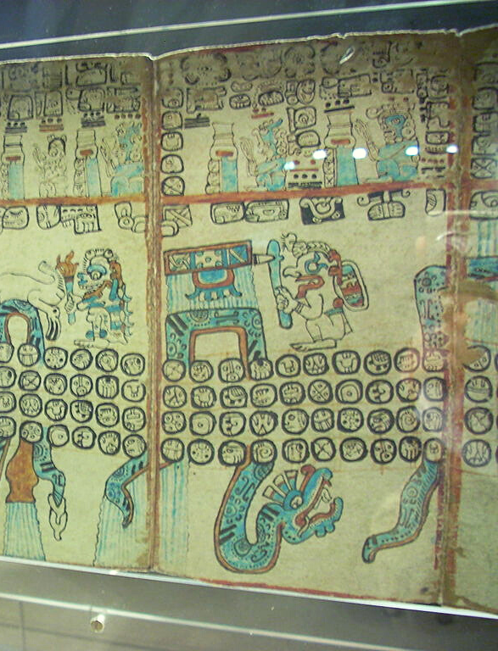
Colonial officials and the Catholic Church, notably Bishop Diego de Landa, destroyed Maya texts wherever they were found. Three pre-Columbian books dated to the Postclassic period were well preserved. These are known as the Dresden Codex, the Madrid Codex, and the Paris Codex. A fourth book, known as the Grolier Codex, emerged in the 1970s and remained controversial until it was authenticated in 2015. The late archaeologist Michael Coe, a Yale professor and Mayanist scholar, published findings supporting its authenticity. A research study using X-rays, UV imaging, and microscopic analysis authenticated the Grolier Codex.

Slide 6
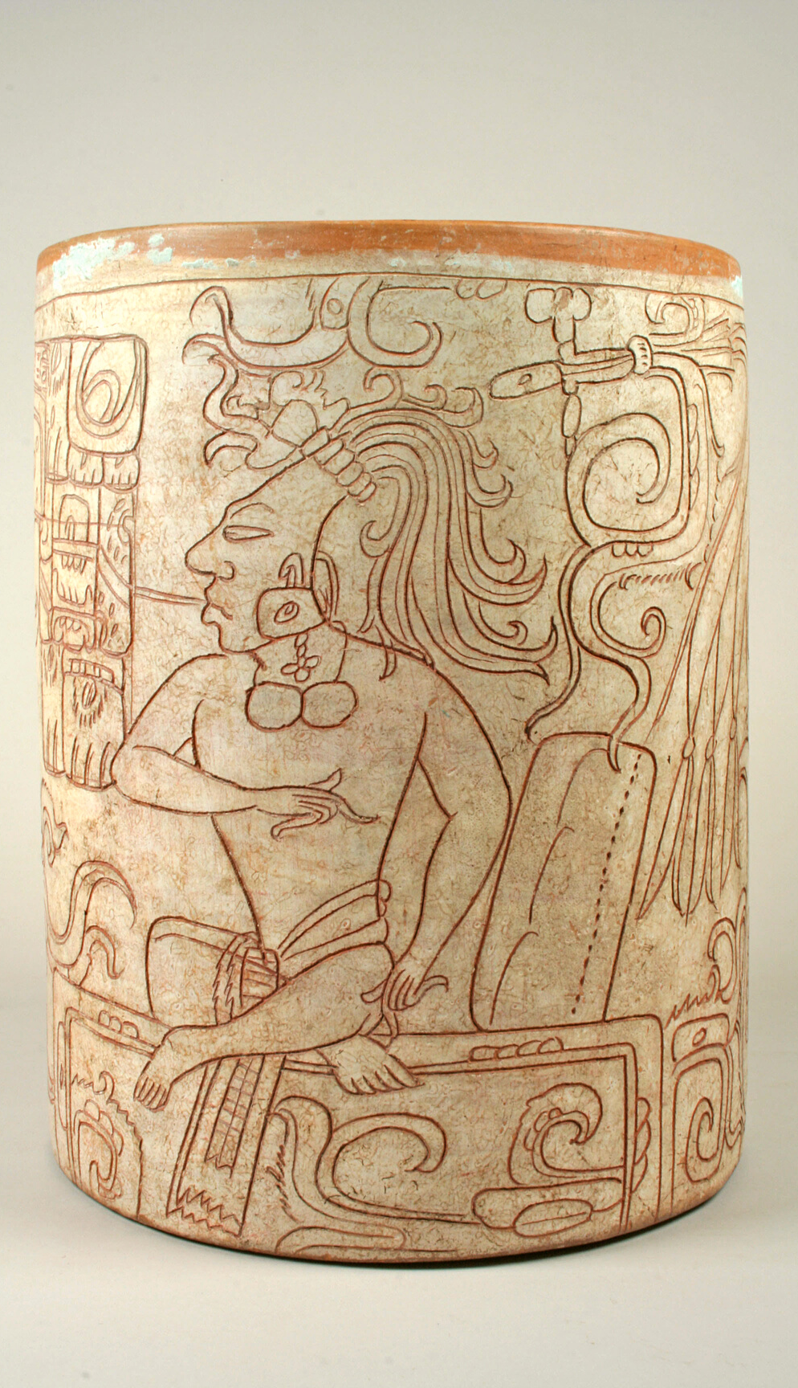


Review these videos about the Maya Codices:
Breaking the Maya Code
Cracking the Maya Code
Deciphering the Maya Code
Deciphering the Maya Script
Maya Writing
The Decipherment of Maya Script

Slide 7
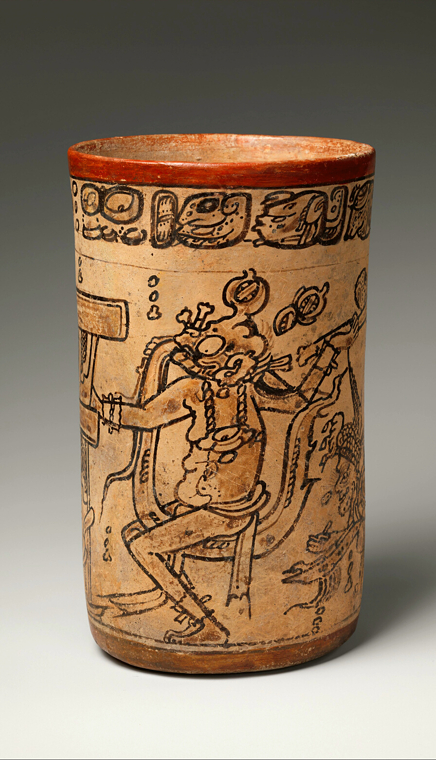
Articles about the Maya Codices
Authenticating the oldest book in the Americas
The Maya Codices – Archaeology Magazine
The Four Surviving Maya Codices
The Maya Hieroglyphic Codices
Breaking the Maya Code
Cracking the Maya Code

Slide 8
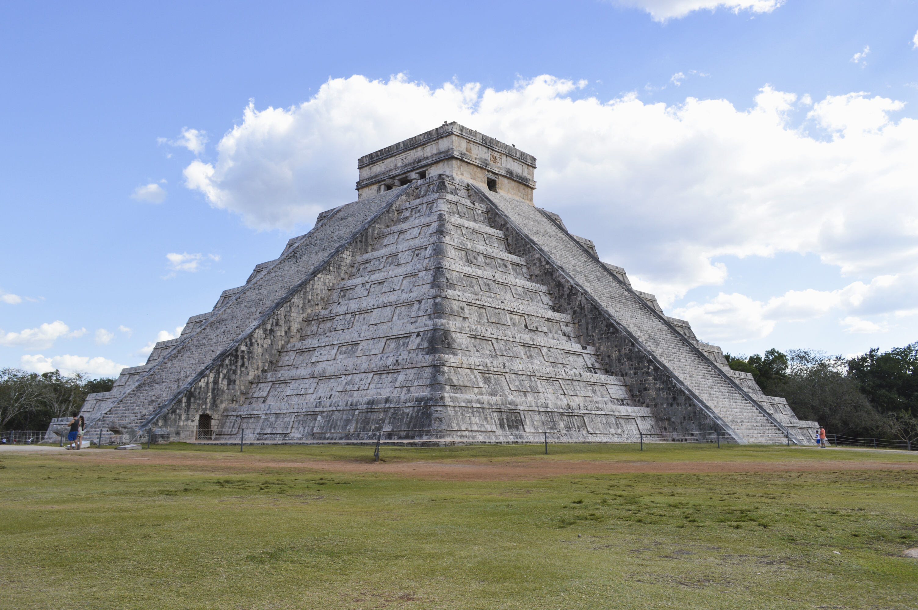
eHRAF Workbook
Part 1: Tradition Summary

Slide 9
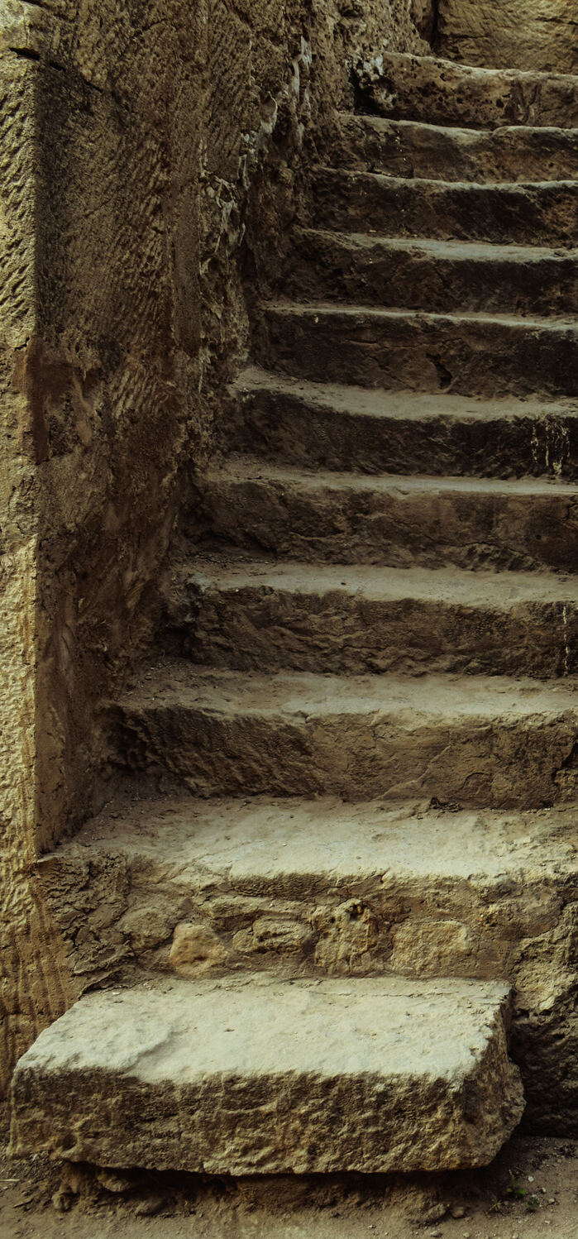
Tradition Summaries
A brief overview for traditions in eHRAF Archaeology is provided in the form of Tradition Summaries.
The format, general outline, and headings are the same for each summary. You will find a basic overview about the tradition, such as its time period, location, history, environment, and sociopolitical organization.
eHRAF
Archaeology
To find a tradition summary, go to the Browse Traditions tab and enter the tradition name into the box, then click on Tradition Summary below the tradition name to read it.

Slide 10
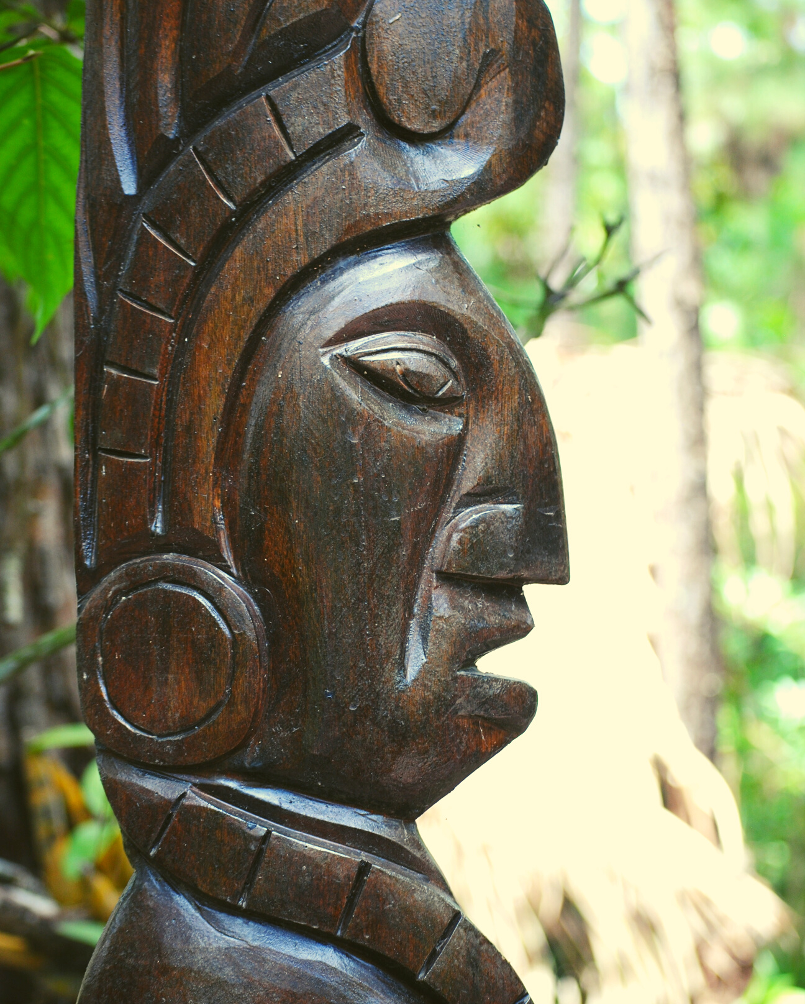
Maya
PART 1
First, read the following eHRAF Tradition Summaries. Then, write a brief description of the Maya.
Preclassic Maya (NY52)
🌐
https://ehrafarchaeology.yale.edu/document?id=ny52-000
Classic Maya (NY53)
🌐
https://ehrafarchaeology.yale.edu/document?id=ny53-000
Postclassic Maya (NY54)
🌐
https://ehrafarchaeology.yale.edu/document?id=ny54-000

Slide 11

eHRAF Workbook
Part 2: Selected Readings

Slide 12
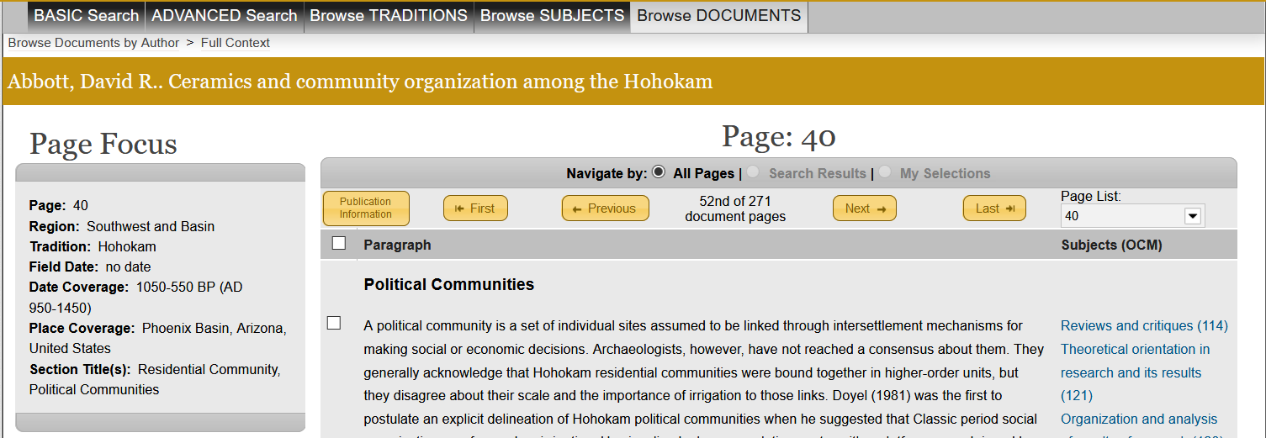
To read documents or pages in eHRAF:
INSTRUCTIONS
First, follow the permalinks provided in the activities below to get to the relevant documents.
For example:
🌐
https://ehrafarchaeology.yale.edu/document?id=nt76-001
Then, use the Page List dropdown menu to navigate to the required page(s).

Slide 13
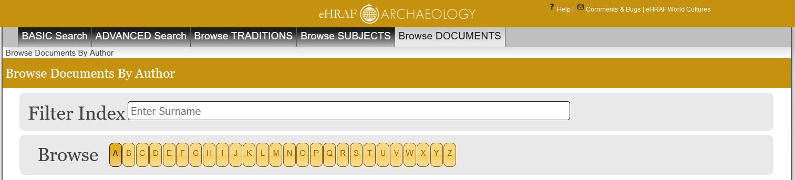
Finding documents without permalinks
INSTRUCTIONS
Follow these steps if you are having trouble with permalinks from off campus while using a proxy or VPN service, or if you have been provided with a HRAF-issued username and password.
Sign in via your library proxy or VPN, or using the HRAF-issued credentials.
Go to the Browse Documents tab.
Enter the author's last name into the Filter Index box.
Click on the required title to access the document, then select the page number from the Page List dropdown menu as shown above.

Slide 14
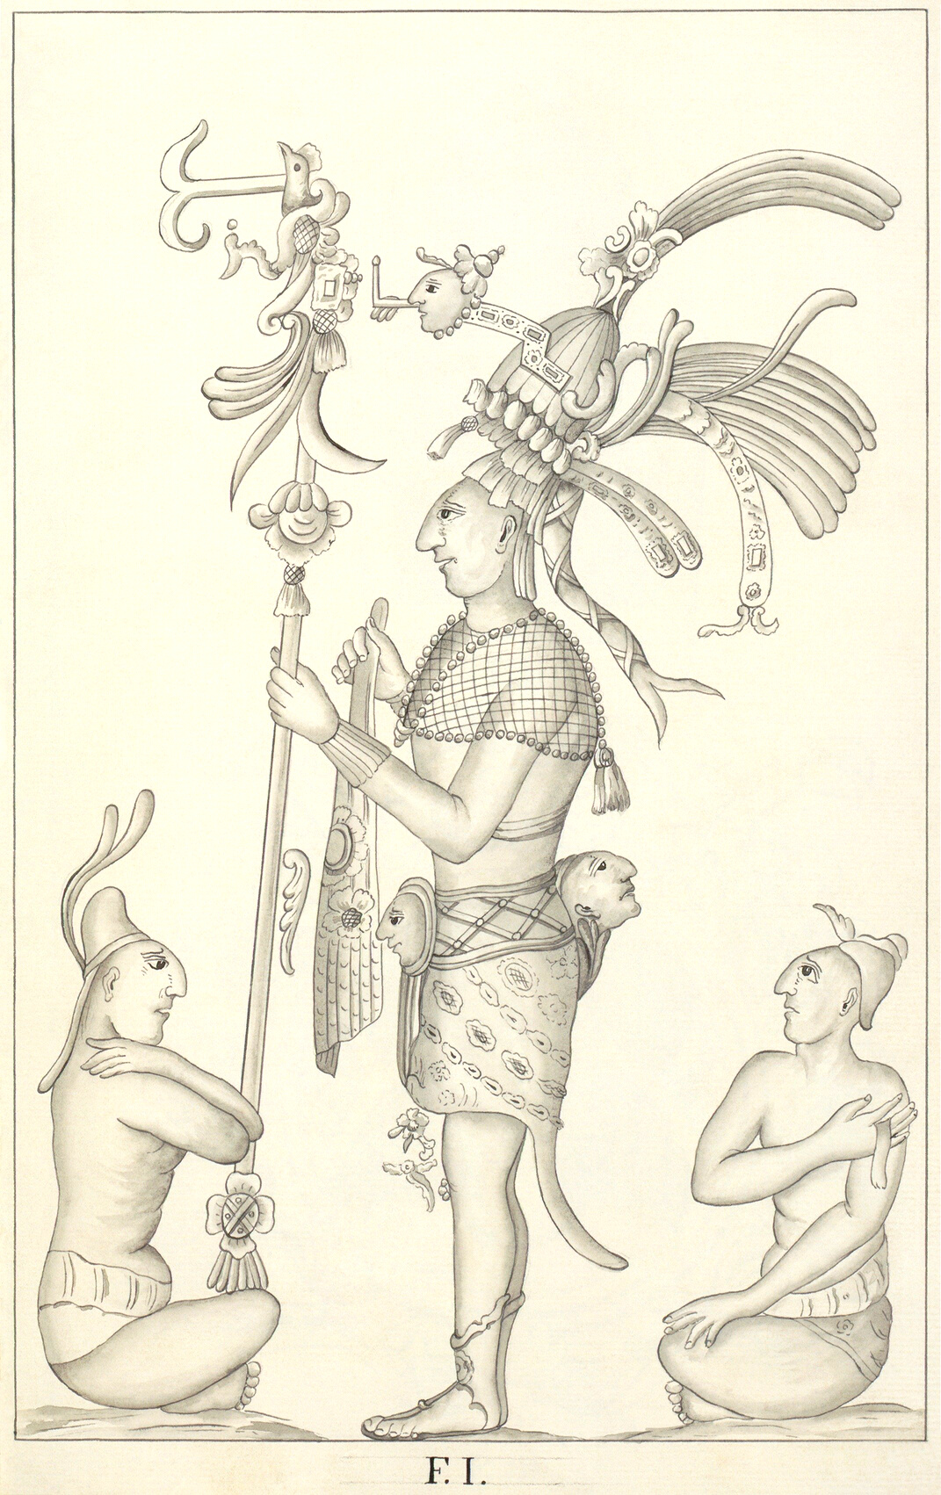
PART 2
Olmec and Maya: A Study in Relationships (Coe 1977)
🌐
https://ehrafarchaeology.yale.edu/document?id=ny52-035
Pages:
186–190, Olmec-Maya Homologies
192–194, The Uniqueness of Maya Civilization
Tikal, a Handbook of the Ancient Maya Ruins (Coe and Villalta 1988)
🌐
https://ehrafarchaeology.yale.edu/document?id=ny53-012
Pages:
37–40, Plaza and Terrace Monuments

Slide 15
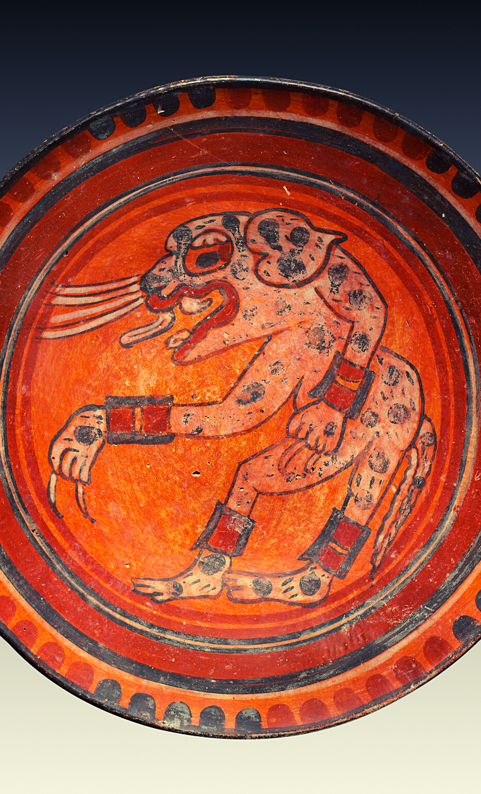
PART 2
Scribes, Warriors, and Kings: The City of Copán and the Ancient Maya (Fash 1991)
🌐
https://ehrafarchaeology.yale.edu/document?id=ny53-005
Pages:
9–10, The Mystery of the Maya, the Dresden, Madrid, and Paris Codices
12–13, 15, Mesoamerica and the Maya, Mayan languages
The Ruins of Coba (Folan 1983)
🌐
https://ehrafarchaeology.yale.edu/document?id=ny53-021
Pages:
80–81, Stelae and other hieroglyphic monuments, the three surviving Maya codices

Slide 16
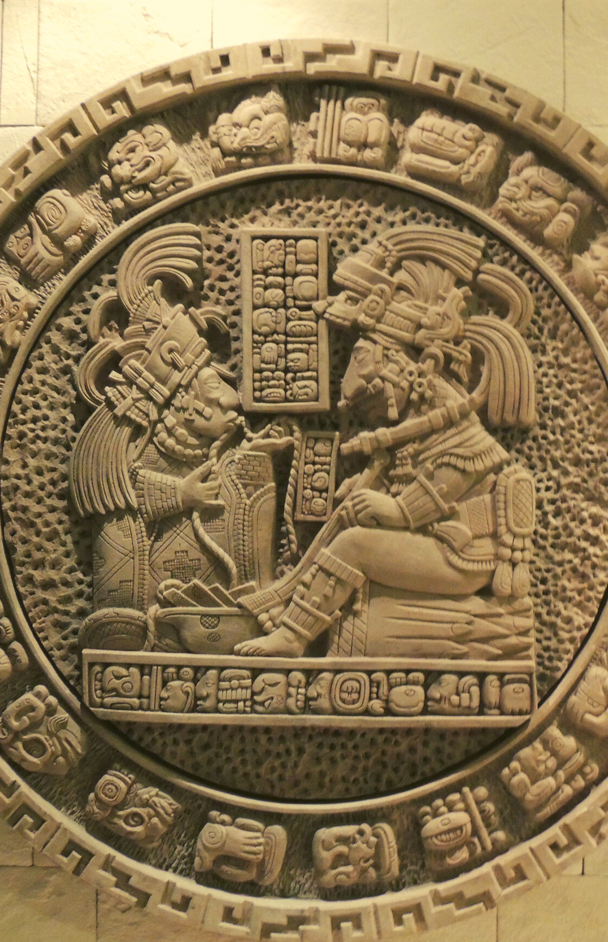
PART 2
The Ancient Maya (Sharer and Morley 1994)
🌐
https://ehrafarchaeology.yale.edu/document?id=ny53-002
Pages:
597-600, 603–617, Ancient Maya Writing, Pre-Columbian Maya Texts, Dresden, Madrid, Paris Codices, Deciphering Maya Writing, Knorozov
The Art and Iconography of the Xochicalco Stele (Smith 2000)
🌐
https://ehrafarchaeology.yale.edu/document?id=nu93-036
Pages:
85–87, Madrid, Dresden, and Paris Codices

Slide 17
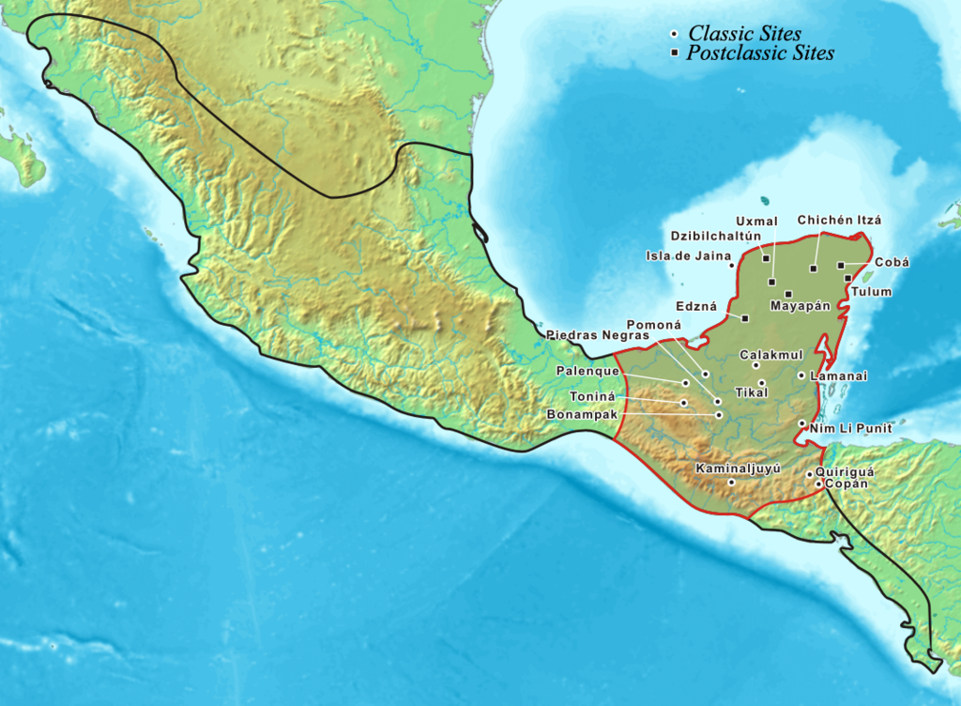
In this activity, you will ual relations across the globe.
eHRAF Workbook
Part 3: Advanced Search

Slide 18
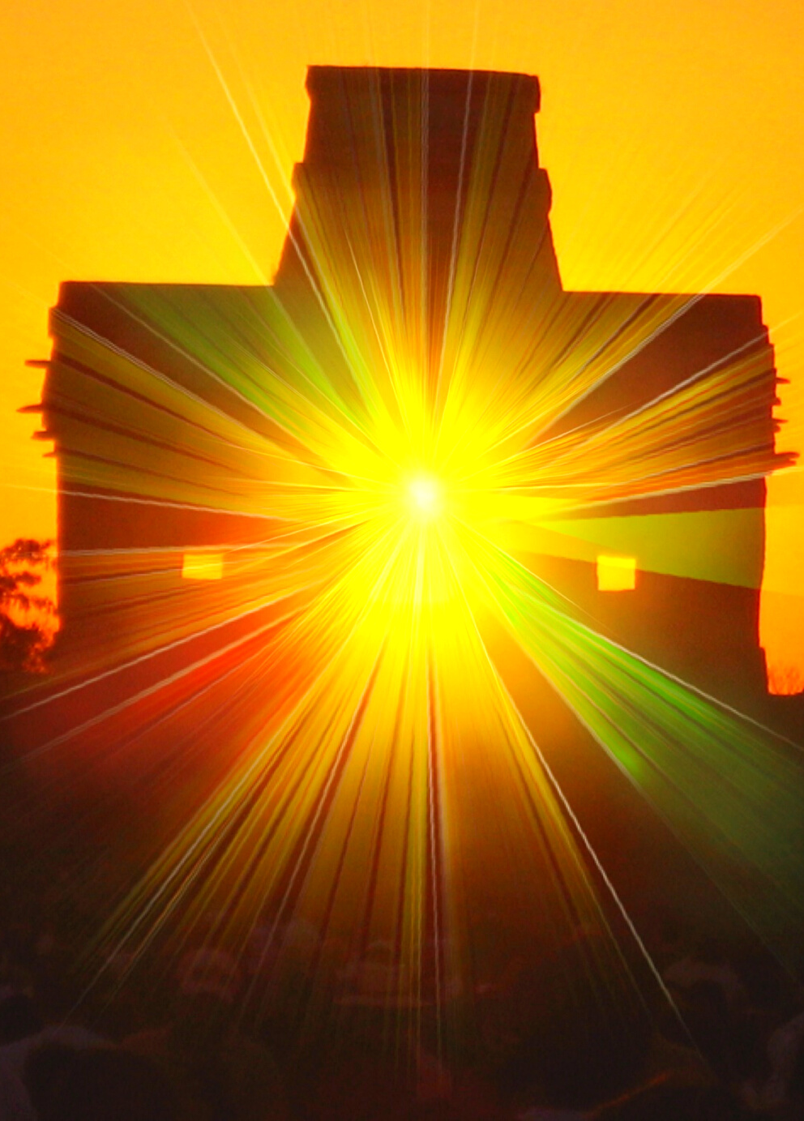
Part 3:
Advanced Search
Now that you have read selected passages from eHRAF Archaeology, dig deeper with Advanced Search. This will enable you to find specific passages in documents that have been indexed by HRAF anthropologists at the paragraph level.
On the following slide, you will find an example of an advanced search. Try this search and then experiment with different subjects and/or keywords.

Slide 19
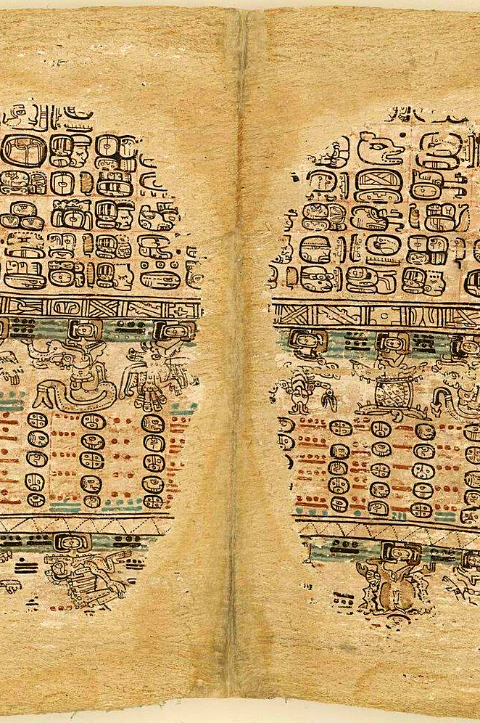
Part 3:
Advanced Search
In the Add Traditions section, select:
Classic Maya (NY53)
Postclassic Maya (NY54)
Preclassic Maya (NY52)
In the Add Subjects section, select:
Writing (212)
In the Add Keywords section, select:
code* codices

Slide 20
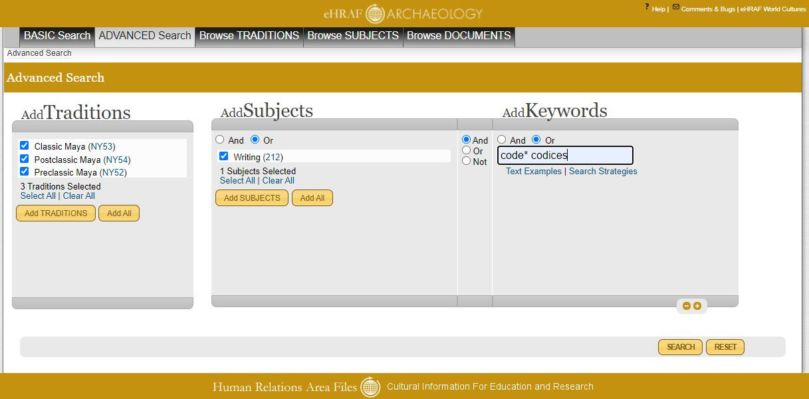
ADVANCED SEARCH
Add traditions:
Classic Maya (NY53)
Postclassic Maya (NY54)
Preclassic Maya (NY52)
Add subject:
Writing (212)
Add keywords:
code* codices

Slide 21
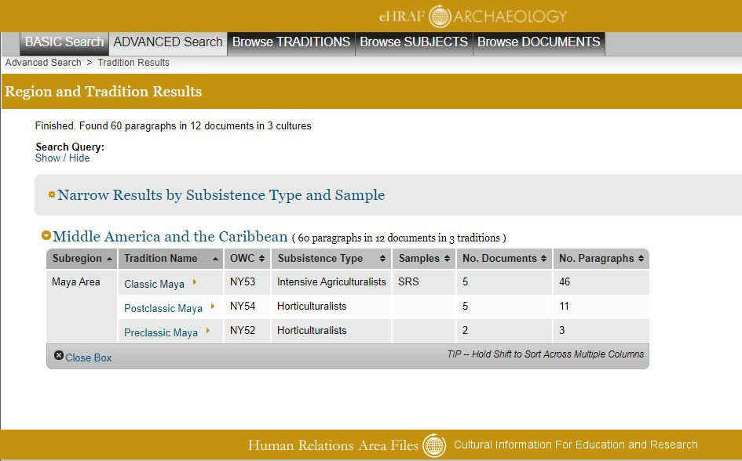
SEARCH RESULTS
The search results can be sorted by the number of documents or paragraphs for each tradition.

Slide 22
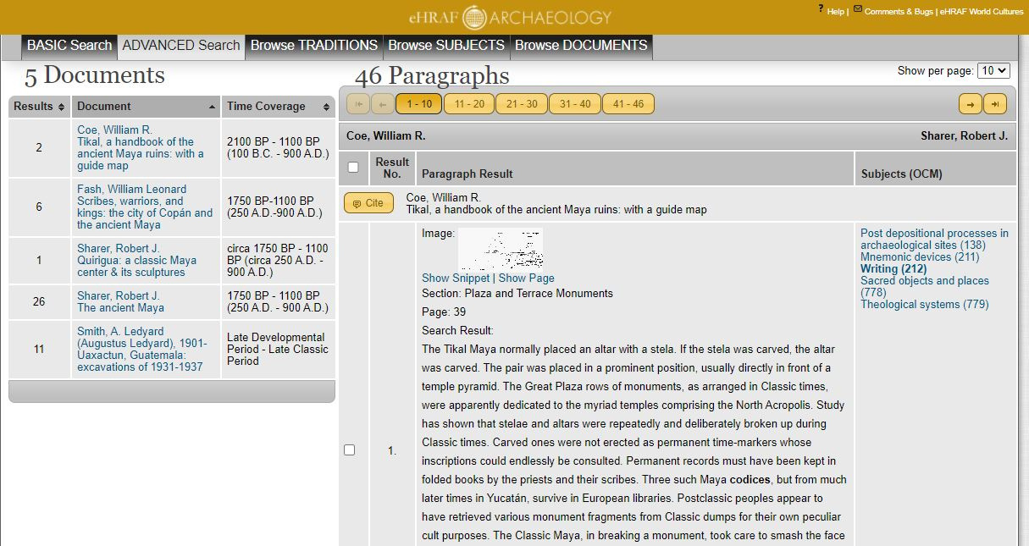
FULL CONTEXT

Slide 23
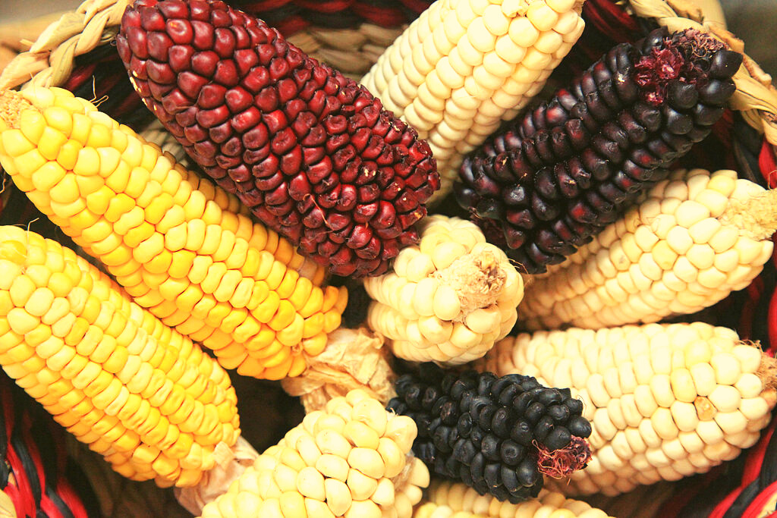
eHRAF Workbook
Part 4: Assignment

Slide 24

ASSIGNMENT
The purpose of this assignment is to present a report summarizing your findings about this great discovery.
This can be done in the form of a group project or an individual paper.
Groups can divide the questions that follow, with each student contributing information about a specific question.
Consider making a slideshow presentation to illustrate your findings.

Slide 25
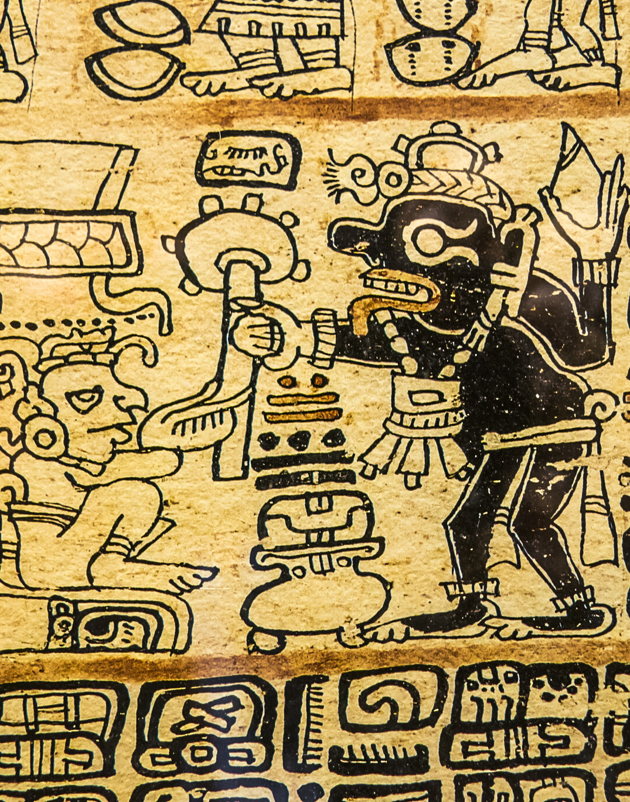
ASSIGNMENT
Your final report describing the Maya Codices should have 6 sections which correspond to these 6 types of questions:
Who?
What?
Where?
When?
How?
Why?

Slide 26
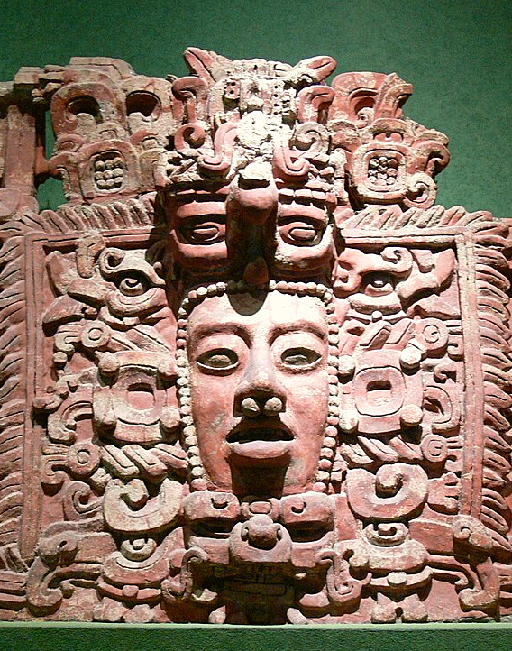
QUESTION 1
Who?
Who are the main archaeologists associated with this discovery? Describe their biographical information, education and training, publications, etc.
Who are the people studied? Describe how people lived during this time at this place, such as: social stratification, division of labor, gender roles, economic life, food and subsistence, religious practices.

Slide 27
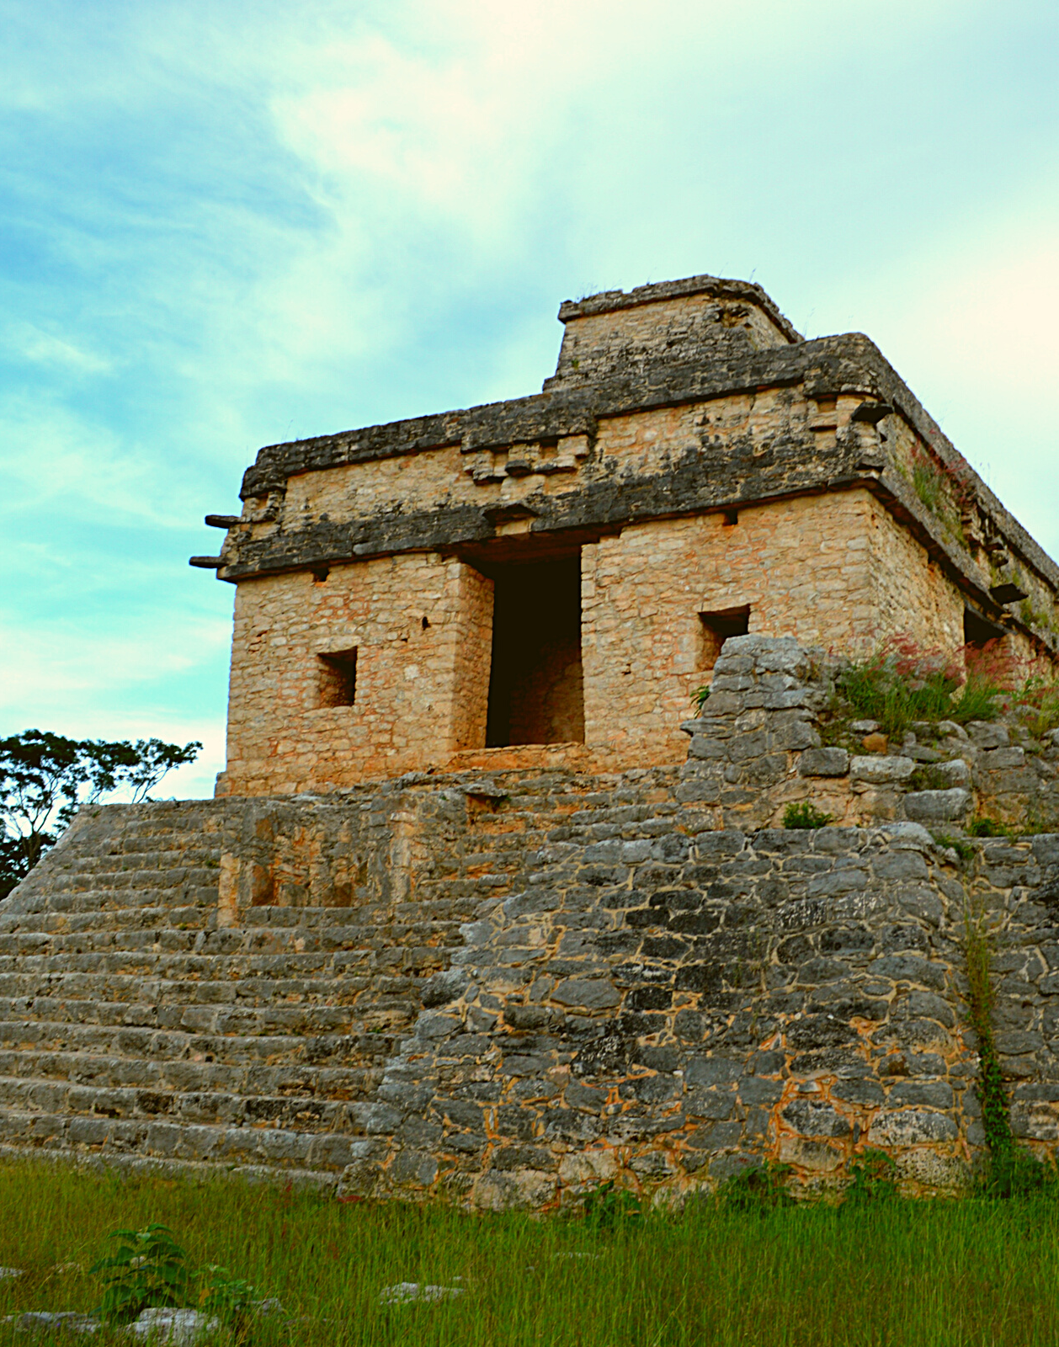
QUESTION 2
What?
What did the archaeologists discover?
Provide a general description of the archaeological site.
Describe the material culture, structures, artifacts, etc.
Include relevant photos and/or interpretive artistic renderings.

Slide 28
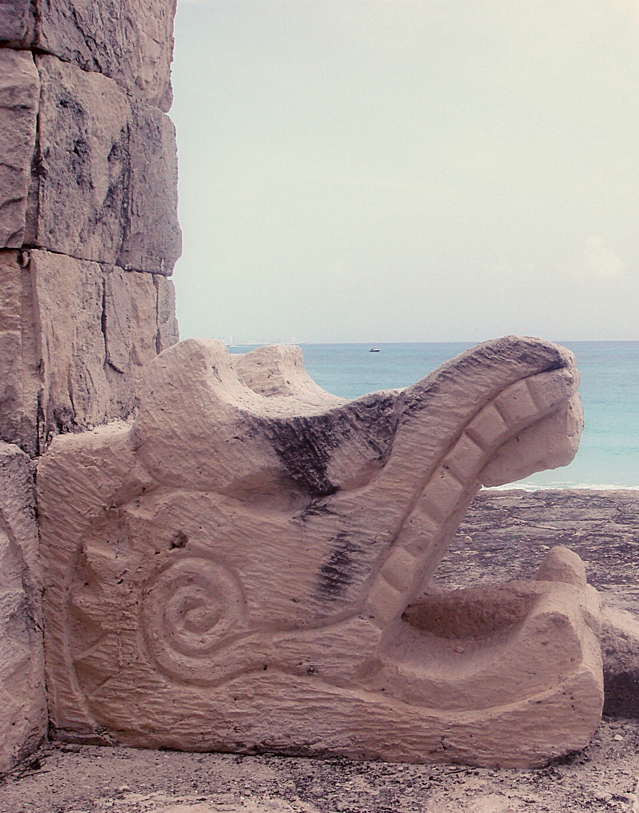
QUESTION 3
Where?
Where is the site located?
Describe the geography of this discovery, its location in the contemporary world, size, scope, etc.
Does the location have strategic importance?
How did the physical environment and natural resources shape cultural practices?

Slide 29
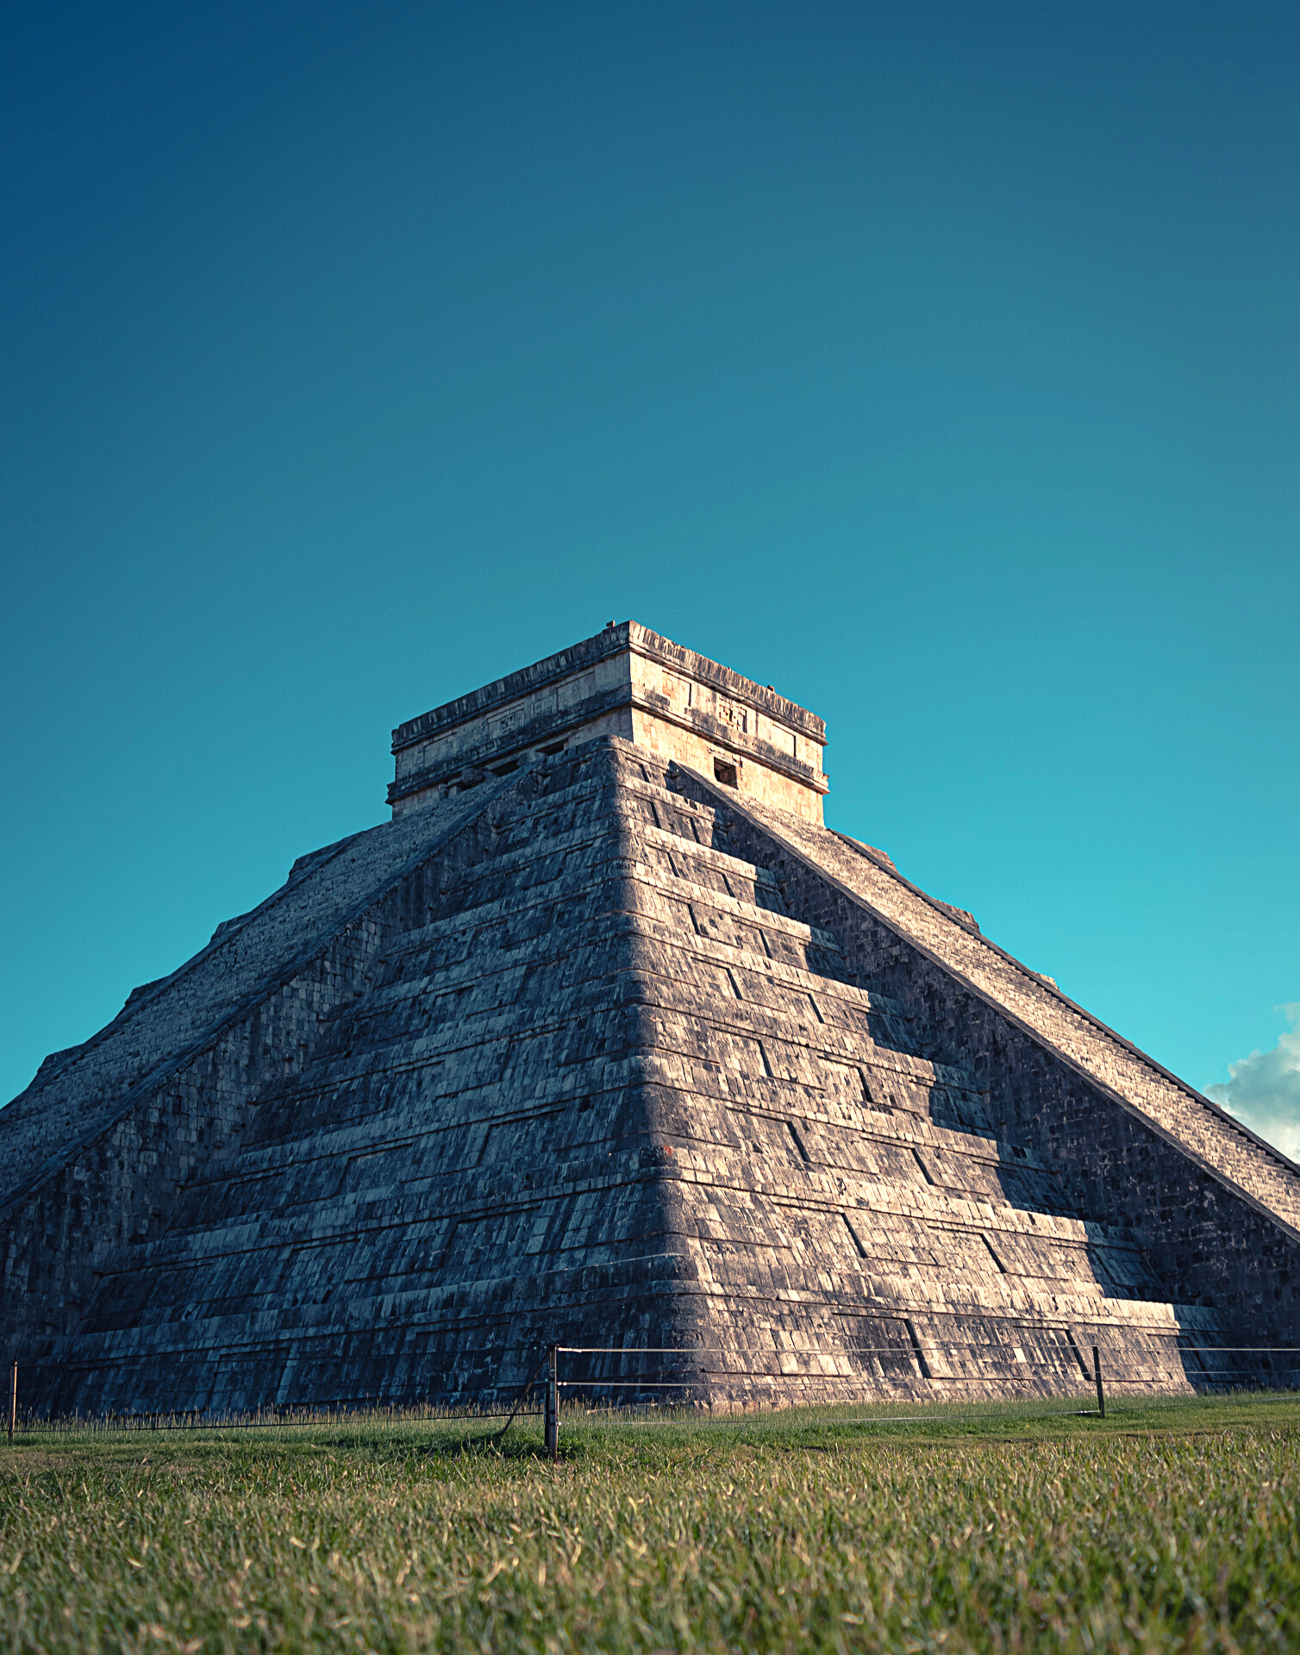
QUESTION 4
When?
When were the discoveries made?
When in human history do archaeologists believe that this site can be dated to?
Describe the relative time period, what preceded it, and what followed it. What does this represent in terms of cultural evolution and progress?

Slide 30
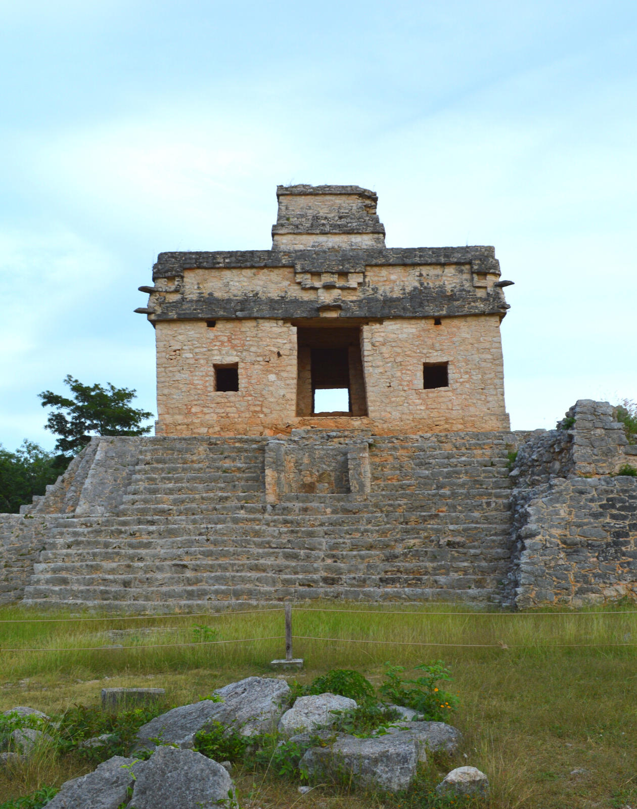
QUESTION 5
How?
How did archaeologists excavate, analyze, and interpret this site?
Tell us about the scientific methods used for excavation and analysis of the materials founds.
What technologies were utilized by the people who lived during this archaeological time period?
How did they construct buildings and make artifacts (lithics, pottery, etc.)?

Slide 31

QUESTION 6
Why?
Why is this archaeological site considered a “great discovery”?
Describe how this site is important in terms of its place in human history.
Why should this great discovery be preserved and who should be responsible for preservation?

Slide 32
Coe, Michael D. 1977. "Olmec and Maya: A Study in Relationships." In The Origins of Maya Civilization, 183–95. Albuquerque: University of New Mexico Press. https://ehrafarchaeology.yale.edu/document?id=ny52-035.
Coe, William R., and Rudy Larios Villalta. 1988. Tikal, a Handbook of the Ancient Maya Ruins: With a Guide Map. Philadelphia: University Museum, University of Pennsylvania. https://ehrafarchaeology.yale.edu/document?id=ny53-012.
Fash, William Leonard. 1991. "Scribes, Warriors, and Kings: The City of Copán and the Ancient Maya." In New Aspects of Antiquity, 192. New York, N. Y.: Thames and Hudson. https://ehrafarchaeology.yale.edu/document?id=ny53-005.
References
Folan, William J. 1983. "The Ruins of Coba." In Cobá, a Classic Maya Metropolis, 65–87. New York: Academic Press. https://ehrafarchaeology.yale.edu/document?id=ny53-021.
Sharer, Robert J., and Sylvanus Griswold Morley. 1994. The Ancient Maya. Stanford, Calif.: Stanford University Press. https://ehrafarchaeology.yale.edu/document?id=ny53-002.
Smith, Virginia. 2000. "The Art and Iconography of the Xochicalco Stele." In The Xochicalco Mapping Project, vol. 2:83–101. Salt Lake City: University of Utah Press. https://ehrafarchaeology.yale.edu/document?id=nu93-036.

Slide 33
Grolier Codex, page 6, Maya Civilization, Public domain, via Wikimedia Commons: https://commons.wikimedia.org/wiki/File:Grolier_Codex,_page_6.jpg
Classic Maya Stucco Glyph "Head Variant," Forgotten Temple, Gary Todd, CC0, via Wikimedia Commons: https://commons.wikimedia.org/wiki/File: Classic_Maya_
Stucco_Glyph_%22Head_Variant,%22_Forgotten_Temple,_Palenque.jpg
Lacambalam, CC BY-SA 4.0, via Wikimedia Commons: https://commons.wikimedia.org/wiki/File:
L%C3%A1minas_8_y_9_del_C%C3%B3dice_de_Dresden.jpg
Image Credits
Dresden Codex, page 9, Public domain, via Wikimedia Commons:
https://commons.wikimedia.org/wiki/File:Dresden_Codex_p09.jpg
Madrid Codex 6, Simon Burchell, CC BY-SA 3.0, via Wikimedia Commons:
https://commons.wikimedia.org/wiki/File:Madrid_Codex_6.JPG
Maya map, Kmusser, CC BY-SA 3.0, via Wikimedia Commons:
https://commons.wikimedia.org/wiki/File:Mayamap.png

Slide 34
Paris Codex, pages 23-24, Public domain, via Wikimedia Commons:
https://en.wikipedia.org/wiki/File:Paris_Codex,_pages_23-24.jpg
Día Internacional de los Pueblos Indígenas, Cancillería Ecuador, CC BY-SA 2.0, via Wikimedia Commons: https://commons.wikimedia.org/wiki/File:
D%C3%ADa_Internacional_de_los_Pueblos_Ind%C3%ADgenas_(7852553230).jpg
Maya mask, Wolfgang Sauber, CC BY-SA 3.0, via Wikimedia Commons:
https://commons.wikimedia.org/wiki/File:Maya-Maske.jpg
Image Credits

Slide 35
Great Discoveries: Maya Codices
Produced by
Human Relations Area Files
at Yale University
An eHRAF Workbook Activity
hraf.yale.edu

