Slide 1
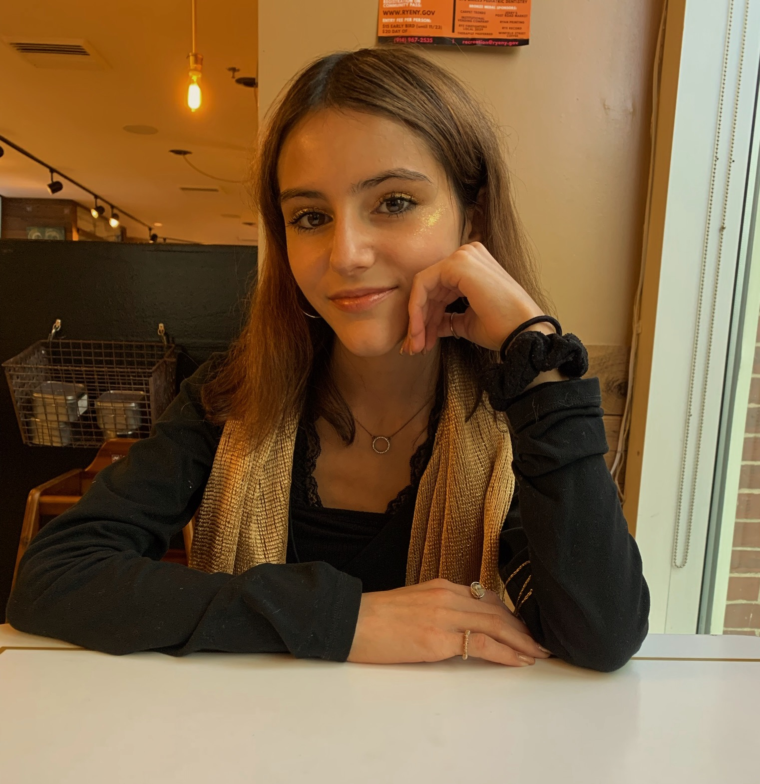
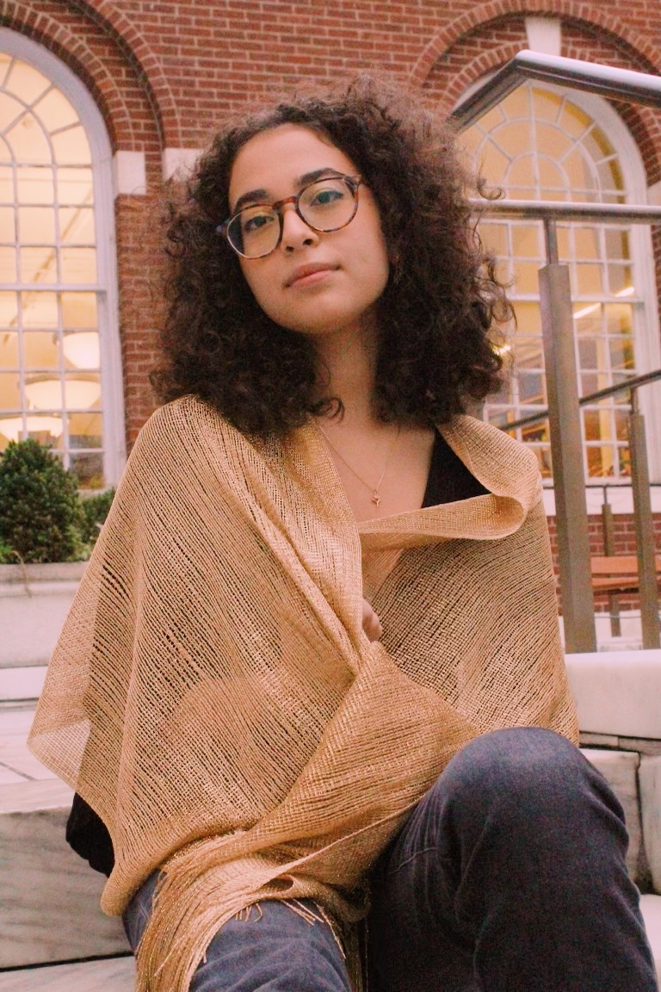
Honors Blue Team: Nascent Worlds
Alyssa Pelletier, Veronica Paez-Deggeller, Natalie Bedoya, Lisbeth Peguero, Juliana Restrepo
Notes:
Veronica

Slide 2
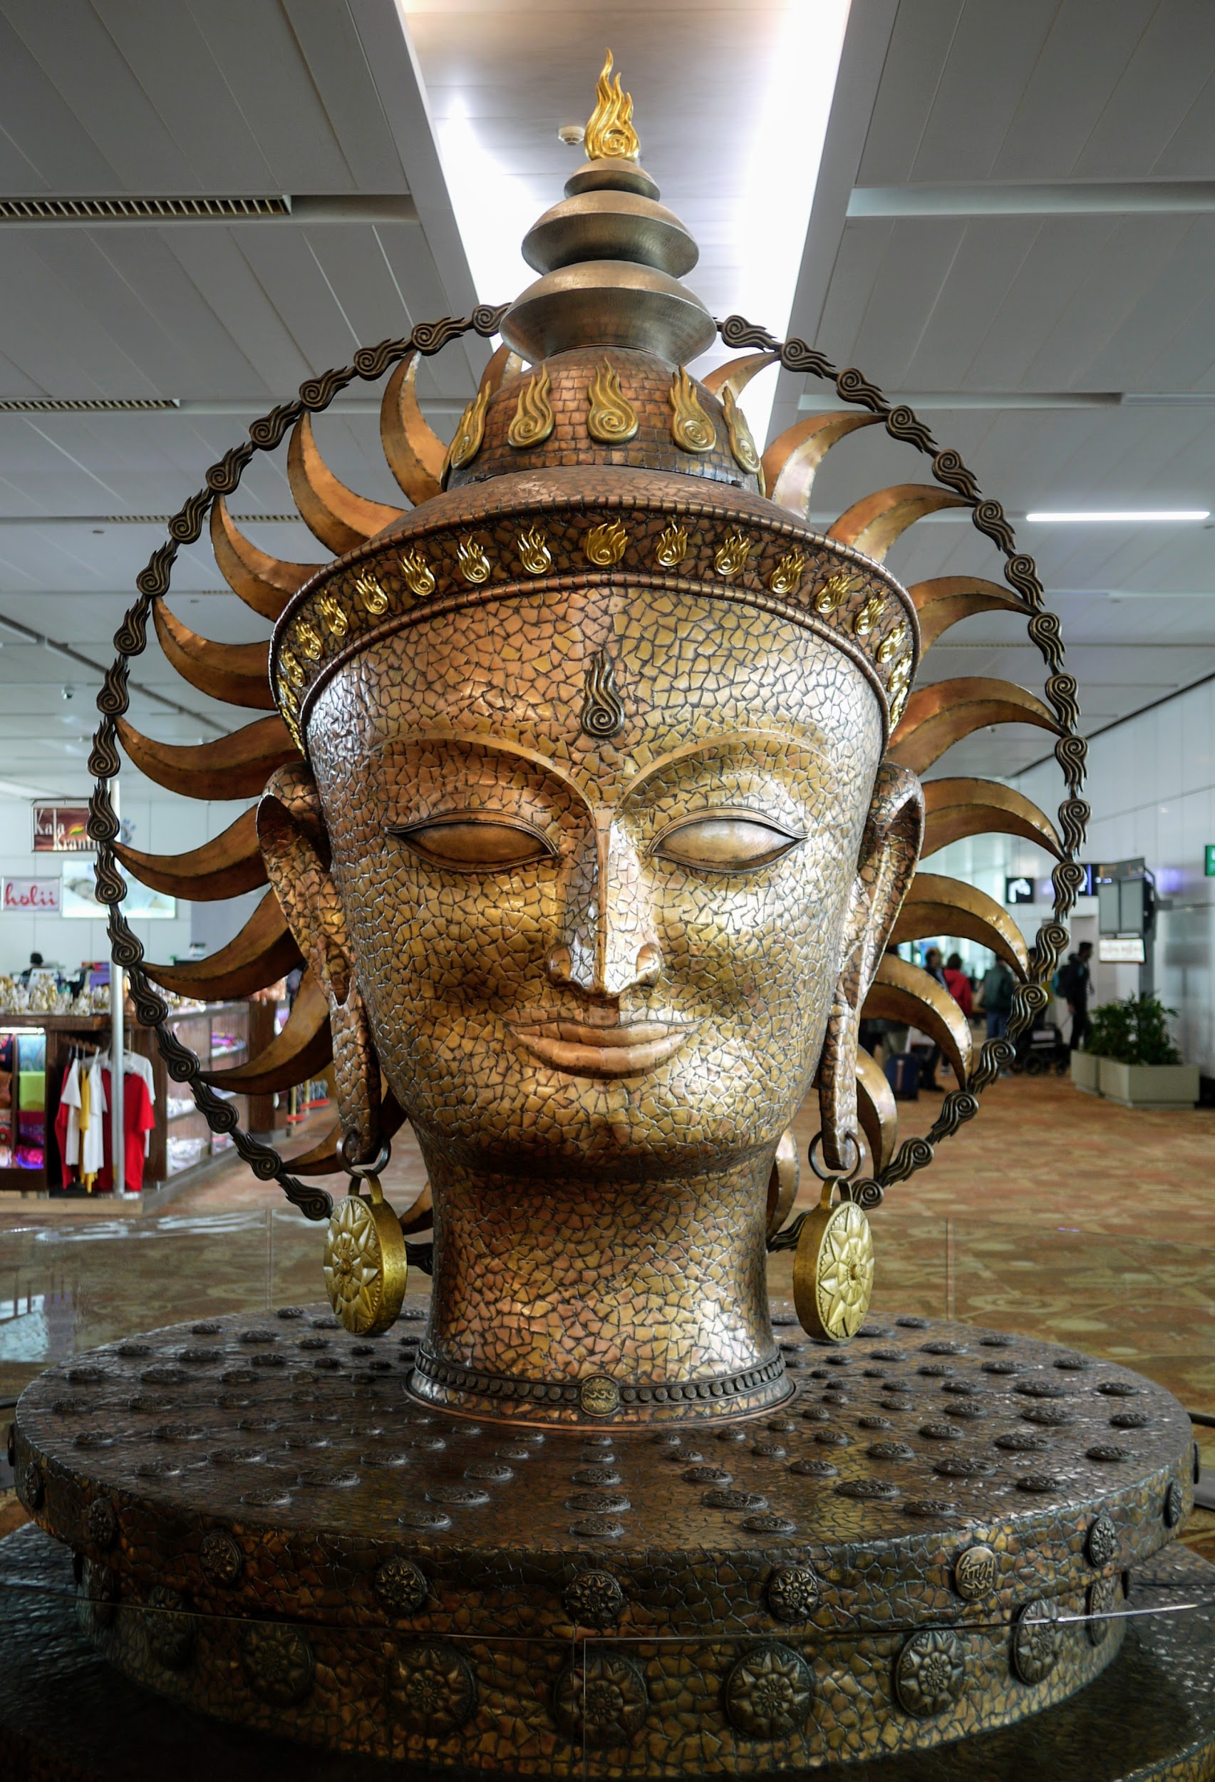
Sun
Society
Notes:
Veronica

Slide 3
Setting the Scene
Notes:
Veronica

Slide 4
First Encounter
As a group of Honors Anthropology students, we traveled to the Hawaiian islands…
Discovered a new island in this area of the North Pacific ocean.
Inhabited by a distant culture: the Sun Society
Centered around worshipping the Sun God.
Filed a report to the Intergalactic Board of Ethnographers.
Notes:
Veronica

Slide 5
Past
Notes:
Veronica

Slide 6
Artifacts
Our team uncovered various artifacts during our exploration of the Sun Society.:
Sacred Text: The journal of the First Woman
Golden seeds
Notes:
Veronica

Slide 7
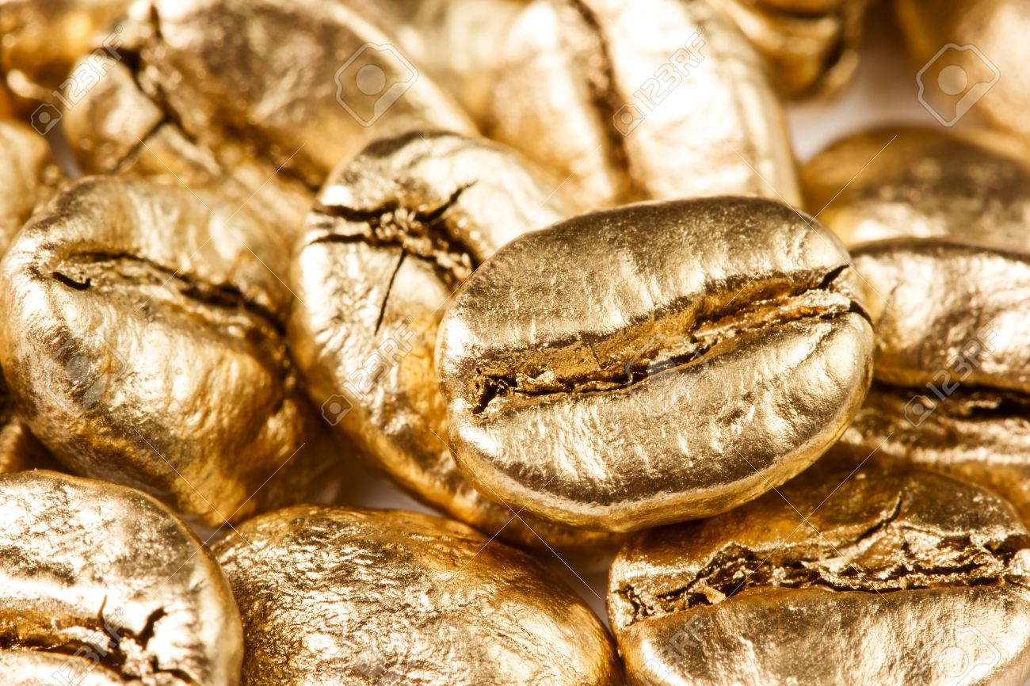
Origin Story
One day, the all-knowing Sun God created the First Woman.
Sun challenged the Woman:
Prove worthiness of species
Woman was gifted 10 seeds, which she used to grow what would, eventually form the Sun Society…
Beginning of the method of reproduction in an all-female society: growing flowers that would each produce a child.
When each flower blossoms, a child emerges from the center of the petals.
Notes:
Veronica

Slide 8
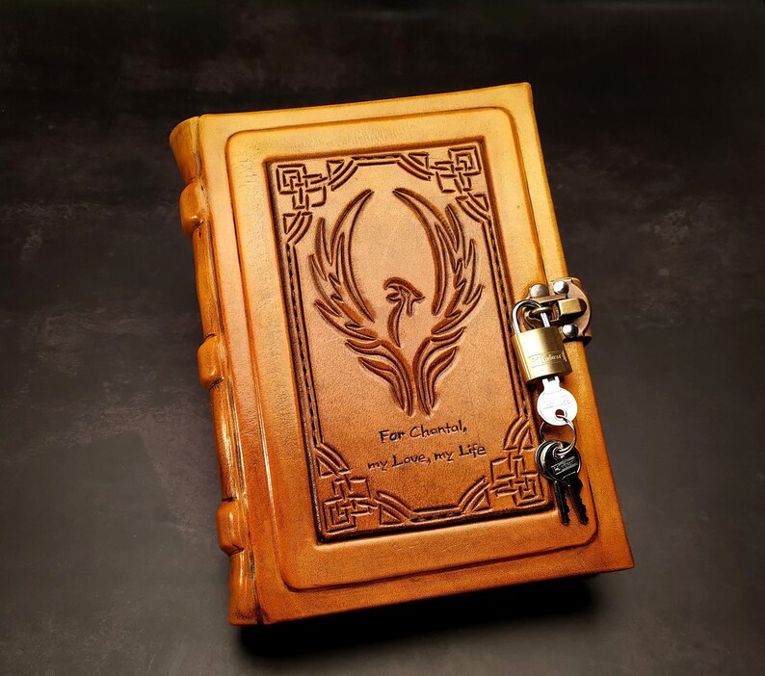
Sacred Relics
First Woman kept a journal - adapted into the Sacred Text.
Journal shaped Sun Society
Personal beliefs
Morality
Law
Protected display in Town Hall
Can only be touched by the
governing council, the Sun Circle.
Notes:
Veronica

Slide 9
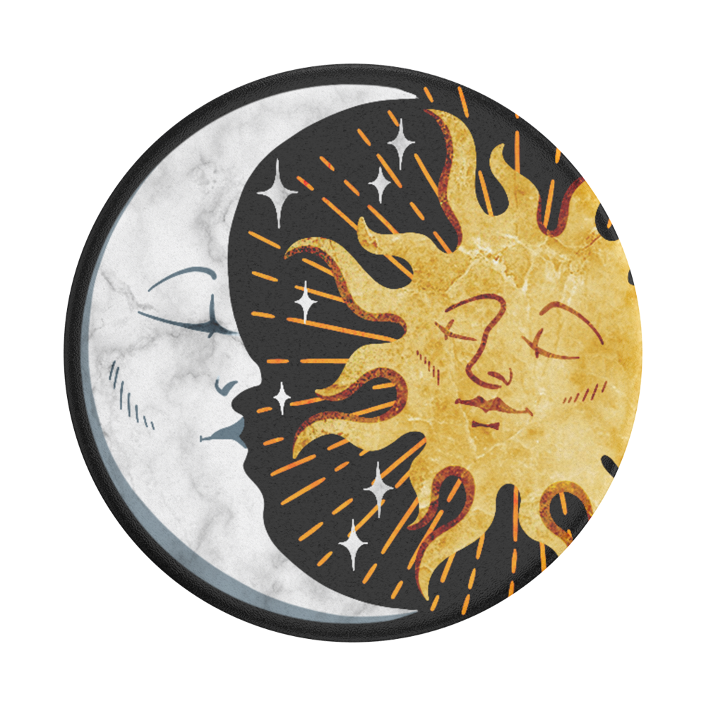
Basis of Belief System
Beliefs centered around the Sun.
All-knowing, center of the sky
Moral justice
Moon is ultimate symbol of sin.
Avoided
Harmful coercion
Notes:
Veronica

Slide 10
Present

Slide 11
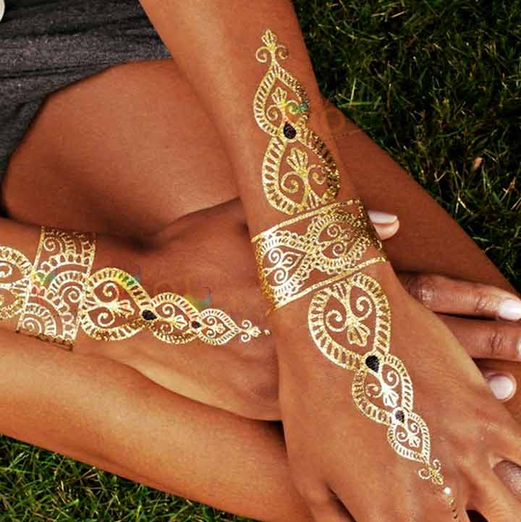
Identity
Bodies decorated in a way that honors the Sun.
Clothing lined with gold.
Flower crowns
Self-expression incorporating gold.
Gold body paint - display personality and style
Sex and gender
Biological: genetically female
Gender-expression: people in the Sun Society are perceived, evaluated, and expected to behave like females.
Identify as girls/women, female

Slide 12
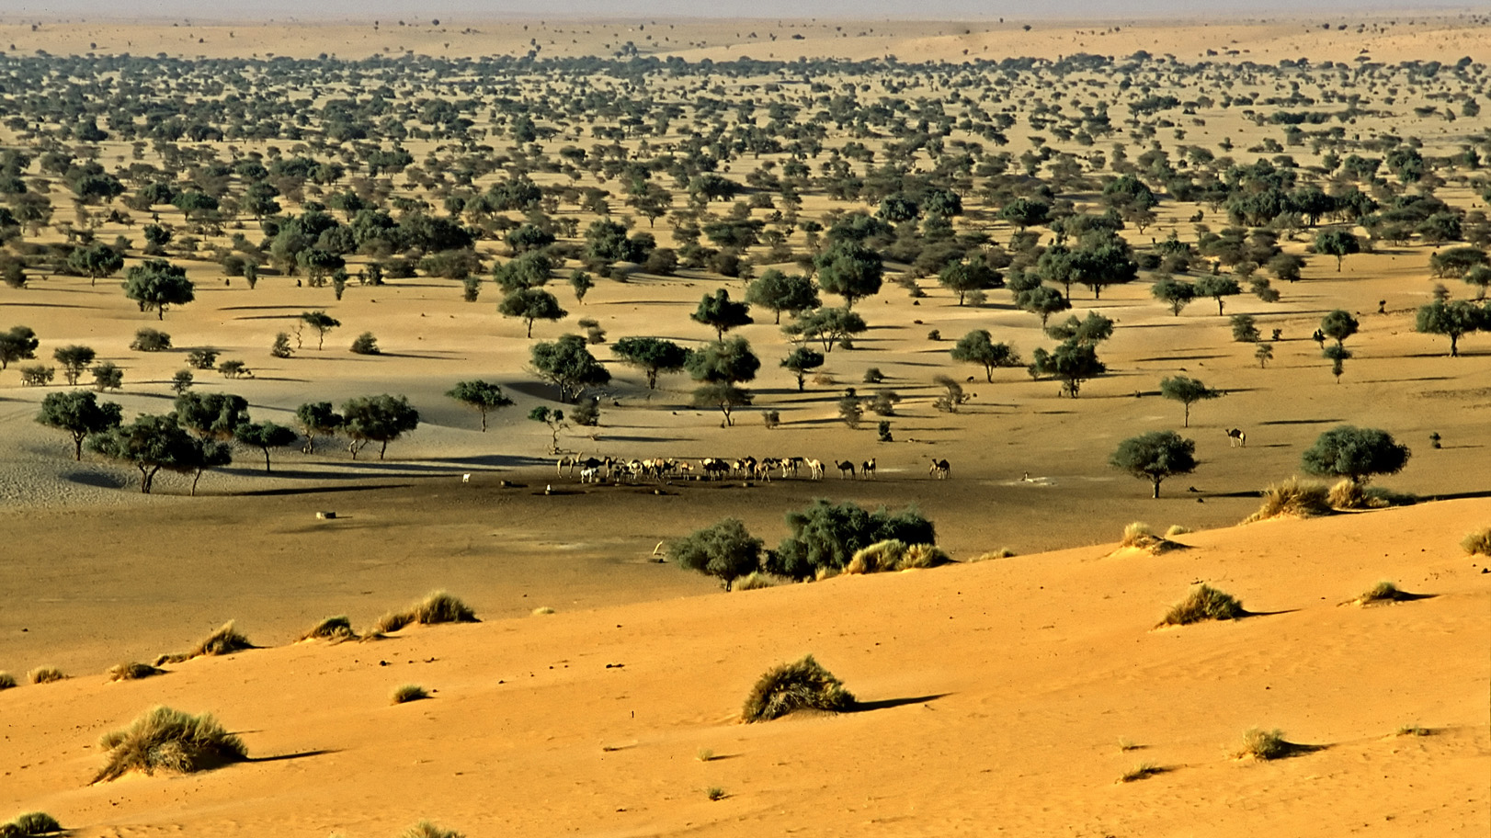
Location/Environment
Island among the Hawaiian islands - warm environment
Open plains
Sunny
Sandy area - religious retreats
More connected to Sun God

Slide 13
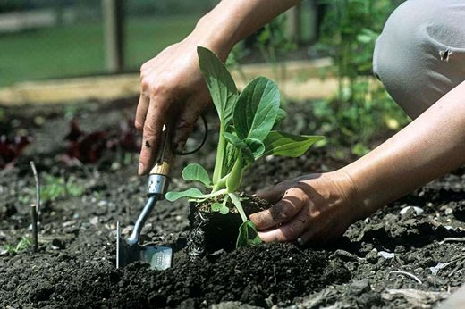
Consumption & Subsistence
Food grown naturally through the Sun.
Horticulture - plant cultivation with simple tools and small plots of land, relying solely on human power.
All natural, plant-based food
Age-based division of labor.
All family members - tend to personal
home gardens
Younger - simple gardening
Older - weave baskets, domestic tasks (cleaning, cooking, child care)
Middle-aged woman: domestic tasks or leave home to pursue other careers
Elderly - source of moral wisdom and guidance

Slide 14
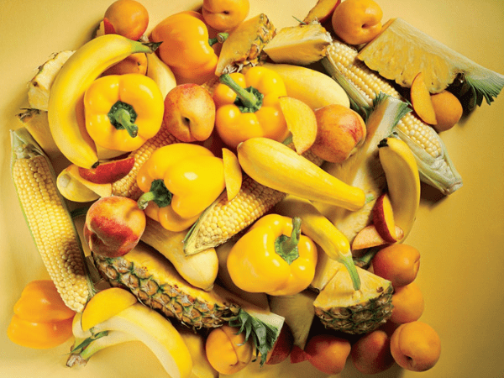
Consumption & Subsistence
Consumption methodology
Yellow foods
Daily meals pertain to sun’s position in sky.
Ceremonial feasts
Start of each season (celebrate relationship between Sun and Earth)
Illness and disease
Moon sickness - exposure to moon and colder atmosphere (fatal symptoms)

Slide 15
Communication
Philosophy - continuous happiness to promote light of the Sun.
Upbeat music to increase moods
Symbolic colors: yellow and gold
Sacred objects: anything gold or yellow
Verbal and physical communication
Sundabbi language - written and spoken
Objects classified in Feminine terms
Personal pronouns: I, you, she, her, it, we,
they, me us
Body language - peace and heart signs

Slide 16
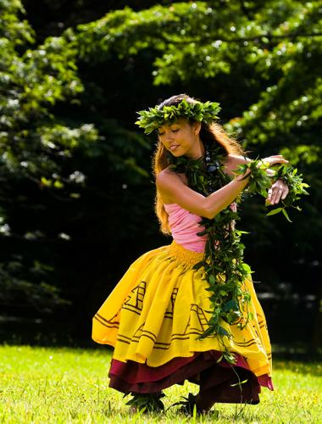
Communication
Sacred rituals and ceremonies
Start of each season
Joyful celebration around the Sun.
Lively dancing and feasts
Wear bright colors to encourage
lively energy and spirits

Slide 17
Homes & Families
Medium sized, yellow villas along island coast.
Outside decoration: Yellow flowers
Materials: yellow straw and palm tree bark
Equipped: sunroof and fireplace for warmth
Home garden: grow fruits and vegetables
needed for survival
Homes put in name of oldest female (“head woman”)
Head woman - teaches girls about Society’s beliefs
When she dies, rituals are performed in her honor.
Ashes spread in dirt of home garden.
Next oldest woman falls in line of caring for home/family.
Division of labor within home - based on age.

Slide 18
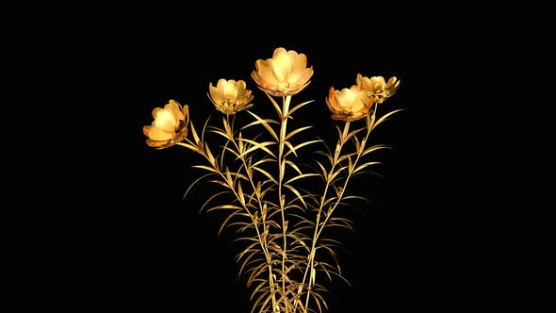
Beliefs
Religious beliefs - Centered around all-knowing, powerful Sun.
Sun: all-mighty God, a woman
Moon: ultimate sinner, coerces Sun Society to engage in moral harms
Origins - Based on story of First Woman
First Woman: Prophet that spoke to Sun God
Woman planted seeds that birthed early
members of society.
Taboo: Lack of gold in attire.
Wearing gold: Sign of respect toward Sun God.
Lack of gold: Sign of disrespect.

Slide 19
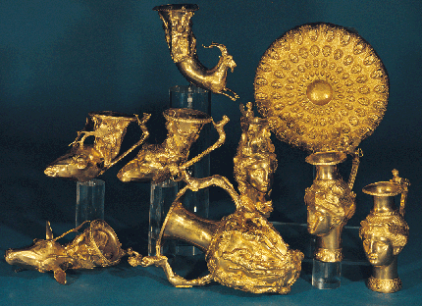
Beliefs
Rituals
Sacred ritual: New Moon festival
One night without the threat of the moon.
Involves dancing and celebration honoring
the Sun.
Religious retreats: Travel to desert to
immerse themselves in Sun’s glory.
Sacred items: All gold and yellow items
Yellow/gold material goods (food, clothing, vases, instruments, art, etc.)
Totem: Sunflower
Symbol of growth and unity.
Tied to women’s dedication to Sun.

Slide 20
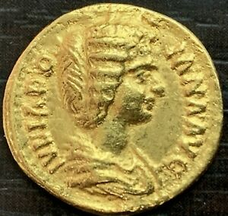
Economics
Freedom of choice
Middle-aged women may choose to stay home and do domestic tasks, or leave to pursue other careers.
Career outside the home - Related to plants / Protection of nature
Expertise in farming / nurturing land
Scientists - research on cultivation /
botanical science
Political authority - member of Sun Circle council
Currency: gold coins
Wealth - based on how much gold one has
Amount of gold in clothing - symbolizes status / power
Gold is traded in markets
Notes:
Lisbeth

Slide 21
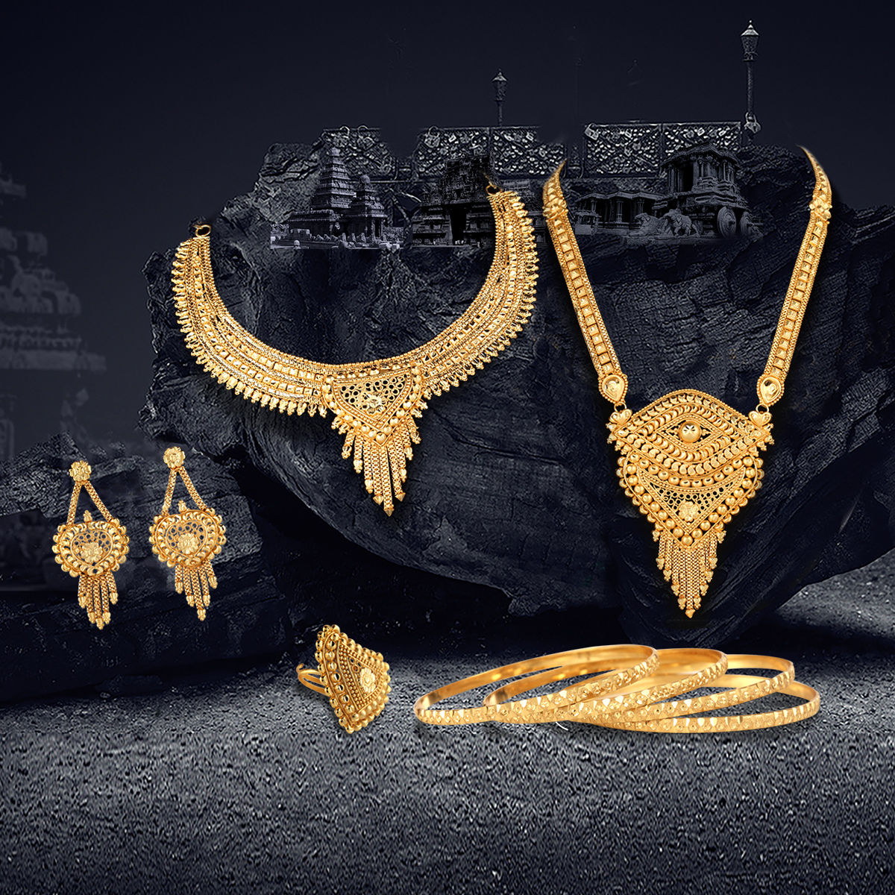
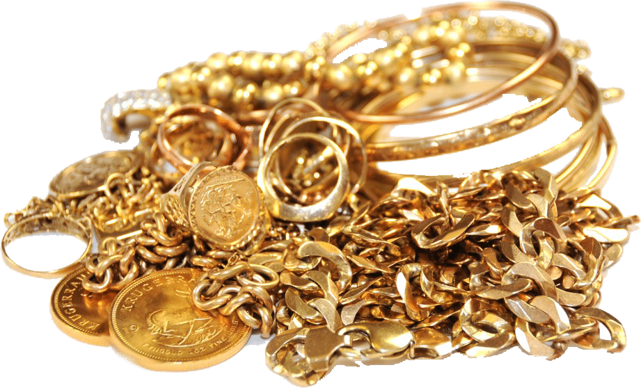
Economics
Gifts
Jewelry from gold - symbol of appreciation
Bridewealth - In the Sun Society, this is defined as a transfer of goods from one bride’s lineage to the other bride’s lineage to legitimize the marriage.
Gifting of object of different metal
- inappropriate
Notes:
Lisbeth

Slide 22
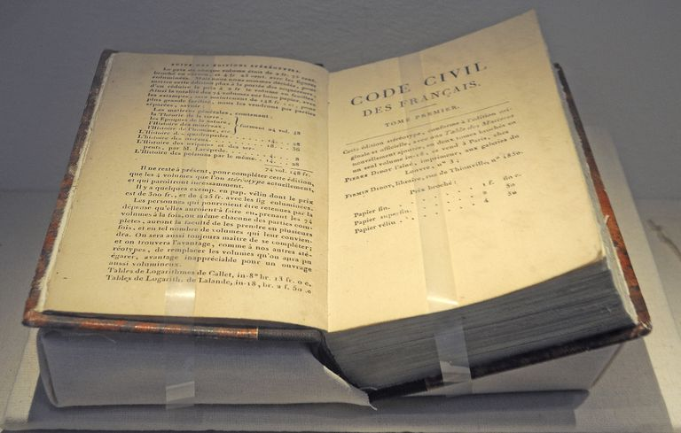
Morality & Law
Code of Laws
Used to determine what is “right” and “wrong”
in the Society.
Punishment
Determined by vote through Sun Council
Consideration of time and place
Punishments vary over range of severity
Community service
Prison
Rehabilitation
Death penalty
Notes:
Lisbeth

Slide 23
Morality & Law
Morality
Motivated to act in accordance with Sun God
Older women - influenced by good nature of Sun God
Guide youth through life stages, ceremonial practices, caring for land
Help youth understand their role in the community
Foster warmth and light in communities
Happy music
Celebration
Kindness
Volunteering
Notes:
Lisbeth

Slide 24
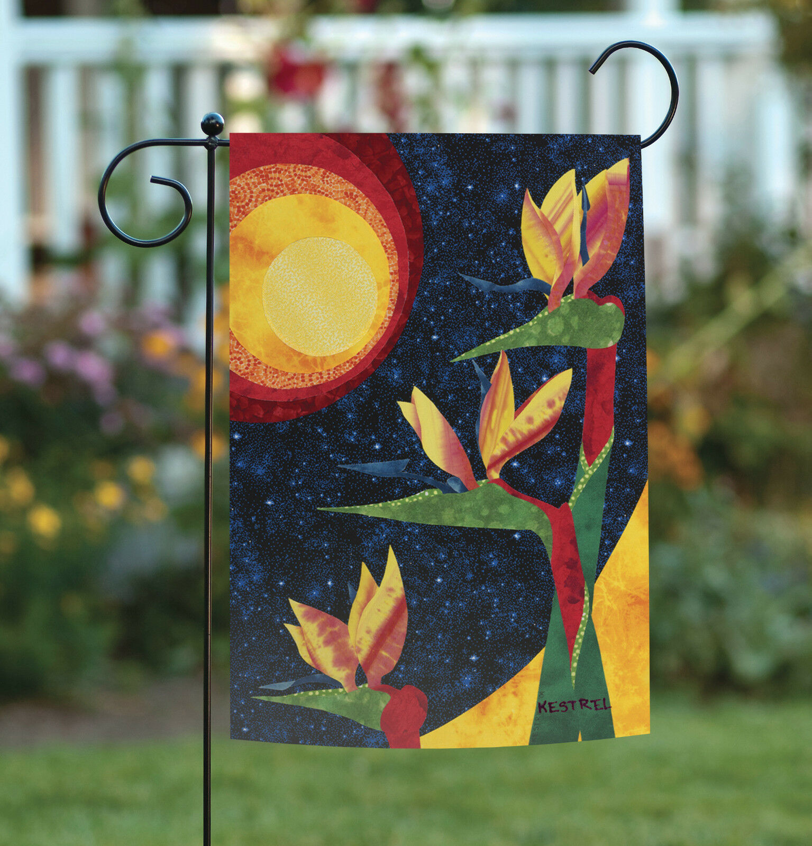
Politics
Matriarchy - In the Sun Society, there is a system of governance whereby women rule
Women hold positions of power
Women serve as leaders inside and outside the home.
Government officialized through:
Flag - symbol of Sun and birthing flowers
Focus on nature / Sun God: No separation of church and state
Town Hall
Located in village center
Members of Sun Circle reside here - council that upholds journal’s beliefs.
Holds Sacred Text and Code of Laws
Notes:
Lisbeth

Slide 25
Politics
Voting - Decisions made through collective and individual views.
All public members invited to Town Hall to vote on legislation.
Two - Part Voting Process
Public participate in collective vote
Sun Circle votes based on individual points raised.
This vote has ultimate say.
Public votes on electing new women into Sun Circle.
Elections held every year on January 1 (to honor Earth’s completion of another cycle around Sun)
Notes:
Lisbeth

Slide 26
Future
Notes:
Alyssa

Slide 27
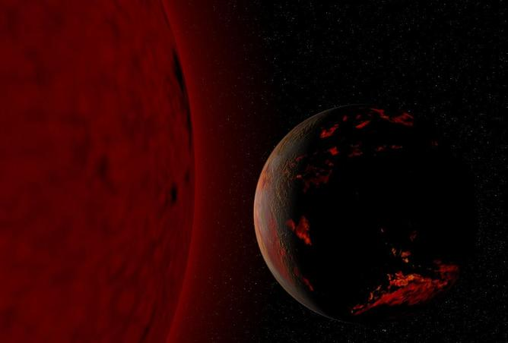
Cataclysmic Event
Global Catastrophe - Earth’s Sun burns out!
Threatens all way of life
Survival: Food production, environment adapted to
Beliefs: Losing “center of their universe”
Notes:
Alyssa

Slide 28
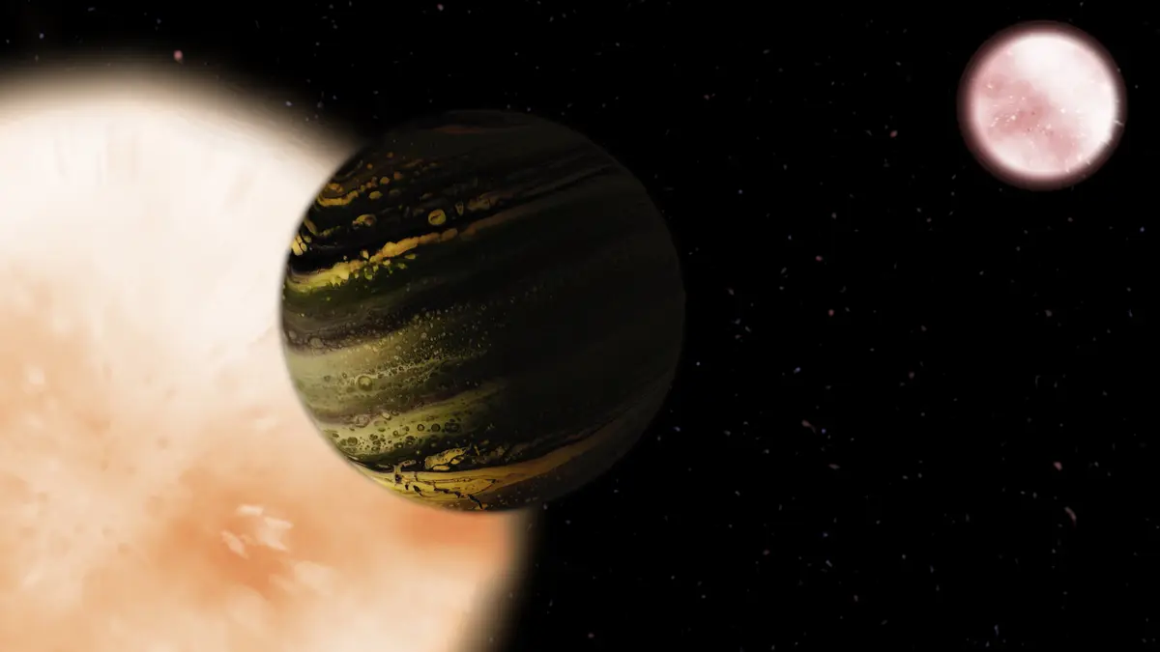
Response
Response - Sun Society migrates to new planet
Located in different region of Space
New planet
Further from new Sun - Colder environment
Inhabited by population of males and females
Motivates Sun Society to adapt to new way of life.
Diffusion of cultural traits suited to their new environment.
Notes:
Alyssa

Slide 29
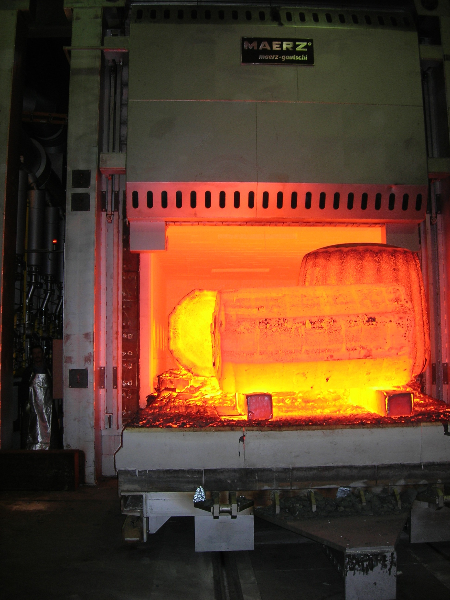
Cultural Diffusion
Change in food sources - Alter diet.
Cooked food to keep them warm.
Foods of greater caloric density - More sustainable energy for body warmth in colder environment.
Spread of disease - Illness with colder weather and greater proximity to the moon.
Flu virus
Moon sickness
Adoption of new technology
Communication on larger planet
(cell phones, computers)
Cooking - stoves and ovens
Furnaces - reliable heat source
Technological advancements threaten the women’s long-held traditions of a more simplistic and natural lifestyle.
Notes:
Alyssa

Slide 30
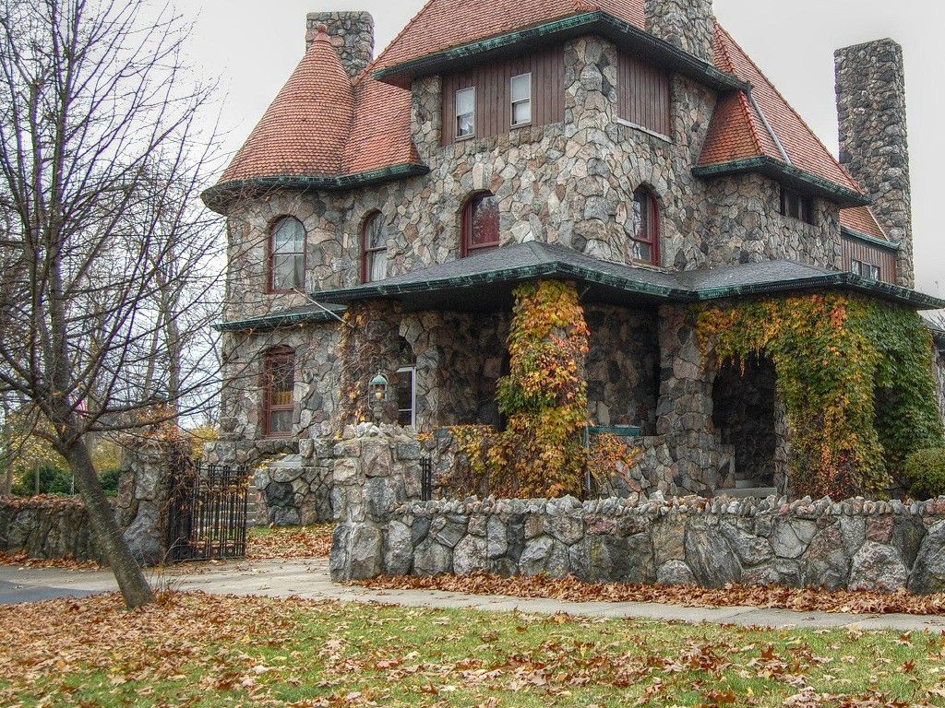
Cultural Diffusion
Economic diffusion - New material for clothes, bedding, and
homes, as well as sharing / diffusion of food production methods.
Cotton imported for thicker clothes / blankets
Bricks and stone imported to build more
insulated homes
Share farming techniques for familiar vegetables.
Adopt new farming methods for
growing unfamiliar vegetables.in cold climate
Develop hybrid plants with familiar and new vegetables.
Beliefs - Adopt new religions and perspectives on the Sun God.
New religions with polytheism - multiple gods,
At first appalled when new people didn’t believe in Sun God.
Some women begin to change their views and despise the Sun (due to unpleasant qualities like sweating, heat flashes, etc.).
Notes:
Alyssa

Slide 31
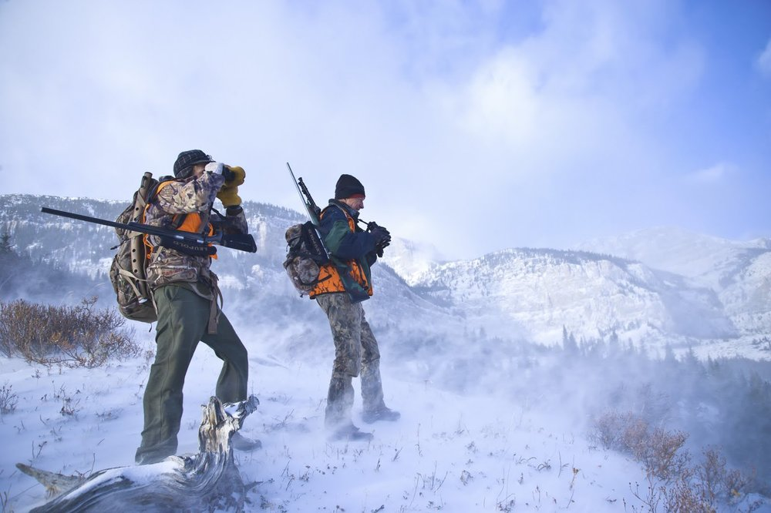
Cultural Diffusion
Encountering new type of human - people of the male sex.
Accepting of men - Benefits provided in sexual reproduction and roles.
New methods of reproduction
Male and female sexual intercourse
Reproduction more efficient
Compared to previous flower-birthing.
Male roles emerge
Hunting - more sustainable food
sources (meat)
Gathering rocks and stones - more
insulated houses
Matriarchy still prevalent - Women continue to rule, assume leading roles in domestic and political work.
Notes:
Alyssa

Slide 32
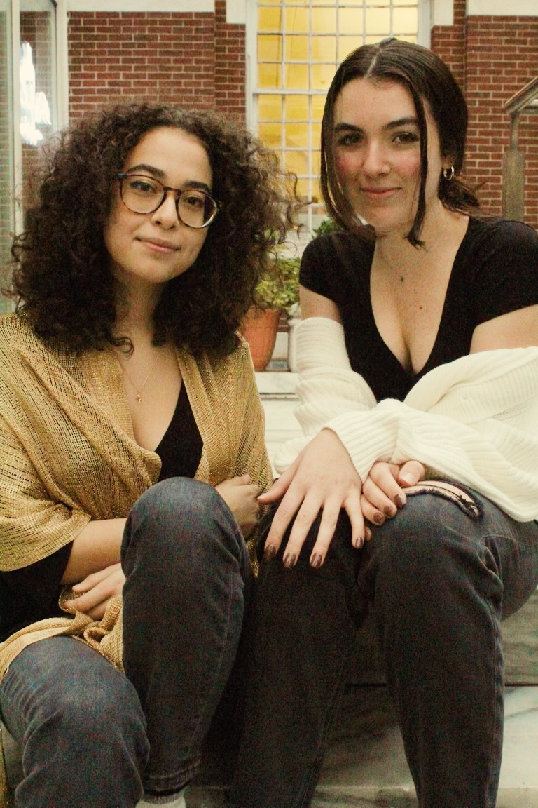
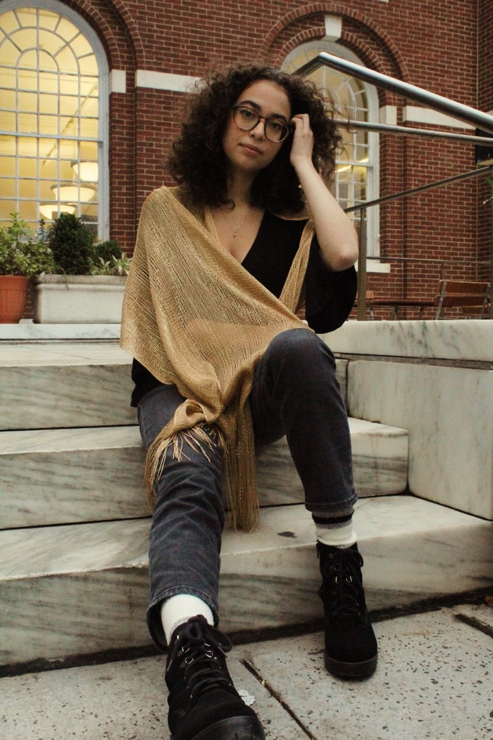
Photo Gallery - Sun Society

Slide 33
Works Cited

Slide 34
Sources
Cultural Anthropology: An Applied Perspective, 11th Edition, Ferraro and Andreatta, 2018.
Mack, Jason, and Grace Pisano. "What Is Cultural Diffusion?| How Does Cultural Diffusion Spread?". Study.Com, 2021,
https://study.com/learn/lesson/cultural-diffusion-examples.html#:~:text=Cultural%20diffusion%20has%20to%20do,many%20different%20countries%20and%20cultures.

