Slide 1
Introduction to Archaeology
Jake Kalodner

Slide 2
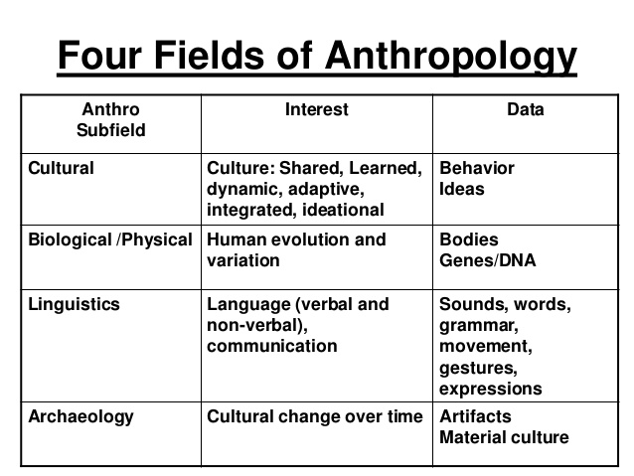
Notes:
Archaeology is a branch of the scientific discipline of anthropology. Can anyone tell me what anthropology is? (get maybe 3 answers)
So anthropology is the study of human culture, and it’s traditionally split up into four branches; cultural anthropology, biological anthropology, linguistic anthropology, and archaeology. Each branch contributes something different to the study of culture, and archaeology is primarily concerned with reconstructing extinct cultures from the material remains of past human behavior, or the things people made or used and left behind.

Slide 3
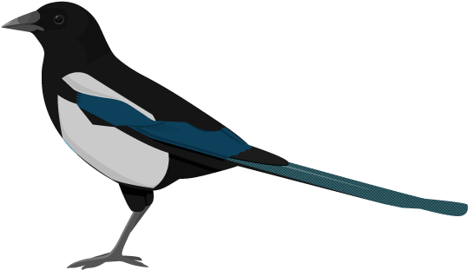
Magpie of the Social Sciences
History
Anthropology
Economics
Philosophy
Sociology
Physical and Material Sciences
Biology
Construction

Slide 4
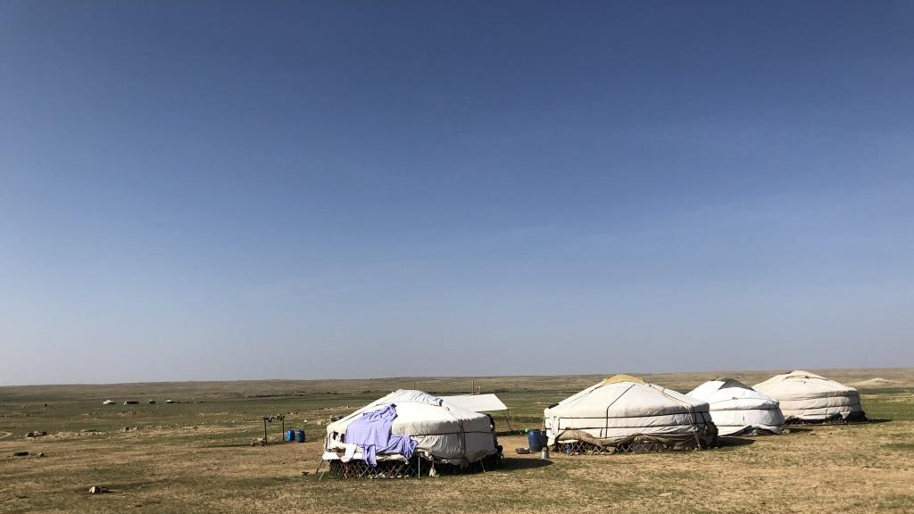
Archaeology is the study of human activity through the examination of what these activities left behind.

Slide 5
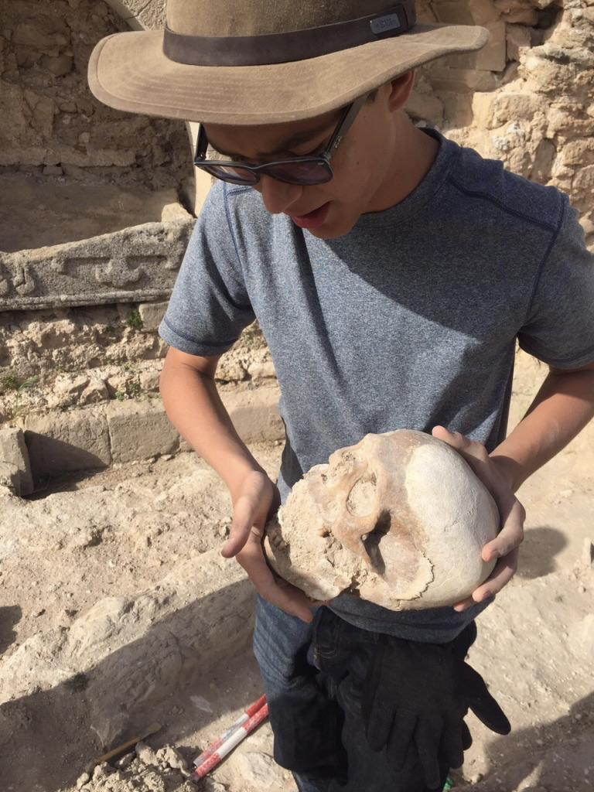
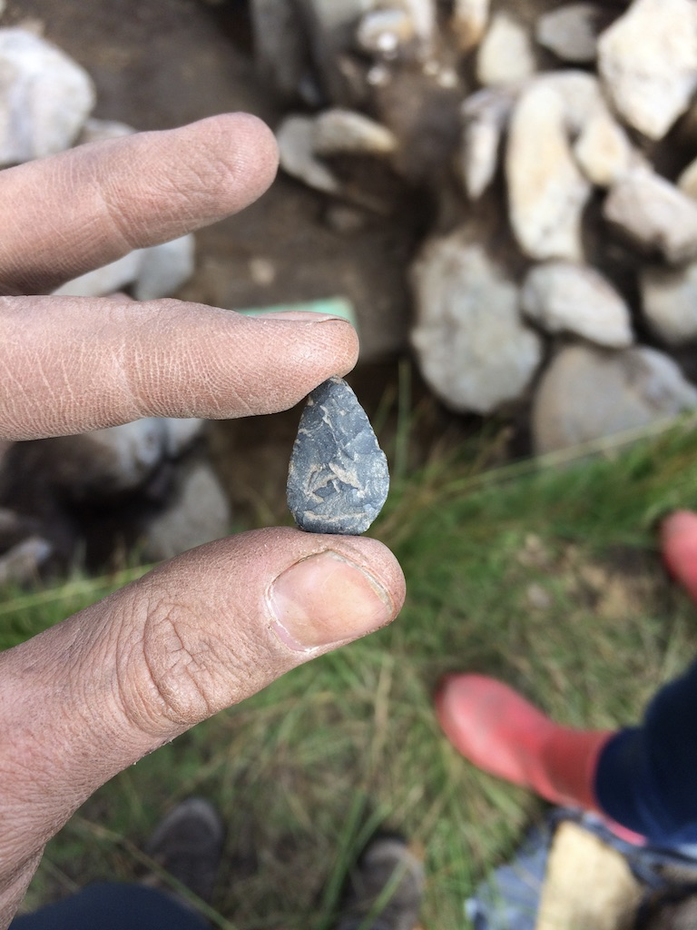

Slide 6
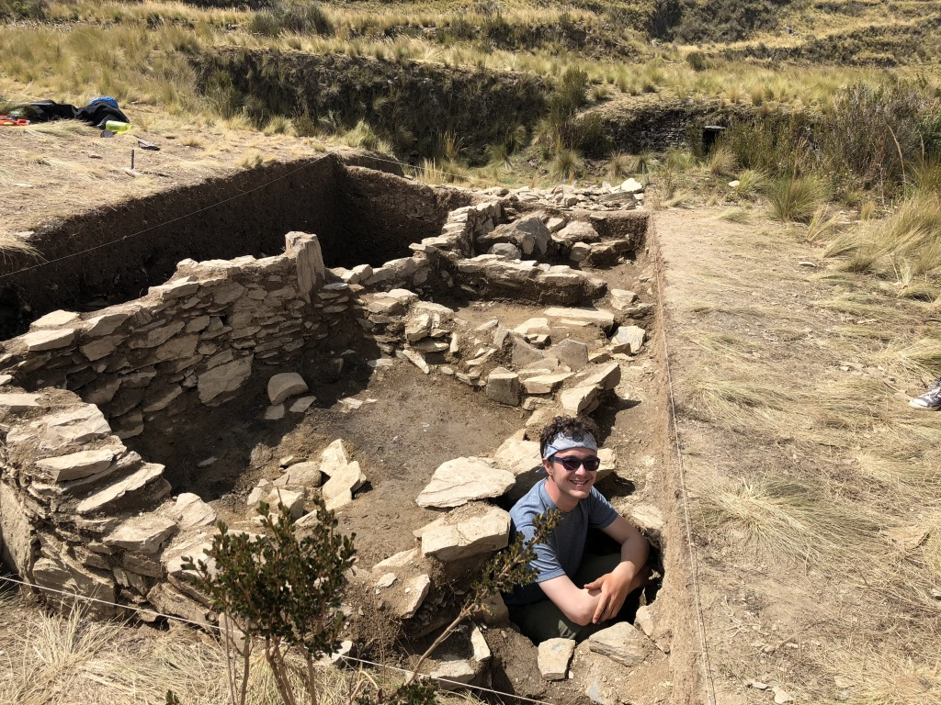

Slide 7
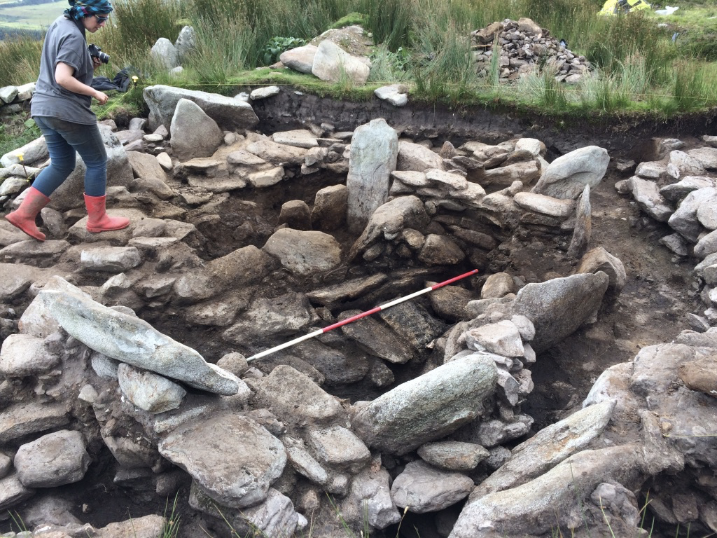
Notes:
So, archaeology is usually carried out through excavation of archaeological “sites”. A site is any location where there is evidence of human activity. This can be a small campsite with a scatter of flaked stone indicating tools were being manufactured or modified, or it can be as large and complex as Chaco Canyon, a Pueblo site in the southwest with hundreds of structures and millions of artifacts. It is through sites that our data collection tends to be done, by observing and documenting architecture, any interesting features we see, and collecting data through artifacts and other means.
Perhaps the most important part of understanding the past is how artifacts are placed in time and space. This relationship is called context. It is based on the geological law of association, which states that objects found in the same geological level are contemporary with each other. Also, objects found in lower layers are older than those found in above them according to the geological law of superposition. These laws help the archaeologists to establish artifacts within a framework of time and space. In addition, the specific locations in which they were found— for example, perhaps in a burial, or in a house— may tell us more precisely how they were used. Context is everything to an archaeologist. Without it artifacts are just objects that provide little more than general information about their function or the people who made them.
This is a site that is about 5000 years old that I excavated in Ireland a couple summers ago, dating back to some of the earliest production of metal.

Slide 8
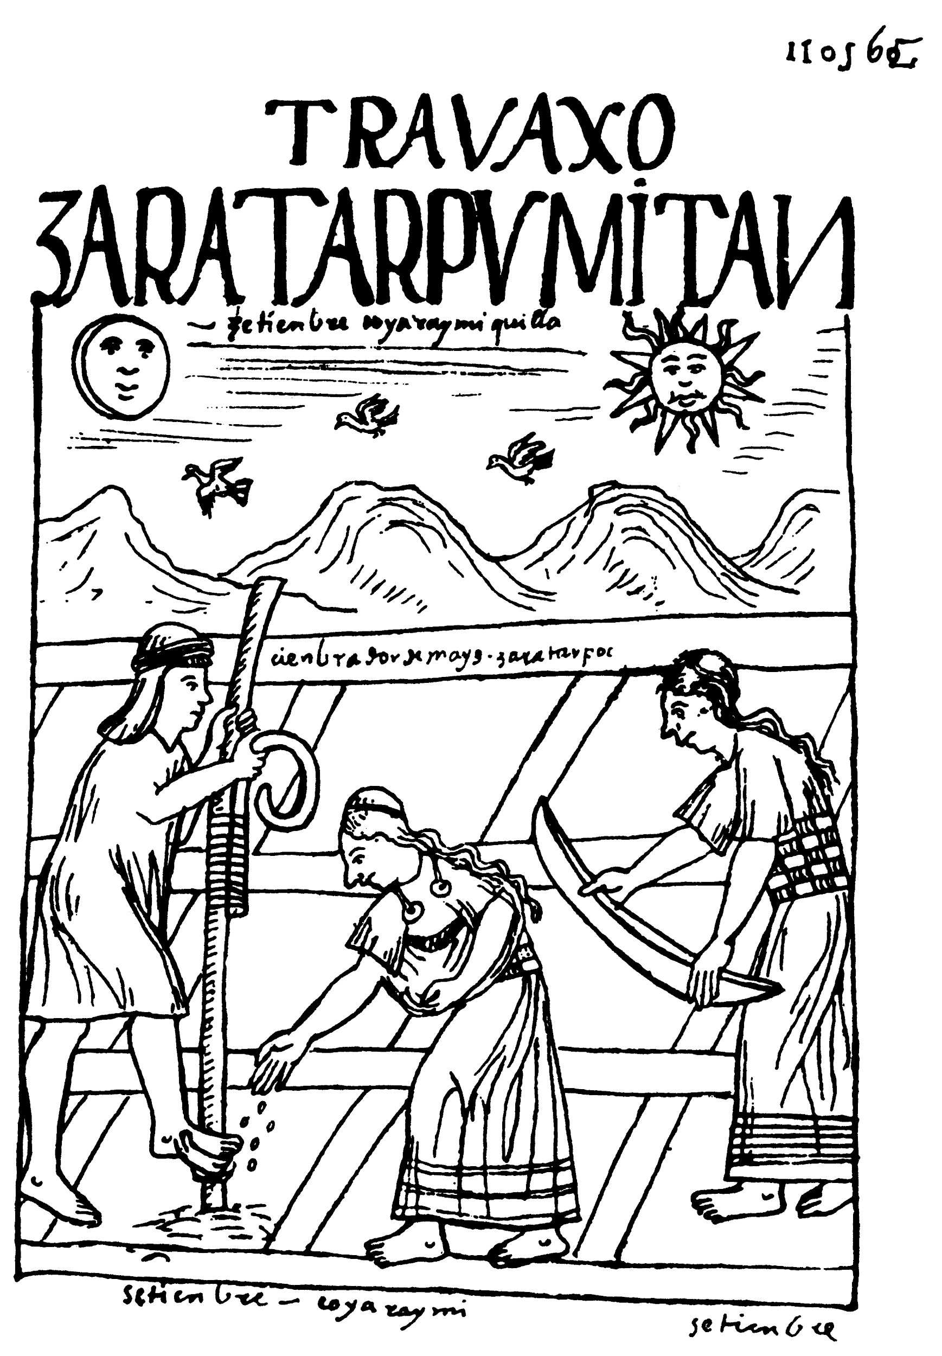
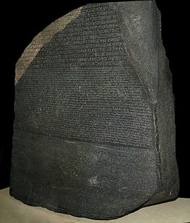

Slide 9
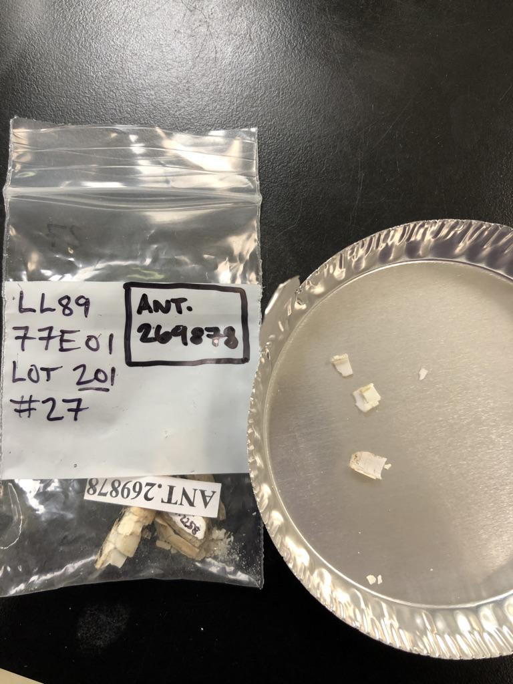
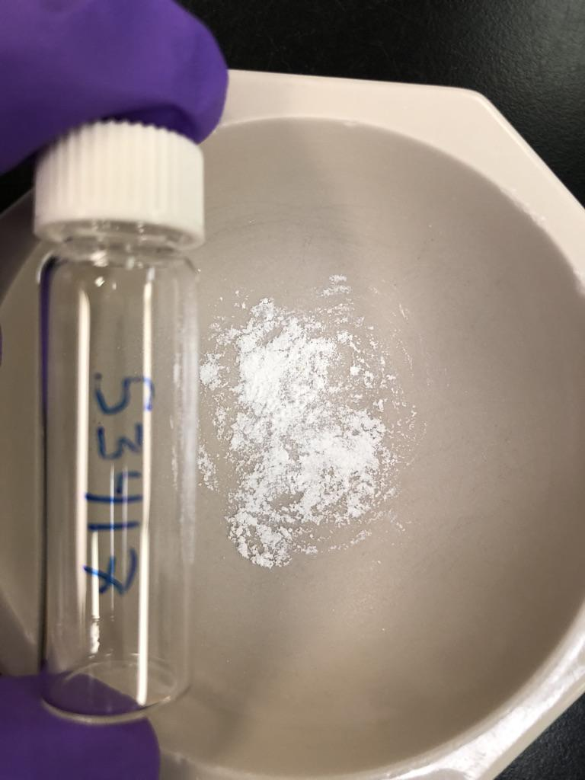
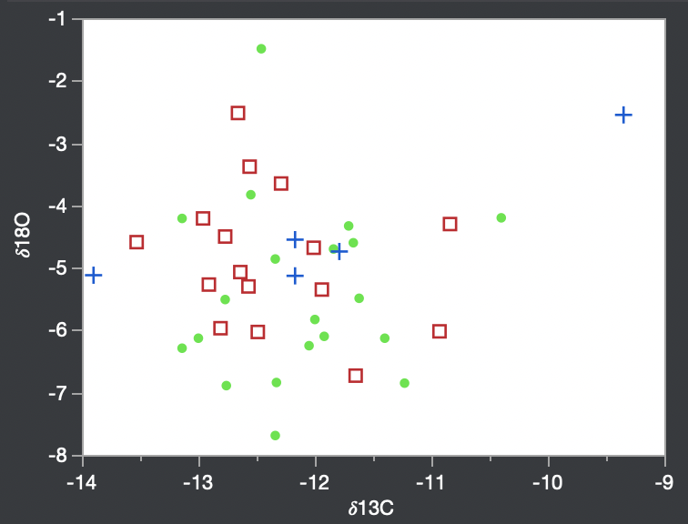

Slide 10
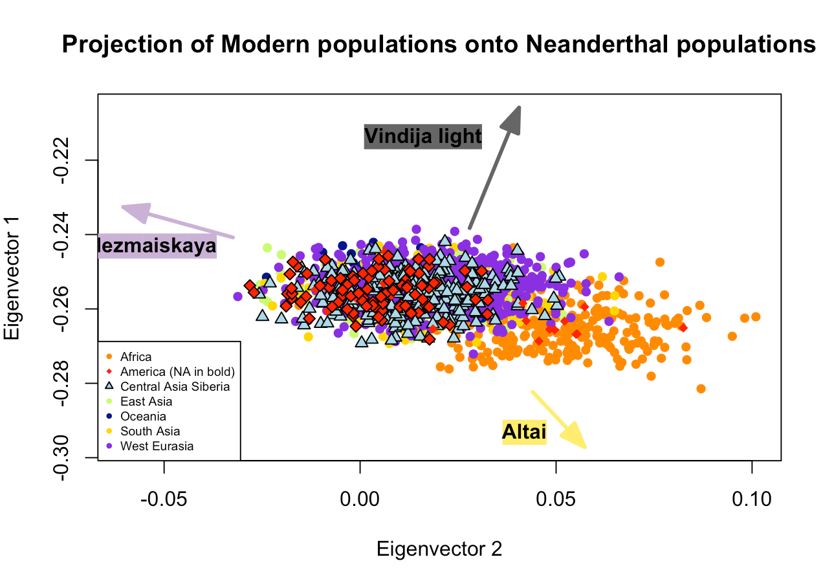
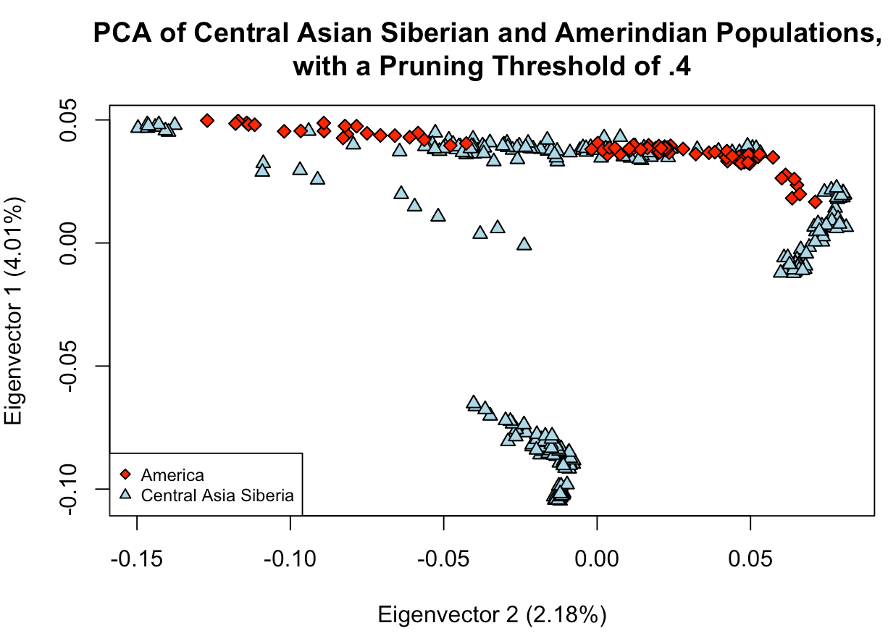

Slide 11
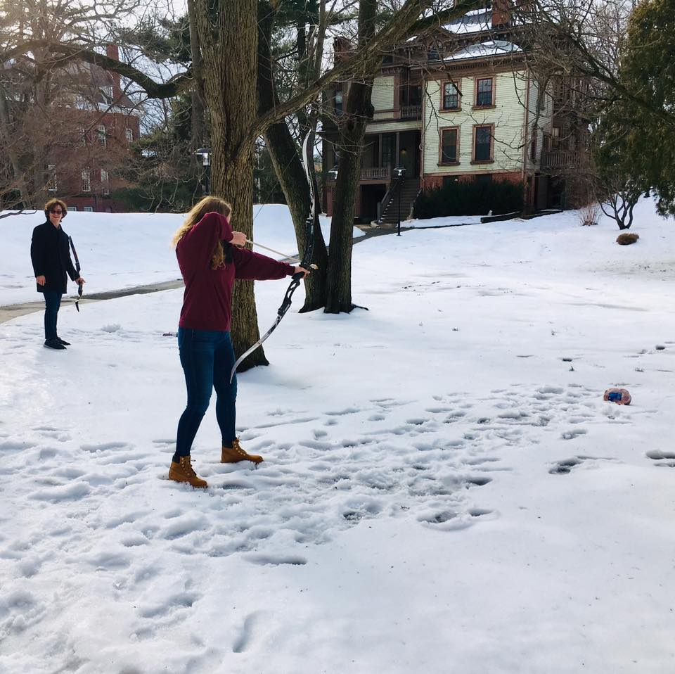
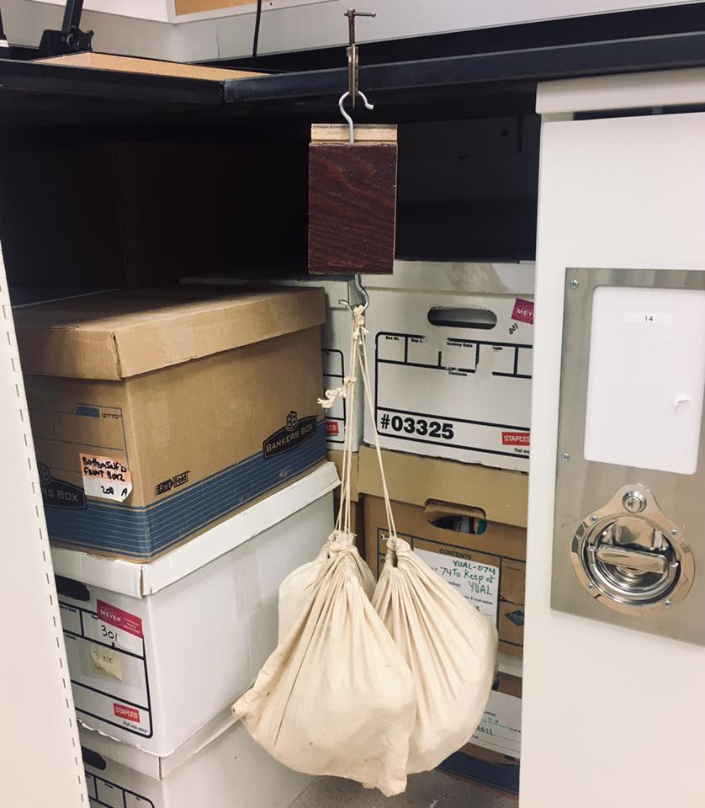

Slide 12
How does this get done?
Survey → Excavation → a lot of time at the lab and in the library

Slide 14
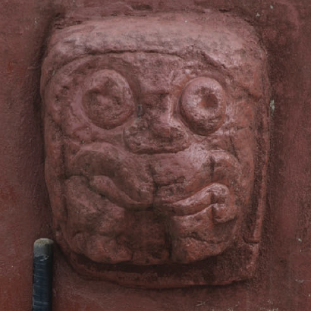
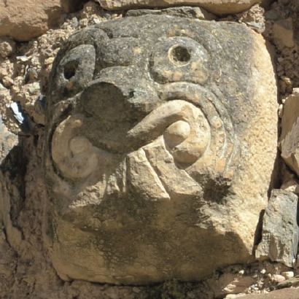

Slide 15
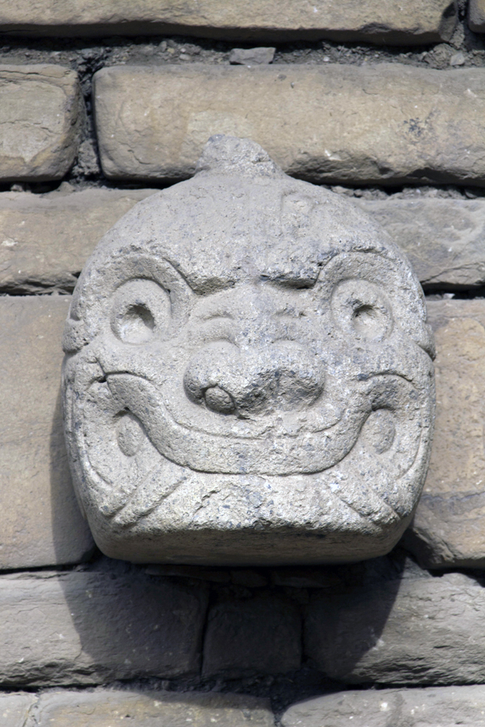
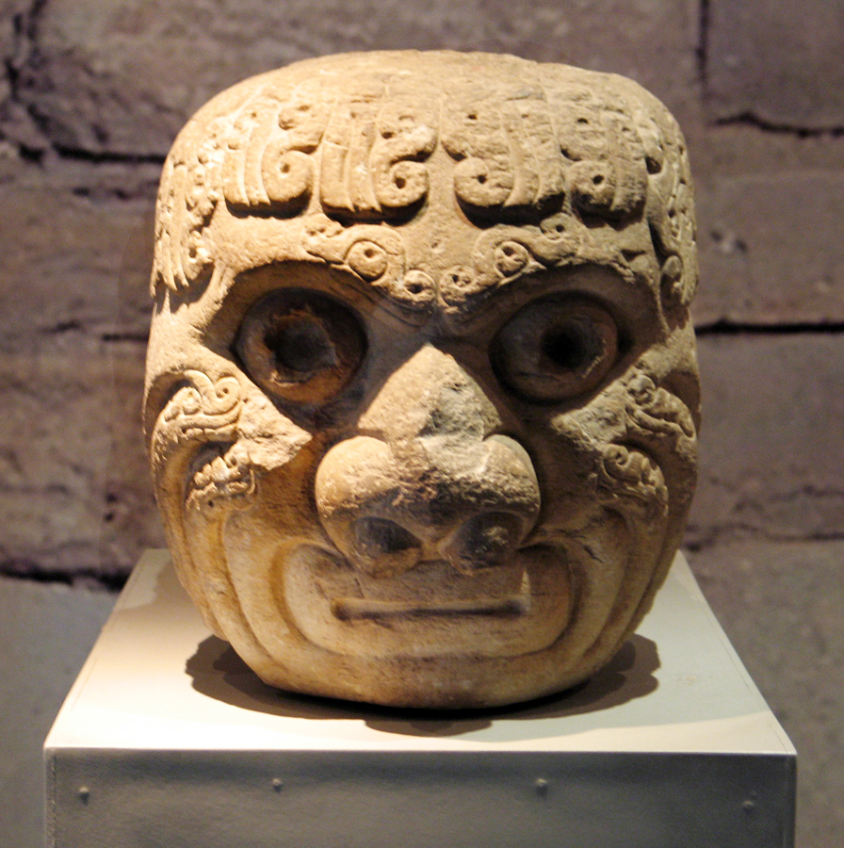

Slide 16
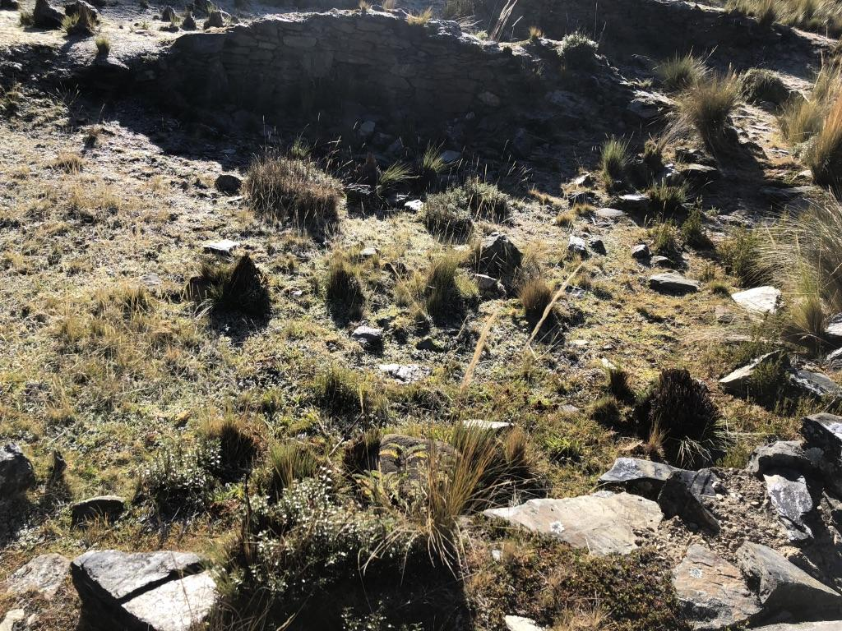

Slide 17
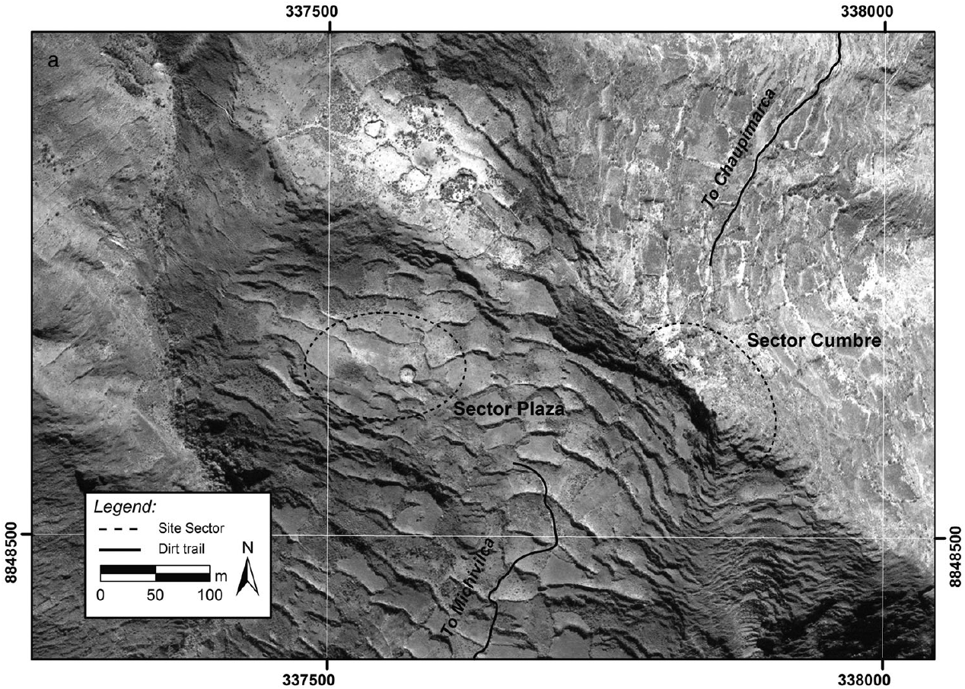

Slide 19
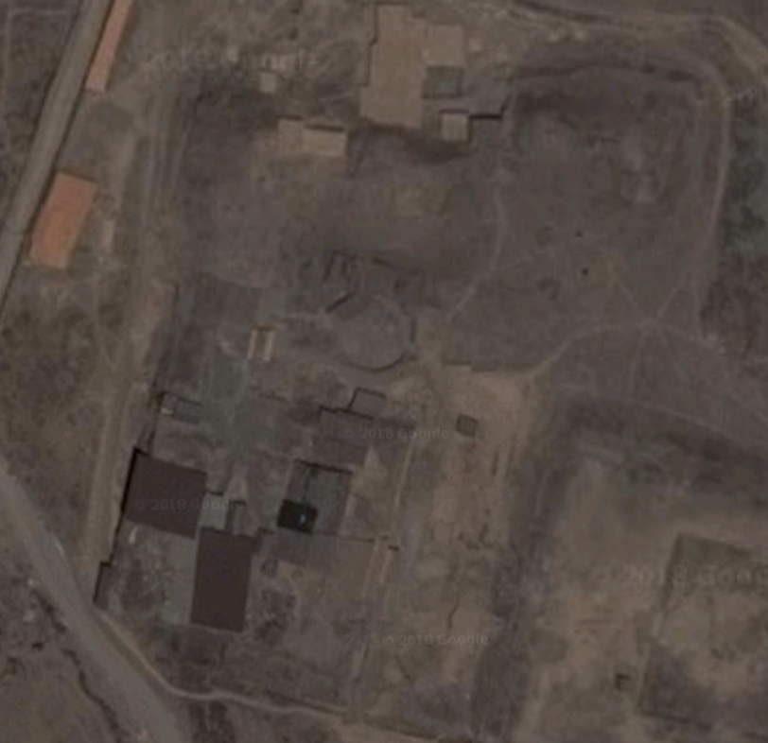

Slide 20
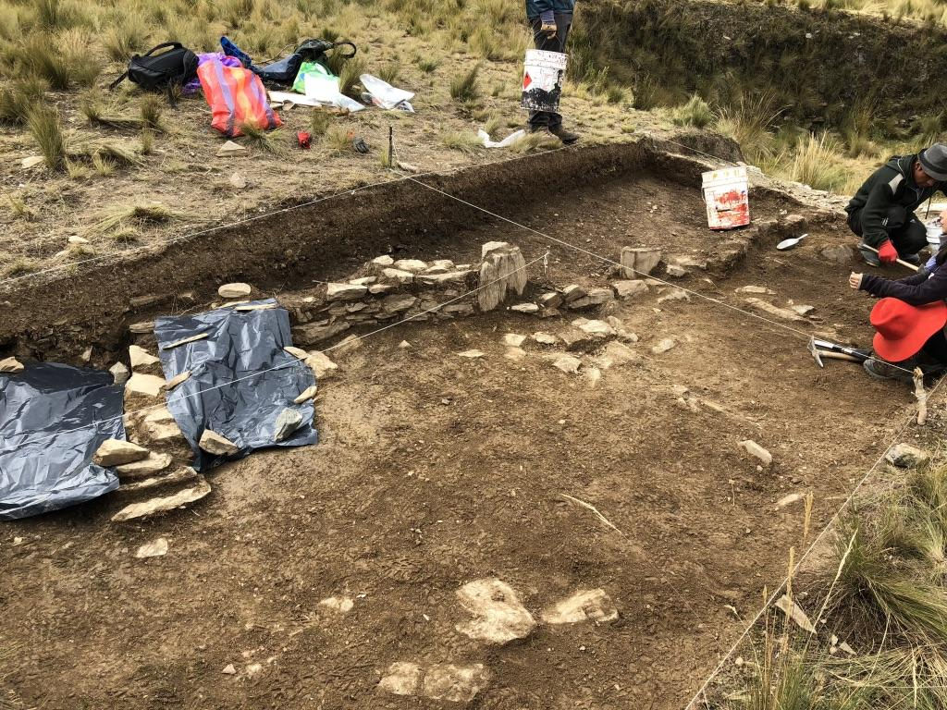
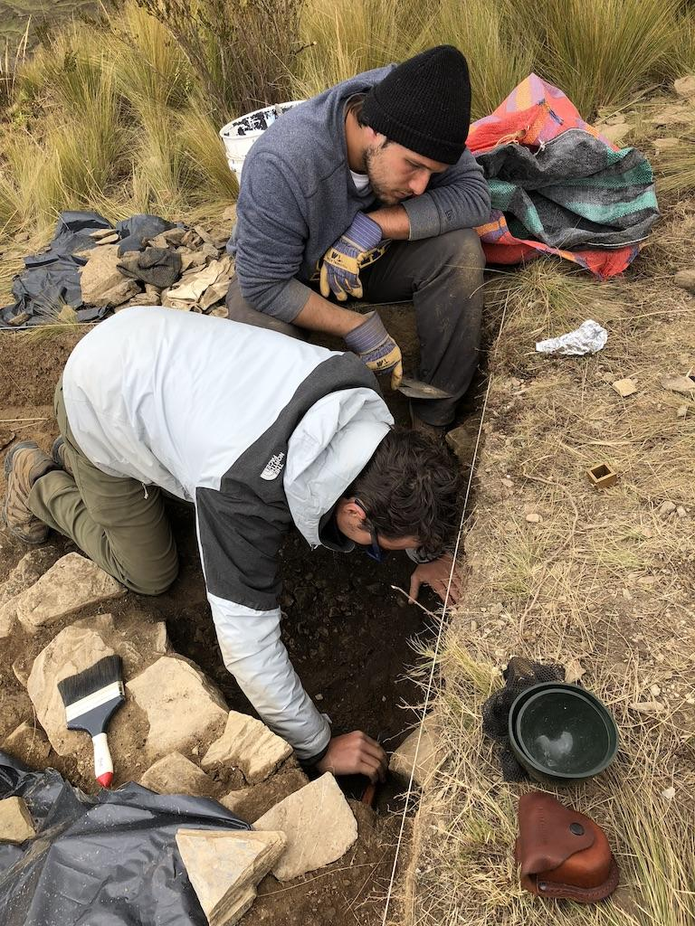

Slide 21
Why is this important??????
Notes:
-preserves the past for future generations and allows people today as well as individuals in the future to be in touch with their past. Discovers information that may have otherwise been destroyed by the tides of time or by human intervention
-allows us to view the world from a larger perspective, giving us insight on how to solve problems that may have cropped up in the past and giving us an idea of where we might be headed. Also allows us to understand the impact that the past has had on us
-explores human diversity and homogeneity and brings to the fore those who have often been neglected by history, allows their stories to be told. Shows us how different and yet similar we all are — contributes to our understanding of a diverse world and our unique nature as human beings

Slide 22
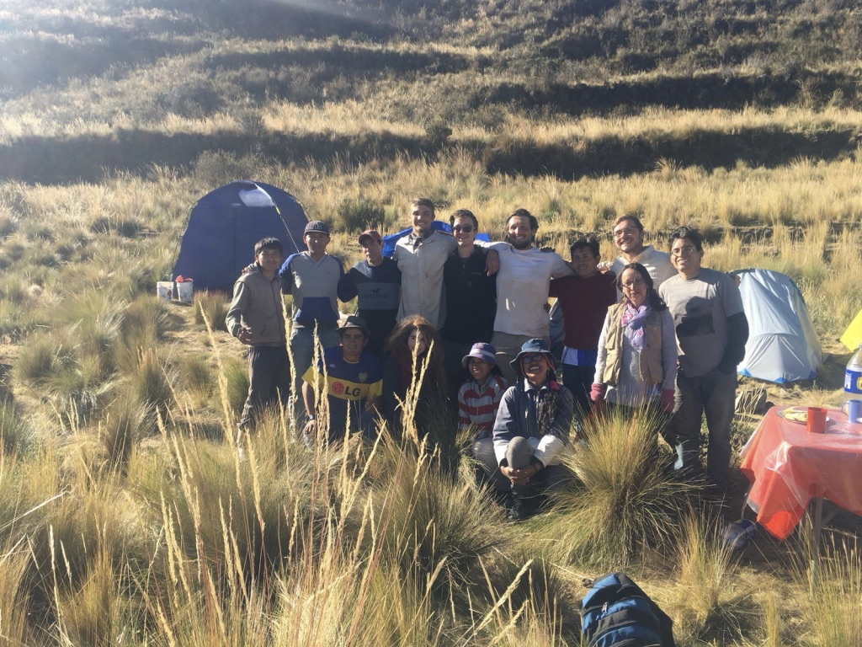

Slide 23
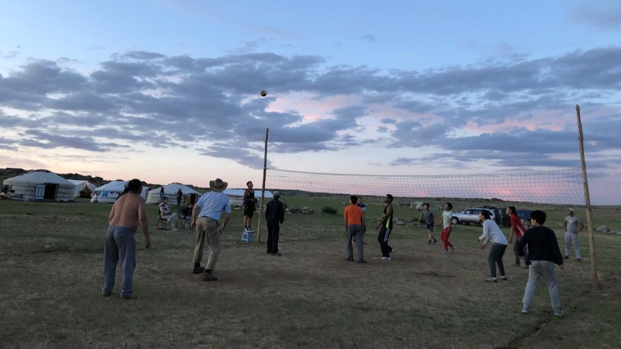

Slide 24
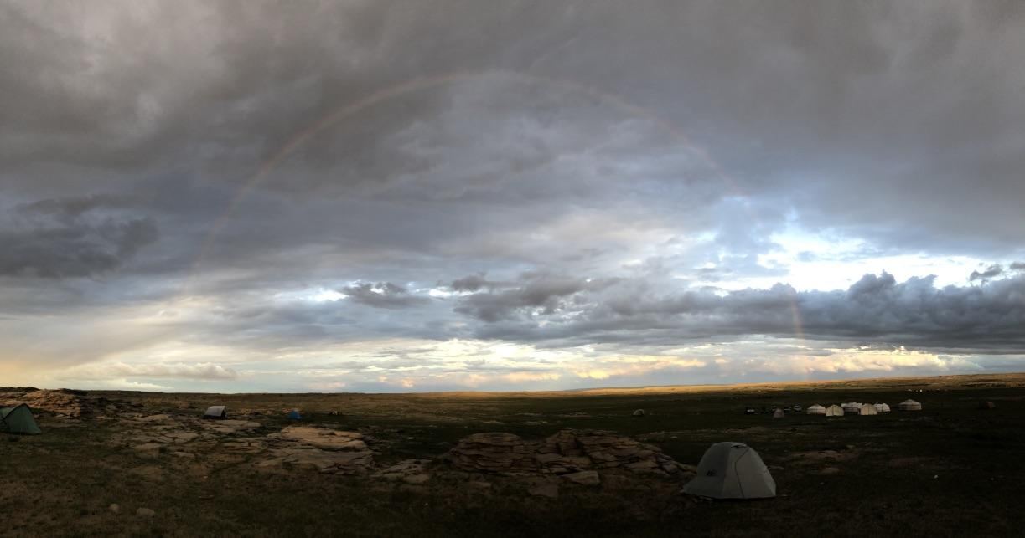
Thank You!

