Slide 1
An eHRAF Workbook Activity
Agrarian Societies
in eHRAF World Cultures
Human Relations Area Files
at Yale University

Slide 2
In this activity
Learn about the place of agriculture in human cultural evolution
Explore the range of agrarian societies across cultures
Consider how differences in agricultural practice might be related to other cultural differences
Topics We'll Cover

Slide 3
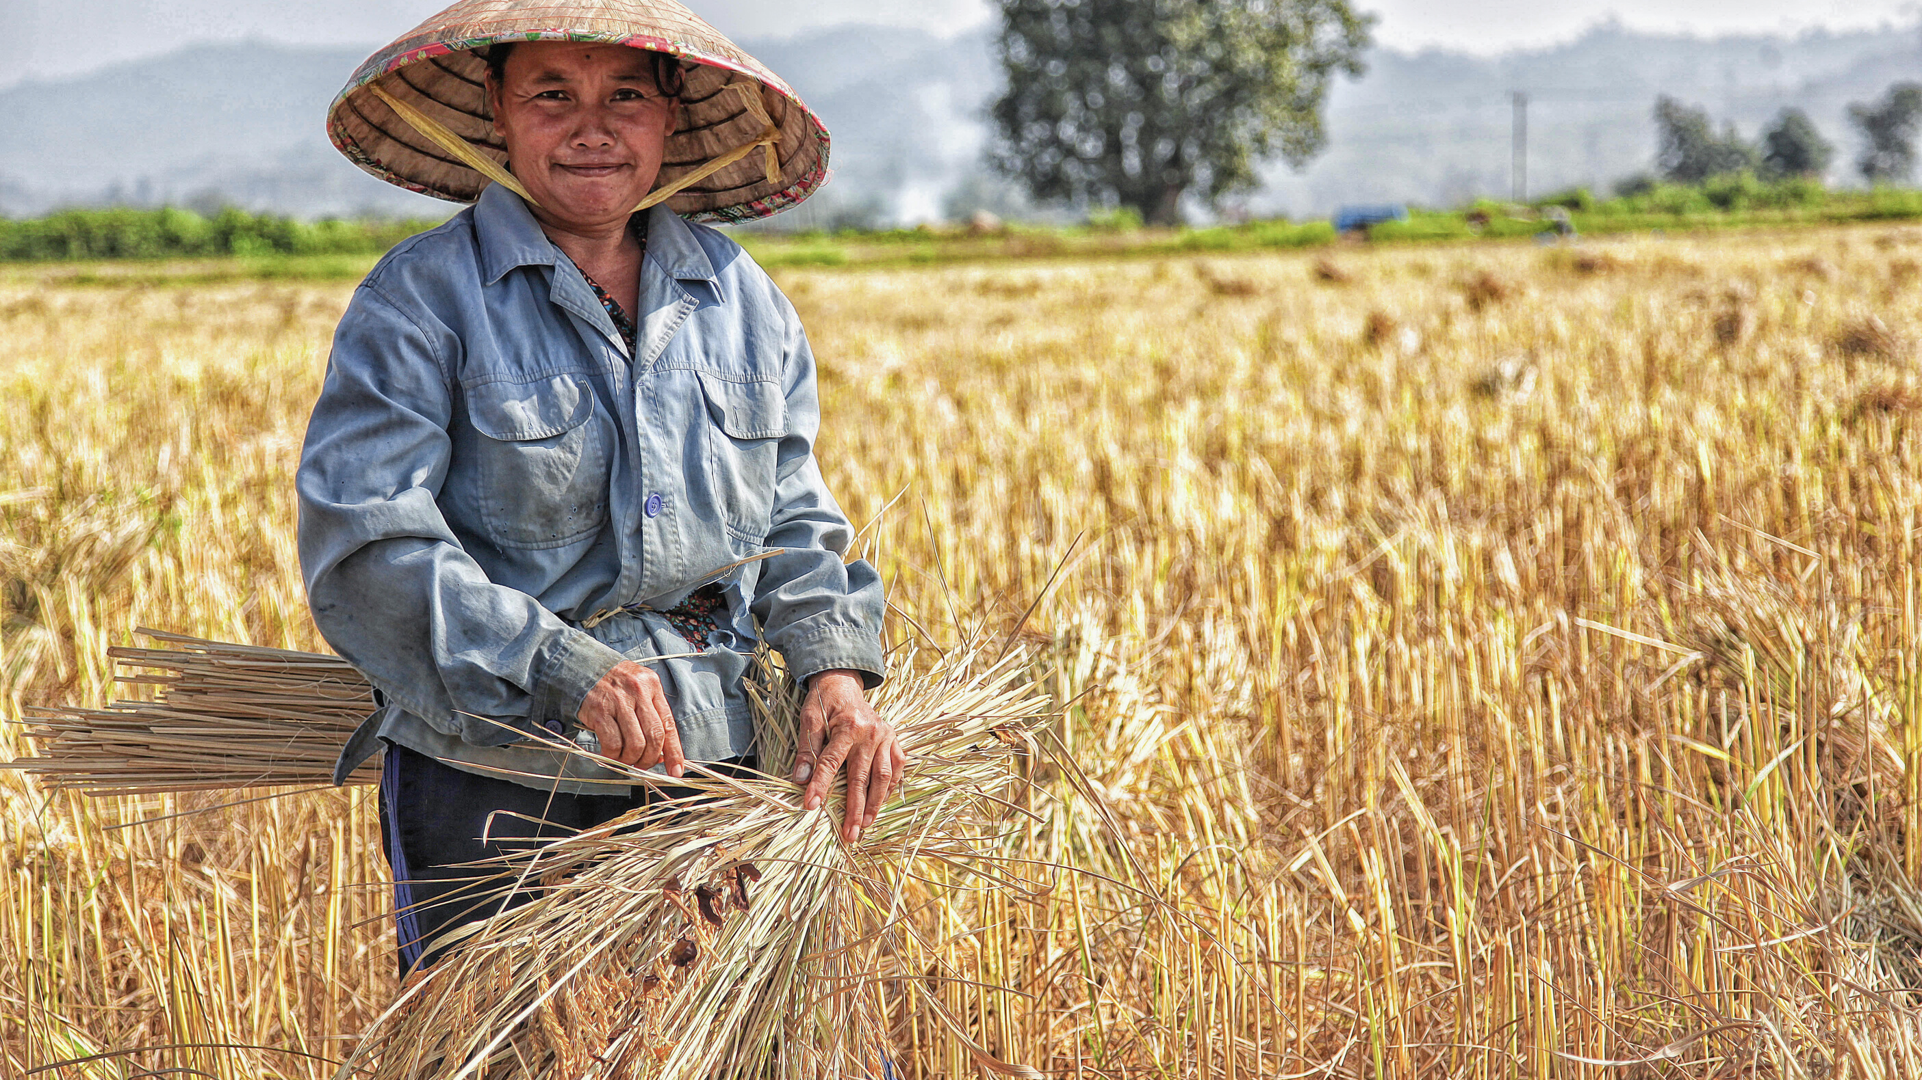
AGRARIAN SOCIETIES

Slide 4
Agricultural societies rely primarily on the cultivation of varieties of crops, often combined with the rearing of domesticated animals. This type of livelihood is generally believed to date to about 10,000 years ago in the Near East.
While food production often involves more labor than food collection and does not necessarily lead to better nutrition, it does allow more people to live in a given region. This may have given agriculturalists competitive advantages over food collectors (hunter-gatherers).
Did you know?

Slide 5
Agricultural societies differ considerably on several features including reliance on:
Shifting or extensive vs. intensive agriculture
Rain vs. irrigation
Cereal crops vs. roots and tubers
Simple tools vs. complex tools (e.g. the plow or plough)
Plant cultivation in comparison to other subsistence types (herding, hunting fishing, gathering, craft production, and trading)

Slide 6
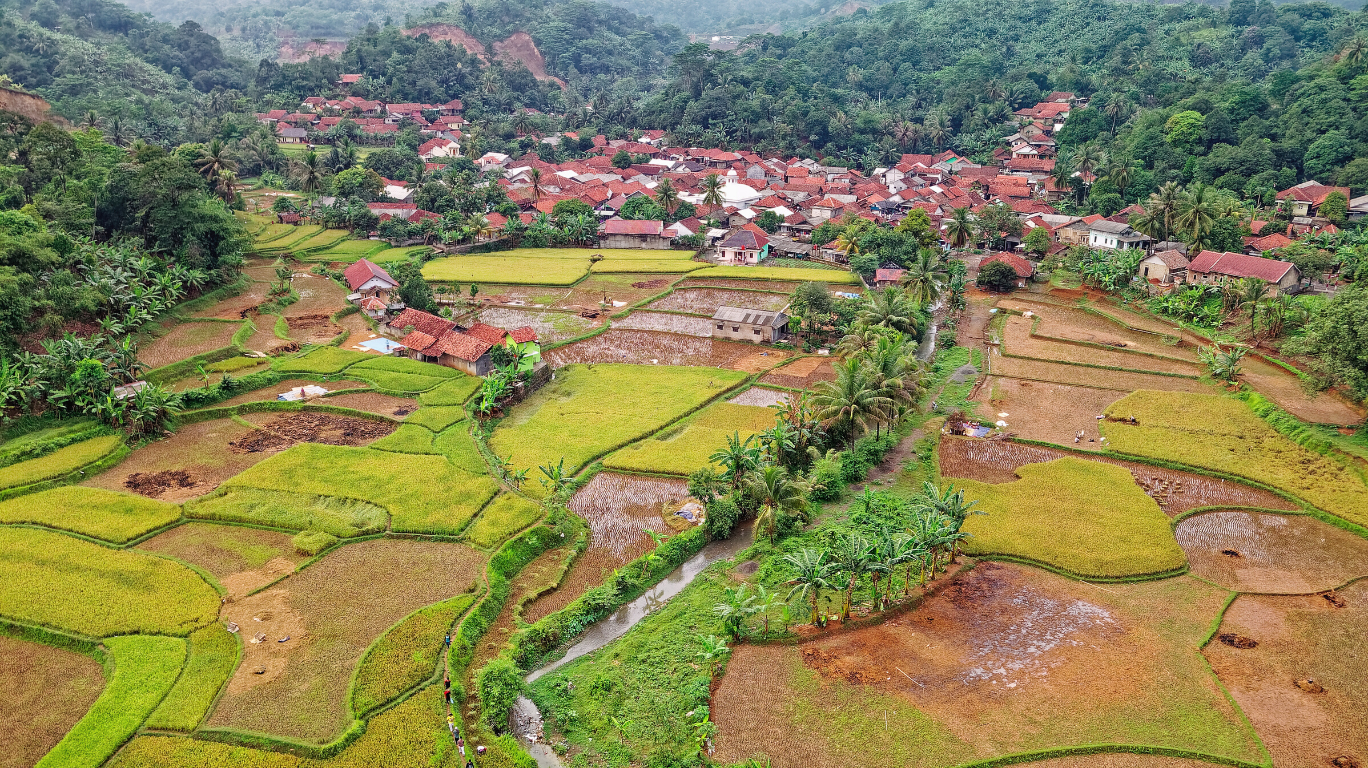
SHIFTING VS. INTENSIVE CULTIVATION

Slide 7
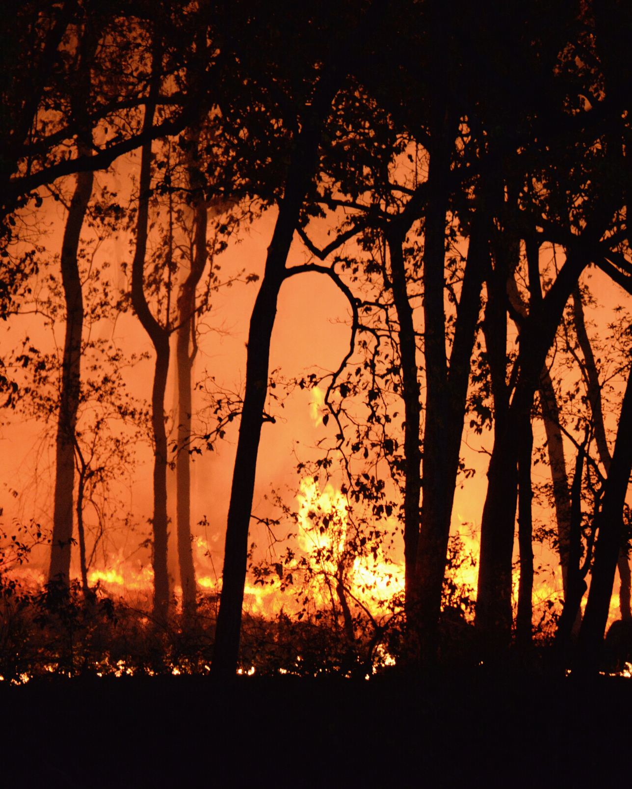
Shifting cultivation involves leaving some land unplanted after a few seasons, opening new plots (or in some cases re-cultivating fallowed ones after a considerable time period), and using the organic matter that has grown up to replenish the soil.
Cutting and burning trees and bushes (slash-and-burn agriculture) is the predominant way of returning nutrients to the soil. This method is most effective in areas of low human population densities where there is sufficient land to allow leaving land fallow.

Slide 8
Intensive cultivation uses techniques that allow more-or-less permanent field cultivation.
Commonly used intensification techniques include enhancing soil fertility by applying manure or chemical fertilizers, building irrigation systems, or building terraces.
Agriculture often intensifies where, in the absence of alternative livelihoods, more food is needed to feed a rapidly growing population.

Slide 9
eHRAF Workbook
ACTIVITY
compare and contrast

Slide 10
Explore and contrast different types of agriculture.
You will read extracts from the following culture collections:
Bemba of northern Zambia
Garo of northern India
Serbs of Serbia (formerly Yugoslavia)
Taiwan Hokkien of Taiwan
Then, compare and contrast your findings in order to answer the questions provided below.

Slide 11
Read the following passages:
Bemba (FQ05)
Audrey Richards: Land, Labour and Diet in Northern Rhodesia - pages 288, 290, 293, 296, 304-305, and 390
🌐 https://ehrafworldcultures.yale.edu/document?id=fq05-002
Garo (AR05)
Dhirendra Majumdar: Calcutta: Anthropological Survey of India - pages 52-57
🌐 https://ehrafworldcultures.yale.edu/document?id=ar05-010
Serbs (EF06)
J. M. Halpern: A Serbian Village - pages 52, 64, and 66-68
🌐 https://ehrafworldcultures.yale.edu/document?id=ef06-025
Taiwan Hokkien (AD05)
Bernard Gallin: Taiwan: A Chinese Village in Change - pages 12-14, 57, 64, 79 and 82
🌐 https://ehrafworldcultures.yale.edu/document?id=ad05-001

Slide 12
1. How would you describe the differences in agricultural practices comparing the (a) Bemba and Garo and (b) Serbs and Taiwan Hokkien?
QUESTIONS
Consider differences in land use, techniques of restoring nutrients to the soil, agricultural implements, and types of crops.
2. Compare the two shifting cultivation societies with the two intensive agricultural societies with respect to total population, division of labor by gender, land ownership, and degree of dependence on other subsistence activities.
You can find additional material on these topics in the culture summaries of each society.

Slide 13
Culture Summaries
A brief overview for societies in eHRAF World Cultures is provided in the form of Culture Summaries.
The format, general outline, and headings are the same for each summary. You will find a basic overview about the culture, such as its economy, history, environment and sociopolitical organization.
eHRAF
World
Cultures
To find a culture summary, go to the Browse Cultures tab. Enter the culture name into the box, then click to expand the result. Click on Full Profile to reach the Culture Profile, then access the Culture Summary via the Summary tab.

Slide 14
eHRAF Workbook
ACTIVITY 2

Slide 15
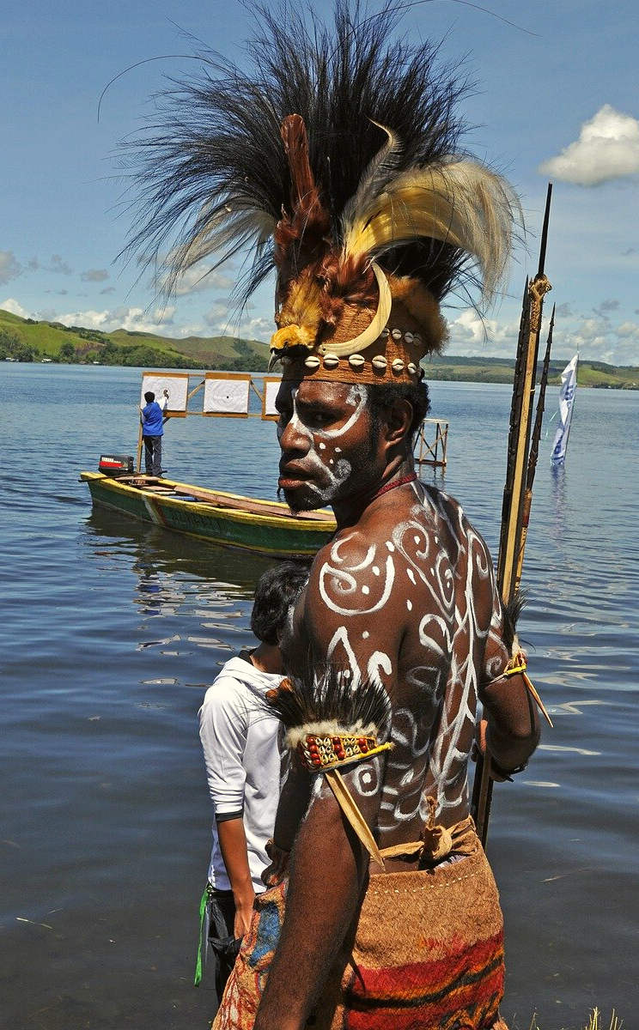
Read the passages below to explore a society that practices both shifting and intensive agriculture: the Kapauku of western New Guinea (now Irian Jaya, Indonesia).
L. Pospisil: Kapauku Papuan Economy - page 197
🌐
https://ehrafworldcultures.yale.edu/document?id=oj29-005
L. Pospisil: Kapauku Papuans and Their Law - pages 14 and 69-70
🌐
https://ehrafworldcultures.yale.edu/document?id=oj29-001
What are the conditions that seem to underlie the two different practices?

Slide 16
1. Gallin, Bernard. 1966. Hsin Hsing, Taiwan: A Chinese Village in Change. Berkeley: University of California Press. https://ehrafworldcultures.yale.edu/document?id=ad05-001.
2. Halpern, Joel Martin. 1967. “A Serbian Village.” In Harper Colophon Books, xxvi, 358. New York: Harper & Row. https://ehrafworldcultures.yale.edu/document?id=ef06-025.
References
3. Majumdar, Dhirendra Narayan. 1978. “Culture Change in Two Garo Villages.” In Memoir, xi, 188 , plates. Calcutta: Anthropological Survey of India, Govt. of India. https://ehrafworldcultures.yale.edu/document?id=ar05-010.
4. Pospisil, Leopold J. 1963. “Kapauku Papuan Economy.” In Yale University Publications in Anthropology, 502 , plates. New Haven, Conn.: Dept. of Anthropology, Yale University. https://ehrafworldcultures.yale.edu/document?id=oj29-005.

Slide 17
5. Pospisil, Leopold J. 1958. “Kapauku Papuans and Their Law.” In Yale University Publications in Anthropology, 296 , plates. New Haven, Conn.: Published for the Dept. Anthropology, Yale University. https://ehrafworldcultures.yale.edu/document?id=oj29-001.
6. Richards, Audrey I. (Audrey Isabel). 1939. Land, Labour and Diet in Northern Rhodesia: An Economic Study of the Bemba Tribe. Pub. for the International Institute of African Languages & Cultures by the Oxford University Press. https://ehrafworldcultures.yale.edu/document?id=fq05-002.
References

Slide 18
Agrarian Societies
in eHRAF World Cultures
Produced by
Human Relations Area Files
at Yale University
An eHRAF Workbook Activity
hraf.yale.edu

