Slide 1
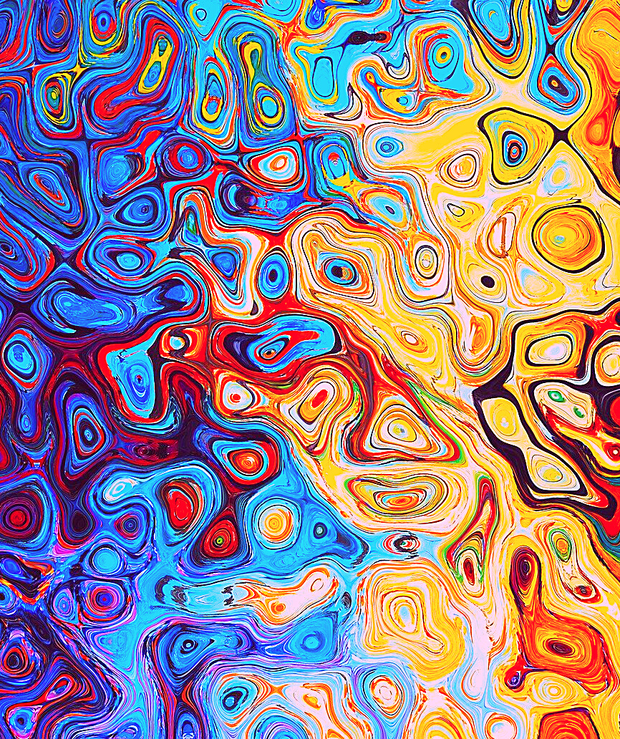
An eHRAF Workbook Activity
Altered States of Consciousness
in eHRAF World Cultures
Human Relations Area Files
at Yale University

Slide 2
In this activity
Learn about altered states of consciousness (ASC)
Conduct an Advanced Search in eHRAF World Cultures
Read and interpret ethnographic data
Describe similarities and differences in ASC across cultures
Topics We'll Cover

Slide 3
ALTERED STATES OF CONSCIOUSNESS

Slide 4
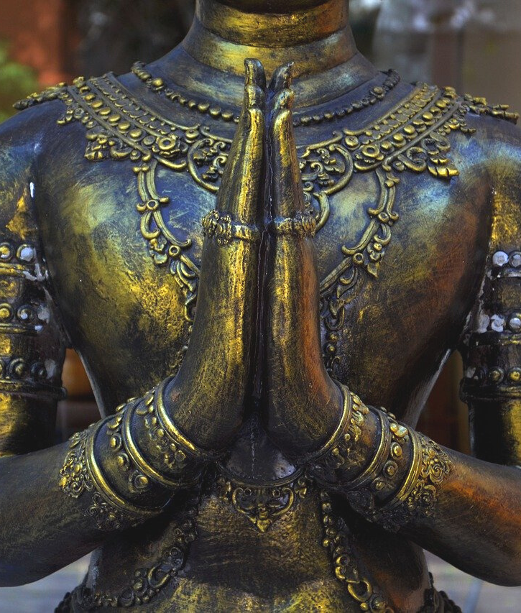
This workbook is based on the Explaining Human Culture (EHC) summary on Altered States of Consciousness
by
Carol R. Ember and Christina Carolus
https://hraf.yale.edu/ehc/summaries/altered-states-of-consciousness
You may wish to read the EHC summary to learn more about altered states of consciousness, trance, healing, dreaming, and out-of-body experiences before beginning the exercises in this workbook.

Slide 5
Cultural Variation
Nearly all societies are known to engage in practices that lead to altered states of consciousness. However, the methods, functions, and cultural context vary widely between societies.
One such variation is whether or not societies believe in spirit possession, trance, religious ecstasy, or the possibility of one’s “soul” traveling to another realm.
Did you know?

Slide 6
Humans can also experience altered states of consciousness (ASC) in wakeful moments.
In contemporary North American culture, these wakeful ASC are thought of either as unusual events, or are connected to practices of specialists, such as hypnotic states induced by therapists or magicians; trances entered into by mediums conducting séances; meditation in yoga classes; or drug-induced hypnotic states.
The idea that bodies might be possessed by demons, witches, or spirits also exists as a popular theme in some religious traditions.

Slide 7
ETHNOGRAPHIC EXPLANATIONS

Slide 8
Altered states of consciousness have likely been part of the human cognitive repertoire for at least 100,000 years, if not longer.
For example, art composed of motifs indicating sensory deprivation and commonly associated forms of visual hallucination can be seen as early as 70,000-100,000 years ago at Blombos Cave in South Africa.
Ancient History of Altered States

Slide 9
Similarly, archaeological evidence for institutionalized ASC has been found in human societies across the globe and throughout human history. For instance, pre-Columbian Maya ritually consumed balché, a mead-like drink made with the hallucinogenic plant Lonchocarpus longistylus.
As the scope of the archaeological record is limited by materiality, pharmacologically-oriented examples represent only a small fraction of the historical and archaeological evidence for institutionalized ASC.
Ancient History of Altered States

Slide 10
eHRAF Workbook
ACTIVITY
compare and contrast ASC

Slide 11
ASC
Across Cultures
Conduct an Advanced Search in eHRAF World Cultures to compare altered states of consciousness among the Chipewyans (ND07) of North America and the Central Thai (AO07) of Asia.
As shown below, use the following OCM subject categories: Revelation and Divination (787) or Ecstatic Religious Practices (786)

Slide 12
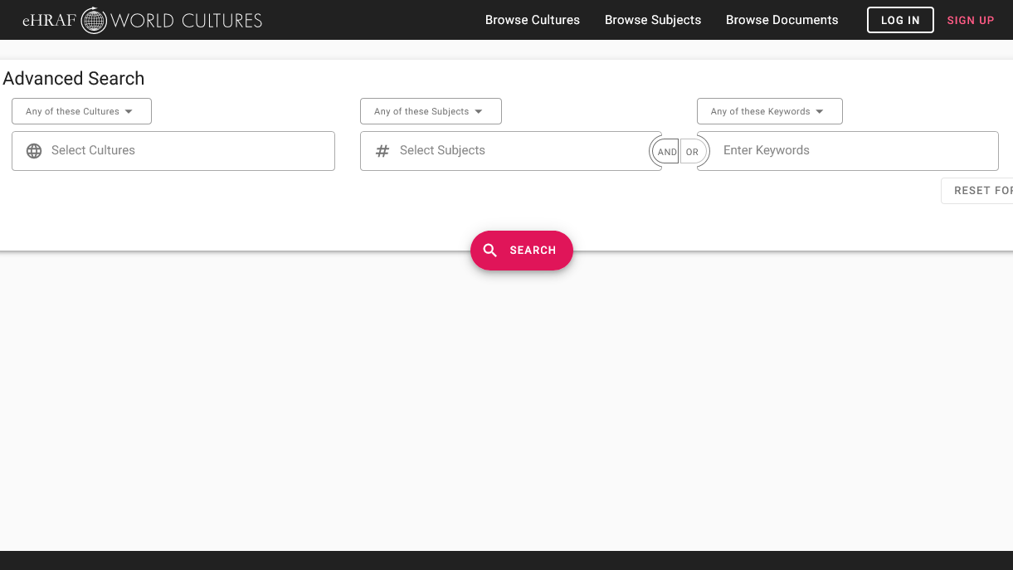
ADVANCED SEARCH
Add subjects:
Ecstatic religious practices (786) or Revelation and divination (787)
Add 2 cultures:
Chipewyans (ND07) and Central Thai (AO07)

Slide 13
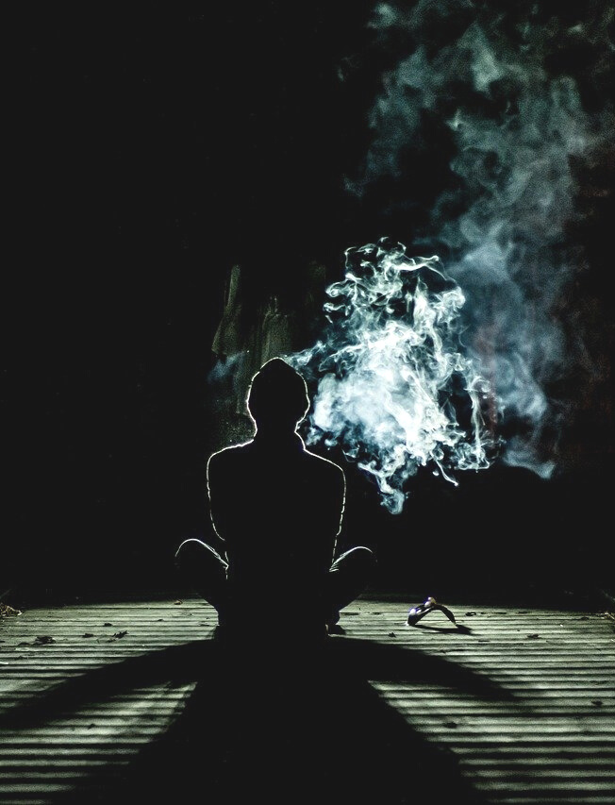
COMPARE & CONTRAST
Questions
Based on the ethnographic data that you found in eHRAF World Cultures, compare and contrast the ethnographic descriptions of ASC among the Chipewyans and Central Thai.
What types of altered states did you find described among these two groups?
What similarities or differences do you note between the trance experiences in the two cultures?
Did you notice any similarities between these trance experiences and any religious or ecstatic experiences that you may have already been familiar with?

Slide 14
This activity was adapted in part from Altered States of Consciousness (Explaining Human Culture), by Carol R. Ember and Christina Carolus. https://hraf.yale.edu/ehc/summaries/altered-states-of-consciousness
References

Slide 15
Altered States of Consciousness
in eHRAF World Cultures
Produced by
Human Relations Area Files
at Yale University
An eHRAF Workbook Activity
hraf.yale.edu

