Slide 1
An eHRAF Workbook Activity
Archaeological Ethics
in eHRAF Archaeology
Human Relations Area Files
at Yale University

Slide 2
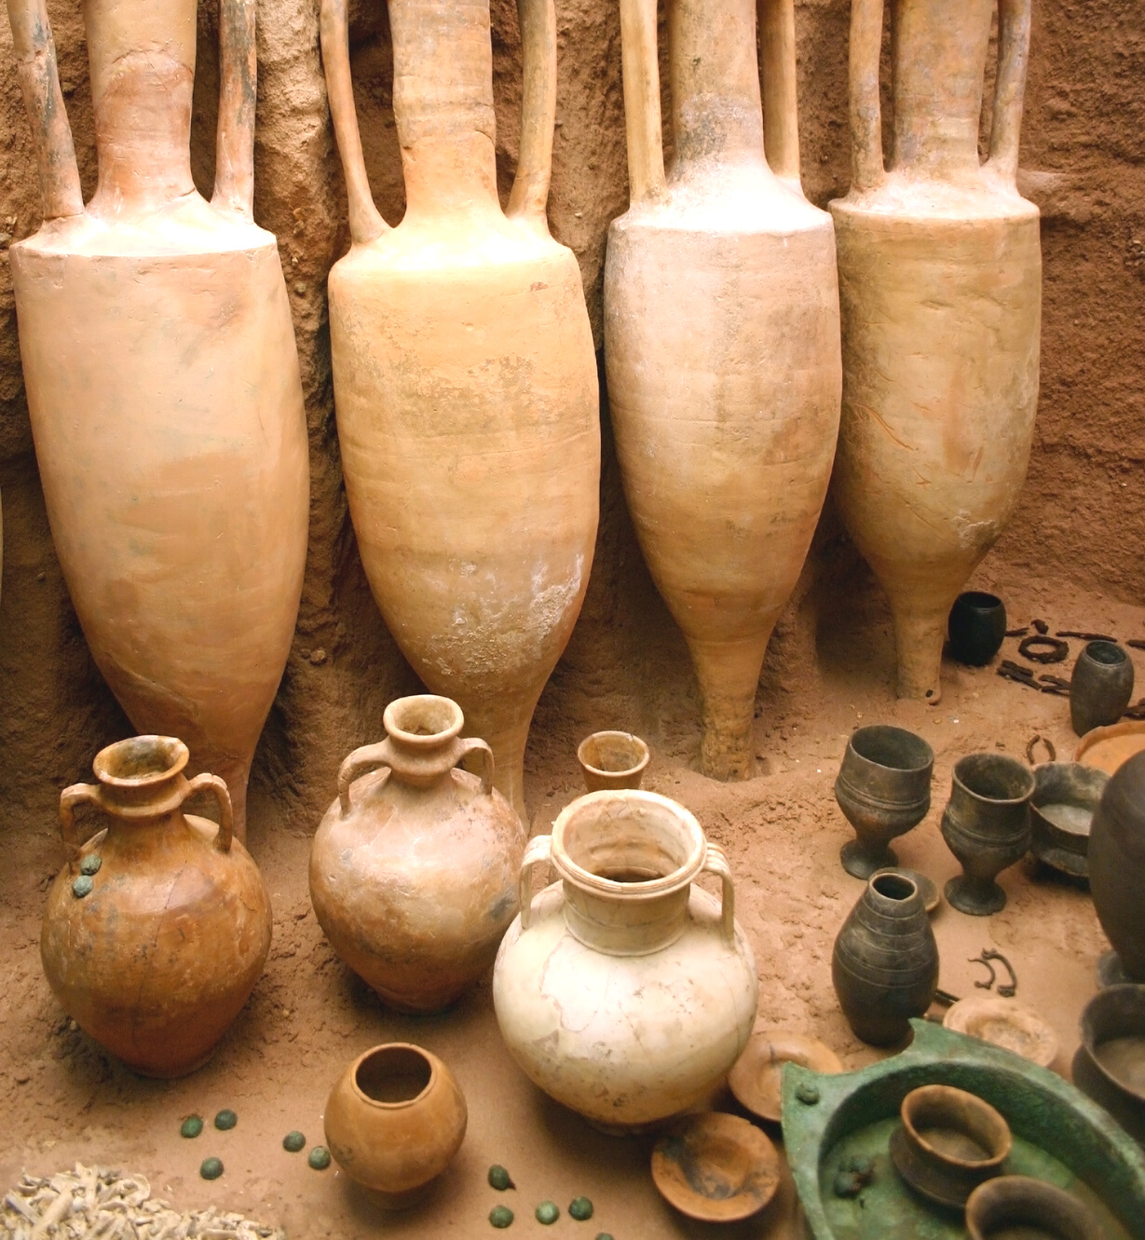
In this activity
Explore ethical concerns in archaeology
Evaluate existing ethical guidelines and laws
Consider the right to ownership over the material past
Read and interpret archaeological data
Topics We'll Cover

Slide 3
Who owns the past?
If you have ever visited a history or art museum in cities like New York, Paris, or London, you will have had the pleasure of viewing thousands of artifacts from different cultures, places and times.
Did you know?
Museums are important public institutions as well as centers for scientific research and discovery. They hold incredible pieces of our shared past, including artwork, pottery, tools, fossils and even the skeletons of animals and early hominids.
Yet, many museum-goers rarely consider the question: who owns the past?

Slide 4
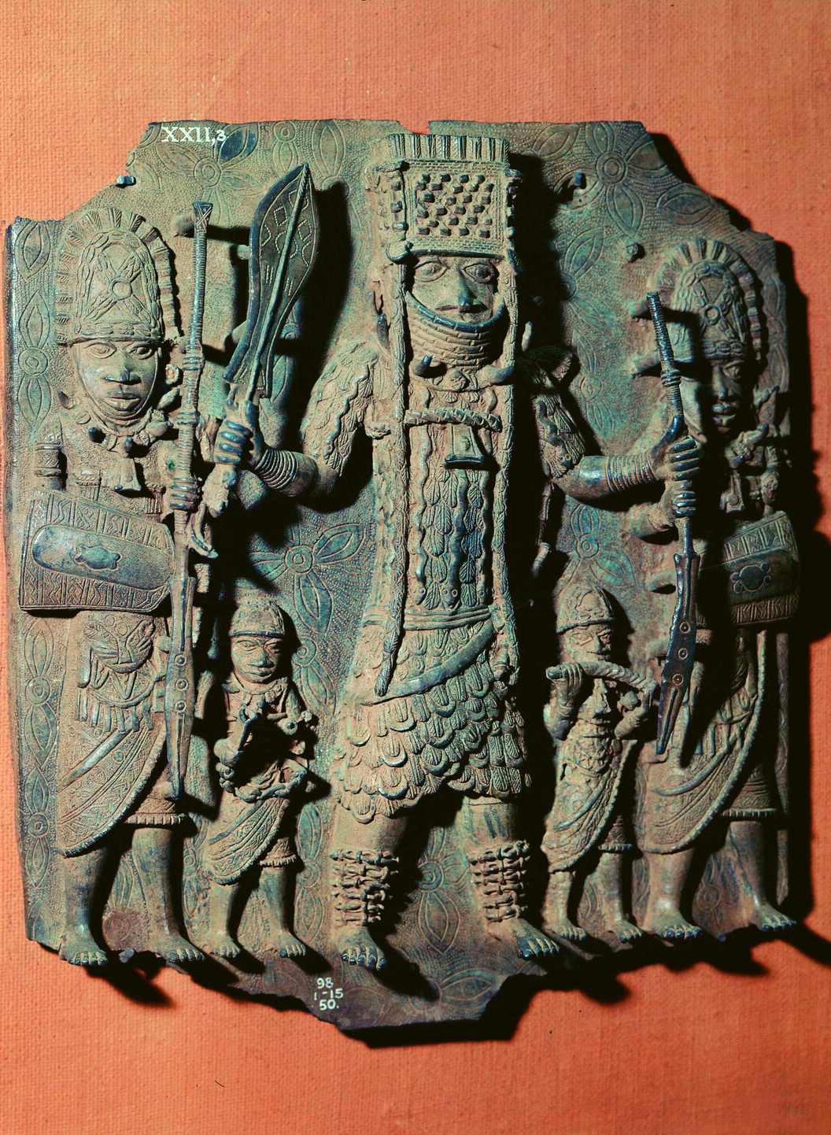
Watch the video below to learn about how some of the world's greatest cultural treasures arrived in Western museums.
What can the history of these artifacts and their travels around the world tell us about cultural heritage and who owns the past?

Slide 5
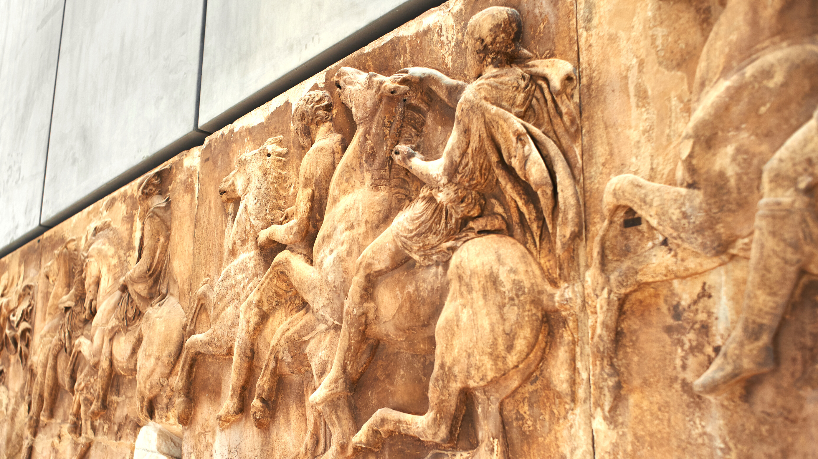
ETHICS

Slide 6
Unlike the swashbuckling, treasure-hunting archaeologists depicted in TV and movies, professional archaeologists and heritage managers carefully consider the ethics of their work at every stage.
Codes of conduct guide the practices of fieldwork, excavation, preservation, curation, cataloguing, display, and the ownership and/or repatriation of artifacts and remains.
Looting, war, destruction, damage, and other sources of cultural property loss have also contributed to ethical guidelines, governmental legislation, and international agreements designed to protect the past in the present. One example is the 1970 UNESCO Convention to Fight Illicit Trafficking of Cultural Property.

Slide 7
Professional and academic archaeological organizations and societies maintain their own ethical codes. You can visit the pages below learn more about these:
Society for American Archaeology (SAA)
Principles of Archaeological Ethics
European Association of Archaeologists (EAA)
Code of Practice and Principles
Register of Professional Archaeologists & Chartered Institute for Archaeologists
Archaeological Ethics Database

Slide 8
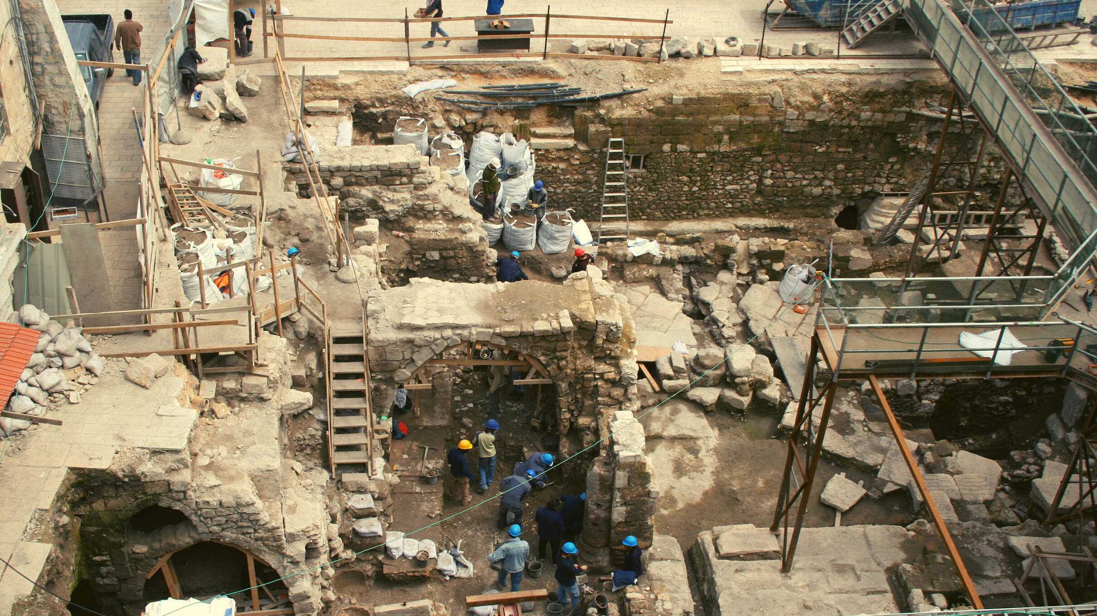
eHRAF Workbook Activity
Preserving Culture

Slide 9
U.S. Legislation
Several key pieces of legislation in the United States have addressed cultural resource management and protection in the course of archaeological practice. These include:
Antiquities Act (1906)
National Historic Preservation Act - NHPA (1966)
Archaeological Resources Protection Act - ARPA (1979)
Native American Graves Protection and Repatriation Act - NAGPRA (1990)
Read the following case study to learn more about some of these laws and acts. Then, answer the questions based on the reading.

Slide 10
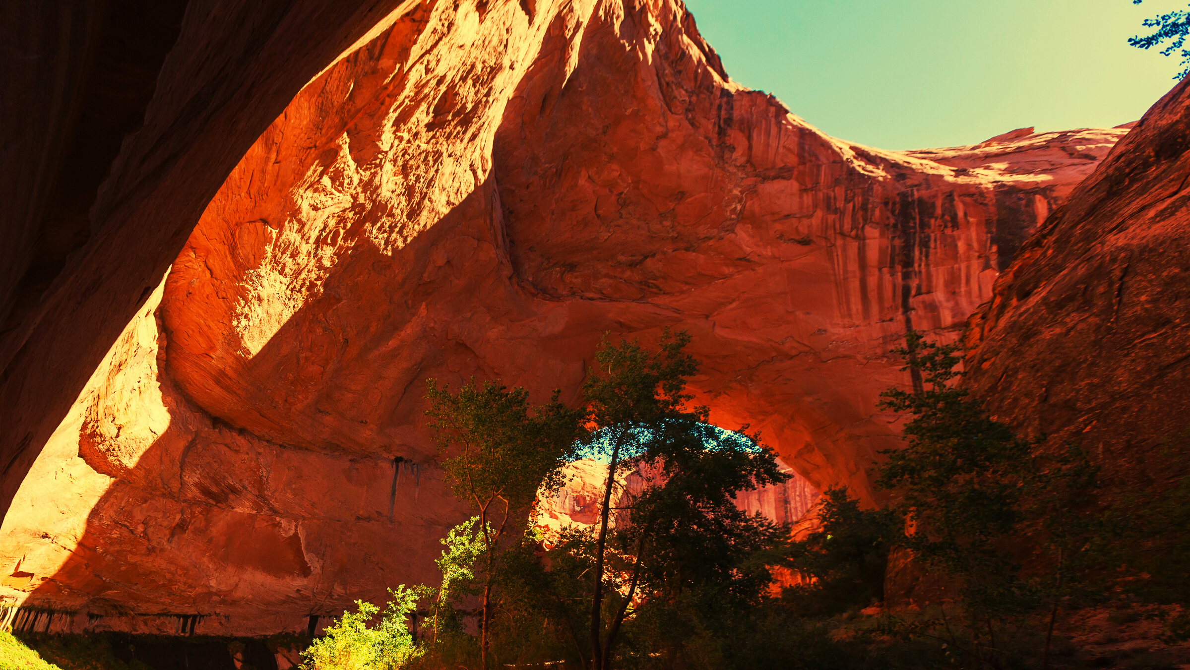
CASE STUDY

Slide 11
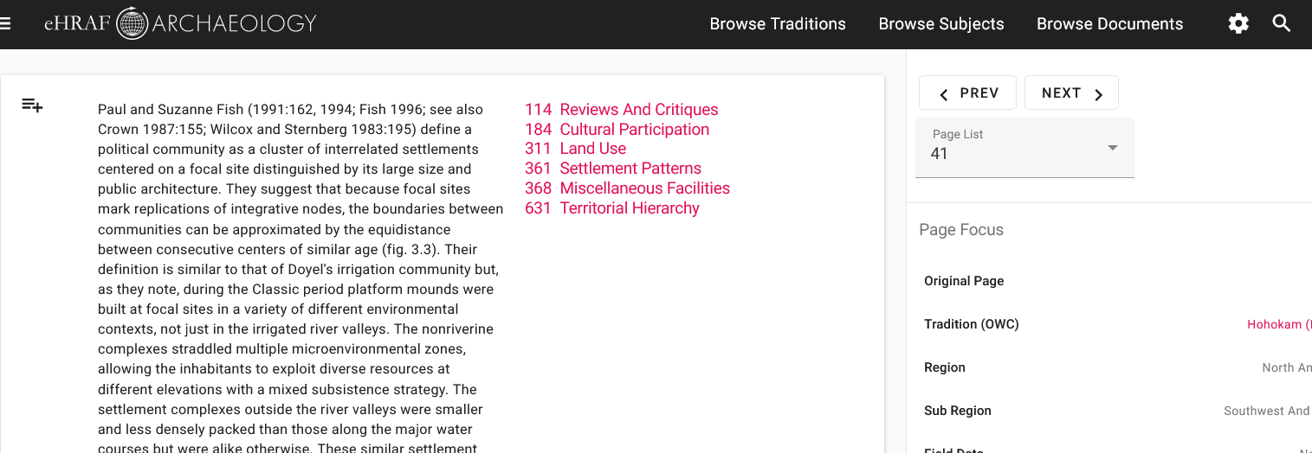
To read documents or pages in eHRAF:
INSTRUCTIONS
First, follow the permalinks provided in the activities below to get to the relevant documents.
For example:
🌐
https://ehrafarchaeology.yale.edu/document?id=nt76-001
Then, use the Page List dropdown menu to navigate to the required page(s).

Slide 12
Finding documents without permalinks
INSTRUCTIONS
Follow these steps if you are having trouble with permalinks from off campus while using a proxy or VPN service, or if you have been provided with a HRAF-issued username and password.
Sign in via your library proxy or VPN, or using the HRAF-issued credentials.
Go to the Browse Documents tab.
Enter the author's name or document title into Search Document List box.
Click on the required title to access the document, then select the page number from the Page List dropdown menu as shown above.

Slide 13
CASE STUDY
Basketmaker (NT93)
Grand Gulch, Utah
In eHRAF Archaeology, read "Section 7: The Future of the Past" in Blackburn & Williamson (1997) Cowboys & Cave Dwellers: Basketmaker Archaeology in Utah’s Grand Gulch
🌐
https://ehrafarchaeology.yale.edu/document?id=nt93-001
Pages:
149-156 on the Turkey Pen Ruin
159-160 on federal laws aimed at preserving and protecting archaeological sites and cultural resources
164 on the ethical responsibilities of anthropologists

Slide 14
QUESTIONS
What happened at Turkey Pen Ruin?
Describe the site. Which culture or tradition is it from?
What artifacts were uncovered?
What are some of the major threats to cultural resources, history, and the environment when digging takes place?
What does the author mean by "people who remove artifacts from public lands literally rob the rest of us twice" (p. 156)?
Which federal preservation laws or legal protections were in place at the time, and how effective were they at Turkey Pen Ruin?
What distinguishes NAGPRA from other federal statutes?

Slide 15
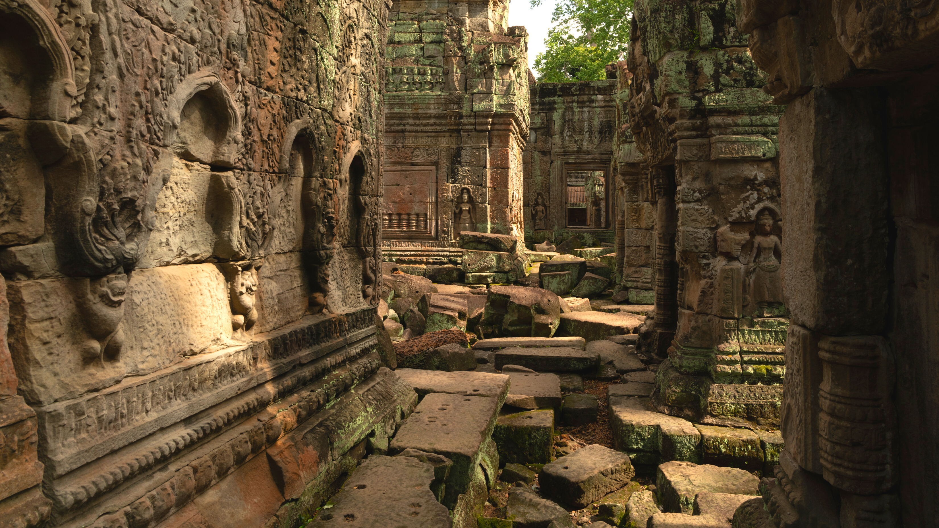
eHRAF Workbook Activity
Advanced Search

Slide 16
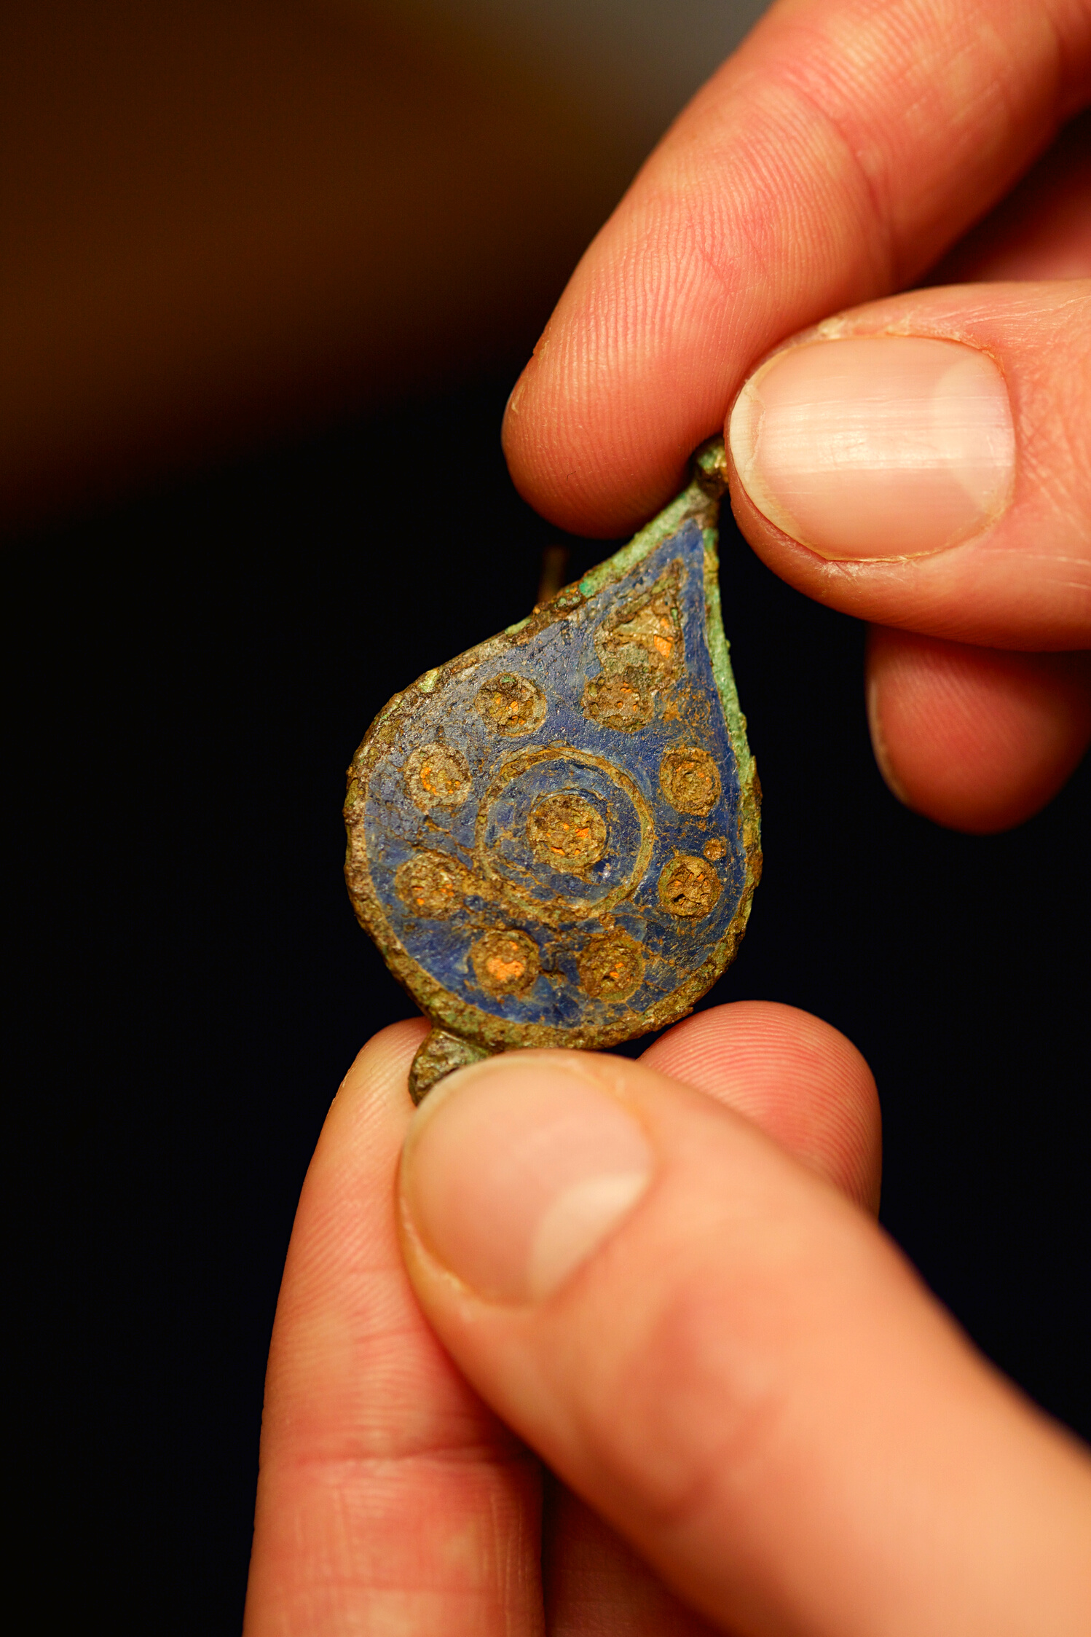
eHRAF ARCHAEOLOGY
Looting & Cultural Heritage
There are, unfortunately, countless cases of looting which have caused irreparable damage to artifacts and sites of historical significance in the archaeological record.
You can learn more about how widespread the issue of looting is and the devastating impact this has on archaeology at various sites around the world by searching in eHRAF Archaeology.
🌐
https://ehrafarchaeology.yale.edu

Slide 17
ADVANCED SEARCH
Construct an Advanced Search as shown on the following page.
To find cases of looting, use the OCM subject identifier Post depositional processes in archaeological sites (138).
Add the keyword loot* to include paragraph-level results that mention both looters and/or looting.
While exploring the data in eHRAF, consider how your findings from different traditions and countries compare with the case study from Turkey Pen Ruin.
How prevalent is looting? How does it impact the work of archaeologists?

Slide 18
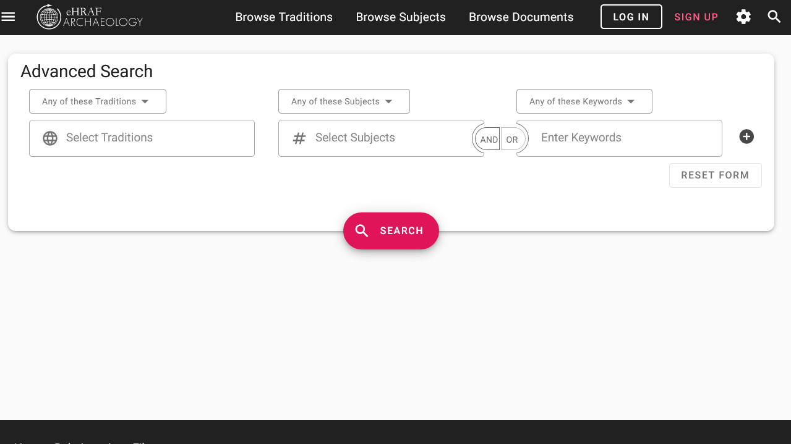
SAMPLE ADVANCED SEARCH
Add subject:
Post depositional processes in archaeological sites (138)
Add keyword:
loot*
Add traditions (optional)

Slide 19
eHRAF Workbook Activity
Controversy & Discussion

Slide 20
CURRENT DEBATES
Below are examples of recent and ongoing ethical debates and controversies in American anthropology. Read the articles, then consider the discussion questions that follow with your classmates.
An Archaeology Society Hosted a Talk Against Returning Indigenous Remains
A Mystery and a Scandal for Anthropology
The Grim Open Secret of College Bone Collections
An Interview with the Editor of American Anthropologist about the March 2020 Cover Controversy
The FBI's Repatriation of Stolen Heritage

Slide 21
QUESTIONS
What are some of the moral issues raised by anthropology, and archaeologists in particular?
In your opinion, should archaeologists be obligated to respect the culture and religious beliefs of others even if it compromises their ability to conduct research and collect data?
Who can legitimately claim to "own" an artifact?
Are archaeologists guilty of "looting" items of cultural heritage?
How effective are the US federal laws and statutes designed to protect and manage historical sites, cultural resources, and/or human remains?
What more can archaeologists and lawmakers do to prevent future damage to individuals, descendent communities, and archaeological sites?

Slide 22
1. American Anthropologist. 2020. "An Interview with the Editor of American Anthropologist about the March 2020 Cover Controversy". Public Anthropologies. June 29. http://www.americananthropologist.org/2020/06/29/an-interview-with-the-editor-of-american-anthropologist-about-the-march-2020-cover-controversy/
2. Ayers, E. 2021. "The Grim Open Secret of College Bone Collections". Slate. April 30. https://slate.com/news-and-politics/2021/04/move-bombing-victims-princeton-penn-museum-history-anthropology.html
References
3. Blackburn, Fred M., and Ray A. Williamson. 1997. Cowboys & Cave Dwellers: Basketmaker Archaeology in Utah’s Grand Gulch. Santa Fe, N.M.: School of American Research Press. https://ehrafarchaeology.yale.edu/document?id=nt93-001.
4. Dance, A. 2020. The FBI’s Repatriation of Stolen Heritage. Sapiens. June 24. https://www.sapiens.org/culture/fbi-repatriation/

Slide 23
5. Flaherty, C. 2021. "A Mystery and a Scandal for Anthropology". Inside Higher Ed. April 23. https://www.insidehighered.com/news/2021/04/23/anthropological-mystery-involving-penn-and-princeton-scandal-too
6. Wade, L. 2021. "An archaeology society hosted a talk against returning Indigenous remains. Some want a new society." Science. April 19. https://www.sciencemag.org/news/2021/04/archaeology-society-hosted-talk-against-returning-indigenous-remains-some-want-new
References
Image Credits
Images licensed via Canva.

Slide 24
Archaeological Ethics
in eHRAF Archaeology
Produced by
Human Relations Area Files
at Yale University
An eHRAF Workbook Activity
hraf.yale.edu

