Slide 1
An eHRAF Workbook Activity
Art
&
Society
in eHRAF World Cultures
Human Relations Area Files
at Yale University

Slide 2
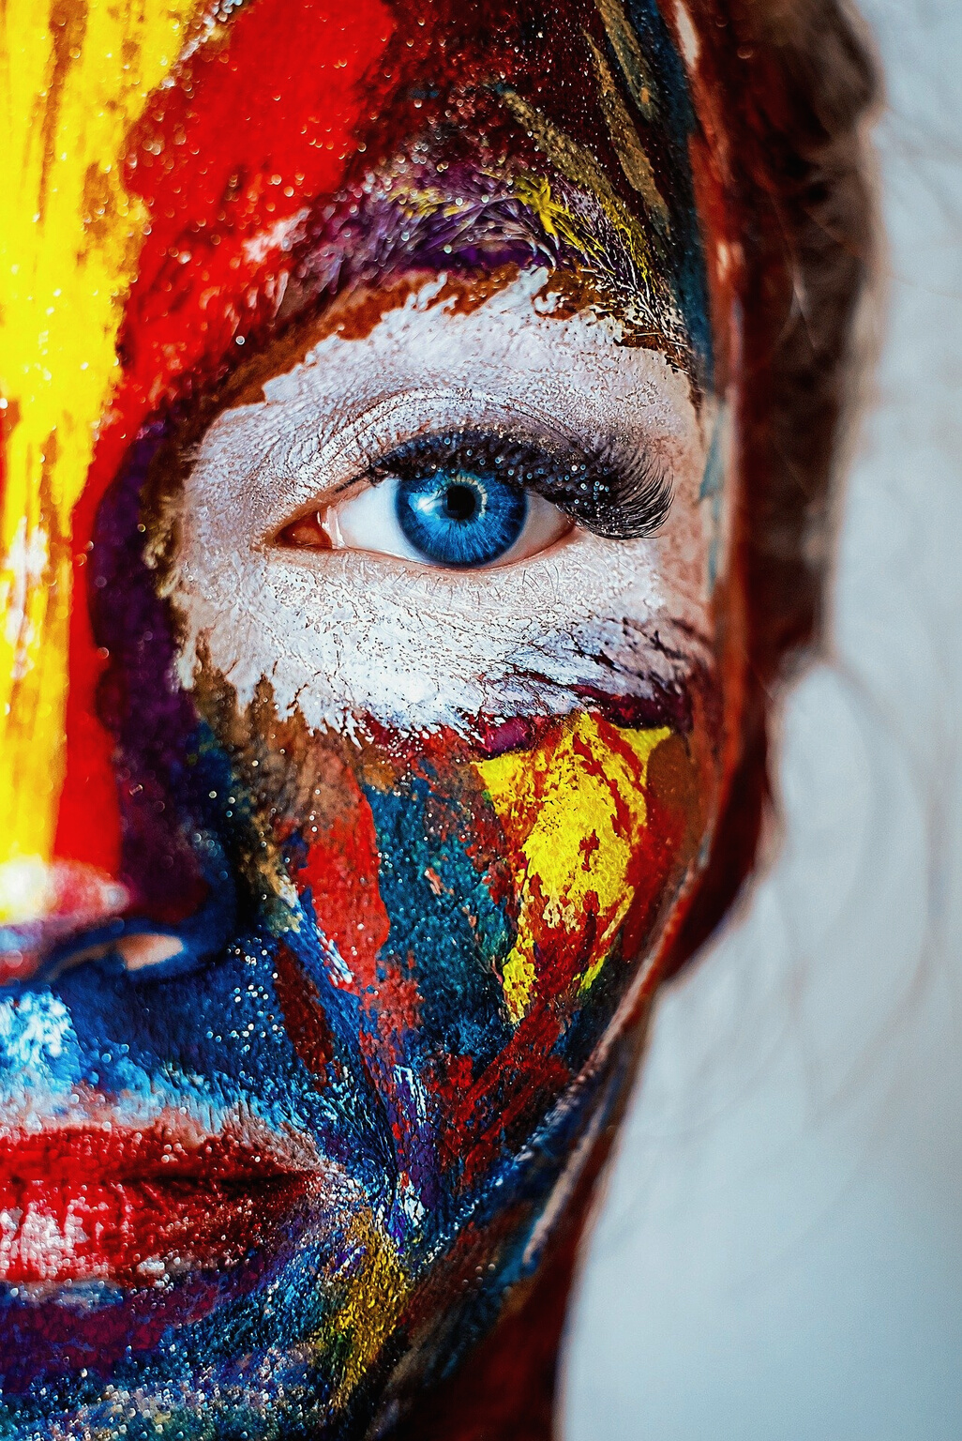
In this activity
Compare and contrast artistic practices across societies
How are societal complexity, subsistence, and artistic symmetry related?
Read and interpret ethnographic data in eHRAF World Cultures
Topics We'll Cover

Slide 3
ART & ANTHROPOLOGY

Slide 4
This workbook is based on the Explaining Human Culture (EHC) summary on Art
by
Carol R. Ember, Abbe McCarter, and Jack Dunnington
https://hraf.yale.edu/ehc/summaries/art
You may wish to read the EHC summary to learn more about artistic creation, performance, and culture before you begin.

Slide 5
All societies have some form of art.
People around the world find all kinds of ways to express themselves creatively, such as decorating their bodies, painting, carving, telling stories, singing, dancing, and playing music.
Art is not just a way for individuals to express themselves. It is also a cultural product.
Did you know?

Slide 6
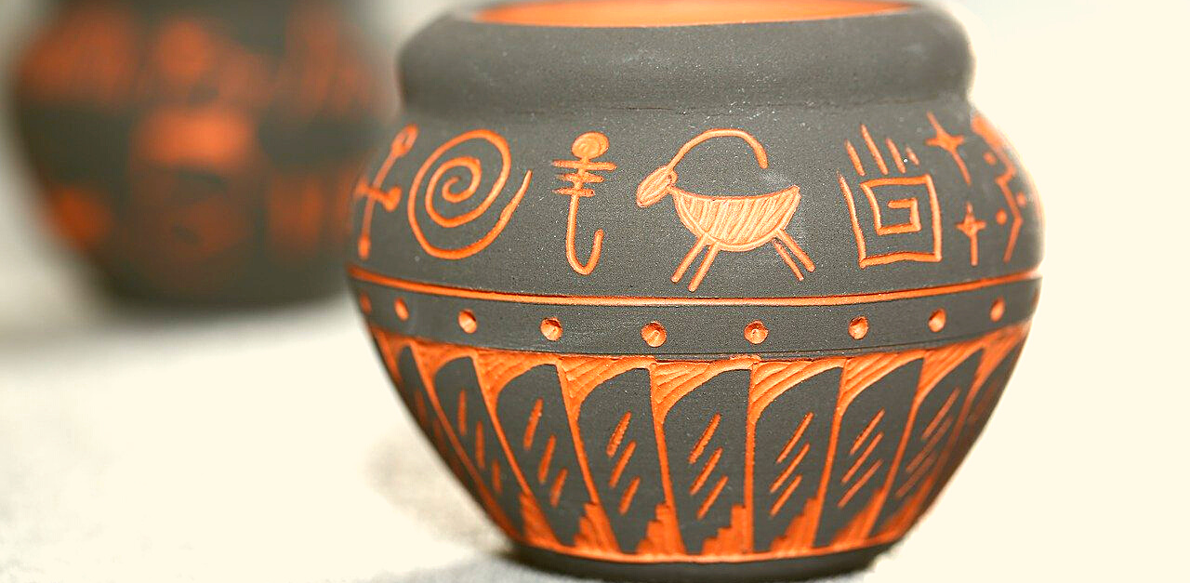
Art &
Society
The different ways that a society organizes itself can have far-reaching impacts in other cultural areas. Variation in degree of stratification or type of subsistence activity, for instance, appear to be related to characteristics of creativity in art.

Slide 7
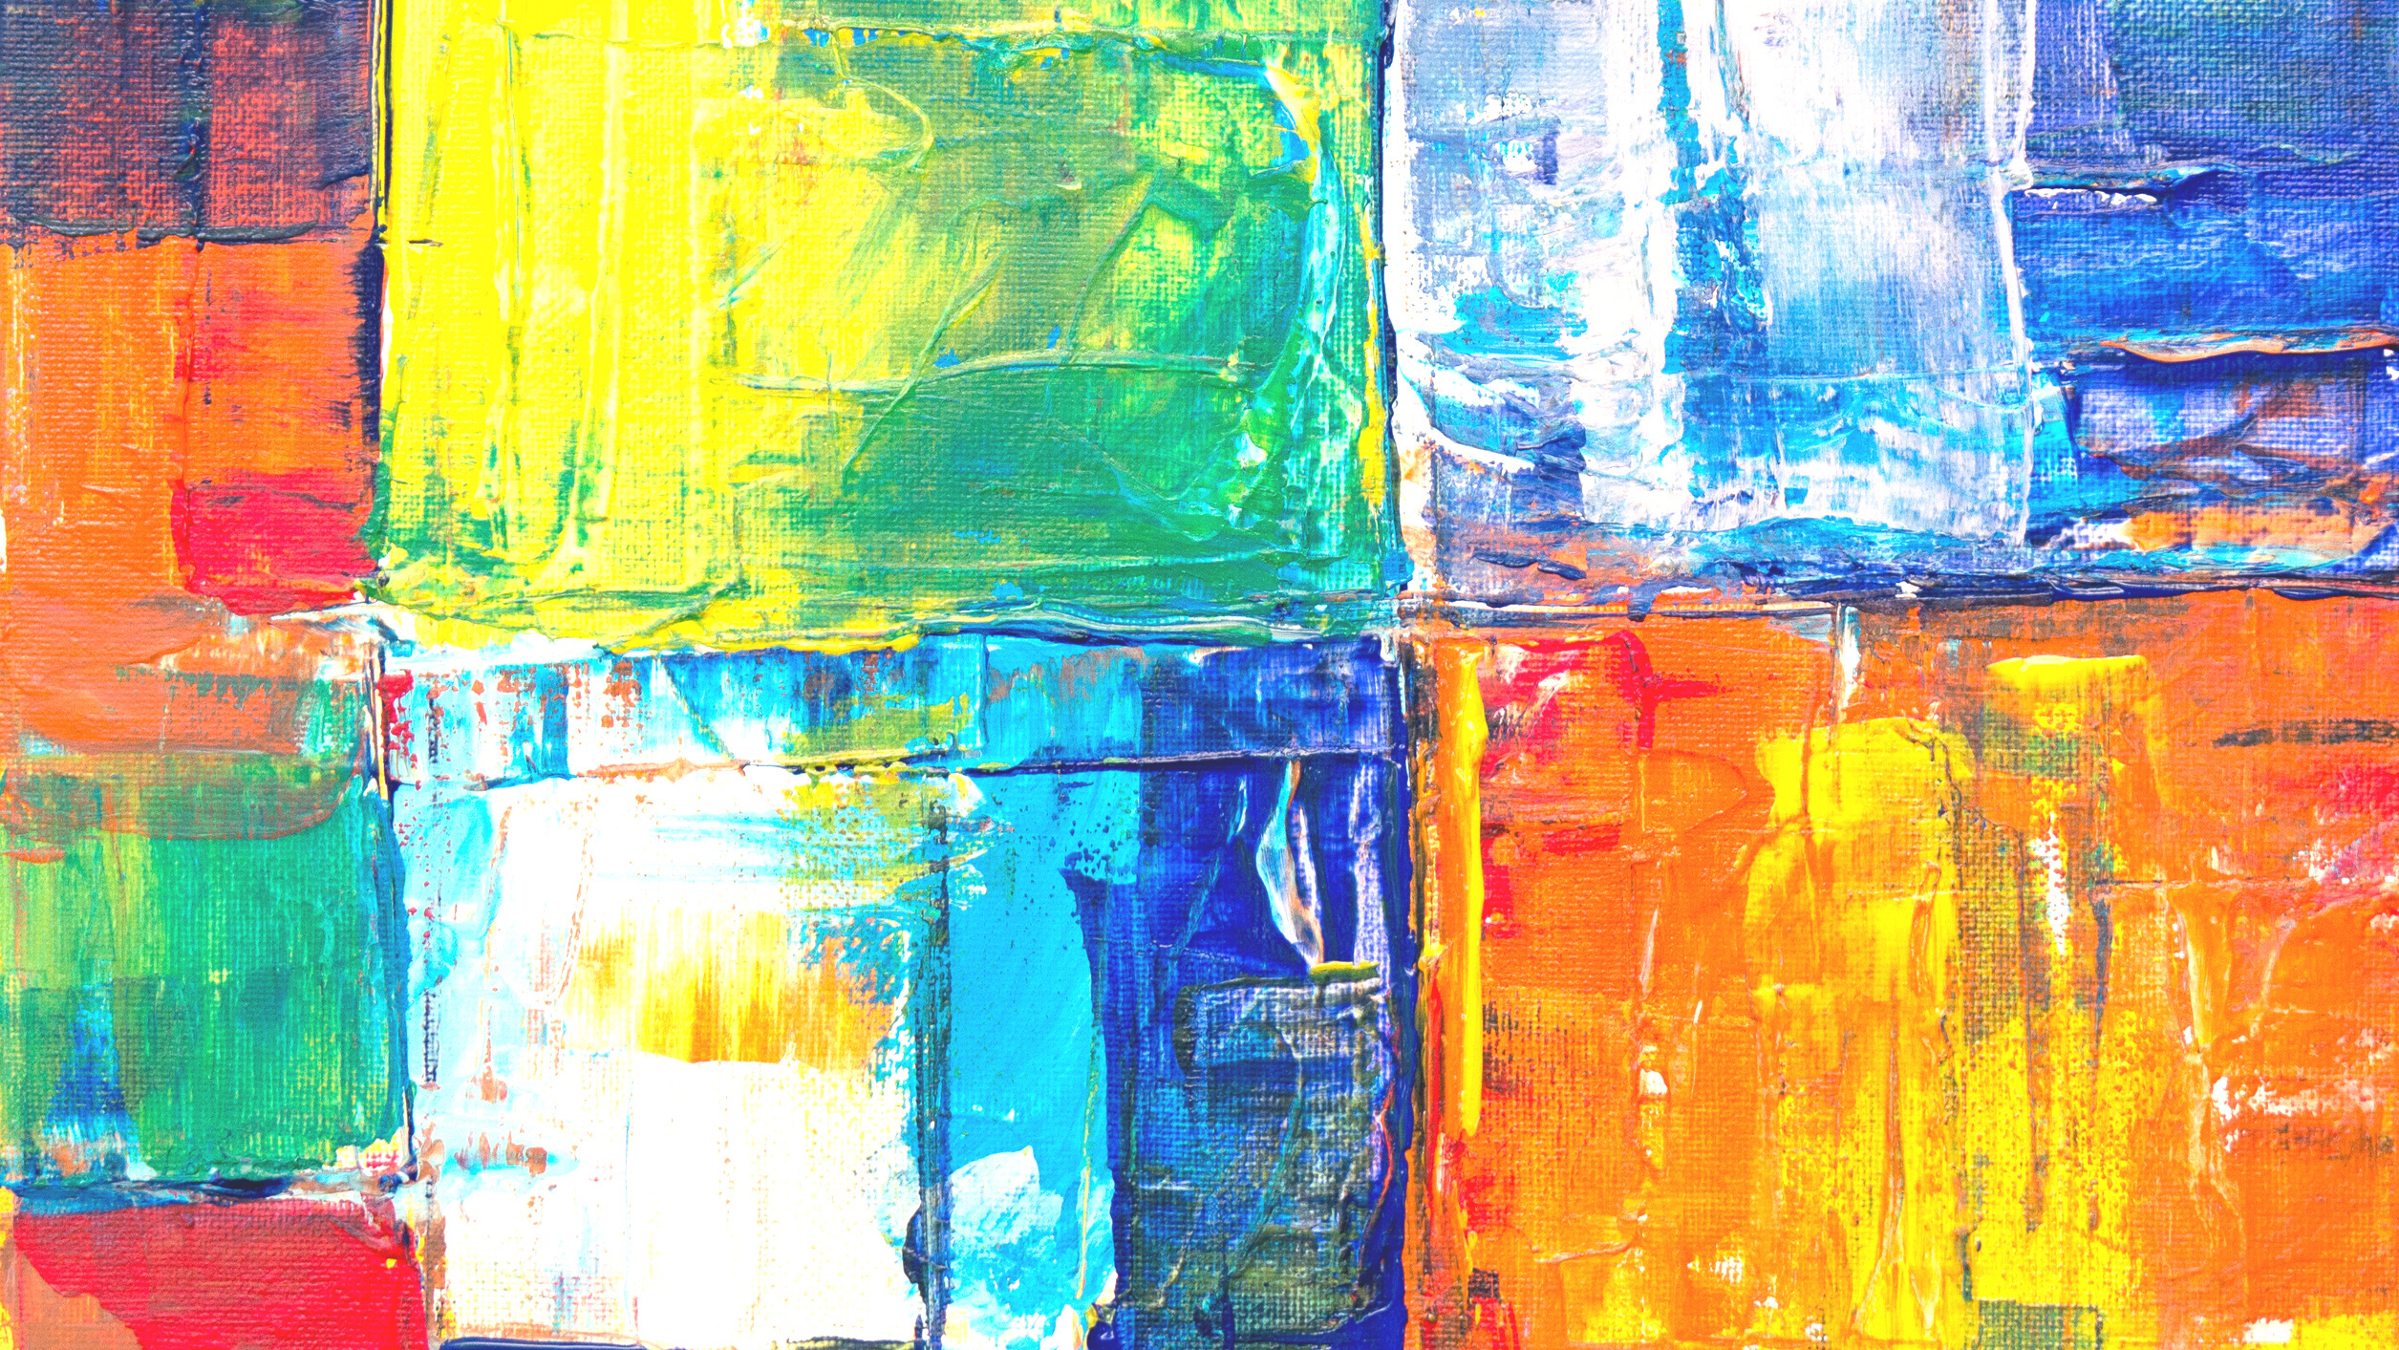
eHRAF Workbook
ACTIVITY 1
compare and contrast types of art

Slide 8
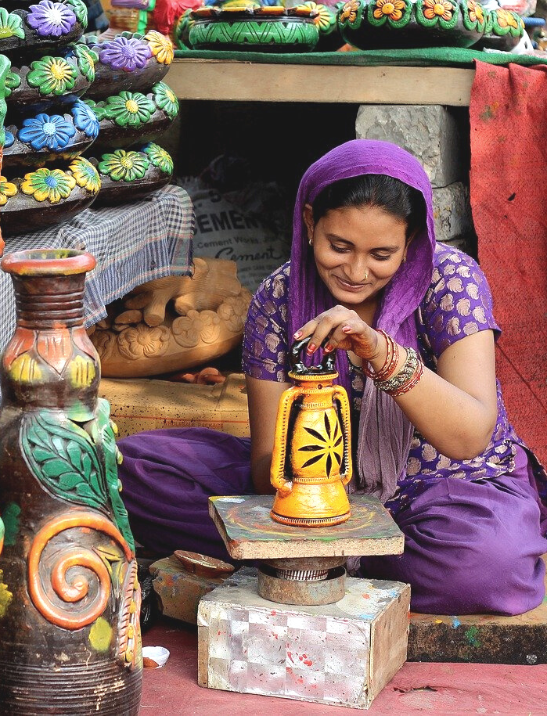
1. ART & CULTURE
Art can vary drastically across societies. This activity will explore how and why artistic practices may differ, and what commonalities they share.
In eHRAF World Cultures, view the following documents. Read the passages indicated, then answer these questions:
How do these societies compare in terms of who creates art?
Is it a communal practice or restricted to specialists?
What distinctions determine who may be an artist? (e.g. gender, training, social status, type of designs)

Slide 9
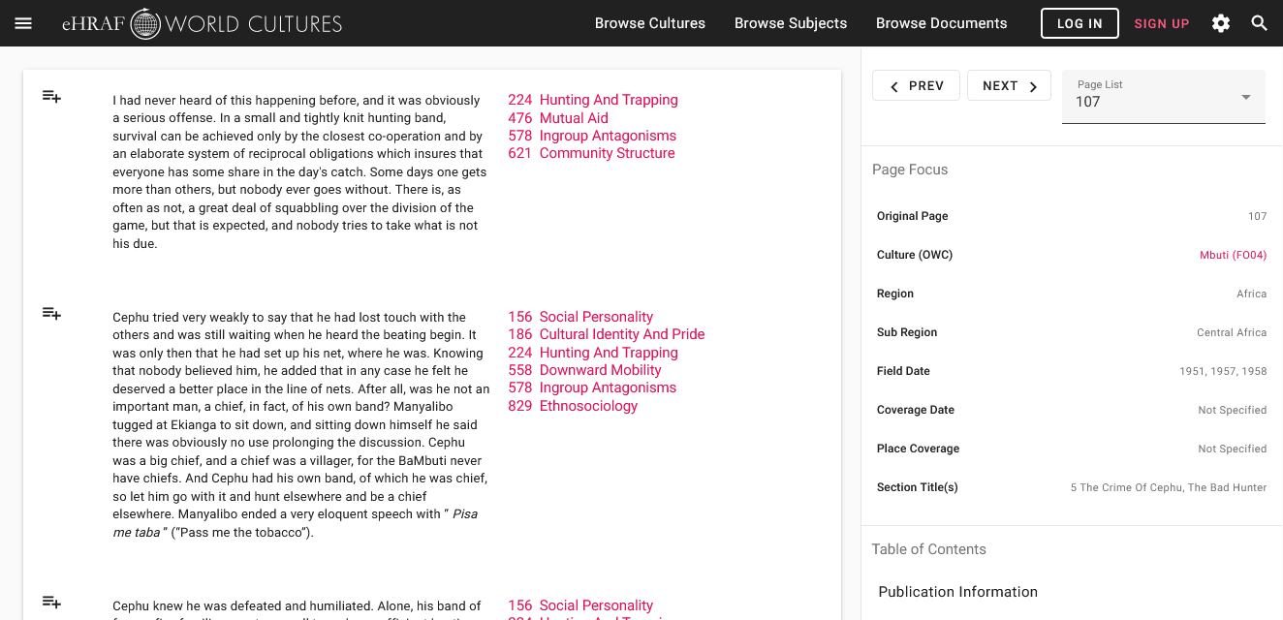
To read pages in eHRAF:
INSTRUCTIONS
First, follow the permalinks provided in the activities below to get to the relevant documents.
For example:
🌐
https://ehrafworldcultures.yale.edu/document?id=fo04-003
Then, use the Page List dropdown menu to navigate to the required page(s).

Slide 10
Finding pages without permalinks
INSTRUCTIONS
Follow these steps if you are having trouble with permalinks from off campus while using a proxy or VPN service, or if you have been provided with a HRAF-issued username and password.
Sign in via your library proxy or VPN, or using the HRAF-issued credentials.
Go to the Browse Documents tab.
Enter the author's name or document title into Search Document List box.
Click on the required title to access the document, then select the page number from the Page List dropdown menu as shown above.

Slide 11
1. ART & CULTURE
Read the following passages:
Blackfoot (NF06)
John Ewers: Blackfeet Crafts - pages 15-16 and 19-27
🌐 https://ehrafworldcultures.yale.edu/document?id=nf06-041
Balinese (O507)
Miguel Covarrubias: Island of Bali - pages 161-164
🌐 https://ehrafworldcultures.yale.edu/document?id=of07-002
Azande(FO07)
E. E. Evans-Pritchard: The Dance - "patterns of the dance" on pages 451-453(1) to 453-454(1)
🌐 https://ehrafworldcultures.yale.edu/document?id=fo07-006

Slide 12
1. ART & CULTURE
Read the following passages:
Hausa (MS12)
Fremont Besmer: Horses, musicians & gods: the Hausa cult of possession-trance
- pages 44, 57-58, and 150
🌐 https://ehrafworldcultures.yale.edu/document?id=ms12-021
Ojibwa (NG06)
Ruth Landes: The Ojibwa Woman - page 129
🌐 https://ehrafworldcultures.yale.edu/document?id=ng06-008
Laura Peers: The Ojibwa of Western Canada, 1780 to 1870 - page 58
🌐 https://ehrafworldcultures.yale.edu/document?id=ng06-036

Slide 13
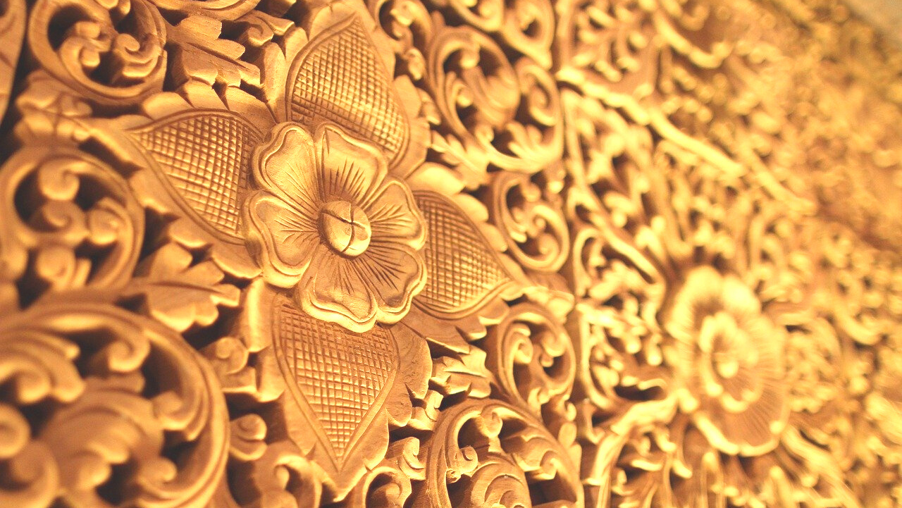
ART & SOCIETAL COMPLEXITY

Slide 14
Exploring Cross-Cultural Findings
trends based on degree of societal complexity
One of Fischer’s (1961) findings is an association between the complexity of a society and the degree of symmetry in art.
He argues that visual art from egalitarian societies will tend to be more repetitive as well as symmetrical in composition compared with art from stratified societies.

Slide 15
Egalitarian societies lack significant status differences between members and value sameness; whereas stratified societies value hierarchy and differentiation.
Assuming that artists reflect society in their work, the art in egalitarian societies would more likely have symmetrical compositions and/or a repetition of similar elements, analogous to the majority of people sharing a similar status.
Conversely, asymmetrical compositions, like the hierarchical societies that tend to produce them, have considerable differentiation and imbalances of power which may be reflected in asymmetry of design.
Why?

Slide 16
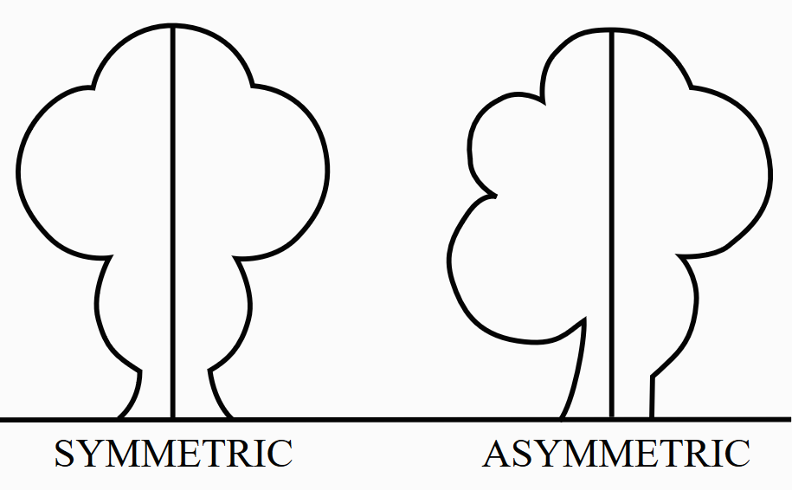
What is symmetry?
A design is symmetrical if, drawing an imaginary line down the middle of the visual field, everything to the left of the line is perfectly reflected on the right.
Asymmetry refers to the absence of this property.

Slide 17
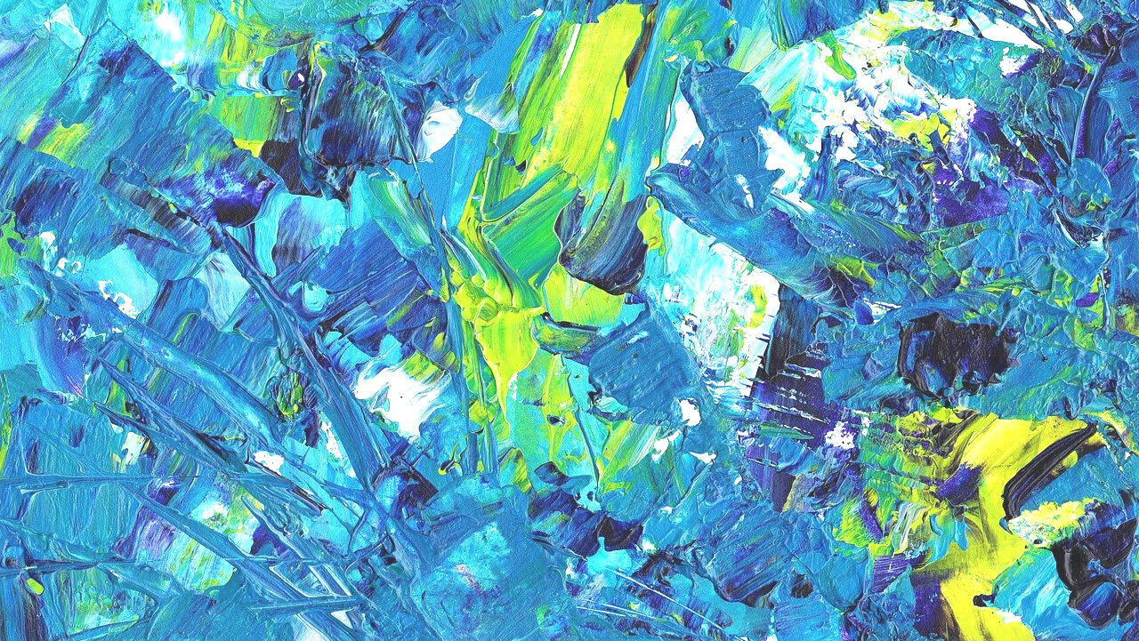
eHRAF Workbook
ACTIVITY 2
symmetry and subsistence

Slide 18
2. SYMMETRY & SUBSISTENCE
One of the major determinants of social complexity is subsistence type. Using this distinction, we may then pose the question:
Is asymmetry more frequent among agriculturalists than hunter-gatherers?
Let's look for answers in the eHRAF World Cultures database:
🌐https://ehrafworldcultures.yale.edu/

Slide 19
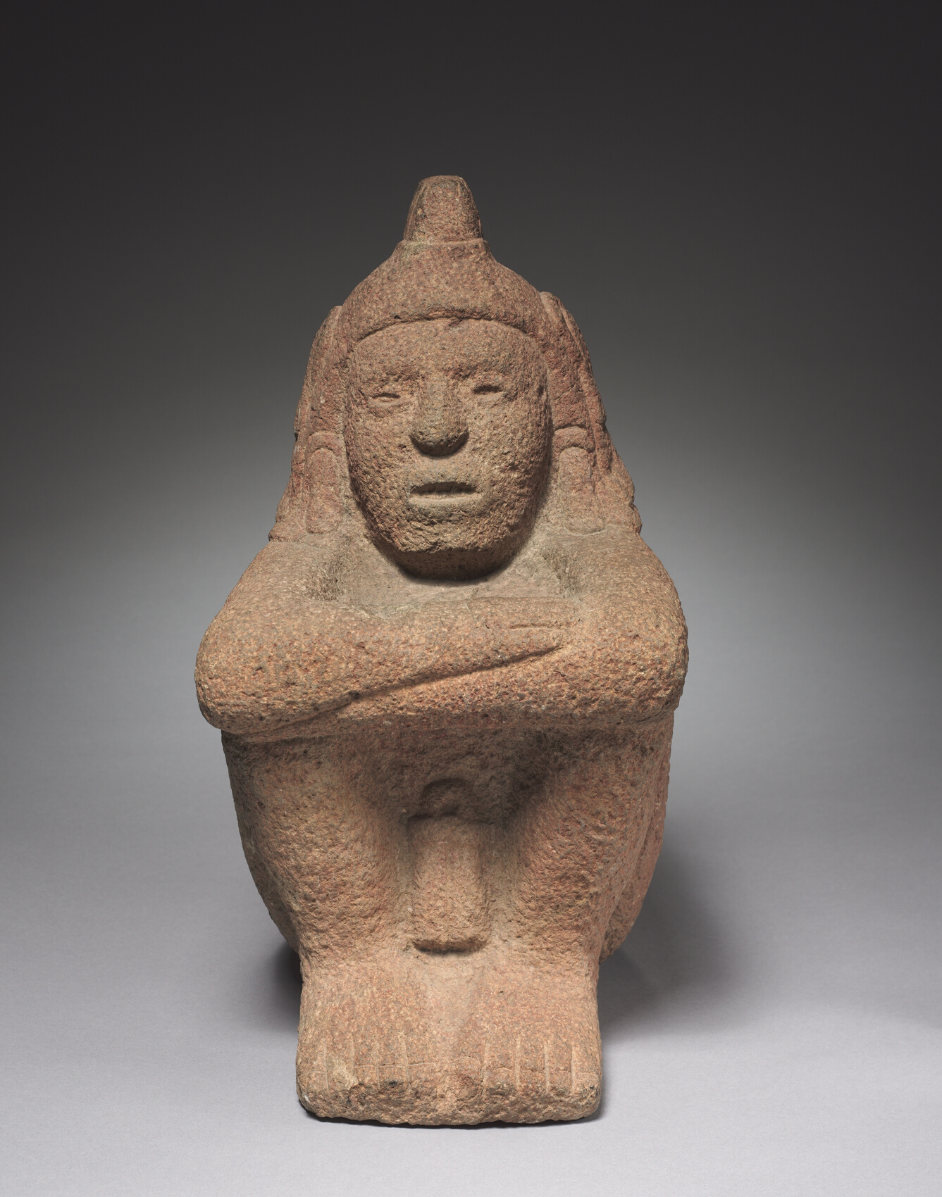
2. SYMMETRY & SUBSISTENCE
In this workbook activity, you will:
conduct an Advanced Search in eHRAF World Cultures
look for thumbnails of images in your search results
(Hint: for the Amhara, view Young’s work; for Haitians, view Courlander; for Mescalero Apache, view Farrer; for Zuni, view Harden; and for Tehuelche, view Lothrup)

Slide 20
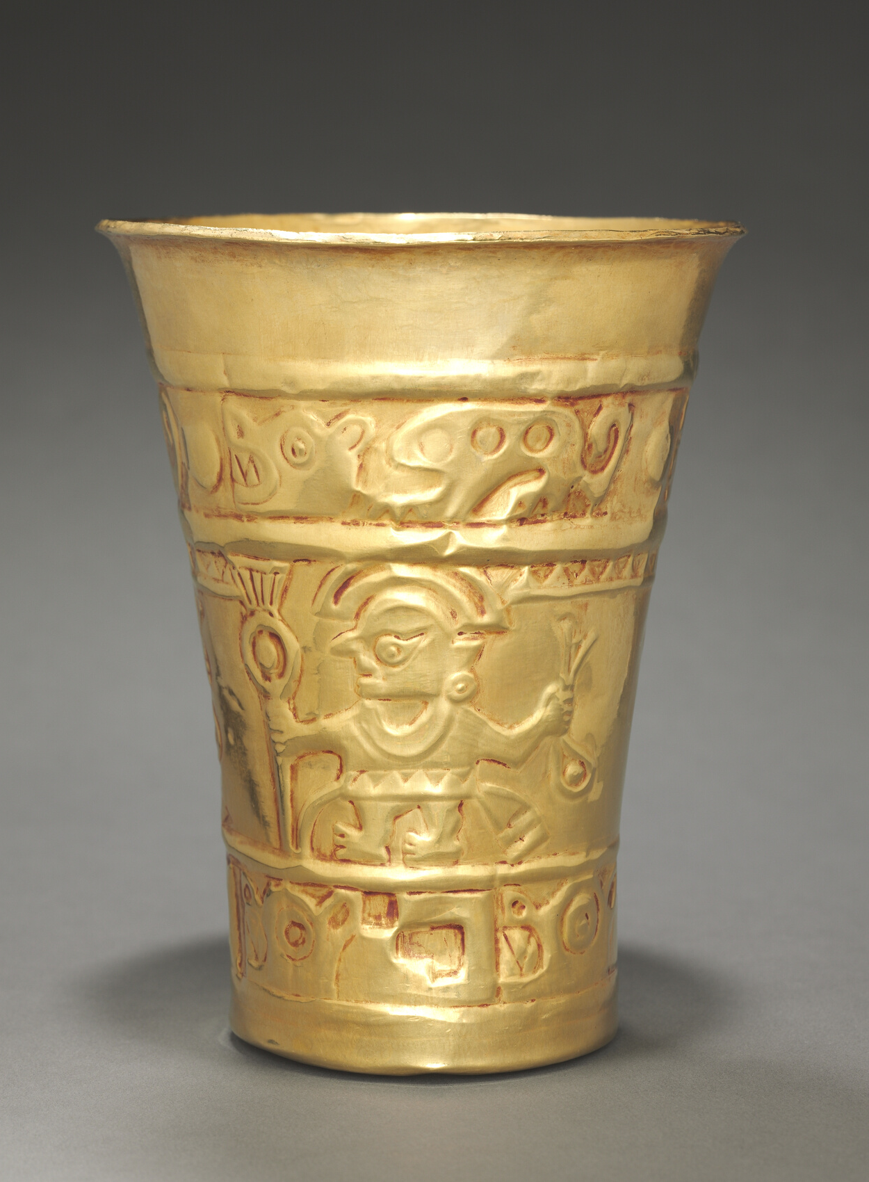
2. SYMMETRY & SUBSISTENCE
Try to evaluate whether designs are mostly symmetrical or mostly asymmetrical in the different cultures
(Hint: if the object is lying down, but is supposed to be upright, try to imagine it upright)
sort your ethnographic findings into a table
evaluate whether or not your results conform to Fischer's proposed relationship between social complexity and asymmetry

Slide 21
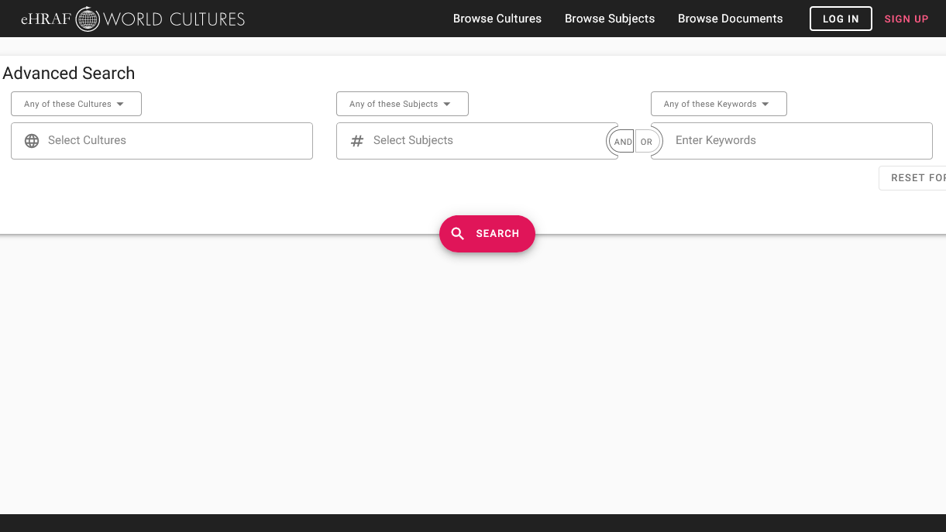
2. SYMMETRY & SUBSISTENCE
Add 5 cultures:
Haitians, Mescalero Apache, Mi'kmaq, Zuni, and Tehuelche
Add 3 subjects:
Decorative art (531),
Visual arts (5311) and Representative Art (532)

Slide 22
2. SYMMETRY & SUBSISTENCE
FILTER YOUR RESULTS
In order to separate the intensive agriculturalist culture results from hunter-gatherers, click "Filters", then check the box for "Intensive Agriculturalists" or "Hunter-Gatherers".

Slide 23
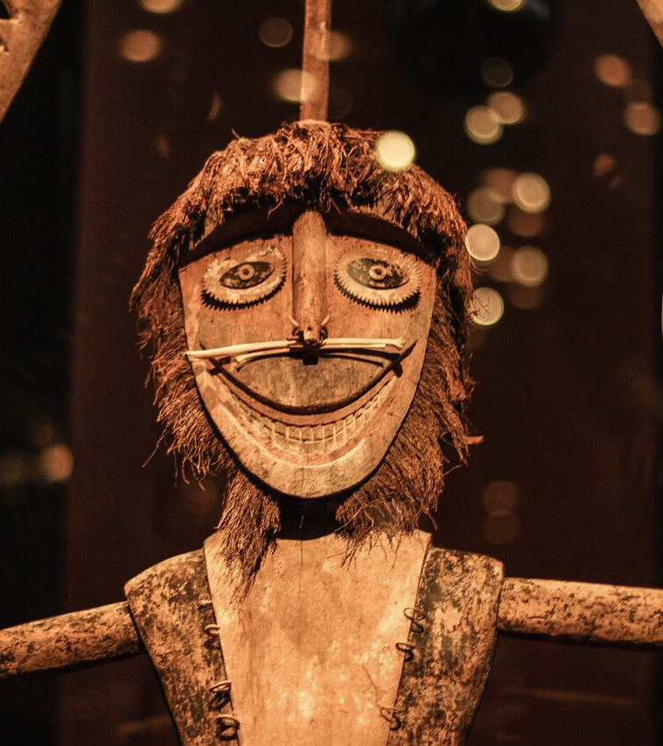
2. SYMMETRY & SUBSISTENCE
Browse the ethnographic documents for each society, paying special attention to the images of art.
When you look at the designs, separate those representing the human face (i.e. masks), because they tend to be symmetrical.
After you have finished looking at the collection of documents for a society, judge whether the artists used mostly symmetrical or asymmetrical designs, and record your evaluation in the table below.
read and interpret ethnographic data

Slide 24
Culture Name
Subsistence Type
Symmetrical?
Page Citation
Haitians
Apache (Mescalero)
Mi’kmaq
Tehuelche
Zuni

Slide 25
2. SYMMETRY & SUBSISTENCE
Now that the table is complete:
Do your results appear to conform to Fischer’s proposed relationship between complexity and asymmetry?
Are there any cases that are ambiguous or otherwise difficult to code? Why do you think this might be?
Are there confounding variables at play that might be skewing the results?
Are there differences by type of art (e.g., masks, baskets, etc.)?
Are there different time periods represented, and if so, how does the art differ between periods?
FINAL QUESTIONS

Slide 26
1. This activity was adapted in part from Art (Explaining Human Culture), by Carol R. Ember and Abbe McCarter, in Teaching eHRAF. https://hraf.yale.edu/teach-ehraf/art-explaining-human-culture/
2. Besmer, Fremont E. 1983. Horses, Musicians & Gods: The Hausa Cult Of Possession-Trance. South Hadley, Mass.: Bergin & Garvey Publishers. https://ehrafworldcultures.yale.edu/document?id=ms12-021.
3. Covarrubias, Miguel. 1938. Island Of Bali New York: Alfred A. Knopf. https://ehrafworldcultures.yale.edu/document?id=of07-002.
References
4. Ember, Carol R., Abbe McCarter, and Jack Dunnington. 2019. "Art", In C. R. Ember, ed. Explaining Human Culture. Human Relations Area Files http://hraf.yale.edu/ehc/summaries/art.
5. Evans-Pritchard, E. E. 1928. The Dance. Africa. London: Oxford University Press. https://ehrafworldcultures.yale.edu/document?id=fo07-006.
6. Ewers, John Canfield. 1945. “Blackfeet Crafts”, Indian Handcrafts. Lawrence, Kan.: United States Indian Service. https://ehrafworldcultures.yale.edu/document?id=nf06-041.
7. Fischer, John L. 1961. "Art Styles as Cultural Cognitive Maps", American Anthropologist 63 (1): 79–93. https://doi.org/10.1525/aa.1961.63.1.02a00050.

Slide 27
8. Landes, Ruth. 1938. The Ojibwa Woman. New York: Columbia University Press. https://ehrafworldcultures.yale.edu/document?id=ng06-008.
9. Peers, Laura L. 1994. "Ojibwa Of Western Canada, 1780 To 1870." Manitoba Studies In Native History. St. Paul: Minnesota Historical Society Press. https://ehrafworldcultures.yale.edu/document?id=ng06-036.
References

Slide 28
Art
&
Society
in eHRAF World Cultures
Produced by
Human Relations Area Files
at Yale University
An eHRAF Workbook Activity
hraf.yale.edu

