Slide 1
An eHRAF Workbook Activity
Burial Practices:
Animals & Humans
Human Relations Area Files
at Yale University

Slide 2
In this activity
Learn about burial practices with animals and humans
Read passages from traditions covered in eHRAF Archaeology
Compare & contrast traditions
Write a research paper using a comparative approach
Topics We'll Cover

Slide 3
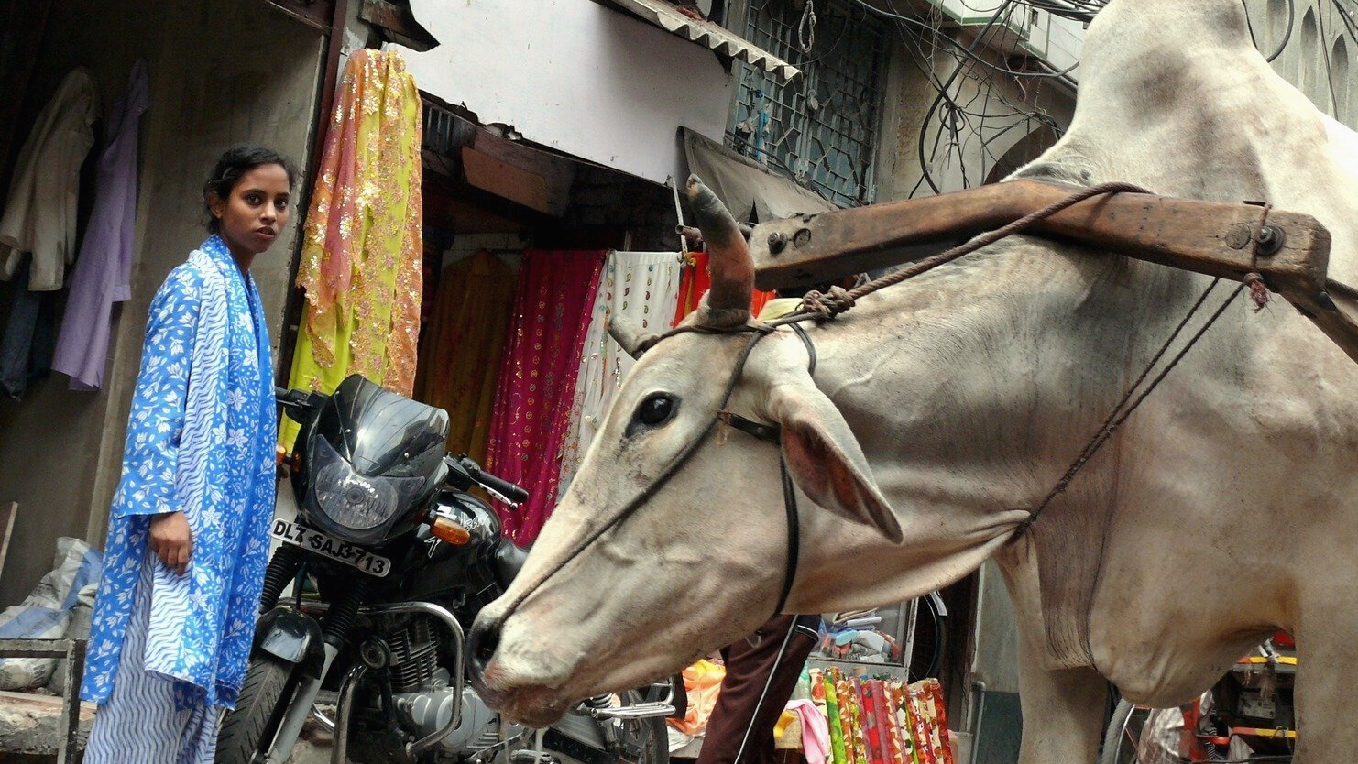
BURIAL PRACTICES:
ANIMALS & HUMANS

Slide 4
Animals & Humans
Human burials often contain remains of different types of animals such as wolves, dogs, cats, bison, sheep, pigs, antelopes, goats, horses, etc.
For example, if a person had a favorite pet, such as a dog or a wolf, the canine was buried with its deceased master to accompany the master on the journey into the afterlife.

Slide 5
To get started, review these videos about ancient burial practices with animals:
Anthropology 101 | The Science of the Human Species Explained (With Dogs!)
Why Did Ancient Egyptians Mummify Cats?
How Dogs (Eventually) Became Our Best Friends
How We Domesticated Cats (Twice)

Slide 6
Articles about animals and humans
Burying key evidence: the social bond between dogs and people
The early evolution of the domestic dog
These may be the world’s first images of dogs—and they’re wearing leashes
Prehistoric cemetery reveals man and fox were pals

Slide 7
More articles about animals and humans
Archaeologists have unearthed an ancient Egyptian pet cemetery
Man’s best friend might be a dog, but a dog’s best friend might be a woman
Ancient pets got proper burials
Is this 2,000-year-old Egyptian burial site the world’s oldest pet cemetery?

Slide 8
eHRAF Workbook
Part 1: Tradition Summaries

Slide 9
Tradition Summaries
A brief overview for traditions in eHRAF Archaeology is provided in the form of Tradition Summaries.
The format, general outline, and headings are the same for each summary. You will find a basic overview about the tradition, such as its time period, location, history, environment, and sociopolitical organization.
eHRAF
Archaeology
To find a tradition summary, go to the Browse Traditions tab and enter the tradition name into the box, then click on Tradition Summary below the tradition name to read it.

Slide 10
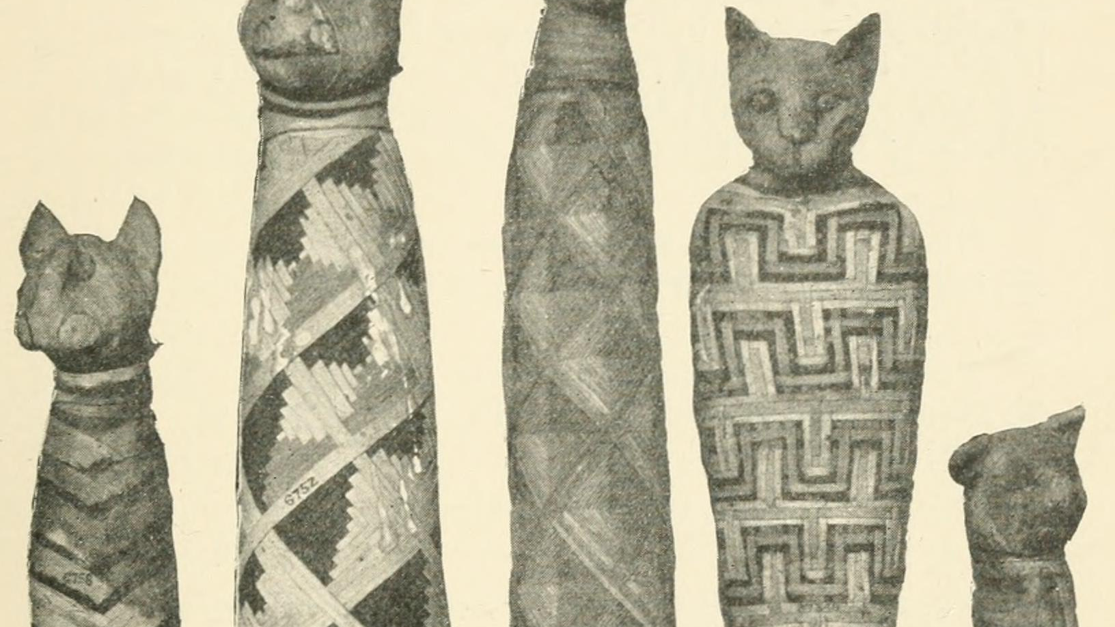
eHRAF Workbook
Part 2: Selected Readings

Slide 11
To read documents or pages in eHRAF:
INSTRUCTIONS
First, follow the permalinks provided in the activities below to get to the relevant documents.
For example:
🌐
https://ehrafarchaeology.yale.edu/document?id=nt76-001
Then, use the Page List dropdown menu to navigate to the required page(s).

Slide 12
Finding documents without permalinks
INSTRUCTIONS
Follow these steps if you are having trouble with permalinks from off campus while using a proxy or VPN service, or if you have been provided with a HRAF-issued username and password.
Sign in via your library proxy or VPN, or using the HRAF-issued credentials.
Go to the Browse Documents tab.
Enter the author's last name into the Filter Index box.
Click on the required title to access the document, then select the page number from the Page List dropdown menu as shown above.

Slide 13
Four Traditions
eHRAF Archaeology allows you to compare and contrast the same subject across different archaeological traditions.
For this workbook activity, start by learning about burial practices with animals across four different archaeological traditions.
On the following slide, you will find a table listing:
Tradition
Animal
Author
Document
Four Traditions

Slide 15
Four Traditions
After you have reviewed the four documents listed on previous slide, make some brief notes summarizing what you have learned about burial practices with animals.
On the following slide, you will find a sample table that you can fill out. Remember to note the page numbers where you found the information and provide a brief description of burial practices involving animals.
Four Traditions

Slide 17
The Dawenkou
Tradition in China
Read the Dawenkou (AF50) tradition summary.
https://ehrafarchaeology.yale.edu/document?id=af50-000
🌐
Read Underhill's chapter on "Display of Status" in "An Analysis of Mortuary Ritual at the Dawenkou Site, Shandong, China".
https://ehrafarchaeology.yale.edu/document?id=af50-002
🌐

Slide 18
The Dawenkou
Tradition in China
Anne Underhill suggests that pigs found in Dawenkou burials in China may signify high status. There are many debates about the meaning of pig bones in Dawenkou Culture graves, with most scholars interpreting them as items for exchange as pigs were considered a kind of "movable wealth".

Slide 19
The Early Dynastic Egypt Tradition (MR70)
Read the Early Dynastic Egypt Tradition (MR70) tradition summary.
https://ehrafarchaeology.yale.edu/document?id=mr70-000
🌐
Read the section "Den" (pages 75-77) Wilkinson(1999) Early Dynastic Egypt.
https://ehrafarchaeology.yale.edu/document?id=mr70-006
🌐

Slide 20
The Early Dynastic Egypt Tradition (MR70)
Mafdet was the first known cat-headed deity in ancient Egypt. During the First Dynasty, she was regarded as protector of the pharaoh's chambers against snakes, scorpions, and evil. According to Wilkinson, "The fierce feline goddess Mafdet — probably a royal protectress — is unusually prominent" in burial sites.

Slide 21
The Ganges Neolithic Tradition in India
Read the Ganges Neolithic (AQ50) tradition summary.
https://ehrafarchaeology.yale.edu/document?id=aq50-000
🌐
Read the subchapter "Burials" in Sinha (1994) Archaeological and cultural history of north Bihar: with special reference to Neolithic-Chirand.
https://ehrafarchaeology.yale.edu/document?id=aq50-006
🌐

Slide 22
The Ganges Neolithic Tradition in India
The chapter from Sinhas titled "Burials" in "Archaeological and cultural history of north Bihar: with special reference to Neolithic-Chirand" supports the aforementioned idea that a dog is often buried alongside its master.

Slide 23
The Scythian Tradition in West-Central Asia
Read the Scythian-Sarmatian (MA51) tradition summary.
https://ehrafarchaeology.yale.edu/document?id=ma51-000
🌐
Read the chapter "Death and burial" in Rolle (1989) The World of the Scythians.
https://ehrafarchaeology.yale.edu/document?id=ma51-002
🌐

Slide 24
The Scythian Tradition in West-Central Asia
In some large Scythian burial chambers, the skeletons of more than 150 horses were unearthed. The horses found in the Scythian burials may indicate the wealth and status of an individual.

Slide 25
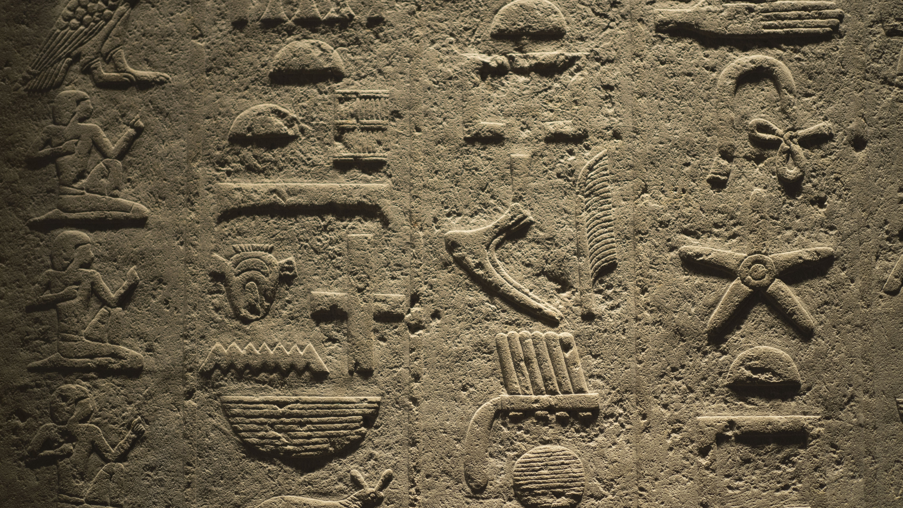
In this activity, you will ual relations across the globe.
eHRAF Workbook
Part 3: Advanced Search

Slide 26
Part 3:
Advanced Search
Now that you have read selected passages from eHRAF Archaeology, dig deeper with Advanced Search. This will enable you to find specific passages in documents that have been indexed by HRAF anthropologists at the paragraph level.
On the following slides, you will find an example of an advanced search. Try this search and then experiment with different subjects and/or keywords. Conducting searches and reviewing results will prepare you to do your own research in Part 4.

Slide 27
Part 3:
Advanced Search
In the Add Traditions column, select the tradition: Dawenkou (AF50)
In the Add Subjects column, select the following subject categories:
Burial practices and funerals (764)
Special burial practices and funerals (766)
In the Keyword section, type pig*.

Slide 28
ADVANCED SEARCH
Add subjects:
Burial practices and funerals (764), Special burial practices and funerals (766)
Add tradition:
Dawenkou (AF50)
Add keyword:
pig*

Slide 29
SEARCH RESULTS

Slide 30
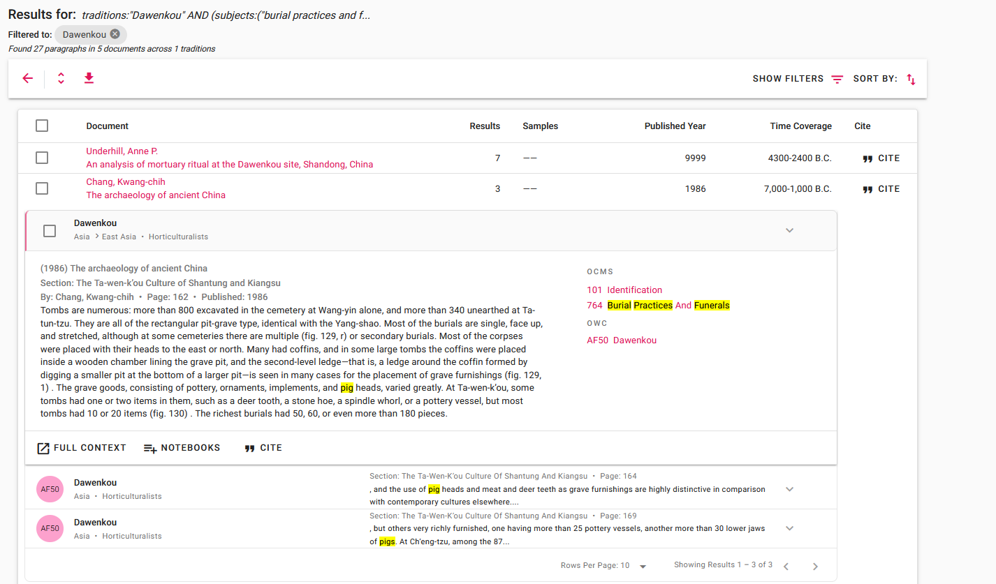
SEARCH RESULTS
Click "Full Context" to view the paragraph in the full page context

Slide 31
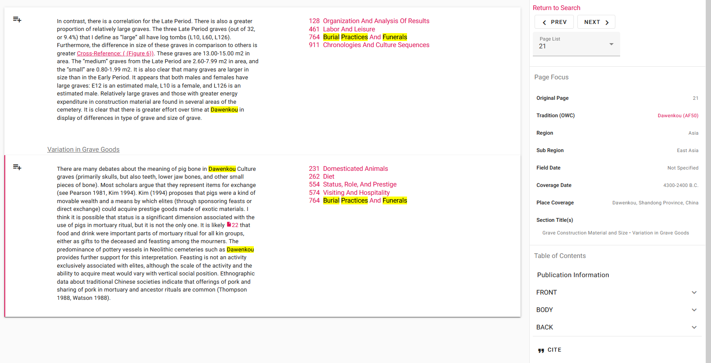
FULL CONTEXT

Slide 32
eHRAF Workbook
Part 4: Assignment

Slide 33
Essay Assignment
eHRAF Archaeology has numerous descriptions of archaeological sites with the remains of animals in human burials.
Select any 3 archaeological traditions from 3 different regions. Write an essay in which you compare and contrast these traditions. Make sure to include the following information:
Name of the tradition and region
Describe the burial context - e.g., are the animals associated with pottery vessels, stone tools, human skeletons?
Are there any ritualistic practices?

Slide 34
This activity was adapted from "Burial Practices: An eHRAF workbook for introductory archaeology courses", Christiane Cunnar, in Teaching eHRAF.
Underhill, Anne P. An Analysis of Mortuary Ritual at the Dawenkou Site, Shandong, China. https://ehrafarchaeology.yale.edu/document?id=af50-002.
Wilkinson, Toby A. H. 1999. Early Dynastic Egypt. London: Routledge. https://ehrafarchaeology.yale.edu/document?id=mr70-006.
References
Sinha, Harendra Prasad. 1994. “Archaeological and Cultural History of North Bihar: With Special Reference to Neolithic-Chirand.” In Heritage of Ancient India, i – x, 1–26, 73–139 , plates. New Delhi: Ramanand Vidya Bhawan. https://ehrafarchaeology.yale.edu/document?id=aq50-006.
Rice, Tamara Talbot. 1957. “The Sycthians.” In Ancient People and Places, 255. New York: F. A. Praeger. https://ehrafarchaeology.yale.edu/document?id=ma51-001..

Slide 35
Dawenkou pig-shaped gui, BabelStone, CC BY-SA 3.0, via Wikimedia Commons:
https://commons.wikimedia.org/wiki/File:Dawenkou_pig-shaped_gui.jpg
Ancient Egyptian bronze cat, British Museum, via Wikimedia Commons:
https://commons.wikimedia.org/wiki/File:Ancient_Egyptian_bronze_cat.jpg
Mafdet pieces, Cnyll, CC BY-SA 4.0,via Wikimedia Commons:
https://commons.wikimedia.org/wiki/File:Mafdet_pieces.jpg
Image Credits
Shiva Bearing the Descent of the Ganges River, Los Angeles County Museum of Art, Public domain, via Wikimedia Commons: https://commons.wikimedia.org/wiki/File
:Shiva_Bearing_the_Descent_of_the_Ganges_River,_folio_from_a_Hindi_manuscript_by_the_saint_Narayan_LACMA_M.86.345.6.jpg
Raja Ravi Varma, Descent of Ganga, Public domain, via Wikimedia Commons:
https://commons.wikimedia.org/wiki/File:Ravi_Varma-Descent_of_Ganga.jpg

Slide 36
Scythian horseman in buff earthenware, Auckland Museum, CC BY 4.0, via Wikimedia Commons: https://commons.wikimedia.org/wiki/File:
Figure,_horse_and_rider_(AM_1941.137-1).jpg
A Scythian, Dimitri Pozdniakov, CC BY-SA 4.0, via Wikimedia Commons:
https://commons.wikimedia.org/wiki/File:A_Scythian_(reconstruction_by_Dimitri_Pozdniakov).jpg
Image Credits

Slide 37
Burial Practices:
Animals & Humans
Produced by
Human Relations Area Files
at Yale University
An eHRAF Workbook Activity
hraf.yale.edu

