Slide 1
An eHRAF Workbook Activity
Burial Practices:
Introduction
Human Relations Area Files
at Yale University

Slide 2
In this activity
Learn about burial practices in the archaeological record
Read passages from traditions covered in eHRAF Archaeology
Answer specific questions about each tradition
Compare & contrast traditions
Topics We'll Cover

Slide 3
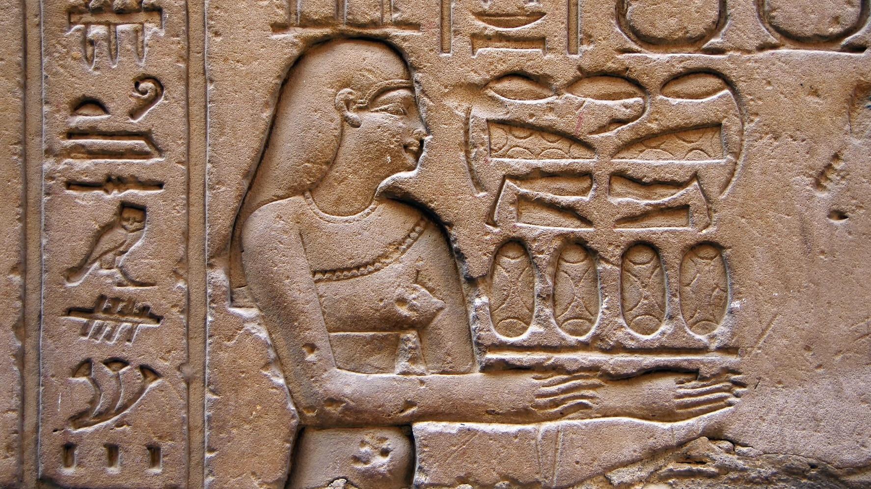
BURIAL PRACTICES
IN PREHISTORY

Slide 4
Compare and Contrast
In this activity, you will compare and contrast prehistoric burial practices found in Asia, Oceania, and North America.
Read passages from eHRAF Archaeology, then answer the questions that follow.
As you read about burial practices, consider:
the level of socio-political and economic complexity of each society
the role that the environment plays in determining burial practices

Slide 5
To read documents or pages in eHRAF:
INSTRUCTIONS
First, follow the permalinks provided in the activities below to get to the relevant documents.
For example:
🌐
https://ehrafarchaeology.yale.edu/document?id=nt76-001
Then, use the Page List dropdown menu to navigate to the required page(s).

Slide 6
Finding documents without permalinks
INSTRUCTIONS
Follow these steps if you are having trouble with permalinks from off campus while using a proxy or VPN service, or if you have been provided with a HRAF-issued username and password.
Sign in via your library proxy or VPN, or using the HRAF-issued credentials.
Go to the Browse Documents tab.
Enter the author's last name into the Filter Index box.
Click on the required title to access the document, then select the page number from the Page List dropdown menu as shown above.

Slide 7
Tradition Summaries
A brief overview for traditions in eHRAF Archaeology is provided in the form of Tradition Summaries.
The format, general outline, and headings are the same for each summary. You will find a basic overview about the tradition, such as its time period, location, history, environment, and sociopolitical organization.
eHRAF
Archaeology
To find a tradition summary, go to the Browse Traditions tab and enter the tradition name into the box, then click on Tradition Summary below the tradition name to read it.

Slide 8
The Scythian Tradition in West-Central Asia
Read the Scythian-Sarmatian (MA51) tradition summary.
https://ehrafarchaeology.yale.edu/document?id=ma51-000
🌐
Read the chapter "Death and burial" in Rolle (1989) The World of the Scythians.
https://ehrafarchaeology.yale.edu/document?id=ma51-002
🌐

Slide 9
The Scythian Tradition in West-Central Asia
Answer the following questions:
What are the burial mounds called in eastern Europe and in the Ukraine?
What precious metal can be found in the graves?
What method of preservation was used for royalty in Scythian times?
What does the height of the burial mound usually indicate?

Slide 10
The Late Southern California Tradition in North America
Read the Late Southern California (NS50) tradition summary.
https://ehrafarchaeology.yale.edu/document?id=ns50-000
🌐
Read the section "Burials" in Arnold (1987) Craft specialization in the prehistoric Channel Islands, California.
https://ehrafarchaeology.yale.edu/document?id=ns50-001
🌐

Slide 11
The Late Southern California Tradition in North America
Answer the following questions:
What are the names of the sites?
What is the place and date coverage for the Late Southern California tradition?
What special items were found at these sites?
What do archaeologists link these special items with?

Slide 12
The Classic Maya Tradition in Eastern Mesoamerica
Read the Classic Maya (NY53) tradition summary.
https://ehrafarchaeology.yale.edu/document?id=ny53-000
🌐
Read the chapter "General Discussion of Burials" in Smith (1950) Uaxactun, Guatemala: excavations of 1931-1937.
https://ehrafarchaeology.yale.edu/document?id=ny53-016
🌐

Slide 13
The Classic Maya Tradition in Eastern Mesoamerica
Answer the following questions:
How does Smith distinguish between a simple grave, cist, crypt, and chamber?
In what two major positions were the skeletons found at Uaxactun?
What two major types of body alterations were performed on the Classic Maya?
What types of ornaments were found as grave goods?

Slide 14
The Hawaiian Tradition in the Major Islands of Hawaii
Read the Hawaiian (OV50) tradition summary.
https://ehrafarchaeology.yale.edu/document?id=ov50-000
🌐
Read the section "Disposal of the Dead" in Kirch (1985) Feathered gods and fishhooks: an introduction to Hawaian archaeology and prehistory.
https://ehrafarchaeology.yale.edu/document?id=ov50-005
🌐

Slide 15
The Hawaiian Tradition in the Major Islands of Hawaii
Answer the following questions:
What different types of burials does Kirch discuss?
According to Kirch, what is the most common form of burial?
Where can the bodies of the deceased be found in house burials?
Who was usually buried in temple burials?

Slide 16
Burial Practices in the Ganges Neolithic Tradition in India
Read the Ganges Neolithic (AQ50) tradition summary.
https://ehrafarchaeology.yale.edu/document?id=aq50-000
🌐
Read the subchapter "Burials" in Sinha (1994) Archaeological and cultural history of north Bihar: with special reference to Neolithic-Chirand.
https://ehrafarchaeology.yale.edu/document?id=aq50-006
🌐

Slide 17
Burial Practices in the Ganges Neolithic Tradition in India
Answer the following questions:
What is the name of the site?
What are the time periods associated with the site?
Why is this site so unique?
Why were no human remains found at the site?

Slide 18
Essay Assignment
Write a short paper (2-3 pages) in which you discuss your findings.
How were the level of social complexity and/or the environment factors in shaping burial practices for each tradition?
What were the most interesting things you learned about the burial practices of these five archaeological traditions?
What similarities and differences did you find in terms of burial practices?

Slide 19
This activity was adapted from "Burial Practices: An eHRAF workbook for introductory archaeology courses", Christiane Cunnar, in Teaching eHRAF.
Arnold, Jeanne E. 1987. “Craft Specialization in the Prehistoric Channel Islands, California.” In University of California Publications in Anthropology, vol. 18: xvii, 278. Berkeley: University of California Press. https://ehrafarchaeology.yale.edu/document?id=ns50-001
Berry, Sarah H. (Archaeologist), and John R. Johnson. 2000. “Tradition Summary: Late Southern California.” New Haven, Conn.: HRAF. https://ehrafarchaeology.yale.edu/document?id=ns50-000.
References
Chattopadhyaya, Umesh. 1999. “Tradition Summary: Ganges Neolithic.” New Haven, Conn.: HRAF. https://ehrafarchaeology.yale.edu/document?id=aq50-000.
Kirch, Patrick Vinton. 1985. Feathered Gods and Fishhooks: An Introduction to Hawaiian Archaeology and Prehistory. Honolulu: University of Hawaii Press.
https://ehrafarchaeology.yale.edu/document?id=ov50
Kolb, Michael. 1999. “Tradition Summary: Hawaiian.” New Haven, Conn.: HRAF. https://ehrafarchaeology.yale.edu/document?id=ov50-000.

Slide 20
Peregrine, Peter N. (Peter Neal). 2000. “Tradition Summary: Scythian-Sarmation.” New Haven, Conn.: HRAF. https://ehrafarchaeology.yale.edu/document?id=ma51-000.
Rolle, Renate, and Gayna Walls. 1989. The World of the Scythians. London: B. T. Batsford. https://ehrafarchaeology.yale.edu/document?id=ma51-002.
Sharer, Robert J., and Sarah Berry. 2000. “Tradition Summary: Classic Maya.” New Haven, Conn.: HRAF. https://ehrafarchaeology.yale.edu/document?id=ny53-000.
References
Sinha, Harendra Prasad. 1994. “Archaeological and Cultural History of North Bihar: With Special Reference to Neolithic-Chirand.” In Heritage of Ancient India, i – x, 1–26, 73–139, plates. New Delhi: Ramanand Vidya Bhawan. https://ehrafarchaeology.yale.edu/document?id=aq50-006.
Smith, A. Ledyard (Augustus Ledyard). 1950. “Uaxactun, Guatemala: Excavations of 1931-1937.” In Carnegie Institution of Washington Publication, 108. Washington: Carnegie Institution of Washington. https://ehrafarchaeology.yale.edu/document?id=ny53-016.

Slide 21
Scythians weapon in the National Museum of the History of Ukraine (Kyiv) by Swadim, CC BY-SA 4.0, via Wikimedia Commons: https://commons.wikimedia.org/wiki/File:Scythians_National_Museum_of_the_History_of_Ukraine.jpg
Achaemenid soldiers against Scythians by Louis-Joseph Delaporte, Public domain, via Wikimedia Commons: https://commons.wikimedia.org/wiki/
File:Achaemenid_soldiers_against_Scythians.jpg
Image Credits
Tecolote Canyon entrance off Genesee Ave. SDarchitect, CC BY-SA 4.0, via Wikimedia Commons: https://commons.wikimedia.org/wiki/
File:Tecolote_Canyon.jpg
Burton Mound Landmark plaque in Ambassador Park, Santa Barbara,
California, Niranjan Arminius, CC BY-SA 4.0, via Wikimedia Commons: https://commons.wikimedia.org/wiki/File:SB_BurtonMoundLandmark_20170915.jpg

Slide 22
Classic Maya Stucco Glyph "Head Variant," Forgotten Temple, Palenque, Gary Todd, CC0, via Wikimedia Commons: https://commons.wikimedia.org/wiki/
File:Classic_Maya_Stucco_Glyph_%22Head_Variant,%22_Forgotten_Temple,_Palenque.jpg
Maya Gallery, INAH, National Museum of Anthropology, Mexico City, Gary Todd, CC0, via Wikimedia Commons: https://commons.wikimedia.org/wiki/
File:Classic_Maya_Codex,_Replica.jpg
Image Credits
Kiʻi at Puʻuhonua o Hōnaunau National Historical Park, CC BY-SA Thomas Tunsch / Kiʻi at Puʻuhonua o Hōnaunau, via Wikimedia Commons: https://commons.wikimedia.org/wiki/File:Ki%CA%BBi_at_Pu%CA%BBuhonua_o_H%C5%8Dnaunau_(a0007729).jpg
Lapakahi, CC BY-SA Thomas Tunsch / Kiʻi at Puʻuhonua o Hōnaunau, via Wikimedia Commons: https://commons.wikimedia.org/wiki/File:Lapakahi.jpg

Slide 23
Didarganj Yakshi statue in the Bihar Museum, Shivam Setu, CC BY-SA 4.0, via Wikimedia Commons: https://commons.wikimedia.org/wiki/
File:Didarganj_Yakshi_statue_in_the_Bihar_Museum.jpg
Pataliputra capital, Bihar Museum, Patna, 3rd century BCE, Gary Todd, CC BY-SA 4.0, via Wikimedia Commons: https://commons.wikimedia.org/wiki/
File:Pataliputra_capital,_Bihar_Museum,_Patna,_3rd_century_BCE.jpg
Image Credits

Slide 24
Burial Practices:
Introduction
Produced by
Human Relations Area Files
at Yale University
An eHRAF Workbook Activity
hraf.yale.edu

