Slide 1
An eHRAF Workbook Activity
Causes of Disease
in eHRAF World Cultures
Human Relations Area Files
at Yale University

Slide 2
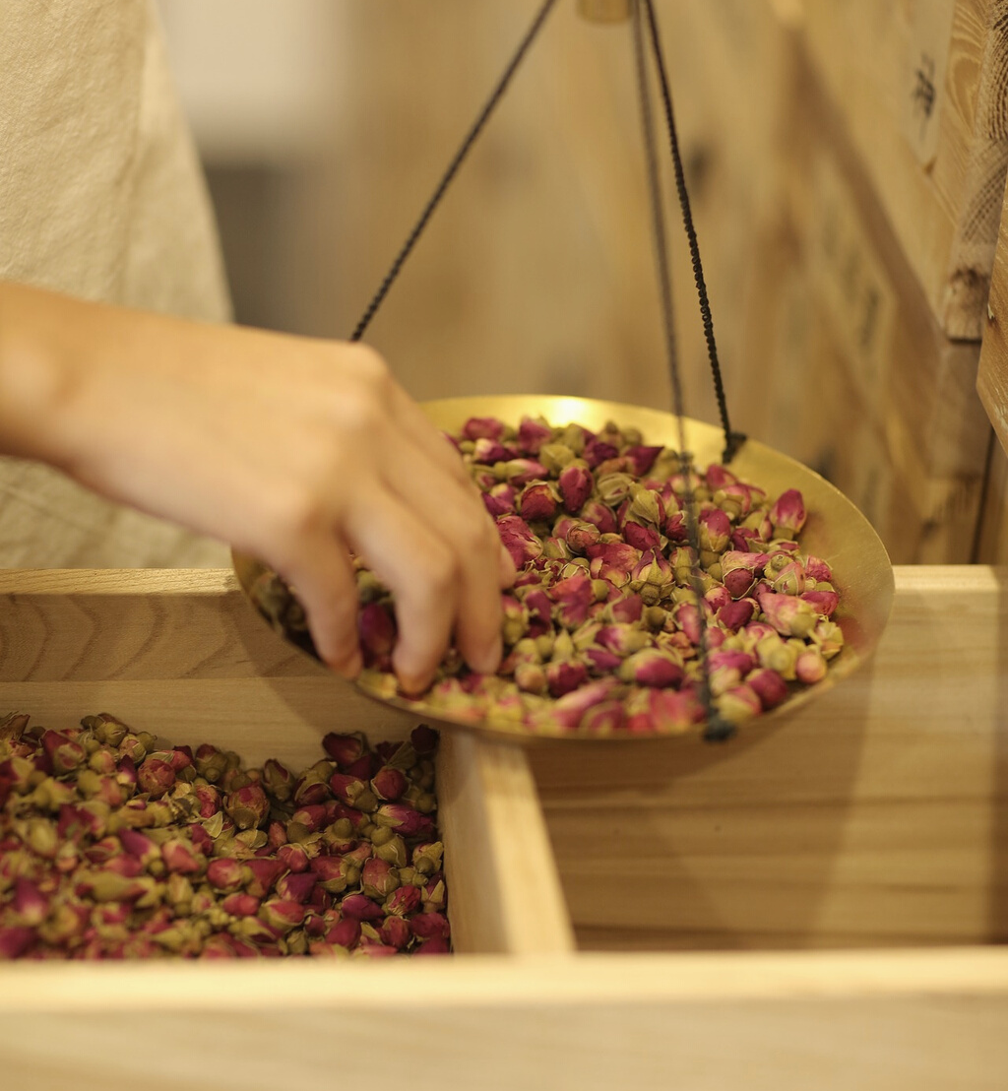
In this activity
How do ideas about causes of disease vary across cultures?
Read ethnographic passages in eHRAF
Answer quiz questions about Hopi, Ojibwa, Central Thai, and Taiwan Hokkien medicine
Topics We'll Cover

Slide 3
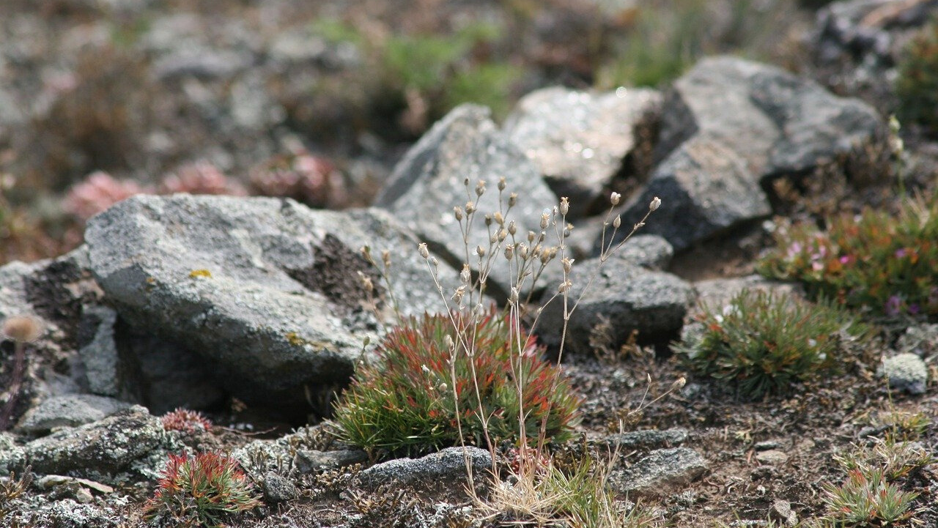
CAUSES OF DISEASE
across cultures

Slide 4
How do different cultures interpret illness and disease?
Cultural views on medicine vary widely. Sometimes they may even clash.
For example, some cultures may interpret the “common cold” as being caused by germs, while other cultures may find causality in angry spirits.
Due to such cultural diversity, it is important for medical staff to understand and be aware of cultural differences in order to treat patients effectively.
Did you know?

Slide 5
Ethnographic examples of
"the common cold"
Found in eHRAF World Cultures
The Croats believe that chilling a part of the body, such as by sitting in a drafty room or going outside with wet hair, causes a cold (Gilliland 1986).
As a remedy, the Croatian liquor rakija is said to cure everything "from a cut to the common cold" (Bennett 1974)
The Tiv of Nigeria believe that the common cold is associated with the phases of the moon (Bohannan 1953).
“Eating raw onions” can be used to treat the cold (Bohannan 1969).
Taiwan-Hokkien believe that cold is caused by “fright or offense” (Gould-Martin 1975).
The Amhara of Ethiopia the believe “that smelling the urine of another will give one a cold” (Levine 1965).

Slide 6
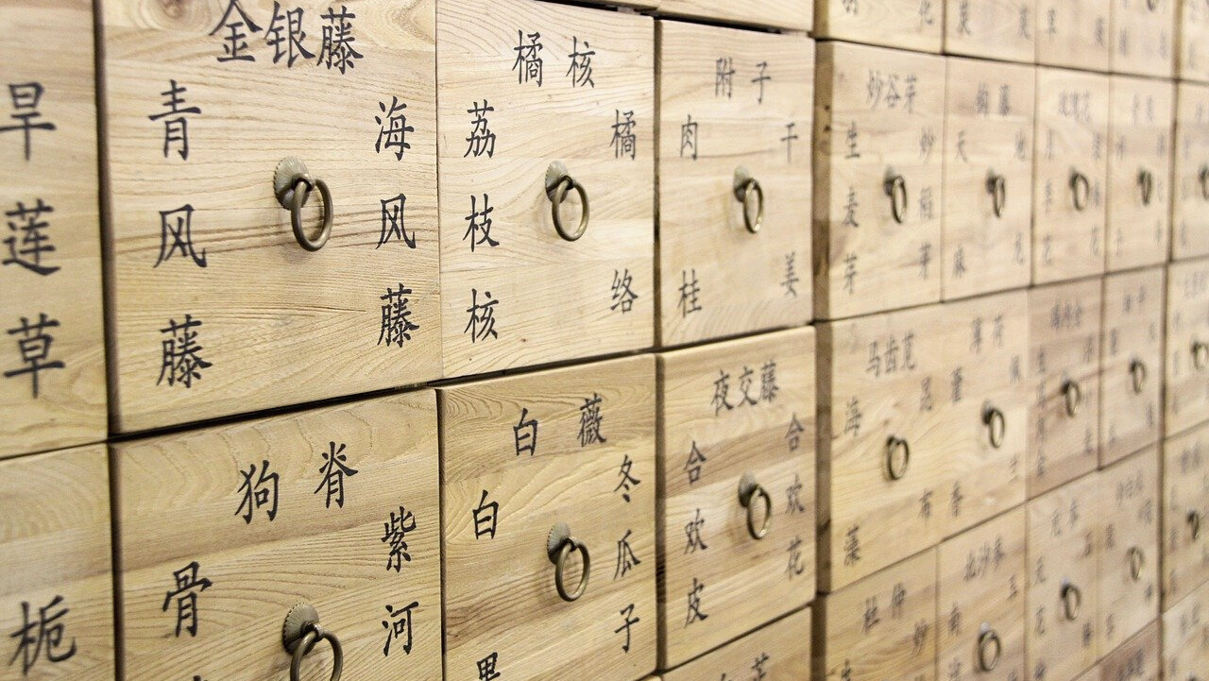
eHRAF
WORKBOOK ACTIVITY
quiz questions

Slide 7
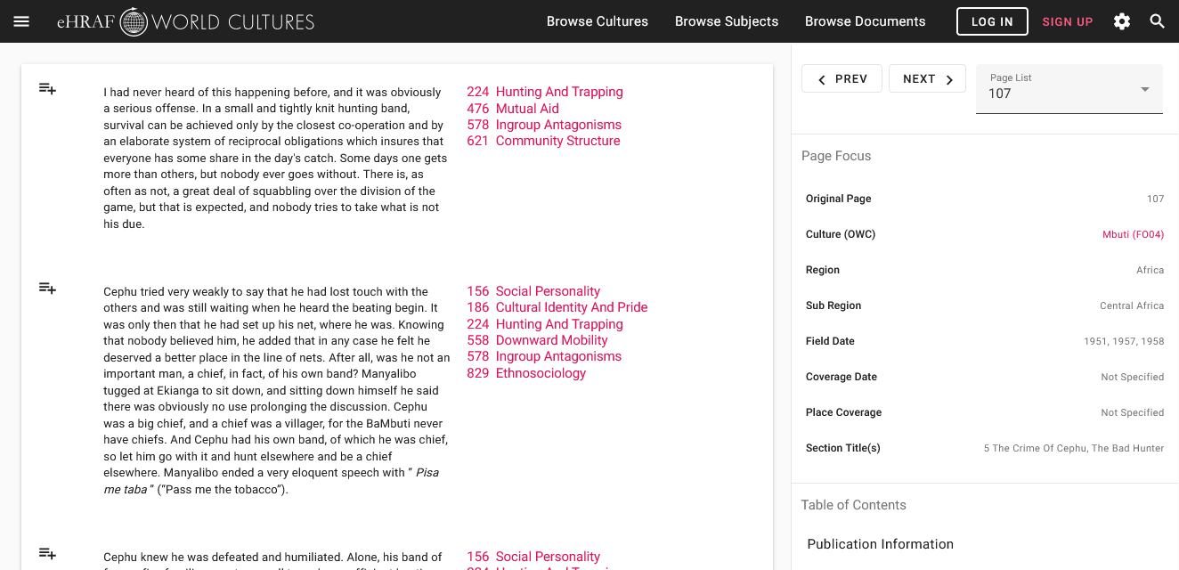
To read documents or pages in eHRAF:
INSTRUCTIONS
First, follow the permalinks provided in the activities below to get to the relevant documents.
For example:
🌐
https://ehrafworldcultures.yale.edu/document?id=fo04-003
Then, use the Page List dropdown menu to navigate to the required page(s).

Slide 8
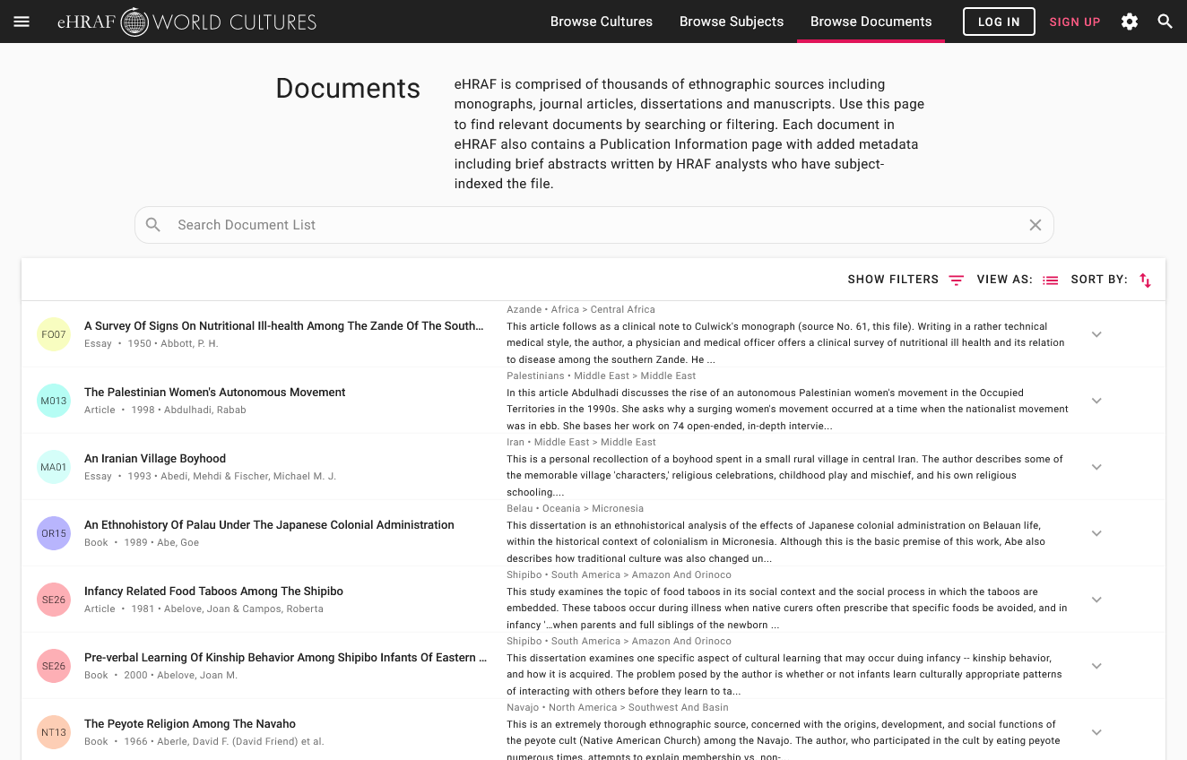
Finding documents without permalinks
INSTRUCTIONS
Follow these steps if you are having trouble with permalinks from off campus while using a proxy or VPN service, or if you have been provided with a HRAF-issued username and password.
Sign in via your library proxy or VPN, or using the HRAF-issued credentials.
Go to the Browse Documents tab.
Enter the author's name or document title into Search Document List box.
Click on the required title to access the document, then select the page number from the Page List dropdown menu as shown above.

Slide 9
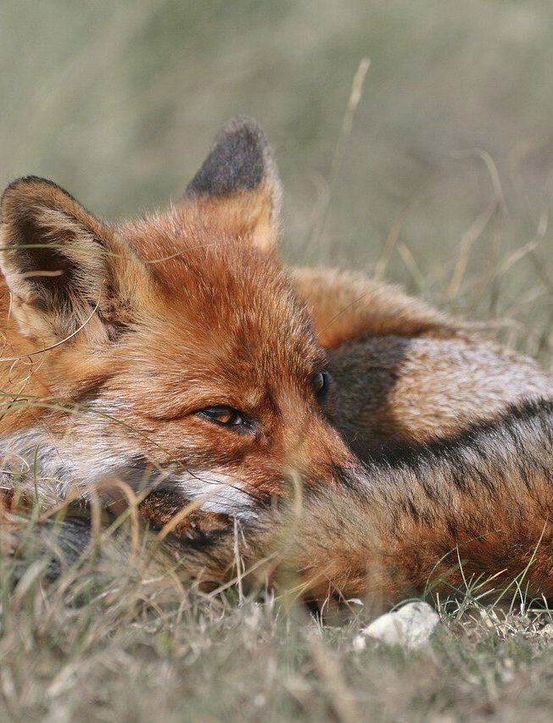
HOPI (NT09)
Southwestern United States
Answers to the following questions can be found in Jerrold E. Levy’s chapter titled “Soul Loss” in Hopi Shamanism: A Reappraisal.
Read pages: 318-319
https://ehrafworldcultures.yale.edu/document?id=nt09-063
🌐

Slide 10
HOPI (NT09)
1. According to Levy, the Hopi did not traditionally believe in soul loss as a cause of illness. Which of the following did they consider to be possible causes of illness?
A
disbelief, bad thoughts, and anxiety
B
bad luck
C
casting a spell on someone
D
emotional imbalance
E
A and D

Slide 11
HOPI (NT09)
2. According to Hopi belief, which illness or condition can witches cause?
A
insanity
B
blindness
C
fright illness
D
malaria
E
smallpox

Slide 12
HOPI (NT09)
3. Hopis believed that contact with improperly killed game animals was the most common cause of seizures among children.
TRUE
or
FALSE

Slide 13
HOPI (NT09)
4. Tewas believe that epilepsy is caused by “evil winds” sent by a witch.
TRUE
or
FALSE

Slide 14
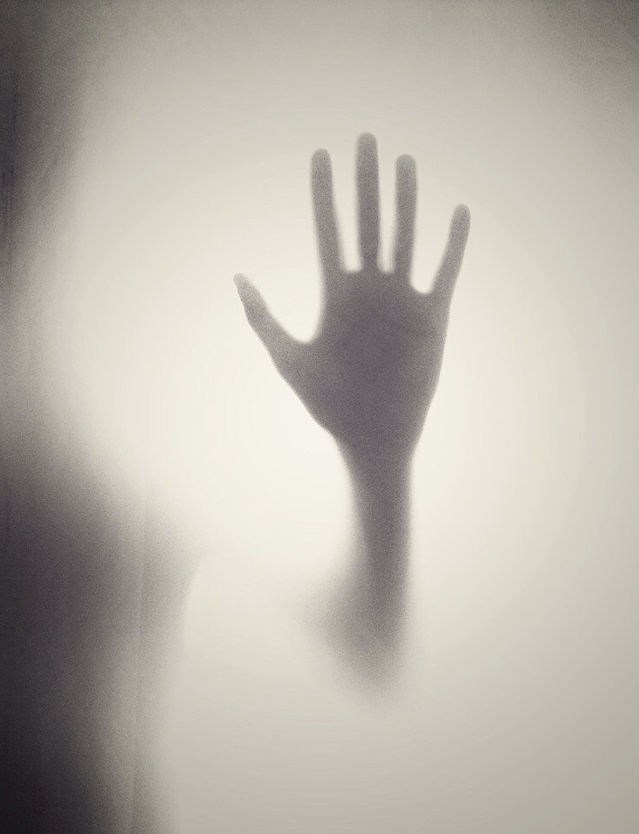
OJIBWA(NG06)
Plains Region, United States and Canada
Read Christopher Vecsey’s chapter titled “Causes of Disease” in “Traditional Ojibwa religion and its historical changes” and answer the following questions.
Pages: 145-148
https://ehrafworldcultures.yale.edu/document?id=ng06-041
🌐

Slide 15
OJIBWA (NG06)
1. To what do the Ojibwa attribute the mythological origin of disease?
A
angering an ancestor spirit
a misbalanced hunting relationship between humans and animals
B
a misbalanced relationship between humans and spirits
C
D
giving someone the "evil eye"
E
A and D

Slide 16
OJIBWA (NG06)
2. In the traditional Ojibwa belief system, the cause or causes for diseases are:
A
intrusion of a foreign object into the body
B
soul loss and manitos
C
improper contact with sources of power
D
all of the above
E
none of the above

Slide 17
OJIBWA (NG06)
3. According to Ojibwa beliefs, witches historically used which kind of methods to induce diseases?
A
cause a water ghost to molest their victim
B
scratch victims with poisons
C
poison victim's food
D
A and B
E
B and C

Slide 18
OJIBWA (NG06)
4. Vecsey reports that some witches were particularly fearsome when posing as which animal?
A
wolf
B
mountain lion
C
bear
D
coyote
E
snake

Slide 19
CENTRAL THAI (AO07)
Central and Southern Thailand
Read Robert Textor’s chapter titled “Initiative-taking, Non-possessing Ghosts that Cause Illness” in “Roster of the gods: an ethnography of the supernatural in a Thai village ” and answer the following questions.
Read pages: 382-383
https://ehrafworldcultures.yale.edu/document?id=ao07-011
🌐

Slide 20
CENTRAL THAI (AO07)
1. According to Textor, the Central Thai see the "Water Ghost" as being derived from a dead person who inhabits not only ponds and lakes, but also forests, mountains, and fields.
TRUE
or
FALSE

Slide 21
CENTRAL THAI (AO07)
2. According to Textor, the Central Thai see the “Epidemic Ghost” as always being male.
TRUE
or
FALSE

Slide 22
CENTRAL THAI (AO07)
3. The Water Ghost and Epidemic Ghost induce illness by intrusion of foreign objects into a body.
TRUE
or
FALSE

Slide 23
CENTRAL THAI (AO07)
4. Which of the following explains how the Water Ghost is generated from a body of water?
A
when a person drowns
when a corpse or ghost is deposited in a body of water
B
from an ancestor spirit that already lives in the water
C
D
A and B
E
A and C

Slide 24
CENTRAL THAI (AO07)
5. What kind of disease may be caused by the Water Ghost?
A
malaria
B
chicken pox
C
stomach flu
D
windigo
E
hiccups

Slide 25
CENTRAL THAI (AO07)
6. What can be used to protect against Epidemic Ghosts?
A
sacralized salt and sand
B
sacralized pepper and salt
C
sacralized salt and rocks
D
sacralized herbs
E
sacralized slate

Slide 26
TAIWAN HOKKIEN (AD05)
Hokkien, Taiwan
Read Emily Martin’s section titled “Knowing the Cause of an Illness” in “Sacred and secular medicine in a Taiwan village: a study of cosmological disorders” and answer the following questions.
Read pages: 99-101
https://ehrafworldcultures.yale.edu/document?id=ad05-063
🌐

Slide 27
TAIWAN HOKKIEN (AD05)
1. According to Martin, the Taiwan Hokkien attribute "Phuà-pi" to:
A
trouble that arises from outside the body
B
being hit or bumped by something
C
being allergic to something
D
all of the above
E
none of the above

Slide 28
TAIWAN HOKKIEN (AD05)
2. What method may a Chinese-style doctor use to diagnose an illness?
A
stethoscope and blood pressure readings
B
urine and blood tests
C
studying the color of the complexion
D
all of the above
E
none of the above

Slide 29
TAIWAN HOKKIEN (AD05)
3. According to Martin, which (if any) of the following best describes a treatment that might be prescribed by a Western-style doctor?
A
herbal and natural substances
B
antibiotics in form of powders or injections
C
special diet
D
all of the above
E
none of the above

Slide 30
1. This activity was adapted in part from Causes of Disease, by Christiane Cunnar, in Teaching eHRAF. https://hraf.yale.edu/teach-ehraf/causes-of-disease/
2. Levy, Jerrold E. 1994. “Hopi Shamanism: A Reappraisal.” North American Indian Anthropology: Essays On Society And Culture. Norman: University of Oklahoma Press. https://ehrafworldcultures.yale.edu/document?id=nt09-063.
3. Martin, Emily. 1975. “Sacred And Secular Medicine In A Taiwan Village: A Study Of Cosmological Disorders.” Medicine In Chinese Cultures: Comparative Studies Of Health Care In Chinese And Other Societies. Washington, D.C.: U.S. Department of Health, Education, and Welfare, National Institutes of Health. https://ehrafworldcultures.yale.edu/document?id=ad05-063.
References
4. Textor, Robert B. 1973. “Roster Of The Gods: An Ethnography Of The Supernatural In A Thai Village.” Ethnography Series. New Haven, Conn.: Human Relations Area Files. https://ehrafworldcultures.yale.edu/document?id=ao07-011.
5. Vecsey, Christopher. 1983. “Traditional Ojibwa Religion And Its Historical Changes.” Memoirs. Philadelphia: American Philosophical Society. https://ehrafworldcultures.yale.edu/document?id=ng06-041.

Slide 31
Causes of Disease
in eHRAF World Cultures
Produced by
Human Relations Area Files
at Yale University
An eHRAF Workbook Activity
hraf.yale.edu

Slide 32
eHRAF
Workbooks
in eHRAF World Cultures
Produced by
Human Relations Area Files
at Yale University
An eHRAF Workbook Activity
hraf.yale.edu

