Slide 1
An eHRAF Workbook Activity
Great Discoveries:
Chavín de Huántar
Human Relations Area Files
at Yale University

Slide 2
In this activity
Learn about Chavín de Huántar
Read passages in eHRAF Archaeology
Answer questions about this archaeological discovery
Find out what makes Chavín de Huántar a "Great Discovery"
Topics We'll Cover

Slide 3
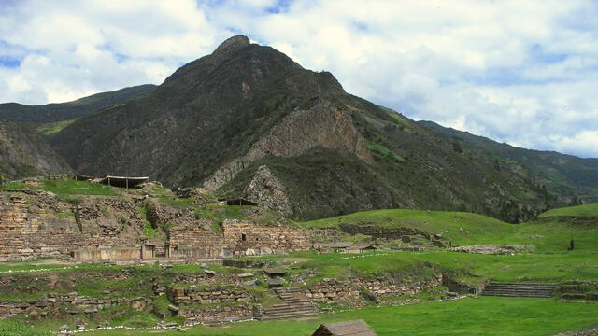
CHAVÍN DE HUÁNTAR

Slide 4
Chavín de Huántar is an archaeological site in Peru. It is one of the most famous ceremonial centers in the Andes mountains and part of Chavín, one of the earliest civilizations in South America.
Did you know?
Chavín de Huántar flourished from 2850 to 2200 BP and was occupied by the Chavín, a major pre-Inca culture. The site is surrounded by snow-covered mountains with peaks rising more than 18,000 feet (5500 meters).

Slide 5
Chavín de Huántar
Chavín de Huántar was initially settled as a small ceremonial center surrounded by a highland community of residences. The site had a strategic location along a key trade route at the midpoint between the Peruvian coast to the west and the lowland tropical forest to the east. This location made Chavín de Huántar a natural trade center. The famous Chavín style of art included a range of fantastical stone carved figures which combine the features of humans, alligators, birds, jaguars, and snakes with intricate geometrical designs.

Slide 6
To get started, review these short videos and articles about Chavín de Huántar:
Chavín (Archaeological Site) (UNESCO/NHK)
Chavín – Peru's enigmatic temple in the Andes
Chavín de Huántar and the Religious Revolution
Fredrik Hiebert: Peruvian Gold
| Nat Geo Live

Slide 7
Articles About Chavín de Huántar
Yale Peabody Museum of Natural History
Chavin (Archaeological Site) – UNESCO
Chavín de Huántar – Khan Academy
Enter the Jaguar

Slide 8
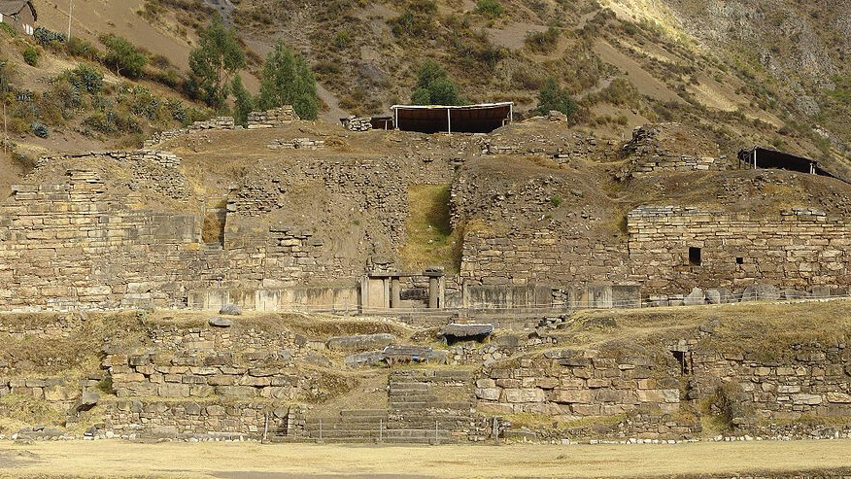
eHRAF Workbook
Part 1: Tradition Summary

Slide 9
Tradition Summaries
A brief overview for traditions in eHRAF Archaeology is provided in the form of Tradition Summaries.
The format, general outline, and headings are the same for each summary. You will find a basic overview about the tradition, such as its time period, location, history, environment, and sociopolitical organization.
eHRAF
Archaeology
To find a tradition summary, go to the Browse Traditions tab and enter the tradition name into the box, then click on Tradition Summary below the tradition name to read it.

Slide 10
Chavín (SE49)
PART 1
Begin by learning more about the Chavín tradition. First, read the eHRAF Tradition Summary:
🌐
https://ehrafarchaeology.yale.edu/document?id=se49-000
Then, write a brief description of the Chavín tradition indicating any significant archaeological elements that stand out to you.

Slide 11
eHRAF Workbook
Part 2: Selected Readings

Slide 12
To read documents or pages in eHRAF:
INSTRUCTIONS
First, follow the permalinks provided in the activities below to get to the relevant documents.
For example:
🌐
https://ehrafarchaeology.yale.edu/document?id=nt76-001
Then, use the Page List dropdown menu to navigate to the required page(s).

Slide 13
Finding documents without permalinks
INSTRUCTIONS
Follow these steps if you are having trouble with permalinks from off campus while using a proxy or VPN service, or if you have been provided with a HRAF-issued username and password.
Sign in via your library proxy or VPN, or using the HRAF-issued credentials.
Go to the Browse Documents tab.
Enter the author's last name into the Filter Index box.
Click on the required title to access the document, then select the page number from the Page List dropdown menu as shown above.

Slide 14
PART 2
Chavin and the Origins of Andean Civilization (Burger 1992)
🌐
https://ehrafarchaeology.yale.edu/document?id=se49-003
Pages:
16, Look at the images of artifacts and the captions describing them
213–215, Ceramic style and changing cultural identity
The Tropical Forest and the Cultural Context of Chavín (Lathrap 1971)
🌐
https://ehrafarchaeology.yale.edu/document?id=se49-011
Pages:
73–77, Eagles depicted in artwork

Slide 15
PART 2
Towards a Re-Evaluation of Chavín (Lumbreras 1971)
🌐
https://ehrafarchaeology.yale.edu/document?id=se49-008
Pages:
1–3, 6, 8, 13, 20, 25, 27–28 Description of the temples at the site
Chavín: An Interpretation of Its Spread and Influence (Patterson 1971)
🌐
https://ehrafarchaeology.yale.edu/document?id=se49-009
Pages:
33–40, Ceramics
41–47, Summary

Slide 16
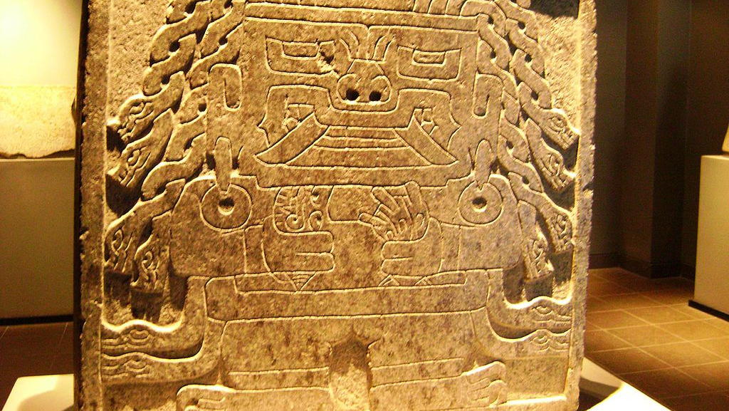
In this activity, you will ual relations across the globe.
eHRAF Workbook
Part 3: Advanced Search

Slide 17
Part 3:
Advanced Search
Now that you have read selected passages from eHRAF Archaeology, dig deeper with Advanced Search. This will enable you to find specific passages in documents that have been indexed by HRAF anthropologists at the paragraph level.
On the following slide, you will find an example of an advanced search. Try this search and then experiment with different subjects and/or keywords.

Slide 18
Part 3:
Advanced Search
In the Add Traditions column, select Chavín (SE49).
In the Add Subjects column, select the subject category Ceramic technology (323).
In the Keyword section, type "pottery".

Slide 19
ADVANCED SEARCH
Add tradition:
Chavín (SE59)
Add subjects:
Ceramic technology (323)
Add keyword:
"pottery"

Slide 20
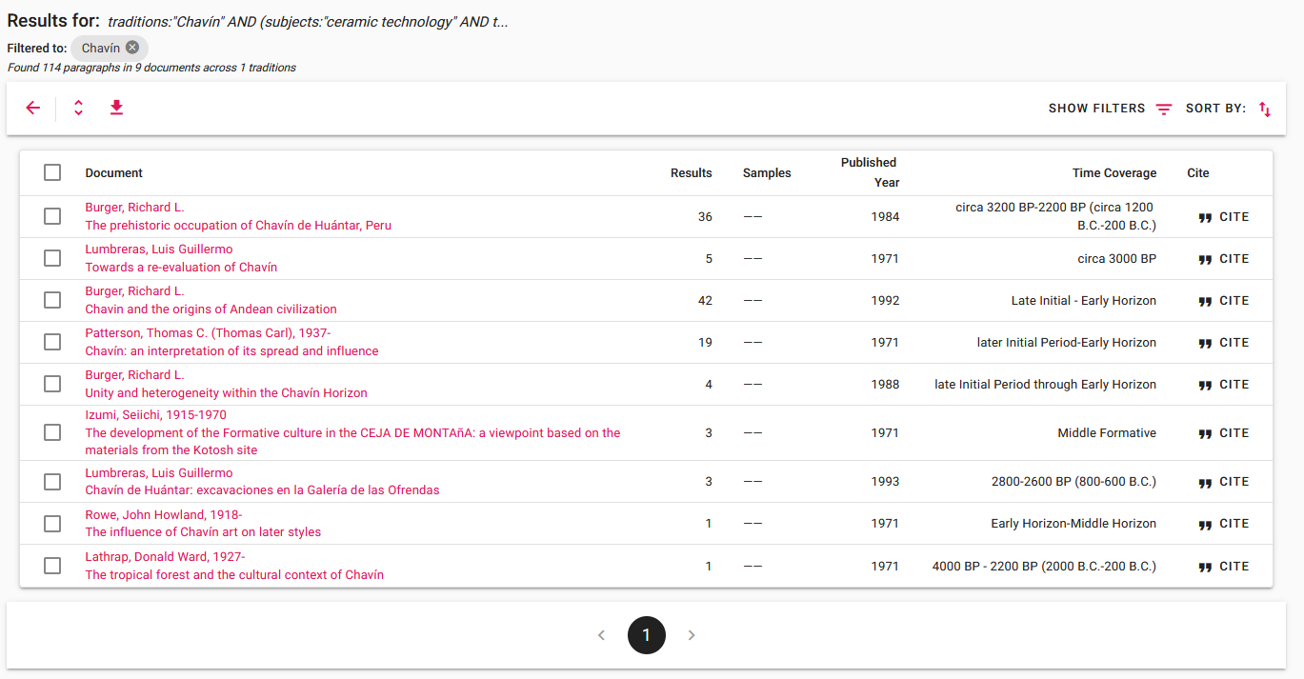
SEARCH RESULTS

Slide 21
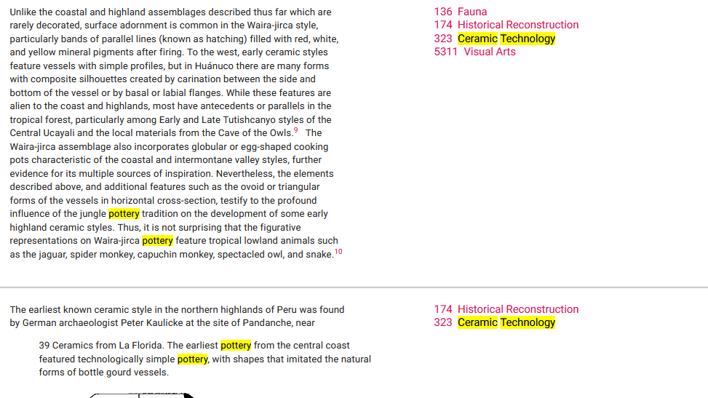
SEARCH RESULTS

Slide 22
FULL CONTEXT

Slide 23
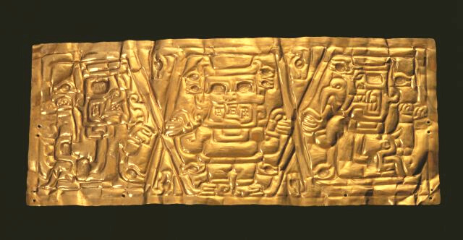
eHRAF Workbook
Part 4: Assignment

Slide 24
ASSIGNMENT
The purpose of this assignment is to present a report summarizing your findings about this great discovery.
This can be done in the form of a group project or an individual paper.
Groups can divide the questions that follow, with each student contributing information about a specific question.
Consider making a slideshow presentation to illustrate your findings.

Slide 25
ASSIGNMENT
Your final report describing Chavín should have 6 sections which correspond to these 6 types of questions:
Who?
What?
Where?
When?
How?
Why?

Slide 26
QUESTION 1
Who?
Who are the main archaeologists associated with this discovery? Describe their biographical information, education and training, publications, etc.
Who are the people studied? Describe how people lived during this time at this place, such as: social stratification, division of labor, gender roles, economic life, food and subsistence, religious practices.

Slide 27
QUESTION 2
What?
What did the archaeologists discover?
Provide a general description of the archaeological site.
Describe the material culture, structures, artifacts, etc.
Include relevant photos and/or interpretive artistic renderings.

Slide 28
QUESTION 3
Where?
Where is the site located?
Describe the geography of this discovery, its location in the contemporary world, size, scope, etc.
Does the location have strategic importance?
How did the physical environment and natural resources shape cultural practices?

Slide 29
QUESTION 4
When?
When were the discoveries made?
When in human history do archaeologists believe that this site can be dated to?
Describe the relative time period, what preceded it, and what followed it. What does this represent in terms of cultural evolution and progress?

Slide 30
QUESTION 5
How?
How did archaeologists excavate, analyze, and interpret this site?
Tell us about the scientific methods used for excavation and analysis of the materials founds.
What technologies were utilized by the people who lived during this archaeological time period?
How did they construct buildings and make artifacts (lithics, pottery, etc.)?

Slide 31
QUESTION 6
Why?
Why is this archaeological site considered a “great discovery”?
Describe how this site is important in terms of its place in human history.
Why should this great discovery be preserved and who should be responsible for preservation?

Slide 32
Burger, Richard L. 1992. Chavin and the Origins of Andean Civilization. London: Thames and Hudson. https://ehrafarchaeology.yale.edu/document?id=se49-003.
Lathrap, Donald Ward. 1971. “The Tropical Forest and the Cultural Context of Chavín.” In Dumbarton Oaks Conference on Chavín, October 26th and 27th, 1968, 73–100. Washington: Dumbarton Oaks Research Library and Collection, Trustees for Harvard University. https://ehrafarchaeology.yale.edu/document?id=se49-011.
References
Lumbreras, Luis Guillermo. 1971. “Towards a Re-Evaluation of Chavín.” In Dumbarton Oaks Conference on Chavín, October 26th and 27th, 1968, 1–28. Washington: Dumbarton Oaks Research Library and Collection, Trustees for Harvard University. https://ehrafarchaeology.yale.edu/document?id=se49-008.
Patterson, Thomas C. (Thomas Carl). 1971. “Chavín: An Interpretation of Its Spread and Influence.” In Dumbarton Oaks Conference on Chavín, October 26th and 27th, 1968, 29–48. Washington: Dumbarton Oaks Research Library and Collection, Trustees for Harvard University. https://ehrafarchaeology.yale.edu/document?id=se49-009.

Slide 33
Chavin gold breastplate, 400-200 BCE, by Peter D. Tillman, via Flickr:
https://www.flickr.com/photos/29050464@N06/43362851744/
Cabeza clava no-name 6, Dtarazona, CC BY-SA 4.0, via Wikimedia Commons:
https://commons.wikimedia.org/wiki/File:Cabeza_clava_no-name_6.JPG
Monumento Arqueológico Chavín de Huántar, Sharon odb, CC BY-SA 3.0, via Wikimedia Commons: https://commons.wikimedia.org/wiki/
File:Chav%C3%ADn_de_Hu%C3%A1ntar.JPG
Image Credits
Estela, Ghirlandajo, Public domain, via Wikimedia Commons:
https://commons.wikimedia.org/wiki/File:Estela.jpg
Cabeza clava en Chavín de Huántar, Dtarazona, CC BY-SA 4.0, via Wikimedia Commons: https://commons.wikimedia.org/wiki/File:
Cabeza_clava_en_su_ubicacion_original_13122009.JPG
Inca bridge at Chavin, Enock, C. Reginald (Charles Reginald), 1868-1970, Public domain, via Wikimedia Commons:
https://commons.wikimedia.org/wiki/File:Inca_bridge_at_Chavin.jpg

Slide 34
Chavin - Août 2007, Martin St-Amant (S23678), CC BY 3.0, via Wikimedia Commons:
https://commons.wikimedia.org/wiki/File:Chavin_-_Ao%C3%BBt_2007.jpg
Cabeza de cóndor Chavín de Huantar, Dtarazona, CC BY-SA 4.0, via Wikimedia Commons: https://commons.wikimedia.org/wiki/
File:Cabeza_de_c%C3%B3ndor_Chav%C3%ADn_de_Huantar_13122009.JPG
Lombards Museum, CC BY 3.0, via Wikimedia Commons:
https://commons.wikimedia.org/wiki/File:Lombards_Museum_039.JPG
Image Credits
Incised Strombus-Shell Trumpet, via Wikimedia Commons:
https://commons.wikimedia.org/wiki/File:Incised_Strombus-Shell_Trumpet,_400-200_B.C.E,_L52.1.jpg
Chavin de Huantar National Museum, by Dtarazone, via Wikimedia Commons:
https://es.m.wikipedia.org/wiki/Archivo:MNCH_08_06122009.jpg
Feline-and-Cactus Stirrup Vessel, Walters Art Museum, Public domain, via Wikimedia Commons: https://commons.wikimedia.org/wiki/File:
Chav%C3%ADn_-_Feline-and-Cactus_Stirrup_Vessel_-_Walters_482832.jpg
Musée Chavin, Bluesy Pete, CC BY-SA 3.0, via Wikimedia Commons:
https://commons.wikimedia.org/wiki/File:Mus%C3%A9eChavin_23.jpg

Slide 35
Chavin Museo Larco, Pattych, CC BY-SA 3.0, via Wikimedia Commons:
https://commons.wikimedia.org/wiki/File:Chavinmuseolarco.jpg
Paron Lake, Alberto Cafferata, CC BY-SA 4.0, via Wikimedia Commons:
https://commons.wikimedia.org/wiki/File:Paron_Lake.jpg
Chavin lanzon stela cyark, CC BY-SA 3.0, via Wikimedia Commons:
https://commons.wikimedia.org/wiki/File:Chavin_lanzon_stela_cyark.jpg
Part of the Castle of Chavin, Enock, Charles Reginald, 1868-1970, Public domain, via Wikimedia Commons: https://commons.wikimedia.org/wiki/File:
Part_of_the_Castle_of_Chavin.jpg
Image Credits
Chavin culture extent map, created by Zenyu, public domain, via Wikimedia Commons: https://commons.wikimedia.org/wiki/File:Chavin-small.png
Chavin lanzon stela2, CyArk, CC BY-SA 3.0, via Wikimedia Commons:
https://commons.wikimedia.org/wiki/File:Chavin_lanzon_stela2_cyark.jpg
Paron Lake, Alberto Cafferata, CC BY-SA 4.0, via Wikimedia Commons:
https://commons.wikimedia.org/wiki/File:Paron_Lake.jpg

Slide 36
Great Discoveries: Chavín de Huántar
Produced by
Human Relations Area Files
at Yale University
An eHRAF Workbook Activity
hraf.yale.edu

