Slide 1
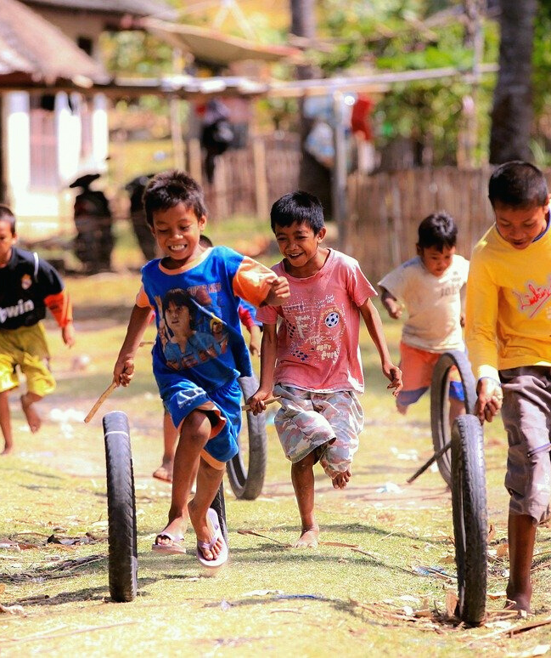
An eHRAF Workbook Activity
Children's Work & Play
in eHRAF World Cultures
Human Relations Area Files
at Yale University

Slide 2
In this activity
Discuss the importance of childhood
Conduct research using eHRAF World Cultures
Explore attitudes towards play and work expected of children
Compare and contrast differences about childhood with your own culture
Topics We'll Cover

Slide 3
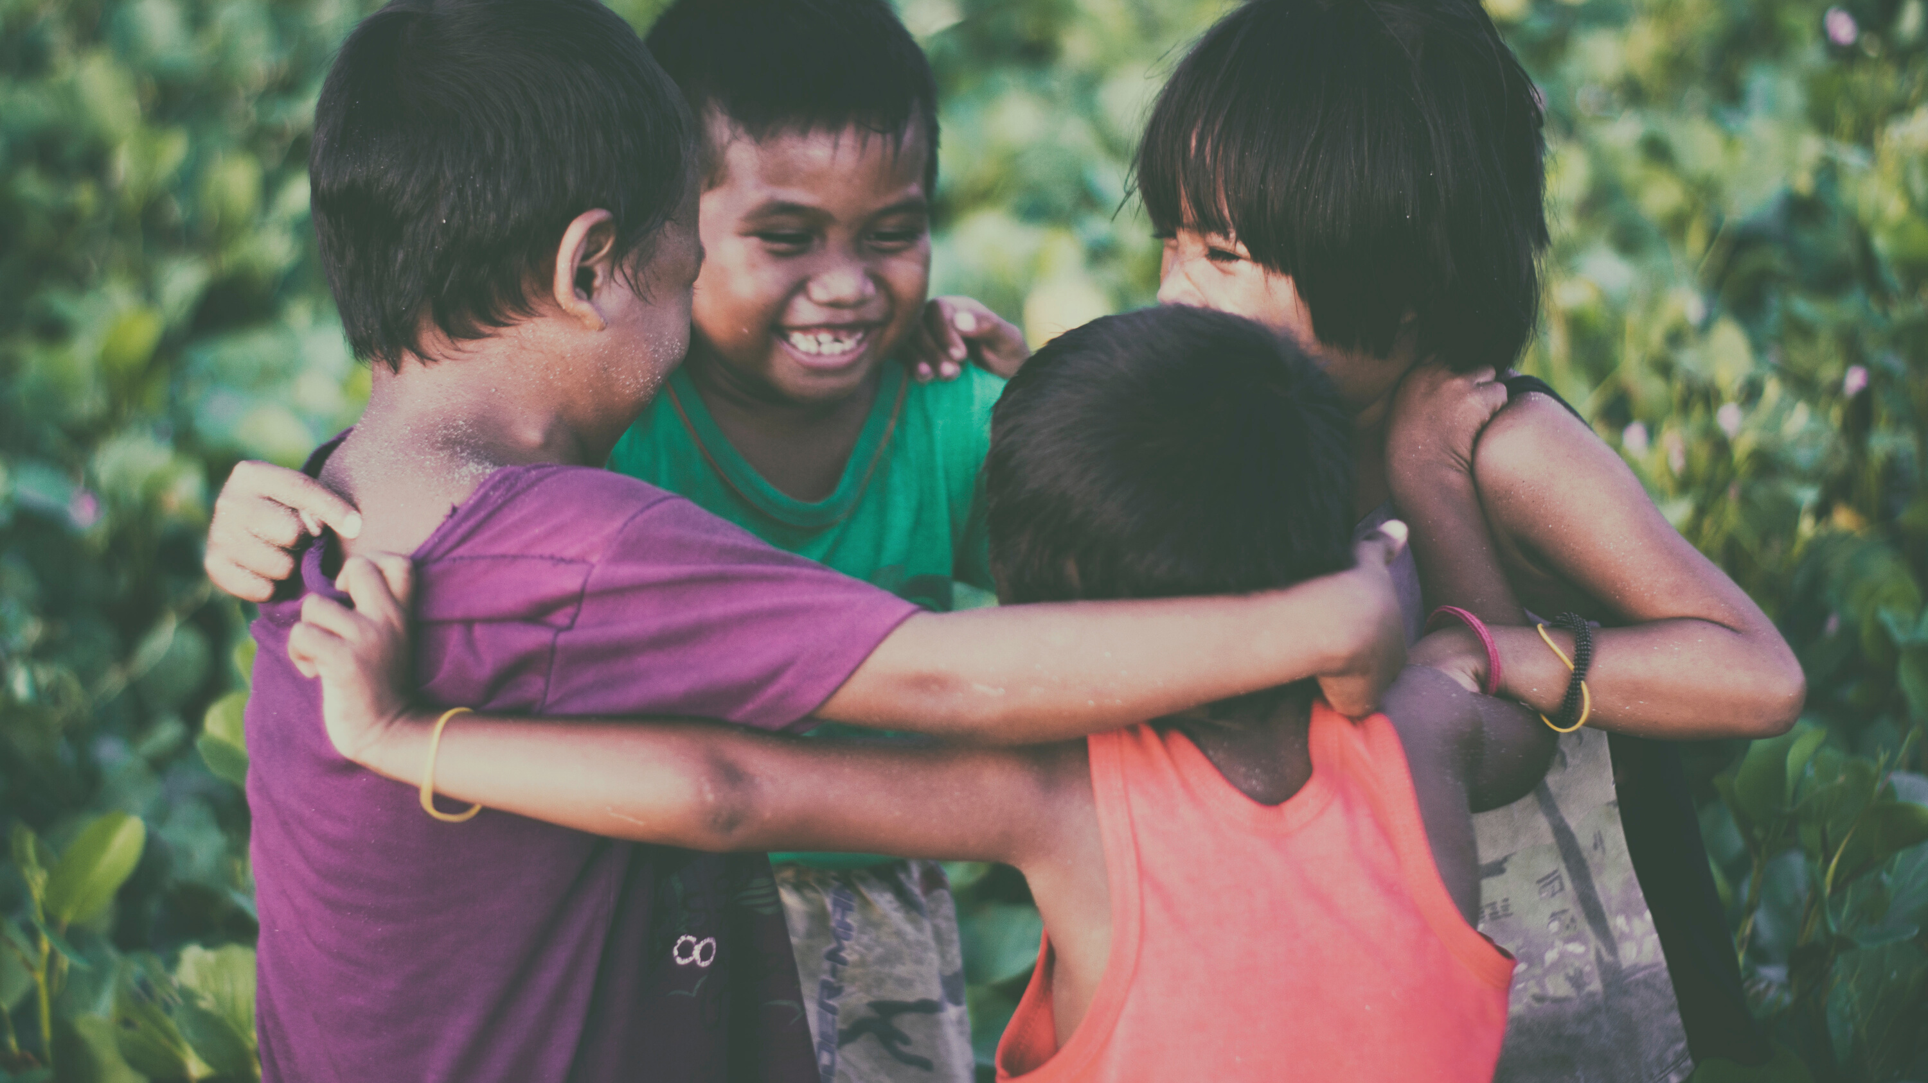
CHILDHOOD

Slide 4
Importance of childhood
Compared to other animals, humans take a long time to become sexually mature as well as fully capable adults.
This period of time, known as childhood, enables a child to develop not only the physical and cognitive skills needed to make a living later in life, but also to learn the complexities and nuances of their social and cultural environment.
Did you know?

Slide 5
Approaches to Learning
Societies vary in how they approach learning during childhood. In some societies, there is a considerable amount of explicit teaching by parents and other adults including assigning children simple and then more complex tasks. In other societies, children spend a long time learning informally by watching, playing at adult roles and voluntarily "pitching in".
Play comes naturally to children. But more importantly, play helps develop physical, mental, and social skills.

Slide 6
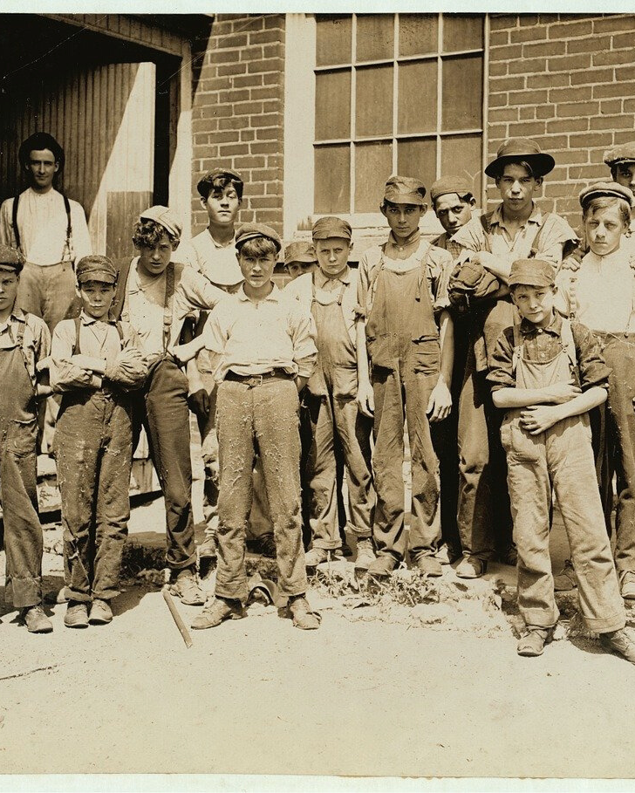
Length of Childhood
In American society today, childhood can last a very long time. Some parents, if asked how long it takes a child to grow up, might jokingly (or maybe not so jokingly), suggest 25-30 years! Of course, attitudes change over time.
In the late 19th century, children as young as 11 years old often worked long hours in textile, glass, iron and steel industries as well as in mines (Parsons and Goldin 1989). As young as five, children were expected to do farm work and household chores (Hindman 2002: 153).

Slide 7
eHRAF Workbook
ACTIVITY
children's play

Slide 8
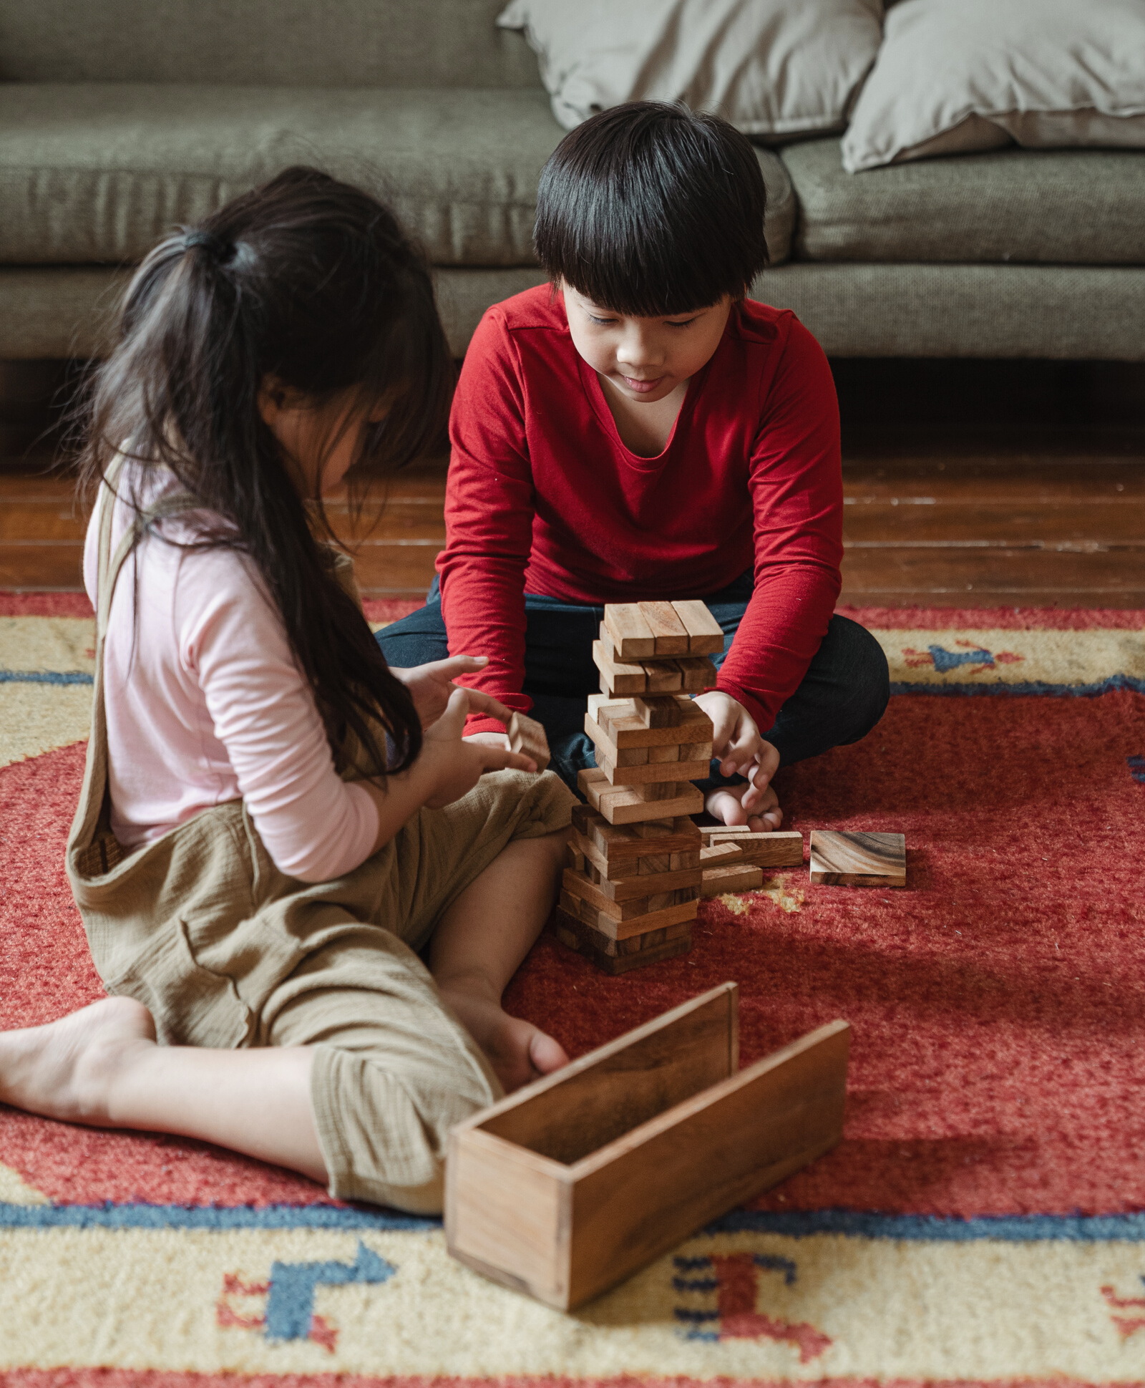
Children's Play
Explore the varied approaches to children's play in four cultures. Then try to answer as many of the following questions as you can for each society.
What are the general attitudes toward play?
At what stages of childhood can children play?
How much time is there to play?
Who typically plays together?
Do parents play with children?
Where can children play?
What do they play at?

Slide 9
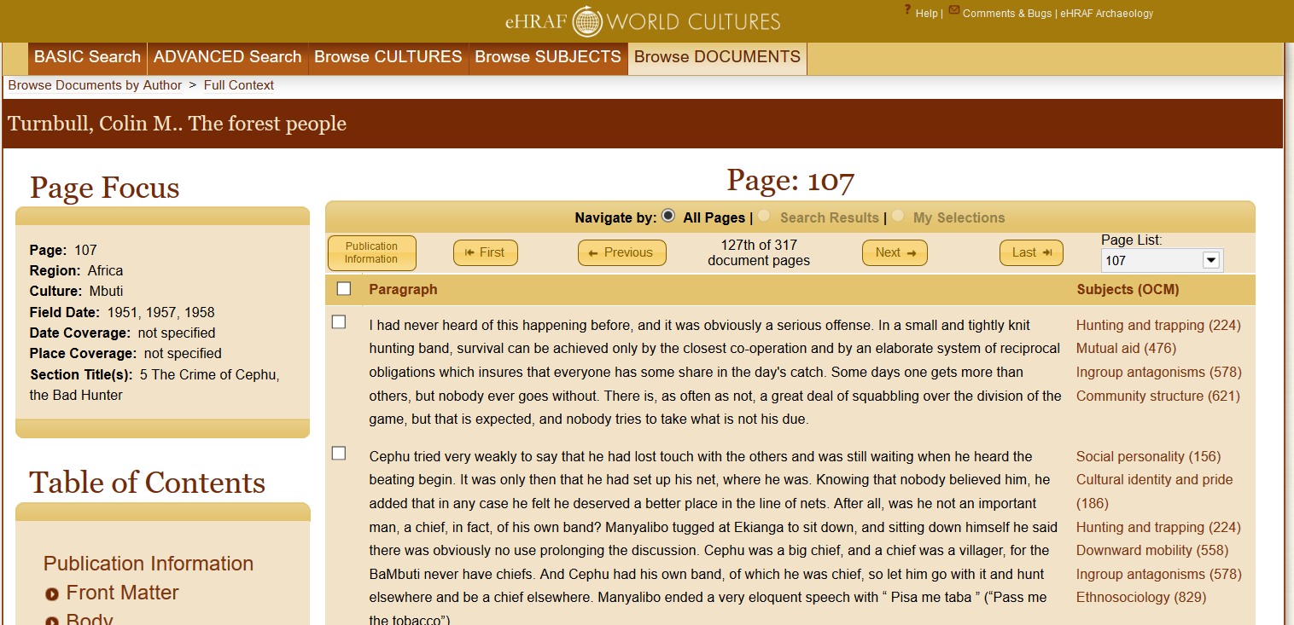
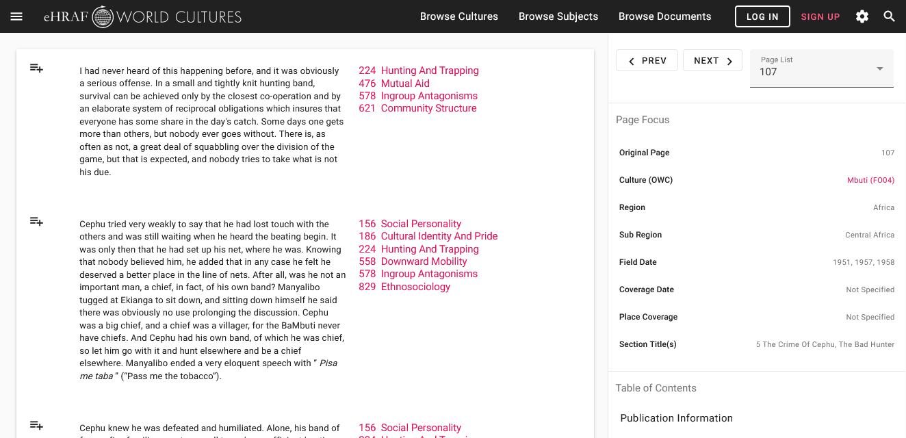
To read documents or pages in eHRAF:
INSTRUCTIONS
First, follow the permalinks provided in the activities below to get to the relevant documents.
For example:
🌐
https://ehrafworldcultures.yale.edu/document?id=fo04-003
Then, use the Page List dropdown menu to navigate to the required page(s).

Slide 10
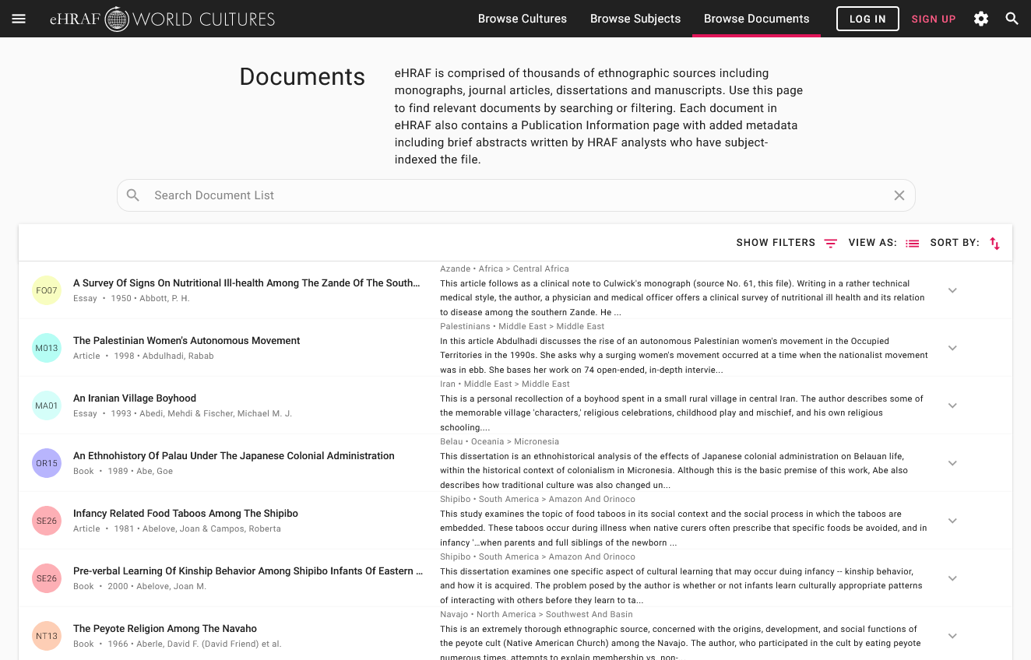
Finding documents without permalinks
INSTRUCTIONS
Follow these steps if you are having trouble with permalinks from off campus while using a proxy or VPN service, or if you have been provided with a HRAF-issued username and password.
Sign in via your library proxy or VPN, or using the HRAF-issued credentials.
Go to the Browse Documents tab.
Enter the author's name or document title into Search Document List box.
Click on the required title to access the document, then select the page number from the Page List dropdown menu as shown above.

Slide 11
Compare the following societies with regard to children's play. For each society, read the suggested pages. Then answer as many of the questions above that you can.
Kurds (MA11)
Hansen: The Kurdish Woman's Life - p 109
🌐
https://ehrafworldcultures.yale.edu/document?id=ma11-004
Masters: Rowanduz - p. 261
🌐
https://ehrafworldcultures.yale.edu/document?id=ma11-002
Blackfoot (NF06)
Ewers: The Blackfeet - pp. 146-8; 151-2
🌐
https://ehrafworldcultures.yale.edu/document?id=nf06-008

Slide 12
Klamath (NR10)
Pearsall: "Klamath Childhood and Education" - pp. 342-b and 343-a
🌐
https://ehrafworldcultures.yale.edu/document?id=nr10-004
Kogi (SC07)
Reichel-Dolmatoff & Muirden: The Kogi - p. 79
🌐
https://ehrafworldcultures.yale.edu/document?id=sc07-001
Park: “Tribes of the Sierra Nevada de Santa Marta, Colombia.” - p. 884.
🌐
https://ehrafworldcultures.yale.edu/document?id=sc07-005
Optional: Compare your own culture's attitudes to those you have read about. Name your culture and try to answer the same questions about play.

Slide 13
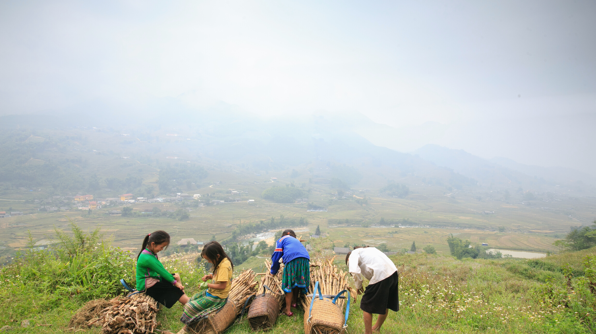
eHRAF Workbook
ACTIVITY
children's work

Slide 14
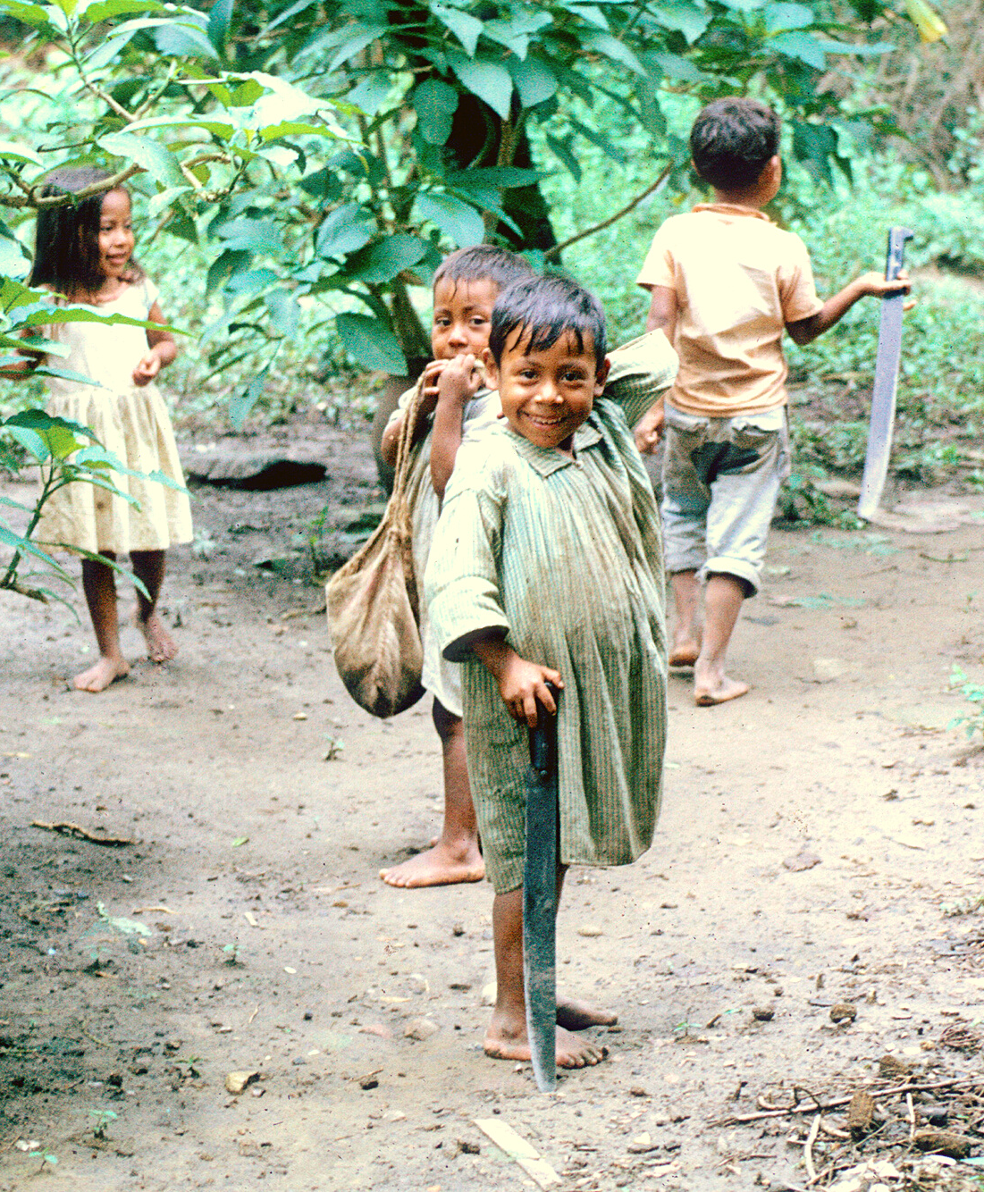
Children's Work
For this activity, read passages from the same four cultures, but this time concentrate on the type of work (including domestic chores and childcare) that children are expected to do. Try to answer the following questions.
Are children expected to work?
At what age?
Does it vary by gender?
Do they voluntarily "pitch in"?
If they work, what kinds of work?
Do they still have time to play?

Slide 15
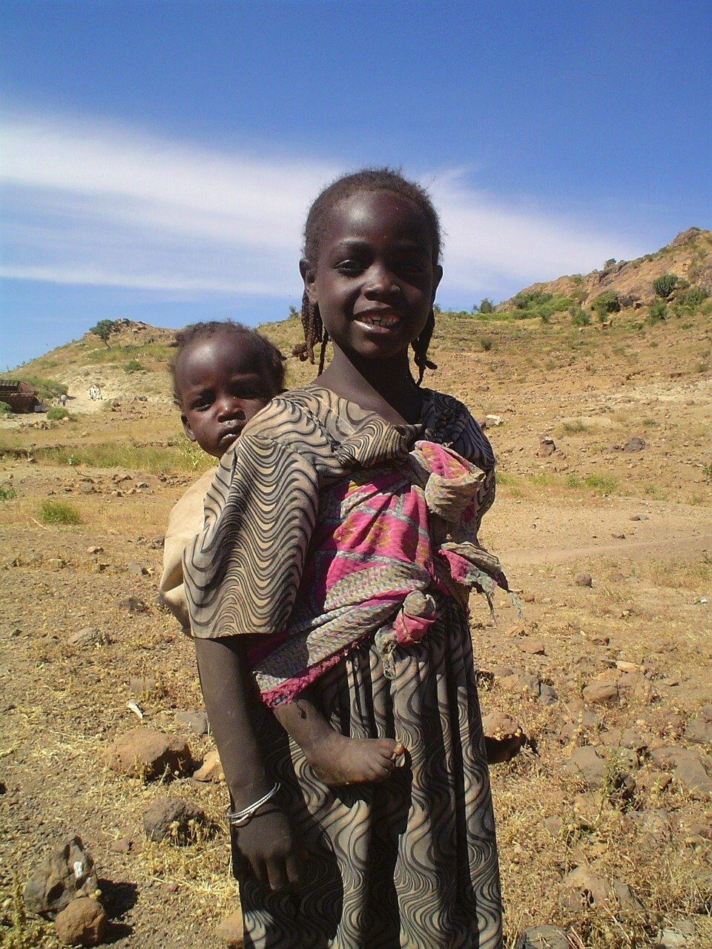
Kurds (MA11)
Hansen: The Kurdish Woman's Life - p 111, 115
🌐
https://ehrafworldcultures.yale.edu/document?id=ma11-004
Masters: Rowanduz - p. 261
🌐
https://ehrafworldcultures.yale.edu/document?id=ma11-002
Blackfoot (NF06)
Ewers: The Blackfeet - p. 103
🌐
https://ehrafworldcultures.yale.edu/document?id=nf06-008
Dempsey: The Blackfoot Indians - p. 421 (bottom)
🌐
https://ehrafworldcultures.yale.edu/document?id=nf06-061

Slide 16
Klamath (NR10)
Pearsall: "Klamath Childhood and Education" - pp. 345-b and 343-a
🌐
https://ehrafworldcultures.yale.edu/document?id=nr10-004
Stern: "The Klamath Tribe" - p. 209 (middle)
🌐
https://ehrafworldcultures.yale.edu/document?id=nr10-003
Kogi (SC07)
Reichel-Dolmatoff & Muirden: The Kogi - p. 106,109, 229
🌐
https://ehrafworldcultures.yale.edu/document?id=sc07-001
Do you see any relationship between children's play and work? Compare your own culture's attitudes towards children's work with that of the other cultures you have read about.

Slide 17
1. Dempsey, Hugh Aylmer. 1986. “The Blackfoot Indians.” In Native Peoples : The Canadian Experience, 404–35. Toronto, Ont.: McClelland and Stewart. https://ehrafworldcultures.yale.edu/document?id=nf06-061.
2. Ewers, John Canfield. 1958. “The Blackfeet: Raiders of the Northwestern Plains.” In Civilization of the American Indian, vol. 49:xviii, 348 , plates. Norman: University of Oklahoma Press. https://ehrafworldcultures.yale.edu/document?id=nf06-008.
3. Hansen, Henny Harald. 1961. “The Kurdish Woman’s Life: Field Research in a Muslim Society, Iraq.” In Copenhagen Ethnographic Museum Record, ix, 213 , 99 plates. Kobenhavn: Nationalmuseet. https://ehrafworldcultures.yale.edu/document?id=ma11-004.
References
4. Hindman, Hugh D. Child labor: an American history. Armonk, New York: M.E. Sharp.
5. Masters, William Murray. 1953. Rowanduz: A Kurdish Administrative and Mercantile Center. [S.L.]: [s.n.]. https://ehrafworldcultures.yale.edu/document?id=ma11-002.
6. Park, Willard Z. (Willard Zerbe), d. 1965. 1946. “Tribes of the Sierra Nevada de Santa Marta, Colombia.” In Handbook of South American Indians, Edited by Julian H. Steward, v. 2:865–86 , plates. Washington: U.S. Govt. Print. Off. https://ehrafworldcultures.yale.edu/document?id=sc07-005.

Slide 18
7. Parsons, Donald O., and Claudia Goldin. 1989. "Parental altruism and self‐interest: Child labor among late nineteenth‐century American families." Economic Inquiry 27, no. 4: 637-659.
8. Pearsall, Marion. 1950. “Klamath Childhood and Education.” In Anthropological Records, vol. 9:339–51. Berkeley: University of California Press. https://ehrafworldcultures.yale.edu/document?id=nr10-004.
9. Reichel-Dolmatoff, Gerardo, and Sydney Muirden. 1949–1950. “The Kogi: A Tribe of the Sierra Nevada de Santa Marta, Colombia. Vol. 1.” In Revista, vol. 4:HRAF MS: 342 [original: 319 ], plates. Bogota: El Instituto. https://ehrafworldcultures.yale.edu/document?id=sc07-001.
References
10. Stern, Theodore. 1965. “The Klamath Tribe: A People and Their Reservation.” In American Ethnological Society, xvi, 356 , plates. Seattle: University of Washington Press. https://ehrafworldcultures.yale.edu/document?id=nr10-003.
Image Credits
Nahua boys in Amatlán play with old machetes, courtesy of Alan R. Sandstrom and Pamela Effrain Sandstrom

Slide 19
Children's Work & Play
in eHRAF World Cultures
Produced by
Human Relations Area Files
at Yale University
An eHRAF Workbook Activity
hraf.yale.edu

