Slide 1
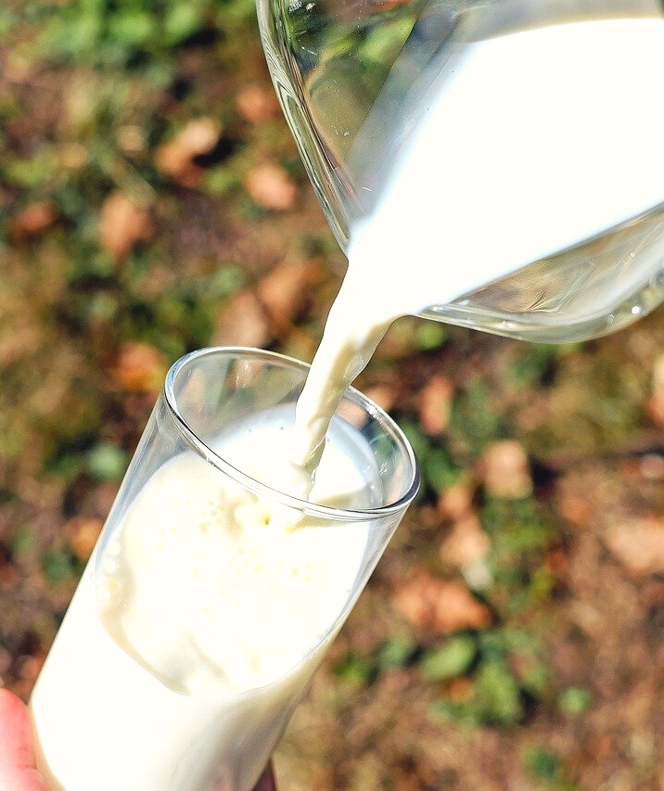
An eHRAF Workbook Activity
Consuming Milk
in eHRAF World Cultures
Human Relations Area Files
at Yale University

Slide 2
In this activity
Explore the place of milk in traditional diets
Conduct searches in eHRAF World Cultures
Compare and contrast milk preparation and consumption practices around the world
Interpret and analyze ethnographic data
Topics We'll Cover

Slide 3
CONSUMING MILK
dairy & digestion

Slide 4
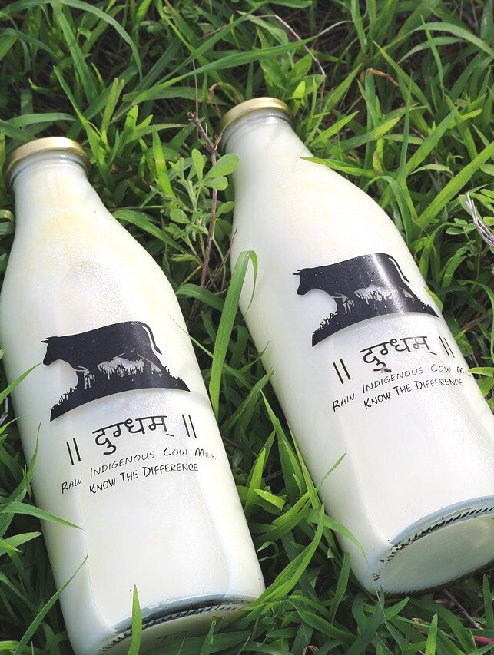
Many adults in the world cannot drink or eat milk without feeling sick. Approximately 65% of the world’s population are lactose intolerant or have a reduced ability to digest lactose – a sugar found in dairy products - after infancy.
This condition is common in some adult populations, particularly in Africa, Asia, and around the Mediterranean. Many cultures have adapted their food customs accordingly, such as by avoiding drinking fresh milk. In other societies, fresh milk remains an essential part of the daily diet.

Slide 5
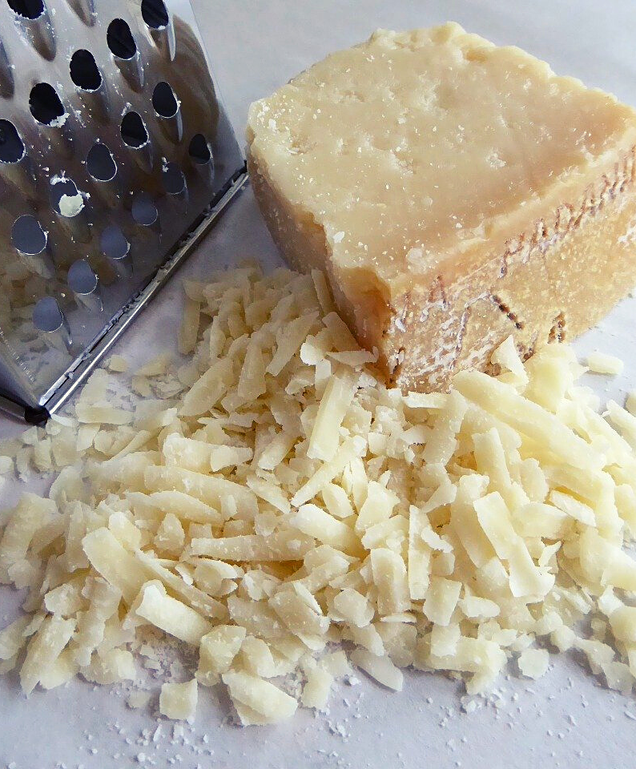
For early farmers, cheese-making may have enabled humans to overcome lactose intolerance through the process of fermentation. Butter, aged cheeses, and yogurts may be more easily tolerated by lactose intolerant individuals due to the fermentation process, during which lactose is broken down and greatly reduced by bacteria.
Today, lactose- and dairy-free options enable more people around the world to enjoy milk despite lactose intolerance.

Slide 6
WORKBOOK ACTIVITY
milk consumption across cultures

Slide 7
Part 1
For the cultures indicated below, explore whether or not milk is an important part of the adult diet.
For example,
Is it consumed fresh?
If not, how is it prepared?
Are other foodstuffs created from milk, such as cheese or yogurt?
Tiv (FF57) Ganda (FK07)

Slide 8
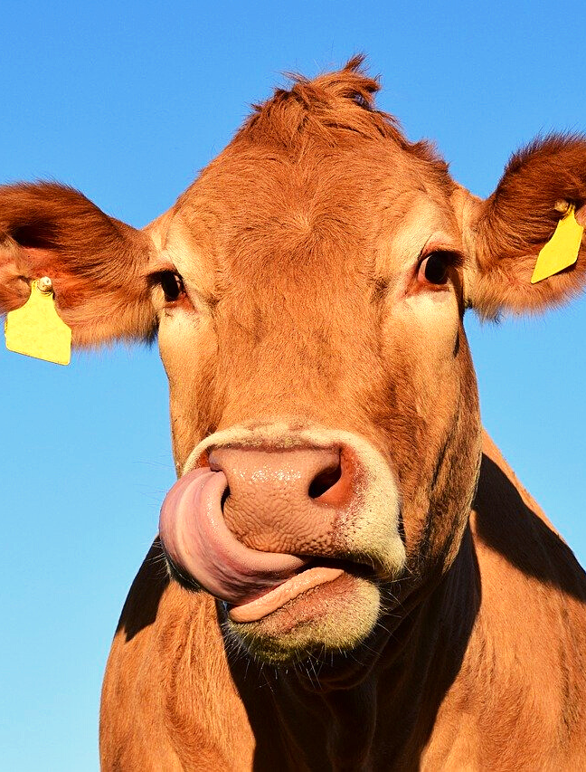
Overview
STEP 1
Refer to the Culture Summary in eHRAF. Write a brief description about the culture, including where they are located and some notes about subsistence or food production.
STEP 2
Use Advanced Search to find ethnographic examples describing whether or not milk is consumed, by whom, and in what form(s).
STEP 3
Summarize your findings for each culture. Keep a note of the document and page where you found the information.

Slide 9
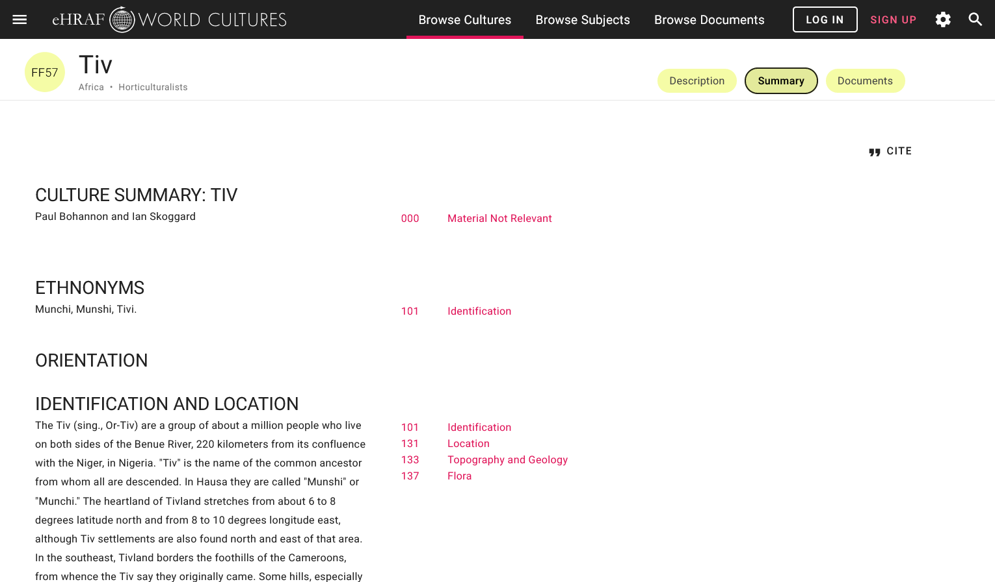
FIND CULTURE SUMMARIES

Slide 10
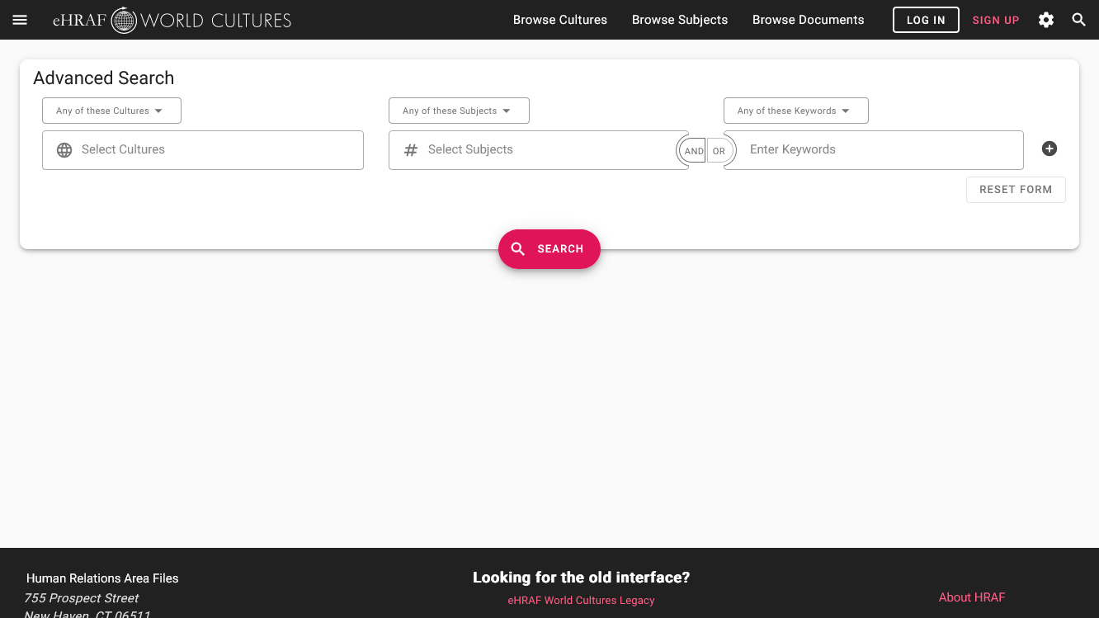
SAMPLE ADVANCED SEARCH
3. choose "and"
1. enter one or more culture names
2. add subjects, e.g:
Diet (262)
4. add "milk*" as keyword

Slide 11
Step 3: Record & Analyze Data
Repeat the search steps above for Tiv and Ganda.
Then, record your findings.
Remember to keep a note of the author's name, document title, and page numbers where you found the information. You can use the Cite button in eHRAF to help save citations.
What have you discovered about milk consumption in these two societies?

Slide 12
PART 2
independent research

Slide 13
Part 2
What other cultures consume milk? Think about where you would expect to find dairy consumption in the ethnographic record.
STEP 1
Use Browse Cultures to select 2-3 additional cultures, preferably from distinct regions or continents. Note the culture's location and other information from the Culture Summary.
STEP 2
Using the same Advanced Search parameters as above - but swapping the Tiv and Ganda for your chosen cultures - find and read ethnographic descriptions of adult milk consumption.
STEP 3
Summarize your findings for each culture.

Slide 14
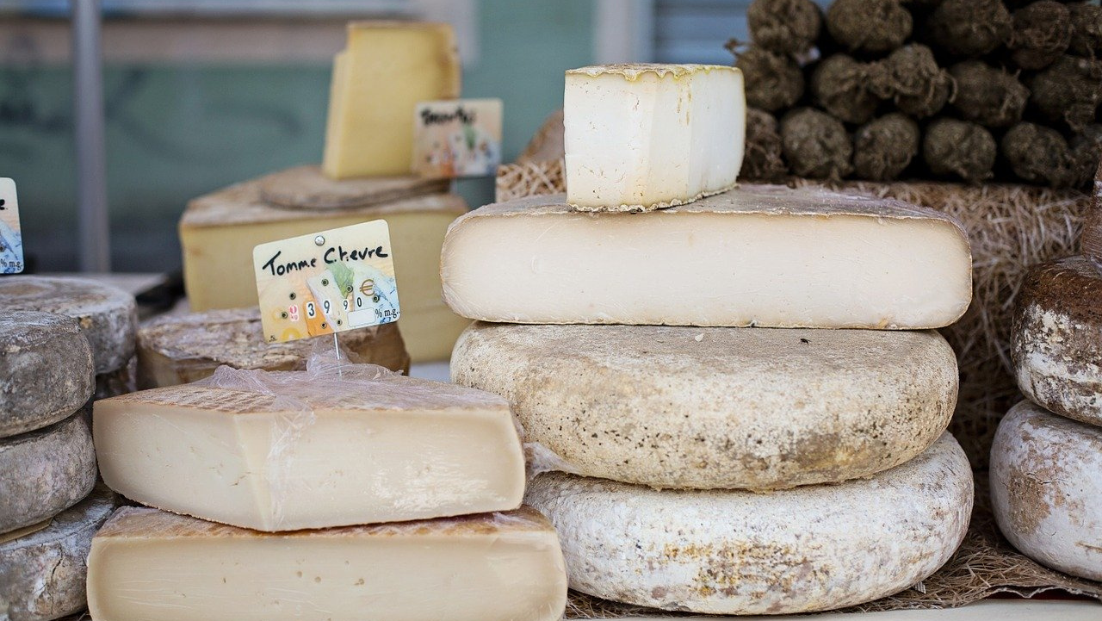
PART 3
compare and contrast

Slide 15
Part 3
Compare and contrast the consumption of milk in your chosen societies (Part 2) with that of the Tiv and Ganda (Part 1).
What similarities and differences have you found?
Are there any common attitudes towards milk and dairy products?
Have milk consumption practices changed over time?
Why do you think this might be the case?

Slide 16
This activity was adapted from "Exercise I. Milk in Diet", by Carol R. Ember, in Teaching eHRAF.
References

Slide 17
Consuming Milk
in eHRAF World Cultures
Produced by
Human Relations Area Files
at Yale University
An eHRAF Workbook Activity
hraf.yale.edu

