Slide 1
An eHRAF Workbook Activity
Dating Methods
in eHRAF Archaeology
Human Relations Area Files
at Yale University

Slide 2
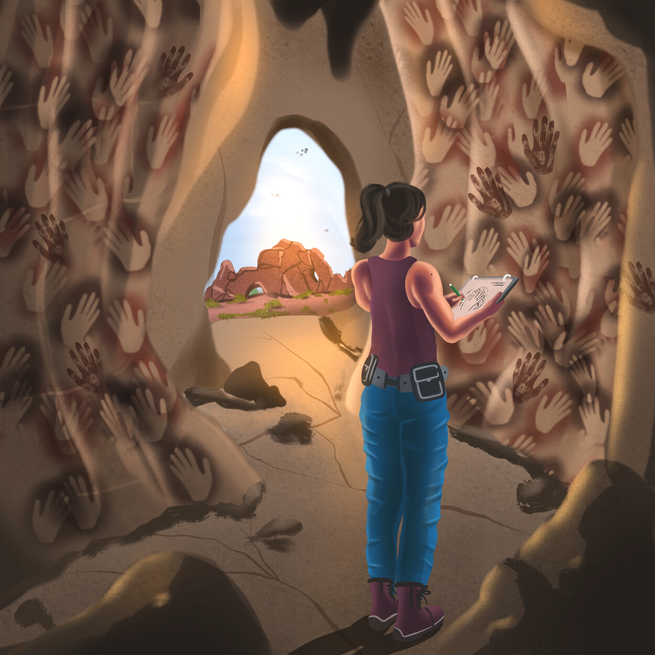
In this activity
Learn about dating methods in archaeology
Compare and contrast relative and absolute dating
Conduct an Advanced Search in eHRAF Archaeology
Read and interpret archaeological data
Topics We'll Cover

Slide 3
The Earth is around 4.6 billion years old.
Physical evidence of geological changes and the mineralized remains of living organisms (fossils), as well as material remains and artifacts of human societies, offer archaeologists important insights into the past.
Did you know?
Archaeologists seek to place discoveries within a broader historical framework; in other words, to get a sense for the time period that an object comes from and how it relates to other finds, times, and places in the archaeological record. This helps to build a better picture of how humans lived in the past, as well as how humanity, culture, and societies have evolved over time.

Slide 4
DATING THE PAST

Slide 5
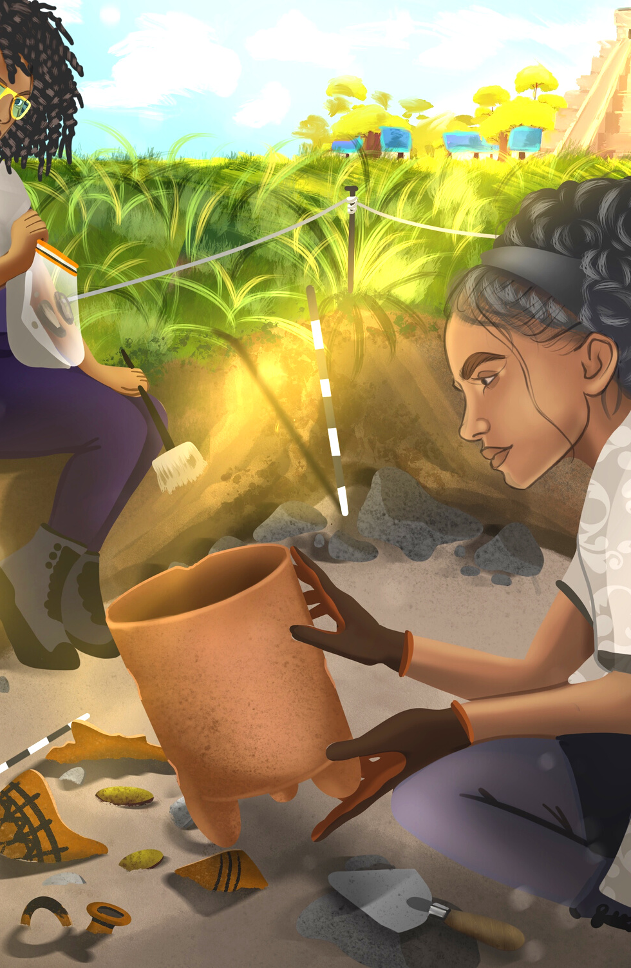
There are a variety of scientific methods that archaeologists use to analyze the age and origins of fossils, remains, or other artifacts.
Dating methods can enable bio-archaeologists to determine factors such as environment, diet, health, or migration patterns of humans, plants, or animals. Knowing the age of an object of material culture, how it was made, and the surrounds in which it was found, also help classical, historical, or ethnoarchaeologists to better hypothesize the purpose or cultural meaning that might have been attributed to it in the past.
Ordering archaeological finds within time periods across traditions is how archaeologists piece together the past that connects all contemporary cultures today.

Slide 6
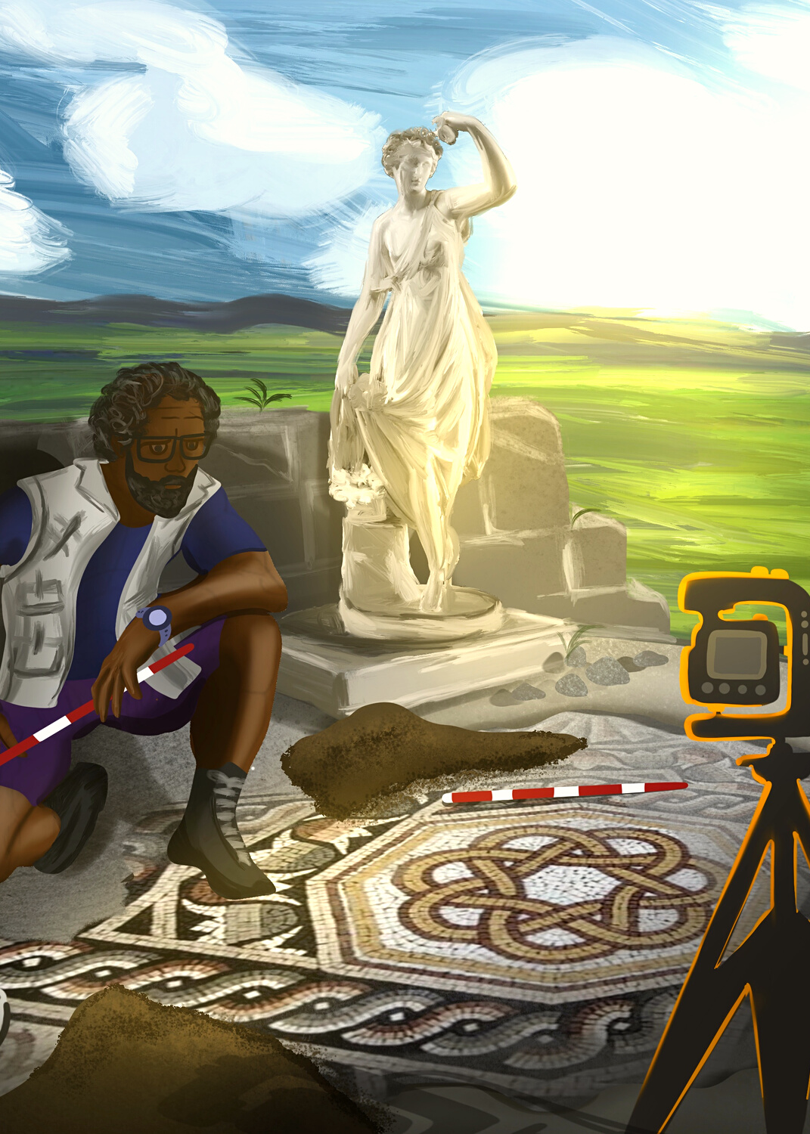
RELATIVE VS. ABSOLUTE DATING
How do archaeologists determine how old an object is?
Relative dating methods estimate whether an object is younger or older than other things found at the site. Relative dating does not offer specific dates, it simply allows to determine if one artifact, fossil, or stratigraphic layer is older than another.
Absolute dating methods provide more specific origin dates and time ranges, such as an age range in years. How specific these dates can be will depend on what method is used.

Slide 7
RELATIVE DATING METHODS
Stratigraphy
Assuming that soil layers in a deposit accumulate on top of one another, and that the bottom layers will be older than the top layers, stratigraphy allows archaeologists to construct a relative chronological sequence from the oldest (bottom) to youngest (top) layers. Artifacts found in these layers are at least as old as the deposit in which they were found.
Seriation
A technique that was common in the mid-20th century, seriation looks at changes in certain styles of artifacts present at a site. A chronology is developed based on the assumption that one cultural style (or typology) will slowly replace an earlier style over time.
Fluorine dating
A technique that analyzes how much of the chemical fluorine has been absorbed by bones from the surrounding soils in order to determine how long the specimen has been underground.

Slide 8
ABSOLUTE DATING METHODS
Radiocarbon dating
Up to 60,000 years ago
One of the most widely known radiometric dating techniques, radiocarbon dating measures the decay of the radioactive isotope Carbon-14 (C-14) in any organic material found in archaeological deposits, such as wood, plants, textiles, and human or animal remains, to determine its age.
Dendrochronology (tree ring dating)
Up to 11,000 years ago
Since most trees produce a ring of new wood annually, archaeologists use the variations in cross-sections of wood to produce timelines.
Thermoluminescence (TL)
5,000 to 100,000 years ago
Useful for determining the age of pottery or ceramics, it can be used to date materials containing crystalline minerals to a specific heating event in the past (such as when the item was made).

Slide 9
ABSOLUTE DATING METHODS
Fission-track dating
10,000 to 400 million years ago
A technique that determines age of various minerals and glasses based on the trails of damage done by the spontaneous fission of uranium-238, the most abundant isotope of uranium.
Potassium-argon (K-Ar)/Argon-argon (Ar-Ar)
100,000 to 4.5 billion years ago
Measuring the ratio of argon gas in igneous volcanic rock to estimate how much time has elapsed since the rock cooled and solidified.
Archaeomagnetic dating
Up to 100,000 years ago
Magnetic particles in most materials of geological origin, such as rocks and clay, are analyzed to track shifts in the earth's magnetic fields over time.

Slide 10
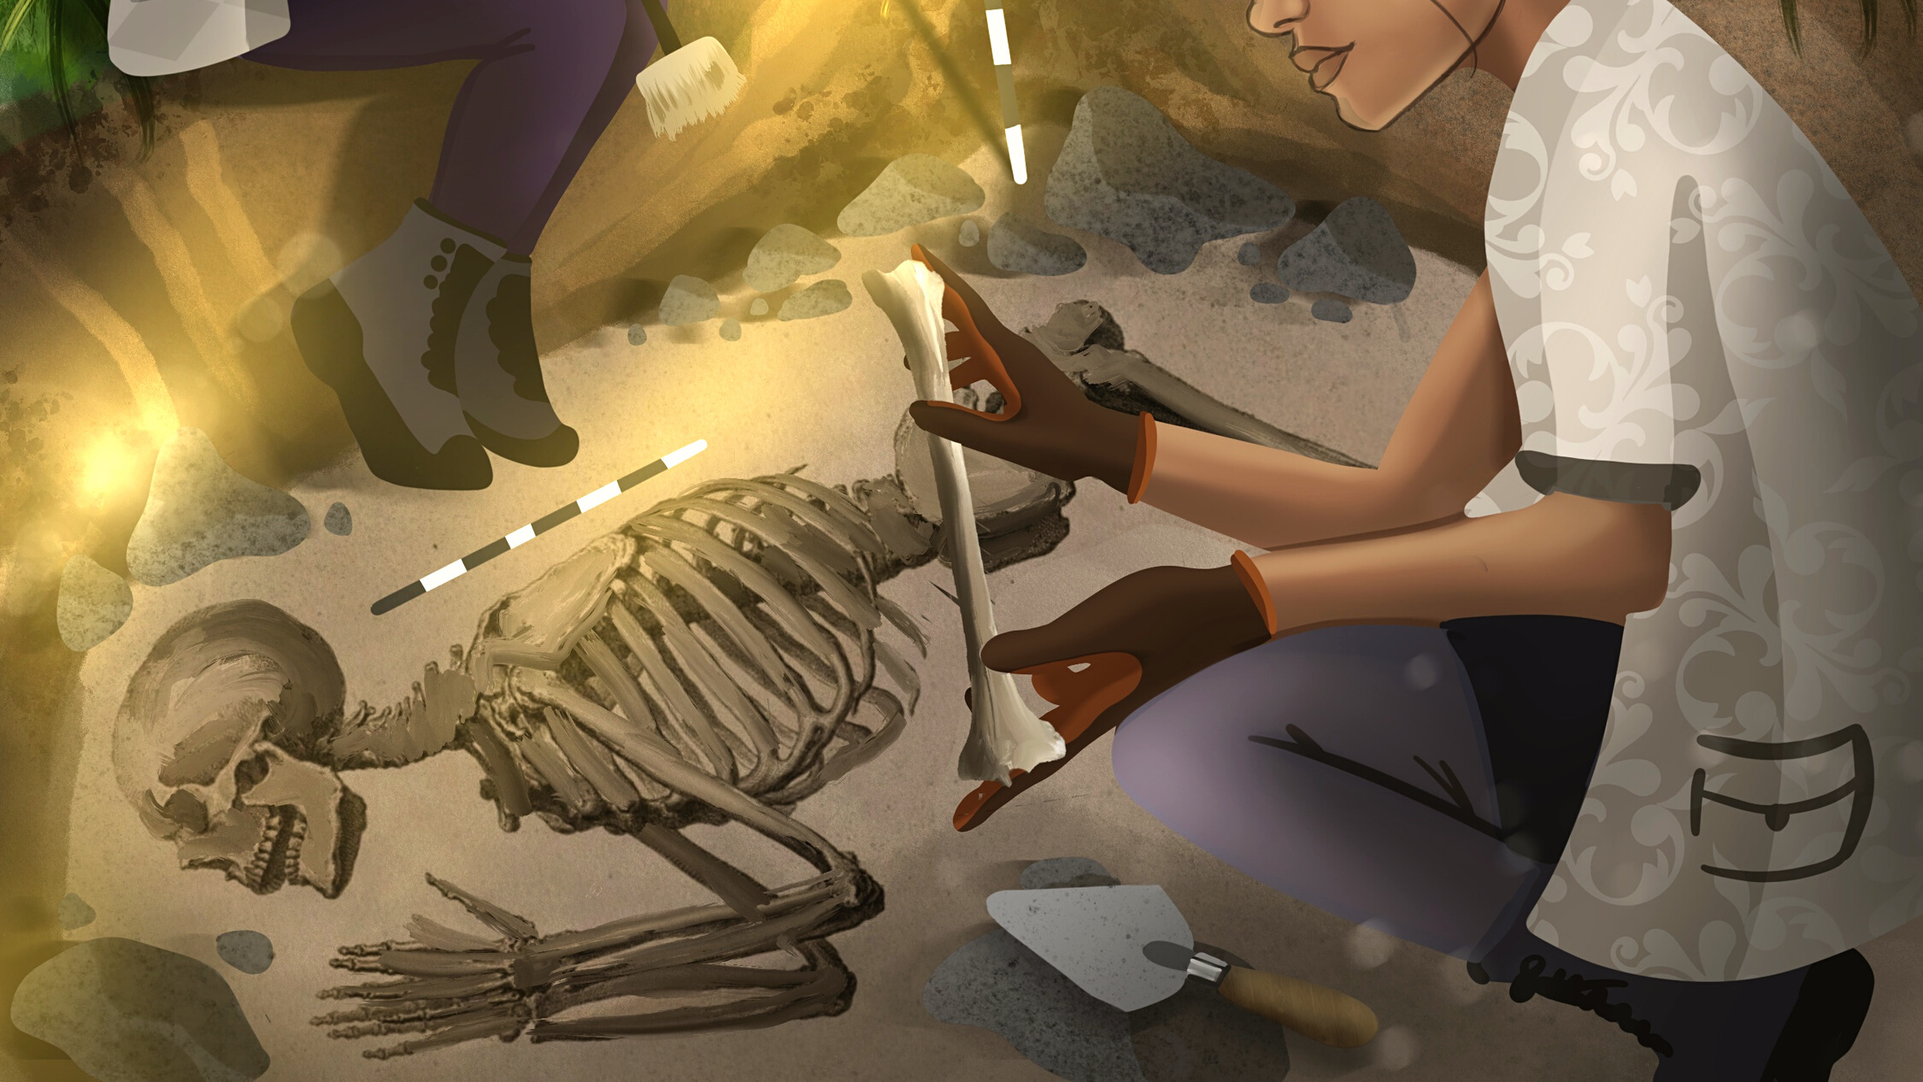
DATING METHODS IN
eHRAF ARCHAEOLOGY

Slide 11
eHRAF ARCHAEOLOGY
Select 3 or more of the dating methods defined above, or any additional techniques described in your textbook.
Then, in eHRAF Archaeology, conduct an Advanced Search to learn more about how these dating methods have been used by archaeologists.
As illustrated below, use the subject identifier Dating Methods in Archaeology (1211) and one or more dating techniques as keywords of your choice.
You may also narrow your search by focusing on one or more regions or traditions, or by adding keywords for specific artifacts or discoveries that you are interested in.

Slide 12
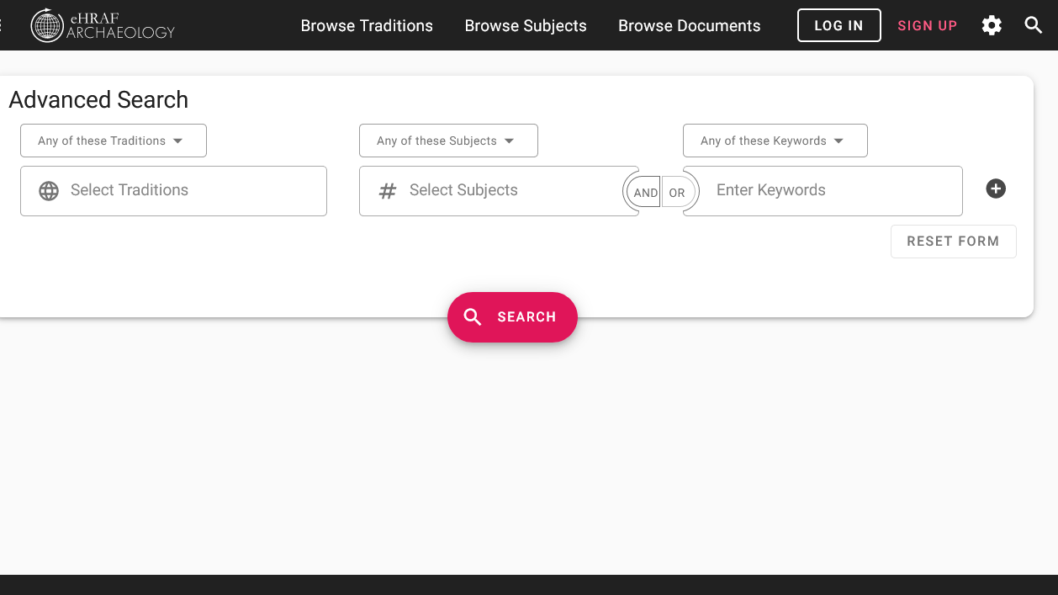
SAMPLE ADVANCED SEARCH
Add keyword(s), such as: radiocarbon, dendrochrono*, thermoluminescence, archaeomagnetic, stratigraph*
Add traditions (optional)
Add subject:
Dating methods in archaeology (1211)

Slide 13
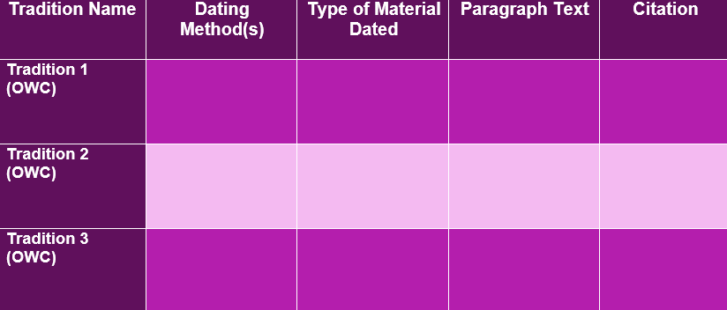
Find evidence from at least 3 traditions and regions in eHRAF. Record your data in a table like this sample table provided below.
Copy and paste the paragraph(s) from eHRAF describing dating methods into the table, along with a citation for the document that it came from.

Slide 14
What object or objects were being dated?
What age was determined?
How trusted were the dates?
What impact did the dating have on archaeologists' understanding of the discovery and its broader chronology?
Did researchers point out any weaknesses or discrepancies in the dating methods used?
Based on your research, which dating method(s) do you believe to be the most accurate? The least accurate?
Was more than one dating method used on the same object? Why or why not?
ANALYSIS

Slide 15
1. King, S. and L. A. Zajicek. 2019. "7. Understanding the Fossil Context" in Shook, Nelson, Aguilera and Braff, eds., Explorations: An Open Invitation to Biological Anthropology. Arlington, VA: American Anthropological Association. www.explorations.americananthro.org
2. Paskey, A. W. and A. B. Cisneros, eds. 2020. Digging into Archaeology: A Brief OER Introduction to Archaeology with Activities. Academic Senate for California Community Colleges via LibreTexts https://chem.libretexts.org/@go/page/74736
References
Image Credits
The illustrations in this workbook are from Anthro Illustrated. https://anthroillustrated.com/

Slide 16
Dating Methods
in eHRAF Archaeology
Produced by
Human Relations Area Files
at Yale University
An eHRAF Workbook Activity
hraf.yale.edu

