Slide 1
An eHRAF Workbook Activity
Dwellings:
A Comparative Approach
in eHRAF Archaeology
Human Relations Area Files
at Yale University

Slide 2
In this activity
Topics We'll Cover
Learn about dwellings
Read passages from traditions covered in eHRAF Archaeology
Compare & contrast traditions
Write a research paper using a comparative approach

Slide 3
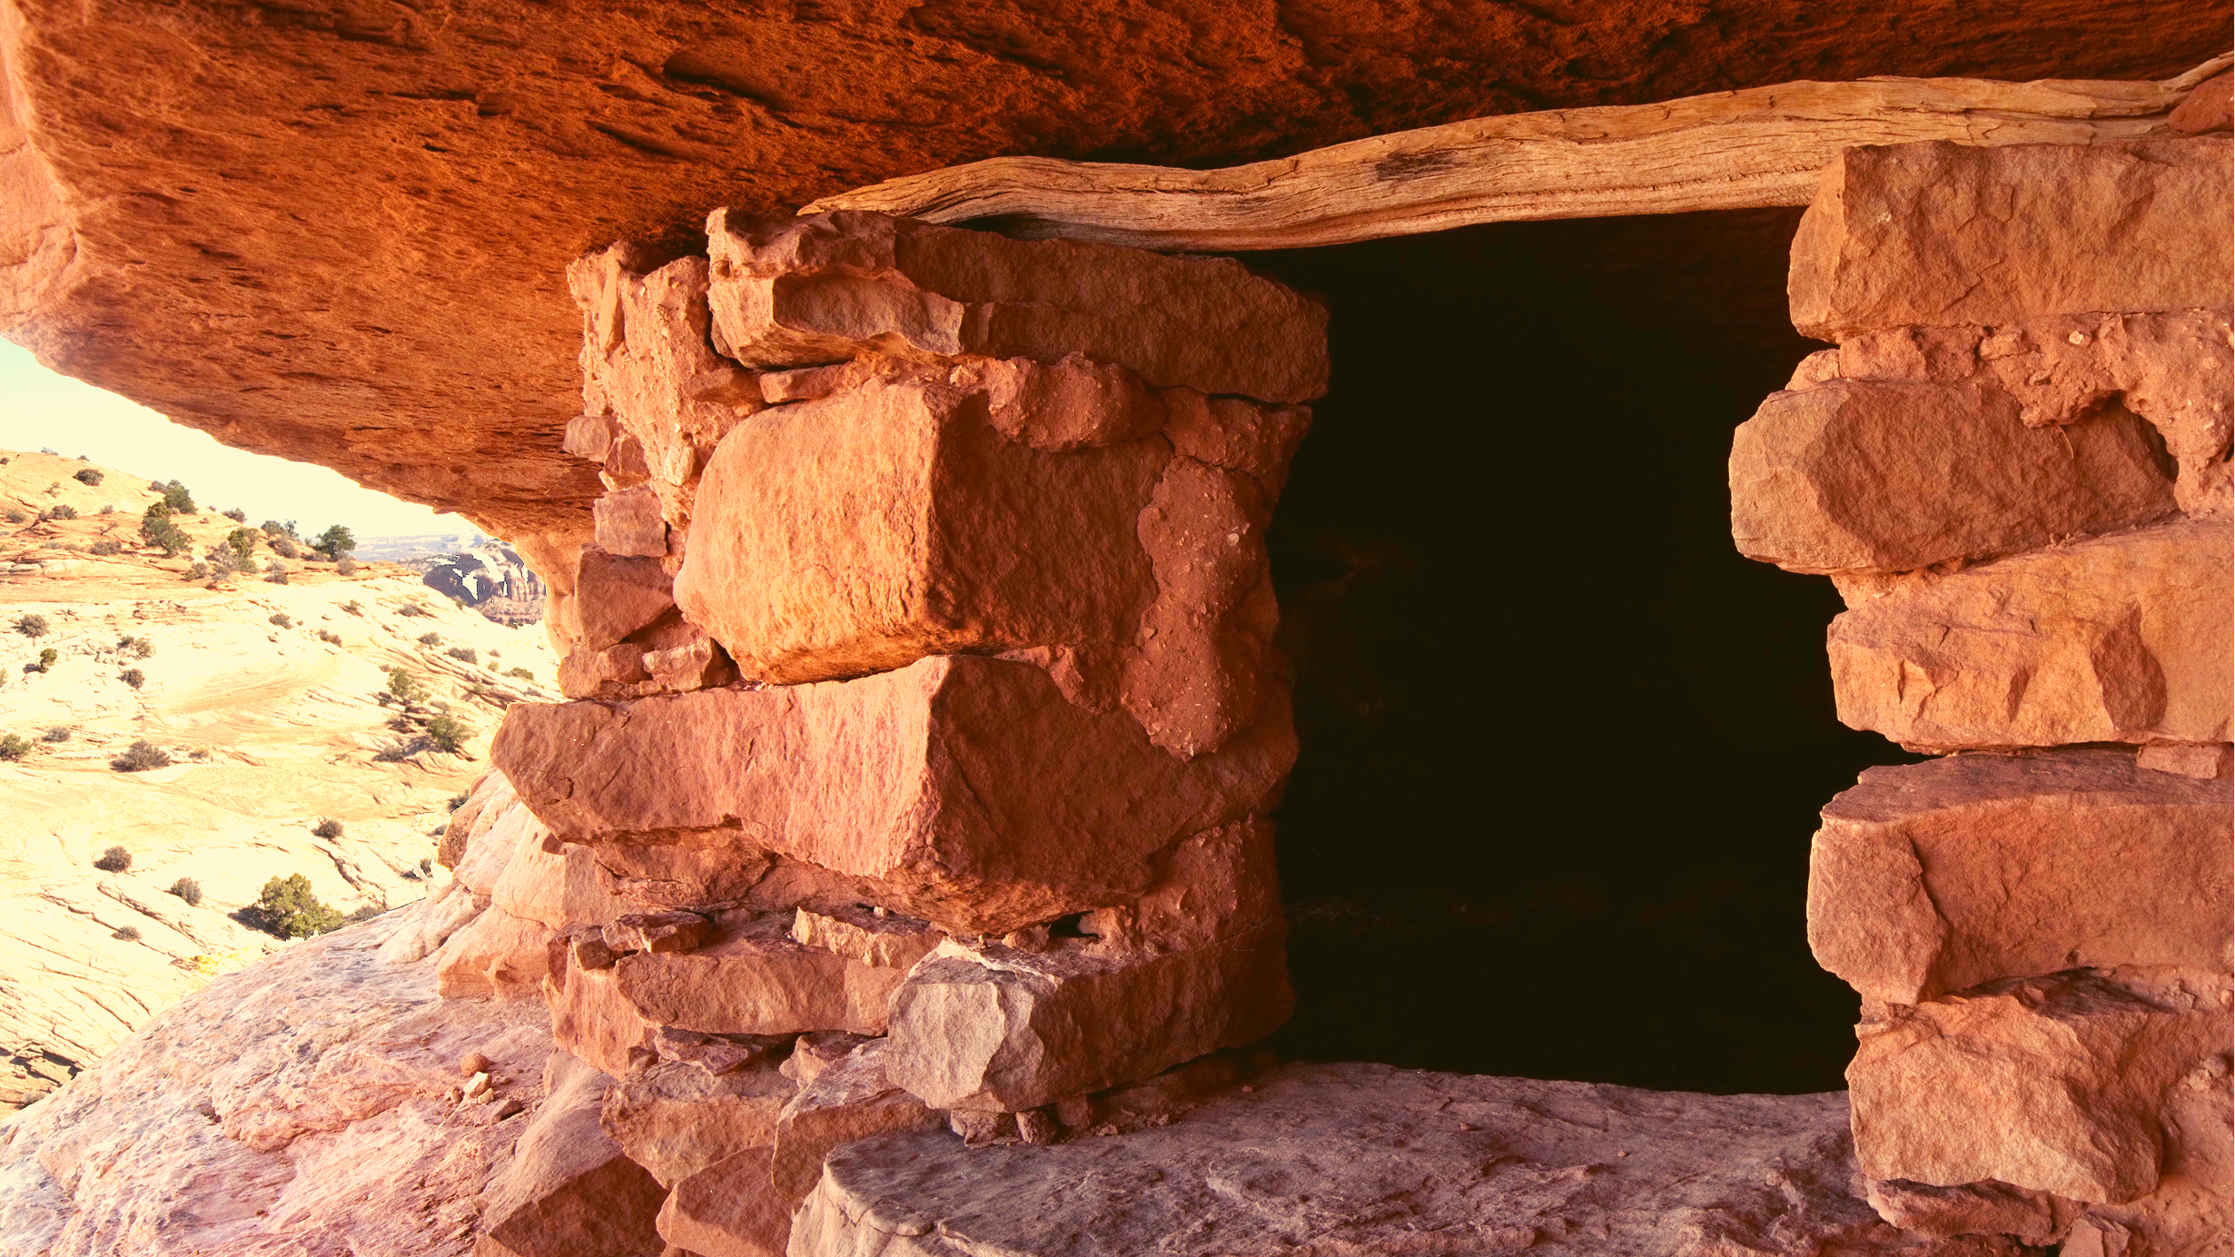
DWELLINGS

Slide 4
This workbook is based on the Explaining Human Culture (EHC) summary on Dwellings by Carol Ember.
https://hraf.yale.edu/ehc/
summaries/dwellings
Read the EHC summary to learn more about dwellings before you begin this activity. The data and cross-cultural research findings referenced throughout this workbook can be found there.

Slide 5
The Explaining Human Culture module on Dwellings provides a general picture of what we have learned from cross-cultural research about predictors of dwellings based on their shape, size, and building materials.
Such predictors are expected to be most useful to archaeologists wishing to find indicators of cultural and social life from the architectural features of dwellings.

Slide 6
Dwellings
Dwellings are one form of material culture unearthed by archaeologists.
Different societies typically have very distinct types of houses or dwellings.
What does a house tell us about peoples' social and cultural life?
Cross-cultural researchers try to predict and explain dwelling size, shape, and building materials.

Slide 7
Rectangular vs. Curvilinear
One cross-cultural finding is that rectangular houses are typical of more complex societies (e.g., those with agriculture, larger communities, and permanent settlements), whereas less complex societies are more likely to have curvilinear, or round, houses. This holds true even if we limit our comparison to societies that are primarily hunter-gatherers. Rectangular houses are associated with hunter-gatherers who live in more permanent settlements.

Slide 8
The yurts of Mongolian pastoral nomads, pictured here, are an example of circular dwellings that can be found in both the archaeological and ethnographic record.
Circular houses are typically constructed from lightweight, flexible materials and are easier to build, take apart, and transport (e.g., tents). Non-agricultural societies are usually more nomadic because they move camp to exploit seasonal wild resources (foragers) and varying pasture and water (pastoralists).

Slide 9
Conversely, when houses are intended to be permanent, they are made with more lasting and heavy materials, such as stone or timber.
The archaeological record shows a common transition from curvilinear to rectangular structures over time. This is usually accompanied by a switch from hunting and gathering (mobile foraging) to a dependence on agriculture and living in permanent settlements.
The following passages from eHRAF Archaeology illustrate this transition.

Slide 10
Bar-Yosef, Ofer. 2011. “Climatic Fluctuations and Early Farming in West and East Asia.” Current Anthropology Vol. 52: s175–93. https://ehrafarchaeology.yale.edu/document?id=af45-013.
Thus, the processes in both China and the Levant were reasonably similar, and sedentism was the common group strategy. The building of domestic dwellings followed the same pattern, starting with round pit houses and shifting gradually to square and rectangular ground plans. Materials varied. In China, wood and bricks became the standard building materials, while in the Levant, undressed and dressed stones played a major role, joined by bricks. Earlier small-scale farming was additionally supplemented by gathering and hunting, a strategy that lasted longer in South China than in either North China or the Levant. While rapid climatic change served as a trigger during the closing centuries of the YD, such changes continue to punctuate the Holocene sequences of both regions, a subject beyond the scope of this paper (e.g., Berger and Guilaine 2009; Chen et al. 2008; Weninger et al. 2009).

Slide 11
Cohen, David Joel. 2011. “The Beginnings of Agriculture in China: A Multiregional View.” Current Anthropology Vol. 52: s273–93. https://ehrafarchaeology.yale.edu/document?id=af45-014.
The appearance of Early Neolithic settlements sometime after 10,100 cal BP marks increased sedentism, population agglomeration, and departures from Late Paleolithic behavioral patterns. Many sites are enclosed by ditches and have distinctinsert_drive_file [S278]insert_drive_file S279 areas for houses, for domestic activities, for storage facilities, and for the earliest planned multigenerational cemeteries, sometimes with hundreds of burials. Early houses are typically small, round, and semisubterranean. Later they shift to a rectangular plan. Houses are frequently found in clusters of several tens, and with a few exceptions, most houses in a village are similar in size. Burials are uniform in size, and grave goods tend to be few. There is little evidence for functional differentiation between households or social status differences between individuals. Within regions, there can be differences in site size.

Slide 12
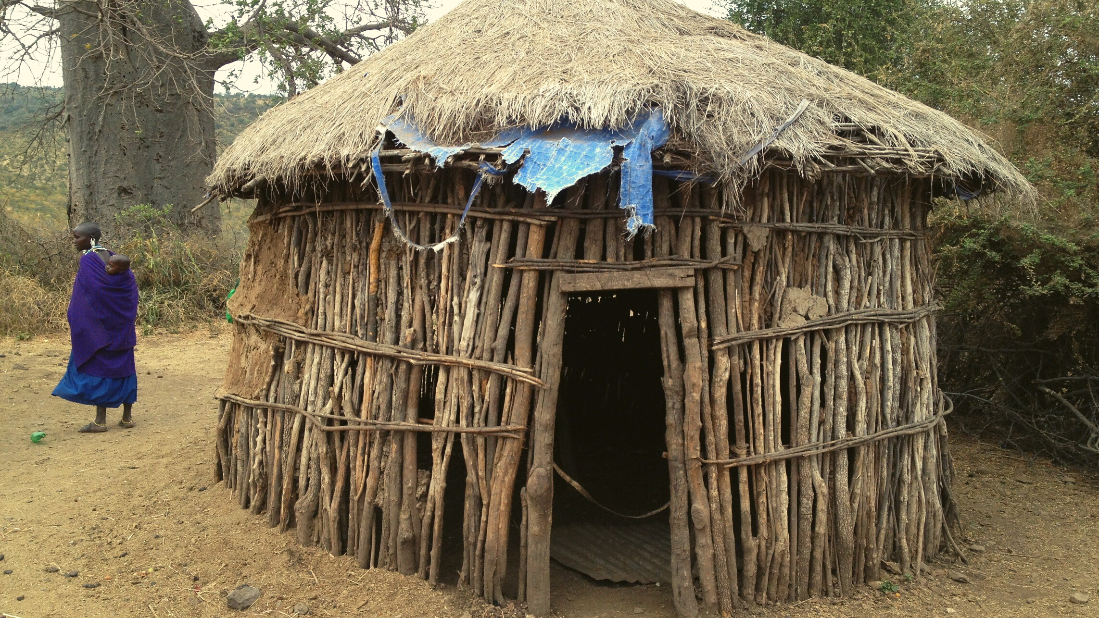
eHRAF Workbook
Part 1: Selected Readings

Slide 13
For this workbook activity, you will learn about dwelling shape across four different archaeological traditions.
On the following slide, you will find a table containing columns for:
Tradition
Dwelling Shape
Description, Document, Page Number
Four Traditions
After reading selected passages provided below, fill in this table with data from eHRAF Archaeology.
Remember to note the titles, authors, and page numbers from the documents where you found the information, and provide a brief description of the dwellings in each of the four traditions.

Slide 15
To read documents or pages in eHRAF:
INSTRUCTIONS
First, follow the permalinks provided in the activities below to get to the relevant documents.
For example:
🌐
https://ehrafarchaeology.yale.edu/document?id=nt76-001
Then, use the Page List dropdown menu to navigate to the required page(s).

Slide 16
Finding documents without permalinks
INSTRUCTIONS
Follow these steps if you are having trouble with permalinks from off campus while using a proxy or VPN service, or if you have been provided with a HRAF-issued username and password.
Sign in via your library proxy or VPN, or using the HRAF-issued credentials.
Go to the Browse Documents tab.
Enter the author's last name into the Filter Index box.
Click on the required title to access the document, then select the page number from the Page List dropdown menu as shown above.

Slide 17
Tradition Summaries
A brief overview for traditions in eHRAF Archaeology is provided in the form of Tradition Summaries.
The format, general outline, and headings are the same for each summary. You will find a basic overview about the tradition, such as its time period, location, history, environment, and sociopolitical organization.
eHRAF
Archaeology
To find a tradition summary, go to the Browse Traditions tab and enter the tradition name into the box, then click on Tradition Summary below the tradition name to read it.

Slide 18
North China Upper
Paleolithic (AF40)
Read the North China Upper Paleolithic (AF40) tradition summary.
https://ehrafarchaeology.yale.edu/document?id=af40-000
🌐
Read the description of curvilinear dwellings and mobility by Liu and Chen on page 51 in "Foragers and collectors".
https://ehrafarchaeology.yale.edu/document?id=af40-016
🌐

Slide 19
Yellow River Early Neolithic (AF45)
Read the Yellow River Early Neolithic (AF45) tradition summary.
https://ehrafarchaeology.yale.edu/document?id=mr70-000
🌐
Read Bar-Yosef (page S188) and Cohen (page S277) on the shift to rectangular.
https://ehrafarchaeology.yale.edu/document?id=af45-013
🌐
https://ehrafarchaeology.yale.edu/document?id=af45-014
🌐

Slide 20
Epipaleolithic (M080)
Read the Epipaleolithic (M080) tradition summary.
https://ehrafarchaeology.yale.edu/document?id=m080-000
🌐
Read the description of circular homes (page 62) in "The Earliest Neolithic in the Levant", Bar-Yosef and Meadow (1995).
https://ehrafarchaeology.yale.edu/document?id=m080-001
🌐

Slide 21
Aceramic Neolithic (M084)
Read the Aceramic Neolithic (M084) tradition summary.
https://ehrafarchaeology.yale.edu/document?id=m084-000
🌐
Read about the transition from rounded to rectangular houses in Bar-Yosef (1995).
https://ehrafarchaeology.yale.edu/document?id=m084-003
🌐

Slide 22
In this activity, you will ual relations across the globe.
eHRAF Workbook
Part 2: Advanced Search

Slide 23
Advanced Search
Now that you have read selected passages from eHRAF Archaeology, dig deeper with Advanced Search. This will enable you to find specific paragraphs in documents that have been indexed by HRAF anthropologists.
On the following slides, you will find an example of an advanced search. Try this search, and then experiment with different subjects and/or keywords. Conducting searches and reviewing results will prepare you to do your own research in Part 4.

Slide 24
Advanced Search
In the Add Traditions column, select the tradition: Early Nomad (RL60)
In the Add Subjects column, select the subject: Dwellings (342)
In the Keyword section, type any of the following keywords: round* circular rectangular

Slide 25
ADVANCED SEARCH
Add tradition:
Early Nomad (RL60)
Add subjects:
Dwellings (342)
Add keyword:
round* circular rectangular

Slide 26
SEARCH RESULTS

Slide 27
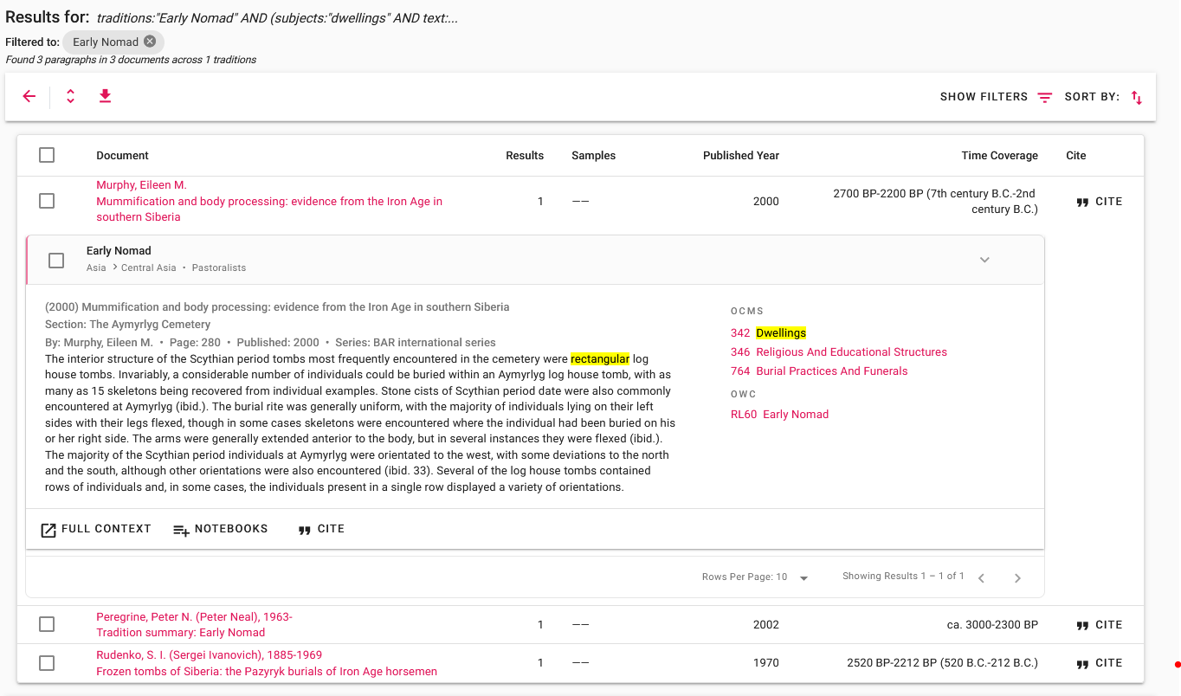
SEARCH RESULTS
Click "Full Context" to view the paragraph in the full page context

Slide 28
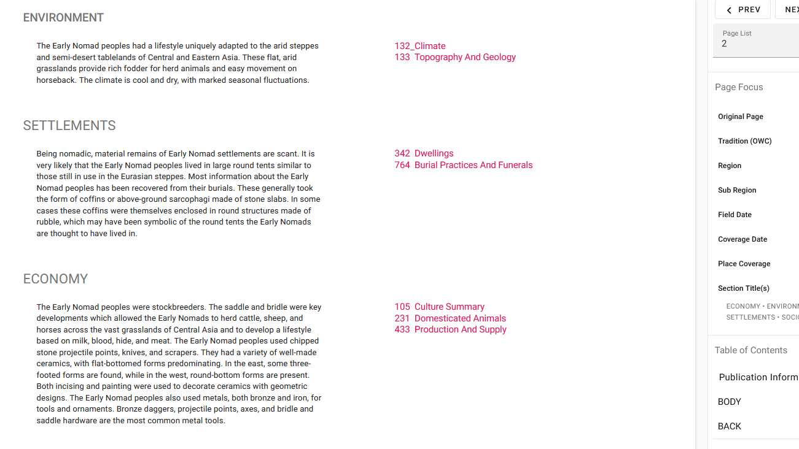
FULL CONTEXT

Slide 29
eHRAF Workbook
Part 3: Assignment

Slide 30
Essay Assignment
eHRAF Archaeology contains numerous descriptions of archaeological sites with curvilinear and rectangular dwellings.
Select any 3 archaeological traditions from 3 different regions. Write an essay in which you compare and contrast these traditions. Include the following information:
Name of the tradition and region
Subsistence type
Describe the dwellings - e.g., shape, size, and building materials.
How do archaeologists interpret these dwellings?
What do you think?

Slide 31
This activity was adapted primarily from the Dwellings module by Carol Ember in Explaining Human Culture: https://hraf.yale.edu/ehc/summaries/dwellings
Banning, E. B. (Edward Bruce). 2010. “Tradition Summary: Aceramic Neolithic.” New Haven, Conn.: Human Relations Area Files. https://ehrafarchaeology.yale.edu/document?id=m084-000.
Bar-Yosef, Ofer. 2011. “Climatic Fluctuations and Early Farming in West and East Asia.” Current Anthropology Vol. 52: s175–93. https://ehrafarchaeology.yale.edu/document?id=af45-013.
References
Bar-Yosef, Ofer. 1995. “Earliest Food Producers: Pre-Pottery Neolithic.” The Archaeology of Society in the Holy Land, 190–204. https://ehrafarchaeology.yale.edu/document?id=m084-003.
Bar-Yosef, Ofer, and Richard H. Meadow. 1995. “The Origins of Agriculture in the Near East.” In Last Hunters, First Farmers, 39–94, 301–46. Santa Fe, N.M.: School of American Research Press. https://ehrafarchaeology.yale.edu/document?id=m080-001
Cohen, David Joel. 2011. “The Beginnings of Agriculture in China: A Multiregional View.” Current Anthropology Vol. 52: s273–93. https://ehrafarchaeology.yale.edu/document?id=af45-014.

Slide 32
Goring-Morris, A. Nigel. 2010. “Tradition Summary: Epipaleolithic.” New Haven, Conn.: Human Relations Area Files. https://ehrafarchaeology.yale.edu/document?id=m080-000.
Liu, Li, and Xingcan Chen. 2012. “Foragers and Collectors in the Pleistocene-Holocene Transition (24,000-9000 CAL. BP).” In The Archaeology of China: From the Late Paleolithic to the Early Bronze Age, 42–74. Cambridge: Cambridge University Press. https://ehrafarchaeology.yale.edu/document?id=af40-016.
References
Miller-Antonio, Sari. 2019. “Tradition Summary: North China Upper Paleolithic.” New Haven, Conn.: Human Relations Area Files. https://ehrafarchaeology.yale.edu/document?id=af40-000.
Peregrine, Peter N. (Peter Neal), and Sarah H. (Archaeologist) Berry. 2020. “Tradition Summary: Yellow River Early Neolithic.” New Haven, Conn.: Human Relations Area Files. https://ehrafarchaeology.yale.edu/document?id=af45-000.

Slide 33
Dwellings:
A Comparative Approach
in eHRAF Archaeology
Produced by
Human Relations Area Files
at Yale University
An eHRAF Workbook Activity
hraf.yale.edu

