Slide 1
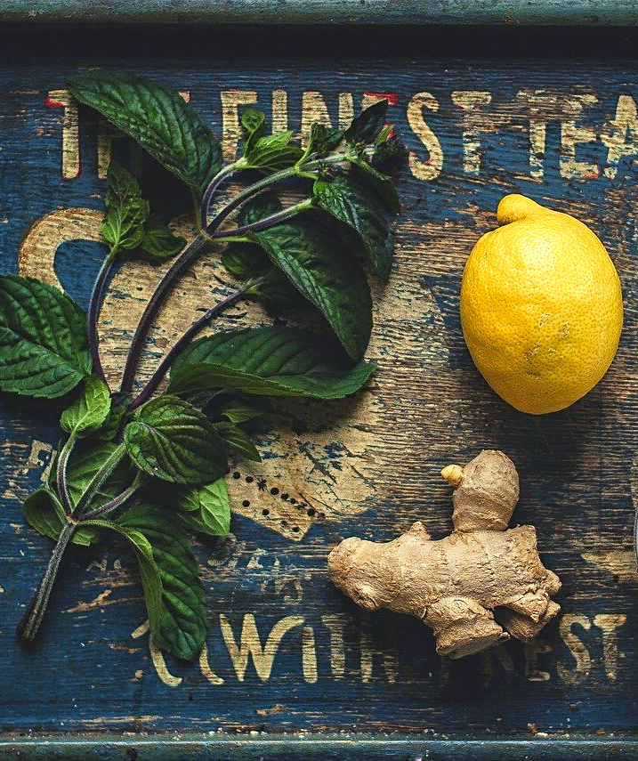
An eHRAF Workbook Activity
Ethnobotany: Medicinal Plants
in eHRAF World Cultures
Human Relations Area Files
at Yale University

Slide 2
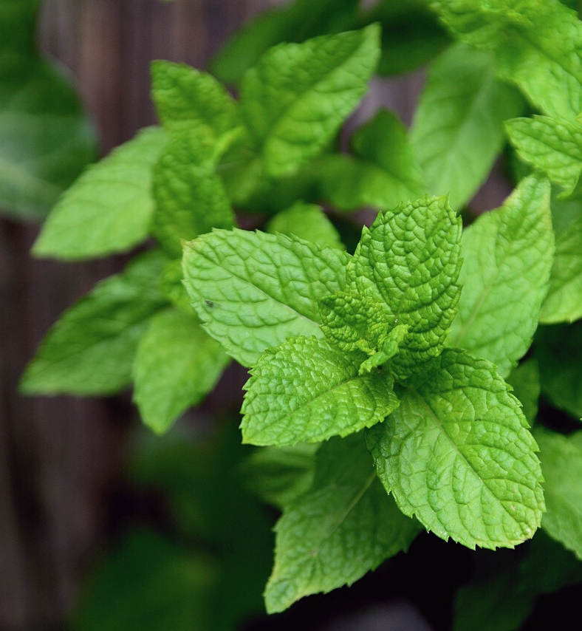
In this activity
Explore medicinal plants around the world
Compare and contrast cultural views regarding medicinal properties of plants, herbs, and fruits
Learn about the cultural diversity of ethnobotanical knowledge in eHRAF World Cultures
Topics We'll Cover

Slide 3
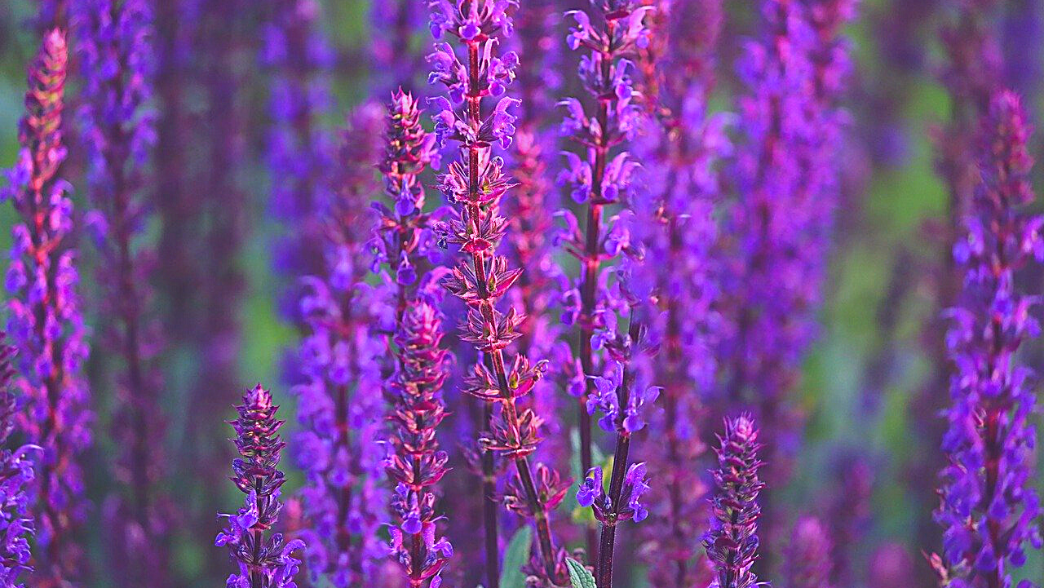
ETHNOBOTANY

Slide 4
Medicinal properties of plants
For many traditional medical practitioners, plants, herbs, and fruits are used for their healing properties. For example, the antiseptic properties of garlic are known to a great number of societies. It has been used to cure everything from bites, colds, and boils to wounds and fevers. Ginger is also widespread as a remedy for eye inflammation, stomach aches, fevers, and colds. Rosemary is an herbal medication believed to cure everything from headaches to toothaches.
Did you know?

Slide 5
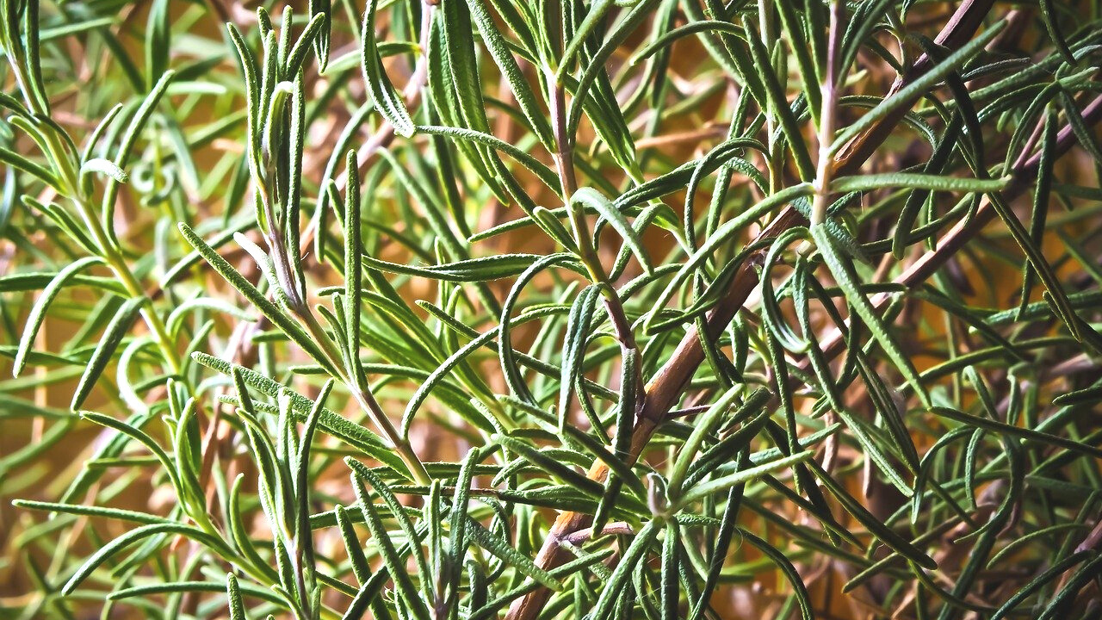
eHRAF Workbook
ACTIVITY
traditional plants and their uses

Slide 6
Explore the traditional medicinal uses of plans, herbs, or fruits across cultures.
Select one or more of the following plant remedies.
Search eHRAF World Cultures to find out how the plant is used by different peoples.
Garlic
Basil
Ginger
Ginseng
Juniper
Mint
Parsley
Rosemary
Sage

Slide 7
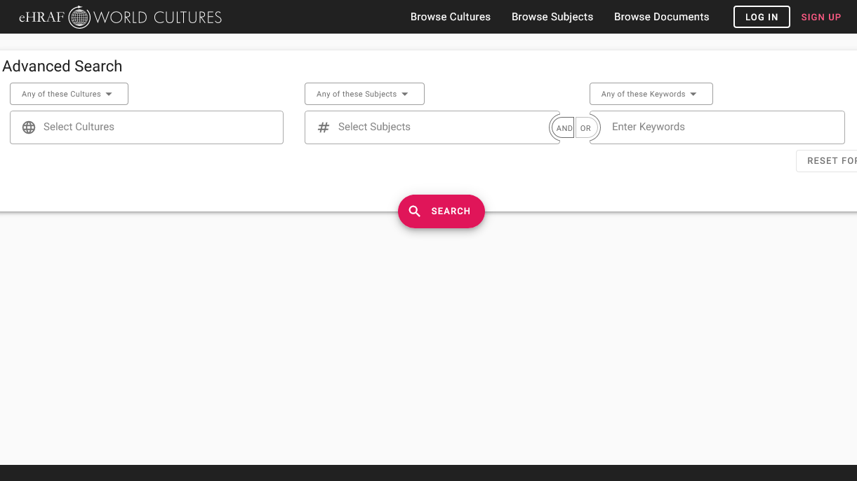
ADVANCED SEARCH
Add one or more subjects:
Bodily injuries (752)
Childbirth (844)
Magical and mental therapy (755)
Medical therapy (757)
Pharmaceuticals (278)
Preventive medicine (751)
Add chosen plant as a keyword

Slide 8
Explore your search results.
Then, create a table to compare your findings on medicinal plant use across the cultures you discovered in eHRAF.
Refer to the sample table below. You may add your own column headers for plant usages that you uncover in the ethnographic data, as well as a column to keep track of the sources where you found the data.

Slide 9
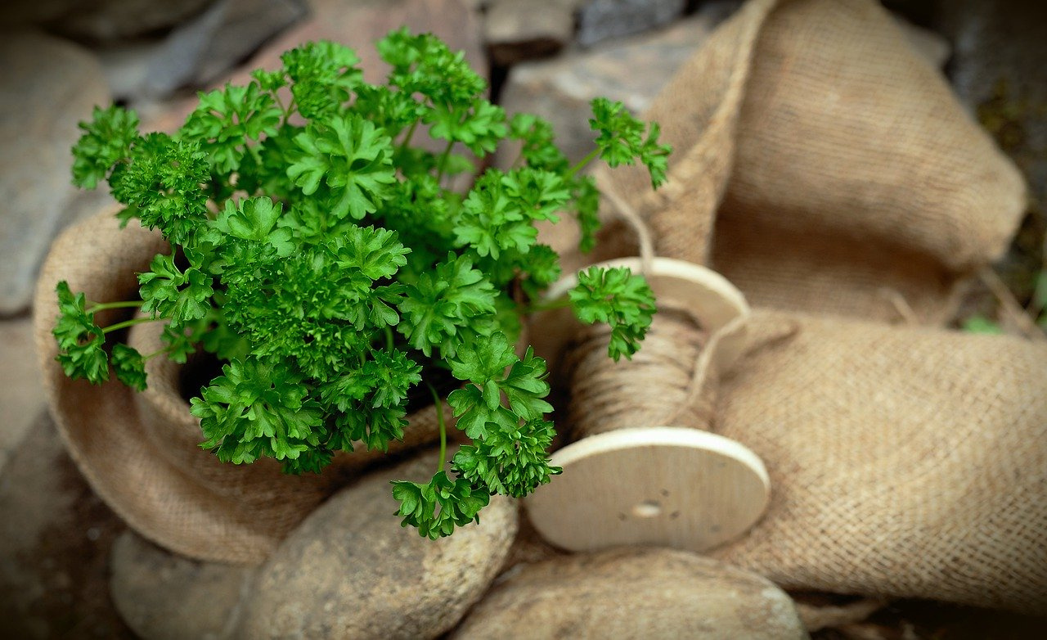
SAMPLE TABLE

Slide 10
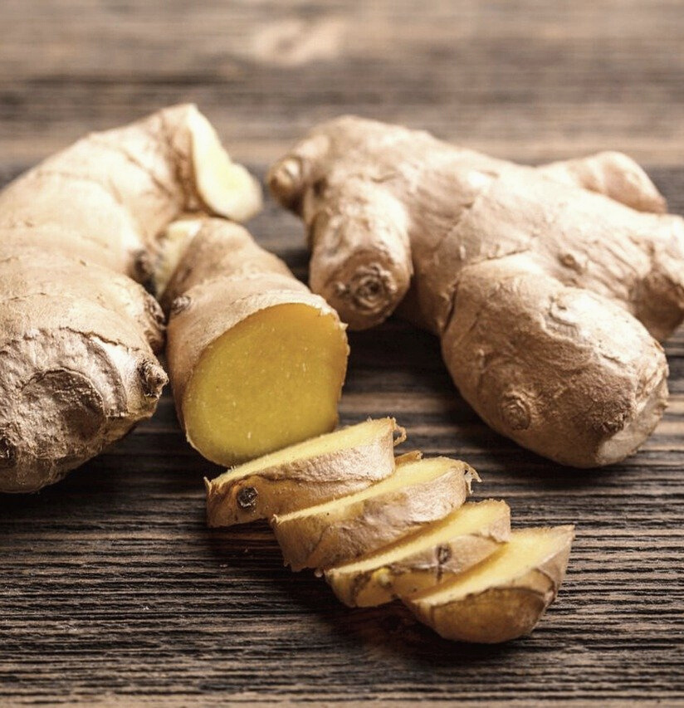
Analyze findings
What similarities or differences have you found in the ways that the cultures in your table use a specific plant or plants to treat illness?

Slide 11
This workbook activity is based on "Topics in Medical Anthropology, Section 5: Ethnobotany and its Medical Uses" in Teaching eHRAF by Christiane Cunnar https://hraf.yale.edu/teach-ehraf/ethnobotany-in-class-activity/
References

Slide 12
Ethnobotany:
Medicinal Plants
in eHRAF World Cultures
Produced by
Human Relations Area Files
at Yale University
An eHRAF Workbook Activity
hraf.yale.edu

