Slide 1
An eHRAF Workbook Activity
Ethnographic Fieldwork
in eHRAF World Cultures
Human Relations Area Files
at Yale University

Slide 2
In this activity
Learn about conducting anthropological research
Define fieldwork and ethnography
Identify emic and etic viewpoints and researcher bias
Read accounts of fieldwork experiences in eHRAF World Cultures
Topics We'll Cover

Slide 3
ETHNOGRAPHIC FIELDWORK

Slide 4
Ethnographic fieldwork is the primary way that cultural anthropologists gather data.
Fieldwork is the process of immersing oneself in as many aspects of people's lives as possible in order to study their behaviors, interactions and ways of viewing the world. Nearly any setting or location can become "the field": a village along the Amazon river, a large corporate office in Tokyo, a small neighborhood café in Seattle, or even a social networking site like Facebook.
Did you know?

Slide 5
Fieldwork takes time. Anthropologists enter the field location much like a newborn child. They may have trouble communicating until they have learned the local language. They will likely make mistakes, and locals will find them funny or strange. It can take months or years to begin to accustom themselves to the society or community within which they will live and learn.
In the fieldwork process, anthropologists eventually piece together ideas about kinship, language, religion, politics, and economic systems, which allows them to build a picture of the society.

Slide 6
Ethnography can mean two things in anthropology:
1. the research methods employed during fieldwork
2. the written descriptive and interpretive results of that research
Ethnography

Slide 7
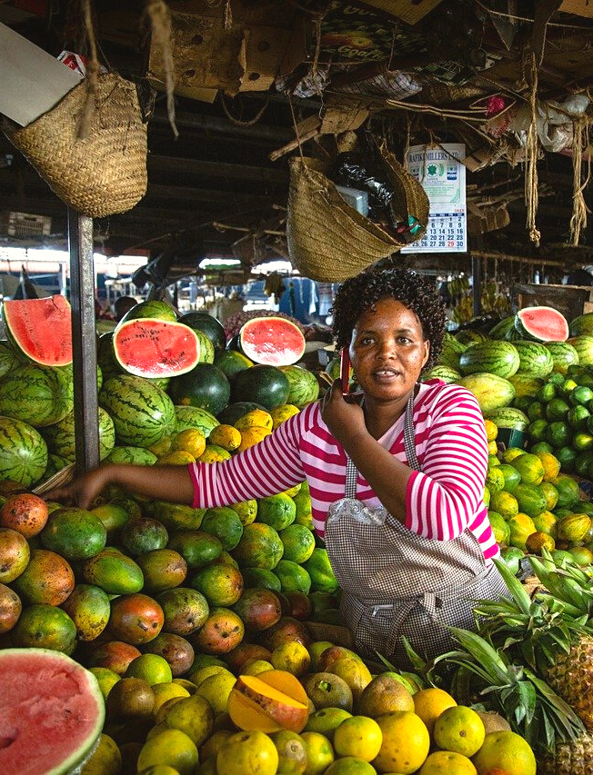
DOING ETHNOGRAPHY
The hallmark method of ethnographic research in anthropology is known as participant-observation. This is when an anthropologist records their experiences and observations while taking part in activities alongside local participants or informants in the field. Anthropologists also engage in informal conversations, formal interviews, surveys, or questionnaires, and create photos, sound or video recordings, as well as conduct historical or archival research into correspondence, public records, or reports, depending on their research interests.

Slide 8
WRITING ETHNOGRAPHY
Ethnographic writing differs from historical, journalistic, or travel writing about peoples and places. While ethnographers may also keep a fieldwork diary containing personal notes, ethnography is much more than a recounting of daily events. Ethnography often engages with the theoretical foundations of anthropology and is written with cultural contextualization in mind, speaking to anthropology as a discipline as well as furnishing in-depth understanding of the cultural world that has been explored. The ultimate aim of ethnographic writing is to produce work that contributes to, and advances, the comparative interpretation of human cultures and societies.

Slide 9
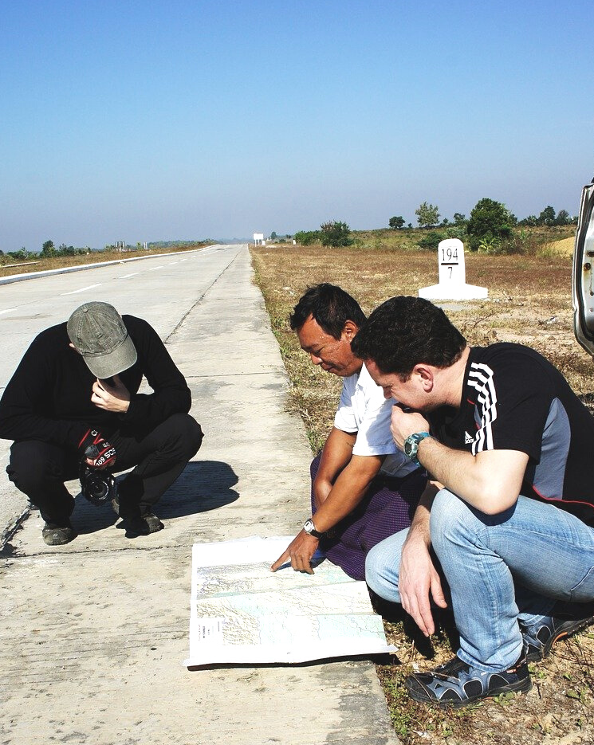
INFORMANTS
Ethnography is a collaborative effort between the ethnographer and their research participants. Anthropologists have ethical codes that guide their behavior in the field as they rely on relationships with others in order to conduct their research. In the ethnographic process, informants or key participants can help to induct the ethnographer into the society and explain its customs and ways.

Slide 10
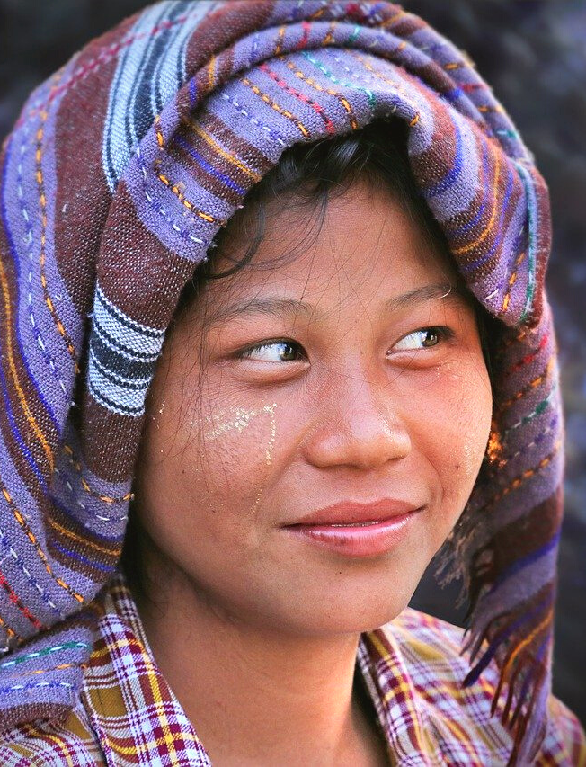
AN INSIDER'S VIEW
Anthropologists try to arrive at an emic perspective or "insider's point of view". In other words, to understand the structures, categories, and patterns of behavior as conceptualized by members of the culture they are studying. This is contrasted with etic models, which are analyses of culture as seen from the "outside", such as how an anthropologist would classify behavior. Both perspectives are important because what people say they do, what they say they should do, and what they actually do, rarely – if ever – coincide. Without asking an insider, outsiders could miss valuable information about why people do what they do.

Slide 11
Anthropologists today are increasingly aware of their own views and biases that they carry with them into the field from their home cultures, acknowledging wherever possible how this affects their methods and findings. Despite all of the best intentions, any practicing fieldworker can tell you that fieldwork is, at best, unpredictable.
A reflexive approach to ethnography acknowledges that no researcher can be 100% objective, and that fieldwork constitutes an ongoing dialogue of consent and mutual respect between participants and the ethnographer.

Slide 12
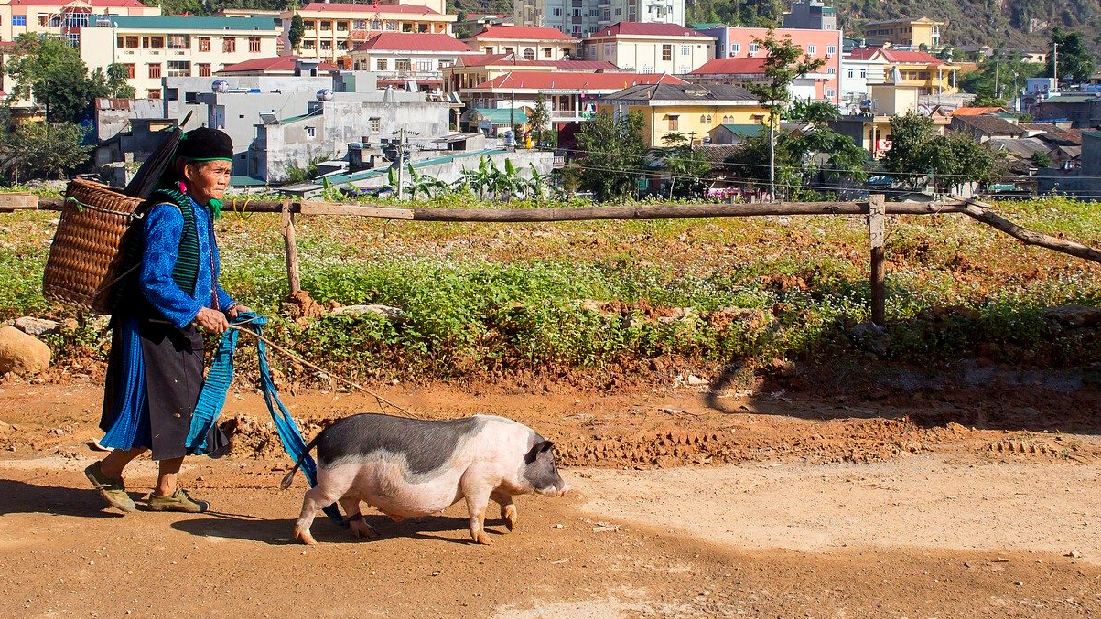
ACTIVITY 1
The Fieldwork Experience

Slide 13
eHRAF World Cultures
Working alone or in small groups, read the following passages in eHRAF World Cultures that describe different aspects of fieldwork and conducting ethnography. Then, answer the questions below.

Slide 14
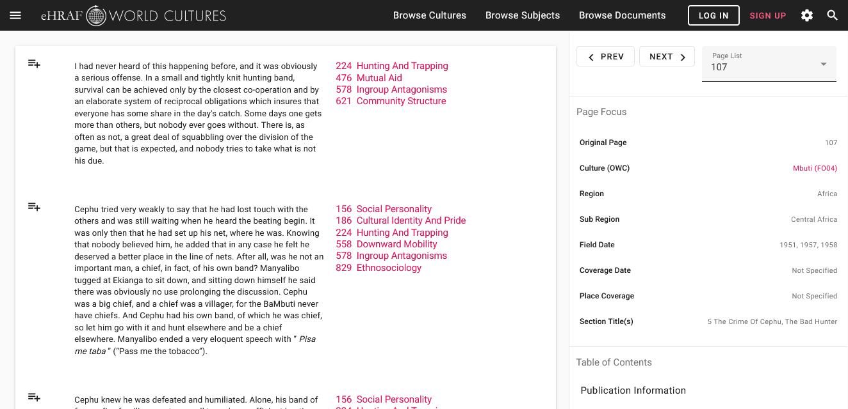
To read documents or pages in eHRAF:
INSTRUCTIONS
First, follow the permalinks provided in the activities below to get to the relevant documents.
For example:
🌐
https://ehrafworldcultures.yale.edu/document?id=fo04-003
Then, use the Page List dropdown menu to navigate to the required page(s).

Slide 15
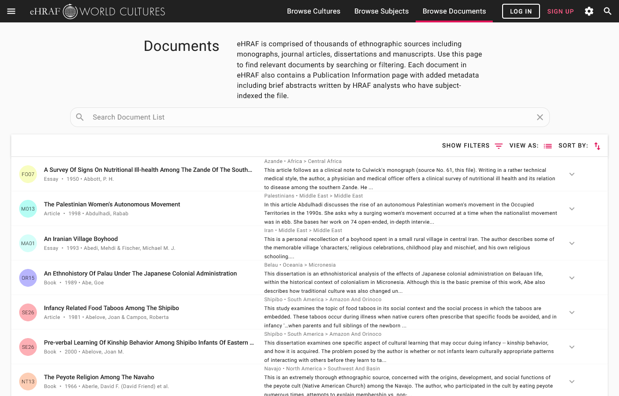
Finding documents without permalinks
INSTRUCTIONS
Follow these steps if you are having trouble with permalinks from off campus while using a proxy or VPN service, or if you have been provided with a HRAF-issued username and password.
Sign in via your library proxy or VPN, or using the HRAF-issued credentials.
Go to the Browse Documents tab.
Enter the author's name or document title into Search Document List box.
Click on the required title to access the document, then select the page number from the Page List dropdown menu as shown above.

Slide 16
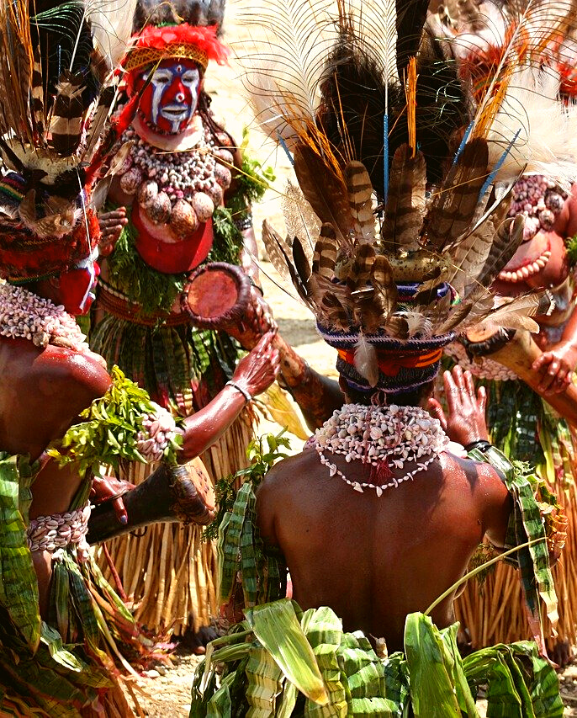
Malinowski (1922) Argonauts of the Western Pacific, Chapter 1, Section VII, pages 17-21 on participant-observation
🌐
https://ehrafworldcultures.yale.edu/document?id=ol06-001
What is "the imponderabilia of actual life"?
How does Malinowski suggest that ethnographers should observe and record this imponderabilia during fieldwork?
According to Malinowski, why is it good for the ethnographer to sometimes put aside their notebook and camera?

Slide 17
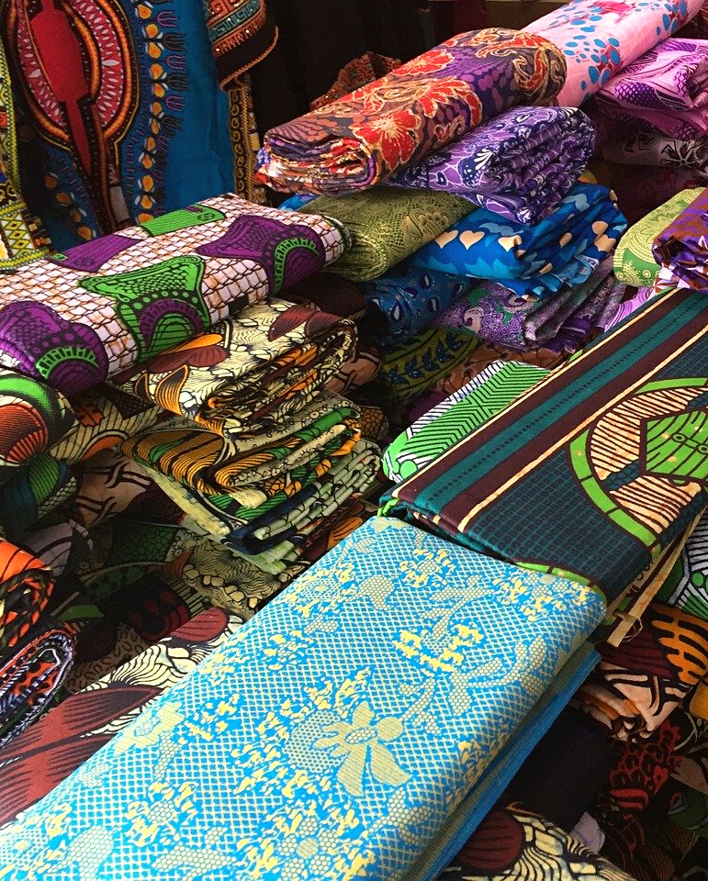
Clark (1994) - Onions Are My Husband, pages xx-xxiii and 18, on local reactions
🌐
https://ehrafworldcultures.yale.edu/document?id=fe12-058
How did locals respond to the presence of the anthropologist?
Why was it not possible to tape interviews?
What unexpected problems did the ethnographer run into?
How did the ethnographer overcome the suspicions about her intentions?

Slide 18
Textor (1973) – Roster of the Gods, Appendix One, pages 855-858 on working with key informants
🌐
https://ehrafworldcultures.yale.edu/document?id=ao07-011
Describe the relationship between the ethnographer and his informants.
How critical were the informants to completing the ethnographic research?
Do you think that learning the local language is essential for doing fieldwork?

Slide 19
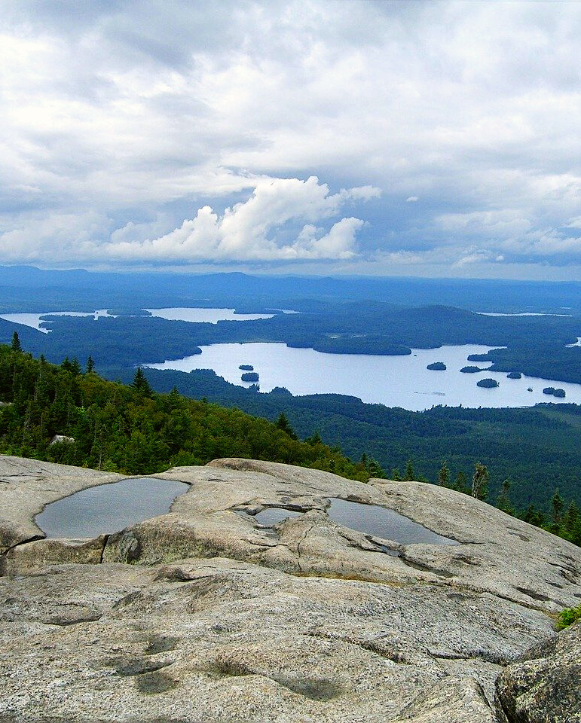
Landsman (1988) – Sovereignty and Symbol, pages 2-8 on taking notes with informants
🌐
https://ehrafworldcultures.yale.edu/document?id=nm09-058
How did the emotions of informants/ research participants impact the ethnographer's fieldnotes?
How were historical, archival, print, and photographic materials utilized in their study?
How did informants assist with this?
How critical do you think informants are to conducting ethnographic research?

Slide 20
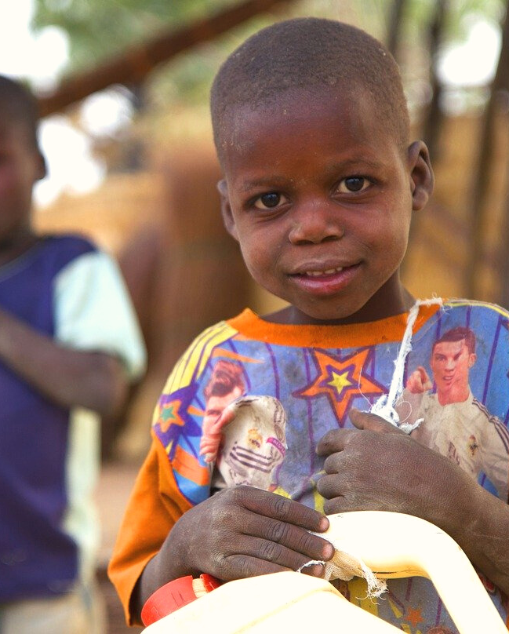
Hill (1972) - Rural Hausa: A Village and Setting, page 148 on the anatomy of poverty
🌐
https://ehrafworldcultures.yale.edu/document?id=ms12-018
What do you think the author means by "the poor are usually unobserved"?
Are there some types of insights that are difficult or impossible to ascertain through participant-observation?
Why might this be the case?
How do you think anthropologists should deal with sensitive information or vulnerable members of a culture?

Slide 21
ACTIVITY 2
Thinking Ethnographically

Slide 22
How would you observe the following cultural practices ethnographically?
Write a brief ethnography of one of the following experiences (or choose your own):
Shopping in a bookstore
Traveling by public transportation
Ordering takeout from your favorite restaurant
Having coffee with friends at Starbucks

Slide 23
Consider methods such as participant-observation, interviews, surveys, and engaging with informants. If you are unable to participate in these activities face-to-face, simply try and imagine how you would describe them to an outsider not familiar with your culture.
Begin by recording your "field notes", keeping track of everything that you see and do, and what you observe others saying and doing.
Then, describe what's happening from both emic and etic perspectives.

Slide 24
For the emic perspective, consider the activity you are engaged in and how it is viewed in your own culture. What are the established “rules” or patterns of each interaction that make up the scene you have chosen?
For example, at a café, you might find that one of your friends buys coffee for the entire group. If asked why they have done so, the buyer may simply reply that "it's a nice thing to do", and indicate that someone else would pay next time.

Slide 25
For the etic perspective, look beyond your notes and step outside your own cultural expectations. What over-arching structures, symbols, or meanings are at play in this setting?
For example, why do you think people really take turns buying rounds of drinks? What happens if one person never pays? Due to the fact that such a person would not be considered a good friend, an etic analysis might find that coffee exchange is meaningful for building and sustaining friendship rather than being about money.

Slide 26
1. This activity is based on An Introduction to Fieldwork and Ethnography, by Francine Barone, in Teaching eHRAF. https://hraf.yale.edu/teach-ehraf/an-introduction-to-fieldwork-and-ethnography/
2. Clark, Gracia. 1994. Onions Are My Husband: Survival and Accumulation by West African Market Women. Chicago: University of Chicago Press. https://ehrafworldcultures.yale.edu/document?id=fe12-058.
3. Hill, Polly. 1972. Rural Hausa: A Village and Setting. Cambridge, England: University Press. https://ehrafworldcultures.yale.edu/document?id=ms12-018.
References
4. Landsman, Gail H. 1988. Sovereignty and Symbol: Indian-White Conflict at Ganienkeh. Albuquerque, N.Mex.: University of New Mexico Press. https://ehrafworldcultures.yale.edu/document?id=nm09-058.
5. Malinowski, Bronislaw. 1922. Argonauts of the Western Pacific. London: George Routledge & Sons, Ltd. https://ehrafworldcultures.yale.edu/document?id=ol06-001.
6. Textor, Robert B. 1973. “Roster of the Gods: An Ethnography of the Supernatural in a Thai Village.” In Ethnography Series, 3, 44, 911 leaves. New Haven, Conn.: Human Relations Area Files. https://ehrafworldcultures.yale.edu/document?id=ao07-011.

Slide 27
Ethnographic Fieldwork
in eHRAF World Cultures
Produced by
Human Relations Area Files
at Yale University
An eHRAF Workbook Activity
hraf.yale.edu

