Slide 1
An eHRAF Workbook Activity
Globalization
&
Change
in eHRAF World Cultures
Human Relations Area Files
at Yale University

Slide 2
In this activity
Define globalization
Understand how and why culture changes
Conduct research in eHRAF World Cultures
Read and interpret ethnographic data
Topics We'll Cover

Slide 3
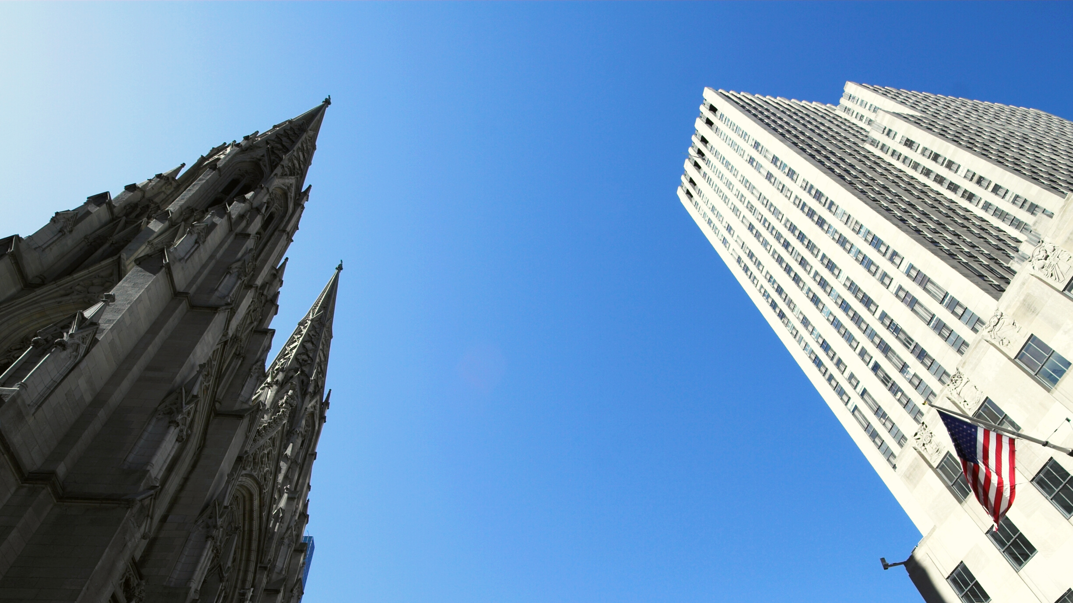
CULTURAL CHANGE

Slide 4
All cultures change.
Globalization refers to the processes of change and interdependence as a result of the interconnectedness of peoples and societies around the world.
Cultural diffusion is when a material item, idea, or behavior spreads from one culture or society to another. When the process of diffusion is asymmetrical, such as when individuals of a minority population are made to assimilate into a dominant culture or cultural sphere, this is known as acculturation.
Did you know?

Slide 5
One example of a globalized commodity is cuisine. From American food chains like McDonald's or Starbucks, to international favorites like pizza and sushi, food is a clear way that culture travels around the world. It is also a good example of the process of glocalization, which is when people adapt foreign items, ideas, or practices to suit local needs.
When McDonald's offers menu options in Japan, Trinidad, or France that differ from its original US menu in order to cater to local tastes in those countries, the food is being glocalized.
when local meets global

Slide 6
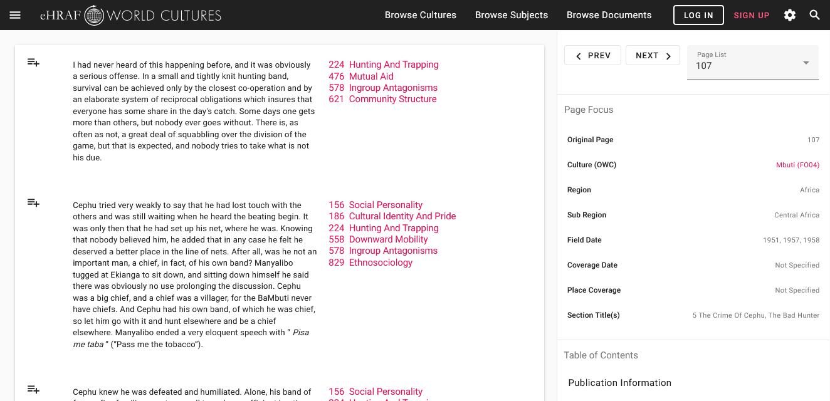
To read documents or pages in eHRAF:
INSTRUCTIONS
First, follow the permalinks provided in the activities below to get to the relevant documents.
For example:
🌐
https://ehrafworldcultures.yale.edu/document?id=fo04-003
Then, use the Page List dropdown menu to navigate to the required page(s).

Slide 7
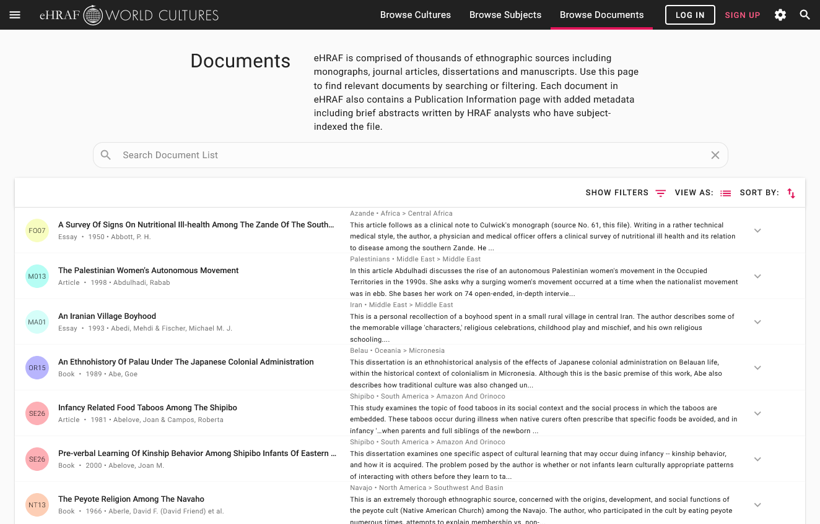
Finding documents without permalinks
INSTRUCTIONS
Follow these steps if you are having trouble with permalinks from off campus while using a proxy or VPN service, or if you have been provided with a HRAF-issued username and password.
Sign in via your library proxy or VPN, or using the HRAF-issued credentials.
Go to the Browse Documents tab.
Enter the author's name or document title into Search Document List box.
Click on the required title to access the document, then select the page number from the Page List dropdown menu as shown above.

Slide 8
TECHNOLOGICAL CHANGE

Slide 9
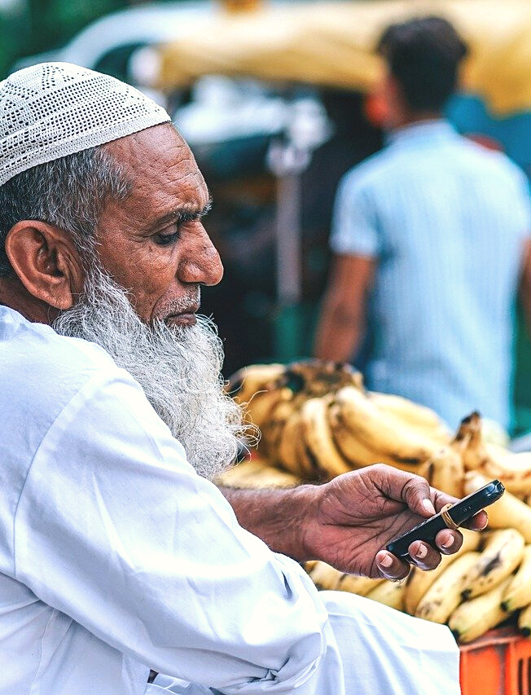
Not all aspects of globalization bring unmitigated benefits to local populations. A counter trend to the process of glocalization is de-localization.
This happens when features of a society must change in order to adapt to a modernizing and globalizing world. An imbalance of power between industrialized nations and non-industrialized societies becomes evident.
An example of this is when technological changes introduced to a society threaten to erode traditional lifestyles, cultural traits, behaviors, or means of subsistence, such by causing a shift to dependence on commercial goods.

Slide 10
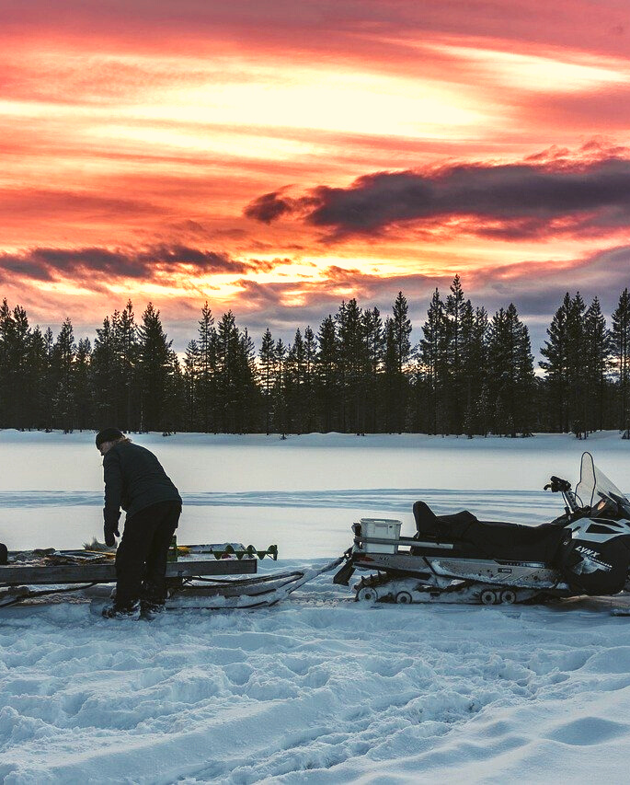
Read the following passages and answer the questions provided.
TECHNOLOGY
Pelto (1987): The Snowmobile Revolution: Technology and Social Change in the Arctic.
🌐
https://ehrafworldcultures.yale.edu/document?id=ep04-022
pages 31-32 and 48-50 on reindeer herding before the snowmobile
pages xiii and 137-140 on changes due to introduction of snowmobile
pages 165-168 – on de-localization

Slide 11
Skolt Saami (EP04)
Sevettijärvi, Northeastern Finland
How has the Saami relationship to reindeer changed since the 19th century? Why?
What was the "snowmobile revolution"?
What impact has technology had on herding practices and on the lifeways of Sevettijärvi people?
In your opinion, has this technological change been beneficial or detrimental to Saami society?

Slide 12
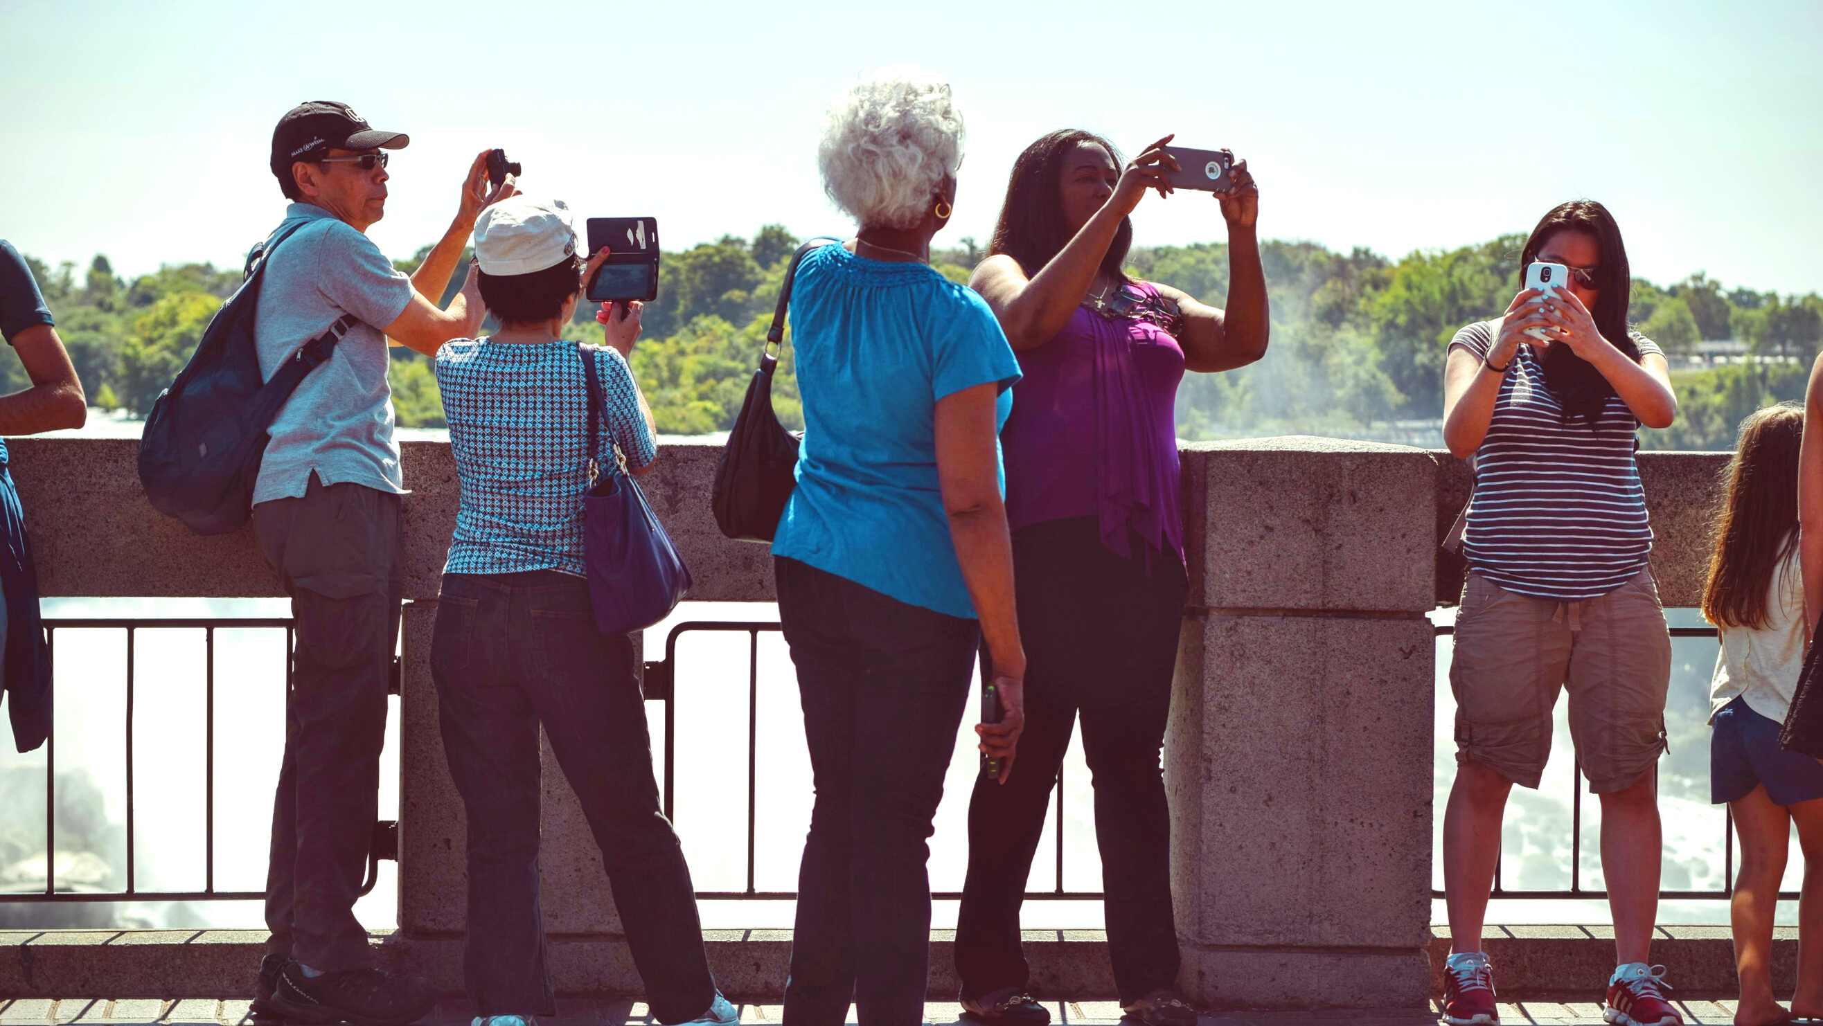
TOURISM & AUTHENTICITY

Slide 13
The global exchange of ideas and commodities is not unilateral. Influences can circulate in many directions.
Western cultural exports like movies and TV have reached all corners of the globe. At the same time, wealthy tourists in industrialized societies purchase products from indigenous peoples hoping to find items that represent an authentic local culture.
This practice of cultural tourism can likewise have an impact on economic development, the flow of material goods, and cultural perspectives around the world.

Slide 14
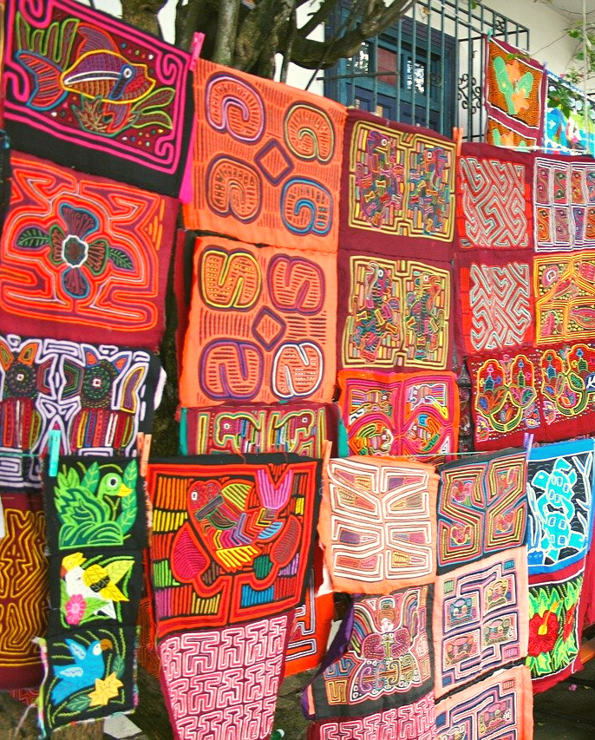
AUTHENTICITY
Read the following passage and answer the questions provided.
Tice (1995): Kuna Crafts, Gender, and the Global Economy.
🌐
https://ehrafworldcultures.yale.edu/document?id=sb05-037
"Gender, Income, Ethnicity, and the Mola Market", on pages 90-98

Slide 15
Kuna (SB05)
San Blas, Panama
How do class, gender, and ethnicity come into play when traditional mola blouses are produced and sold?
For what reasons are both rich and poor Panamanians unlikely to purchase molas? Has this changed?
What impact has demand from the United States had on Kuna crafts?
How much do local mola producers and their international consumers know about each other's cultures?

Slide 16
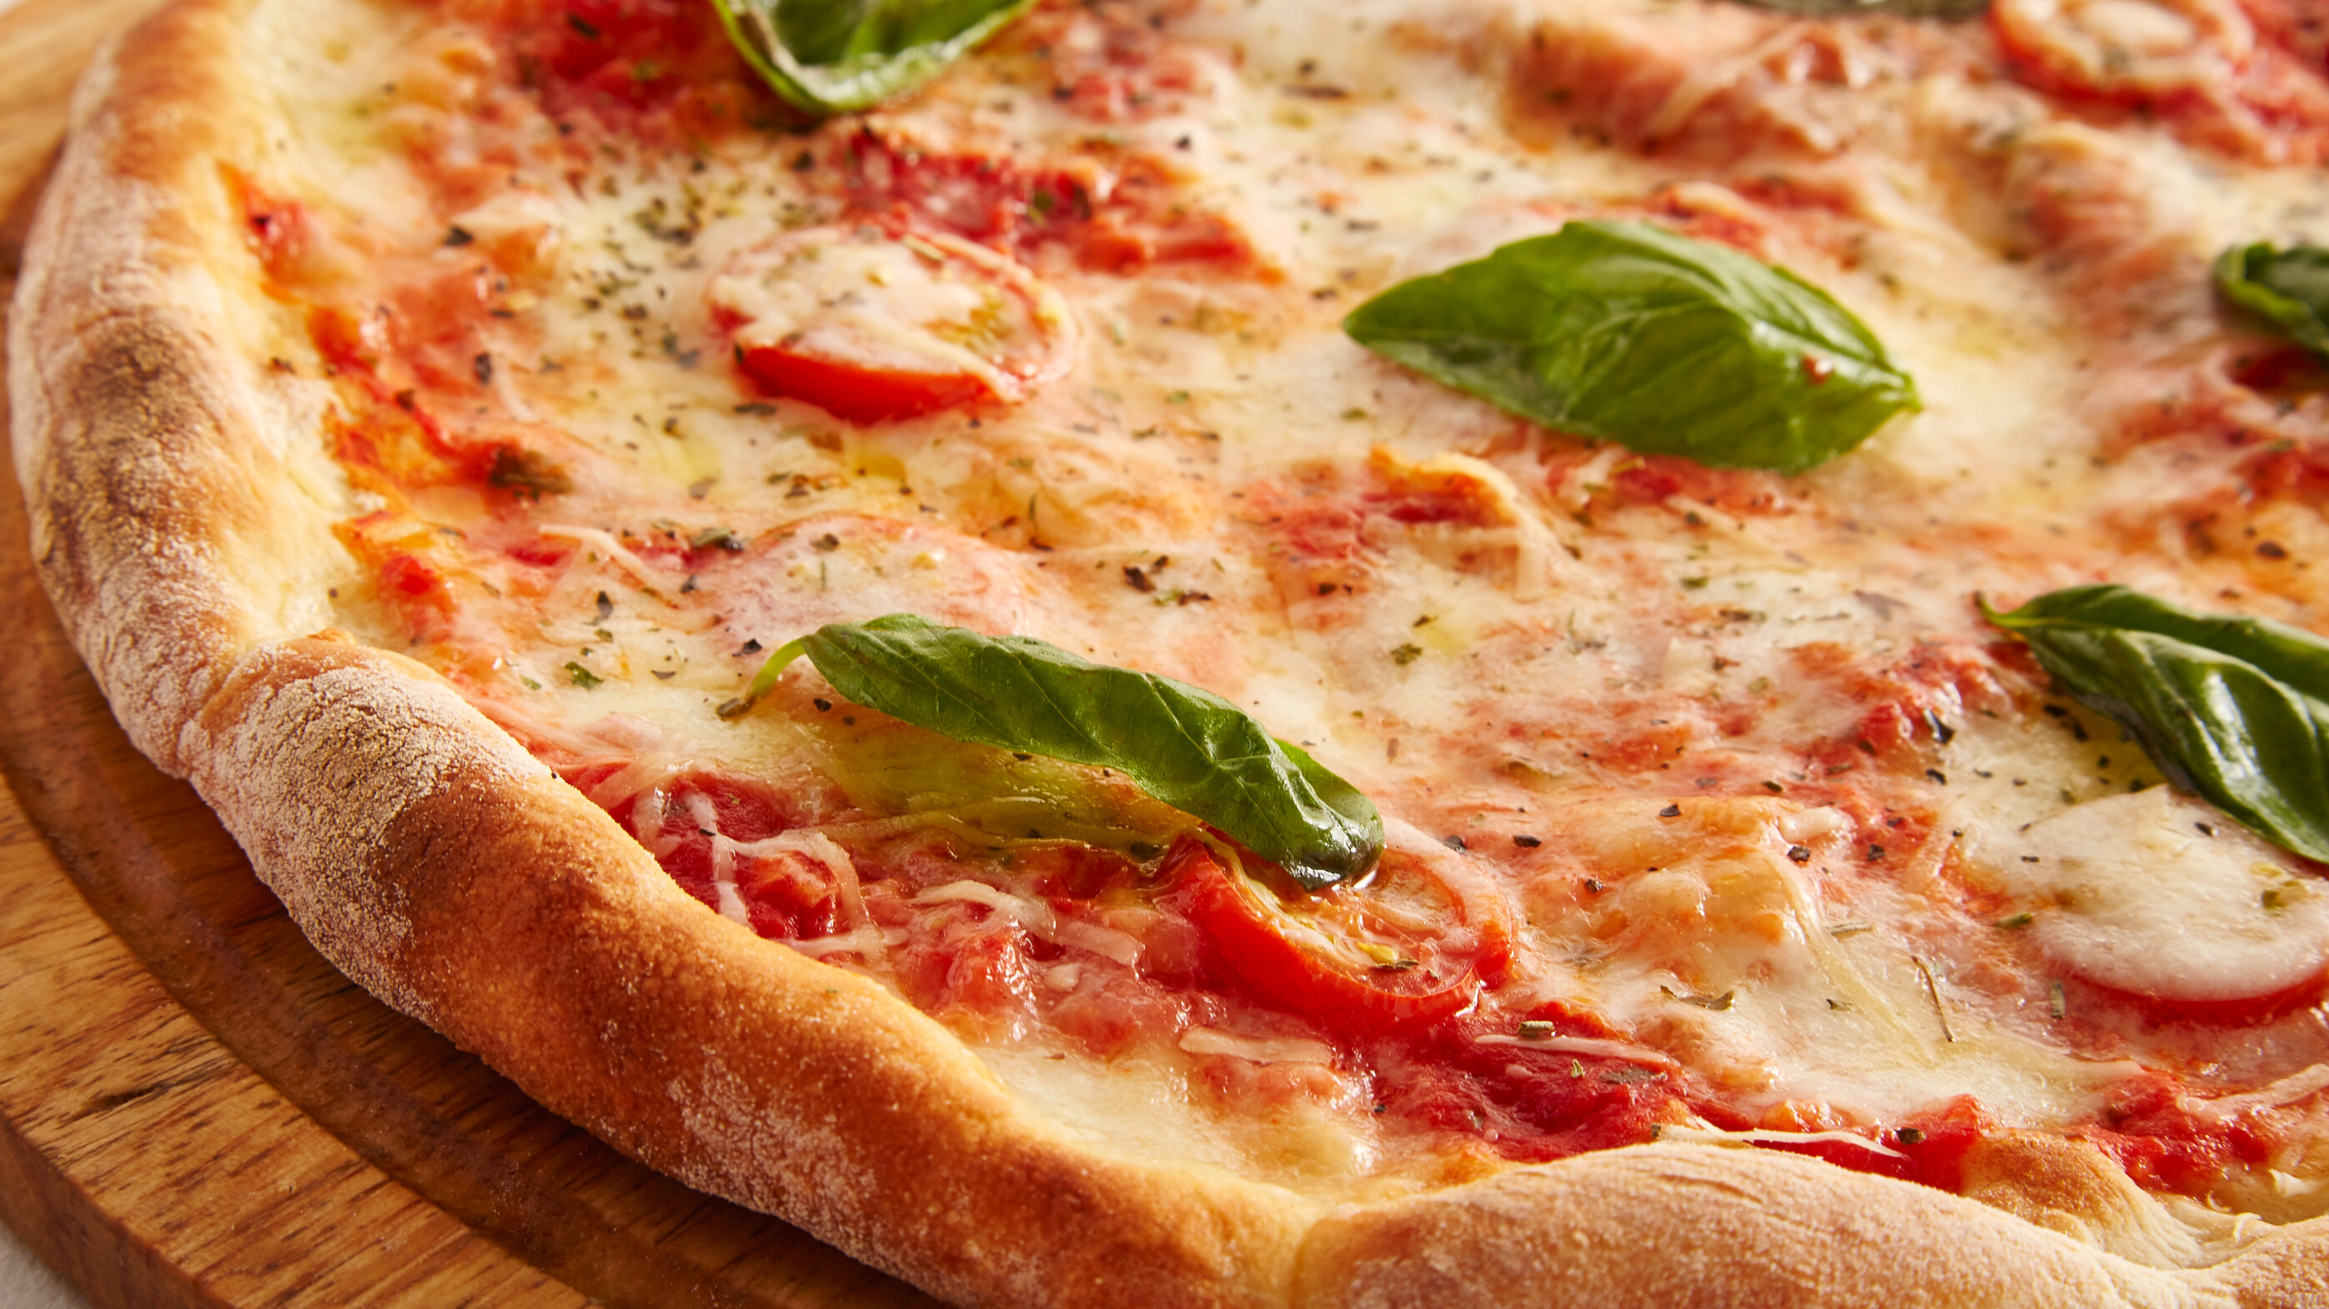
eHRAF Workbook
ACTIVITY
Advanced Search

Slide 17
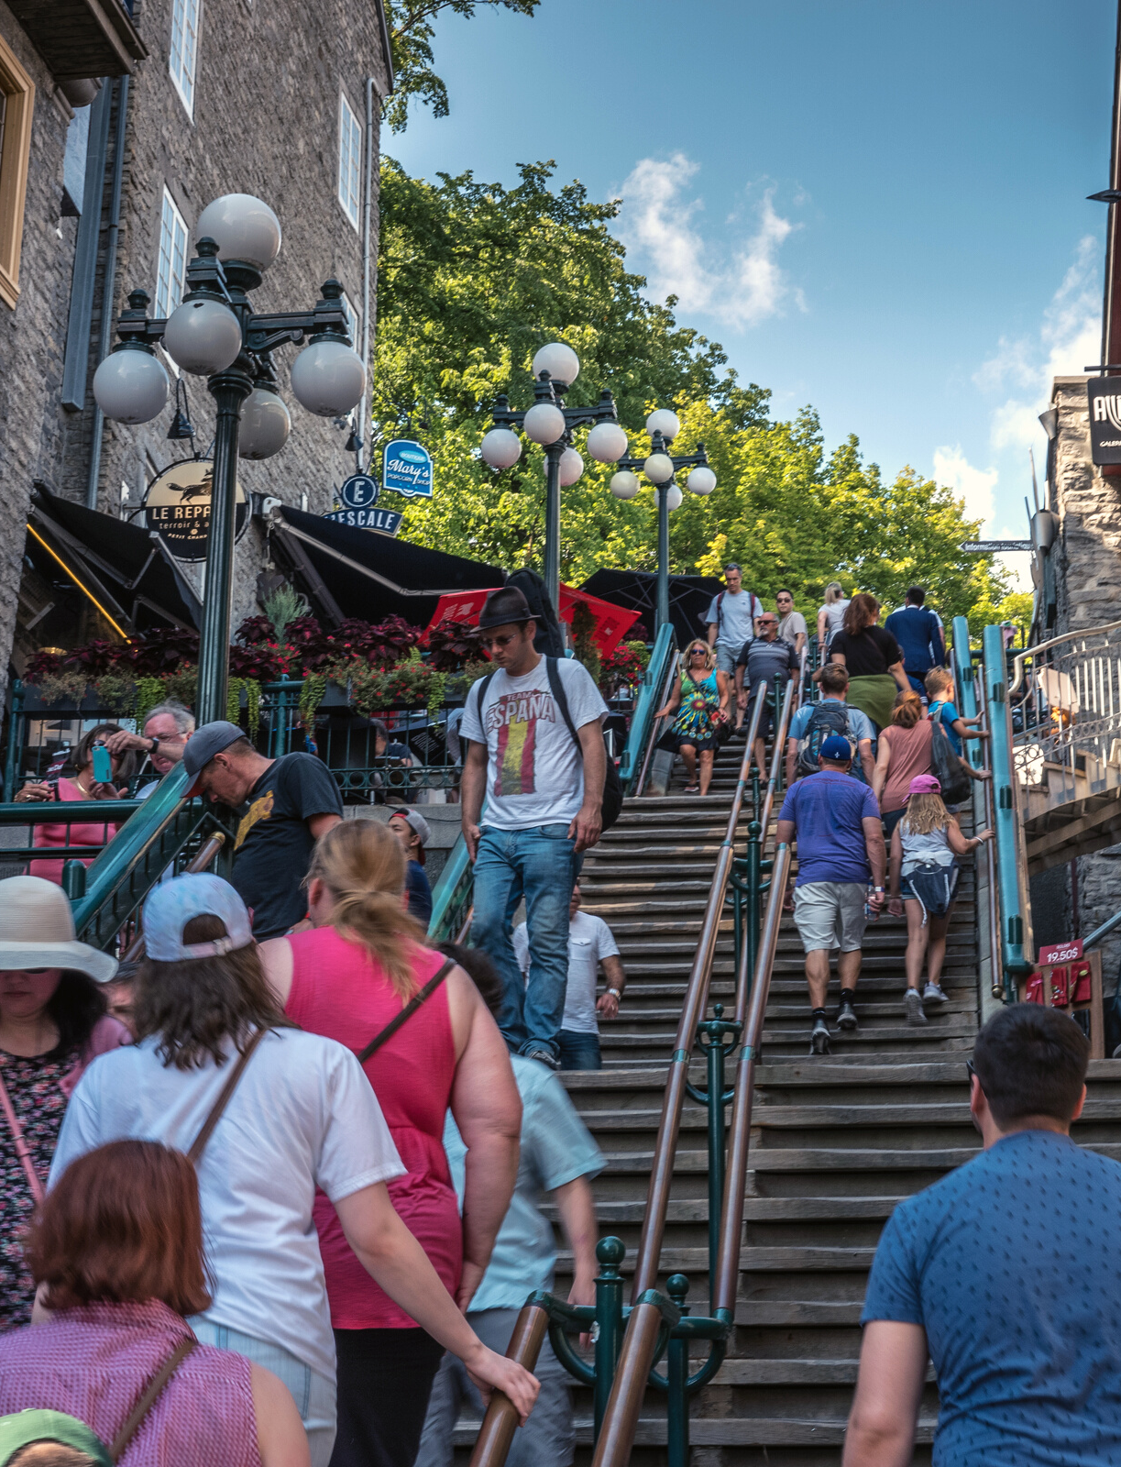
Find examples illustrating globalization, cultural diffusion, or culture change in eHRAF World Cultures.
🌐
https://ehrafworldcultures.yale.edu
Conduct an Advanced Search, adding the OCM identifier Acculturation and culture contact (177).
You can also add key words to your search, such as technology, food, tourism, gender, or religion, to narrow your focus to a specific type of change or facet of globalization.

Slide 18
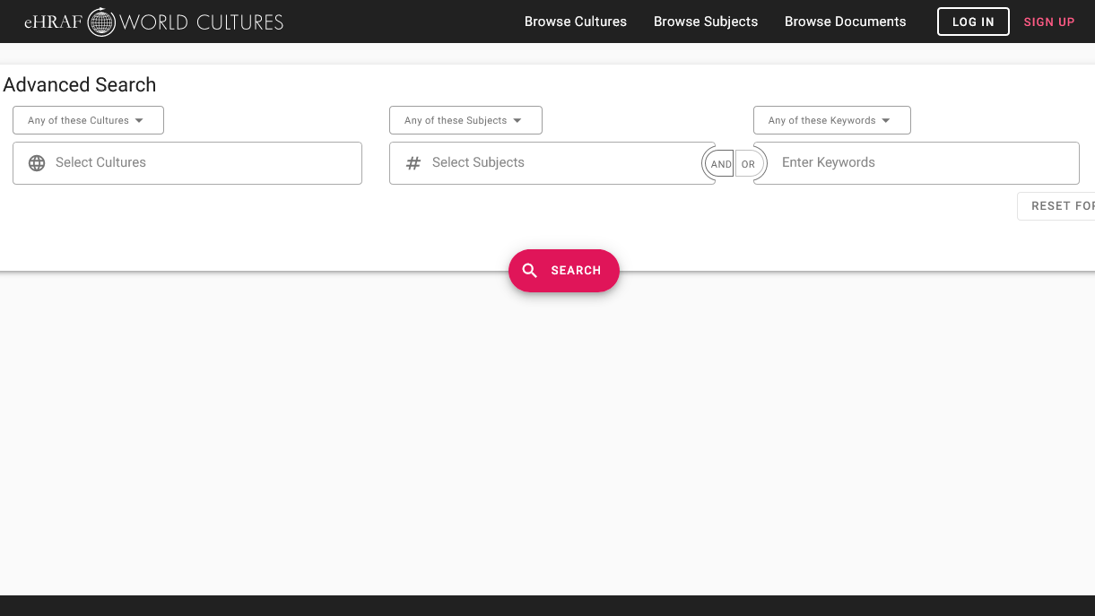
SAMPLE ADVANCED SEARCH
Add subject:
Acculturation and culture contact (177)
Add optional keywords:
e.g. food, gender, tourism, religion, economy

Slide 19
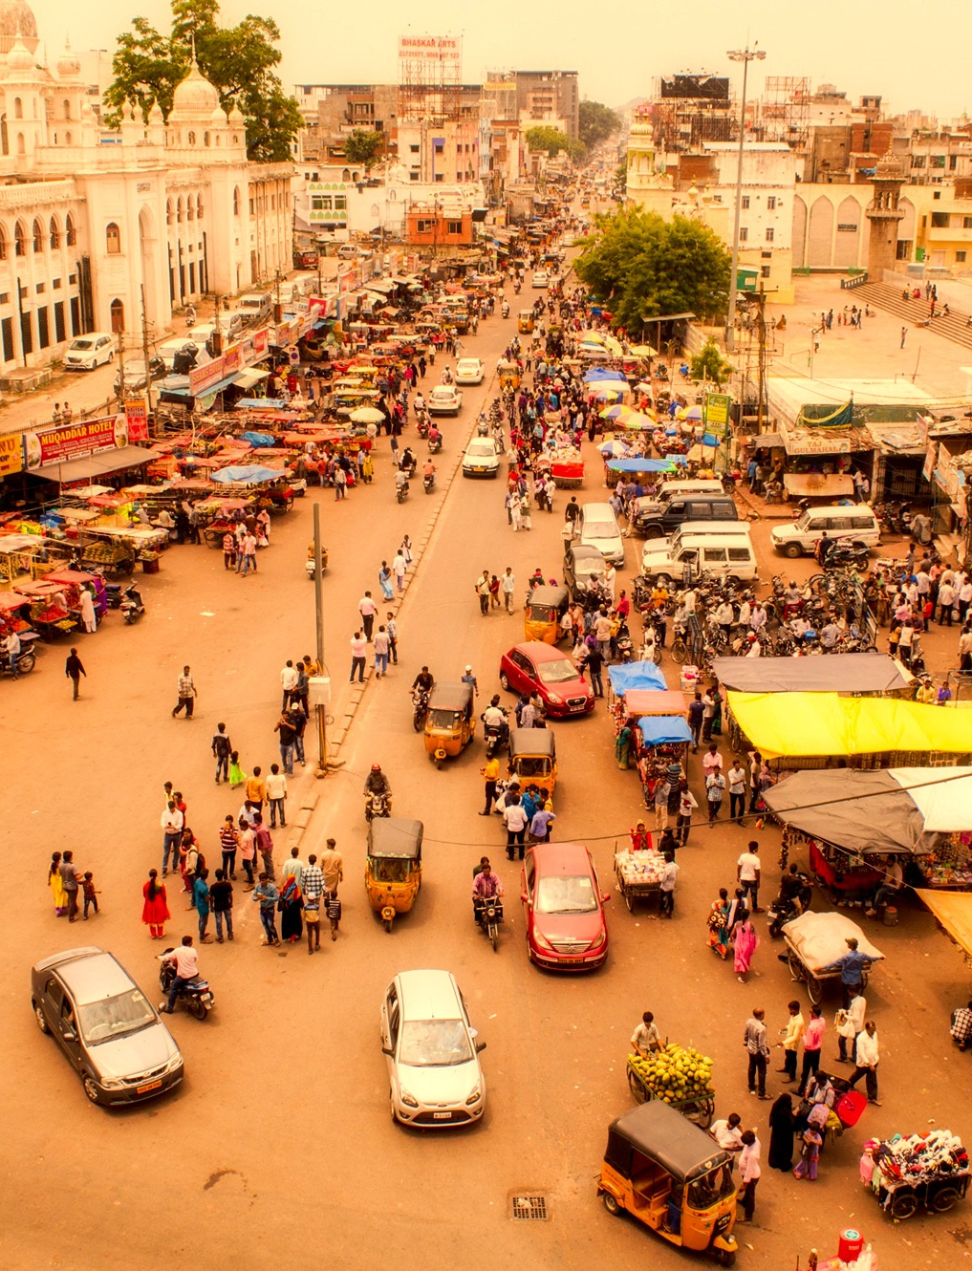
List 3-5 ethnographic examples that you have found which show some aspect of acculturation and globalization in a society based on data in eHRAF.
Name the culture, and copy the paragraph illustrating each finding. Be sure to cite the document, page number, and time period for each ethnographic example.
Summarize your findings. What similarities and differences have you found across your examples?

Slide 20
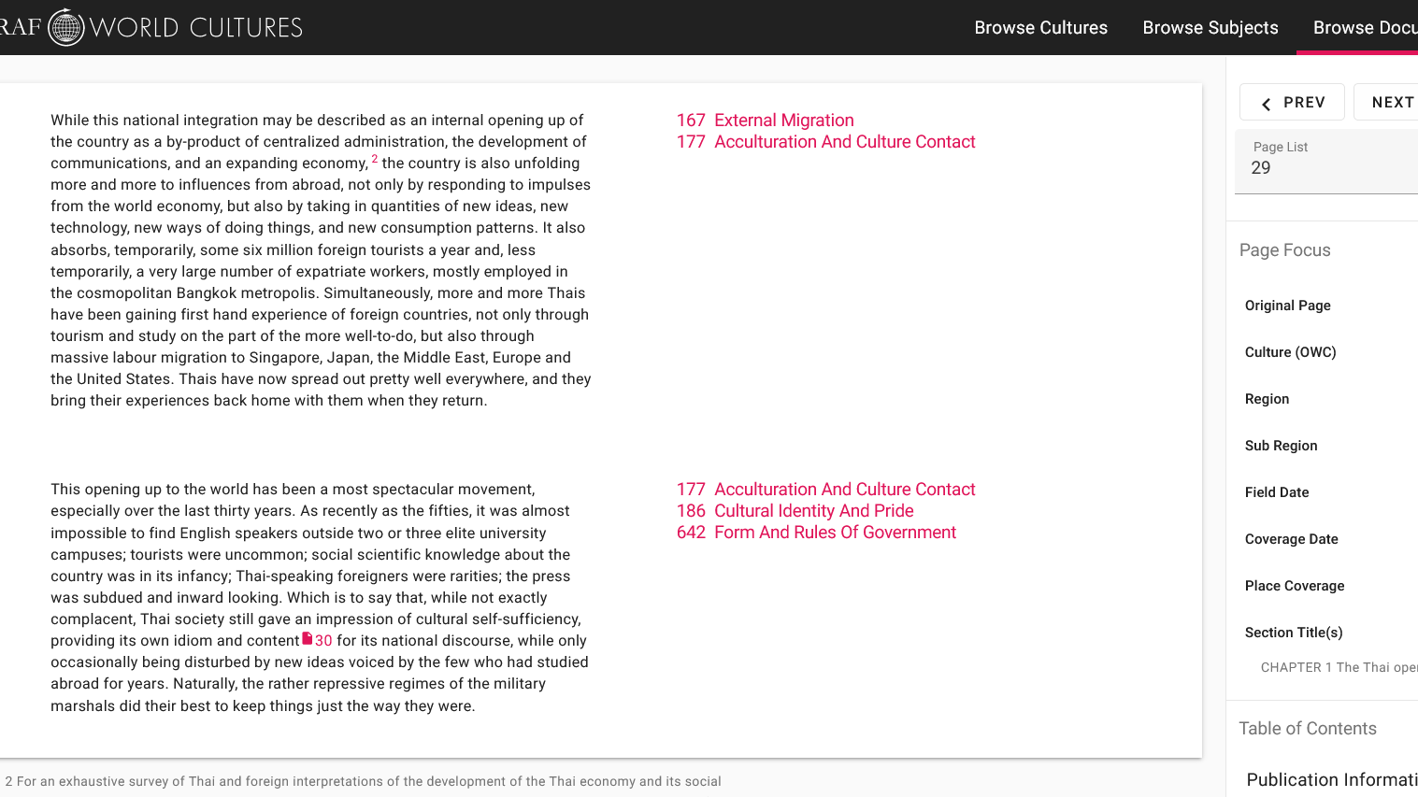
SAMPLE DATA
paragraph result
culture name, time and place coverage

Slide 21
Think about ways that you observe cultural diffusion in your everyday life.
What are some examples of foreign influences that have been adopted into your culture?
DISCUSS
What cultural exports has your society given to the world?
Have these been good or bad?
What kinds of impacts have these transfers of cultural currency had on the recipient societies?

Slide 22
1. Mulder, Niels. 1996. Inside Thai Society: Interpretations of Everyday Life. Amsterdam: The Pepin Press. https://ehrafworldcultures.yale.edu/document?id=ao07-060.
2. Pelto, Pertti J. 1987. The Snowmobile Revolution: Technology and Social Change in the Arctic. Prospect Heights, Ill.: Waveland Press. https://ehrafworldcultures.yale.edu/document?id=ep04-022.
References
3. Tice, Karin E. (Karin Elaine). 1995. Kuna Crafts, Gender, and the Global Economy. Austin: University of Austin Press. https://ehrafworldcultures.yale.edu/document?id=sb05-037.

Slide 23
Globalization
&
Change
in eHRAF World Cultures
Produced by
Human Relations Area Files
at Yale University
An eHRAF Workbook Activity
hraf.yale.edu

