Slide 1
An eHRAF Workbook Activity
Great Discoveries:
Cahokia
Human Relations Area Files
at Yale University

Slide 2
In this activity
Learn about Cahokia
Read passages in eHRAF Archaeology
Answer questions about this archaeological discovery
Find out what makes Cahokia a "Great Discovery"
Topics We'll Cover

Slide 3
CAHOKIA

Slide 4
Cahokia Mounds State Historic Site near Collinsville, Illinois, is home to the archaeological remnants of the most sophisticated prehistoric native civilization north of Mexico. Within a 2,200-acre tract lies the central section of the ancient Mississippian settlement that is today known as Cahokia.
Did you know?
In 1250 CE, the city of Cahokia was larger than London. Cahokia was constructed by accomplished builders who erected a variety of structures, from family residences to monumental public architecture, that have endured for centuries.

Slide 5
Cahokia
Cahokia has 140 mounds and three chronological periods with multiple phases. Early settlement dates from 300 CE, the Late Woodland period. Cahokia has been variously called a "city", a "state", and a "complex chiefdom".
Archaeologist Warren Wittry found evidence of a solar calendar at Cahokia. He named this "Woodhenge" in deference to Stonehenge. Several "Woodhenges" were built over the centuries, which may have been used by leaders to solidify their supernatural and political authority.

Slide 6
To get started, review these short videos and articles about Cahokia:
Cahokia: City of the Sun
Lost City of Cahokia
In Search Of History - Cahokia:
The Mound Builders
Cahokia's Celestial Calendar
(Woodhenge) Native America | PBS

Slide 7
ARTICLES ABOUT CAHOKIA
Ancient Native Americans Once Thrived in Bustling Urban Centers
Cahokia Mounds Civic and Sacred Landscape
The Solar Calendar of Woodhenge in Cahokia | Native America: Cities of the Sky
White Settlers Buried the Truth About the Midwest's Mysterious Mound Cities

Slide 8
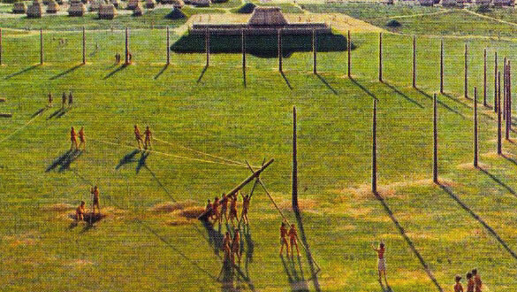
eHRAF Workbook
Part 1: Tradition Summary

Slide 9
Tradition Summaries
A brief overview for traditions in eHRAF Archaeology is provided in the form of Tradition Summaries.
The format, general outline, and headings are the same for each summary. You will find a basic overview about the tradition, such as its time period, location, history, environment, and sociopolitical organization.
eHRAF
Archaeology
To find a tradition summary, go to the Browse Traditions tab and enter the tradition name into the box, then click on Tradition Summary below the tradition name to read it.

Slide 10
Mississippian (NP60)
PART 1
Begin by learning more about the Mississippian tradition. First, read the eHRAF Tradition Summary:
🌐
https://ehrafarchaeology.yale.edu/document?id=np60-000
Then, write a brief description of the Mississippian tradition indicating any significant archaeological elements that stand out to you.

Slide 11
eHRAF Workbook
Part 2: Selected Readings

Slide 12
To read documents or pages in eHRAF:
INSTRUCTIONS
First, follow the permalinks provided in the activities below to get to the relevant documents.
For example:
🌐
https://ehrafarchaeology.yale.edu/document?id=nt76-001
Then, use the Page List dropdown menu to navigate to the required page(s).

Slide 13
Finding documents without permalinks
INSTRUCTIONS
Follow these steps if you are having trouble with permalinks from off campus while using a proxy or VPN service, or if you have been provided with a HRAF-issued username and password.
Sign in via your library proxy or VPN, or using the HRAF-issued credentials.
Go to the Browse Documents tab.
Enter the author's last name into the Filter Index box.
Click on the required title to access the document, then select the page number from the Page List dropdown menu as shown above.

Slide 14
PART 2
The Cahokia chiefdom: the archaeology of a Mississippian society (Milner 1998)
🌐
https://ehrafarchaeology.yale.edu/document?id=np60-044
Pages:
1-10, Introduction to Cahokia
137-138, Settlement Organization, Solstices
Cahokia identity and interaction models of Cahokia (Hall 1991)
🌐
https://ehrafarchaeology.yale.edu/document?id=np60-004
Pages:
4, The Origin of the Cahokia Mounds
33-34, Summary

Slide 15
PART 2
Some perspectives on Cahokia and the northern Mississippian expansion (Emerson 1991)
🌐
https://ehrafarchaeology.yale.edu/document?id=np60-015
Page:
223, Cahokia and American Bottom Research
Mississippian political economy (Muller 1997)
🌐
https://ehrafarchaeology.yale.edu/document?id=np60-045
Page:
271, Elites and Production: Mounds and Scale

Slide 16
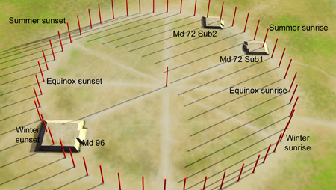
In this activity, you will ual relations across the globe.
eHRAF Workbook
Part 3: Advanced Search

Slide 17
Part 3:
Advanced Search
Now that you have read selected passages from eHRAF Archaeology, dig deeper with Advanced Search. This will enable you to find specific passages in documents that have been indexed by HRAF anthropologists at the paragraph level.
On the following slide, you will find an example of an advanced search. Try this search and then experiment with different subjects and/or keywords.

Slide 18
Part 3:
Advanced Search
In the Add Traditions column, select Mississippian (NP60).
In the Add Subjects column, select the major subject categories Building and Construction (330) and Structures (340).
In the Keyword section, type Mound*.

Slide 19
ADVANCED SEARCH
Add subjects:
Building and Construction (330)
Structures (340)
Add tradition:
Mississippian (NP60)
Add keyword:
mound*

Slide 20
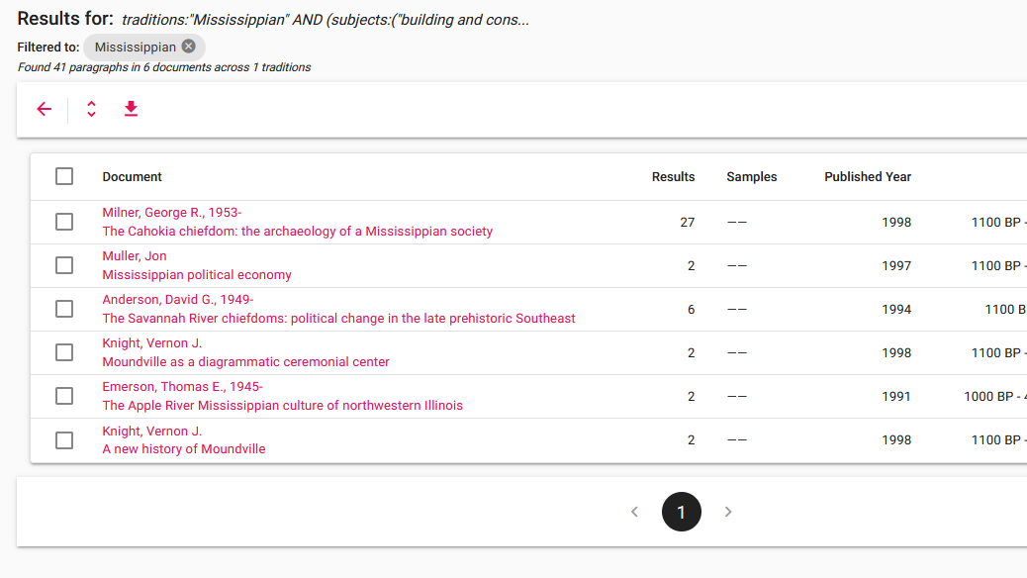
SEARCH RESULTS

Slide 21
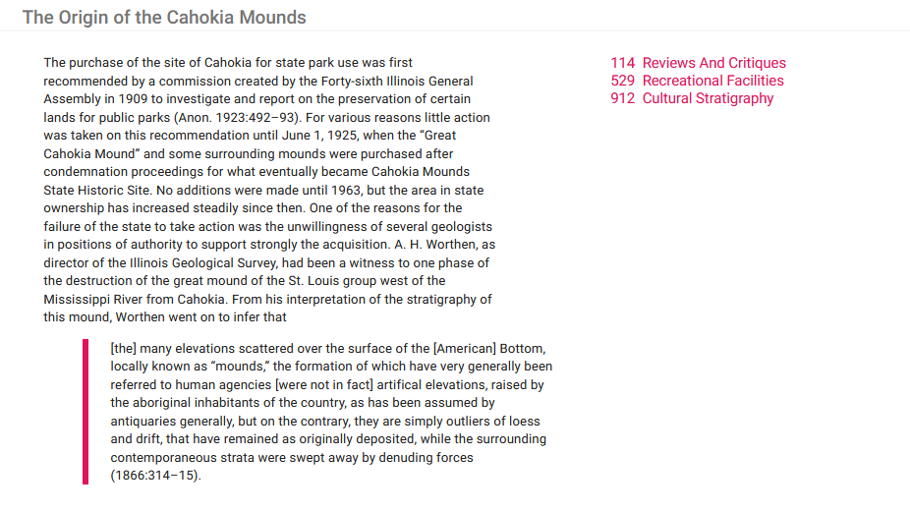
SEARCH RESULTS

Slide 22
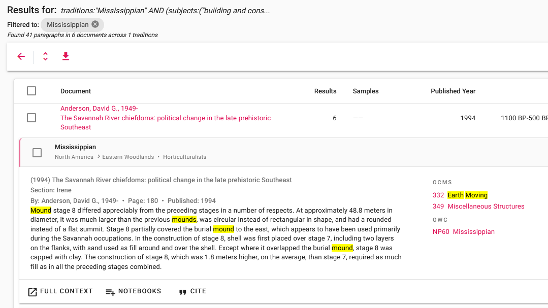
FULL CONTEXT

Slide 23
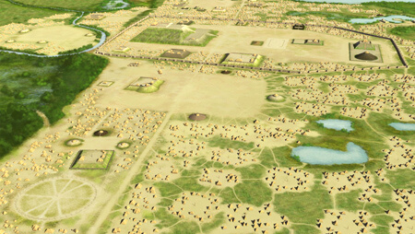
eHRAF Workbook
Part 4: Assignment

Slide 24
ASSIGNMENT
The purpose of this assignment is to present a report summarizing your findings about this great discovery.
This can be done in the form of a group project or an individual paper.
Groups can divide the questions that follow, with each student contributing information about a specific question.
Consider making a slideshow presentation to illustrate your findings.

Slide 25
ASSIGNMENT
Your final report describing Cahokia should have 6 sections which correspond to these 6 types of questions:
Who?
What?
Where?
When?
How?
Why?

Slide 26
QUESTION 1
Who?
Who are the main archaeologists associated with this discovery? Describe their biographical information, education and training, publications, etc.
Who are the people studied? Describe how people lived during this time at this place, such as: social stratification, division of labor, gender roles, economic life, food and subsistence, religious practices.

Slide 27
QUESTION 2
What?
What did the archaeologists discover?
Provide a general description of the archaeological site.
Describe the material culture, structures, artifacts, etc.
Include relevant photos and/or interpretive artistic renderings.

Slide 28
QUESTION 3
Where?
Where is the site located?
Describe the geography of this discovery, its location in the contemporary world, size, scope, etc.
Does the location have strategic importance?
How did the physical environment and natural resources shape cultural practices?

Slide 29
QUESTION 4
When?
When were the discoveries made?
When in human history do archaeologists believe that this site can be dated to?
Describe the relative time period, what preceded it, and what followed it. What does this represent in terms of cultural evolution and progress?

Slide 30
QUESTION 5
How?
How did archaeologists excavate, analyze, and interpret this site?
Tell us about the scientific methods used for excavation and analysis of the materials founds.
What technologies were utilized by the people who lived during this archaeological time period?
How did they construct buildings and make artifacts (lithics, pottery, etc.)?

Slide 31
QUESTION 6
Why?
Why is this archaeological site considered a “great discovery”?
Describe how this site is important in terms of its place in human history.
Why should this great discovery be preserved and who should be responsible for preservation?

Slide 32
Emerson, Thomas E. 1991. “Some Perspectives on Cahokia and the Northern Mississippian Expansion.” In Cahokia and the Hinterlands : Middle Mississipian Cultures of the Midwest, 221–36. Urbana: Published in cooperation with the Illinois Historic Preservation Agency by the University of Illinois Press. https://ehrafarchaeology.yale.edu/document?id=np60-015.
Hall, Robert L. 1991. “Cahokia Identity and Interaction Models of Cahokia Mississippian.” In Cahokia and the Hinterlands : Middle Mississipian Cultures of the Midwest, 3–34. Urbana: Published in cooperation with the Illinois Historic Preservation Agency by the University of Illinois Press. https://ehrafarchaeology.yale.edu/document?id=np60-004.
References
Milner, George R. 1998. “The Cahokia Chiefdom: The Archaeology of a Mississippian Society.” In Smithsonian Series in Archaeological Inquiry, xvi, 216. Washington: Smithsonian Institution Press. https://ehrafarchaeology.yale.edu/document?id=np60-044.
Muller, Jon. 1997. “Mississippian Political Economy.” In Interdisciplinary Contributions to Archaeology, xiii, 455. New York: Plenum Press. https://ehrafarchaeology.yale.edu/document?id=np60-045.

Slide 33
Monks Mound in July, Skubasteve834, CC BY-SA 3.0, via Wikimedia Commons: https://commons.wikimedia.org/wiki/File:Monks_Mound_in_July.JPG
Woodhenge motif black drink beaker, by Heironymous Rowe, via Wikimedia Commons: https://commons.wikimedia.org/wiki/File:
Woodhenge_motif_black_drink_beaker_HRoe_2013.jpg
Illinois 1718, Guillaume Delisle, Public domain, via Wikimedia Commons: https://commons.wikimedia.org/wiki/File:Illinois_1718.jpg
Image Credits
Cahokia Mound, Prayitno, via Wikimedia Commons:
https://commons.wikimedia.org/wiki/File:Cahokia_Mound_(49088979911).jpg
Keller figurine, by Tim Vickers, via Wikimedia Commons:
https://en.wikipedia.org/wiki/File:Keller_figurine.jpg
Chromesun mississippian priest digital painting, Herb Roe, CC BY-SA 3.0, via Wikimedia Commons: https://commons.wikimedia.org/wiki/
File:Chromesun_mississippian_priest_digital_painting.jpg
An Illustration of the Cahokia Woodhenge:
https://drloihjournal.blogspot.com/2019/06/the-cahokia-woodhenge.html

Slide 34
Spiro Wulfing and Etowah repousse plates, by Herb Roe, via Wikimedia Commons: https://en.m.wikipedia.org/wiki/File%3ASpiro_Wulfing_
and_Etowah_repousse_plates_HRoe_2012.jpg
Bird Man Cahokia USA, jefgodesky, CC BY-SA 3.0, via Wikimedia Commons: https://commons.wikimedia.org/wiki/File:Bird_Man_Cahokia_USA.jpg
Mound 72 Woodhenge diagram, by Herb Roe, CC BY-SA 3.0, via Wikimedia Commons: https://commons.wikimedia.org/wiki/
File:Mound_72_Woodhenge_diagram_HRoe_2013.jpg
Image Credits
Stairway to Heaven? Cahokia Mounds! by Aemurray wustl, via Wikimedia Commons: https://commons.m.wikimedia.org/wiki/
File:Stairway_to_Heaven%3F_Cahokia_Mounds!.jpg
Cahokia pottery making tools, Herb Roe, CC BY-SA 3.0, via Wikimedia Commons:
https://commons.wikimedia.org/wiki/File:Cahokia_pottery_making_tools_HRoe_2010.jpg
Cahokia Aerial, by Herb Roe, CC BY-SA 4.0, via Wikimedia Commons:
https://commons.wikimedia.org/wiki/File:Cahokia_Aerial_HRoe_2015.jpg

Slide 35
Aerial shot Monks Mound, by Terry Robinson, CC BY-SA 2.0, via Wikimedia Commons:
https://commons.wikimedia.org/wiki/File:Aerial_shot_Monks_Mound.jpg
Cahokia Mounds, Prayitno CC BY 2.0, via Wikimedia Commons:
https://commons.wikimedia.org/wiki/File:Cahokia_Mounds.jpg
Birdman Tablet cropped, Paul Sableman, CC BY 2.0, via Wikimedia Commons: https://commons.wikimedia.org/wiki/File: Birdman_Tablet_cropped.jpg
Image Credits
Southeastern Ceremonial Complex map, by Heironymous Rowe CC BY-SA 3.0, via Wikimedia Commons: https://commons.wikimedia.org/wiki/File:
Southeastern_Ceremonial_Complex_map.jpg
Cahokia monks mound McAdams 1887, W. R. Brink & Co., via Wikimedia Commons: https://en.wikipedia.org/wiki/File: Cahokia_monks_mound_McAdams_1887.jpg
The Ramey Tablet displays war symbols of the Southeastern Ceremonial Complex: https://drloihjournal.blogspot.com/2019/06/the-cahokia-woodhenge.html

Slide 36
Great Discoveries: Cahokia
Produced by
Human Relations Area Files
at Yale University
An eHRAF Workbook Activity
hraf.yale.edu

