Slide 1
An eHRAF Workbook Activity
Great Discoveries:
Machu Picchu
Human Relations Area Files
at Yale University

Slide 2
In this activity
Learn about Machu Picchu
Read passages in eHRAF Archaeology
Answer questions about this archaeological discovery
Find out what makes Machu Picchu a "Great Discovery"
Topics We'll Cover

Slide 3
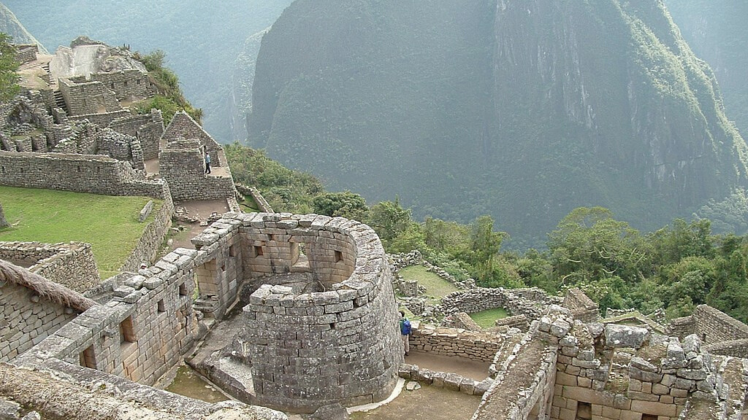
MACHU PICCHU

Slide 4
Machu Picchu was an Inka (also spelled "Inca") city in the southern part of Peru. It was built around 1450 A.D. and abandoned less than a century later, at the time of the Spanish Conquest. It was located in the vicinity of Cuzco, the Inka capital. The purpose of the Machu Picchu is debated: was it a residence for the king, or an astronomical obervatory?
Did you know?
Hiram Bingham, a Yale University professor, is credited for the "discovery" of Machu Picchu. However, he did not actually discover it. The ruins of the city were shown to him by locals, who already knew that it was there.

Slide 5
Machu Picchu
Bingham excavated Machu Picchu in 1912, 1914, and 1915. He wrote articles and books about his findings.
Machu Picchu is a spectacular site. It is divided into what appears to have been residential and royal districts.
The Temple of the Sun includes a tower, known as the Torreón, which may have been an observatory. Expert stonemasons cut and fitted stones together so perfectly that no mortar was needed.

Slide 6
To get started, review these short videos and articles about Machu Picchu:
Machu Picchu 101 | National Geographic
Cradle of Gold: The Story of Hiram Bingham
and Machu Picchu | National Geographic
Space Archaeology: A New Frontier of Exploration | National Geographic
Agreement by Yale & UNSAAC:
Study of Machu Picchu & Inca Culture

Slide 7
NATIONAL GEOGRAPHIC
Travel - World Heritage: Machu Picchu
Machu Picchu Mystery
Myths and Truths on the Nat Geo Screen
NATIONAL PUBLIC RADIO
Photos: Machu Picchu 100 Years Ago
Retracing An Explorer's Footsteps to Machu Picchu
Finders Not Keepers: Yale Returns Artifacts To Peru

Slide 8
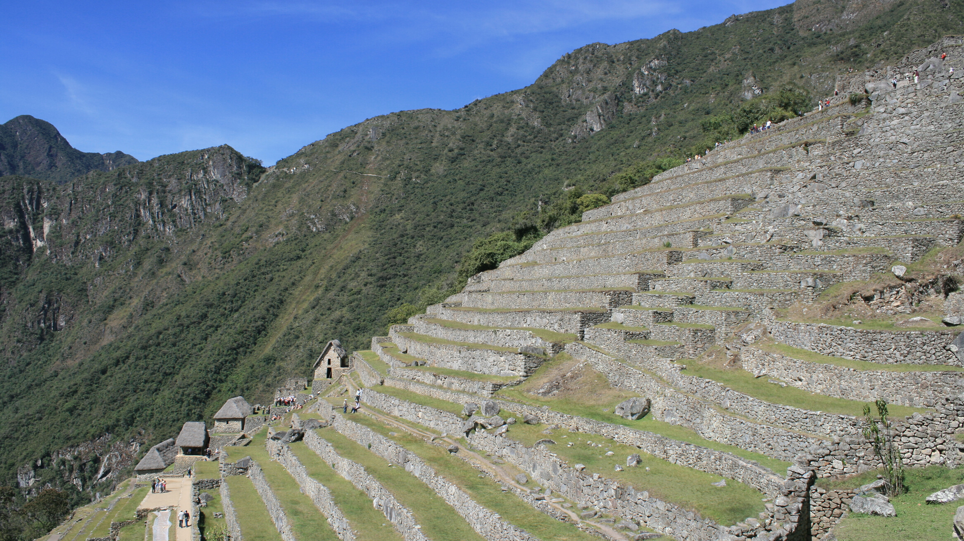
eHRAF Workbook
Part 1: Tradition Summary

Slide 9
Tradition Summaries
A brief overview for traditions in eHRAF Archaeology is provided in the form of Tradition Summaries.
The format, general outline, and headings are the same for each summary. You will find a basic overview about the tradition, such as its time period, location, history, environment, and sociopolitical organization.
eHRAF
Archaeology
To find a tradition summary, go to the Browse Traditions tab and enter the tradition name into the box, then click on Tradition Summary below the tradition name to read it.

Slide 10
Inka (SE80)
PART 1
Begin by learning more about the Inka. First, read the eHRAF Tradition Summary:
🌐
https://ehrafarchaeology.yale.edu/document?id=se80-000
Then, write a brief description of the Inka indicating any significant archaeological elements that stand out to you.

Slide 11
eHRAF Workbook
Part 2: Selected Readings

Slide 12
To read documents or pages in eHRAF:
INSTRUCTIONS
First, follow the permalinks provided in the activities below to get to the relevant documents.
For example:
🌐
https://ehrafarchaeology.yale.edu/document?id=nt76-001
Then, use the Page List dropdown menu to navigate to the required page(s).

Slide 13
Finding documents without permalinks
INSTRUCTIONS
Follow these steps if you are having trouble with permalinks from off campus while using a proxy or VPN service, or if you have been provided with a HRAF-issued username and password.
Sign in via your library proxy or VPN, or using the HRAF-issued credentials.
Go to the Browse Documents tab.
Enter the author's last name into the Filter Index box.
Click on the required title to access the document, then select the page number from the Page List dropdown menu as shown above.

Slide 14
PART 2
The Sacred Landscape of the Inca:
The Cusco Ceque System (Bauer 1998)
🌐
https://ehrafarchaeology.yale.edu/document?id=se80-014
Pages:
69, The Eighth Ceque of Chinchaysuyu
145, Evidence of Other Inca Ceques
Tradition Summary: Inca (Bray 2004)
🌐
https://ehrafarchaeology.yale.edu/document?id=se80-000
Page:
4, Settlement System, Machu Piccu

Slide 15
PART 2
Inka settlement planning (Hyslop 1990)
🌐
https://ehrafarchaeology.yale.edu/document?id=se80-016
Pages:
108, Stones and Architecture in the Cuzco Arean
110, 112, Machu Picchu
Inca culture at the time of the Spanish conquest. (Rowe 1946)
🌐
https://ehrafarchaeology.yale.edu/document?id=se80-001
Pages:
200, Late Inca Period (including Machu Picchu)
222-233, Houses and Architecture

Slide 16
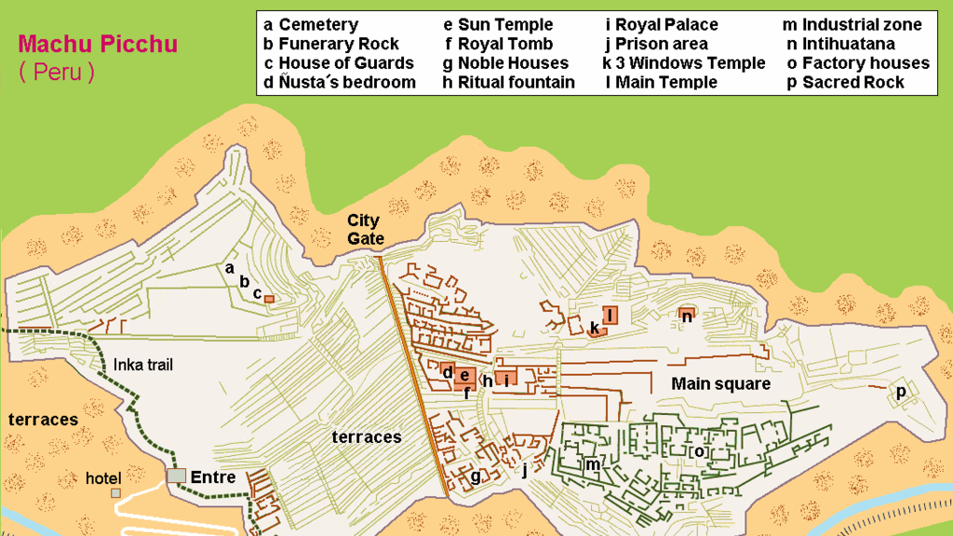
In this activity, you will ual relations across the globe.
eHRAF Workbook
Part 3: Advanced Search

Slide 17
Part 3:
Advanced Search
Now that you have read selected passages from eHRAF Archaeology, dig deeper with Advanced Search. This will enable you to find specific passages in documents that have been indexed by HRAF anthropologists at the paragraph level.
On the following slide, you will find an example of an advanced search. Try this search and then experiment with different subjects and/or keywords.

Slide 18
Part 3:
Advanced Search
In the Add Traditions column, select Inka (SE80). In the Add Subjects column, select the major subject categories Building and Construction (330) and Structures (340).
These categories include information about Construction (331), Masonry (333), Architecture (341), and Dwellings (342).
In the Keyword section, type "Machu Picchu".

Slide 19
ADVANCED SEARCH
Add subjects:
Building and Construction (330)
Structures (340)
Add tradition:
Inka (SE80)
Add keywords:
"Machu Picchu"

Slide 20
SEARCH RESULTS

Slide 21
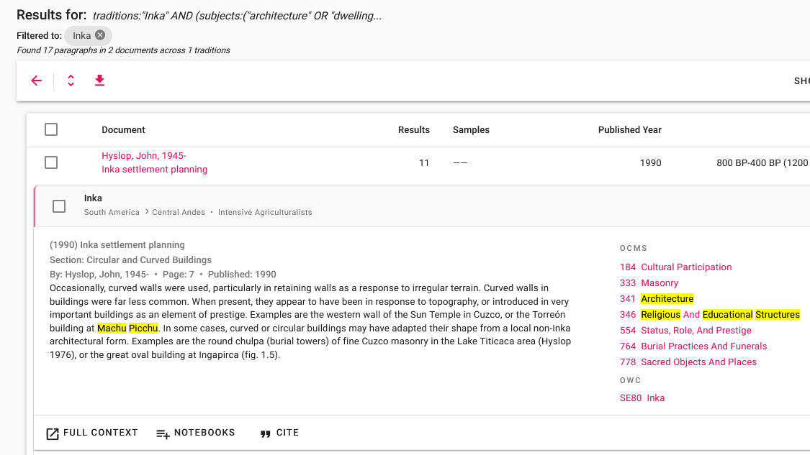
SEARCH RESULTS

Slide 22
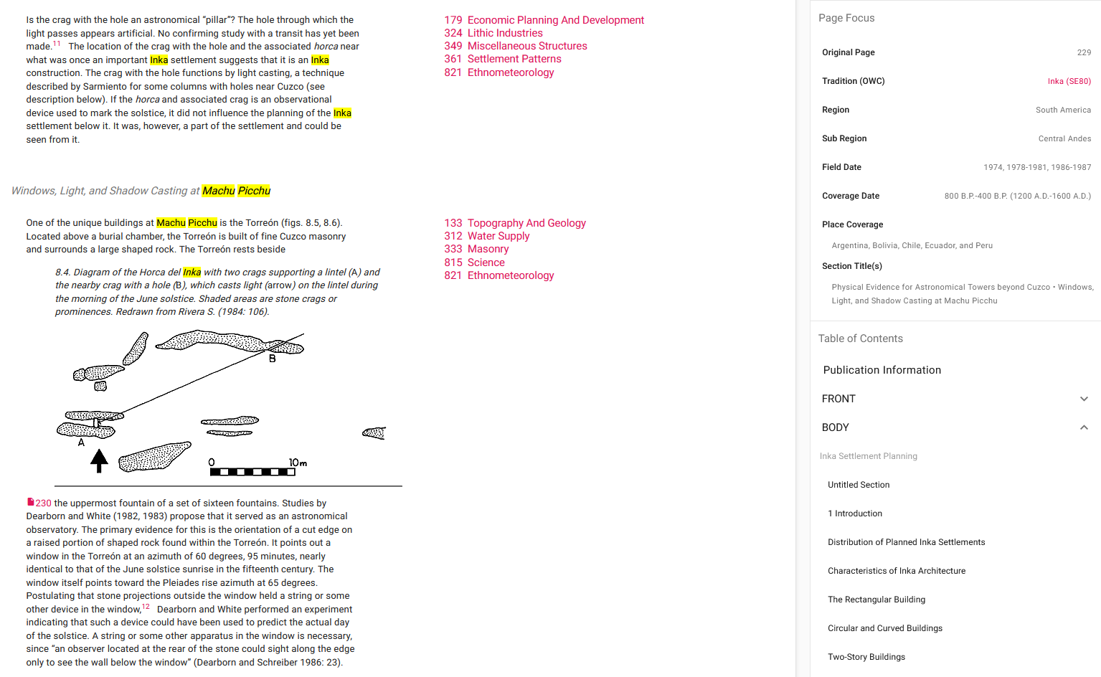
FULL CONTEXT

Slide 23
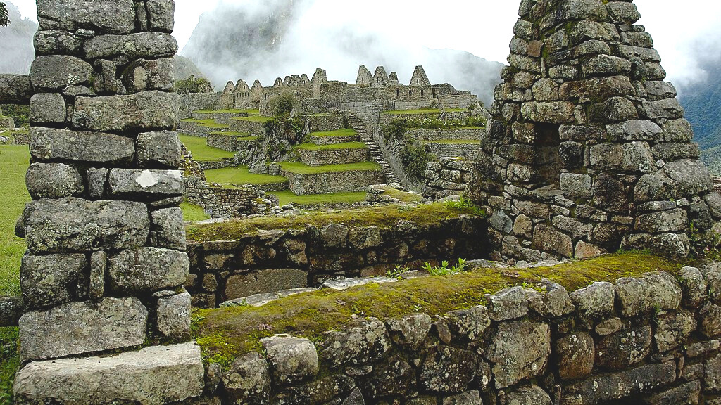
eHRAF Workbook
Part 4: Assignment

Slide 24
ASSIGNMENT
The purpose of this assignment is to present a report summarizing your findings about this great discovery.
This can be done in the form of a group project or an individual paper.
Groups can divide the questions that follow, with each student contributing information about a specfic question.
Consider making a slideshow presentation to ilustrate your findings.

Slide 25
ASSIGNMENT
Your final report describing Machu Picchu should have 6 sections which correspond to these 6 types of questions:
Who?
What?
Where?
When?
How?
Why?

Slide 26
QUESTION 1
Who?
Who are the main archaeologists associated with this discovery? Describe their biographical information, education and training, publications, etc.
Who are the people studied? Describe how people lived during this time at this place, such as: social stratification, divison of labor, gender roles, economic life, food and subsistence, religious practices.

Slide 27
QUESTION 2
What?
What did the archaeologists discover?
Provide a general description of the archaeological site.
Describe the material culture, structures, artifacts, etc.
Include relevant photos and/or interpretive artistic renderings.

Slide 28
QUESTION 3
Where?
Where is the site located?
Describe the geography of this discovery, its location in the contemporary world, size, scope, etc.
Does the location have strategic importance?
How did the physical environment and natural resources shape cultural practices?

Slide 29
QUESTION 4
When?
When were the discoveries made?
When in human history do archaeologists believe that this site can be dated to?
Describe the relative time period, what preceded it, and what followed it. What does this represent in terms of cultural evolution and progress?

Slide 30
QUESTION 5
How?
How did archaeologists excavate, analyze, and interpret this site?
Tell us about the scientific methods used for excavation and analysis of the materials founds.
What technologies were utilized by the people who lived during this archaeological time period?
How did they construct buildings and make artifacts (lithics, pottery, etc.)?

Slide 31
QUESTION 6
Why?
Why is this archaeological site considered a “great discovery”?
Describe how this site is important in terms of its place in human history.
Why should this great discovery be preserved and who should be responsible for preservation?

Slide 32
Bauer, Brian S. 1998. The Sacred Landscape of the Inca: The Cusco Ceque System. Austin: University of Texas Press. https://ehrafarchaeology.yale.edu/document?id=se80-014.
Bray, Tamara L. 2004. “Tradition Summary: Inca.” New Haven, Conn.: HRAF. https://ehrafarchaeology.yale.edu/document?id=se80-000.
References
Hyslop, John. 1990. Inka Settlement Planning. Austin: University of Texas Press. https://ehrafarchaeology.yale.edu/document?id=se80-016.
Rowe, John Howland. 1946. "Inca Culture at the Time of the Spanish Conquest." In Handbook of South American Indians, Edited by Julian H. Steward, v. 2:183–330. Washington: U.S. G.P.O. https://ehrafarchaeology.yale.edu/document?id=se80-001.
Special thanks to the National Geographic Society and National Public Radio for the short videos and articles featured in this eHRAF Workbook.

Slide 33
Hiram Bingham III at his tent door near Machu Picchu in 1912, Public domain, via Wikimedia Commons: https://commons.wikimedia.org/wiki/
File:Hiram_Bingham_III_at_his_tent_door_near_Machu_Picchu_in_1912.jpg.
Interior of an Inca building, featuring trapezoidal windows by Martin St-Amant (S23678), CC BY-SA 3.0 via Wikimedia Commons: https://commons.wikimedia.org/wiki/File:124_-_Machu_Picchu_-_Juin_2009.jpg
Image Credits
Temple of the Sun or Torreón, Public domain, via Wikimedia Commons: https://commons.wikimedia.org/wiki/File:Machupicchu_intihuatana.JPG
The National Geographic Magazine, April, 1913: https://www.doaks.org/
research/library-archives/dumbarton-oaks-archives/collections/ephemera/in-the-wonderland-of-peru-the-national-geographic-magazine-april-1913
Hiram Bingham III in 1916. Harris & Ewing, photographer, Public domain, via Wikimedia Commons:
https://commons.wikimedia.org/wiki/File:Hiram_Bingham_III_in_1916.jpg

Slide 34
Terraces used for farming at Machu Picchu, RAF-YYC from Calgary, Canada, CC BY-SA 2.0, via Wikimedia Commons: https://commons.wikimedia.org/wiki/File:Machu_Picchu_(3833992683).jpg
UNESCO World Heritage emblem; Designer: Michel Olyff. Uploaded by Siyuwj, Public domain, via Wikimedia Commons: https://commons.wikimedia.org/wiki/File:World_Heritage_Logo_global.svg
Silver tupus collected on Bingham's 1912 expedition, on display at the Museo Machu Picchu, Pi3.124, CC BY-SA 4.0, via Wikimedia Commons: https://commons.wikimedia.org/wiki/File:Silver_tupus_collected_on_Bingham%27s_1912_expedition_to_Macchu_Picchu.jpg
Image Credits
Map of Machu Picchu by Hobe / Holger Behr, Public domain, via Wikimedia Commons: https://commons.wikimedia.org/wiki/File:Karta_MachuPicchu.PNG
View of the residential section of Machu Picchu, Christophe Meneboeuf - XtoF, CC BY-SA 3.0, via Wikimedia Commons: https://en.wikipedia.org/
wiki/Machu_Picchu#/media/File:MachuPicchu_Residential_(pixinn.net).jpg

Slide 35
Interior of an Inca building, featuring trapezoidal windows, Martin St-Amant (S23678), CC BY-SA 3.0, via Wikimedia Commons: https://commons.wikimedia.org/wiki/File:124_-_Machu_Picchu_-_Juin_2009.jpg
Manco Capac, First Inca, 1 of 14 Portraits of Inca Kings, Brooklyn Museum, Public domain, via Wikimedia Commons: https://commons.wikimedia.org/
wiki/File:Brooklyn_Museum_Manco_Capac,_First_Inca,_1_of_14_Portraits_of_Inca_Kings_-_overall.jpg
Image Credits
Artifact collected on Bingham's 1912 expedition, on display at the Museo Machu Picchu by Pi3.124, CC BY-SA 4.0 via Wikimedia Commons: https://commons.wikimedia.org/wiki/File:Artifact_collected_on_Bingham%27s_1912_expedition_to_Macchu_Picchu.jpg
Machu Picchu location via Wikimedia Commons:
https://upload.wikimedia.org/wikipedia/commons/d/dd/Machu_Picchu_Locn.png

Slide 36
Intihuatana Solar Clock by Jordan Klein from San Francisco, USA, CC BY 2.0 via Wikimedia Commons: https://commons.wikimedia.org/wiki/File:Intihuatana_Solar_Clock.jpg
Another artifact collected on Bingham's 1912 expedition, on display at the Museo Machu Picchu, Pi3.124, CC BY-SA 4.0, via Wikimedia Commons: https://commons.wikimedia.org/wiki/File:Another_artifact_collected_on_Bingham%27s_1912_expedition_to_Macchu_Picchu.jpg
Image Credits

Slide 37
Great Discoveries: Machu Picchu
Produced by
Human Relations Area Files
at Yale University
An eHRAF Workbook Activity
hraf.yale.edu

