Slide 1
An eHRAF Workbook Activity
Great Discoveries:
Olmec Colossal Heads
Human Relations Area Files
at Yale University

Slide 2
In this activity
Learn about the Olmec Colossal Heads
Read passages in eHRAF Archaeology
Answer questions about this archaeological discovery
Find out what makes the Olmec Colossal Heads a "Great Discovery"
Topics We'll Cover

Slide 3
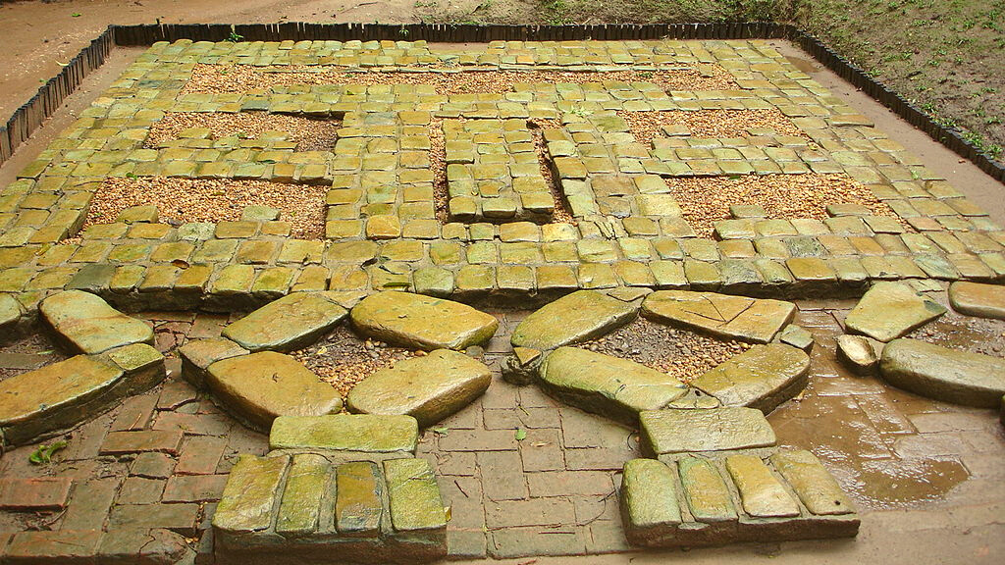
OLMEC COLOSSAL HEADS

Slide 4
The Olmec civilization dates from as early as 1500 BCE to about 400 BCE and is the earliest known Mesoamerican civilization. The Olmecs occupied the tropical lowlands of the modern-day Mexican states of Veracruz and Tabasco. The Olmec civilization centered on the San Lorenzo Tenochtitlán site near the coast in southeast Veracruz. The Olmecs laid many of the foundations for the civilizations that followed, and they played the Mesoamerican ballgame, a hallmark of nearly all subsequent Mesoamerican societies.
Did you know?

Slide 5
The most familiar aspect of the Olmecs is their artwork, especially the "colossal heads", stone representations of human heads sculpted from large basalt boulders. They range in height from 3.8 to 11.2 feet (1.17 to 3.4 meters). All portray mature adults with distinctive headdresses. The boulders were brought from the Sierra de Los Tuxtlas mountains of Veracruz. These extremely large slabs of stone were transported over large distances, but the method of transporting the stone to these sites remains unclear. It is believed that these monuments represent portraits of powerful individual Olmec rulers.

Slide 6
To get started, review these videos about the Olmec Colossal Heads:
Art of the Olmec
Olmec Colossal Heads
The Olmec Legacy
The Olmec Civilization
Olmecs (Culture of Ancient Mexico)

Slide 7
Articles about the Olmec Colossal Heads
Olmec Civilization – National Geographic
Olmec Civilization – World History Encyclopedia
Olmec in eHRAF Archaeology
The Olmec Head – Yale Peabody Museum of Natural History
Michael Coe Obituary – The Guardian

Slide 8
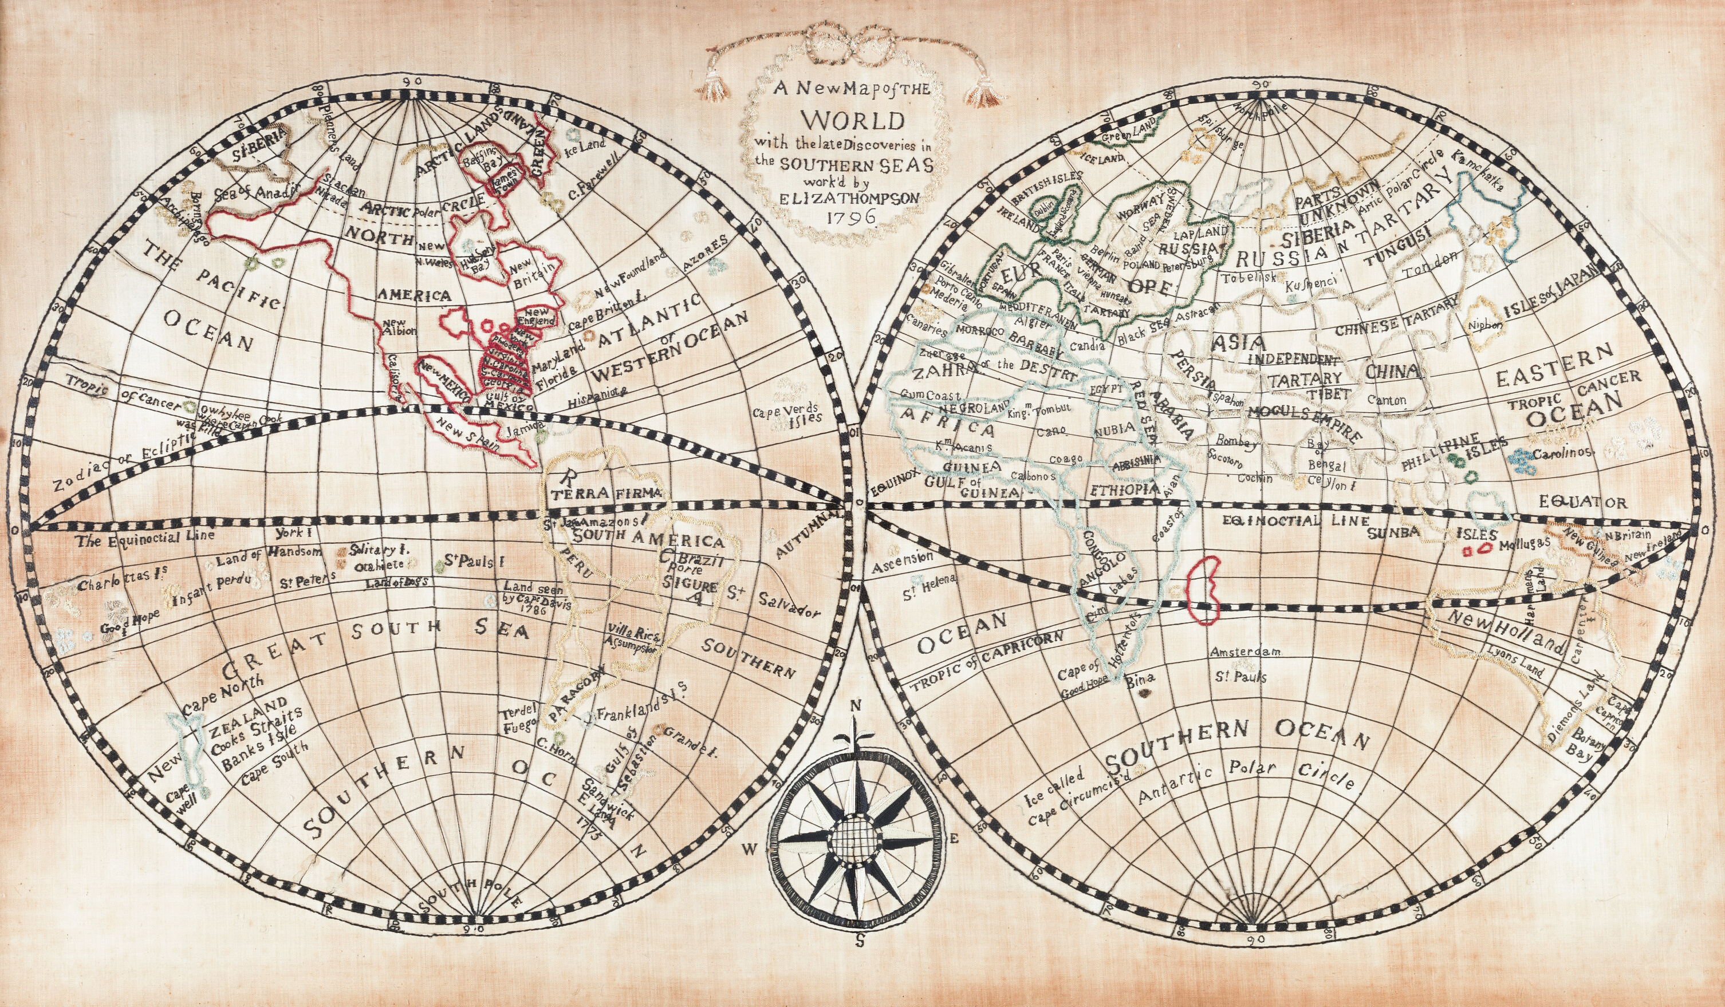
eHRAF Workbook
Part 1: Tradition Summary

Slide 9
Tradition Summaries
A brief overview for traditions in eHRAF Archaeology is provided in the form of Tradition Summaries.
The format, general outline, and headings are the same for each summary. You will find a basic overview about the tradition, such as its time period, location, history, environment, and sociopolitical organization.
eHRAF
Archaeology
To find a tradition summary, go to the Browse Traditions tab and enter the tradition name into the box, then click on Tradition Summary below the tradition name to read it.

Slide 10
Olmec (NU95)
PART 1
Begin by learning more about the Olmec tradition. First, read the eHRAF Tradition Summary:
🌐
https://ehrafarchaeology.yale.edu/document?id=nu95-000
Then, write a brief description of Olmec indicating any significant archaeological elements that stand out to you.

Slide 11
eHRAF Workbook
Part 2: Selected Readings

Slide 12
To read documents or pages in eHRAF:
INSTRUCTIONS
First, follow the permalinks provided in the activities below to get to the relevant documents.
For example:
🌐
Then, use the Page List dropdown menu to navigate to the required page(s).

Slide 13
Finding documents without permalinks
INSTRUCTIONS
Follow these steps if you are having trouble with permalinks from off campus while using a proxy or VPN service, or if you have been provided with a HRAF-issued username and password.
Sign in via your library proxy or VPN, or using the HRAF-issued credentials.
Go to the Browse Documents tab.
Enter the author's last name into the Filter Index box.
Click on the required title to access the document, then select the page number from the Page List dropdown menu as shown above.

Slide 14
PART 2
The Archaeology of San Lorenzo Tenochtitlán (Coe and Diehl 1980)
🌐
https://ehrafarchaeology.yale.edu/document?id=nu95-042
Pages:
3–10a, Introduction
The Olmec World (Bernal 1969)
🌐
https://ehrafarchaeology.yale.edu/document?id=nu95-001
Pages:
56–57, The Colossal Heads

Slide 15
PART 2
The Olmecs: America’s First Civilization (Diehl 2004)
🌐
https://ehrafarchaeology.yale.edu/document?id=nu95-043
Pages:
7–10, Preface
11–18, Introduction
111–113, Colossal Heads
Olmec Archaeology: A Half Century of Research and Its Accomplishments (Grove 1997)
🌐
https://ehrafarchaeology.yale.edu/document?id=nu95-002
Pages:
51–60, Introduction
80–83, Monumental art

Slide 16
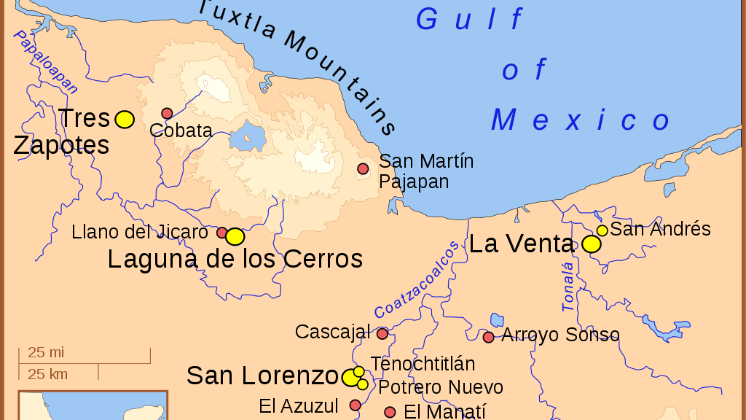
In this activity, you will ual relations across the globe.
eHRAF Workbook
Part 3: Advanced Search

Slide 17
Part 3:
Advanced Search
Now that you have read selected passages from eHRAF Archaeology, dig deeper with Advanced Search. This will enable you to find specific passages in documents that have been indexed by HRAF anthropologists at the paragraph level.
On the following slide, you will find an example of an advanced search. Try this search and then experiment with different subjects and/or keywords.

Slide 18
Part 3:
Advanced Search
In the Add Traditions, select the tradition name:
Olmec (NU95)
In the Add Subjects column, select the subject category:
Visual arts (5311)
In the Keyword section, type colossal.

Slide 19
ADVANCED SEARCH
Add tradition:
Olmec (NU95)
Add subject:
Visual arts (5311)
Add keyword:
colossal

Slide 20
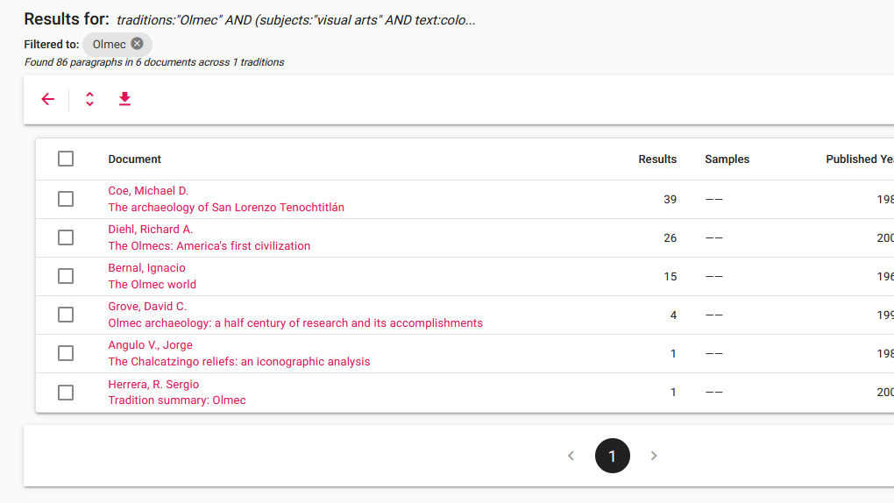
SEARCH RESULTS

Slide 21
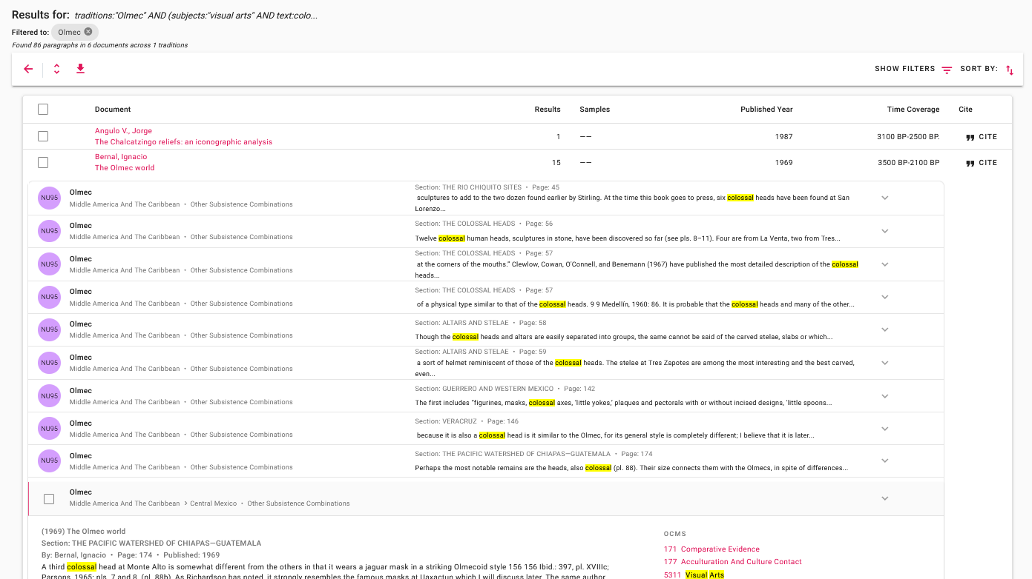
SEARCH RESULTS

Slide 22
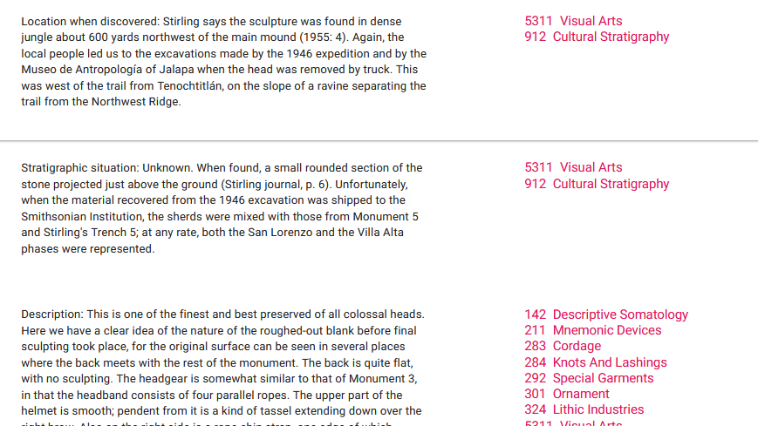
FULL CONTEXT

Slide 23
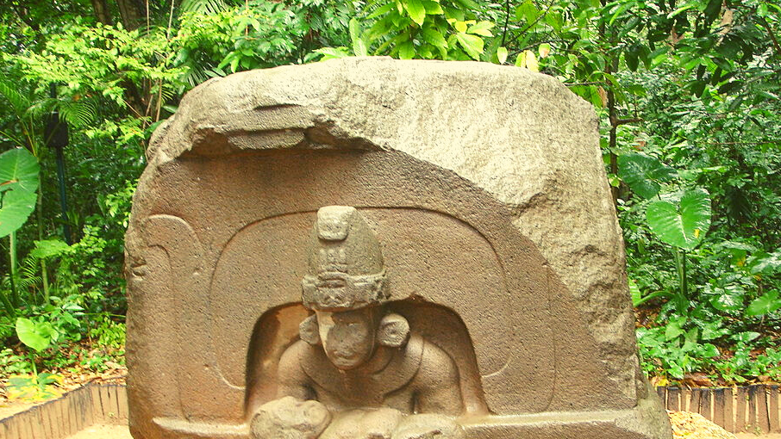
eHRAF Workbook
Part 4: Assignment

Slide 24
ASSIGNMENT
The purpose of this assignment is to present a report summarizing your findings about this great discovery.
This can be done in the form of a group project or an individual paper.
Groups can divide the questions that follow, with each student contributing information about a specific question.
Consider making a slideshow presentation to illustrate your findings.

Slide 25
ASSIGNMENT
Your final report describing the Olmec Colossal Heads should have 6 sections which correspond to these 6 types of questions:
Who?
What?
Where?
When?
How?
Why?

Slide 26
QUESTION 1
Who?
Who are the main archaeologists associated with this discovery? Describe their biographical information, education and training, publications, etc.
Who are the people studied? Describe how people lived during this time at this place, such as: social stratification, division of labor, gender roles, economic life, food and subsistence, religious practices.

Slide 27
QUESTION 2
What?
What did the archaeologists discover?
Provide a general description of the archaeological site.
Describe the material culture, structures, artifacts, etc.
Include relevant photos and/or interpretive artistic renderings.

Slide 28
QUESTION 3
Where?
Where is the site located?
Describe the geography of this discovery, its location in the contemporary world, size, scope, etc.
Does the location have strategic importance?
How did the physical environment and natural resources shape cultural practices?

Slide 29
QUESTION 4
When?
When were the discoveries made?
When in human history do archaeologists believe that this site can be dated to?
Describe the relative time period, what preceded it, and what followed it. What does this represent in terms of cultural evolution and progress?

Slide 30
QUESTION 5
How?
How did archaeologists excavate, analyze, and interpret this site?
Tell us about the scientific methods used for excavation and analysis of the materials founds.
What technologies were utilized by the people who lived during this archaeological time period?
How did they construct buildings and make artifacts (lithics, pottery, etc.)?

Slide 31
QUESTION 6
Why?
Why is this archaeological site considered a “great discovery”?
Describe how this site is important in terms of its place in human history.
Why should this great discovery be preserved and who should be responsible for preservation?

Slide 32
Bernal, Ignacio. 1969. The Olmec World. Berkeley: University of California Press. https://ehrafarchaeology.yale.edu/document?id=nu95-001.
The Colossal Heads, pages 56–57
Coe, Michael D., and Richard A. Diehl. 1980. “The Archaeology of San Lorenzo Tenochtitlán.” In In the Land of the Olmec, Vol. 1:viii, 416. Austin: University of Texas Press. https://ehrafarchaeology.yale.edu/document?id=nu95-042.
Diehl, Richard A. 2004. “The Olmecs: America’s First Civilization.” In Ancient Peoples and Places, 7–202. New York: Thames and Hudson. https://ehrafarchaeology.yale.edu/document?id=nu95-043.
References
Grove, David C. 1997. “Olmec Archaeology: A Half Century of Research and Its Accomplishments.” Journal of World Prehistory Vol. 11: 51–101. https://ehrafarchaeology.yale.edu/document?id=nu95-002.

Slide 33
Olmeca head in Villahermosa, Glysiak, CC BY-SA 4.0, via Wikimedia Commons:
https://commons.wikimedia.org/wiki/File:Olmeca_head_in_Villahermosa.jpg
Monument 1, Hajor, July 2001, CC BY-SA, via Wikimedia Commons:
https://commons.wikimedia.org/wiki/File:Mexico.Tab.OlmecHead.01.jpg
La Venta Mosaic, Ruben Charles, CC BY 2.0, via Wikimedia Commons:
https://commons.wikimedia.org/wiki/File:La_Venta_Mosaic_(Ruben_Charles).jpg
Image Credits
Olmec sculpture carved from stone, via Canva:
https://www.canva.com/media/MADer9bG2xw
Olmec Head 8, Adam sk, CC BY-SA 3.0, via Wikimedia Commons:
https://commons.wikimedia.org/wiki/File:Olmec_Head_8.jpg
San Lorenzo Monument 4, Marshall Astor (Life on the Edge), CC BY-SA 2.0, via Wikimedia Commons:
https://commons.wikimedia.org/wiki/File:San_Lorenzo_Monument_4_crop.jpg
San Lorenzo Monumental Head 6, Maunus, CC BY-SA 3.0, via Wikimedia Commons:
https://commons.wikimedia.org/wiki/File:OlmecheadMNAH.jpg

Slide 34
Cabeza olmeca, Santiago Tuxtla, Gunnar Wolf, CC BY-SA 3.0, via Wikimedia Commons:
https://commons.wikimedia.org/wiki/File:Cabeza_olmeca,_Santiago_Tuxtla.jpg
Olmec Heartland Overview, Madman2001, via Wikimedia Commons:
https://en.wikipedia.org/wiki/File:Olmec_Heartland_Overview_4.svg
Olmec Head No. 1 at Xalapa, Veracruz, Mexico, Mesoamerican, CC BY-SA 4.0 , via Wikimedia Commons: https://commons.wikimedia.org/wiki/File:
Olmec_Head_No._1_at_Xalapa,_Veracruz,_Mexico.jpg
Image Credits
Cabeza olmeca, museo de San Andrés Tuxtla, Gunnar Wolf, CC BY-SA 3.0, via Wikimedia Commons: https://commons.wikimedia.org/wiki/File:
Cabeza_olmeca,_museo_de_San_Andr%C3%A9s_Tuxtla.JPG
La Venta Altar 5, Ruben Charles, CC BY 2.0, via Wikimedia Commons:
https://commons.wikimedia.org/wiki/File:La_Venta_Altar_5_(Ruben_Charles).jpg
Olmec Head, Mexico, c. 1960, Caldwell Kvaran Archives, CC BY-SA 3.0, via Wikimedia Commons:
https://commons.wikimedia.org/wiki/File:Olmec_Head,_Mexico,_c._1960.jpg

Slide 35
Infantile Figure, Walters Art Museum, Public domain, via Wikimedia Commons:
https://commons.wikimedia.org/wiki/File:Olmec_-_Infantile_Figure_-_Walters_20092064_-_Three_Quarter.jpg
Olmec-style mask from Tabasco, Michel wal, CC BY-SA 3.0, via Wikimedia Commons: https://commons.wikimedia.org/wiki/File:Olmec_mask_802.jpg
Tres Zapotes Monument, HJPD, CC BY-SA 3.0, via Wikimedia Commons:
https://commons.wikimedia.org/wiki/File:Tres_Zapotes_Monument_A.jpg
Image Credits
San Lorenzo Monument, Maribel Ponce Ixba (frida27ponce), CC BY 2.0, via Wikimedia Commons:
https://commons.wikimedia.org/wiki/File:San_Lorenzo_Monument_3.jpg
Olmec warrior, Public domain, Via Wikimedia Commons:
https://en.wikipedia.org/wiki/File:Olmec_warrior.jpg

Slide 36
Great Discoveries: Olmec Colossal Heads
Produced by
Human Relations Area Files
at Yale University
An eHRAF Workbook Activity
hraf.yale.edu

