Slide 1
An eHRAF Workbook Activity
Great Discoveries:
Pyramids
of Giza
Human Relations Area Files
at Yale University

Slide 2
In this activity
Learn about the Giza Pyramids
Read passages in eHRAF Archaeology
Answer questions about this archaeological discovery
Find out what makes the Giza Pyramids a "Great Discovery"
Topics We'll Cover

Slide 3
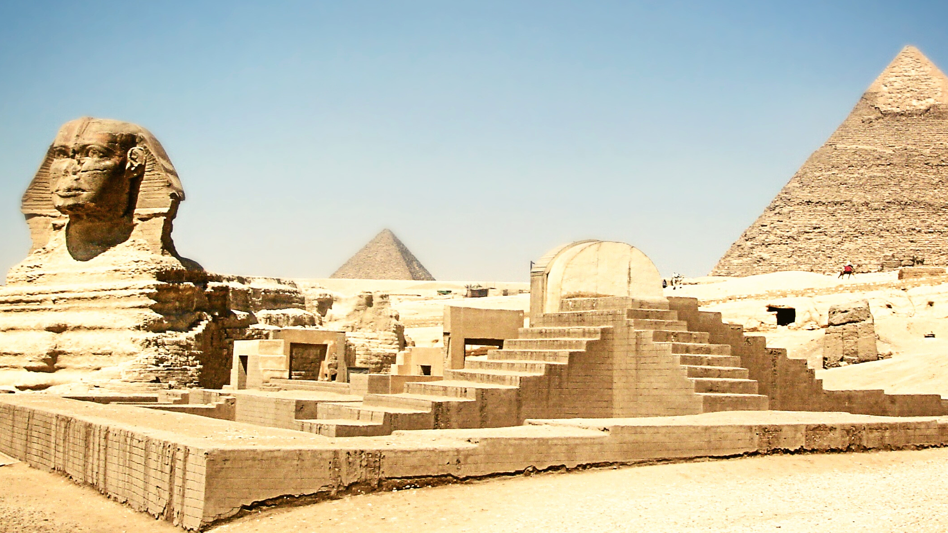
PYRAMIDS OF GIZA

Slide 4
The Pyramids of Giza, also known as the Giza Pyramid Complex and the Giza Necropolis, is a world-famous archaeological site on the Giza Plateau in Greater Cairo, Egypt. The site includes the Great Pyramid of Giza, the Pyramid of Khafre, the Pyramid of Menkaure, and the Great Sphinx of Giza. The Great Sphinx is a limestone statue of a reclining sphinx, a mythical creature that comprises a pharaoh’s head with a lion's body.
The pyramids and the sphinx were all built during the Fourth Dynasty of the Old Kingdom of Ancient Egypt.
Did you know?

Slide 5
The Pyramids of Giza are located at the edges of the Western Desert, west of the Nile River, and southwest of the city center of Cairo. The Great Pyramid and the Pyramid of Khafre are the largest pyramids built in ancient Egypt. They were popularized in Hellenistic times, when the Great Pyramid was listed by Antipater of Sidon as one of the Seven Wonders of the World. It is by far the oldest of the Seven Wonders and the only one still in existence. Current consensus among Egyptologists is that the head of the Great Sphinx is that of Khafre, pharaoh during the Fourth Dynasty of the Old Kingdom.

Slide 6
To get started, review these videos about the Pyramids of Giza:
The Evolution of Ancient Egypt's Pyramids – National Geographic
Why Pharaohs Switched from Pyramids to Underground Tombs - Smithsonian
The Pyramids of Egypt - How and Why
Why Was The Great Sphinx of Giza Built?

Slide 7
Articles about the Pyramids of Giza
Pyramids at Giza – National Geographic
The Egyptian Pyramid - Smithsonian
The Pennsylvania-Yale Giza Project
Giza in Another Dimension – Innovation at Harvard

Slide 8
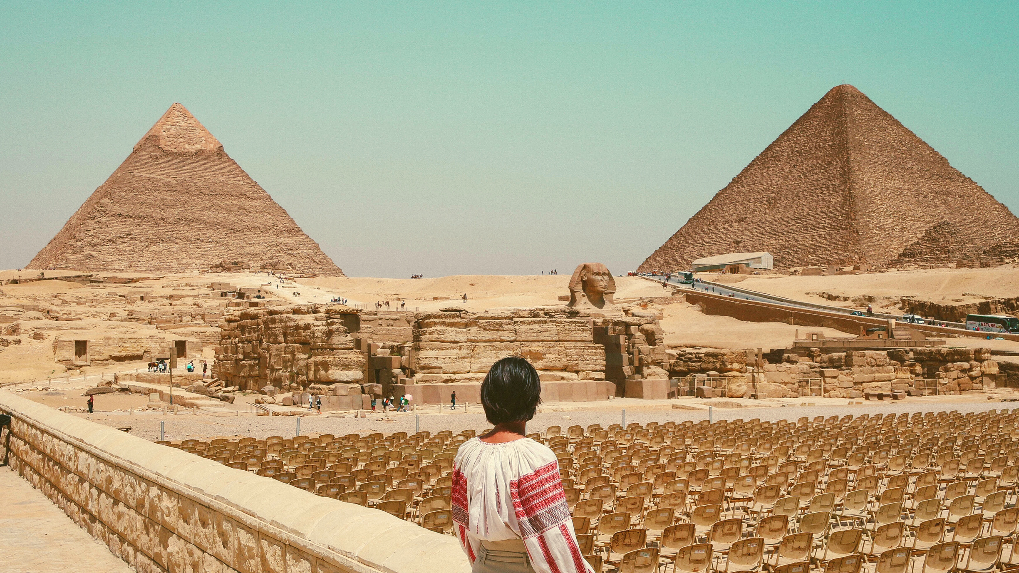
eHRAF Workbook
Part 1: Tradition Summary

Slide 9
Tradition Summaries
A brief overview for traditions in eHRAF Archaeology is provided in the form of Tradition Summaries.
The format, general outline, and headings are the same for each summary. You will find a basic overview about the tradition, such as its time period, location, history, environment, and sociopolitical organization.
eHRAF
Archaeology
To find a tradition summary, go to the Browse Traditions tab and enter the tradition name into the box, then click on Tradition Summary below the tradition name to read it.

Slide 10
PART 1
Protohistoric Egypt (MR80)
Begin by learning more about Protohistoric Egypt (MR80). First, read the eHRAF Tradition Summary:
🌐
https://ehrafarchaeology.yale.edu/document?id=mr80-000
Then, write a brief description of Protohistoric Egypt indicating any significant archaeological elements that stand out to you.

Slide 11
eHRAF Workbook
Part 2: Selected Readings

Slide 12
To read documents or pages in eHRAF:
INSTRUCTIONS
First, follow the permalinks provided in the activities below to get to the relevant documents.
For example:
🌐
https://ehrafarchaeology.yale.edu/document?id=nt76-001
Then, use the Page List dropdown menu to navigate to the required page(s).

Slide 13
Finding documents without permalinks
INSTRUCTIONS
Follow these steps if you are having trouble with permalinks from off campus while using a proxy or VPN service, or if you have been provided with a HRAF-issued username and password.
Sign in via your library proxy or VPN, or using the HRAF-issued credentials.
Go to the Browse Documents tab.
Enter the author's last name into the Filter Index box.
Click on the required title to access the document, then select the page number from the Page List dropdown menu as shown above.

Slide 14
PART 2
“Egypt to the End of the Old Kingdom.” (Aldred 1992)
🌐
https://ehrafarchaeology.yale.edu/
document?id=mr80-007
Pages:
81, 84-85, 87, 90, 92, 95, 98, 101-103,
The Giza Pyramids and The Later Buildings
Elephantine in the Old Kingdom.
(El-Dissouky 2004)
🌐
https://ehrafarchaeology.yale.edu/
document?id=mr80-004
Page:
86, Granite from Elephantine

Slide 15
PART 2
“Old Kingdom, Middle Kingdom, and Second Intermediate Period C. 2686-1552 BC”
(Kemp 1983)
🌐
https://ehrafarchaeology.yale.edu/
document?id=mr80-008
Pages:
76-79, The Royal Family
“Early Dynastic Egypt" (Wilkinson 1999)
🌐
https://ehrafarchaeology.yale.edu/
document?id=se51-011
Pages:
183-186, Kingship

Slide 16
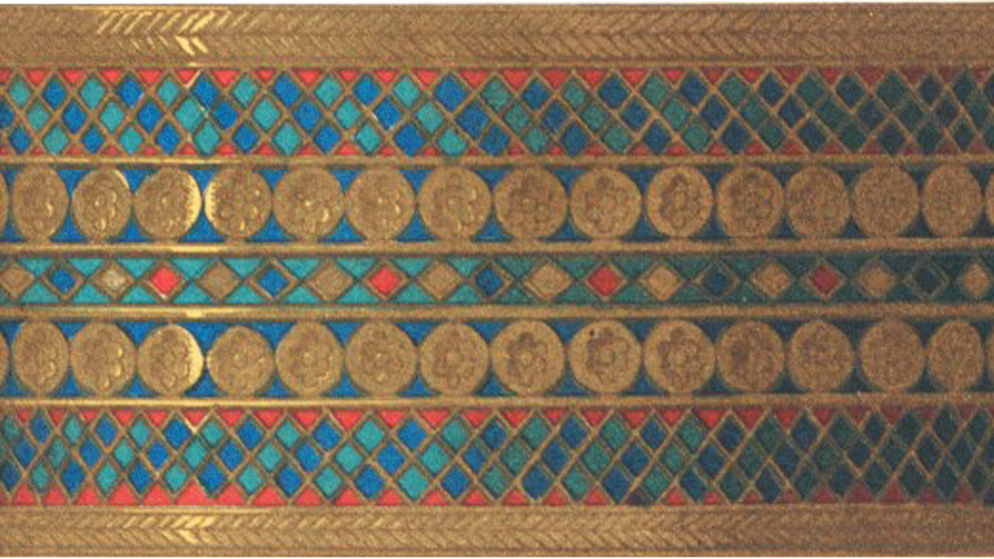
In this activity, you will ual relations across the globe.
eHRAF Workbook
Part 3: Advanced Search

Slide 17
Part 3:
Advanced Search
Now that you have read selected passages from eHRAF Archaeology, dig deeper with Advanced Search. This will enable you to find specific passages in documents that have been indexed by HRAF anthropologists at the paragraph level.
On the following slide, you will find an example of an advanced search. Try this search and then experiment with different subjects and/or keywords.

Slide 18
Part 3:
Advanced Search
In the Add Traditions column, select the tradition: Protohistoric Egypt (MR80)
In the Add Subjects column, select the subject category: Structures (340)
In the Keyword section, type Giza.

Slide 19
ADVANCED SEARCH
Add tradition:
Protohistoric Egypt (MR80)
Add subject:
Structures (340)
Add keyword:
Giza

Slide 20
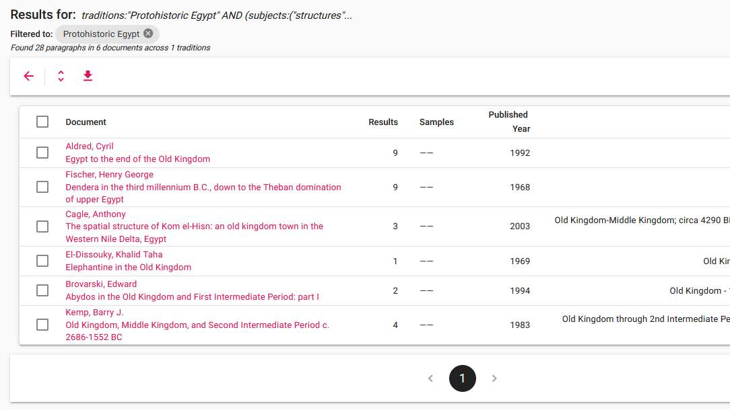
SEARCH RESULTS

Slide 21
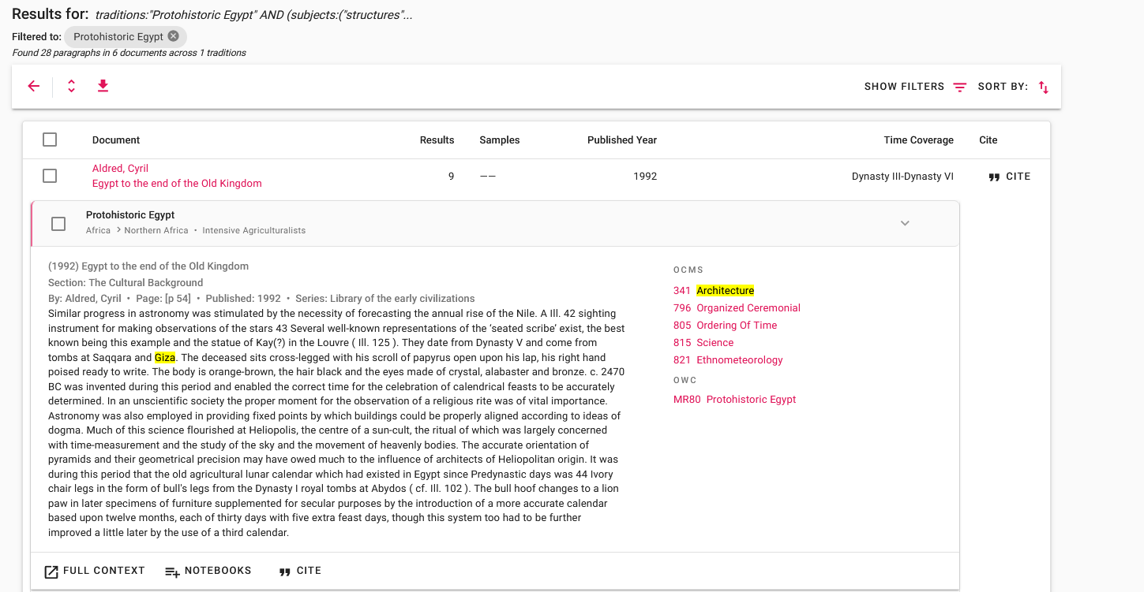
SEARCH RESULTS

Slide 22
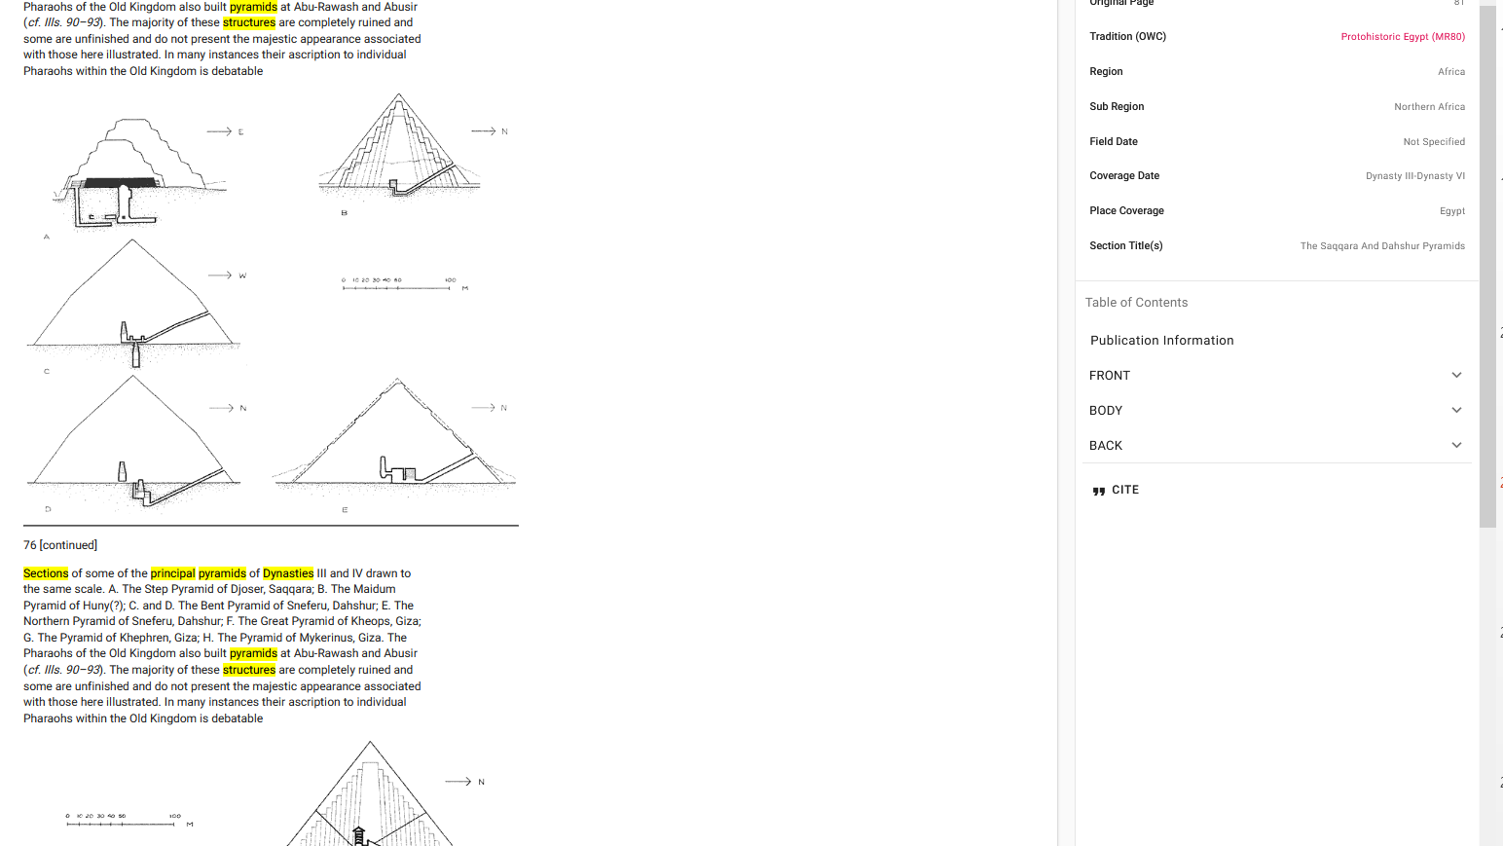
FULL CONTEXT

Slide 23
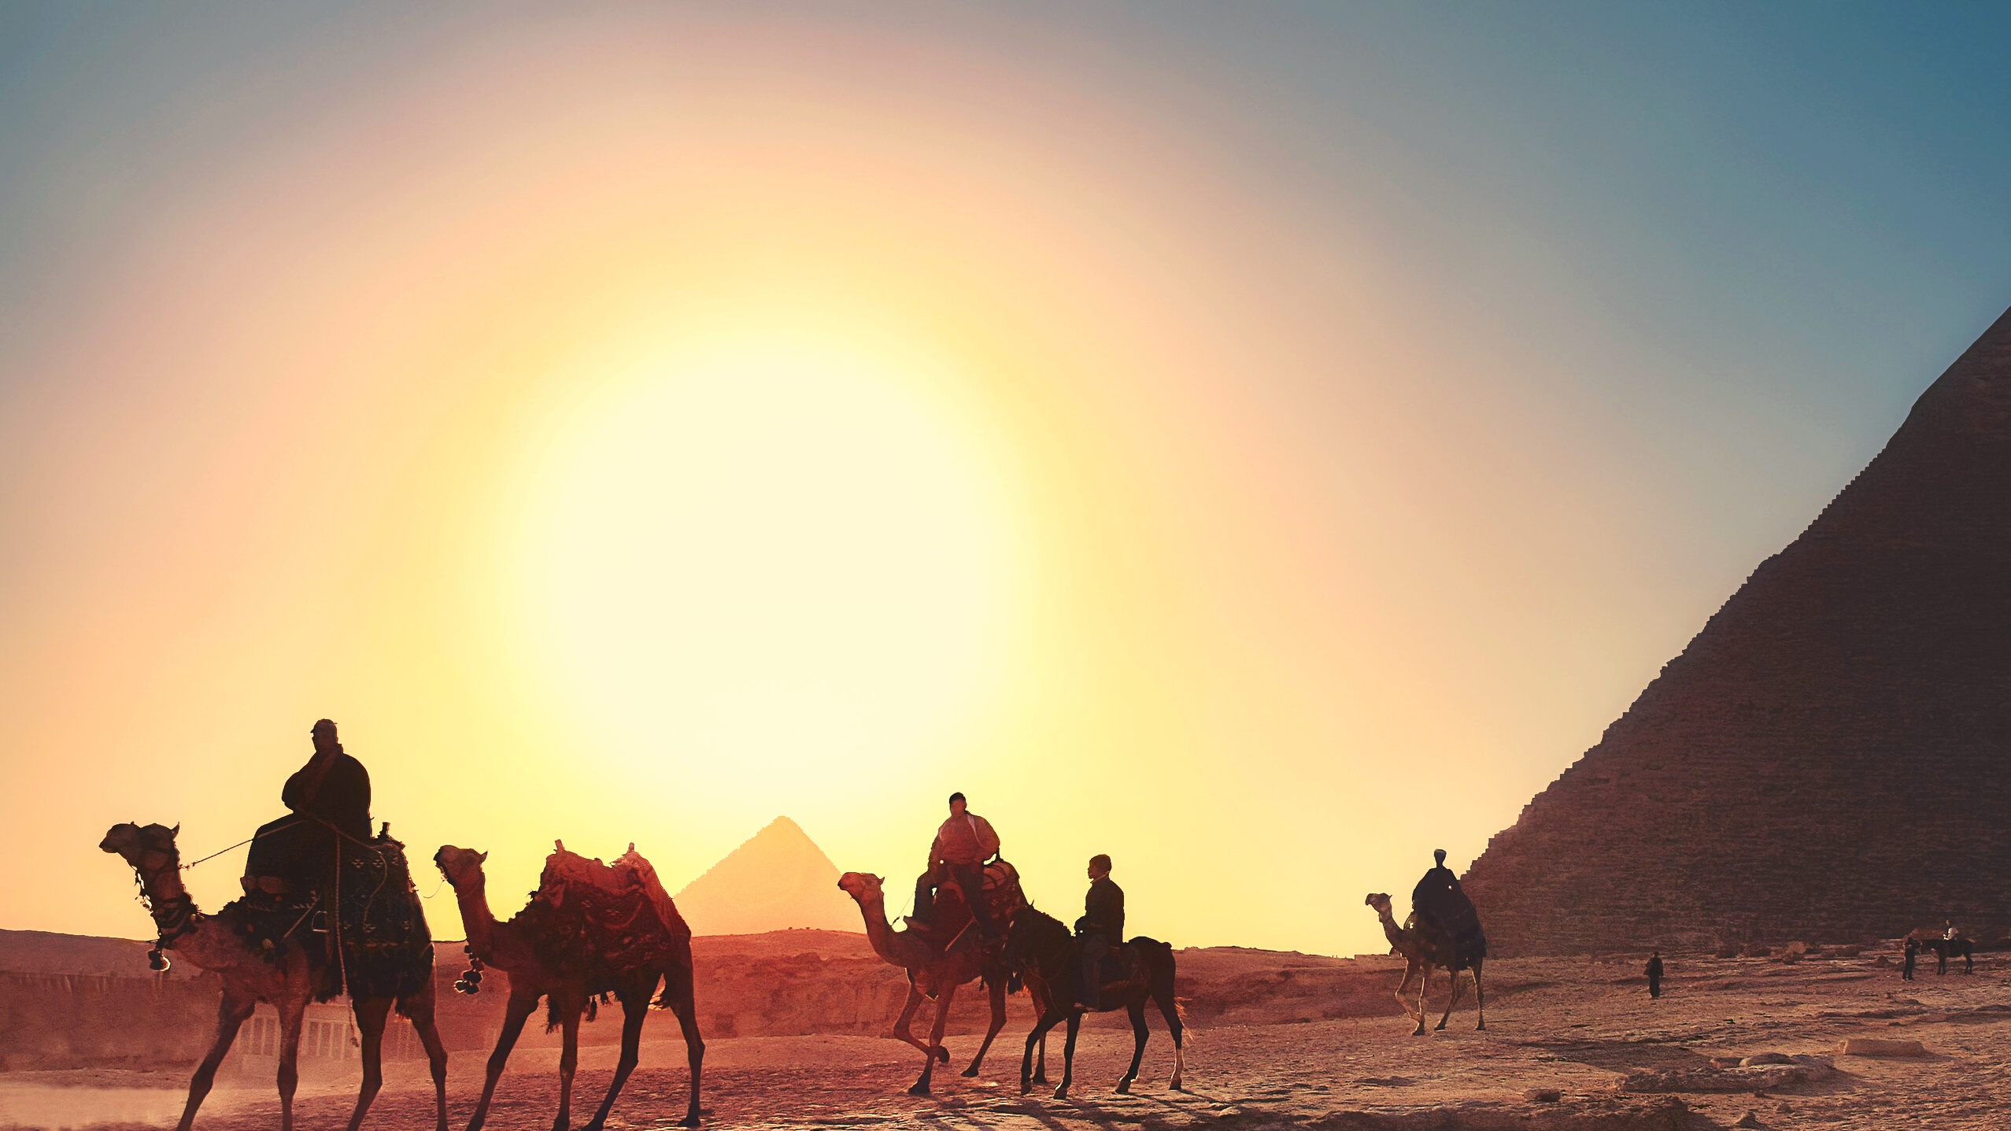
eHRAF Workbook
Part 4: Assignment

Slide 24
ASSIGNMENT
The purpose of this assignment is to present a report summarizing your findings about this great discovery.
This can be done in the form of a group project or an individual paper.
Groups can divide the questions that follow, with each student contributing information about a specific question.
Consider making a slideshow presentation to illustrate your findings.

Slide 25
ASSIGNMENT
Your final report describing the Pyramids of Giza should have 6 sections which correspond to these 6 types of questions:
Who?
What?
Where?
When?
How?
Why?

Slide 26
QUESTION 1
Who?
Who are the main archaeologists associated with this discovery? Describe their biographical information, education and training, publications, etc.
Who are the people studied? Describe how people lived during this time at this place, such as: social stratification, division of labor, gender roles, economic life, food and subsistence, religious practices.

Slide 27
QUESTION 2
What?
What did the archaeologists discover?
Provide a general description of the archaeological site.
Describe the material culture, structures, artifacts, etc.
Include relevant photos and/or interpretive artistic renderings.

Slide 28
QUESTION 3
Where?
Where is the site located?
Describe the geography of this discovery, its location in the contemporary world, size, scope, etc.
Does the location have strategic importance?
How did the physical environment and natural resources shape cultural practices?

Slide 29
QUESTION 4
When?
When were the discoveries made?
When in human history do archaeologists believe that this site can be dated to?
Describe the relative time period, what preceded it, and what followed it. What does this represent in terms of cultural evolution and progress?

Slide 30
QUESTION 5
How?
How did archaeologists excavate, analyze, and interpret this site?
Tell us about the scientific methods used for excavation and analysis of the materials founds.
What technologies were utilized by the people who lived during this archaeological time period?
How did they construct buildings and make artifacts (lithics, pottery, etc.)?

Slide 31
QUESTION 6
Why?
Why is this archaeological site considered a “great discovery”?
Describe how this site is important in terms of its place in human history.
Why should this great discovery be preserved and who should be responsible for preservation?

Slide 32
Aldred, Cyril. 1992. “Egypt to the End of the Old Kingdom.” In Library of the Early Civilizations, 143. New York, N.Y.: Thames and Hudson.
https://ehrafarchaeology.yale.edu/document?id=mr80-007.
El-Dissouky, Khalid Taha. 2004. Elephantine in the Old Kingdom. Ann Arbor, Mich.: UMI Dissertation Services. https://ehrafarchaeology.yale.edu/
document?id=mr80-004.
References
Kemp, Barry J. 1983. “Old Kingdom, Middle Kingdom, and Second Intermediate Period C. 2686-1552 BC.” In Ancient Egypt: A Social History / B.G. Trigger … [et Al, 71–182, 371–99. Cambridge [Cambridgeshire]: Cambridge University Press.
https://ehrafarchaeology.yale.edu/document?id=mr80-008.
Wilkinson, Toby A. H. 1999. Early Dynastic Egypt. London: Routledge.
https://ehrafarchaeology.yale.edu/document?id=mr70-006.
All images courtesy of Canva.

Slide 33
Great Discoveries: Pyramids
of Giza
Produced by
Human Relations Area Files
at Yale University
An eHRAF Workbook Activity
hraf.yale.edu

