Slide 1
An eHRAF Workbook Activity
Great Discoveries:
Royal Tombs
of Ur
Human Relations Area Files
at Yale University

Slide 2
In this activity
Learn about the Royal Tombs of Ur
Read passages in eHRAF Archaeology
Answer questions about this archaeological discovery
Find out what makes the Royal Tombs of Ur a "Great Discovery"
Topics We'll Cover

Slide 3
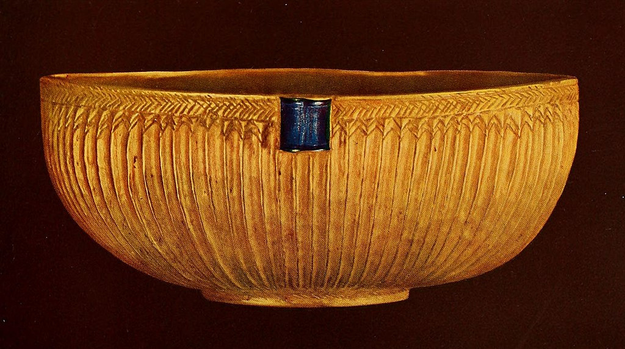
ROYAL TOMBS OF UR

Slide 4
From 1922 to 1935, archaeologists Leonard and Katharine Woolley led an excavation of Ur, the burial site of what may have been many Sumerian royals. This massive project was co-sponsored by the University of Pennsylvania and the British Museum.
Predating the famed pyramids of Egypt by thousands of years, this southern Mesopotamian site developed its own rich culture and monumental architecture, notably the ziggurat, a stepped structure topped by a temple.
Did you know?

Slide 5
The Woolleys and their team made important archaeological discoveries, including the Bull-Headed Lyre, the Copper Bull, and a pair of Ram in a Thicket figurines. The tombs contained great material wealth, including gold and silver jewelry and large paintings of ancient Sumerian culture at its zenith. The most extravagant tomb was that of "Queen" Puabi, an important person during the First Dynasty of Ur. The novel Murder in Mesopotamia, by Agatha Christie, was inspired by the discovery of the royal tombs. Christie later married the Woolleys' young assistant, Max Mallowan.

Slide 6
To get started, review these videos about the Royal Tombs of Ur:
Treasures from the Royal Tombs of Ur
Penn Museum – The Royal Tombs of Ur
Ur: The Rise and Fall of the Ancient Sumerian City State
Intro to Archaeology – Sir Leonard Woolley, Agatha Christie, and Ur

Slide 7
Articles about the Royal Tombs of Ur
Current World Archaeology – Issue 49
Great Discoveries – Royal Tombs of Ur
Penn Museum – Ur and its Treasures: The Royal Tombs
Archaeological Wonders of Mesopotamia: The Royal Cemetery at Ur
Standard of Ur and other objects from the Royal Graves

Slide 8
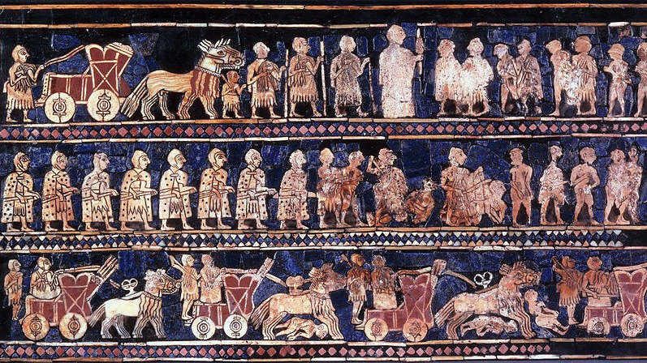
eHRAF Workbook
Part 1: Tradition Summary

Slide 9
Tradition Summaries
A brief overview for traditions in eHRAF Archaeology is provided in the form of Tradition Summaries.
The format, general outline, and headings are the same for each summary. You will find a basic overview about the tradition, such as its time period, location, history, environment, and sociopolitical organization.
eHRAF
Archaeology
To find a tradition summary, go to the Browse Traditions tab and enter the tradition name into the box, then click on Tradition Summary below the tradition name to read it.

Slide 10
Early Dynastic Mesopotamia (MH64)
PART 1
Begin by learning more about the Early Dynastic Mesopotamia tradition. First, read the eHRAF Tradition Summary:
🌐
https://ehrafarchaeology.yale.edu/document?id=mh64-000
Then, write a brief description of Early Dynastic Mesopotamia indicating any significant archaeological elements that stand out to you.

Slide 11
eHRAF Workbook
Part 2: Selected Readings

Slide 12
To read documents or pages in eHRAF:
INSTRUCTIONS
First, follow the permalinks provided in the activities below to get to the relevant documents.
For example:
🌐
https://ehrafarchaeology.yale.edu/document?id=nt76-001
Then, use the Page List dropdown menu to navigate to the required page(s).

Slide 13
Finding documents without permalinks
INSTRUCTIONS
Follow these steps if you are having trouble with permalinks from off campus while using a proxy or VPN service, or if you have been provided with a HRAF-issued username and password.
Sign in via your library proxy or VPN, or using the HRAF-issued credentials.
Go to the Browse Documents tab.
Enter the author's last name into the Filter Index box.
Click on the required title to access the document, then select the page number from the Page List dropdown menu as shown above.

Slide 14
PART 2
The Sumerians: Their History, Culture, and Character (Kramer 1963)
🌐
https://ehrafarchaeology.yale.edu/document?id=mh64-004
Pages:
100-102, 103-104, the Royal Tombs of Ur
Of priestesses, princes and poor relations: the dead in the royal cemetery of Ur
(Pollock 1955)
🌐
https://ehrafarchaeology.yale.edu/document?id=mh64-009
Pages:
171, 173,175, 177,180, 182-189, the Epic of Gilgamesh, the Royal Burials at Ur

Slide 15
PART 2
Sumer and the Sumerians (Crawford 1990)
🌐
https://ehrafarchaeology.yale.edu/document?id=mh64-002
Pages:
103-122, Chapter 6 Life, Death, and the Meaning of the Universe
Early Mesopotamia: Society and Economy at the Dawn of History (Postgate 1992)
🌐
https://ehrafarchaeology.yale.edu/document?id=mh64-010
Pages:
99-100, the Royal Cemetery of Ur

Slide 16
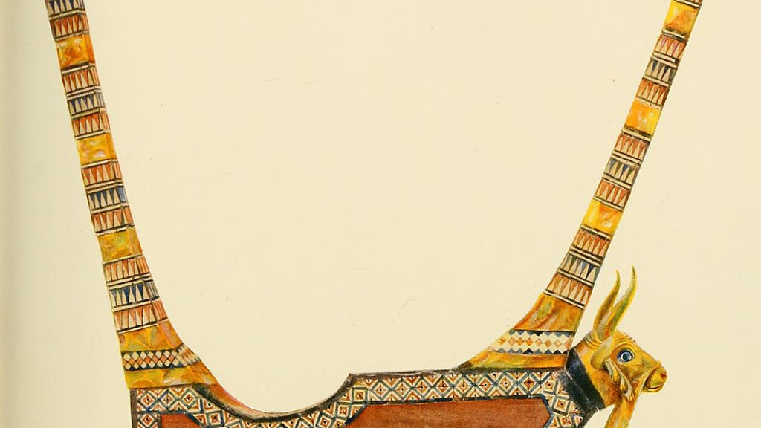
In this activity, you will ual relations across the globe.
eHRAF Workbook
Part 3: Advanced Search

Slide 17
Part 3:
Advanced Search
Now that you have read selected passages from eHRAF Archaeology, dig deeper with Advanced Search. This will enable you to find specific passages in documents that have been indexed by HRAF anthropologists at the paragraph level.
On the following slide, you will find an example of an advanced search. Try this search and then experiment with different subjects and/or keywords.

Slide 18
Part 3:
Advanced Search
In the Add Traditions column, select the tradition category:
Early Dynastic Mesopotamia (MH64)
In the Add Subjects column, select the subject category:
Burial practices and funerals (764)
In the Keyword section, type royal.

Slide 19
ADVANCED SEARCH
Add tradition:
Early Dynastic Mesopotamia (MH64)
Add subject:
Burial practices and funerals (764)
Add keyword:
royal

Slide 20
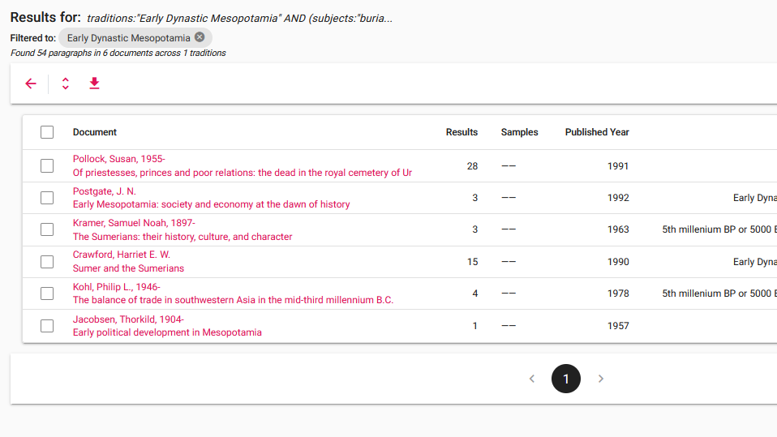
SEARCH RESULTS

Slide 21
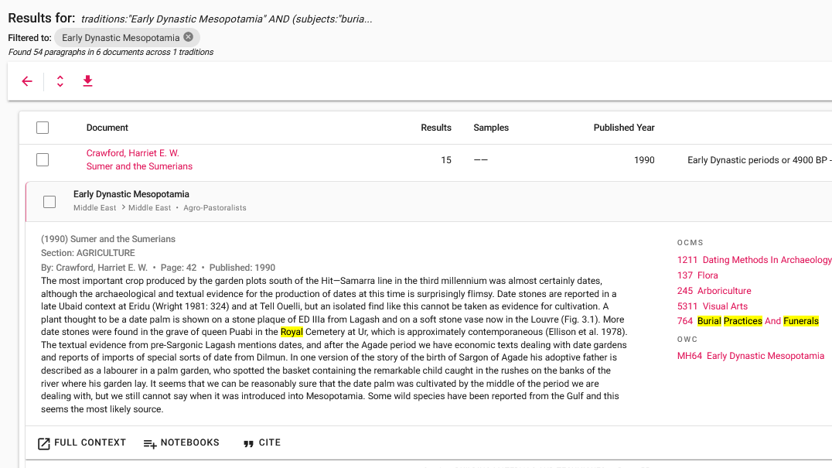
SEARCH RESULTS

Slide 22
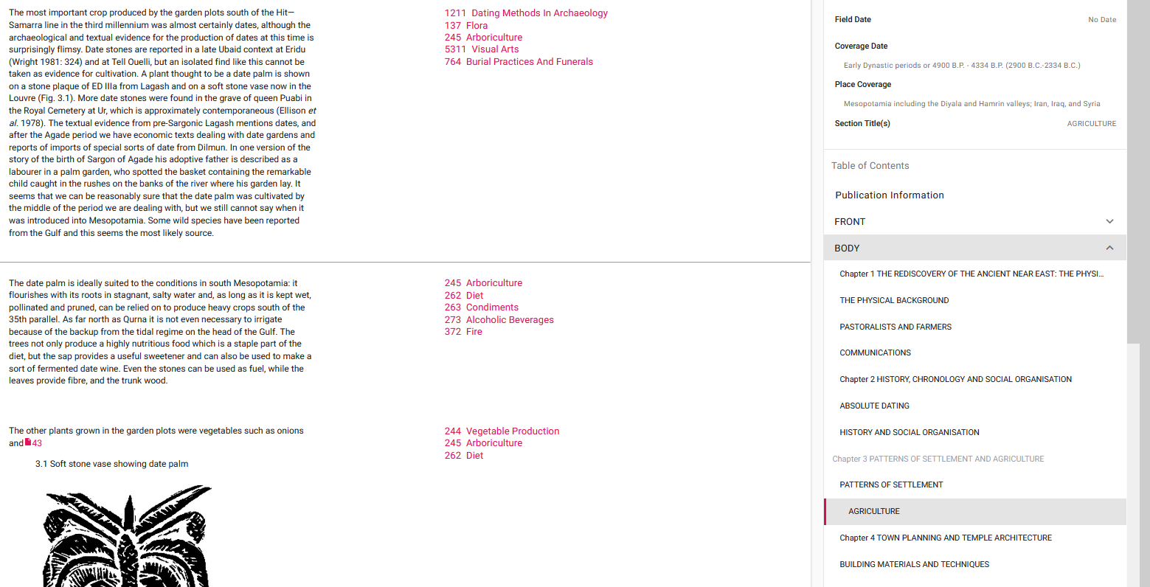
FULL CONTEXT

Slide 23
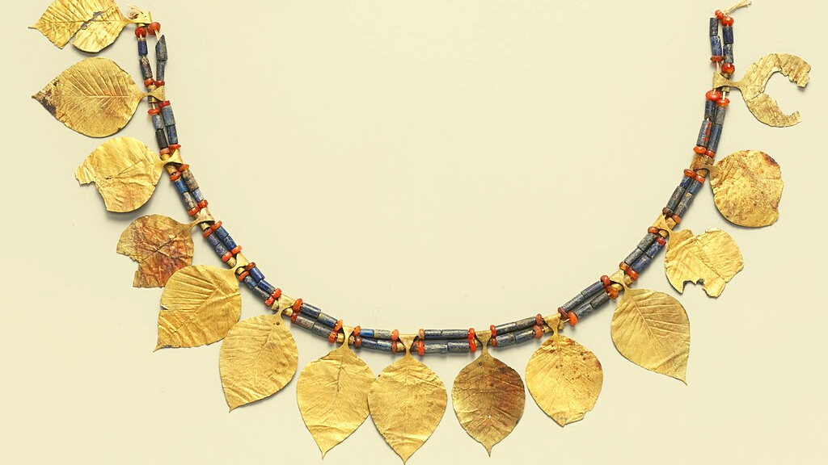
eHRAF Workbook
Part 4: Assignment

Slide 24
ASSIGNMENT
The purpose of this assignment is to present a report summarizing your findings about this great discovery.
This can be done in the form of a group project or an individual paper.
Groups can divide the questions that follow, with each student contributing information about a specific question.
Consider making a slideshow presentation to illustrate your findings.

Slide 25
ASSIGNMENT
Your final report describing the Royal Tombs of Ur should have 6 sections which correspond to these 6 types of questions:
Who?
What?
Where?
When?
How?
Why?

Slide 26
QUESTION 1
Who?
Who are the main archaeologists associated with this discovery? Describe their biographical information, education and training, publications, etc.
Who are the people studied? Describe how people lived during this time at this place, such as: social stratification, division of labor, gender roles, economic life, food and subsistence, religious practices.

Slide 27
QUESTION 2
What?
What did the archaeologists discover?
Provide a general description of the archaeological site.
Describe the material culture, structures, artifacts, etc.
Include relevant photos and/or interpretive artistic renderings.

Slide 28
QUESTION 3
Where?
Where is the site located?
Describe the geography of this discovery, its location in the contemporary world, size, scope, etc.
Does the location have strategic importance?
How did the physical environment and natural resources shape cultural practices?

Slide 29
QUESTION 4
When?
When were the discoveries made?
When in human history do archaeologists believe that this site can be dated to?
Describe the relative time period, what preceded it, and what followed it. What does this represent in terms of cultural evolution and progress?

Slide 30
QUESTION 5
How?
How did archaeologists excavate, analyze, and interpret this site?
Tell us about the scientific methods used for excavation and analysis of the materials founds.
What technologies were utilized by the people who lived during this archaeological time period?
How did they construct buildings and make artifacts (lithics, pottery, etc.)?

Slide 31
QUESTION 6
Why?
Why is this archaeological site considered a “great discovery”?
Describe how this site is important in terms of its place in human history.
Why should this great discovery be preserved and who should be responsible for preservation?

Slide 32
Crawford, Harriet E. W. 1990. Sumer and the Sumerians. Cambridge: Cambridge University Press. https://ehrafarchaeology.yale.edu/document?id=mh64-002.
Kramer, Samuel Noah. 1963. The Sumerians: Their History, Culture, and Character. Chicago: University of Chicago Press. https://ehrafarchaeology.yale.edu/document?id=mh64-004.
References
Pollock, Susan. 1991. “Of Priestesses, Princes and Poor Relations: The Dead in the Royal Cemetery of Ur.” Cambridge Archaeological Journal Vol. 1 (no. 2): 171–89. https://ehrafarchaeology.yale.edu/document?id=mh64-009.
Postgate, J. N. 1992. Early Mesopotamia: Society and Economy at the Dawn of History. London: Routledge. https://ehrafarchaeology.yale.edu/document?id=mh64-010.

Slide 33
Golden helmet of Meskalamdug, possible founder of the First Dynasty of Ur, via Wikimedia Commons: https://commons.wikimedia.org/wiki/File:
Golden_helmet_of_Meskalamdug_in_the_British_Museum.jpg
Ancient ziggurat at Ali Air Base Iraq, Hardnfast, CC BY 3.0, via Wikimedia Commons: https://commons.wikimedia.org/wiki/File:
Ancient_ziggurat_at_Ali_Air_Base_Iraq_2005.jpg
Image Credits
Golden bowl from the grave of Meskalamdug, via Wikimedia Commons:
https://commons.wikimedia.org/wiki/File:Golden_bowl_from_the_grave_of_Meskalamdug_(PG_755,_Ur).jpg
Expedition house and staff, C. Leonard Wolley, Katharine Woolley, 1928-29, Public Domain via Wikimedia Commons:https://commons.wikimedia.org/
wiki/File: Expedition-house-and-staff_-1928_29.jpg
Excavating grave material, 1928-29. In center foreground, Katharine and C. Leonard Woolley [sic], via Wikimedia Commons: https://commons.wikimedia.org/wiki/File:Excavating-grave-material.jpg

Slide 34
Queen's Lyre Ur Royal Cemetery, Osama Shukir Muhammed Amin FRCP(Glasg), CC BY-SA 4.0, via Wikimedia Commons: https://commons.wikimedia.org/wiki/
File: Queen%27s_Lyre_Ur_Royal_Cemetery.jpg
Cylinder-seal of the "Lady" or "Queen" Puabi, Nic McPhee, CC BY-SA 2.0, via Wikimedia Commons: https://commons.wikimedia.org/wiki/File: Flickr_-_
Nic%27s_events_-_British_Museum_with_Cory_and_Mary,_6_Sep_2007_-_185.jpg
Image Credits
Standard of Ur, 26th century BC, "War" panel, Public domain, via Wikimedia Commons: https://commons.wikimedia.org/wiki/File:Standard_of_Ur_-_War.jpg
A gold dagger and a dagger with a gold-plated handle, via Wikimedia Commons: https://commons.wikimedia.org/wiki/File: A_gold_dagger_and_a_dagger
_with_a_gold plated_handle,_Ur_excavations_(1900)_(14581033499).jpg
Reconstructed Sumerian headgear necklaces found in the tomb of Puabi, British Museum, CC BY-SA 3.0, via Wikimedia Commons: https://commons.wikimedia.org
/wiki/File:Reconstructed_sumerian_headgear_necklaces_british_museum.JPG

Slide 35
Ram in a Thicket, British Museum, Jack1956, CC BY-SA 3.0, via Wikimedia Commons: https://commons.wikimedia.org/wiki/File:Raminathicket2.jpg
The gold lyre from the Great Death-Pit, Ur excavations, M. Louise Baker, via Wikimedia Commons: https://commons.wikimedia.org/wiki/File:
The_gold_lyre_from_the_Great_Death-Pit,_Ur_excavations_(1900).jpg
Lyre detail (Royal Cemetery of Ur), Mary Harrsch, CC BY 2.0, via Wikimedia Commons: https://commons.wikimedia.org/wiki/File:
Lyre_detail_(Royal_Cemetery_of_Ur).jpg
Image Credits
Gold and carnelian beads, Royal cemetery of Ur, Vassil, CC0, via Wikimedia Commons: https://commons.wikimedia.org/wiki/File:
British_Museum_Middle_East_14022019_Gold_and_carnelian_beads_2600-2300_BC_Royal_cemetery_of_Ur_(composite).jpg
Sumerian Headdress Metalwork-Ornaments, Metropolitan Museum of Art, CC0, via Wikimedia Commons: https://commons.wikimedia.org/wiki/File:
Headdress_MET_DP226592_(cropped).jpg

Slide 36
Bull's head of the Queen's lyre from Puabi's grave, Osama Shukir Muhammed Amin FRCP(Glasg), CC BY-SA 4.0, via Wikimedia Commons: https://commons.wikimedia.org/wiki/File:Bull%27s_head_of_the_Queen%27s_lyre_from_Pu-abi%27s_grave_PG_800,_the_Royal_Cemetery _at_Ur,_Southern_Mesopotamia,_Iraq._The_British_Museum,_London..JPG
Royal Cemetery of Ur excavations, via Wikimedia Commons:
https://commons.wikimedia.org/wiki/File:
Royal_Cemetery_of_Ur_excavations_(B%26W).jpg
Image Credits
Gold vessels, Ur excavations, via Wikimedia Commons: https://commons.wikimedia.org/ wiki/File:
Ur_excavations_(1900)_(14767364572).jpg
Ruins in the Town of Ur, M. Lubinski, via Wikimedia Commons:
https://en.wikipedia.org/wiki/File:Ur-Nassiriyah.jpg
The golden bull's head from the lyre, Ur excavations, M. Louise Baker, via Wikimedia Commons: https://commons.wikimedia.org/wiki/File:
The_golden_bull%27s_head_from_the_lyre,_Ur_excavations_(1900).jpg

Slide 37
Great Discoveries: Royal Tombs
of Ur
Produced by
Human Relations Area Files
at Yale University
An eHRAF Workbook Activity
hraf.yale.edu

