Slide 1
An eHRAF Workbook Activity
Great Discoveries:
Stonehenge
Human Relations Area Files
at Yale University

Slide 2
In this activity
Learn about Stonehenge
Read passages in eHRAF Archaeology
Answer questions about this archaeological discovery
Find out what makes Stonehenge a "Great Discovery"
Topics We'll Cover

Slide 3
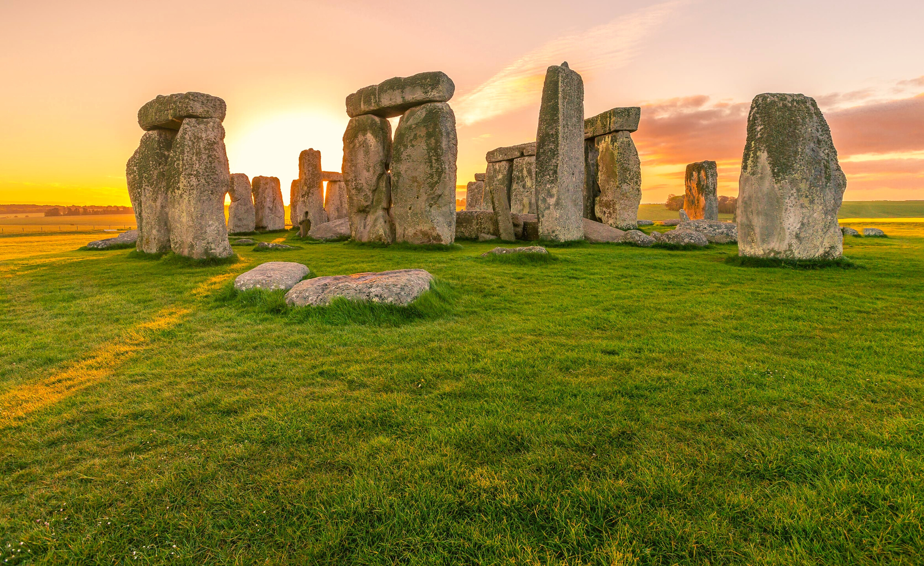
STONEHENGE

Slide 4
Stonehenge is an archaeological site on Salisbury Plain in Wiltshire, England. It is a prehistoric monument consisting of an outer ring of vertical standing stones, topped by connecting horizontal stones. A ring of smaller bluestones can be found inside. The monument is oriented towards the sunrise on the summer solstice. It took hundreds of years to build Stonehenge. Work began in the late Neolithic Age and major changes were made in the early Bronze Age.
Did you know?

Slide 5
Stonehenge
Stonehenge is one of the most famous landmarks in Great Britain. In 1882, the site became protected as a Scheduled Ancient Monument. In 1986, it became a UNESCO World Heritage Site. Stonehenge is owned by the British Crown and managed by English Heritage, a charity that manages over 400 historic monuments, buildings, and places. Modern-day Pagan and Druid groups believe that it is their temple and that they have the right to worship there. For them, Stonehenge is the equivalent of a church or a cathedral.

Slide 6
To get started, review these videos about Stonehenge:
Uncovering the secrets of Stonehenge
Decoding the ancient astronomy of Stonehenge
Stonehenge: The Lost Circle Revealed
Massive Prehistoric Monument Found at Stonehenge

Slide 7
Articles About Stonehenge
New Thoughts on the Origins of the Stonehenge
Was Stonehenge a ‘Secondhand’ Monument?
Why Was Stonehenge Built?
Celebrating the Vernal Equinox

Slide 8
eHRAF Workbook
Part 1: Tradition Summary

Slide 9
Tradition Summaries
A brief overview for traditions in eHRAF Archaeology is provided in the form of Tradition Summaries.
The format, general outline, and headings are the same for each summary. You will find a basic overview about the tradition, such as its time period, location, history, environment, and sociopolitical organization.
eHRAF
Archaeology
To find a tradition summary, go to the Browse Traditions tab and enter the tradition name into the box, then click on Tradition Summary below the tradition name to read it.

Slide 10
Bell Beaker (E050)
PART 1
Begin by learning more about the Bell Beaker tradition. First, read the eHRAF Tradition Summary:
🌐
https://ehrafarchaeology.yale.edu/document?id=e050-000
Then, write a brief description of the Bell Beaker tradition indicating any significant archaeological elements that stand out to you.

Slide 11
eHRAF Workbook
Part 2: Selected Readings

Slide 12
To read documents or pages in eHRAF:
INSTRUCTIONS
First, follow the permalinks provided in the activities below to get to the relevant documents.
For example:
🌐
https://ehrafarchaeology.yale.edu/document?id=nt76-001
Then, use the Page List dropdown menu to navigate to the required page(s).

Slide 13
Finding documents without permalinks
INSTRUCTIONS
Follow these steps if you are having trouble with permalinks from off campus while using a proxy or VPN service, or if you have been provided with a HRAF-issued username and password.
Sign in via your library proxy or VPN, or using the HRAF-issued credentials.
Go to the Browse Documents tab.
Enter the author's last name into the Filter Index box.
Click on the required title to access the document, then select the page number from the Page List dropdown menu as shown above.

Slide 14
PART 2
The Beaker Folk: Copper Age Archaeology in Western Europe (Harrison 1980)
🌐
https://ehrafarchaeology.yale.edu/document?id=e050-008
Pages:
72, 90, 94–96, Western Europe, Copper Age
“Central Europe”, In The Bronze Age in Europe (Harding 1979)
🌐
https://ehrafarchaeology.yale.edu/document?id=e065-004
Pages:
335–336, Central Europe, Bronze Age

Slide 15
PART 2
“An Assessment of Previous Studies of the Nazca Glyphs” In The Lines of Nazca
(Aveni 1990)
🌐
https://ehrafarchaeology.yale.edu/document?id=se51-007
Pages:
15, 19–20, 40, Megalithic Astronomy
“A Statistical Examination of the Radial Line Azimuths at Nazca.” In The Lines of Nazca (Ruggles 1990)
🌐
https://ehrafarchaeology.yale.edu/document?id=se51-011
Pages:
248–249, Megalithic Astronomy

Slide 16
In this activity, you will ual relations across the globe.
eHRAF Workbook
Part 3: Advanced Search

Slide 17
Part 3:
Advanced Search
Now that you have read selected passages from eHRAF Archaeology, dig deeper with Advanced Search. This will enable you to find specific passages in documents that have been indexed by HRAF anthropologists at the paragraph level.
On the following slide, you will find an example of an advanced search. Try this search and then experiment with different subjects and/or keywords.

Slide 18
Part 3:
Advanced Search
In the Add Subjects column, select the subject categories:
Sacred objects and places (OCM 778)
Ethnometerology (OCM 821)
In the Keyword section, type Stonehenge.

Slide 19
ADVANCED SEARCH
Add subjects:
Sacred objects and places (778)
Ethnometerology (821)
Add keyword:
Stonehenge

Slide 20
SEARCH RESULTS

Slide 21
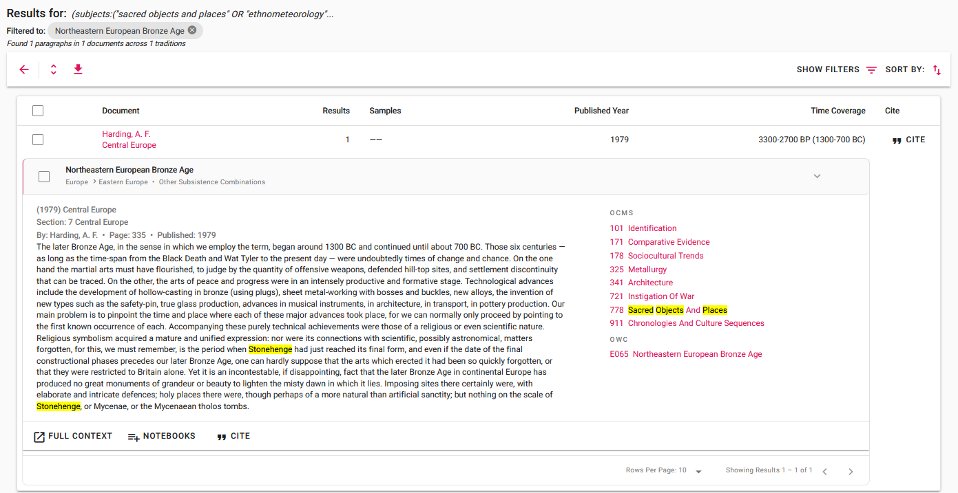
SEARCH RESULTS

Slide 22
SAMPLE PARAGRAPH

Slide 23
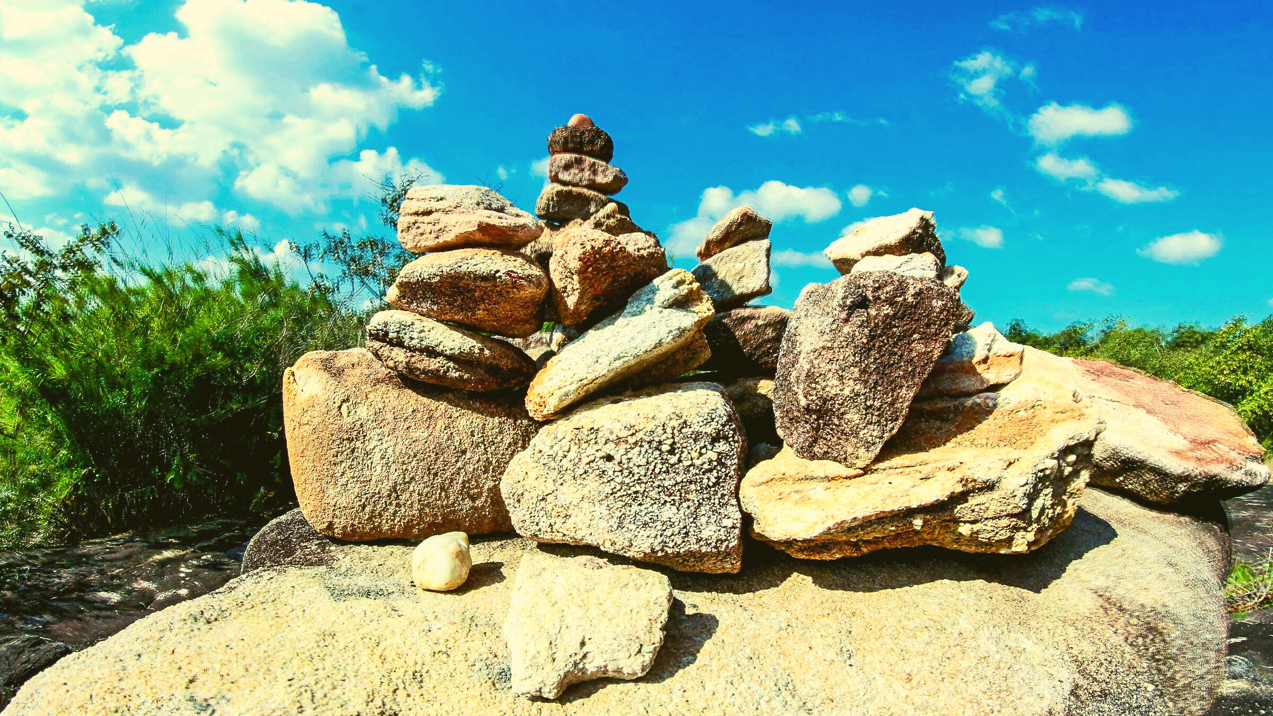
eHRAF Workbook
Part 4: Assignment

Slide 24
ASSIGNMENT
The purpose of this assignment is to present a report summarizing your findings about this great discovery.
This can be done in the form of a group project or an individual paper.
Groups can divide the questions that follow, with each student contributing information about a specific question.
Consider making a slideshow presentation to illustrate your findings.

Slide 25
ASSIGNMENT
Your final report describing Stonehenge should have 6 sections which correspond to these 6 types of questions:
Who?
What?
Where?
When?
How?
Why?

Slide 26
QUESTION 1
Who?
Who are the main archaeologists associated with this discovery? Describe their biographical information, education and training, publications, etc.
Who are the people studied? Describe how people lived during this time at this place, such as: social stratification, division of labor, gender roles, economic life, food and subsistence, religious practices.

Slide 27
QUESTION 2
What?
What did the archaeologists discover?
Provide a general description of the archaeological site.
Describe the material culture, structures, artifacts, etc.
Include relevant photos and/or interpretive artistic renderings.

Slide 28
QUESTION 3
Where?
Where is the site located?
Describe the geography of this discovery, its location in the contemporary world, size, scope, etc.
Does the location have strategic importance?
How did the physical environment and natural resources shape cultural practices?

Slide 29
QUESTION 4
When?
When were the discoveries made?
When in human history do archaeologists believe that this site can be dated to?
Describe the relative time period, what preceded it, and what followed it. What does this represent in terms of cultural evolution and progress?

Slide 30
QUESTION 5
How?
How did archaeologists excavate, analyze, and interpret this site?
Tell us about the scientific methods used for excavation and analysis of the materials founds.
What technologies were utilized by the people who lived during this archaeological time period?
How did they construct buildings and make artifacts (lithics, pottery, etc.)?

Slide 31
QUESTION 6
Why?
Why is this archaeological site considered a “great discovery”?
Describe how this site is important in terms of its place in human history.
Why should this great discovery be preserved and who should be responsible for preservation?

Slide 32
Aveni, Anthony F. 1990. “An Assessment of Previous Studies of the Nazca Glyphs.” In The Lines of Nazca, v. 183:1–40. Philadelphia: American Philosophical Society. https://ehrafarchaeology.yale.edu/document?id=se51-007..
Harding, A. F., and J. M. (John M.) Coles. 1979. “Central Europe.”
In The Bronze Age in Europe: An Introduction to the
Prehistory of Europe, C. 2000-700 BC, 335–85. London: Methuen.
https://ehrafarchaeology.yale.edu/document?id=e065-004
References
Harrison, Richard J. (Richard John). 1980. “The Beaker Folk: Copper Age Archaeology in Western Europe.” In Ancient Peoples and Places, vol. 97:176. London: Thames and Hudson. https://ehrafarchaeology.yale.edu/document?id=e050-008.
Ruggles, C. L. N. (Clive L. N.). 1990. “A Statistical Examination of the Radial Line Azimuths at Nazca.” In The Lines of Nazca, v. 183:245–69. Philadelphia: American Philosophical Society. https://ehrafarchaeology.yale.edu/document?id=se51-011.

Slide 33
One of the central triliths at Stonehenge, floodlit in blue against the night sky, Photograph © Andrew Dunn, 21 June 2005:
https://commons.wikimedia.org/wiki/File:Stonehenge_Floodlit_trilith.jpg
A group of Druids summoning their spirit animal at Stonehenge in Wiltshire, England, sandyraidy, CC BY-SA 2.0, via Wikimedia Commons:
https://commons.wikimedia.org/wiki/File:Druids_celebrating_at_Stonehenge.jpg
Stonehenge, a neolithic stone monument, garethwiscombe,
CC BY 2.0, via Wikimedia:
https://commons.wikimedia.org/wiki/File:Stonehenge2007_07_30.jpg
Image Credits
Stonehenge - Wiltonia sive Comitatus Wiltoniensis; Anglice Wilshire (Atlas van Loon), Public Domain via Wikimedia Commons: https://en.wikipedia.org/
wiki/File:Stonehenge_Wiltonia_sive_Comitatus_Wiltoniensis;_Anglice_Wilshire_(Atlas_van_Loon).jpg
Stonehenge84, Salix alba, CC BY-SA 3.0, via Wikimedia Commons:
https://commons.wikimedia.org/wiki/File:Stonehenge84.jpg
Stonehenge, Lucas de Heere, Public domain, via Wikimedia Commons:
https://commons.wikimedia.org/wiki/File:Stonehenge_Lucas_de_Heere.jpg

Slide 34
Illuminated manuscript, the construction of Stonehenge by a giant with the assistance of Merlin, the oldest known illustration of Stonehenge, British Library, Public domain, via Wikimedia Commons: https://commons.wikimedia.org/wiki/
File:BLEgerton3028Fol30rStonehengeCropped.jpg
Druids celebrating at Stonehenge, sandyraidy, CC BY-SA 2.0, via Wikimedia Commons: https://commons.wikimedia.org/wiki/ File:
Druids_celebrating_at_Stonehenge_(0).png
Image Credits

Slide 35
Great Discoveries: Stonehenge
Produced by
Human Relations Area Files
at Yale University
An eHRAF Workbook Activity
hraf.yale.edu

