Slide 1
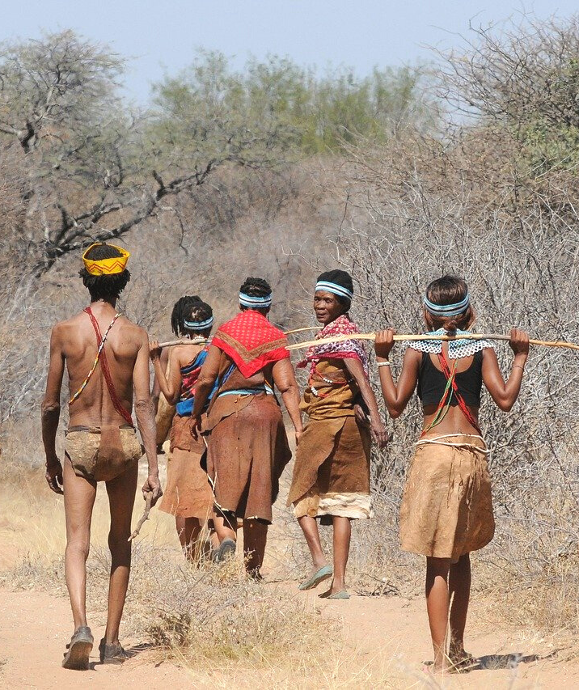
An eHRAF Workbook Activity
Hunter-Gatherer Societies
in eHRAF World Cultures
Human Relations Area Files
at Yale University

Slide 2
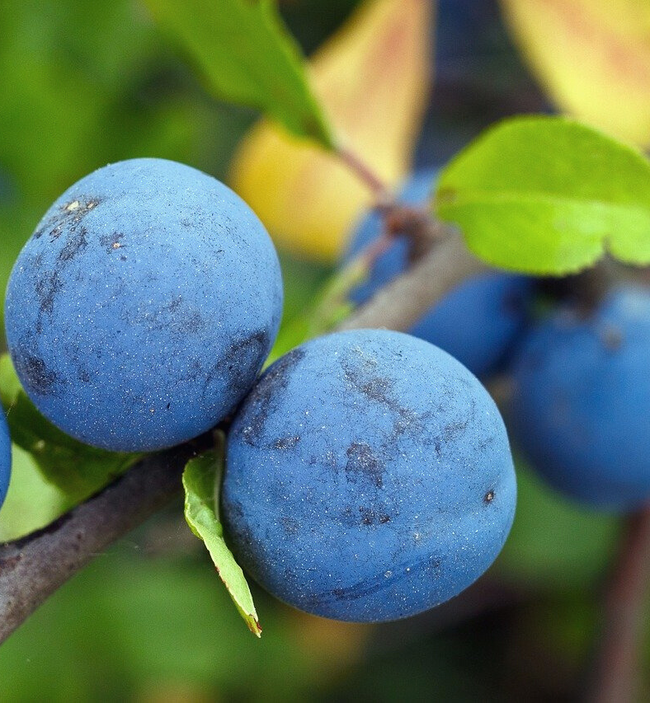
In this activity
Topics We'll Cover
Learn about the hunter-gatherer way of life
Investigate and evaluate cross-cultural findings
Compare and contrast traits of hunter-gatherer societies
Analyze your results

Slide 3
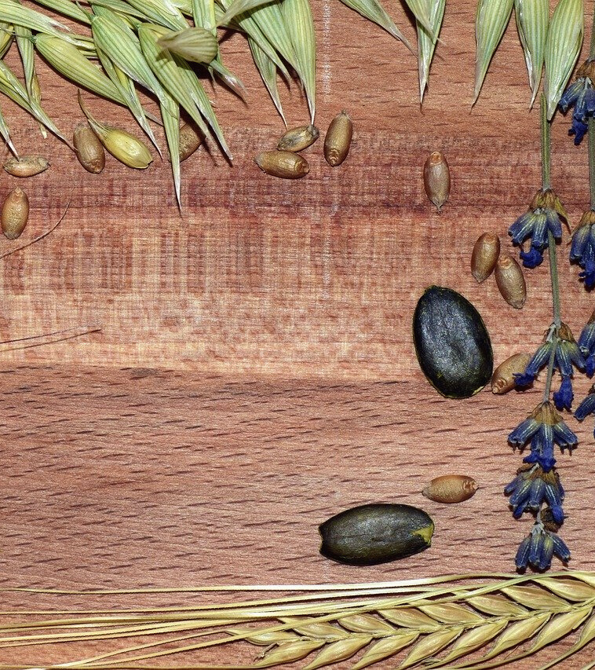
This workbook is based on the Explaining Human Culture (EHC) summary on Hunter-Gatherers
by Carol R. Ember
https://hraf.yale.edu/ehc/summaries/hunter-gatherers
You may wish to read the EHC summary to learn more about hunter-gatherers and foraging before you begin this activity. The data and cross-cultural research findings referenced throughout this workbook can be found there.

Slide 4
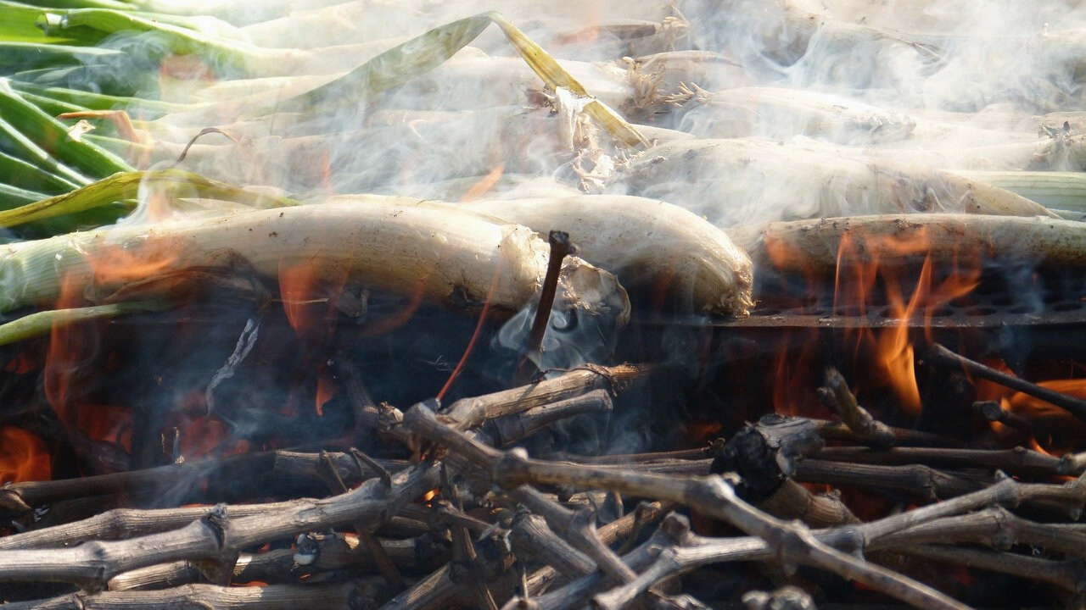
Hunter-gatherers
How do foragers live?

Slide 5
Hunter-gatherers has become the commonly-used term for people who depend largely on food collection or foraging for wild resources.
The hunter-gatherer way of life is of great interest to anthropologists because of the widely held belief that knowledge of hunter-gatherer societies could open a window into understanding early human cultures since dependence on wild food resources was the way humans acquired food for the vast stretch of human history.

Slide 6
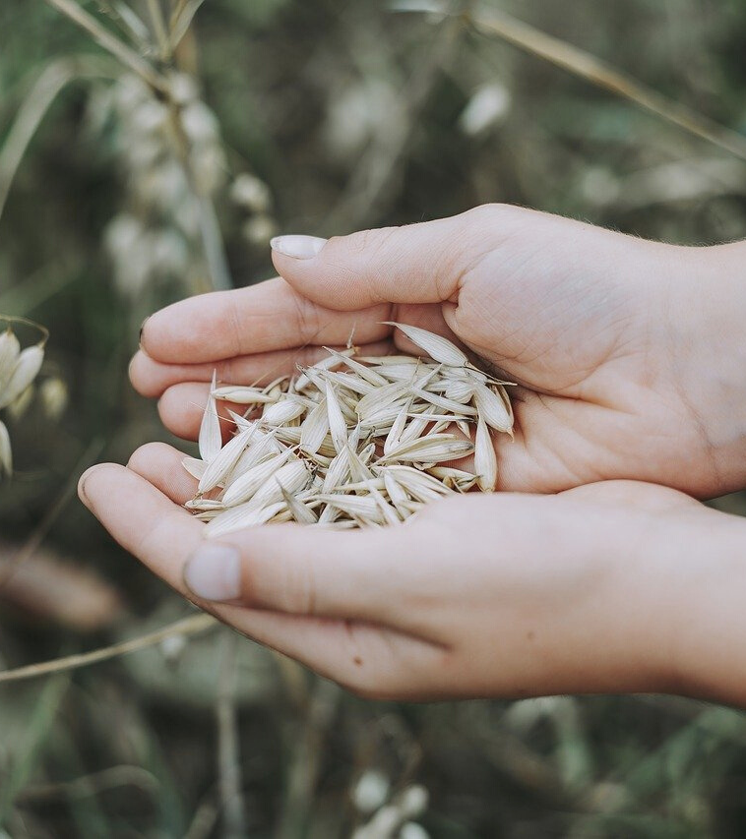
Foraging vs. Cultivation
Foraged wild resources are obtained by a variety of methods including gathering plants, collecting shellfish or other small fauna, hunting, scavenging, and fishing.
This is in contrast to food production, where people rely on cultivating domesticated plants and breeding and raising domesticated animals for food.

Slide 7
In fact, the term hunter-gatherers can be misleading. By emphasizing hunting, downplaying gathering, and entirely ignoring fishing, it obscures the reality that fishing is the most common subsistence activity in these societies, while hunting is less common.
Foragers is perhaps a fairer label, though “hunter-gatherers” is used more often.
Did you know?

Slide 8
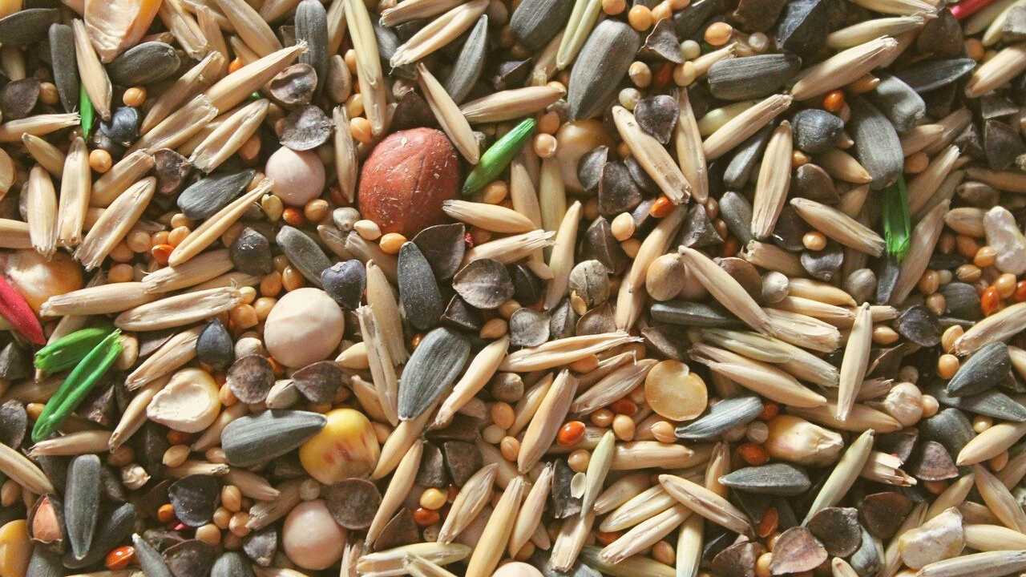
Hunter-Gatherers
CrOSS-CULTURALLY
questions and findings

Slide 9
Cross-Cultural Questions
Cross-cultural researchers focus on studying patterns across societies and try to answer questions such as:
What are recent hunter-gatherers generally like?
How do they differ from food producers?
How do hunter-gatherer societies vary and what may explain their variability?

Slide 10
What can we infer about our distant ancestors by looking at well-known hunter-gatherer societies of recent times?
To draw reliable inferences about the distant past, we would need to believe that pockets of human society could exist unchanged over tens of thousands of years, and that hunter-gatherers did not learn, innovate, or adapt to changes in their natural and social environments over time.
Even a cursory look at the ethnographic record reveals that this is simply not the case.

Slide 11
Based on ethnographic data and cross-cultural comparisons, it is widely accepted that recent hunter-gatherer societies generally:
are fully or semi-nomadic
live in small communities with low population densities
do not have political officials
have little wealth differentiation
are economically specialized only by age and gender
divide labor by gender (with women gathering wild plants and men fishing and almost always doing the hunting)
have animistic religions

Slide 12
Hunter-Gatherers
WORKBOOK ACTIVITY
culture summaries

Slide 13
Culture Summaries
A brief overview for societies in eHRAF World Cultures is provided in the form of Culture Summaries.
The format, general outline, and headings are the same for each summary. You will find a basic overview about the culture, such as its economy, history, environment and sociopolitical organization.
eHRAF
World
Cultures
In this workbook activity, you will review culture summaries of hunter-gatherer societies to determine similarities, differences, or exceptions to common traits of foragers.

Slide 14
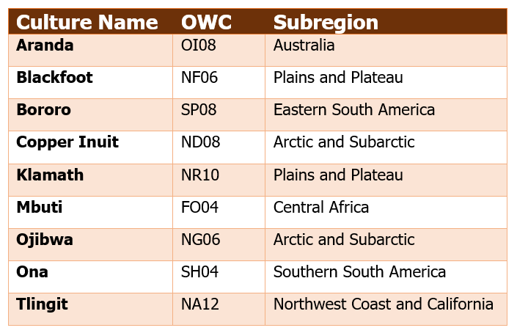
Read eHRAF Culture Summaries from 2-4 hunter-gatherer societies from this chart.
Based on the ethnographic data, report on how well the relevant aspects of these societies appear to align with the list of traits and patterns common to foragers presented above.
To find a culture summary, go to the Browse Cultures tab and enter the culture name into the box, then click on Culture Summary below the culture name to read it.
Workbook Activity

Slide 15
Workbook Activity
While researching in the eHRAF Culture Summaries, use a table like the one below to keep track of your results. Then, write a summary of your findings. How many fit the model presented and how many do not? Have you found any other common traits?
Sample student data table

Slide 16
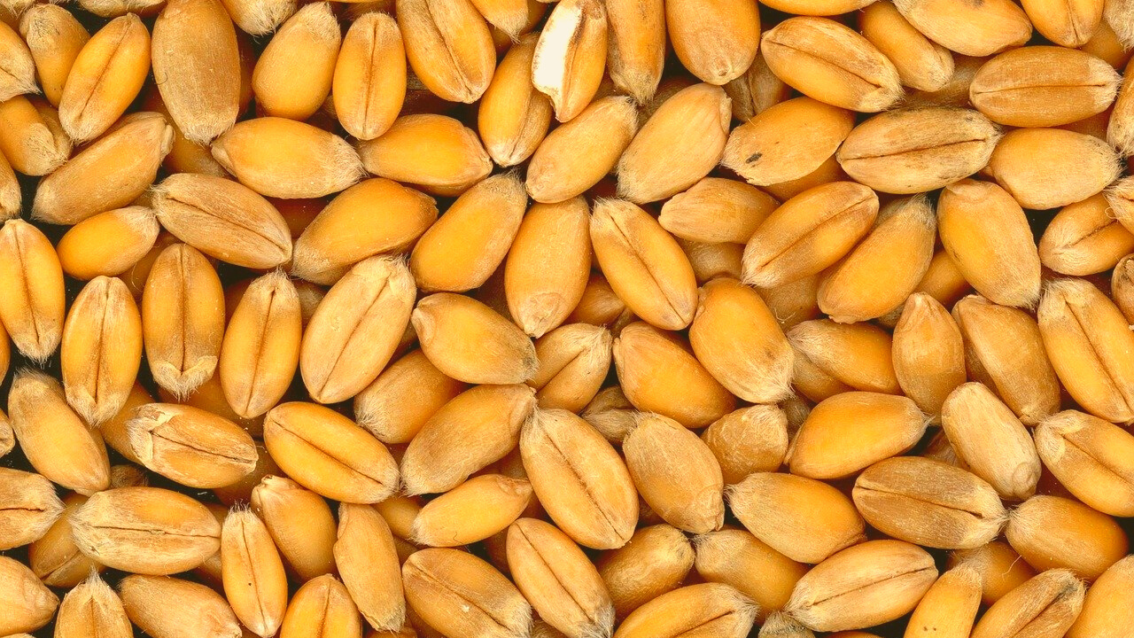
Hunter-Gatherers
WORKBOOK ACTIVITY
analysis & further discussion

Slide 17
Exceptions to the Rule
Now that you have completed your research and table, reflect on the similarities and differences that you have recorded between the hunter-gatherer societies.
Do any of the cultures have traits that stand out as “exceptions” for hunter-gatherers?
ANALYSIS

Slide 18
SOCIAL STRATIFICATION
Most hunter-gatherers are egalitarian, can you find an example of a socially stratified forager society?
DISCUSSION
DIVISION OF LABOR BY GENDER
Are there any hunter-gatherer societies where women do the hunting?
CHANGE IN THE ETHNOGRAPHIC RECORD
Looking at historical and newer ethnographic data in eHRAF, can you find any examples of cultures where aspects of hunter-gatherer life or society have changed notably over time?
POPULATION DENSITY
What conditions might result in a hunter-gatherer society that settles in larger populations with a higher density?

Slide 19
1. This activity was adapted in part from Hunter-Gatherers (Explaining Human Culture), by Carol R. Ember, in Teaching eHRAF. https://hraf.yale.edu/teach-ehraf/hunter-gatherers-explaining-human-culture/
2. Ember, Carol R. 2020. "Hunter-Gatherers", in C. R. Ember, ed. Explaining Human Culture. Human Relations Area Files, http://hraf.yale.edu/ehc/summaries/hunter-gatherers
References

Slide 20
Hunter-Gatherer Societies
in eHRAF World Cultures
Produced by
Human Relations Area Files
at Yale University
An eHRAF Workbook Activity
hraf.yale.edu

