Slide 1
An eHRAF Workbook Activity
Introducing
eHRAF Archaeology
Human Relations Area Files
at Yale University

Slide 2
In this activity
Topics We'll Cover
Learn about eHRAF Archaeology
Discover tradition summaries in
Conduct an Advanced Search
Compare and contrast two archaeological traditions

Slide 3
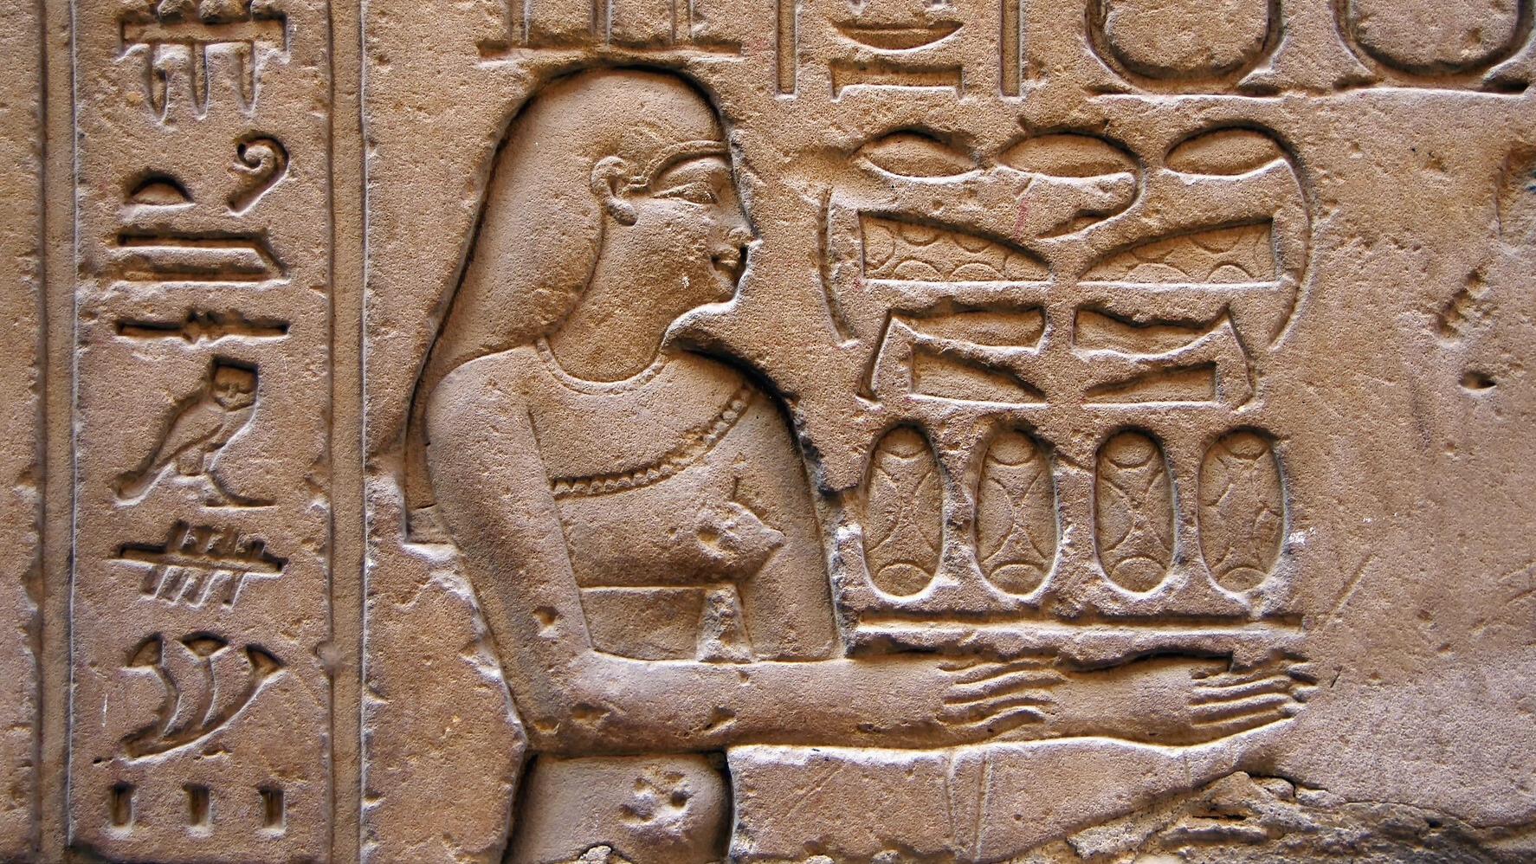
ANTHROPOLOGY & ARCHAEOLOGY

Slide 4
Anthropology
Anthropology is the study of humankind, past and present. Anthropologists believe that the best understanding of the human condition arises from a comparative, holistic, and global approach. There are four major subfields of anthropology:
Archaeology
Biological anthropology
Cultural anthropology
Linguistic anthropology

Slide 5
Archaeology
According to the Society for American Archaeology (SAA):
"Archaeology is the study of the ancient and recent human past through material remains. Archaeologists might study the million-year-old fossils of our earliest human ancestors in Africa. Or they might study 20th-century buildings in present-day New York City. Archaeology analyzes the physical remains of the past in pursuit of a broad and comprehensive understanding of human culture."

Slide 6
What do archaeologists do?
Whereas cultural anthropologists study learned and shared behaviors, or culture, by conducting fieldwork amongst living people, archaeologists study the tangible results of such patterns of behavior and the evidence of human activity through excavations and surface surveys.

Slide 7
Cross-Cultural Research
Cross-cultural researchers use ethnographic and archaeological records to discover and explain patterns and variation in human cultures past and present.
They ask questions such as:
Which aspects of culture are constant across human societies and which vary?
What accounts for these similarities and differences?

Slide 8
Cross-Cultural Archaeology
According to archaeologist Peter Peregrine, there are three major types of cross-cultural comparison:
comparative ethnology
comparative archaeology
archaeoethnology

Slide 9
eHRAF ARCHAEOLOGY

Slide 10
Archaeological Traditions
eHRAF Archaeology contains hundreds of documents describing archaeological traditions from around the world. The list of traditions is drawn from the Outline of Archaeological Traditions (OAT) and is then incorporated into HRAF's Outline of World Cultures (OWC), a classification system for the world's cultures. An archaeological tradition is: "a group of populations sharing similar subsistence practices, technology, and forms of socio-political organization, which are spatially contiguous over a relatively large area and which endure temporally for a relatively long period."

Slide 11
eHRAF Archaeology
The eHRAF Archaeology database includes both a random sample of traditions and selected tradition sequences. These traditions are organized by region, subregion, and subsistence type.
eHRAF Archaeology currently contains over 100 traditions, with new traditions added to the database each year.

Slide 12
Outline of Cultural Materials (OCM)
Using the Outline of Cultural Materials (OCM), a classification system for anthropological subjects, HRAF anthropologists have subject-indexed each document at the paragraph level. The OCM is an ethnographic classification system on human behavior, social life and customs, and material culture.
It contains over 90 major dubjects with over 700 subcategories.

Slide 13
Browsing Traditions
Traditions in the database can be found via the Browse Traditions tab. Use the A-Z Index or search for traditions by typing into the Filter Index. Traditions can also be browsed by region and by current country. Access the Tradition Profile by clicking on the tradition name.
For each tradition, there is a Tradition Summary, Collection Description, and a List of Collection Documents

Slide 14
Browsing Traditions

Slide 15
Browsing Subjects
Every paragraph of text in eHRAF Archaeology has been subject-indexed by a HRAF anthropologist.
Subjects or OCMs can be found under the Browse Subjects tab. They can be browsed using the A-Z Index or searched for by typing into the Filter Index. You may also choose to browse subjects by using the Major Subjects (hierarchy) tab or by OCM identifier.

Slide 16
Browsing Subjects

Slide 17
Example Subject: Architecture
Suppose we are interested in learning more about architecture in eHRAF Archaeology. Using the A-Z Index, we can click on the letter A to find the relevant subject codes, or we can begin to type "architecture" into the Filter Index box.
Review the subjects listed to select the most relevant OCM(s) for your query. Later, we will see how to add these subjects to an Advanced Search.

Slide 19
In this activity, you will ual relations across the globe.
eHRAF Workbook
Part 1: Comparative Archaeology

Slide 20
Part 1:
Comparative Archaeology
Comparative Archaeology is the study of social change over time through archaeological research.
According to Ember (2016), "comparisons help us identify both similarities and differences. Even when we describe uniqueness, we are implicitly saying that something differs from all other cases we know about".

Slide 21
Part 1:
Comparative Archaeology
Let's visit eHRAF Archaeology to take a look at the work of two distinguished archaeologists who were contempories:
Dr. Sarah M. Nelson (1931-2020), author of The Neolithic of northeastern China and Korea
Dr. Michael D. Coe (1929-2019), author of Olmec and Maya: a study in relationships

Slide 22
Part 1:
Comparative Archaeology
Dr. Sarah Milledge Nelson(1931-2020) was Distinguished Professor Emerita from the Department of Anthropology, University of Denver. Nelson was a practicing archaeologist and a leader of feminist perspectives in archaeology. Her comparative work, The Neolithic of northeastern China and Korea, can be found in eHRAF Archaeology.
https://ehrafarchaeology.yale.edu/document?id=af45-005
🌐

Slide 23
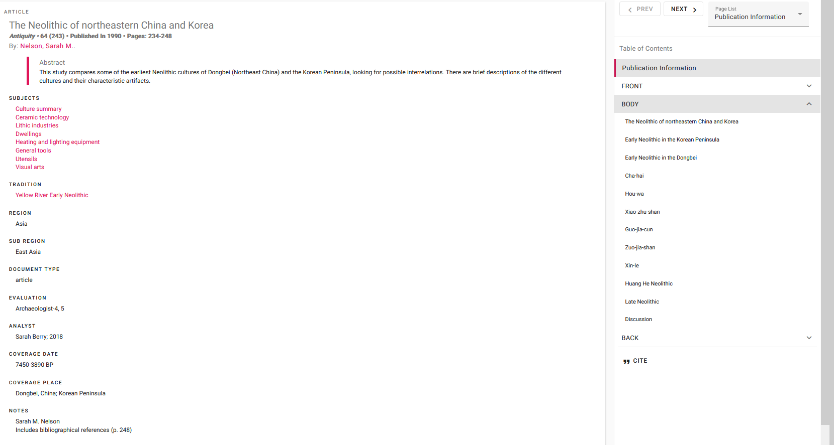

Slide 24
Part 1:
Comparative Archaeology
Dr. Michael Douglas Coe (1929-2019) was Professor Emeritus of Anthropology at Yale University and a well-known archaeologist and epigrapher who worked in Mesoamerica and in Cambodia on the Maya and Angkor civilizations. His comparative work, Olmec and Maya: a study in relationships, can be found in eHRAF Archaeology.
https://ehrafarchaeology.yale.edu/document?id=ny52-035
🌐

Slide 25
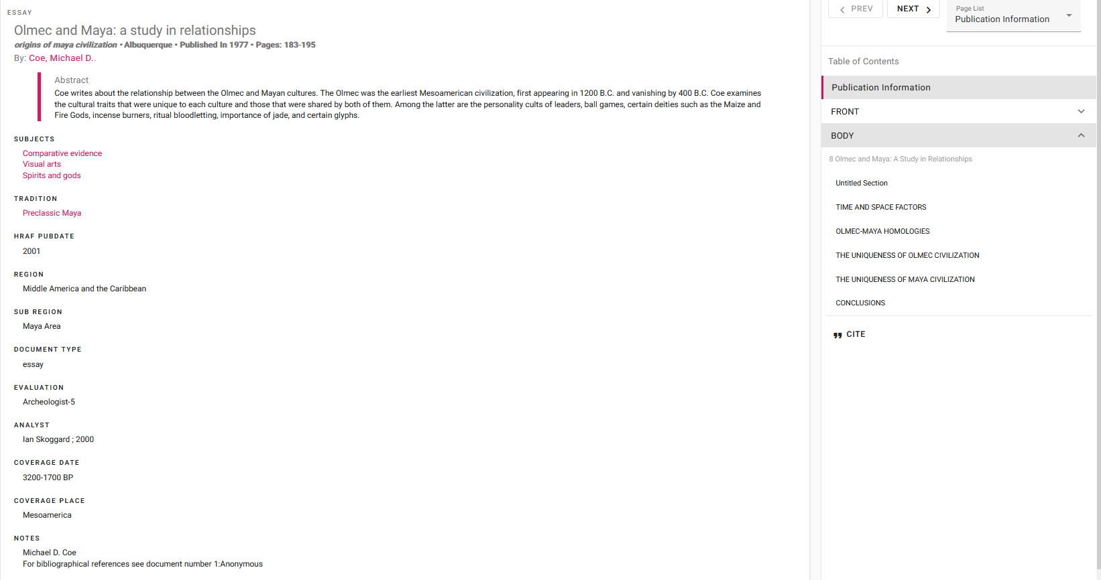

Slide 26
Part 1: Discussion
After exploring the two examples (Nelson and Coe) of comparative archaeology, answer the following questions:
1) How do archaeologists compare and contrast two different traditions?
2) is it important to compare traditions from the same time period (ex: Neolithic) and/or same region (ex: Mesoamerica)?
3) Would photographs of artifacts be helpful for side-by-side comparisons?

Slide 27
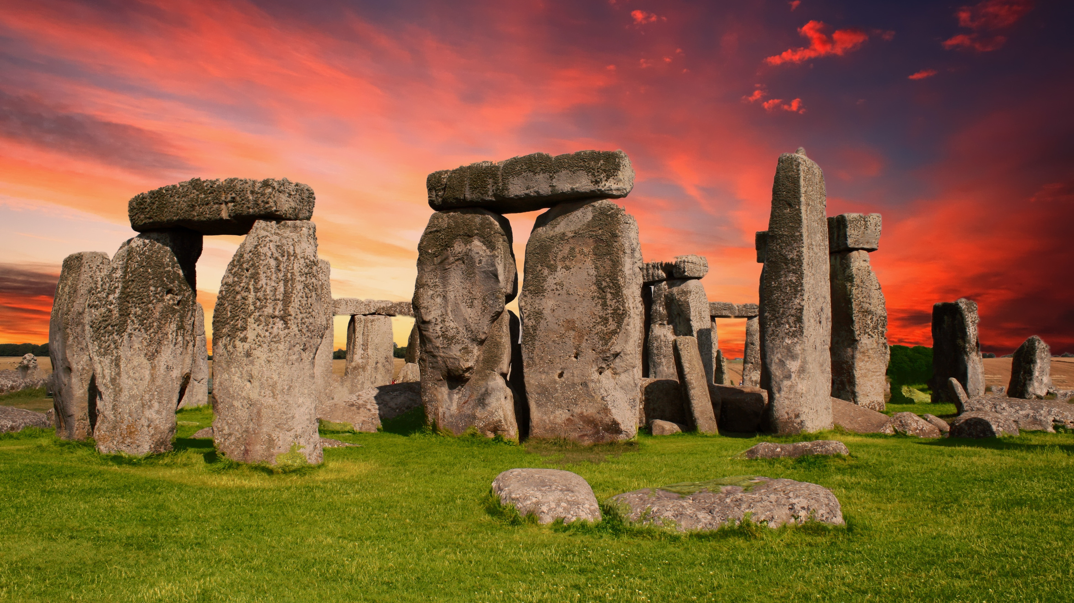
In this activity, you will ual relations across the globe.
eHRAF Workbook
Part 2: Tradition Summaries

Slide 28
Part 2:
Tradition Summaries
Taking our inspiration from the work of Professors Nelson and Coe, let's do some of our own comparative research and analysis using eHRAF Archaeology.
To get started, read the tradition summaries for the Olmec (NU95) and the Classic Maya (NY53).

Slide 29
Part 2:
Tradition Summaries
Herrera, R. Sergio. and Leon Doyon. 2009. "Tradition Summary: Olmec."
https://ehrafarchaeology.yale.edu/document?id=nu95-000
🌐
Sharer, Robert J., and Sarah Berry. 2000. "Tradition Summary: Classic Maya."
https://ehrafarchaeology.yale.edu/document?id=ny53-000
🌐

Slide 30
Part 2:
Tradition Summaries
Next, take notes on what you find in each tradition summary in terms of three aspects of the archaeological record:
Social Organization
Calendars
Monuments
The following table can be used to organize your notes side-by-side.

Slide 31
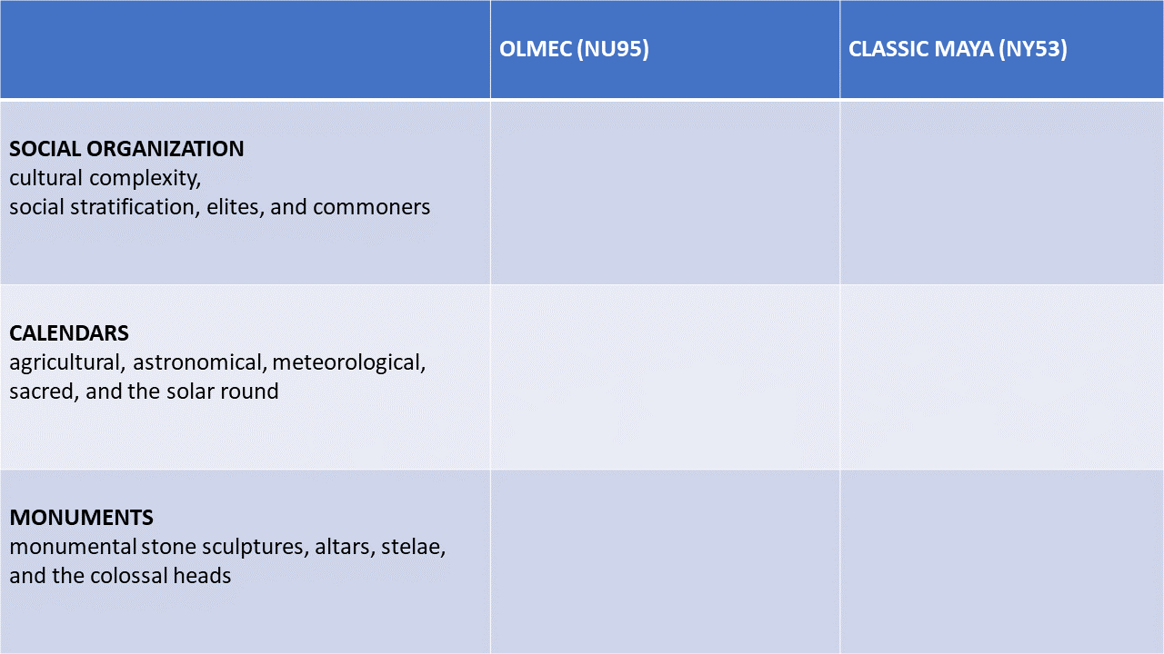

Slide 32
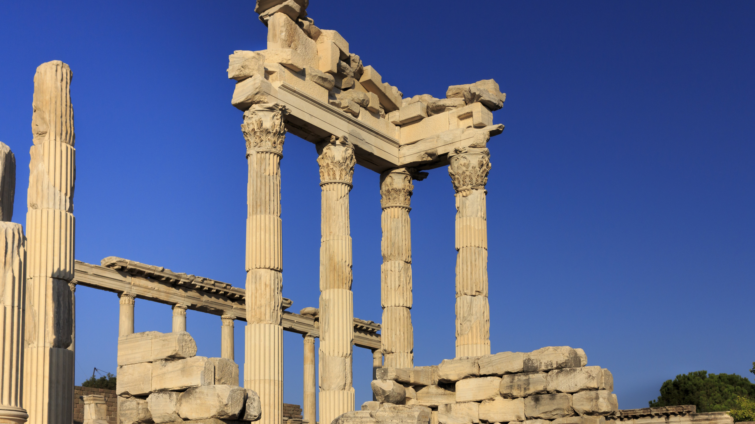
In this activity, you will ual relations across the globe.
eHRAF Workbook
Part 3: Advanced Search

Slide 33
Part 3:
Advanced Search
Now that we have found ways to compare and contrast the Olmec and the Maya, let's dig deeper with Advanced Search.
This will enable us to find specific passages in documents that have been indexed by HRAF anthropologists at the paragraph level.

Slide 34
Part 3:
Advanced Search
In the Add Traditions column, select Classic Maya (NY53) and Olmec (NU95). In the Add Subjects column type "architecture" into the Filter Index. Select these subjects: Architecture (341), Dwellings (342), and Grounds (351).
When using keywords, make sure to truncate search terms using an asterisk (*) as needed. For example, truncate the term "pyramid" by typing "pyramid*" to include varant endings like pyramid, pyramids, or pyramidal.

Slide 36
Region & Tradition Results
Search results are organized by region, subregion, and tradition. For example:
Region: Middle America & Caribbean
Subregion: Central Mexico
Tradition: Olmec (NU95)
Region: Middle America & Caribbean
Subregion: Maya Area
Tradition: Classic Maya (NY53)
The search results can also be filtered by subsistence type or sample, and sorted by the number of documents or paragraphs.

Slide 38
Filtering
You can use filtering options to narrow your results by subsistence type or by sample. Search results can be filtered by nine different subsistence types. Hover above a subsistence type for a brief description.
Results can also be filtered by sample. The Simple Random Sample is a non-stratified sample of traditions randomly selected from the OAT. There are over 45 traditions in the Simple Random Sample, with new cases added from time to time.

Slide 39
Essay Assignment
Write a short paper (2-3 pages) in which you discuss your findings.
What were the most interesting things you learned about the archaeological record of the Olmec and the Maya?
What would you describe as the most important archaeological discoveries for each of these traditions?

Slide 40
Coe, Michael D. 1977. “Olmec and Maya: A Study in Relationships.” In The Origins of Maya Civilization, 183–95. Albuquerque: University of New Mexico Press. https://ehrafarchaeology.yale.edu/document?id=ny52-035.
Ember, Carol R. 2016. Introducing Cross Cultural Research. New Haven: Human Relations Area Files. https://hraf.yale.edu/ccc/
Herrera, R. Sergio. and Leyon Doyon. 2009. “Tradition Summary: Olmec.” New Haven, Conn.: Human Relations Area Files. https://ehrafarchaeology.yale.edu/document?id=nu95-000.
References
Nelson, Sarah M. 1990. “The Neolithic of Northeastern China and Korea.” Antiquity Vol. 64 (no. 243): 234–48. https://ehrafarchaeology.yale.edu/document?id=af45-005.
Sharer, Robert J., and Sarah Berry. 2000. “Tradition Summary: Classic Maya.” New Haven, Conn.: Human Relations Area Files. https://ehrafarchaeology.yale.edu/document?id=ny53-000.

Slide 41
Introducing eHRAF Archaeology
Produced by
Human Relations Area Files
at Yale University
An eHRAF Workbook Activity
hraf.yale.edu

