Slide 1
An eHRAF Workbook Activity
Great Discoveries:
Jenné-Jeno
Human Relations Area Files
at Yale University

Slide 2
In this activity
Learn about Jenné-Jeno
Read passages in eHRAF Archaeology
Answer questions about this archaeological discovery
Find out what makes Jenné-Jeno a "Great Discovery"
Topics We'll Cover

Slide 3
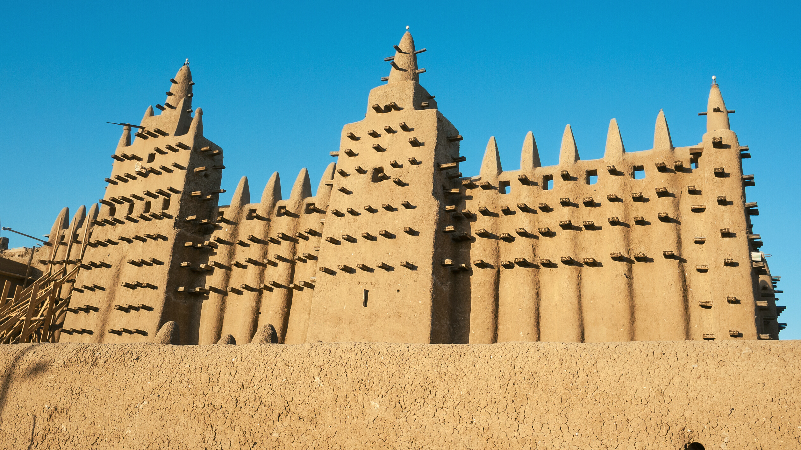
JENNÉ-JENO

Slide 4
Jenne-Jeno (also Djenné-Djenno) is an archaeological site located in the Niger River Valley in the country of Mali.
Based on excavations by archaeologists Susan and Roderick McIntosh, the site is believed to have been occupied from 250 B.C.E. to 900 C.E. It is the best-known archaeological site in sub-Saharan Africa and considered to be among the oldest urbanized centers. The modern-day town of Jenné in Mali is famous for its distinctive adobe architecture, most notably the Great Mosque, built in 1907.
Did you know?

Slide 5
Previously, it was assumed that complex societies and advanced trade networks did not exist in West Africa until the arrival of traders from Southwest Asia. However, Jenné-Jenno disproves this, as the city flourished much earlier. The McIntosh excavations over three decades have revealed that the city had a surrounding wall made of mud bricks, constructed around 800 C.E. Jenné-jenno prospered as a hub of regional trade thanks to fertile agricultural land. As its peak, the city boasted a population of around 20,000. Terracotta sculptures are among the most interesting finds at this UNESCO World Heritage Site.

Slide 6
To get started, review these videos about Jenné-Jeno:
Roderick McIntosh – Yale University – Why Study African Cities?
Old Towns of Djenné (UNESCO/NHK)
Lost History: the Terracotta Sculpture of Djenné Djenno
West African Sudano Sahelian Architecture

Slide 7
Articles about Jenné-Jeno
Old Towns of Djenné – UNESCO World Heritage
Djenné-Djeno Archaeological Site
Djenné-Djenno – World History Encyclopedia
Djenné-Jeno, ancient city, Mali – Brittanica

Slide 8
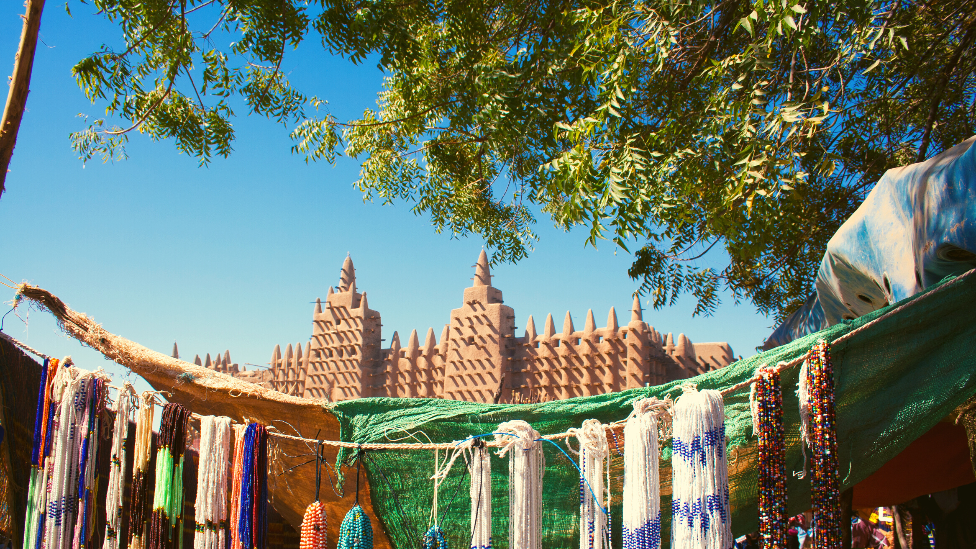
eHRAF Workbook
Part 1: Tradition Summary

Slide 9
Tradition Summaries
A brief overview for traditions in eHRAF Archaeology is provided in the form of Tradition Summaries.
The format, general outline, and headings are the same for each summary. You will find a basic overview about the tradition, such as its time period, location, history, environment, and sociopolitical organization.
eHRAF
Archaeology
To find a tradition summary, go to the Browse Traditions tab and enter the tradition name into the box, then click on Tradition Summary below the tradition name to read it.

Slide 10
PART 1
West African Iron Age (FA75)
Begin by learning more about the West African Iron Age (FA75). First, read the eHRAF Tradition Summary:
🌐
https://ehrafarchaeology.yale.edu/document?id=fa75-000
Then, write a brief description of the West African Iron Age indicating any significant archaeological elements that stand out to you.

Slide 11
eHRAF Workbook
Part 2: Selected Readings

Slide 12
To read documents or pages in eHRAF:
INSTRUCTIONS
First, follow the permalinks provided in the activities below to get to the relevant documents.
For example:
🌐
https://ehrafarchaeology.yale.edu/document?id=nt76-001
Then, use the Page List dropdown menu to navigate to the required page(s).

Slide 13
Finding documents without permalinks
INSTRUCTIONS
Follow these steps if you are having trouble with permalinks from off campus while using a proxy or VPN service, or if you have been provided with a HRAF-issued username and password.
Sign in via your library proxy or VPN, or using the HRAF-issued credentials.
Go to the Browse Documents tab.
Enter the author's last name into the Filter Index box.
Click on the required title to access the document, then select the page number from the Page List dropdown menu as shown above.

Slide 14
PART 2
Excavations at Jenné-Jeno
(McIntosh 1994)
🌐
https://ehrafarchaeology.yale.edu/document?id=fa75-003
Pages:
1-13, Background to the 1981 Research, Historical Background
Pathways to Complexity: an African perspective (McIntosh 1999)
🌐
https://ehrafarchaeology.yale.edu/document?id=fa75-005
Pages:
20-23, Pathways to Complexity, Conclusion

Slide 15
PART 2
Cities without Citadels: understanding urban origins along the middle Niger
(McIntosh 1993)
🌐
https://ehrafarchaeology.yale.edu/document?id=fa75-013
Pages:
631-633, Reconstructing Lifeways at Jenné-Jeno
Current Directions in West African Prehistory (McIntosh 1981)
🌐
https://ehrafarchaeology.yale.edu/document?id=fa75-00
Pages:
245-249, Emergence of Complex Societies, Conclusions

Slide 16
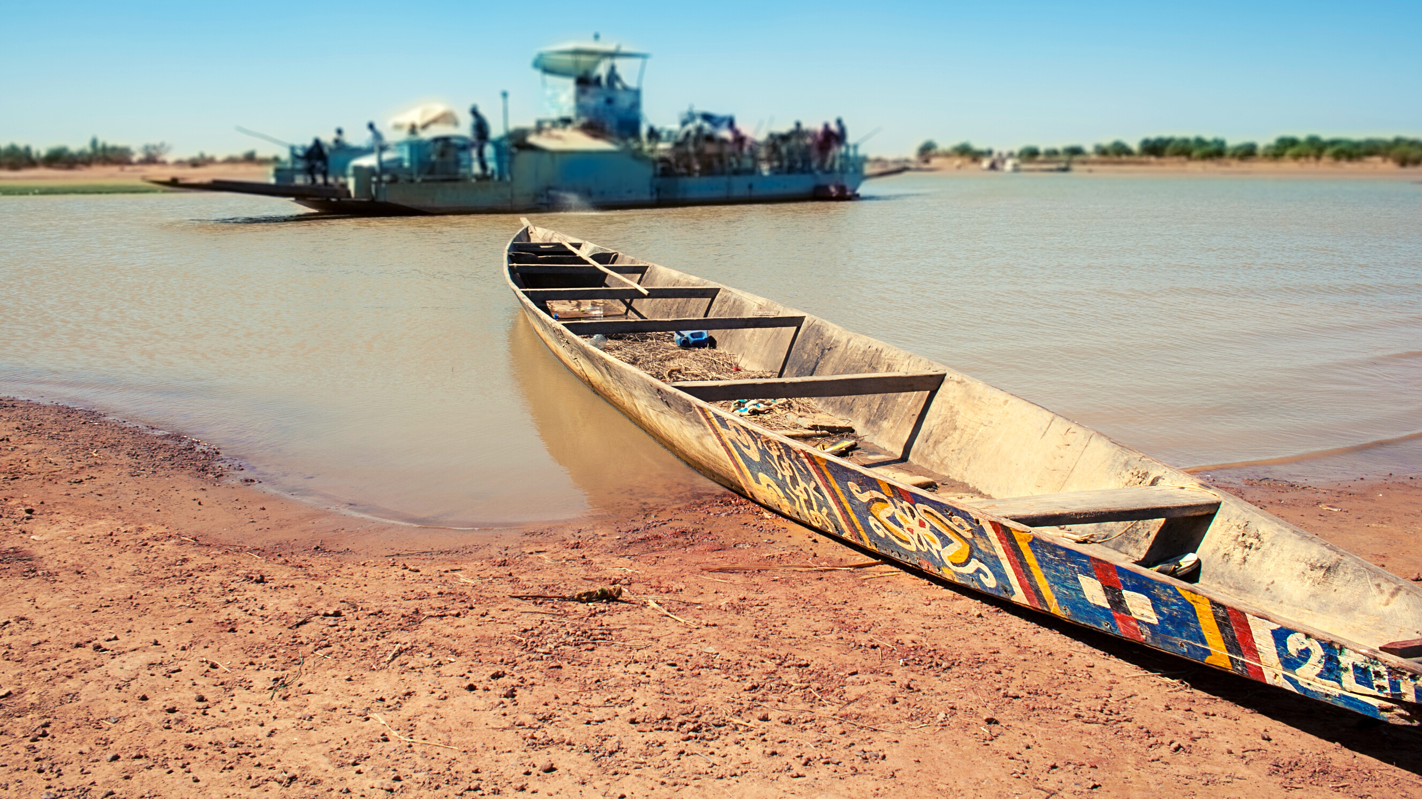
In this activity, you will ual relations across the globe.
eHRAF Workbook
Part 3: Advanced Search

Slide 17
Part 3:
Advanced Search
Now that you have read selected passages from eHRAF Archaeology, dig deeper with Advanced Search. This will enable you to find specific passages in documents that have been indexed by HRAF anthropologists at the paragraph level.
Below, you will find an example of an advanced search. Try this search and then experiment with different subjects and/or keywords.

Slide 18
Part 3:
Advanced Search
In the Add Traditions column, select the tradition: West African Iron Age (FA75)
In the Add Subjects column, select the subject categories: Metallurgy (325) and Smiths and their crafts (326)
In the Keyword section, type Jenne-Jeno.

Slide 19
ADVANCED SEARCH
Add subject:
Metallurgy (325)
Smiths and their crafts (326)
Add tradition:
West African Iron Age (FA75)
Add keyword:
Jenne-Jeno

Slide 20
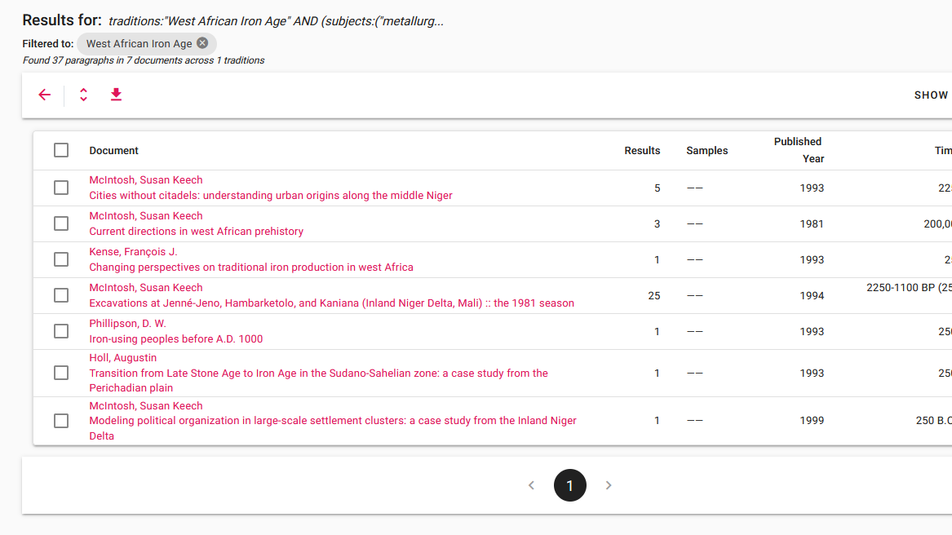
SEARCH RESULTS

Slide 21
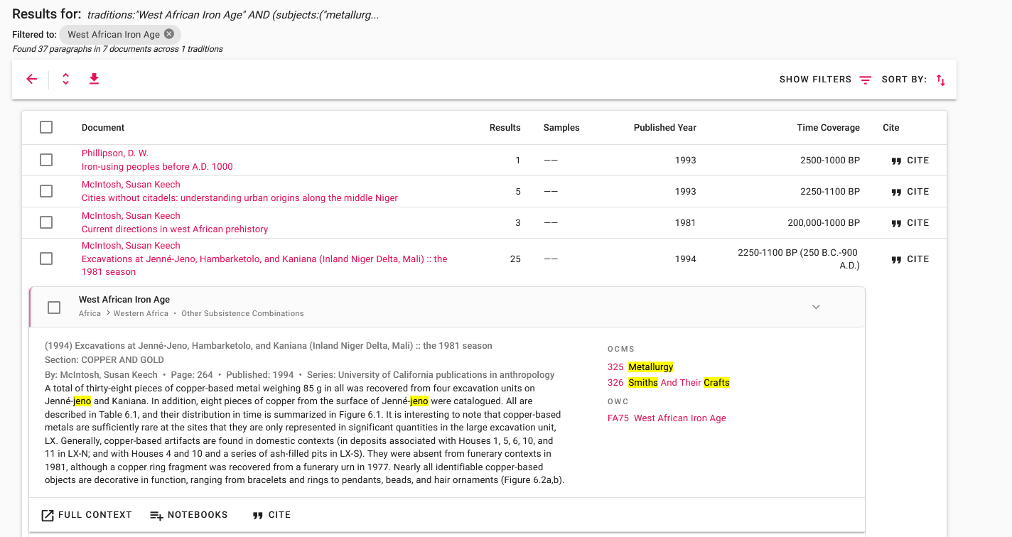
SEARCH RESULTS

Slide 22
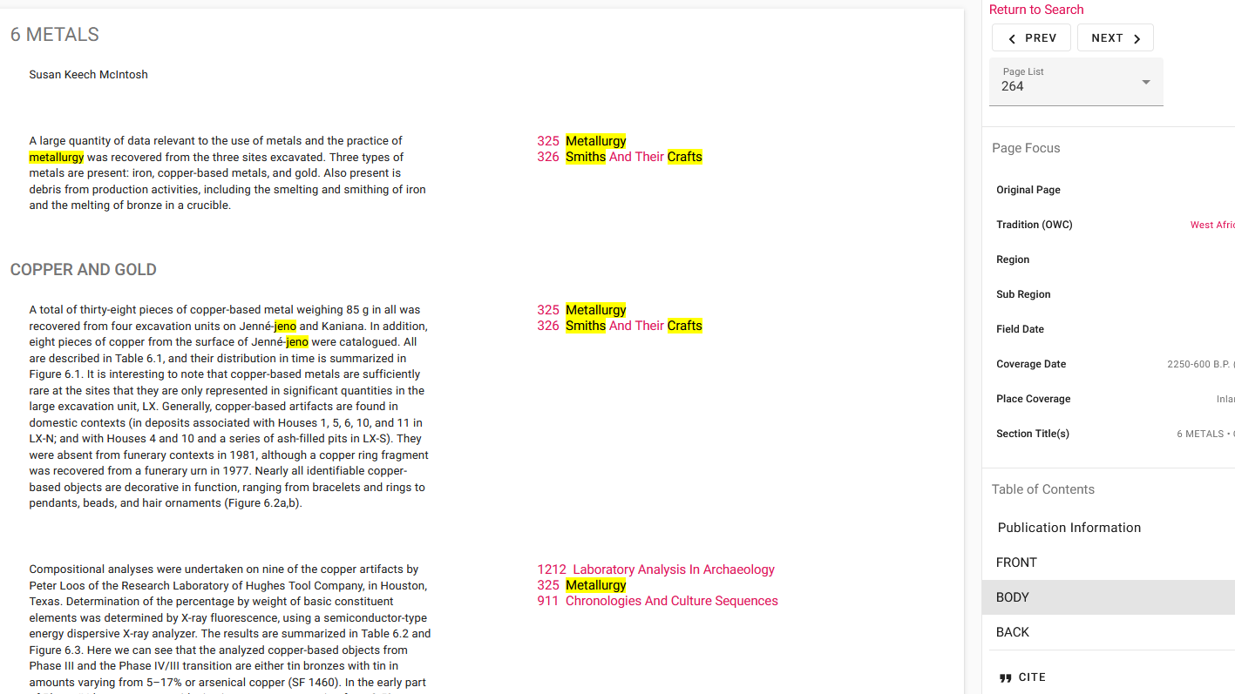
FULL CONTEXT

Slide 23
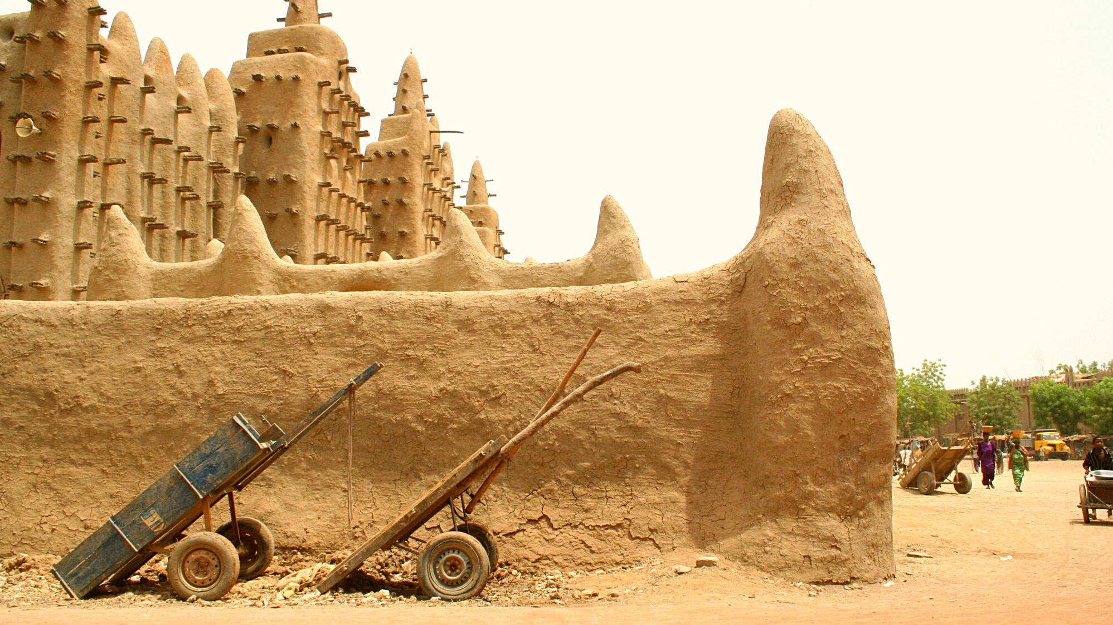
eHRAF Workbook
Part 4: Assignment

Slide 24
ASSIGNMENT
The purpose of this assignment is to present a report summarizing your findings about this great discovery.
This can be done in the form of a group project or an individual paper.
Groups can divide the questions that follow, with each student contributing information about a specific question.
Consider making a slideshow presentation to illustrate your findings.

Slide 25
ASSIGNMENT
Your final report describing Jenné-Jeno should have 6 sections which correspond to these 6 types of questions:
Who?
What?
Where?
When?
How?
Why?

Slide 26
QUESTION 1
Who?
Who are the main archaeologists associated with this discovery? Describe their biographical information, education and training, publications, etc.
Who are the people studied? Describe how people lived during this time at this place, such as: social stratification, division of labor, gender roles, economic life, food and subsistence, religious practices.

Slide 27
QUESTION 2
What?
What did the archaeologists discover?
Provide a general description of the archaeological site.
Describe the material culture, structures, artifacts, etc.
Include relevant photos and/or interpretive artistic renderings.

Slide 28
QUESTION 3
Where?
Where is the site located?
Describe the geography of this discovery, its location in the contemporary world, size, scope, etc.
Does the location have strategic importance?
How did the physical environment and natural resources shape cultural practices?

Slide 29
QUESTION 4
When?
When were the discoveries made?
When in human history do archaeologists believe that this site can be dated to?
Describe the relative time period, what preceded it, and what followed it. What does this represent in terms of cultural evolution and progress?

Slide 30
QUESTION 5
How?
How did archaeologists excavate, analyze, and interpret this site?
Tell us about the scientific methods used for excavation and analysis of the materials founds.
What technologies were utilized by the people who lived during this archaeological time period?
How did they construct buildings and make artifacts (lithics, pottery, etc.)?

Slide 31
QUESTION 6
Why?
Why is this archaeological site considered a “great discovery”?
Describe how this site is important in terms of its place in human history.
Why should this great discovery be preserved and who should be responsible for preservation?

Slide 32
Corse, Christopher De. 2002. “Tradition Summary: West African Iron Age.” HRAF. https://ehrafarchaeology.yale.edu/document?id=fa75-000.
McIntosh, Susan Keech. 1999. “Pathways to Complexity: An African Perspective.” In Beyond Chiefdoms: Pathways to Complexity in Africa, 1–30. Cambridge: Cambridge University Press. https://ehrafarchaeology.yale.edu/document?id=fa75-005.
McIntosh, Susan Keech, and Roderick J. McIntosh. 1981. “Current Directions in West African Prehistory.” In Annual Review of Anthropology, Vol. 12:215–58. Palo Alto, Calif.: Annual Reviews Inc. https://ehrafarchaeology.yale.edu/document?id=fa75-00.
References
McIntosh, Susan Keech, and Roderick J. McIntosh. 1993. “Cities without Citadels: Understanding Urban Origins along the Middle Niger.” In The Archaeology of Africa: Foods, Metals, and Towns, 622–41. London: Routledge. https://ehrafarchaeology.yale.edu/document?id=fa75-013.
McIntosh, Susan Keech, Roderick J. McIntosh, Robert H. Brill, Kevin C. MacDonald, and Wim Van Neer. 1994. “Excavations at Jenné-Jeno, Hambarketolo, and Kaniana (Inland Niger Delta, Mali): The 1981 Season.” In University of California Publications in Anthropology, v. 20: xxvi, 605.

Slide 33
Terracotta seated figure; 13th century, Wmpearl, CC0, via Wikimedia Commons: Https://commons.wikimedia.org/wiki/File:Seated_figure_grom_Mali,_13th_century,_Djenn%C3%A9_peoples,_Metropolitan_Museum_of_Art,_1981.218.JPG
Equestrian figure; circa 13th–15th century, Franko Khoury, Public domain, via Wikimedia Commons: https://commons.wikimedia.org/
wiki/File:Djenne_Terracotta_Equestrian_(13th-15th_cent).jpg
Image Credits
Seated female figure; circa 12th to 15th century, Daderot, Public domain, via Wikimedia Commons: https://commons.wikimedia.org/wiki/File:
Seated_female_figure,_Jenne_people,_Inland_Niger_Delta_region,_Mali,_c._late_13th_to_17th_century_AD,_terracotta_-_Krannert_Art_Museum,_UIUC_-_DSC06149.jpg
Female figure on her knees; 15th–18th century, Sailko, CC BY 3.0, via Wikimedia Commons: https://commons.wikimedia.org/wiki/File:
Mali,_jenne,_figura_femminile_in_ginocchio,_xv-xviii_secolo_01.jpg
Female figure; 13th–15th century; terracotta covered with red ochre, Musée du quai Branly, CC BY-SA 3.0, via Wikimedia Commons: https://commons.wikimedia.org/wiki/
File:Statuette_f%C3%A9minine-R%C3%A9gion_de_Djenn%C3%A9-Mali.jpg

Slide 34
Figure of an archer; circa 13th–15th century, Franko Khoury, Public domain, via Wikimedia Commons: https://commons.wikimedia.org/wiki/File:
Djenne_Terracotta_Archer_(13th-15th_cent).jpg
Bound figure; circa 12th to 15th century, Daderot, Public domain, via Wikimedia Commons: https://commons.wikimedia.org/wiki/File:Bound_figure,_Jenne_people,_
Jenne-Jeno,_Inland_Niger_Delta_region,_Mali,_c._12th_to_15th_century
_AD,_terracotta_-_Krannert_Art_Museum,_UIUC_-_DSC06152.jpg
Image Credits
Figure with arched back; 15th–18th century, Sailko, CC BY 3.0, via Wikimedia Commons: https://commons.wikimedia.org/wiki/File:
Mali,_jenne,_figura_incurvata,_xv-xviii_secolo.jpg

Slide 35
Great Discoveries:
Jenné-Jeno
Produced by
Human Relations Area Files
at Yale University
An eHRAF Workbook Activity
hraf.yale.edu

