Slide 1
An eHRAF Workbook Activity
Kinship
& Descent
in eHRAF World Cultures
Human Relations Area Files
at Yale University

Slide 2
In this activity
Learn about kinship and descent
Compare societies with bilateral descent
Compare matrilineal and patrilineal systems
Compare cousin marriage
Topics We'll Cover

Slide 3
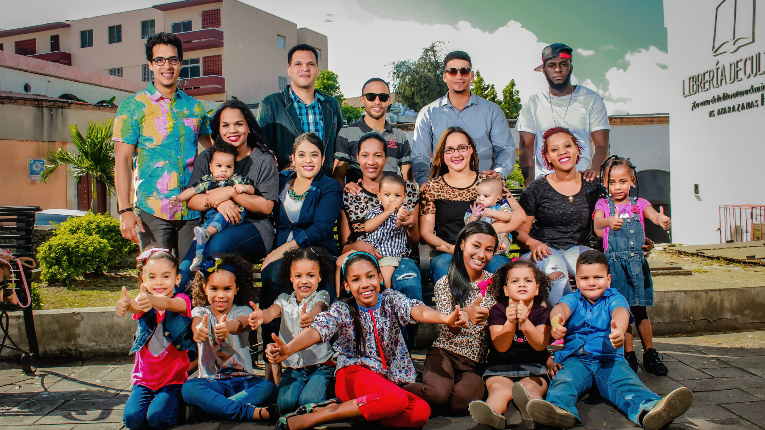
KINSHIP & DESCENT

Slide 4
Types of Families
Families come in all shapes and sizes, but minimally consist of at least one parent and a child. In many societies families regularly consist of multiple parent-child groups linked by a blood tie (extended families) which usually include three or sometimes four generations. All known societies have families and they are the fundamental social unit in all societies.

Slide 5
CONSANGUINEAL
Kinship ties between parents and children related by “blood”.
AFFINAL
Kinship ties between people related by marriage.
FICTIVE KIN
Close relationships which create “kinship” ties through ritual.

Slide 6
Defining Family
In most societies, adopted children are legally and socially treated as if they were consanguineal kin.
Some examples of fictive kin include godparents and godchildren, a "blood brotherhood", fraternity brothers, and sorority sisters.

Slide 7
Bilateral (two-sided) kinship is common in many societies around the world. Bilateral means that both the mother’s and the father’s sides of the family are included equally.
A bilateral kin group would include your parents, your maternal and paternal aunts, uncles, grandparents, great-aunts, great-uncles, and cousins.

Slide 8
UNILINEAL DESCENT
Unilineal descent systems specify a connection to an ancestor via one sex—only through males (patrilineal) or only through females (matrilineal).
AMBILINEAL DESCENT
Ambilineal descent also connects sets of kin to an ancestor, but such systems allow the link to be through a father or a mother as reflected in the prefix ‘ambi’.

Slide 9
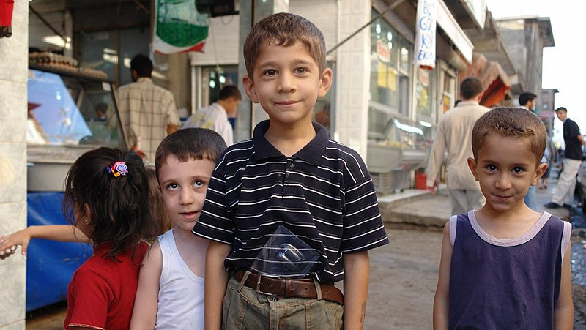
WORKBOOK ACTIVITY
Kinship & Descent

Slide 10
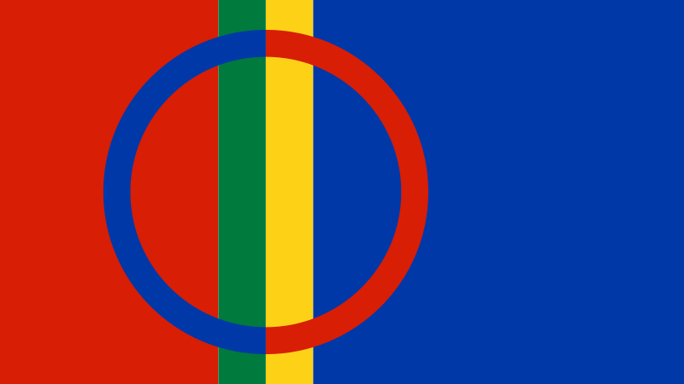
PART 1

Slide 11
Compare societies with bilateral descent
PART 1
COMPARE SOCIETIES WITH BILATERAL DESCENT
Compare two of the three societies with bilateral descent:
Tarahumara (NU33)
Saami (EP04)
Copper Inuit (ND08)
Answer the following questions:
1) How do the two societies you have chosen differ in the importance of bilateral kinship ties?
2) What kind of roles do those bilateral kin play in a person’s life?

Slide 12
For the Tarahumara read:
Fried, Jacob. 1951. Ideal Norms and Social Control in Tarahumara Society. [New Haven, Conn.]: [Yale University], pp. 128-130. https://ehrafworldcultures.yale.edu/document?id=nu33-010.
For the Saami read:
Pehrson, Robert N. 1957. “The Bilateral Network of Social Relations in Könkämä Lapp District.” In Indiana University Publications,. Bloomington, Ind.: [Indiana University]. Pp. 107-108 https://ehrafworldcultures.yale.edu/document?id=ep04-006.
For the Copper Inuit read:
Condon, Richard G. (Richard Guy). 1983. “Inuit Behavior and Seasonal Change in the Canadian Arctic.” In Studies in Cultural Anthropology, 228. Ann Arbor, Mich.: UMI Research Press, pp. 66. https://ehrafworldcultures.yale.edu/document?id=nd08-034.
Tarahumara (NU33)
Fried, Jacob. 1951. Ideal Norms and Social Control in Tarahumara Society. pp. 128-130.
COMPARE SOCIETIES WITH BILATERAL DESCENT
🌐
https://ehrafworldcultures.yale.edu/document?id=nu33-010
Saami (EP04)
Pehrson, Robert N. 1957. “The Bilateral Network of Social Relations in Könkämä Lapp District.” pp. 107-108.
🌐
https://ehrafworldcultures.yale.edu/document?id=ep04-006
Copper Inuit (ND08)
Condon, Richard G. (Richard Guy). 1983. “Inuit Behavior and Seasonal Change in the Canadian Arctic.” pp. 66.
🌐
https://ehrafworldcultures.yale.edu/document?id=nd08-034

Slide 13
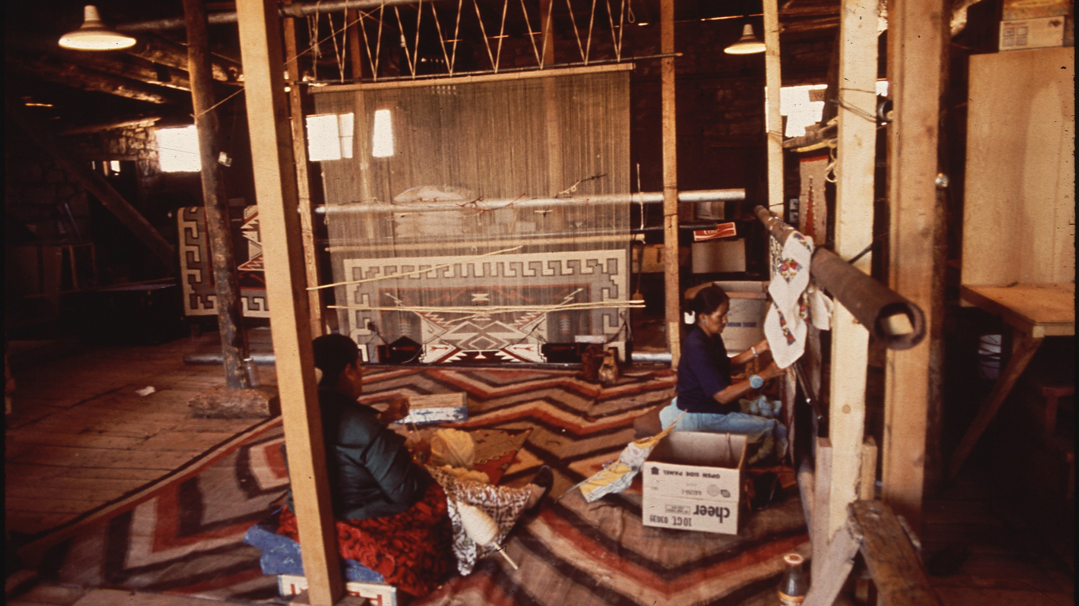
PART 2

Slide 14
PART 2
COMPARE MATRILINEAL
& patrilineal SYSTEMS
Compare the Bemba (FQ05), a matrilineal society in Zambia with the Kurds (MA11), a patrilineal society in the Middle East.
What kind of kin groups do the Bemba and Kurds have?
Which principles are they based on?
What are some of the functions of each of the groups?

Slide 15
COMPARE MATRILINEAL
& PATRILINEAL SYSTEMS
Bemba (FQ05)
Richards, Audrey I. (Audrey Isabel). 1939. Land,
Labour and Diet in Northern Rhodesia: An Economic Study of the Bemba Tribe. p. 114.
🌐
https://ehrafworldcultures.yale.edu/document?id=fq05-002
Kurds (EP04)
Barth, Fredrik. 1954. “Father’s Brother's Daughter Marriage in Kurdistan.” Southwestern Journal of Anthropology. pp.165-168
🌐
https://ehrafworldcultures.yale.edu/document?id=ma11-003

Slide 16
PART 3

Slide 17
PART 3
COMPARE COUSIN MARRIAGE
Using Advanced Search add the subject Regulation of Marriage (582) and also the keyword cousin*.
Compare the allowance or disapproval of cousin marriage for the Bemba (FQ05), the Saami (EP04), and the Kurds (MA11).
Concentrate on the authors you read earlier.

Slide 18
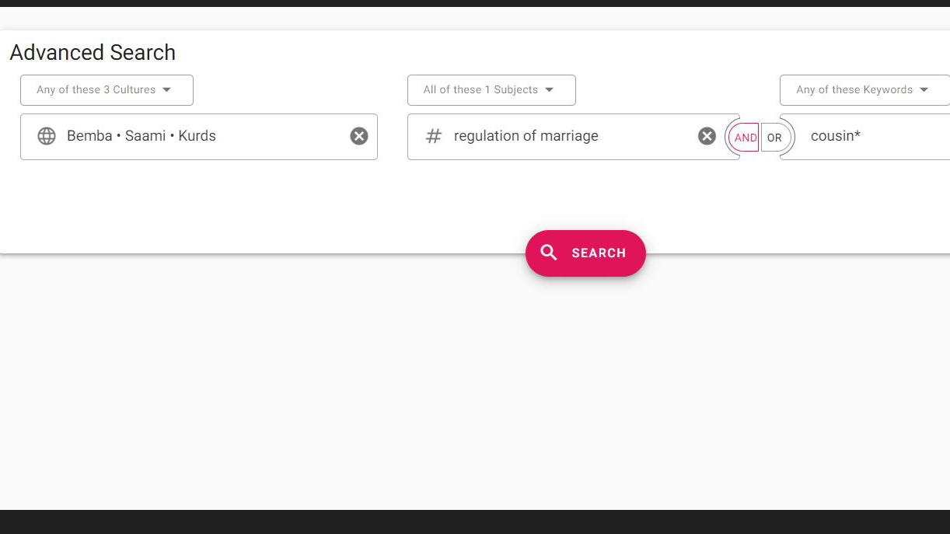
Advanced Search
1. enter one or more culture names
2. add subject Regulation of Marriage(562)
3. add keyword cousin*

Slide 19
Compare societies with bilateral descent
PART 3
COMPARE COUSIN MARRIAGE
How do the societies vary in the type of cousin marriage allowed or preferred?
If they allow cousin marriage, what kind do they allow?
If there are reasons given for the allowance or disapproval, what are they?

Slide 20
1. This workbook activity was written by Carol Ember.
2. Barth, Fredrik. 1954. “Father’s Brother's Daughter Marriage in Kurdistan.” Southwestern Journal of Anthropology Vol. 10: 164–71. https://ehrafworldcultures.yale.edu/document?id=ma11-003.
3. Condon, Richard G. (Richard Guy). 1983. “Inuit Behavior and Seasonal Change in the Canadian Arctic.” Ann Arbor, Mich.: UMI Research Press. https://ehrafworldcultures.yale.edu/document?id=nd08-034.
References
4. Fried, Jacob. 1951. Ideal Norms and Social Control in Tarahumara Society. [New Haven, Conn.]: [Yale University]. https://ehrafworldcultures.yale.edu/document?id=nu33-010.
5. Pehrson, Robert N. 1957. “The Bilateral Network of Social Relations in Könkämä Lapp District.” In Indiana University Publications, vol. 5:x, 128. Bloomington, Ind.: [Indiana University]. https://ehrafworldcultures.yale.edu/document?id=ep04-006.
6. Richards, Audrey I. (Audrey Isabel). 1939. Land, Labour and Diet in Northern Rhodesia: An Economic Study of the Bemba Tribe. Pub. for the International Institute of African Languages & Cultures by the Oxford University Press. https://ehrafworldcultures.yale.edu/document?id=fq05-002.

Slide 21
Navajo girl Lavenna White working as a museum aid at Hubbel Trading Post National Historic Site by Fred E. Mang, Jr. via Wikimedia Commons. https://commons.wikimedia.org/wiki/File:Navajo_girl_Lavenna_White_working_as_a_museum_aid_at_Hubbel_Trading_Post_National_Historic_Site._Image_Number_69-431-69_(bec609b8d7744f0181ec20d1f25ebf44).jpg
Extended family. Chagcharan Ghowr province by Corporal Vilius Džiavečka, Lithuania via Wikimedia Commons. https://commons.wikimedia.org/wiki/File:Extended_Family_(4197770551).jpg
Image Credits
Dos varones tarahumaras, fotografiados en Tuaripa, Chihuahua, México by Carl S. Lumholtz via Wikimedia Commons. https://commons.wikimedia.org/wiki/File:Tarahumaras1.jpg
Kurdish boys in Diyarbakir by Charles Fred. https://www.flickr.com/photos/charlesfred/213403139/

Slide 22
Nordic Sami (Saami) people in Sapmi (Lapland) in front of two Lavvo Tents by Granbergs Nya Aktiebolag via Wikimedia Commons. https://commons.wikimedia.org/wiki/File:Nordic_Sami_people_Lavvu_1900-1920.jpg
Navajo Woman Weave A Rug At The Hubbel Trading Post by Terry Eiler via Wikimedia Commons. https://commons.wikimedia.org/wiki/File:NAVAJO_WOMEN_WEAVE_A_RUG_AT_THE_HUBBEL_TRADING_POST,_FIRST_TRADING_POST_ON_THE_NAVAJO_RESERVATION_-_NARA_-_544416.jpg
Image Credits

Slide 23
Kinship
& Descent
in eHRAF World Cultures
Produced by
Human Relations Area Files
at Yale University
An eHRAF Workbook Activity
hraf.yale.edu

