Slide 1
An eHRAF Workbook Activity
Language
&
Identity
in eHRAF World Cultures
Human Relations Area Files
at Yale University

Slide 2
In this activity
Topics We'll Cover
Learn about how social status and identity affect language use
Explore how different cultures communicate
Read and interpret ethnographic data
Conduct your own research

Slide 3
Communicating Culture
A distinguishing aspect of human communication is that it is symbolic. In order to convey meaning, language uses arbitrary signs to stand for concepts. Whether spoken, written, or via gestures, people continually communicate with others throughout their lives.
Did you know?
Yet the power and meaning of language goes far beyond its signs or symbols. Through language, humans are able to share beliefs, worries, perceptions, expectations, experiences and knowledge. These are the building blocks of communicating culture.

Slide 4
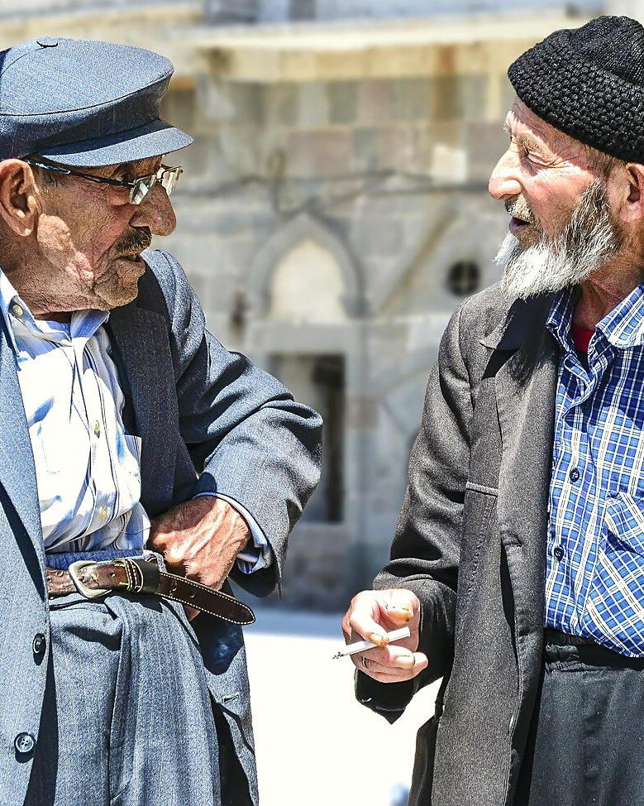
Ethnolinguistics is a field of linguistic anthropology that studies the relationship between language and patterns of thought and perception in different societies.
Sociolinguistics is the study of language as it relates to social structure and contexts such as gender, age, religion, geography, social class and status, education, occupation, ethnicity, nationality, and identity.
Societal norms and practices impact the ways that people communicate with each other. Thus, by observing how people speak to each other, we can deduce certain things about their culture as well as relationships and relative status in society.

Slide 5
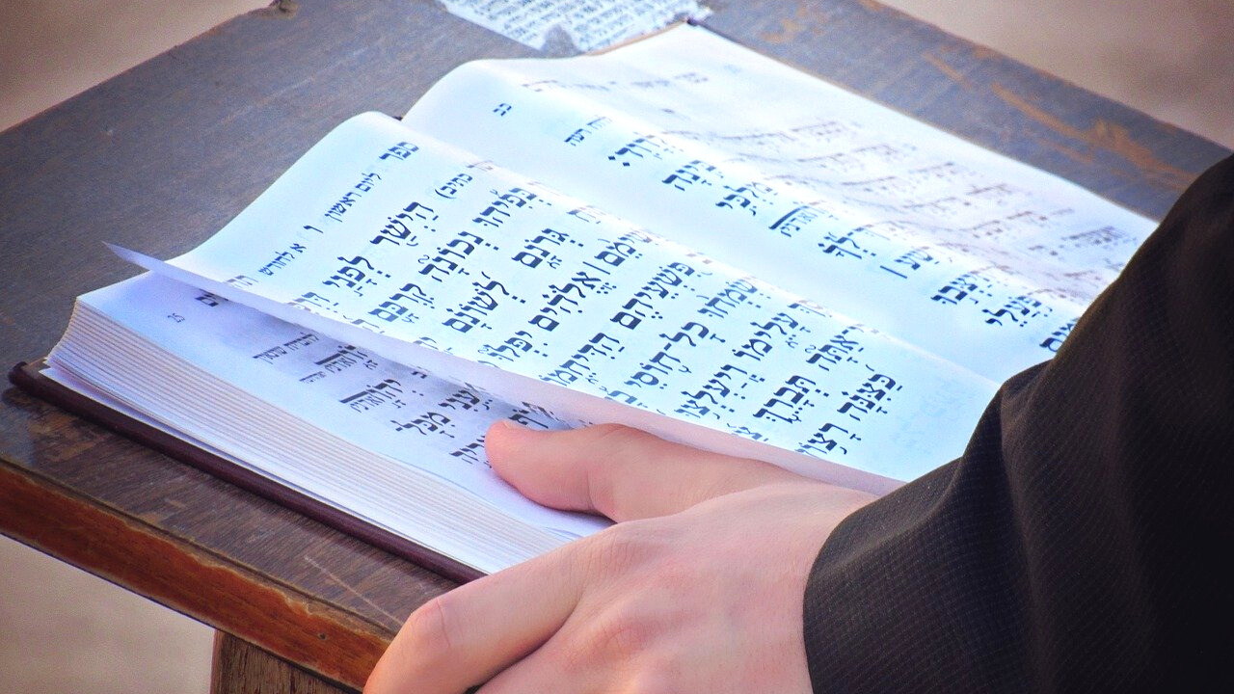
THE POWER OF LANGUAGE

Slide 6
Language use and patterns of speaking can tell us a great deal about power and agency in society. For example, ritual and religion are domains in which words are endowed with performative qualities, such as speaking a prayer aloud to ward off evil spirits. Saying "I’m sorry" can mend a strained relationship, while refusing to apologize can just as easily break it.
Oratory is another category of expression that can "make things happen", such as the speech from a charismatic leader that inspires a revolution.

Slide 7
Sometimes people are restricted from speaking in certain situations, such as based on gender or age. Linguistic anthropologists pay attention to this contestable nature of language, including how more than one exclusive variant of a language can exist among its speakers.
For example, one might speak differently when chatting with friends versus when addressing a college professor.

Slide 8
Bilingual, multilingual and plurilingual people may likewise switch from one language to another in the course of a conversation with one or more participants. This practice is known as code-switching.
The motivations for switching codes in mid-conversation can range from a polite attempt to include nearby speakers of other languages, to a deliberate political act of defiance.

Slide 9
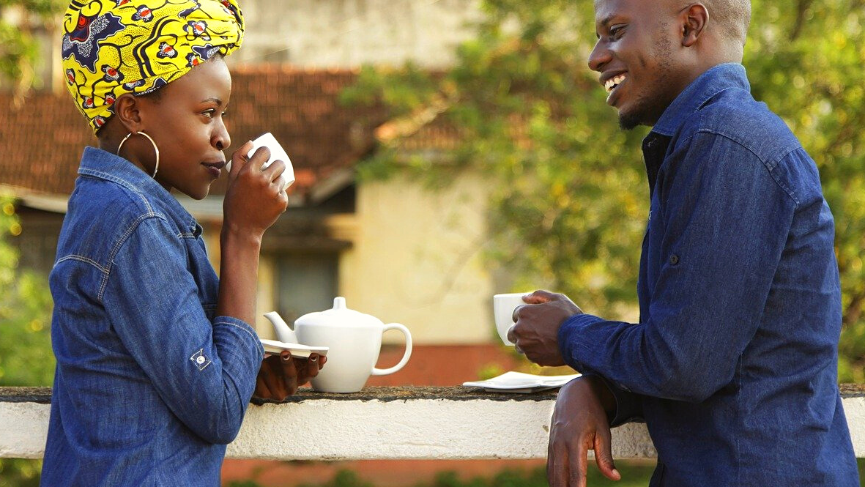
ACTIVITY 1
Ethnographic Examples

Slide 10
eHRAF
World Cultures
Read the following ethnographic accounts of language use in different cultures and answer the questions provided.

Slide 11
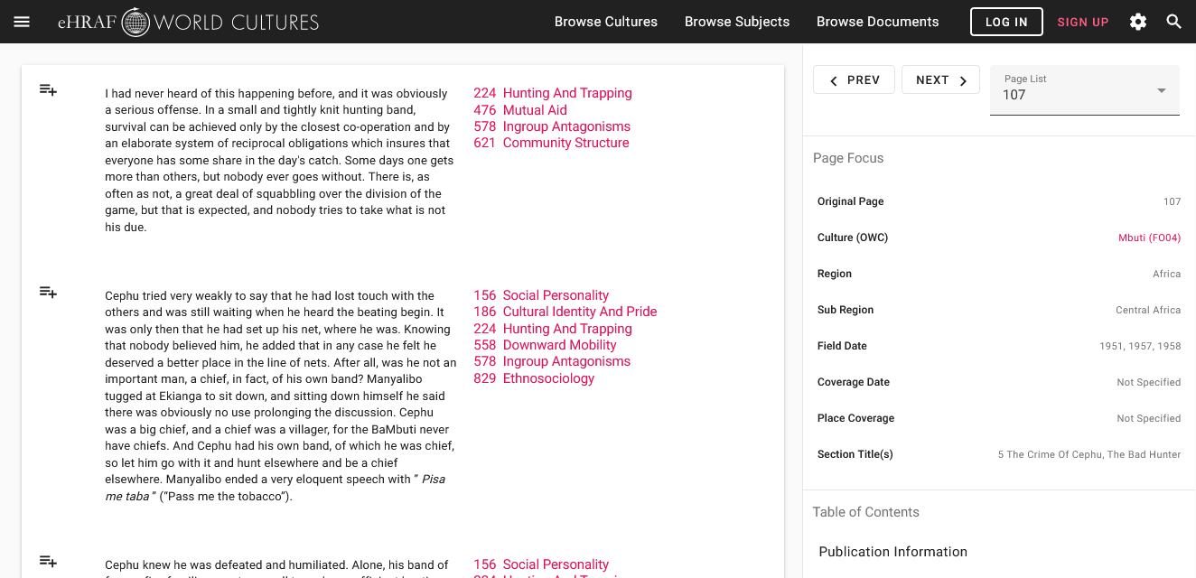
To read documents or pages in eHRAF:
INSTRUCTIONS
First, follow the permalinks provided in the activities below to get to the relevant documents.
For example:
🌐
https://ehrafworldcultures.yale.edu/document?id=fo04-003
Then, use the Page List dropdown menu to navigate to the required page(s).

Slide 12
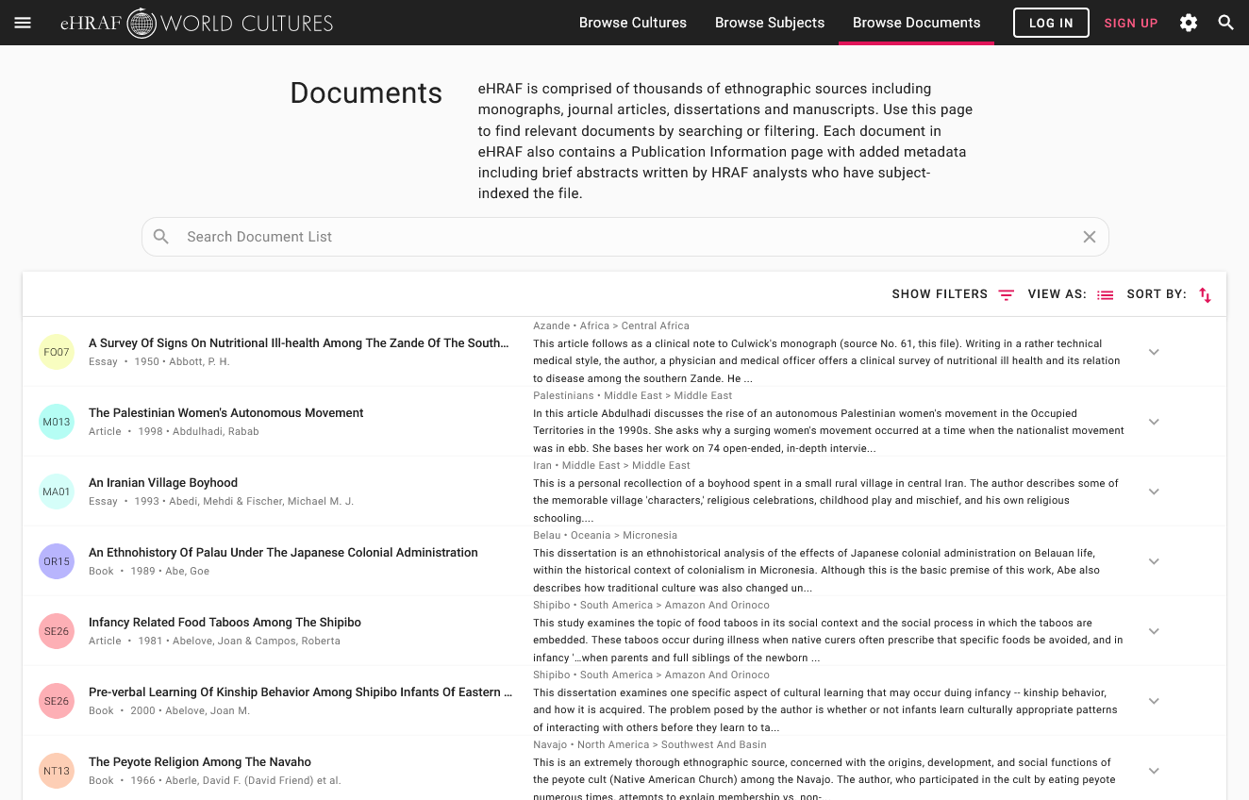
Finding documents without permalinks
INSTRUCTIONS
Follow these steps if you are having trouble with permalinks from off campus while using a proxy or VPN service, or if you have been provided with a HRAF-issued username and password.
Sign in via your library proxy or VPN, or using the HRAF-issued credentials.
Go to the Browse Documents tab.
Enter the author's name or document title into Search Document List box.
Click on the required title to access the document, then select the page number from the Page List dropdown menu as shown above.

Slide 13
Tukano (SQ19)
Sorensen (1967) - "Multilingualism in the Northwest Amazon"
Multilingualism, pages 677-678 on language exogamy
🌐
https://ehrafworldcultures.yale.edu/document?id=sq19-007
How are language, gender, and kinship connected in Tukano society?
How does this connection influence marriage patterns?
How many languages may be spoken in a single Tukano longhouse?
How does a Tukano decide which language to speak?

Slide 14
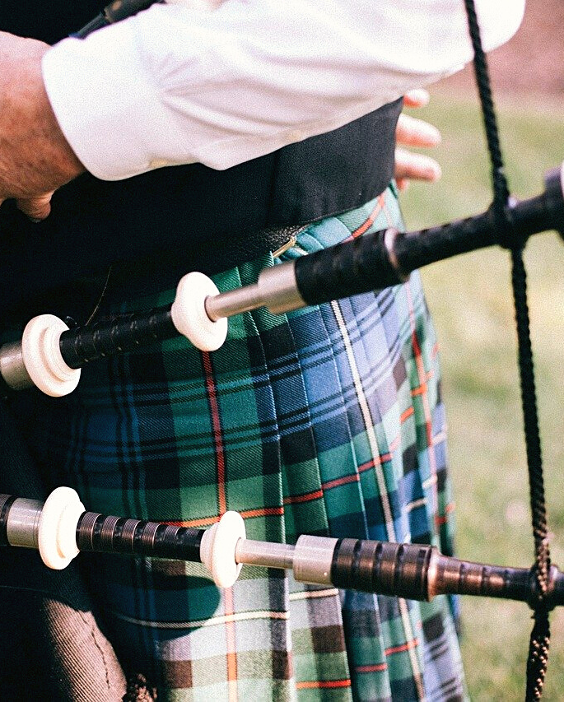
Highland Scots (ES10)
Coleman (1984) - Language Shift in a Bilingual Hebridean Crofting Community
Pages 74 and 84-88 on Gaelic vs. English language identity
🌐
https://ehrafworldcultures.yale.edu/document?id=es10-015
What impression is given when a local person chooses to speak English over Gaelic?
How does age and location factor into Gaelic language identity?
Under what conditions do young people prefer to use English?
What other aspects of culture is Gaelic language use associated with?

Slide 15
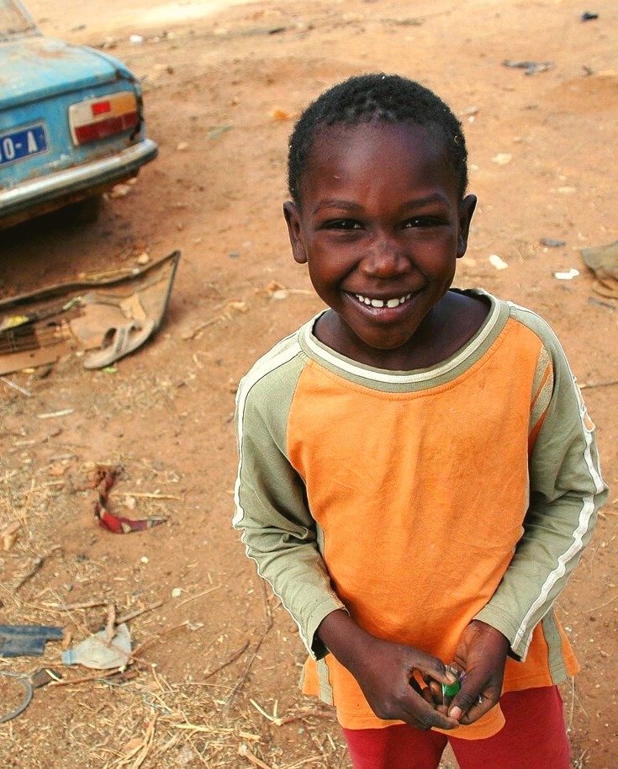
Wolof (MS30)
Swigart (1994) - "Cultural Creolisation and Language Use in Post-Colonial Africa: The Case of Senegal"
Pages 177-178 on urban vernacular language
🌐
https://ehrafworldcultures.yale.edu/document?id=ms30-059
How do bilingual French and Wolof speakers combine the two languages?
What is the difference between an urban variety and a creole language?
What cultural status does mixing a vernacular language with a European language confer the urban Wolof speaker?

Slide 16
Taiwan Hokkien (AD05)
Barnett (1971) - An Ethnographic Description of Sanlei Ts'un, Taiwan, with Emphasis on Women's Roles
Languages, pages 77-78 on plurilingualism, gender, and age
🌐
https://ehrafworldcultures.yale.edu/document?id=ad05-004
What languages are spoken in Sanlei and for what purposes?
How does language use vary by age group?
What inhibits Taiwanese speakers from learning and speaking Mandarin?
What other language is most likely spoken by older men?

Slide 17
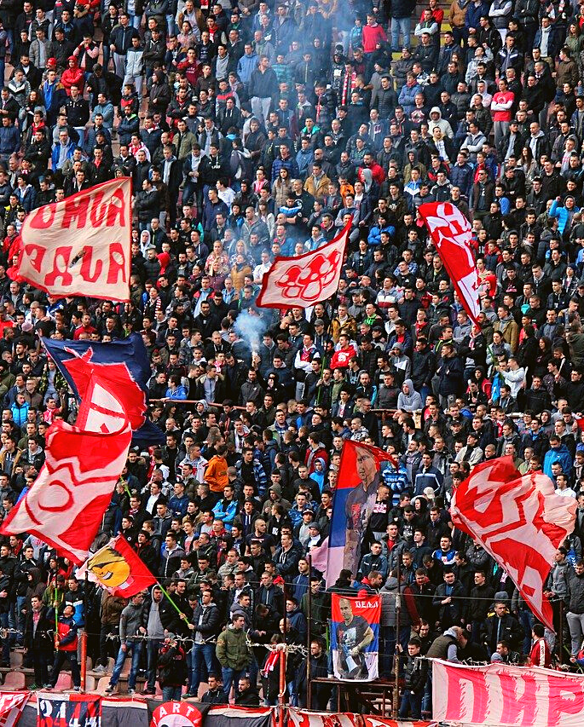
Serbs (EF06)
Pavlovic (1973) - Folk Life and Customs in the Kragujevac Region of the Jasenica in Sumdaija
Swearwords, Curses, and Oaths, pages 131-133 on power and speech
🌐
https://ehrafworldcultures.yale.edu/document?id=ef06-019
How common or uncommon is swearing?
What differences are there between how men and women curse?
How are curses invoked, and who might be cursed?
What are oaths used for?

Slide 18
ACTIVITY 2
Essay

Slide 19
Use eHRAF World Cultures to research how language intersects with another aspect of culture such as: class, ethnicity, race, age, religion, gender occupation, or nationality.
Try to find at least 2 ethnographic examples of language use from different world regions as it relates to your chosen aspect of culture.
Write a short paper of 2-4 pages summarizing your findings. Compare and contrast any similarities or differences you have found across the cultures you selected.

Slide 20
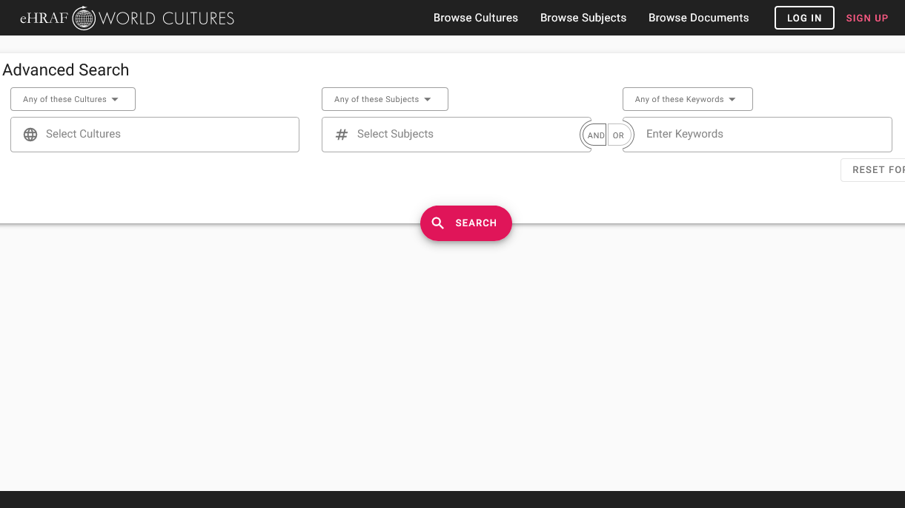
SAMPLE ADVANCED SEARCH
Add subjects, such as:
Sociolinguistics (195)
Speech (191)
Linguistic identification (197)
Add keywords such as:
gender, age, religion, class, or codeswitching

Slide 21
1. This activity is based on Language, Culture & Society, by Francine Barone, in Teaching eHRAF. https://hraf.yale.edu/teach-ehraf/language-culture-society/
2. Barnett, William Kester. 1971. An Ethnographic Description of Sanlei Ts’un, Taiwan, with Emphasis on Women's Roles: Overcoming Research Problems Caused by the Presence of a Great Tradition. Ann Arbor, Mich.: University Microfilms. https://ehrafworldcultures.yale.edu/document?id=ad05-004.
3. Coleman, Jack David Bo. 1984. Language Shift in a Bilingual Hebridean Crofting Community. Ann Arbor, Mich.: Xerox University Microfilms. https://ehrafworldcultures.yale.edu/document?id=es10-015.
References
4. Pavlovic, Jeremija M. 1973. Folk Life and Customs in the Kragujevac Region of the Jasenica in Sumdaija. New Haven, Conn.: Human Relations Area Files. https://ehrafworldcultures.yale.edu/document?id=ef06-019.
5. Sorensen Jr, Arthur P. 1967. “Multilingualism in the Northwest Amazon.” American Anthropologist Vol. 69 (no. 6): 670–84. https://ehrafworldcultures.yale.edu/document?id=sq19-007.
6. Swigart, Leigh. 1994. “Cultural Creolisation and Language Use in Post-Colonial Africa: The Case of Senegal.” Africa Vol. 64 (no. 2): 175–89. https://ehrafworldcultures.yale.edu/document?id=ms30-059.

Slide 22
Language
&
Identity
in eHRAF World Cultures
Produced by
Human Relations Area Files
at Yale University
An eHRAF Workbook Activity
hraf.yale.edu

