Slide 1
An eHRAF Workbook Activity
Marriage
&
Choice
in eHRAF World Cultures
Human Relations Area Files
at Yale University

Slide 2
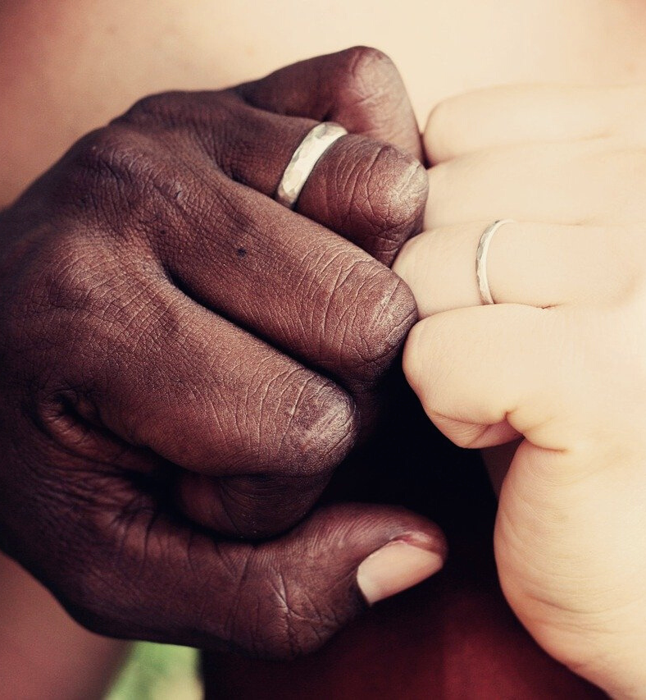
In this activity
Find cultural data about marriage and partner choice in eHRAF World Cultures
Read and analyze concepts of marital choice among a variety of cultures around the world
Compare and contrast ethnographic data
Interpret your results
Topics We'll Cover

Slide 3
MARRIAGE & CHOICE

Slide 4
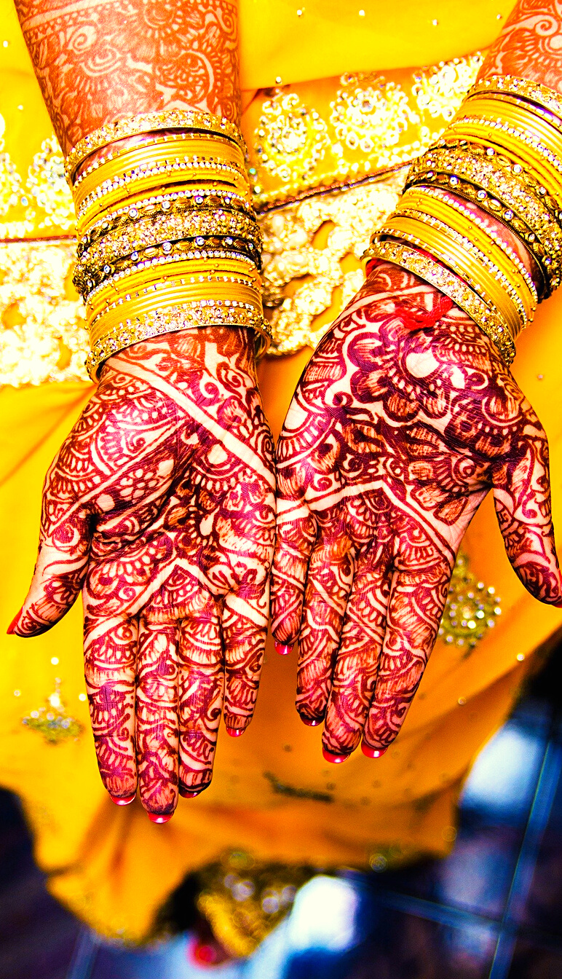
Who can marry whom?
In some cultures, parents or other relatives are involved in making the decisions on who may court and marry; while in other cultures, potential spouses choose for themselves.
There may also be a combination of both free and arranged marriage choices. Possible restrictions on marriage choice can likewise differ within cultures. For example, men may be less subject to strict regulation of marriage choices than women.
Did you know?

Slide 5
eHRAF Workbook
ACTIVITY
marriage and choosing a partner

Slide 6
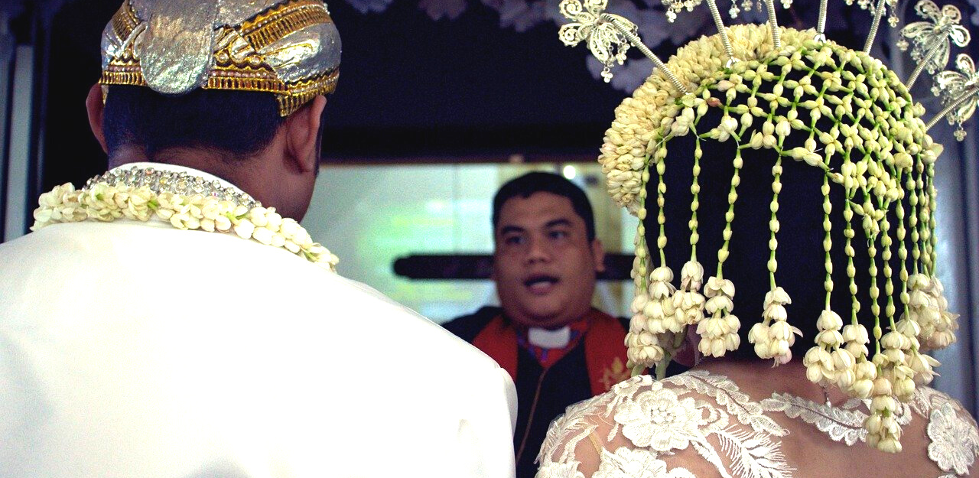
eHRAF
World
Cultures
Information for answering the following questions can be found by searching for the culture name in combination with the OCM subject category Arranging a Marriage (584) in the Add Subjects box of an eHRAF Advanced Search.

Slide 7
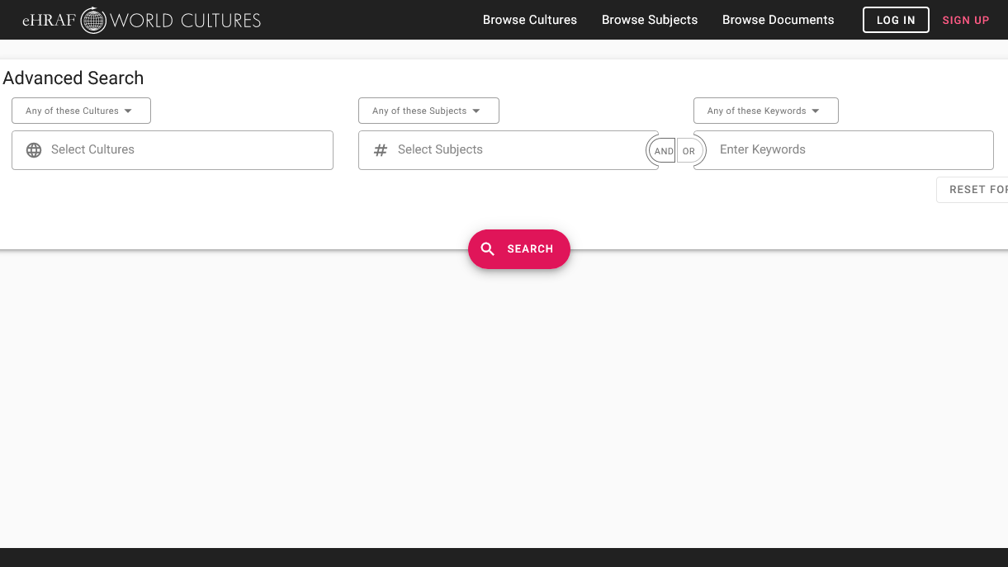
SAMPLE ADVANCED SEARCH
Add subject
Arranging a marriage (584)
Add one or more cultures
from the exercises below

Slide 8
MARRIAGE & CHOICE
Refer to the search tips above to answer the following questions.
Question 1
The Ganda (FK07) and Dogon (FA16) differ in how much freedom males and females have in choosing a spouse.
Briefly compare their freedom of choice.

Slide 9
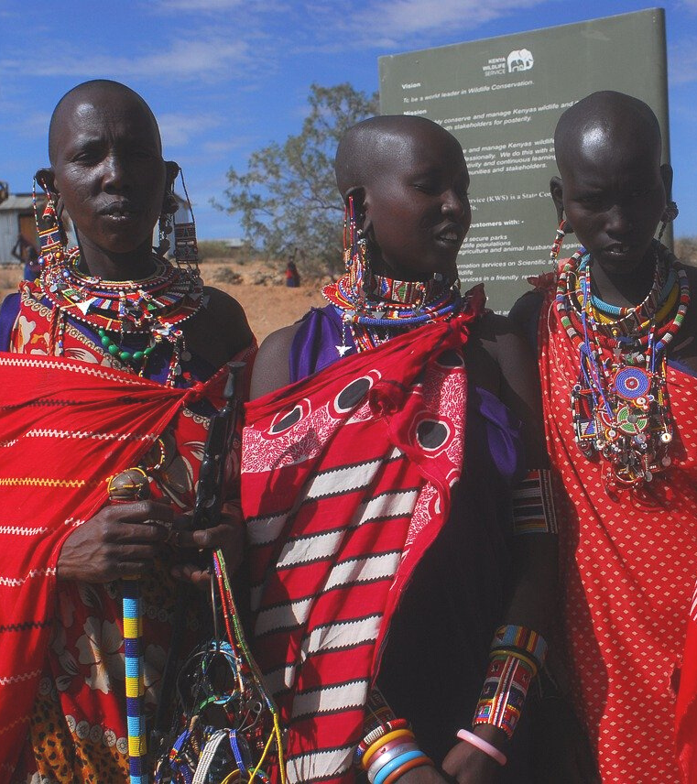
MARRIAGE & CHOICE
Question 2
Technically, a Maasai (FL12) male has free choice in choosing a spouse, but it is considerably different from what most people expect by "free choice".
How do Maasai males choose? What is the situation for females?
Briefly compare their freedom of choice.

Slide 10
MARRIAGE & CHOICE
Question 3
How does wealth difference affect marriage among Garo (AR05) and Ifugao (OA19) societies?

Slide 11
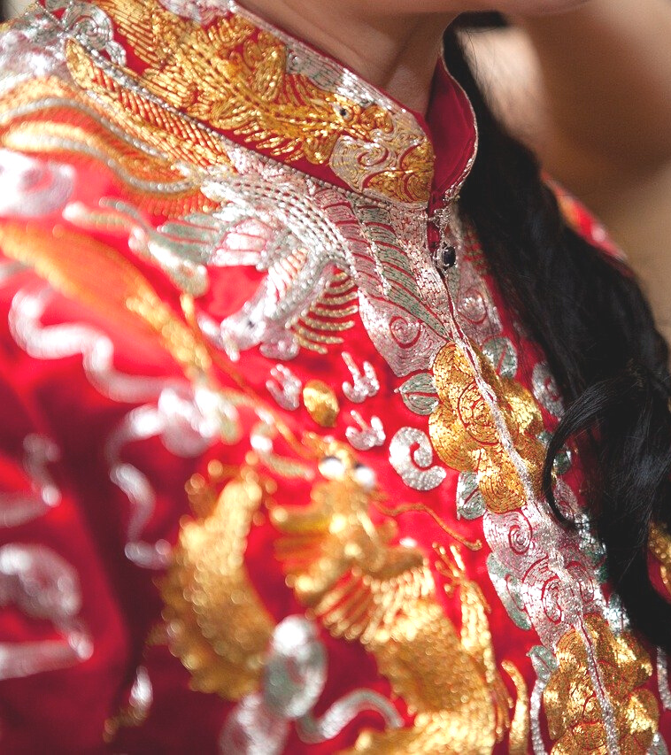
MARRIAGE & CHOICE
Question 4
How have marriage arrangements changed over time for the Taiwan Hokkien (AD05)?
Refer to the search results from Diamond (1969). K’Un Shen: A Taiwan Village.
https://ehrafworldcultures.yale.edu/document?id=ad05-009
🌐

Slide 12
Analyze
cross-cultural findings
What similarities and differences in marital practices and partner choice have you found across cultures?

Slide 13
1. This workbook activity is based on the Marriage & Choice In-Class Activity adapted from the Teaching eHRAF Exercise "Exercises Using eHRAF World Cultures, Marriage" by Carol Ember https://hraf.yale.edu/teach-ehraf/marriage-choice-in-class-activity/
References

Slide 14
Marriage
&
Choice
in eHRAF World Cultures
Produced by
Human Relations Area Files
at Yale University
An eHRAF Workbook Activity
hraf.yale.edu

