Slide 1
An eHRAF Workbook Activity
Medical Anthropology & Ethnomedicine
in eHRAF World Cultures
Human Relations Area Files
at Yale University

Slide 2
In this activity
Topics We'll Cover
What do medical anthropologist do?
What is ethnomedicine?
Understanding causes of disease
eHRAF research task

Slide 3
What do
MEDICAL ANTHROPOGISTS
do?

Slide 4
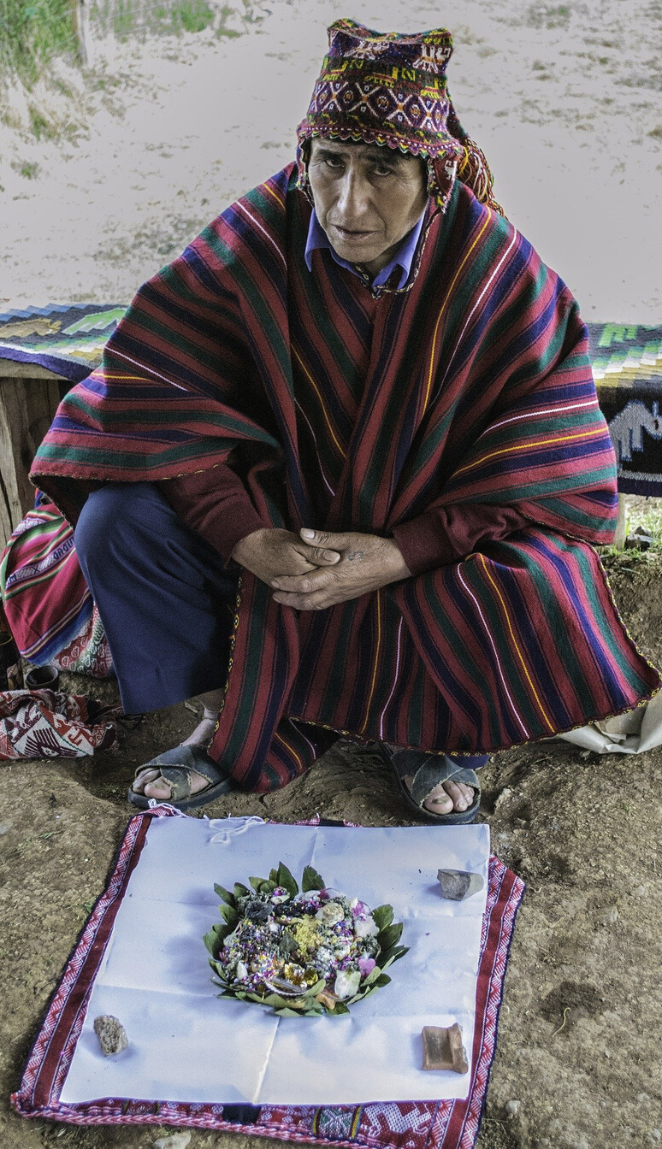
What do medical anthropologists do?
Medical anthropologists study what people believe to be the causes of illness and disease, their methods of treatment, and societal approaches to sickness and health as a product of different cultures.
Did you know?

Slide 5
What is Ethnomedicine?
Ethnomedicine is the comparative study of cultural ideas about wellness, illness, and healing.

Slide 6
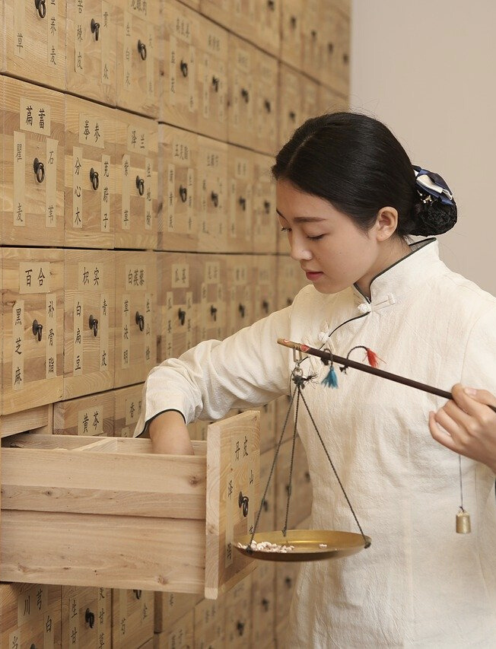
Ethnomedicine
Anthropologists understand that cultures around the world have different explanations for underlying causes of health problems.
While the biomedical approach is common in societies like the United States, in non-Western contexts, biomedical explanations are often viewed as unsatisfactory or incomplete.

Slide 7
Causes of Disease
Beliefs about illness vary across cultures
A Western doctor may diagnose an illness as being caused by germs or infection and prescribe penicillin as cure.
A traditional healer may interpret the same illness as being caused by evil spirits and perform elaborate rituals in order to cure the patient.

Slide 8
The eHRAF World Cultures database can be used for cross-cultural studies of medical systems and beliefs
eHRAF
World
Cultures
The following workbook tasks are designed to discover and explore ideas about illness causation and medicinal treatments across cultures.

Slide 9
As you explore causes of disease across cultures, keep the following questions in mind:
How are causes of disease classified?
What commonalities and differences exist within and between cultures?
How do healers and medical practitioners differ around the world?
How do local religious or philosophical beliefs affect medical practices and treatments?
How do the diagnosis, treatment, and remedies of diseases compare with your own cultural beliefs?
KEY QUESTIONS

Slide 10
Ethnographic examples of
"the common cold"
Found in eHRAF World Cultures
The Croats believe that chilling a part of the body, such as by sitting in a drafty room or going outside with wet hair, causes a cold (Gilliland 1986).
As a remedy, the Croatian liquor rakija is said to cure everything "from a cut to the common cold" (Bennett 1974)
The Tiv of Nigeria believe that the common cold is associated with the phases of the moon (Bohannan 1953).
“Eating raw onions” can be used to treat the cold (Bohannan 1969).
Taiwan-Hokkien believe that cold is caused by “fright or offense” (Gould-Martin 1975).
The Amhara of Ethiopia the believe “that smelling the urine of another will give one a cold” (Levine 1965).

Slide 11
eHRAF Workbook
ACTIVITY
compare and contrast causes of disease

Slide 12
Workbook Activity
Disease causation as defined by George P. Murdock
There are many different theories on illness causation. In his classification system, George Peter Murdock defines illness causation as “natural” and “supernatural” as outlined in below (Moore 1988).

Slide 13
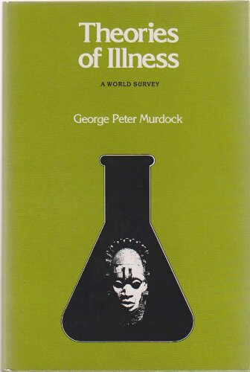
Workbook Activity
CHOOSE
Select 1 or more causes of disease from the chart below, including the "natural" and "supernatural".
RESEARCH
In eHRAF World Cultures, find 3 cultures from different regions (e.g. Asia, Africa, Europe, North America).
ANALYZE
Compare and contrast the cultural similarities and differences for the illness and cause(s) of disease chosen.

Slide 14
NATURAL CAUSATION
SUPERNATURAL CAUSATION
Infection
Stress
Organic Deterioration
Accident
Mystical
Fate
Ominous Sensation
Contagion
Mystical Retribution
Animistic
Soul Loss
Spirit Aggression
Magical
Sorcery
Witchcraft

Slide 15
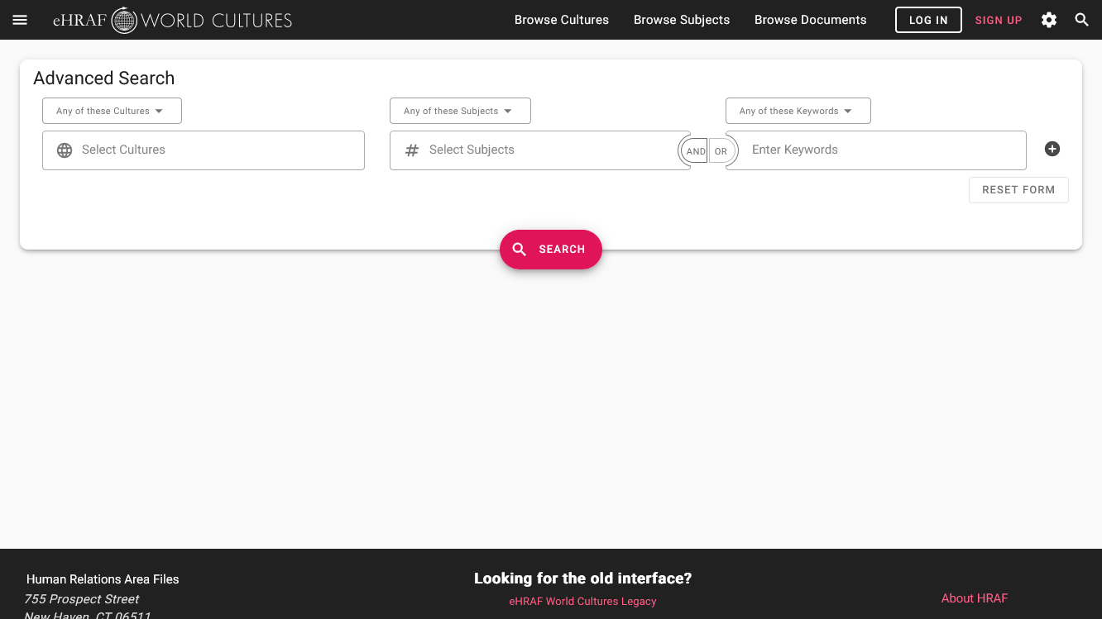
Searching in eHRAF
The OCM identifiers for Sorcery and Theory of Disease may be added to an Advanced Search in eHRAF World Cultures. Use the "Add Subjects" box to add OCM subjects to your search.

Slide 16
1. This activity was adapted in part from Topics in Medical Anthropology, by Christiane Cunnar, in Teaching eHRAF.
2. Henniger-Rener, Sashur. "Health and Medicine", in Brown, Nina, Laura Tubelle de González, and Thomas McIlwraith. 2017. Perspectives: an open invitation to cultural anthropology, 2nd edition.
3. Bennett, Brian Carey. 1974. Sutivan: A Dalmatian Village in Social and Economic Transition. San Francisco: R and E Research Associates. https://ehrafworldcultures.yale.edu/document?id=ef04-001.
Notes & References
4. Bohannan, Laura, and Paul Bohannan. 1953. "Tiv of Central Nigeria." Ethnographic Survey of Africa: Western Africa. London: International African Institute. https://ehrafworldcultures.yale.edu/document?id=ff57-019.
5. Bohannan, Paul, and Laura Bohannan. 1969. "Source Book on Tiv Religion.” Hraflex Books. Ethnography Series. New Haven, Conn.: Human Relations Area Files. https://ehrafworldcultures.yale.edu/document?id=ff57-030.
6. Gilliland, Mary Katherine. 1986. “Maintenance Of Family Values In A Yugoslav Town.” Ann Arbor, Michigan: University Microfilms International. https://ehrafworldcultures.yale.edu/document?id=ef04-003.

Slide 17
7. Gould-Martin, Katherine. 1975. “Medical Systems in a Taiwan Village: Ong-Ia-Kong, The Plague God as Modern Physician.” Medicine In Chinese Cultures : Comparative Studies of Health Care in Chinese and Other Societies. Washington, D.C.: U.S. Department of Health, Education, and Welfare, National Institutes of Health. https://ehrafworldcultures.yale.edu/document?id=ad05-062.
8. Levine, Donald Nathan. 1965. Wax & Gold: Tradition and Innovation in Ethiopian Culture. Chicago: University of Chicago Press. https://ehrafworldcultures.yale.edu/document?id=mp05-011.
Notes & References
9. Moore, C. C. 1988. "An Optimal Scaling of Murdock’s Theories of Illness Data—an Approach to the Problem of Interdependence", Behavior Science Research, 22(1–4), 161–179. https://doi.org/10.1177/106939718802200112
10. Murdock, George P. 1980. Theories of Illness: A World Survey. Pittsburgh: University of Pittsburgh Press.

Slide 18
Medical Anthropology & Ethnomedicine
in eHRAF World Cultures
Produced by
Human Relations Area Files
at Yale University
An eHRAF Workbook Activity
hraf.yale.edu

