Slide 1
An eHRAF Workbook Activity
Property
in eHRAF World Cultures
Human Relations Area Files
at Yale University

Slide 2
In this activity
Compare the concept of property among these cultures:
Tiv (FF57) of Africa
Ganda (FK07) of Africa
Ifugao (OA19) of Asia
Copper Inuit (ND08) of North America
To get started, let’s take a look at Property System (OCM 421).
Topics We'll Cover

Slide 3
Subject Description
Property System (OCM 421)
Principles of property law; rights, privileges, and powers commonly involved in property relations (e.g., rights that others shall not use or destroy, privileges of enjoyment, powers of alienation and of transmission after death); recognized types of titles or tenure; recognized types of ownership (e.g., individual, joint, corporate, collective, public); their relation to classes of subject matter (e.g., land, movables, dwellings); their degree of integration, their legal and statistical importance; their association with kin and other social groups; etc.

Slide 4
Tiv of Africa
The Tiv, numbering about a million people, live on both sides of the Benue River in Nigeria, about 220 kilometers from its confluence with the Niger. They are primarily subsistence farmers—their main crops are yams, cassava, and sweet potatoes. Their social organization is based on a very deep patrilineal lineage system and they claim that they are one people all descendants of the male ancestor “Tiv.”

Slide 5
Ganda of Africa
The Ganda, who refer to themselves as "Baganda," are located north and west of Lake Victoria (Lake Victoria Nyanza). For most of their history they were organized as a centralized kingdom and, at the time of European contact, were a dominant power in the region. They are an agricultural people, relying principally on bananas and yams. Today they comprise about 17 percent of Uganda’s population.

Slide 6
Ifugao of Asia
The Ifugao, who are known for their wet-rice terraced fields that were developed over the last four centuries, live in the mountainous region of northern Luzon in the Philippines. They have no political chiefs or councils although they have districts comprised of a few small hamlets which jointly conduct rice rituals and make agricultural decisions.

Slide 7
Copper Inuit of North America
The Copper Inuit occupied the coastal and adjoining inland regions of much of Victoria Island and the opposite shores of the Canadian Arctic mainland. Traditionally, the Copper Inuit relied largely on hunting seals and caribou for food. The people had no name for themselves as a total group, but rather identified only with their local nomadic bands. Today they primarily live in settled villages.

Slide 8
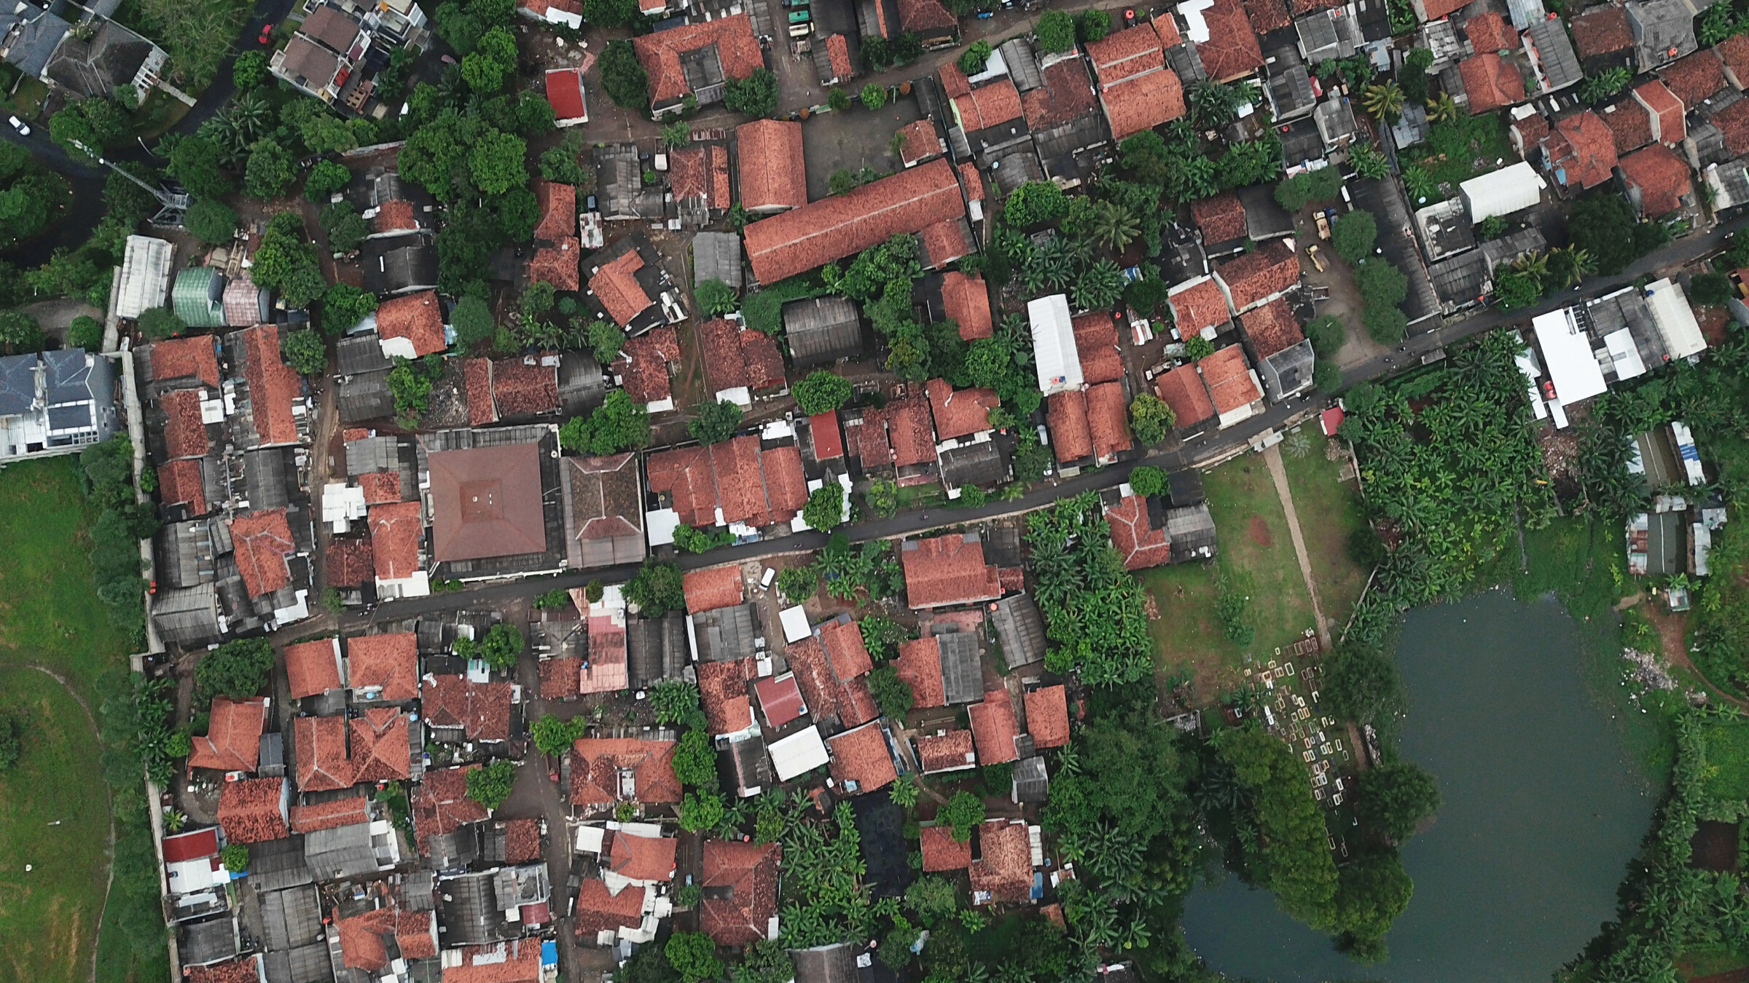
In this activity, you will ual relations across the globe.
COMMUNAL VS. PRIVATE
PROPERTY

Slide 9
Communal vs. Private Property
One of the problems encountered by 19th century Western ethnographers was recognizing and understanding communal forms of property.
This was a difficult concept to grasp for ethnographers for whom individual property rights were taken for granted. Understanding communal property required a leap of imagination.

Slide 10
Communal vs. Private Property
Many societies studied by anthropologists did not have the institution of private property.
Instead, property was often held in common and its use was dictated by rules, customs, and status associated with kin groups (such as clans, lineages) or residential communities.

Slide 11
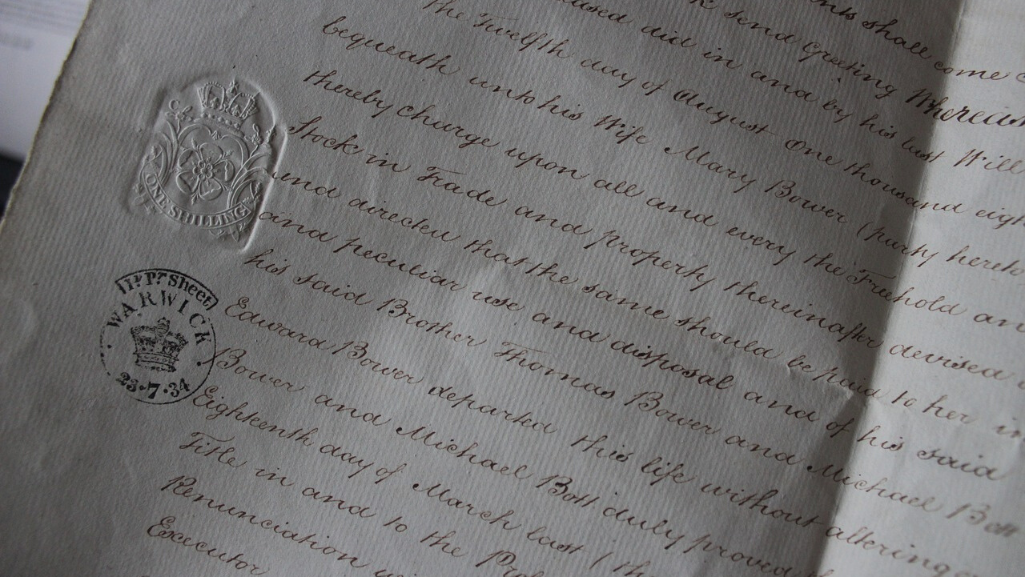
In this activity, you will ual relations across the globe.
PROPERTY RIGHTS

Slide 12
Property Rights
To understand communal property one has to understand important social groups larger than the family that may serve as “owners” of land and other assets.
There are many types of rights. These include the right of use, the right to alter or modify, the right to exclude others, and right to sell or transfer.

Slide 13
Property Rights
Even when property is communal, individuals and households are usually granted at some of those rights.
Different types of rights may exist in the same society for different types of things (e.g., land, livestock, bodies of water).

Slide 14
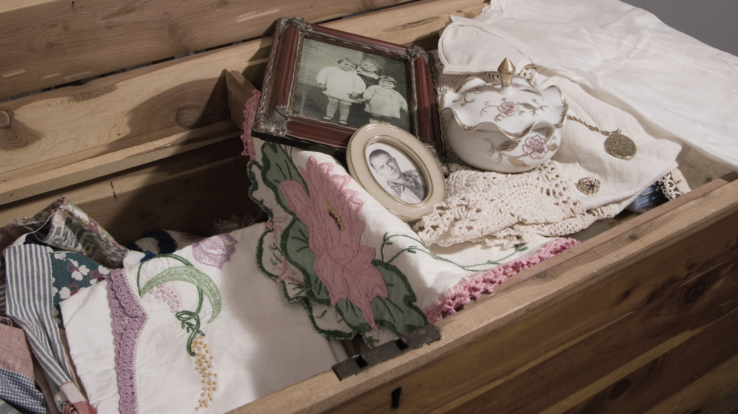
eHRAF Workbook
ACTIVITY
concepts of property
In this activity, you will ual relations across the globe.

Slide 15
ACTIVITY
Use the Advanced Search to find information and compare property concepts in the cultures below:
Tiv (FF57) of Africa
Ganda (FK07) of Africa
Ifugao (OA19) of Asia
Copper Inuit (ND08) of North America
Choose the cultures above in Add Cultures and in Add Subjects choose Property System (OCM 421).

Slide 16
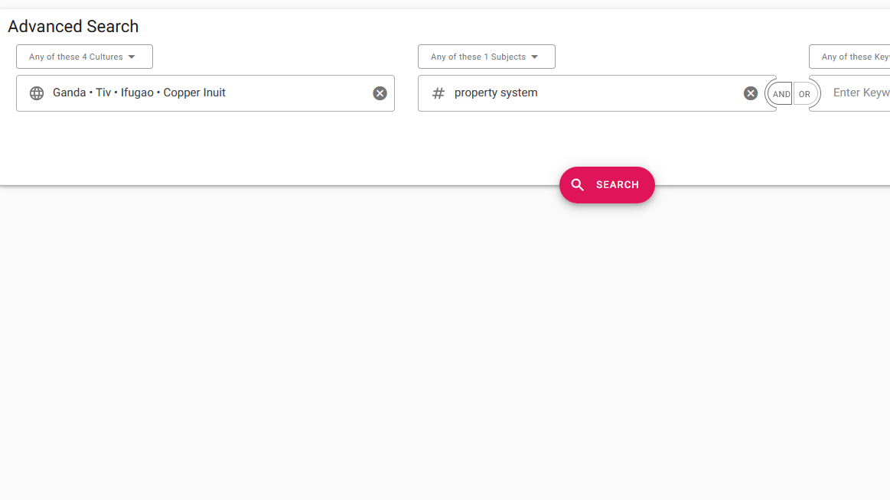
Add one or more cultures:
Tiv (FF57) of Africa
Ganda (FK07) of Africa
Ifugao (OA19) of Asia
Copper Inuit (ND08) of North America
Add subject:
Property Systems
(OCM 421)
Click "search"
ADVANCED SEARCH

Slide 17
eHRAF World Cultures
First, we will focus on the Tiv as an example of how we can determine the property concept of a culture to complete this activity. Then, you will complete these same steps for the remaining cultures, and fill in the table below.
To get familiar with the Tiv, first read its culture summary:
Bohannan, Paul. 1998. “Culture Summary: Tiv.” New Haven, Conn.: HRAF.
🌐
https://ehrafworldcultures.yale.edu/document?id=ff57-000

Slide 18
eHRAF World Cultures
Then read the following passage describing the Tiv and their relationship to the land.
Bohannan, Paul. 1957. "Tiv Farm and Settlement." In Colonial Research Studies. London: Her Majesty’s Stationery Office. Page 74 (b).
🌐
https://ehrafworldcultures.yale.edu/document?id=ff57-018

Slide 19
Tiv (FF57)
For the Tiv, the word "tar" means many things, including the land on which they live, the lineage to which they belong, and the ancestors from whom they are descended.
The use of one word to refer to these three different important cultural items suggests that they are inextricably linked in the Tiv imagination.

Slide 20
Tiv (FF57)
For the Tiv, ancestors are a key focal point of lineages. One’s access to jointly held property is through membership in a kin group such as a lineage. Some lineages act like corporations holding property in common.

Slide 21
Fill in the table below with information about the property concept in each culture and the source of information from eHRAF World Cultures.

Slide 22
QUESTIONS
1. How do the cultures compare with reference to concepts of land ownership?
2. Is there any concept of private property? What kinds of things are private?
3. How are the concepts of property in these cultures different from those in your own society?

Slide 23
Adapted from Teaching eHRAF Exercise "Exercise IV. Property" by Carol Ember:
https://hraf.yale.edu/teach-ehraf/exercises-using-ehraf-world-cultures/#exercise-iv-property, and "Communal Property" by Ian Skoggard:
https://hraf.yale.edu/teach-ehraf/understanding-ethnography-an-ehraf-workbook-for-introductory-anthropology-courses/#6-communal-property
References

Slide 24
Nationalmuseet - National Museum of Denmark from Denmark / CC BY-SA https://commons.wikimedia.org/wiki/File:T%C3%B8j_til_mand_fra_Kobber-inuit_i_arktisk_Canada_-_Man%E2%80%99s_clothing_from_Copper_Inuit_in_Arctic_Canada_(15144851729).jpg
Alawode Olusegun / CC BY-SA https://commons.wikimedia.org/wiki/File:Tiv_cultural_dancer.jpg
Image Credits
Afri Ug / CC BY-SA https://commons.wikimedia.org/wiki/File:We_Embrace_happiness.jpg
Yves PICQ / CC BY-SA https://commons.wikimedia.org/wiki/File:PHIL2764a.jpg
Alawode Olusegun / CC BY-SA https://commons.wikimedia.org/wiki/File:Female_Tiv_dancers_movements.jpg
Magicc0077 / CC BY-SA https://commons.wikimedia.org/wiki/File:A_costume_parade_on_Tiv_and_Yoruba_ethnic_group.jpg

Slide 25
Alawode Olusegun / CC BY-SA
https://commons.wikimedia.org/wiki/File:Tiv_Traditional_drummers.jpg
Wilses / CC BY-SA https://commons.wikimedia.org/wiki/File:Tiv_elders.jpg
Sbwebale / CC BY-SA https://commons.wikimedia.org/wiki/File:IMG-20181112-WA0007(1).jpg
Image Credits

Slide 26
Property
in eHRAF World Cultures
Produced by
Human Relations Area Files
at Yale University
An eHRAF Workbook Activity
hraf.yale.edu

