Slide 1
An eHRAF Workbook Activity
Race
&
Class
in eHRAF World Cultures
Human Relations Area Files
at Yale University

Slide 2
In this activity
Explore the concept of race in anthropology
Learn about the relationship between race and class
Read ethnographic accounts of race and class identity
Conduct research in eHRAF World Cultures
Topics We'll Cover

Slide 3
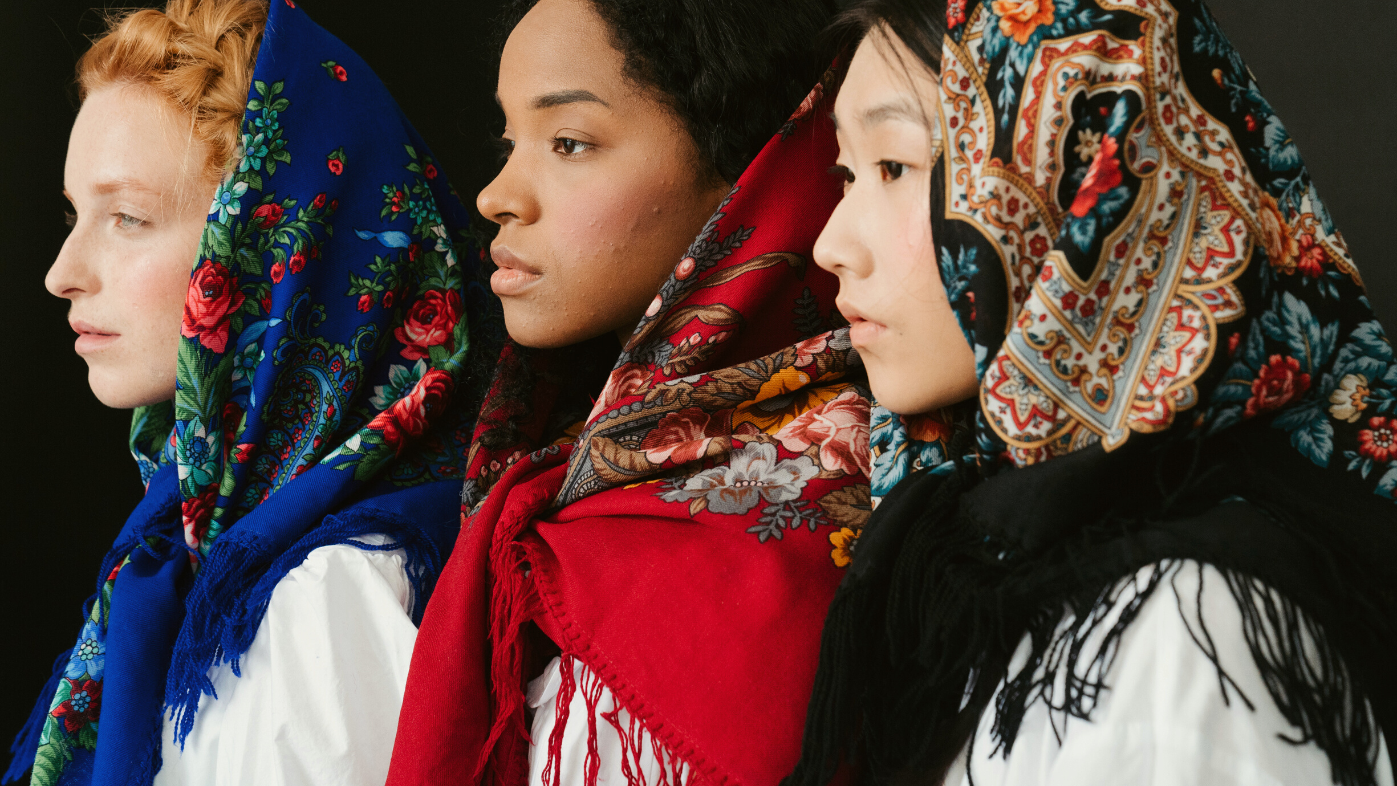
ANTHROPOLOGY & RACE

Slide 4
Does race exist?
Are there human races? The history of anthropology and the concept of race is complicated and contradictory. Indeed, early approaches to race in anthropology would serve as a foundation to a so-called science of race. Proposed evolutionary hierarchies of peoples based on physical traits aided in formulating the basis of racist ideologies of difference that persist to this day. Anthropologists have since fervently criticized the idea that bounded racial categories correspond to any human biological reality. In essence, they argue that distinct biological races do not exist among humans.
Did you know?

Slide 5
While anthropologists have discredited using racial labels to explain biological variation between human populations, race remains a very real social construct.
It can be used to justify racism, prejudice, and discrimination, which most certainly exist and fundamentally shape the world in which we live.
Even detached from an erroneous association with the scientific "facts" of the 19th century, racial stratification is perpetuated by cultural beliefs and practices. These vary from place to place, as do racial definitions that exist around the world today.

Slide 6
AAA Statement on Race
According to the American Anthropological Association's statement on race (May 17, 1998):
"Physical variations in the human species have no meaning except the social ones that humans put on them".
Race "as an ideology about human differences … became a strategy for dividing, ranking, and controlling … and to justify social, economic, and political inequalities".
Source: https://www.americananthro.org/ConnectWithAAA/Content.aspx?ItemNumber=2583

Slide 7
"How people have been accepted and treated within the context of a given society or culture has a direct impact on how they perform in that society. The "racial" worldview was invented to assign some groups to perpetual low status, while others were permitted access to privilege, power, and wealth."
The AAA concludes that "present-day inequalities between so-called 'racial' groups are not consequences of their biological inheritance but products of historical and contemporary social, economic, educational, and political circumstances."

Slide 8
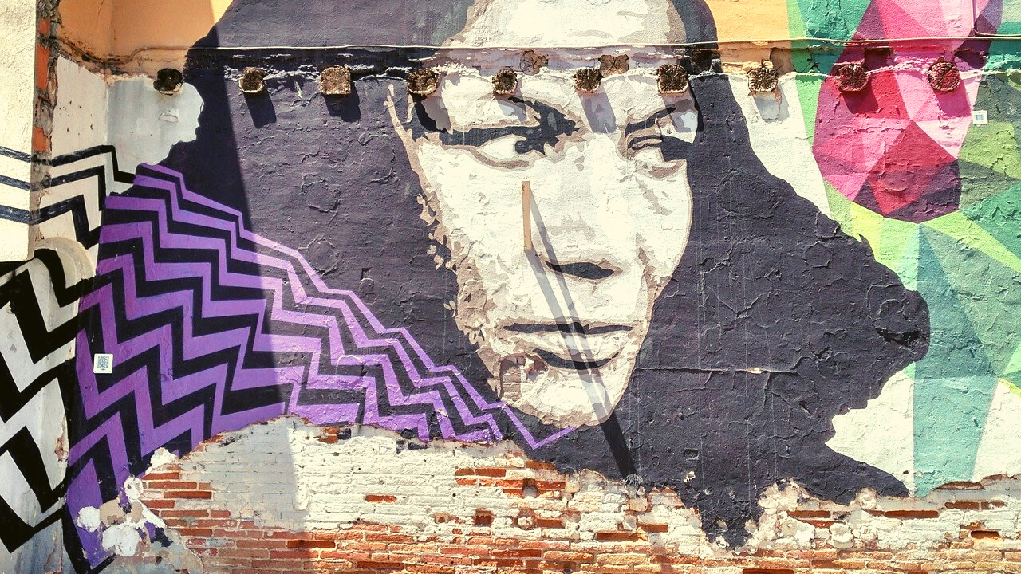
RACE, CLASS & INEQUALITY

Slide 9
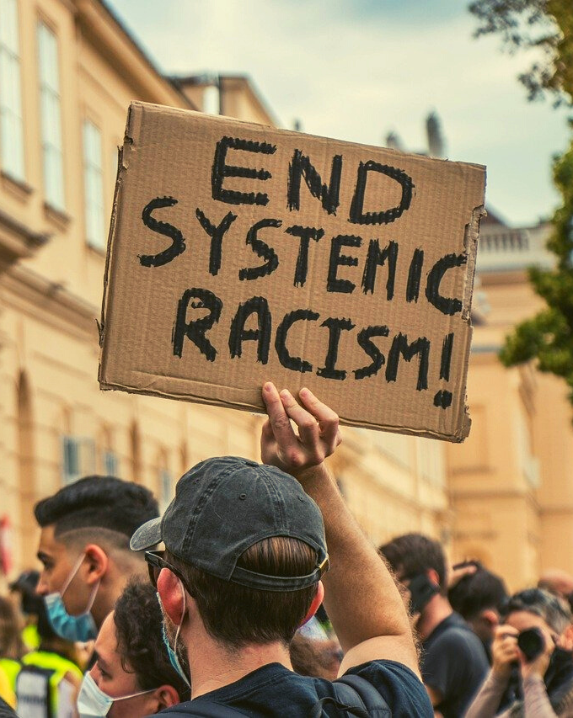
In societies such as the United States, racial inequities are systemic and pervasive. They impact all areas of life, as highlighted by ongoing protest movements.
For example, Black Lives Matter seeks to confront and acknowledge the social, economic and political impacts of white supremacy, and to end police brutality and racially motivated violence against Black people. That this movement has galvanized peoples around the world in the fight against systemic racism speaks to how ideas about race, class, and social inequality intersect well beyond the United States.

Slide 10
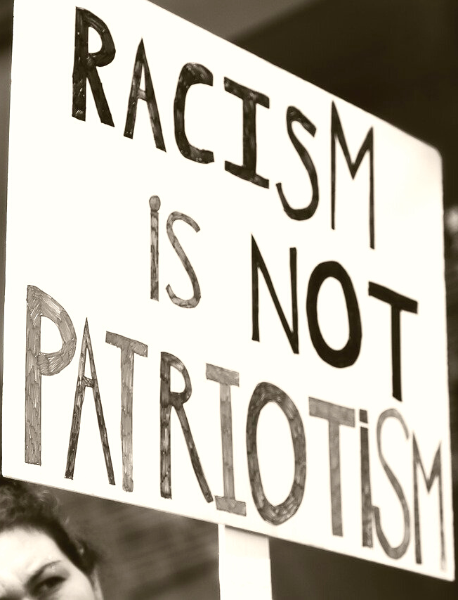
Just as racism has a contestable history in the United States - a self-ascribed "melting pot" of cultures and ethnicities – so do ideas about race and the socio-economic impacts of racial categories reappear in different ways in other societies, even when multiculturalism and a tolerance of ethnic differences is purported as an ideal.
Learn more about how race and class are cultural constructs in the following case study among Bahia Brazilians from eHRAF World Cultures.

Slide 11
eHRAF Workbook
ACTIVITY 1

Slide 12
Case Study:
Visit the culture summary for Bahia Brazilians in eHRAF World Cultures to learn more about this
society.
Bahia Brazilians (SO11)
🌐
https://ehrafworldcultures.yale.edu/document?id=so11-000

Slide 13
Culture Summaries
A brief overview for societies in eHRAF World Cultures is provided in the form of Culture Summaries.
The format, general outline, and headings are the same for each summary. You will find a basic overview about the culture, such as its economy, history, environment, and sociopolitical organization.
eHRAF
World
Cultures
To find a culture summary, go to the Browse Cultures tab. Enter the culture name into the box, then click to expand the result. Click on Full Profile to reach the Culture Profile, then access the Culture Summary via the Summary tab.

Slide 14
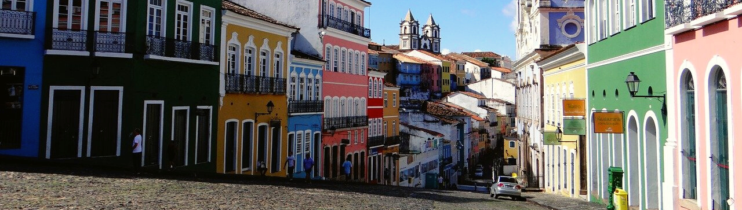
CASE STUDY
Pierson & Lantz's 1967 study of race in Bahia, Brazil contrasts the concepts of racial and class identification in the United States with that of Bahia. You can read the full abstract (extracted below) in eHRAF World Cultures.
eHRAF World Cultures
🌐
https://ehrafworldcultures.yale.edu/document?id=so11-004

Slide 15
CASE STUDY
ABSTRACT
Although the racial situation in Brazil and the United States is compared and contrasted throughout the book, the situation in Brazil is more complex, as noted for example in the use of such terms as 'preto' and 'branco' which cannot be equated to 'Negro' and 'White' as they are used in the United States since they are considered to be categories of social position as well as related to physical appearance (rather than race), and which terms vary not only with individuals but also with the same individual at different times. Social status in Brazil, therefore, is determined by an individual's competence rather than ethnic origin, and a Brazilian's loyalty is not to his race but to his country. This situation contrasts strongly to that in the United States where color and race are the determining factors of one's loyalties, and where persons of one race are expected to feel a mutual bond to one another. Where prejudice exists in Brazil it is class oriented, rather than based on race or color.

Slide 16
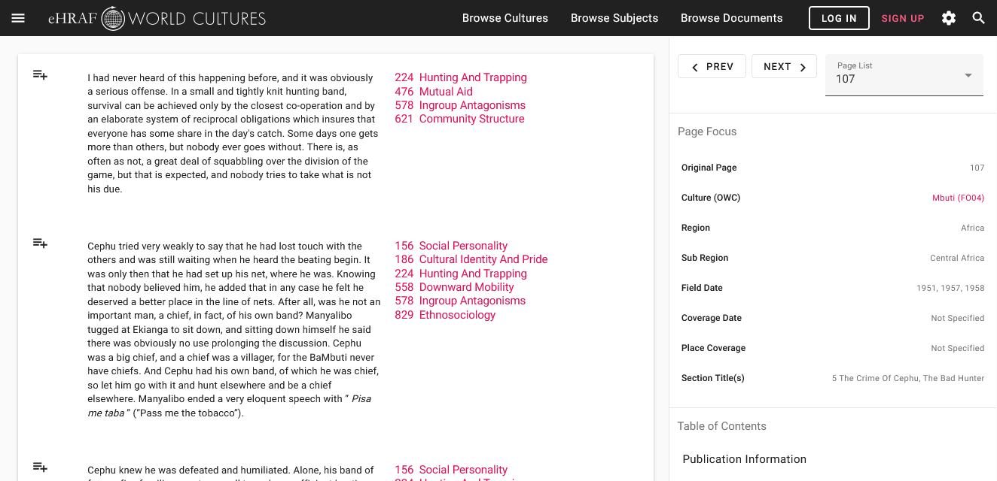
To read documents or pages in eHRAF:
INSTRUCTIONS
First, follow the permalinks provided in the activities below to get to the relevant documents.
For example:
🌐
https://ehrafworldcultures.yale.edu/document?id=so11-004
Then, use the Page List dropdown menu to navigate to the required page(s).

Slide 17
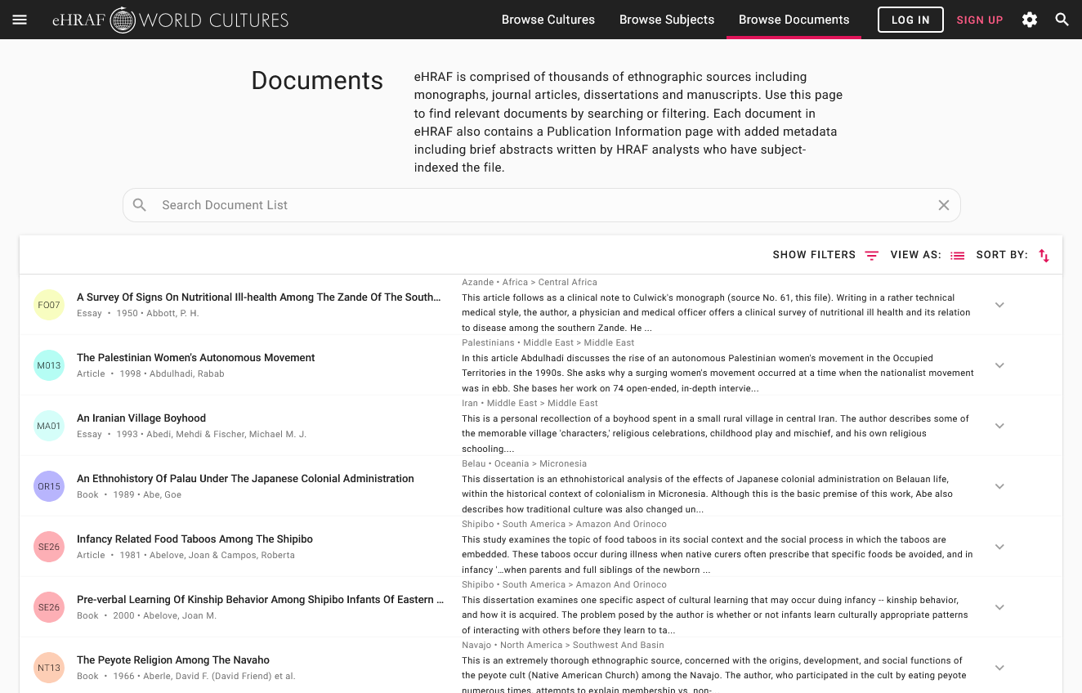
Finding documents without permalinks
INSTRUCTIONS
Follow these steps if you are having trouble with permalinks from off campus while using a proxy or VPN service, or if you have been provided with a HRAF-issued username and password.
Sign in via your library proxy or VPN, or using the HRAF-issued credentials.
Go to the Browse Documents tab.
Enter the author's name or document title into Search Document List box.
Click on the required title to access the document, then select the page number from the Page List dropdown menu as shown above.

Slide 18
QUESTIONS
Once you have read the culture summary and the document abstract, read pages 218-227 in Pierson & Lantz's (1967).
Then, answer the following questions.
How are race and class interconnected in Bahia society?
Can an individual traverse racial and/or class categories in this society? How?
In your opinion, is the "cultural situation" described in Brazil a racial one, or is it a class one that simply coincides with racial categories as suggested by the author (p. 224-5)?

Slide 19
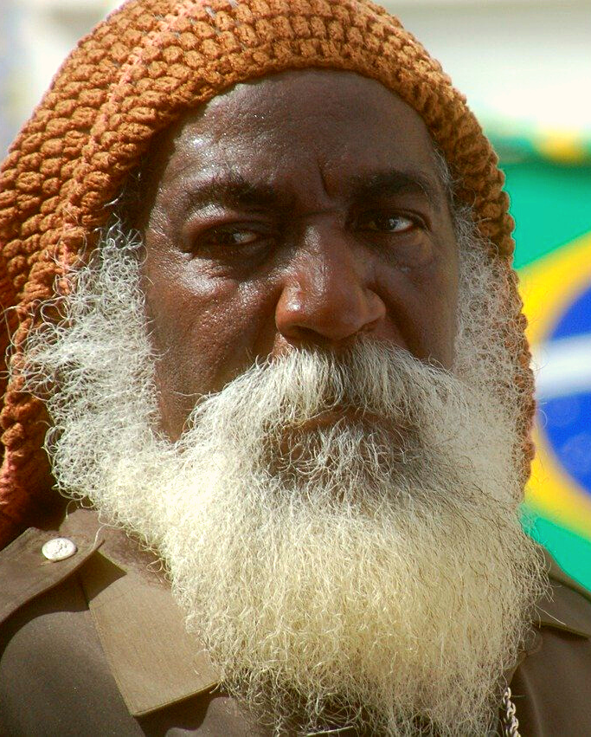
QUESTIONS
Describe the attitude of black and white Bahians towards each other (p. 225-6). Do you think these attitudes are based on class or race?
What does this quotation from Joāo Varella indicate to you about race, class, and identity in Bahia (p. 227)?
Of his white father, whom he never saw,
He has a picture in the parlor;
But of the Negro woman who gave him birth
He has no picture, nor does he even speak of her.
How does the perception of race, class, and social mobility in Bahian society differ with that of your own society?

Slide 20
eHRAF Workbook
ACTIVITY 2

Slide 21
Essay Assignment
Now that you have considered similarities and differences between race and class in Bahia Brazil and the United States, compare race and class in Bahia Brazil with one or more additional societies in eHRAF World Cultures.
You may also consider how other social categories intersect with race and class, such as age, gender, occupation, or belief systems.
Write an essay of around 1000-1500 words detailing which aspects of race and identity appear similar or different between the societies and how. Remember to cite your sources from eHRAF and provide quotations from the ethnographic data to support your findings.

Slide 22
Advanced Search
Use Advanced Search in eHRAF to locate your ethnographic examples.
Some OCM subject categories you may wish to use in your search include:
For ideas about race, use Ethnosociology (829)
For racism (discrimination and assimilation, use Ethnic stratification (563)
For race prejudice or ethnocentrism, use Cultural identity and pride (186)
A sample search appears on the next page.

Slide 23
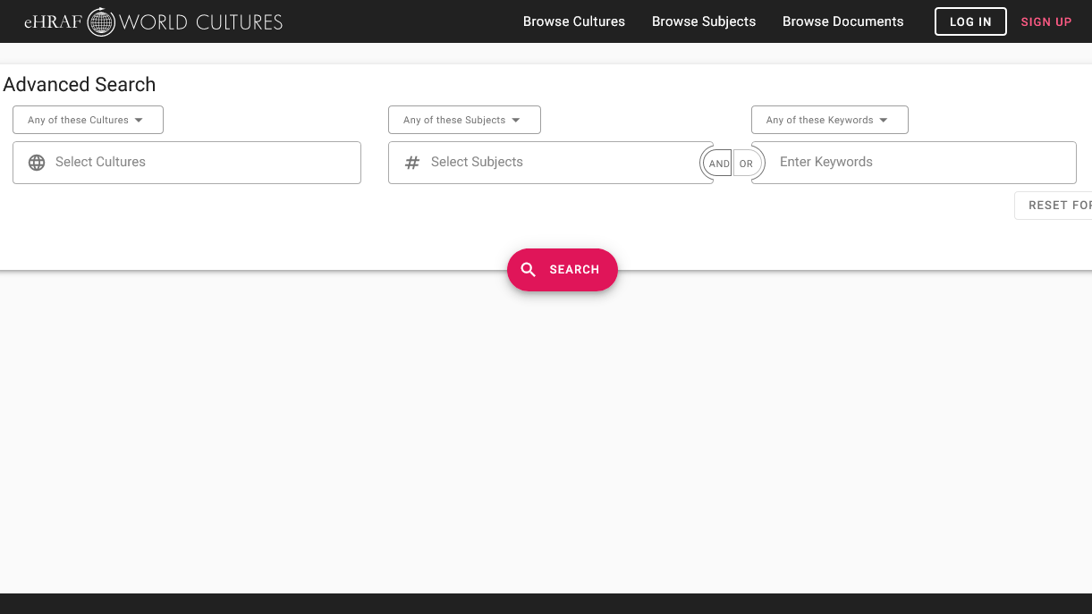
SAMPLE ADVANCED SEARCH
Add 1 or more subjects:
Cultural identity and pride (186)
Ethnic stratification (563) Ethnosociology (829)
Add optional keywords such as race, gender, identity, class, or ethnicity

Slide 24
1. Beierle, John. 1999. "Culture Summary: Bahia Brazilians." New Haven, Conn.: HRAF. https://ehrafworldcultures.yale.edu/document?id=so11-000.
2. Pierson, Donald, and Herman R. Lantz. 1967. Negroes in Brazil: A study of race contact at Bahia. Perspectives In Sociology. Carbondale: Southern Illinois University Press. https://ehrafworldcultures.yale.edu/document?id=so11-004.
References

Slide 25
Race
&
Class
in eHRAF World Cultures
Produced by
Human Relations Area Files
at Yale University
An eHRAF Workbook Activity
hraf.yale.edu

