Slide 1
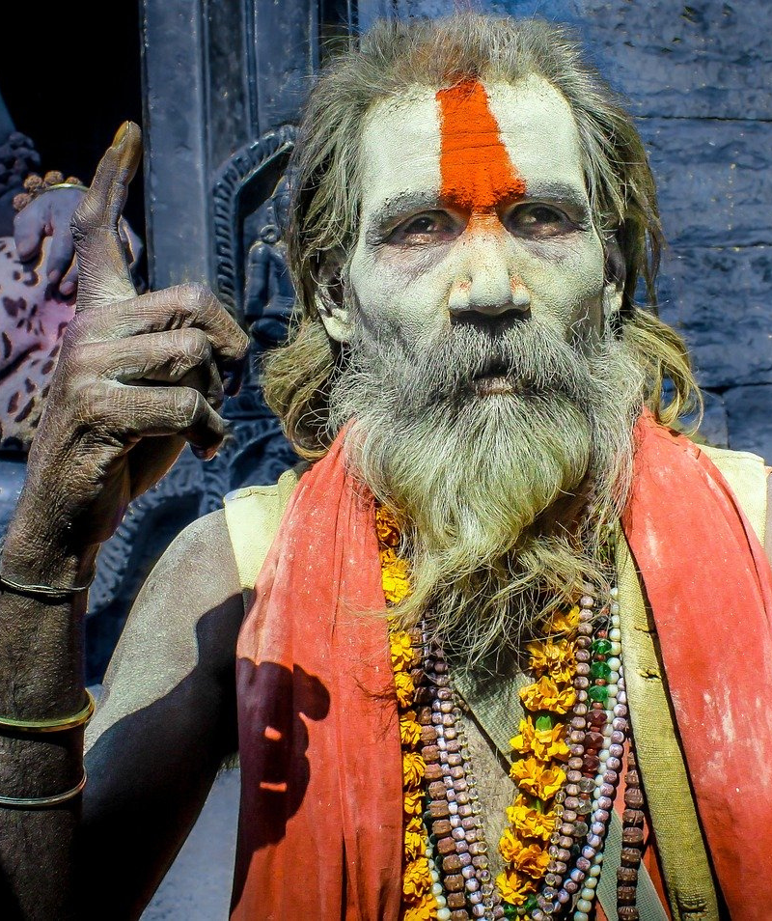
An eHRAF Workbook Activity
Religion:
The Afterlife
in eHRAF World Cultures
Human Relations Area Files
at Yale University

Slide 2
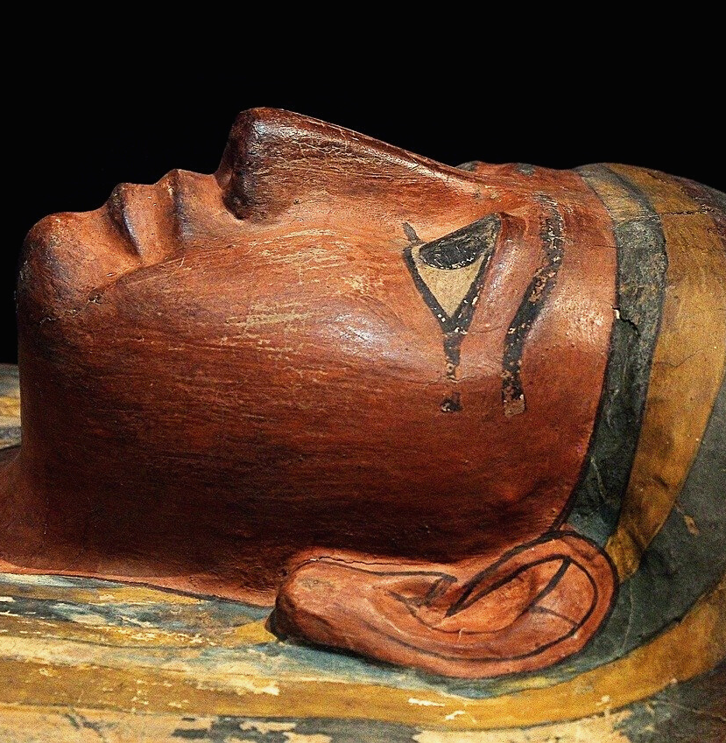
In this activity
Learn about how religious beliefs vary across cultures
Compare and contrast notions of the afterlife
Read and interpret ethnographic data in eHRAF World Cultures
Topics We'll Cover

Slide 3
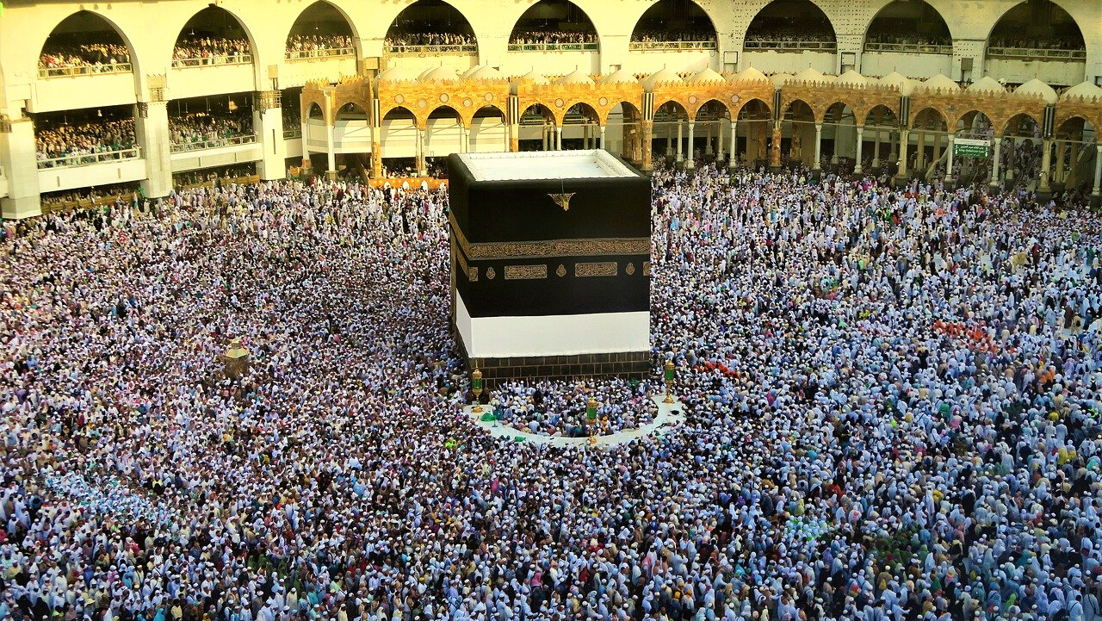
RELIGION

Slide 4
This workbook is based on the Explaining Human Culture (EHC) summary on Religion
by
Stephen D. Glazier and Carol R. Ember
https://hraf.yale.edu/ehc/summaries/religion
You may wish to read the EHC summary to learn more about religion, gods and spirits, ancestor worship, the afterlife, and ritual, before beginning the exercises in this workbook.

Slide 5
Religion may be defined as any set of attitudes, beliefs, and practices pertaining to supernatural power, whether that power be forces, gods, spirits, ghosts, or demons.
Religious beliefs and practices vary widely from society to society and change over time. Different societies not only have varying types of gods, spirits, and supernatural forces, they have different types and numbers of religious practitioners, different types of ritual, and different ways of interacting with supernatural forces.
Did you know?

Slide 6
Regardless of the many societal differences in how religion is structured and practiced, religion has been identified in all studied cultures. Why religion is universal has been the subject of considerable scholarly discussion.
Religion serves many functions and has consequences for both individuals and societies. Religions offer explanations. Religion can be both comforting and terrifying. Most researchers subscribe to Émile Durkheim's notion that religion acts as a "glue" (some think the most important "glue") that holds society together.

Slide 7
eHRAF Workbook
ACTIVITY
The Afterlife

Slide 8
The notion of afterlife is based on the idea that some aspect of an individual's personal identity or consciousness continues to exist after the death of the body. The specific aspect of an individual that lives on after death varies from culture to culture.
Survival may be partial or complete and individuals may or may not maintain personal identity. Belief in an afterlife–whether natural or supernatural–contrasts with a belief in oblivion or "nothing" after death.
The Afterlife

Slide 9
The Afterlife
Belief in an afterlife prevails around the globe; one study found that such beliefs are present in 79% of world societies. As seen in the ethnographic record, ideas surrounding the afterlife are diverse.
Read the following excerpts to learn about seven societies’ beliefs surrounding the afterlife.

Slide 10
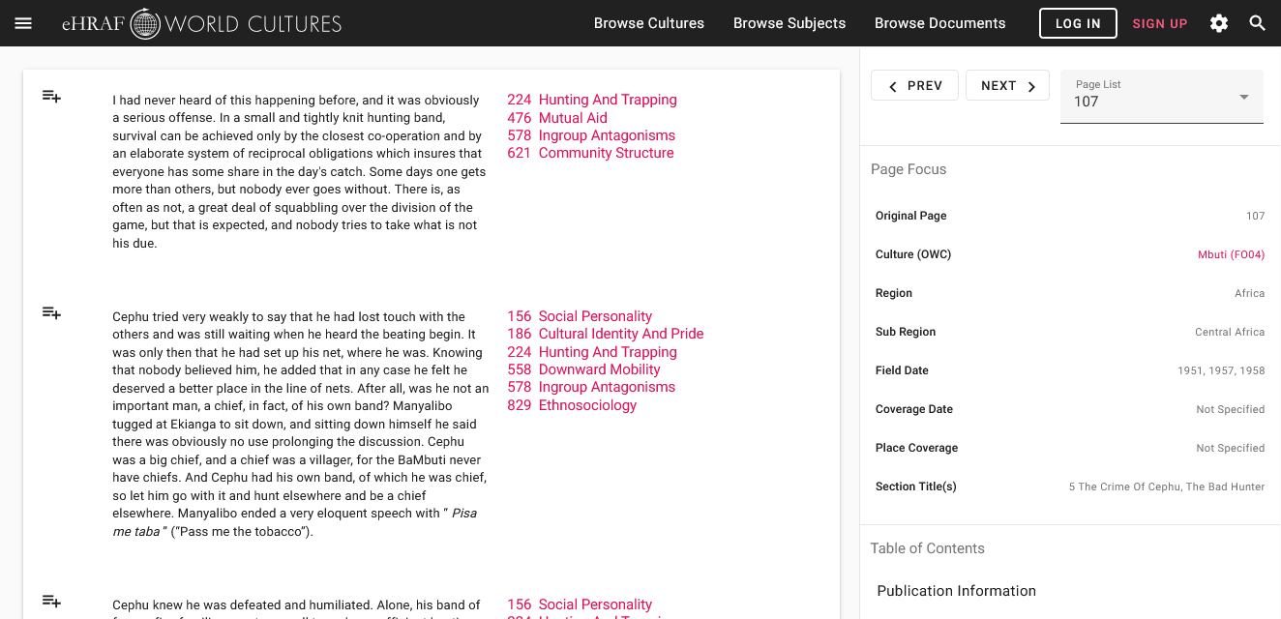
To read documents or pages in eHRAF:
INSTRUCTIONS
First, follow the permalinks provided in the activities below to get to the relevant documents.
For example:
🌐
https://ehrafworldcultures.yale.edu/document?id=fo04-003
Then, use the Page List dropdown menu to navigate to the required page(s).

Slide 11
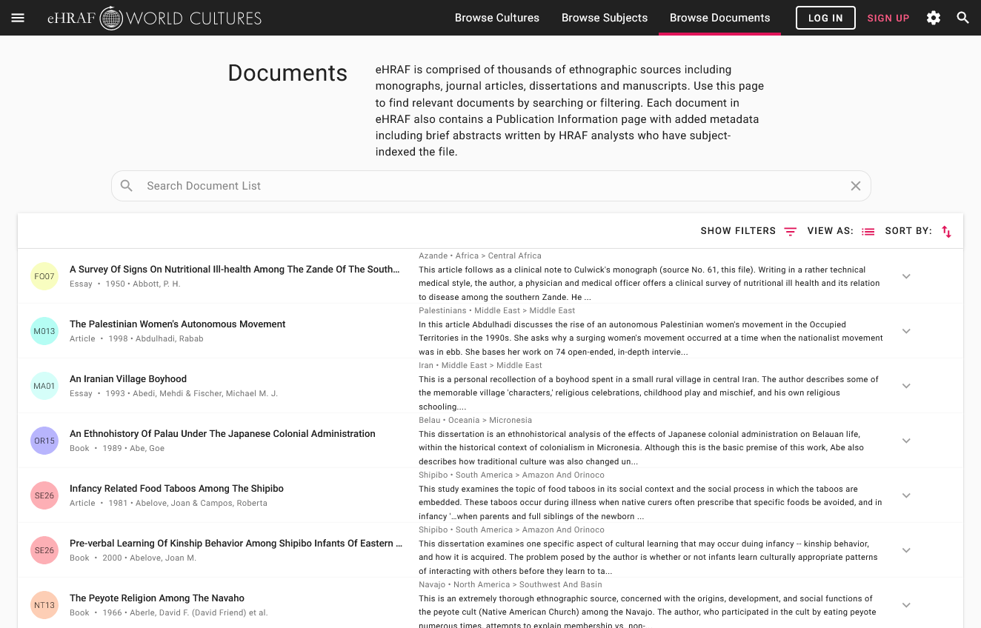
Finding documents without permalinks
INSTRUCTIONS
Follow these steps if you are having trouble with permalinks from off campus while using a proxy or VPN service, or if you have been provided with a HRAF-issued username and password.
Sign in via your library proxy or VPN, or using the HRAF-issued credentials.
Go to the Browse Documents tab.
Enter the author's name or document title into Search Document List box.
Click on the required title to access the document, then select the page number from the Page List dropdown menu as shown above.

Slide 12
THE AFTERLIFE
Read the following passages:
Amhara (MP05)
D. N. Levine: Wax & gold: Tradition and innovation in Ethiopian culture - pages 65 and 67
🌐 https://ehrafworldcultures.yale.edu/document?id=mp05-011
Tiv (FF57)
Rupert Downes: Tiv Religion - page 42
🌐 https://ehrafworldcultures.yale.edu/document?id=ff57-035
San (FX10)
Lorna Marshall: "The !Kung Bushmen of the Kalahari Desert" - page 269
🌐 https://ehrafworldcultures.yale.edu/document?id=fx10-015

Slide 13
THE AFTERLIFE
Read the following passages:
Ojibwa (NG06)
Christopher Vecsey: "Traditional Ojibwa Religion and Its Historical Changes" – pages 63-65
🌐 https://ehrafworldcultures.yale.edu/document?id=ng06-041
Santal (AW42)
Marine Carrin-Bouez: "Culture Summary: Santal" – page 10
🌐 https://ehrafworldcultures.yale.edu/document?id=aw42-000
Kogi (SC07)
Gerardo Reichel-Dolmatoff: "The Loom of Life: A Kogi Principle of Integration" – pages 20-21
🌐 https://ehrafworldcultures.yale.edu/document?id=sc07-012

Slide 14
COMPARE & CONTRAST
Part 1
For each society, determine if belief in an afterlife is present. Then, compare and contrast the societies' description of the afterlife. Answer the following questions:
Is the afterlife described as a specific place?
Is there punishment or reward after death?
Do actions in this life affect your experience in the next life?
Does a supernatural being determine where one goes after death?
Any other differences?

Slide 15
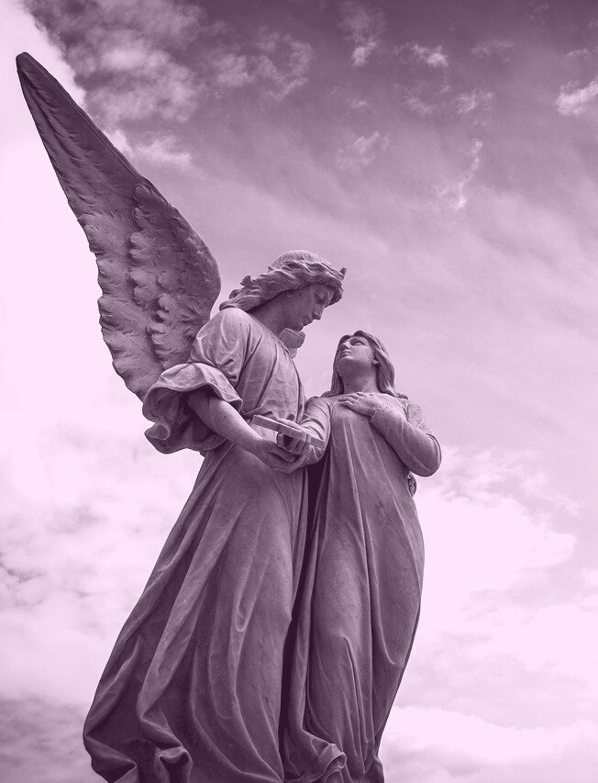
Part 2
CROSS-CULTURAL FINDINGS
Do these descriptions fit the cross-cultural finding that societies supporting fewer people per unit of land (e.g., hunter-gatherers) are likely to lack the idea that where you go in the afterlife reflects a reward or punishment for behavior, whereas societies that support more people (with more agriculture, particularly intensive agriculture) are likely to have such beliefs?
Intensive Agriculturalists: Amhara, Santal
Horticulturalists: Tiv, Kogi
Hunter-Gatherers: San, Ojibwa

Slide 16
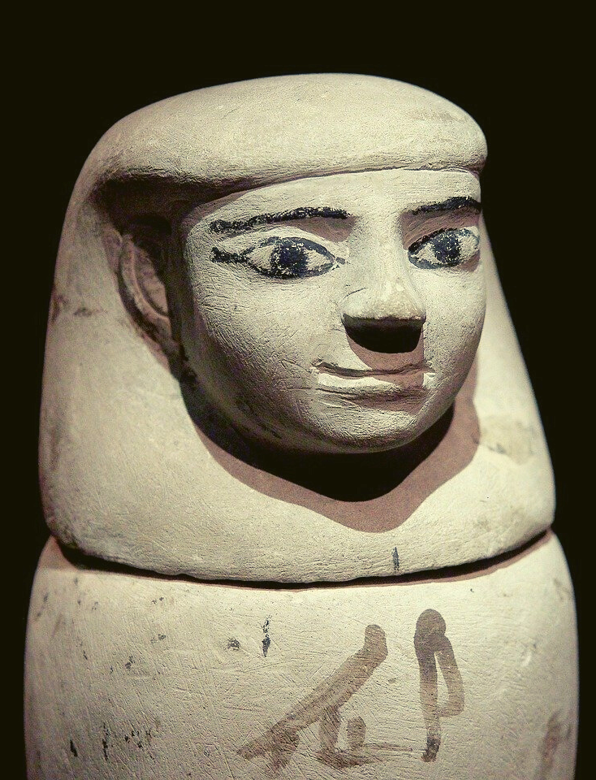
REFLECTIONS
Part 3
How are these examples different from ideas about the afterlife in the religions of industrial societies like the United States?
Part 4
Reflect on how your own ideas about gods and the afterlife are different from the experiences of people in other societies.

Slide 17
Carrin-Bouez, Marine. 1998. “Culture Summary: Santal.” New Haven, Conn.: HRAF. https://ehrafworldcultures.yale.edu/document?id=aw42-000.
Downes, Rupert Major. 1971. Tiv Religion. [Ibadan, Nigeria]: Ibadan University Press. https://ehrafworldcultures.yale.edu/document?id=ff57-035.
Glazier, Stephen D. and Carol R. Ember. 2018. “Religion” in C. R. Ember, editor and compiler. Explaining Human Culture. New Haven, CT: Human Relations Area Files https://hraf.yale.edu/ehc/summaries/religion
References
Levine, Donald Nathan. 1965. Wax & Gold: Tradition and Innovation in Ethiopian Culture. Chicago: University of Chicago Press. https://ehrafworldcultures.yale.edu/document?id=mp05-011.
Marshall, Lorna. 1965. “The !Kung Bushmen of the Kalahari Desert.” In Peoples of Africa, 243–78. New York: Holt, Rinehart and Winston. https://ehrafworldcultures.yale.edu/document?id=fx10-015.

Slide 18
Reichel-Dolmatoff, Gerardo. 1978. “The Loom of Life: A Kogi Principle of Integration.” Journal of Latin American Lore Vol. 4 (no. 1): 5–27. https://ehrafworldcultures.yale.edu/document?id=sc07-012.
Vecsey, Christopher. 1983. “Traditional Ojibwa Religion and Its Historical Changes.” In Memoirs, vol. 152:x, 233. Philadelphia: American Philosophical Society. https://ehrafworldcultures.yale.edu/document?id=ng06-041.
References

Slide 19
Religion:
The Afterlife
in eHRAF World Cultures
Produced by
Human Relations Area Files
at Yale University
An eHRAF Workbook Activity
hraf.yale.edu

