Slide 1
An eHRAF Workbook Activity
Residence, Descent
& Status
in eHRAF World Cultures
Human Relations Area Files
at Yale University

Slide 2
In this activity
Learn about descent and residence patterns
Compare the relative status of women across cultures
Search and browse in eHRAF World Cultures
Interpret and analyze your results
Topics We'll Cover

Slide 3
RESIDENCE, DESCENT
& STATUS

Slide 4
Types of Residence
In the modern world, it is increasingly common to live apart from kin upon reaching adulthood and/or getting married.
This pattern of residence called neolocal residence (literally “new” place).

Slide 5
In the span of human history, this is a relatively recent phenomenon associated with the trend toward increased commercialization and markets. However, this pattern of residence was not common in the past and is still uncommon in many cultures. Most of the time a couple (or single adult) will live with (or near) a set of kin.

Slide 6
WORKBOOK ACTIVITY
residence, descent & status

Slide 7
Residence Patterns
Patrilocal Residence
The most common pattern worldwide. A pattern of marital residence in which couples typically live with or near the husband’s parents.
Matrilocal Residence
The next most common pattern worldwide. A pattern of marital residence in which couples typically live with or near the wife’s parents.

Slide 8
Residence Patterns
Neolocal Residence
A pattern of residence in which the couple resides separately, usually at some distance, from both the husband's natal household and the wife's natal household.
Bilocal Residence
This is an uncommon pattern worldwide where a couple live with or near either set of parents. This is also known as ambilocal residence.
Avunculocal Residence
This is another relatively uncommon pattern where a couple lives with or near the husband’s mother’s brother.

Slide 9
Descent Patterns
Matrilineal Descent
The rule of descent that affiliates individuals with kin of both sexes related to them through women; at birth an individual affiliates with their mother’s kin group.
Patrilineal Descent
The rule of descent that affiliates individuals with kin of both sexes related to them through men; at birth an individual affiliates with their father’s kin group.

Slide 10
Community Structure
As you might imagine, where you live for the rest of your life and who lives near you has profound consequences, especially if you live in the same household as your parents or your spouse’s parents.
But even just living next door to one set of kin is consequential as it will affect the structure of your community.

Slide 11
Patrilocal vs. Matrilocal
If patrilocal residence is practiced consistently over time and wives come from other communities, women will be the “outsiders” marrying into a community formed largely of related males.
One might expect that conversely men will be the “outsiders” when matrilocal residence is practiced.

Slide 12
Patrilocal vs. Matrilocal
However, this is not the case: matrilocal cultures are not mirror images of patrilocal ones.
Men in matrilocal cultures tend to have authority roles in their matrilineal kin groups and often do not move that far away from their natal household or village.

Slide 13
Activity Overview
STEP 1
Read the Relative Status of Women and Men section of the EHC Gender module:
https://hraf.yale.edu/ehc/summaries/gender#relative-status-of-women-and-men
🌐
STEP 2
a) Find and read culture summaries for: Vietnamese (AM11) and Hopi (NT09)
b) Find and read subject descriptions for: Gender status (562), Residence (591), and Rule of descent (611)
c) Follow a sample advanced search using these cultures and subjects, and learn how to analyze the results.

Slide 14
Activity Overview
STEP 3
Conduct an Advanced Search for two additional patrilocal / patrilineal cultures and fill in the table with a status rating for women (low, moderate, high) in those cultures.
STEP 4
Conduct an Advanced Search for two additional matrilocal / matrilineal cultures and fill in the table with a status rating for women (low, moderate, high) in those cultures.
STEP 5
Write a short essay (500-1000 words) in which you describe your findings.

Slide 15
STEP 1
Read the Relative Status of Women and Men section of the EHC Gender module.
https://hraf.yale.edu/ehc/summaries/gender
#relative-status-of-women-and-men

Slide 16
Culture Summaries
A brief overview for societies in eHRAF World Cultures is provided in the form of Culture Summaries.
The format, general outline, and headings are the same for each summary. You will find a basic overview about the culture, such as its economy, history, environment, and sociopolitical organization.
eHRAF
World
Cultures
To find a culture summary, go to the Browse Cultures tab and enter the culture name into the box, then click on Culture Summary below the culture name to read it.

Slide 17
STEP 2a
Read the culture summaries for: Vietnamese (AM11) and Hopi (NT09)

Slide 18
STEP 2b
Browse Subjects
Read more about the subjects in this activity. You can browse the list of the subjects covered in eHRAF by clicking on the Browse SUBJECTS tab. Type the word into the A-Z filter box, or browse by OCM identifier to find the subject description.

Slide 19
STEP 2b
Read the subject descriptions for Gender status (562)

Slide 20
STEP 2b
Read the subject descriptions for Residence (591)

Slide 21
STEP 2b
Read the subject descriptions for
Rule of descent (611)

Slide 22
ADVANCED SEARCH
step-by-step

Slide 23
STEP 2c
Follow the steps indicated below to conduct an Advanced Search in eHRAF World Cultures. Then, read and analyze the results.
Paragraph excerpts have been provided to indicate what kind of information to look for in order to determine residence and descent patterns and the status of women.
A sample table shows ratings for female status for the Vietnamese and Hopi. In Step 3, you will repeat these steps for other cultures in your own search.

Slide 24
Advanced Search
1. enter one or more culture names
2. add subjects, e.g: Gender status(562)
3. Click "search"

Slide 25
STEP 2c
Review the sample table for Vietnamese and Hopi. Information in the table about residence pattern, descent pattern, and female status is filled in to provide you with examples.

Slide 26
STEP 2c
This screenshot shows how the paragraph from Kleinen (1999: 178) on the Vietnamese (AM11) appears in eHRAF World Cultures. Read the text to find out more about female status in the society.

Slide 27
SAMPLE ANALYSIS
This example illustrates how to analyze the above paragraph to find support for a rating for female status in the society. A description of the residence pattern is also indicated.
Residence Pattern: Patrilocal
Female Status: Moderate/Low
From the moment that the marriage is solemnized the wife will live in the house of her parents-in-law when her husband is the oldest son. In other cases, a house within the compound or the housing area of the village will serve as the future home of the couple. As we have stated earlier, the time that the wife has to obey her husband in every respect seems to be over now. In the past a special ceremony, called hop can or giao duyen, prescribed that the newly-wed bride bowed for her husband after which two cups of rice alcohol were emptied by the couple. This custom is modified by a mutual toast after which the cups are emptied by linking arms. But the old adage is still heard: “in the family, the daughter has to obey her father; married, the wife has to obey her husband; and being a widow she has to obey her first son” (Kleinen 1999: 178).

Slide 28
STEP 2c
Continue to review the remaining 3 sources in eHRAF as displayed in the table above. For each source, analyze the paragraph for relevant information on descent, residence, and female status.

Slide 29
SAMPLE ANALYSIS
The analysis of the sources provided in the table above has been done for you. Relevant sections have been highlighted. In Parts 3 and 4 of the activity, you will determine the status of women on your own and fill in the status column of the table provided.
Descent Pattern: Patrilineal
THE VIETNAMESE have a patrilineal kinship system. The toc or patrilineage found in northern and central Vietnam is reckoned through the male line to a male ancestor in the fifth ascending generation (some families trace ancestry farther). In Khanh Hau, however, with the exception of several families, the common ancestor is in the third ascending generation. Reference terminology clearly distinguishes patrilineal from nonpatrilineal kin, and males in Ego's and ascending generations in the patrilineage are age graded, a feature related to the traditional means of selecting the truong toc or head of the patrilineage according to age priority (Hickey 1964: 82).

Slide 30
STEP 2c
Continue to read and analyze the paragraphs.

Slide 31
SAMPLE ANALYSIS
Residence Pattern: Matrilocal
Female Status: Moderate/High
The household, the central institution with which we are most concerned, is composed of the matrilocal stem or extended family; that is, upon marriage the boys leave the household for that of their wives, and bridegrooms move in. Although men are responsible for building houses and provisioning them with food and other goods, the house and all its contents, including food, belong to the female head. At all times in his life, a male lives in a house under the authority of a female — his mother as a boy, his wife or sister as an adult, and his daughter as an old man ... the final authority of the female head is never questioned (Schlegel 1979: 126).

Slide 32
STEP 2c

Slide 33
SAMPLE ANALYSIS
Descent Pattern: Matrilineal
Not for some years, regardless of a baby's sex, is the predominance of women in ordering its adjustment to life relaxed. As a consequence of the Hopi custom of having daughters remain for life in their mother's household, and through the agencies of matrilineal descent and strict matrilocal residence, a newly-born child automatically becomes a member of a household group among whom it comes to distinguish its maternal grandparents, its parents, its mother's sisters with their husbands and children, its mother's unmarried brothers, its married sisters with their husbands and children, and its unmarried brothers and sisters. It is in the company of these relatives that the growing child eats, sleeps and plays, and it is among them that it first becomes cognizant of those ties of kinship which in later life are to be extended to other relatives (Titiev 1944: 7).

Slide 34
PART 3

Slide 35
Female Status in Patrilineal/Patrilocal societies
Now that you have seen how to conduct a search, analyze paragraph results, and fill in the table, you will conduct your own research.
Using the Advanced Search criteria below, select two additional patrilocal and patrilineal cultures. Read the results, then fill in the table with a status rating for women (low, moderate, or high) in those cultures.

Slide 36
Advanced Search
1. enter one or more culture names
2. add subjects, e.g: Gender status(562)
3. Click "search"

Slide 37
Patrilocal/Patrilineal
Using the ethnographic sources from eHRAF provided in the column on the right, determine a rating for female status for each society in the table.

Slide 38
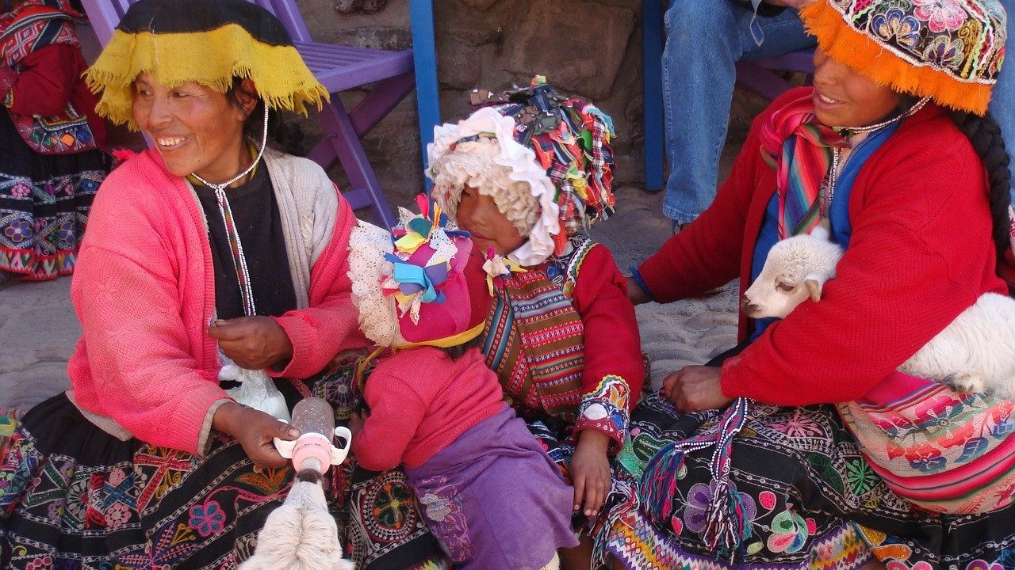
PART 4

Slide 39
Female Status in Matrilineal/Matrilocal societies
Compare these results with matrilineal and matrilocal societies.
Using the Advanced Search criteria below, select two additional matrilocal and matrilineal cultures.
Read the results, then fill in the table with a status rating for women (low, moderate, or high) in those cultures.

Slide 40
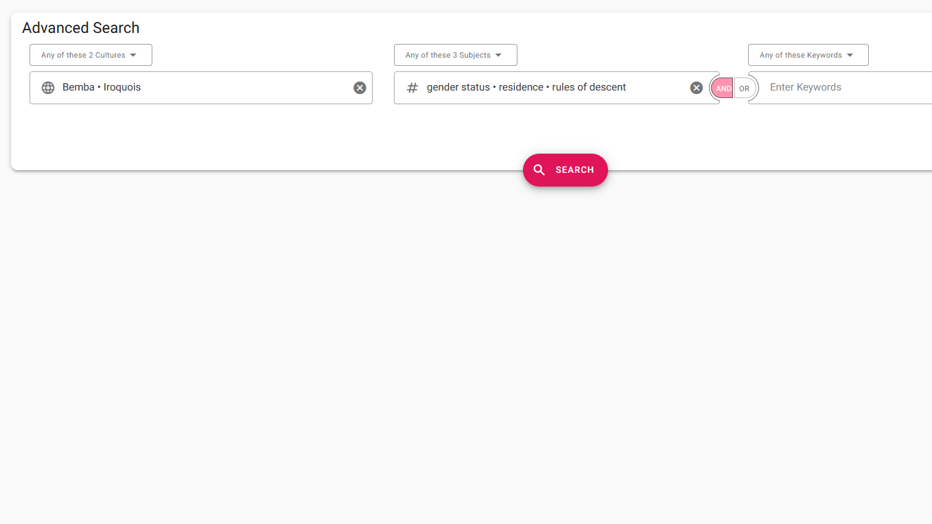
Advanced Search
1. enter one or more culture names
2. add subjects, e.g: Gender status(562)
3. Click "search"

Slide 41
Matrilocal/Matrilineal
Using the ethnographic sources from eHRAF provided in the column on the right, determine a rating for female status for each society in the table.

Slide 42
PART 5
essay assignment

Slide 43
Short Essay Guidelines
Write a short essay (500-1000 words) in which you describe your findings from Parts 3 and 4.
Give your reasons for your rating of the status of women for each society as you recorded them in the tables provided.
Include appropriate quotes and references to the ethnographic sources from eHRAF in your essay.

Slide 44
In your essay, consider the following questions:
What can anthropologists predict about the relationship between gender status, residence, and decent patterns across cultures?
Do you see any trends between your status ratings for women and the residence and descent patterns that you listed in the table?
If so, why do you think that might be?
What role do descent and residence play in determining power dynamics?
Can you think of any other factors that may influence the status of women?

Slide 45
Baxter, P. T. W., and Audrey Butt. 1953. “The Azande, and Related Peoples of the Anglo-Egyptian Sudan and Belgian Congo.” In Ethnographic Survey of Africa, East Central Africa, x, 152. London: International African Institute. https://ehrafworldcultures.yale.edu/document?id=fo07-056.
Ember, Carol R., Milagro Escobar, Noah Rossen, and Abbe McCarter. 2019. In C. R. Ember, ed. Explaining Human Culture. Human Relations Area Files. https://hraf.yale.edu/ehc/summaries/gender.
References
Hickey, Gerald Cannon. 1964. Village in Vietnam. New Haven: Yale University Press. https://ehrafworldcultures.yale.edu/document?id=am11-173.
Kleinen, John. 1999. Facing the Future, Reviving the Past: A Study of Social Change in a Northern Vietnamese Village. Singapore: Institute
of Southeast Asian Studies. https://ehrafworldcultures.yale.edu/document?id=am11-174.
Randle, Martha Champion. 1951. “Iroquois Women, Then and Now.” In Symposium on Local Diversity in Iroquois Culture, 167–87. Washington, D.C.: Smithsonian Institution. https://ehrafworldcultures.yale.edu/document?id=nm09-037.

Slide 46
Richards, Audrey I. (Audrey Isabel). 1956. CHISUNGU: A Girls’ Initiation Ceremony among the Bemba of Northern Rhodesia. London, England: Faber and Faber. https://ehrafworldcultures.yale.edu/document?id=fq05-003.
Schlegel, Alice. 1979. “Sexual Antagonism among the Sexually Egalitarian Hopi.” Ethos Vol. 7 (no. 2): 124–41. https://ehrafworldcultures.yale.edu/document?id=nt09-066.
References
Spencer, Paul. 1988. “The Maasai of Matapato: A Study of Rituals of Rebellion.” In International African Library, [xiv], [297]. Bloomington, Ind.: Indiana University Press. https://ehrafworldcultures.yale.edu/document?id=fl12-020.
Spencer, Paul. 1996. “Culture Summary: Maasai.” New Haven, Conn.:
HRAF. https://ehrafworldcultures.yale.edu/document?id=fl12-000.
Titiev, Mischa. 1944. “Old Oraibi: A Study of the Hopi Indians of the Third Mesa.” In Papers, xi, 277 , plates. New York: Kraus Reprint Co. https://ehrafworldcultures.yale.edu/document?id=nt09-001.

Slide 47
Residence, Descent & Status
in eHRAF World Cultures
Produced by
Human Relations Area Files
at Yale University
An eHRAF Workbook Activity
hraf.yale.edu

