Slide 1
An eHRAF Workbook Activity
Rites of Passage
in eHRAF World Cultures
Human Relations Area Files
at Yale University

Slide 2
In this activity
Discover life cycle rituals
Learn the 3 stages of rites of passage
Search eHRAF World Cultures to find examples of coming-of-age rituals
Compare and contrast rites of passage with events from your own culture
Topics We'll Cover

Slide 3
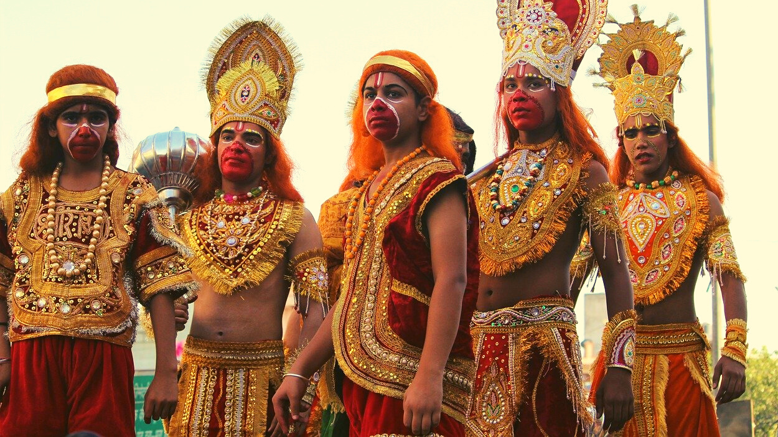
RITES OF PASSAGE

Slide 4
Rites of passage are ceremonies that mark an individual's progression from one stage of life to another. Examples of life cycle events include birth, puberty, the transition to adulthood, and marriage, as well as sacred or secular initiations. These events are often marked by special practices or rituals that signify changes in status.
Did you know?
Anthropologist Arnold van Gennep (1960) recognized that rites of passage generally consist of three distinct phases: separation, liminality, and incorporation.

Slide 5
Separation refers to when an individual is seen to change from their current status in life and must prepare to enter a new stage.
Liminality describes the in-between period of transition that follows separation. An individual may be temporarily removed from regular society to undergo special tasks or activities (such as rituals) that will prepare them for their new role.
Incorporation is the final stage, where the returning individual is welcomed back into society with their newly attained status and responsibilities.

Slide 6
Coming of Age
Coming-of-age ceremonies are a type of life cycle ritual that exemplify Van Gennep's model.
These rites of passage transition members of a society into a new status at various points in their lives.
Special practices or beliefs that signify becoming a full adult member of society are common in many cultures around the world.

Slide 7
CASE STUDY
YANOAMA (SQ18)
Venezuela & Brazil
RITE OF PASSAGE: FIRST MENSTRUATION
"The first menstruation takes place between 12 and 13 years of age ... To signify the occasion, the girl's family erects a small leaf enclosure within the communal dwelling (yano). Her hair is cut close to the scalp with bamboo arrow tips (or scissors). She remains isolated in the enclosure and only her mother and sisters will whisper to her. No male may see or converse with her, or even mention her name. The female members of the family feed her and accompany her outside for baths and other necessities. When her hair has returned to normal length, she abandons the enclosure and resumes her normal activities. This rite of passage marks the transition from childhood to womanhood (Early and Peters 1990: 41)".

Slide 8
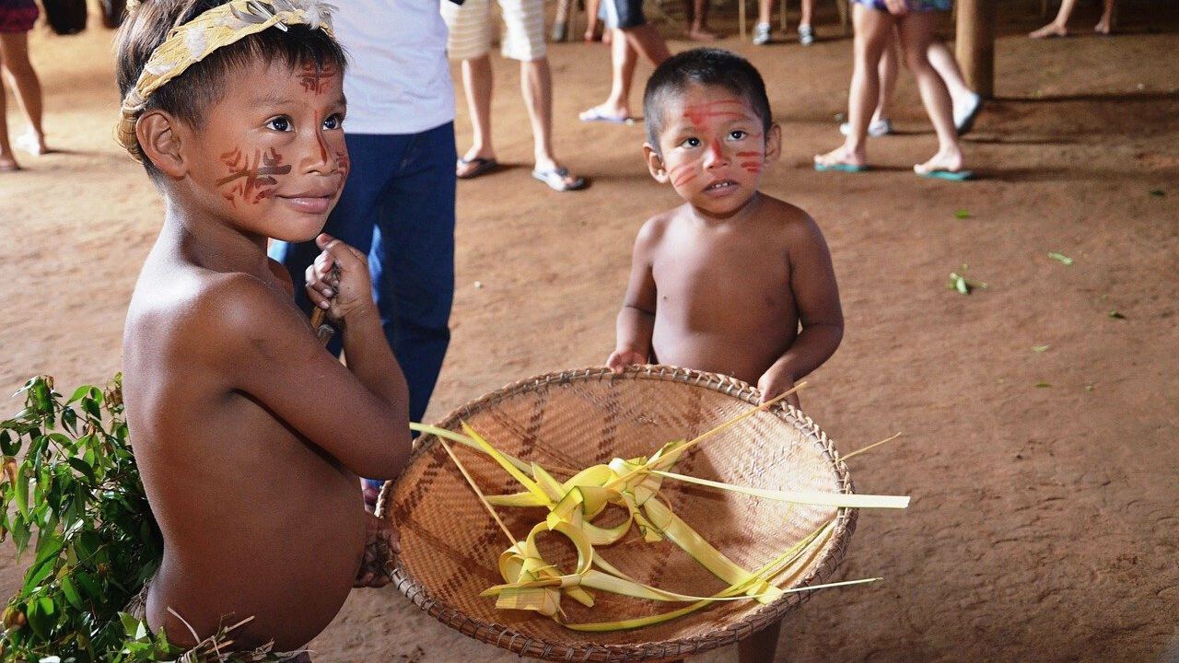
eHRAF Workbook
ACTIVITY

Slide 9
Use Advanced Search in eHRAF World Cultures to find 3 additional examples of coming-of-age, life cycle rituals, or other rites of passage.
eHRAF World Cultures
Examples may come from any culture. Try to find cases from different parts of the world.
See below for a sample search with suggested OCM subject identifiers and keywords.

Slide 10
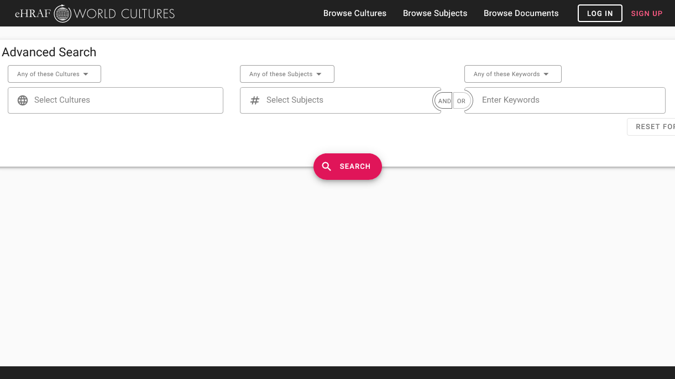
SAMPLE ADVANCED SEARCH
Add 1 or more subjects:
Age stratification (561)
Ceremonial during infancy and childhood (852)
Puberty and initiation (881)
Add optional keywords such as ritual, initiation, adulthood, marriage, or death

Slide 11
ASSIGNMENT
For each culture, prepare a brief overview of the society and its location as detailed in the eHRAF Culture Summary. Then, describe the coming-of-age ritual that you found in eHRAF World Cultures for that society. Answer the following questions for each example.
Describe the coming-of-age ceremony or ritual. Who takes part?
What activities or events mark the three stages that correspond to Van Gennep’s separation, liminality, and incorporation?
What are some symbolic elements? What do you think they stand for?
Are any physical changes undergone by participants?
How is the new status of the individual recognized?

Slide 12
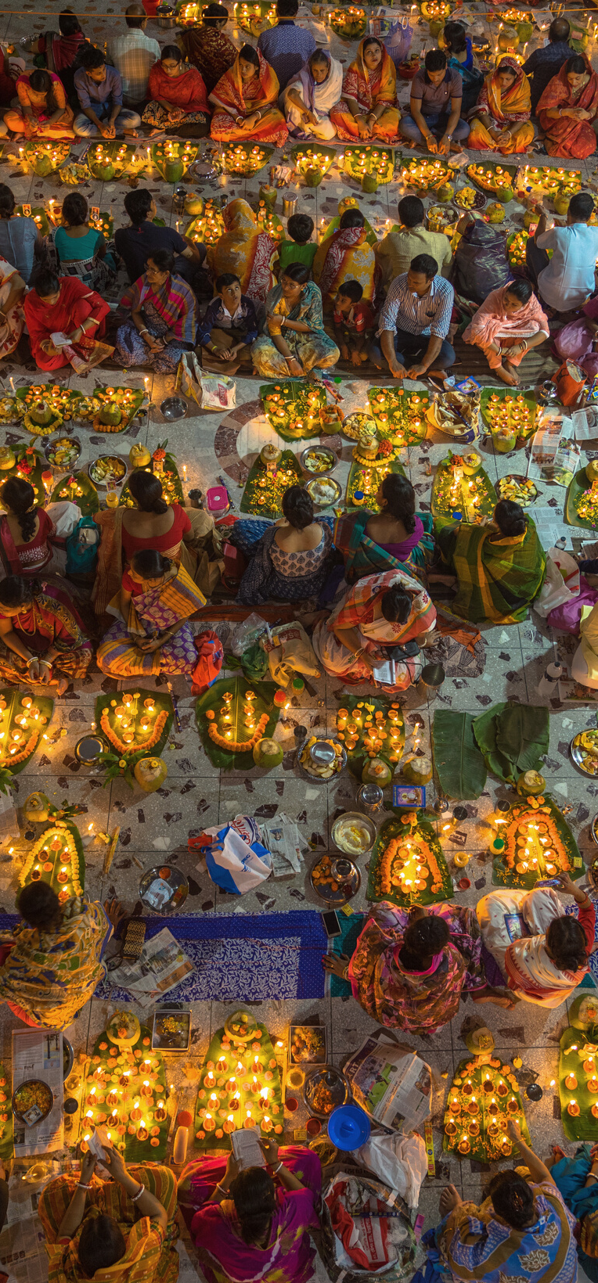
Culture Summaries
A brief overview for societies in eHRAF World Cultures is provided in the form of Culture Summaries.
The format, general outline, and headings are the same for each summary. You will find a basic overview about the culture, such as its economy, history, environment, and sociopolitical organization.
eHRAF
World
Cultures
To find a culture summary, go to the Browse Cultures tab. Enter the culture name into the box, then click to expand the result. Click on Full Profile to reach the Culture Profile, then access the Culture Summary via the Summary tab.

Slide 13
DISCUSSION
Did you find any examples of societies that do not have coming-of-age rituals?
What role do you think rites of passage play in society? Are they important or unimportant?
Why do you think some coming-of-age rituals include physical pain or endurance challenges?
What rites of passage have you experienced in your life so far?
How do the rites of passage you have experienced compare to those that you discovered in other cultures? List any similarities and differences.

Slide 14
1. Early, John D., and John F. Peters. 1990. The Population Dynamics of the Mucajai Yanomama. San Diego, Calif.: Academic Press. https://ehrafworldcultures.yale.edu/document?id=sq18-012.
2. Van Gennep, A. [1909] 1960. The Rites of Passage. London: Routledge and Kegan Paul.
References
Image Credits
9–10-year-old boys of the Yao tribe in Malawi participating in circumcision and initiation rites by Steve Evans from Citizen of the World via Wikimedia Commons https://commons.wikimedia.org/wiki/File:Initiation_ritual_of_boys_in_Malawi.jpg

Slide 15
Rites of Passage
in eHRAF World Cultures
Produced by
Human Relations Area Files
at Yale University
An eHRAF Workbook Activity
hraf.yale.edu

