Slide 1
An eHRAF Workbook Activity
Sexuality:
Premarital Sex
in eHRAF World Cultures
Human Relations Area Files
at Yale University

Slide 2
In this activity
Explore the diversity of social attitudes towards premarital sex
Conduct an Advanced Search in eHRAF World Cultures
Read and interpret ethnographic data
Critique whether certain human sexual behaviors or attitudes are universal
Topics We'll Cover

Slide 3
This workbook is based on the Explaining Human Culture (EHC) summary on Sexuality
by
Carol R. Ember, Milagro Escobar, and Noah Rossen
https://hraf.yale.edu/ehc/summaries/sexuality
You may wish to read the EHC summary to learn more about cross-cultural patterns in sexuality and explanations of why sexual attitudes and practice may vary before beginning the exercises in this workbook.

Slide 4
ATTITUDES TOWARDS SEXUALITY
across cultures
In this activity, you will ual relations across the globe.

Slide 5
Attitudes towards sexuality
Societies vary markedly in their attitudes towards sexuality.
Questions to address cross-cultural similarities and differences include:

Slide 6
ATTITUDES TOWARDS SEXUALITY
What is sex?
Who should engage in it?
Under what circumstances?
When and where is sexual behavior permissible?

Slide 7
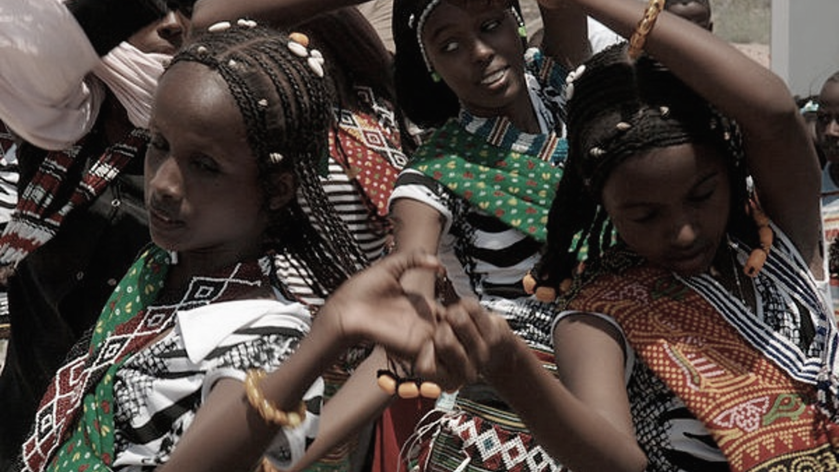
eHRAF Workbook
ACTIVITY
attitudes towards premarital sex
In this activity, you will ual relations across the globe.

Slide 8
Cultural Comparison
In this activity, you will compare attitudes towards premarital sexual relations across several cultures, observing and analyzing differences in general social permissiveness and restriction towards sexual behavior.

Slide 9
PART 1
Compare attitudes toward premarital sex among the following cultures:
Trobriands (OL06)
Copper Inuit (ND08)
Kanuri (MS14)
Libyan Bedouin (MT09)
Pawnee (NQ18)
Use the OCM subject category Premarital Sex Restrictions (836) and the culture names listed above in an eHRAF World Cultures Advanced Search.

Slide 10
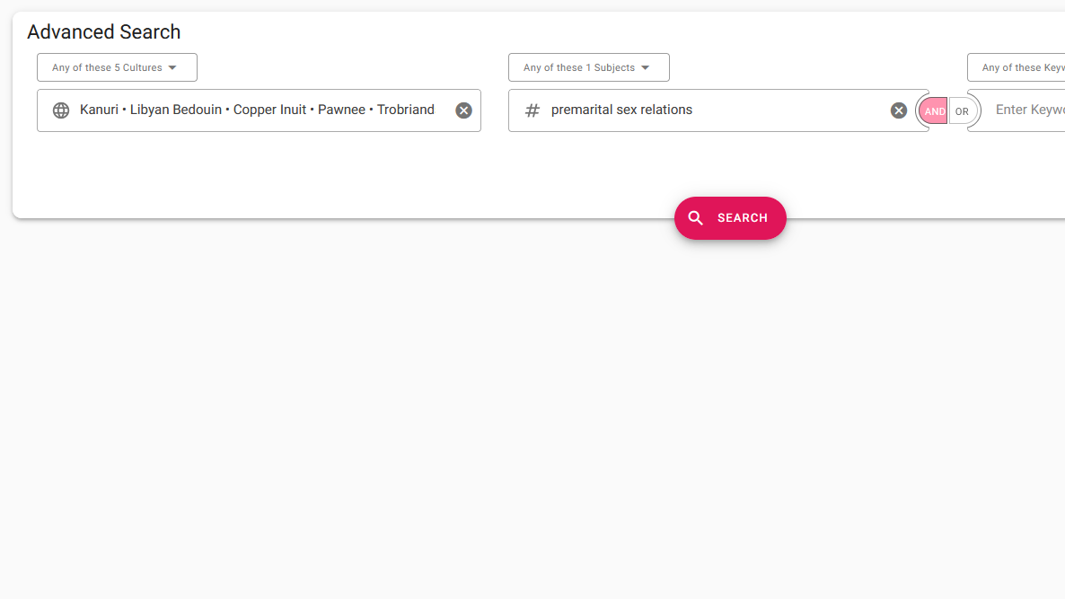
ADVANCED SEARCH
Add one or more cultures:
Kanuri (MS14)
Libyan Bedouin (MT09)
Copper Inuit (ND08)
Pawnee (NQ18)
Trobriands (OL06)
Add subject:
Premarital sex relations (836)
Click "search"

Slide 11
PART 1
What are the reasons for premarital sex restrictions?
Use the table on the following page to summarize your findings for each culture.
Consider the moral, familial, and pragmatic reasons why each culture may be restrictive or permissive.

Slide 13
PART 2
Similarities & Differences
Which cultures hold similar attitudes towards premarital sex?
Which cultures hold different attitudes towards premarital sex?

Slide 14
PART 2
Why are some cultures more restrictive or permissive about premarital sexual behavior?
Which culture is the most restrictive?
Which culture is the most permissive?

Slide 15
Adapted from Teaching eHRAF Exercise "Exercise VI. Sexuality" by Carol Ember. https://hraf.yale.edu/teach-ehraf/exercises-using-ehraf-world-cultures/
Ember, Carol R., Milagro Escobar, and Noah Rossen. 2019. "Sexuality", In C. R. Ember, ed. Explaining Human Culture. Human Relations Area Files http://hraf.yale.edu/ehc/summaries/sexuality.
References
Cover image
Scenes from the Kama Sutra in a Hindu temple. Kandukuru Nagarjun from Bangalore, India CC BY 2.0, via Wikimedia Commons. https://commons.wikimedia.org/wiki/File:Scenes_from_the_Kama_Sutra_in_a_Hindu_temple.jpg

Slide 16
Sexuality:
Premarital Sex
in eHRAF World Cultures
Produced by
Human Relations Area Files
at Yale University
An eHRAF Workbook Activity
hraf.yale.edu

