Slide 1
An eHRAF Workbook Activity
Shell Working:
A Comparative Approach
in eHRAF Archaeology
Human Relations Area Files
at Yale University

Slide 2
In this activity
Topics We'll Cover
Learn about shell working
Read passages from traditions covered in eHRAF Archaeology
Compare & contrast traditions
Write a research paper using a comparative approach

Slide 3
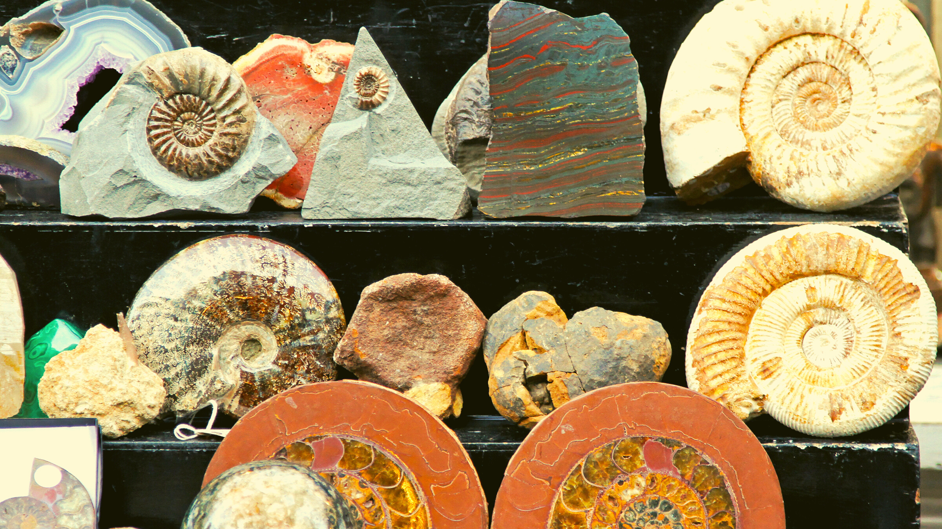
SHELL WORKING

Slide 4
Archaeology of Shells
For thousands of years, shells (also known as molluscs) have served humans in a variety of ways, across many traditions.
Shells have been modified into jewelry and fashioned into musical instruments, like conch horns. Color dyes have been extracted from shells. They have even been used as building materials.
What can shells tell us about the people who collected them? How were shells part of social and cultural life?

Slide 5
To get started, review these videos about shell working:
RSTV Documentary - The Shell Story
Moments in Indigenous History: Shell rings/Shell Midden Mounds
Listen as a 17,000-year-old conch shell is played once more
Virginia Oyster Heritage

Slide 6
Articles about shell working
The Archaeological Study of Shell Middens
Ancient hunter-gatherer seashell resonates after 17,000 years
The Ancient Use of Seashells in Arizona and Beyond
Conservation of Archaeological Shell Objects
Shell-Working in the Indus Civilization

Slide 7
The following slides feature excerpts from descriptions of
shell working in two different archaeological traditions.
You will learn more about these traditions in eHRAF Archaeology.

Slide 8
"The king of Chimor had in his retinue a servant called the Fonga Sigde, whose job it was to strew crushed Spondylus powder before the king as he walked, creating a 'red carpet' for him to walk on and showing his extreme wealth and power."
Introduction to the Chimú culture Dr. Sarahh Scher, Khan Academy

Slide 9
"Evidence shows Harappans participated in a vast maritime—sea—trade network extending from Central Asia to the Middle East. Harappans also engaged in shellworking, and shells used in their crafts have origins from as far away as the coast of modern-day Oman."
Indus River Valley civilizations
Khan Academy

Slide 10
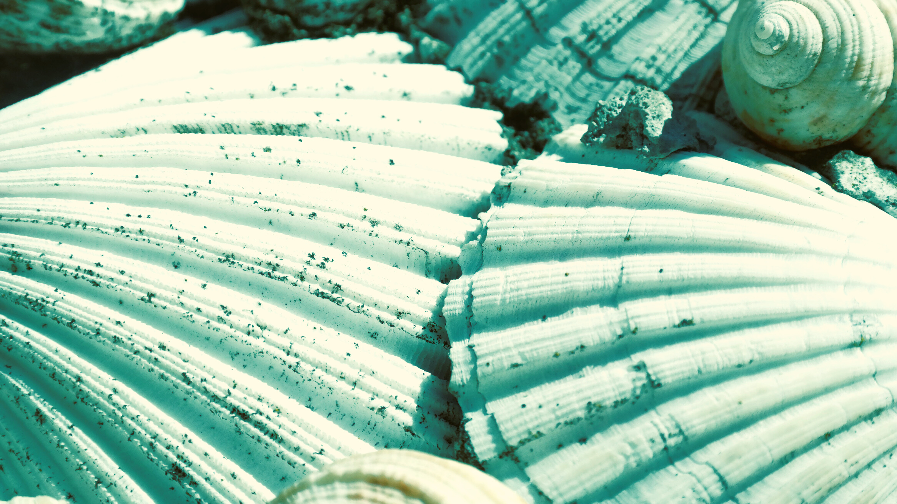
eHRAF Workbook
Part 1: Selected Readings

Slide 11
For this workbook activity, you will learn about shell working across four different archaeological traditions.
On the following slide, you will find a table containing columns for:
Tradition
Shell
Description, Document, Page Number
Four Traditions
After reading selected passages provided below, fill in this table with data from eHRAF Archaeology.
Remember to note the titles, authors, and page numbers from the documents where you found the information, and provide a brief description of shell working in each of the four traditions.

Slide 12
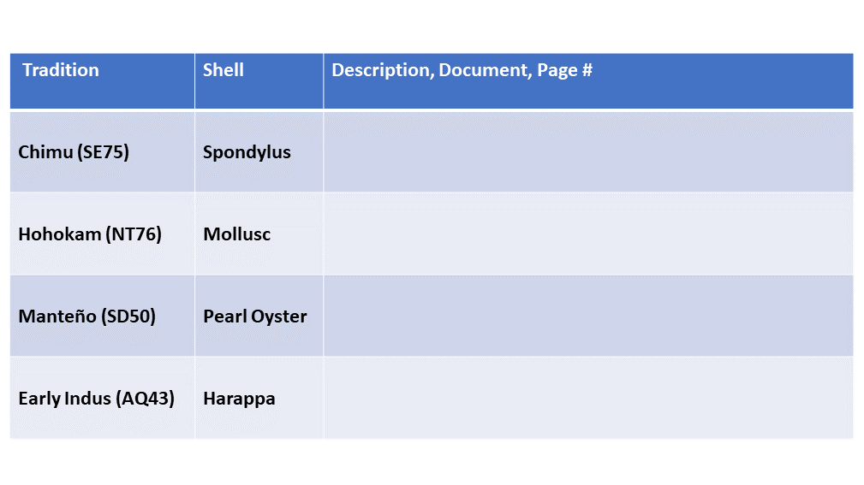

Slide 13
Tradition Summaries
A brief overview for traditions in eHRAF Archaeology is provided in the form of Tradition Summaries.
The format, general outline, and headings are the same for each summary. You will find a basic overview about the tradition, such as its time period, location, history, environment, and sociopolitical organization.
eHRAF
Archaeology
To find a tradition summary, go to the Browse Traditions tab and enter the tradition name into the box, then click on Tradition Summary below the tradition name to read it.

Slide 14
To read documents or pages in eHRAF:
INSTRUCTIONS
First, follow the permalinks provided in the activities below to get to the relevant documents.
For example:
🌐
https://ehrafarchaeology.yale.edu/document?id=nt76-001
Then, use the Page List dropdown menu to navigate to the required page(s).

Slide 15
Finding documents without permalinks
INSTRUCTIONS
Follow these steps if you are having trouble with permalinks from off campus while using a proxy or VPN service, or if you have been provided with a HRAF-issued username and password.
Sign in via your library proxy or VPN, or using the HRAF-issued credentials.
Go to the Browse Documents tab.
Enter the author's last name into the Filter Index box.
Click on the required title to access the document, then select the page number from the Page List dropdown menu as shown above.

Slide 16
Chimu (SE75)
Read the Chimu (SE75) tradition summary.
https://ehrafarchaeology.yale.edu/document?id=se75-000
🌐
Read Cordy-Collins (1990) about Spondylus use in ancient Peru pages 396-397, 399-404, 406, 408-413.
https://ehrafarchaeology.yale.edu/document?id=se75-030
🌐

Slide 17
Hohokam (NT76)
Read the Hohokam (NT76) tradition summary.
https://ehrafarchaeology.yale.edu/document?id=nt76-000
🌐
Read Haury (1976) about the use of molluscs for shell products in the Hohokam tradition pages 116, 305-311, 313-319, 321
https://ehrafarchaeology.yale.edu/document?id=nt76-002
🌐

Slide 18
Manteño (SD50)
Read the Manteño (SD50) tradition summary.
https://ehrafarchaeology.yale.edu/document?id=sd50-000
🌐
Read Mester (1997) about pearl oyster utilization at Los Frailes pages 156-159.
https://ehrafarchaeology.yale.edu/document?id=sd50-001
🌐

Slide 19
Early Indus (AQ43)
Read the Early Indus (AQ43) tradition summary.
https://ehrafarchaeology.yale.edu/document?id=aq43-000
🌐
Read Kenoyer (1997) about Harappa shell trade and shell working pages 566, 568-574.
https://ehrafarchaeology.yale.edu/document?id=aq43-002
🌐

Slide 20
In this activity, you will ual relations across the globe.
eHRAF Workbook
Part 2: Advanced Search

Slide 21
Advanced Search
Now that you have read selected passages from eHRAF Archaeology, dig deeper with Advanced Search. This will enable you to find specific paragraphs in documents that have been indexed by HRAF anthropologists.
On the following slides, you will find an example of an advanced search. Try this search, and then experiment with different subjects and/or keywords. Conducting searches and reviewing results will prepare you to do your own research in Part 3.

Slide 22
Advanced Search
In the Add Traditions column, select the tradition: Hawaiian (OV50)
In the Add Subjects column, select the subject: Bone, horn, and shell technology (321)
In the Keyword section, type the following keyword: shell*

Slide 23
ADVANCED SEARCH
Add subjects:
Bone, horn, and shell technology (321)
Add tradition:
Hawaiian (OV50)
Add keyword:
shell*

Slide 24
SEARCH RESULTS

Slide 25
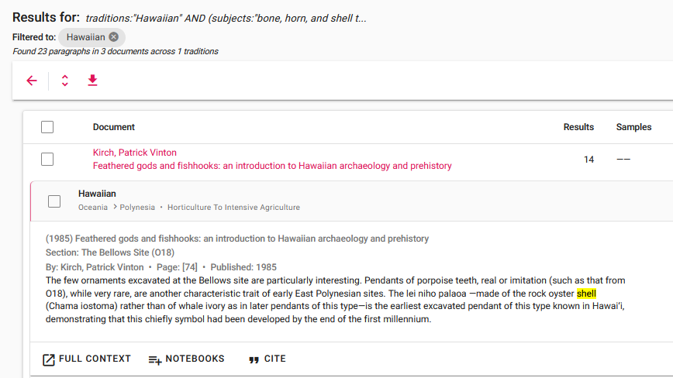
SEARCH RESULTS
Click "Full Context" to view the paragraph in the full page context

Slide 26
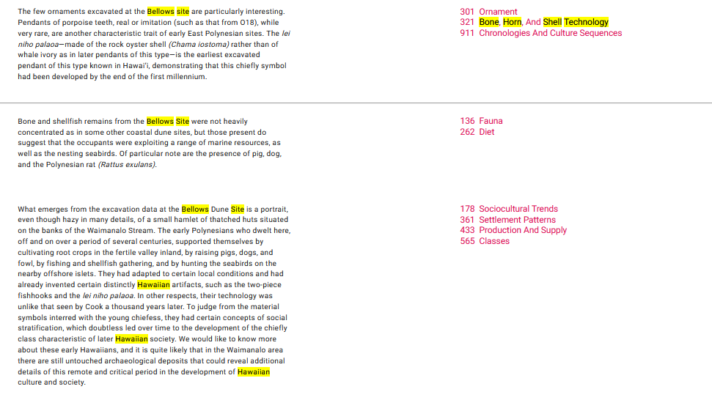
FULL CONTEXT

Slide 27
eHRAF Workbook
Part 3: Assignment

Slide 28
Essay Assignment
eHRAF Archaeology contains numerous descriptions of archaeological sites with artifacts from shell working activity.
Select any 3 archaeological traditions from 3 different regions. Write an essay in which you compare and contrast these traditions. Include the following information:
Name of the tradition and region
Subsistence type
Describe the shell working - e.g., types of shells, purpose of artifacts, etc.
How do archaeologists interpret these findings?
What do you think?

Slide 29
Cordy-Collins, Alana. 1990. “Fonga Sigde, Shell Purveyor to the Chimu Kings.” In The Northern Dynasties: Kingship and Statecraft in Chimor: A Symposium at Dumbarton Oaks, 12th and 13th October 1985, 393–417. Washington, D.C.: Dumbarton Oaks Research Library and Collection. https://ehrafarchaeology.yale.edu/document?id=se75-030.
Doyel, David E. (David Elmond), Stephen H. Lekson, and Devin Alan White. 2010. “Tradition Summary: Hohokam.” New Haven, Conn.: Human Relations Area Files. https://ehrafarchaeology.yale.edu/document?id=nt76-000
References
Haury, Emil W. (Emil Walter). 1976. The Hohokam, Desert Farmers & Craftsmen: Excavations at Snaketown, 1964-1965. Tucson: University of Arizona Press. https://ehrafarchaeology.yale.edu/document?id=nt76-002.
Kenoyer, Jonathan Mark. 1995. “Shell Trade and Shell Working during the Neolithic and Early Chalcolithic at Mehrgarh, Pakistan.” In Mehrgarh: Field Reports 1974-1985 from Neolithic Times to the Indus Civilization, 566–81. Karachi, Pakistan: Golden Graphics Limited. https://ehrafarchaeology.yale.edu/document?id=aq43-002.

Slide 30
Kenoyer, Jonathan Mark. 2016. “Tradition Summary: Early Indus.” New Haven, Conn.: Human Relations Area Files. https://ehrafarchaeology.yale.edu/document?id=aq43-000.
Mester, Ann Marie. 1997. The Pearl Divers of Los Frailes: Archaeological and Ethnohistorical Explorations of Sumptuary Good Trade and Cosmology in the North and Central Andes. Ann Arbor, Michigan: University Microfilms International. https://ehrafarchaeology.yale.edu/document?id=sd50-001.
References
Moore, Jerry D. 2015. “Tradition Summary: Chimu.” New Haven, Conn.: Human Relations Area Files. https://ehrafarchaeology.yale.edu/document?id=se75-000.
Stothert, Karen. 1999. “Tradition Summary: Manteño.” New Haven, Conn.: HRAF. https://ehrafarchaeology.yale.edu/document?id=sd50-000.

Slide 31
Indus bracelet, ALFGRN and Darafsh, CC BY-SA 3.0, via Wikimedia Commons: https://upload.wikimedia.org/wikipedia/commons/5/5c/Indus_bracelet_made_of_Fasciolaria_Trapezium_or_Xandus_Pyrum_imported_front_and_back_with_inscribed_chevron_to_Susa_in_2600-1700_BCE_LOUVRE_Sb14473.jpg
Image Credits

Slide 32
Shell Working:
A Comparative Approach
in eHRAF Archaeology
Produced by
Human Relations Area Files
at Yale University
An eHRAF Workbook Activity
hraf.yale.edu

