Slide 1
An eHRAF Workbook Activity
Social
Control
in eHRAF World Cultures
Human Relations Area Files
at Yale University

Slide 2
In this activity
Learn about different ways that societies maintain social control
Understand social control cross-culturally
Conduct your own search
Read and analyze ethnographic data in eHRAF World Cultures
Topics We'll Cover

Slide 3
SOCIAL CONTROL

Slide 4
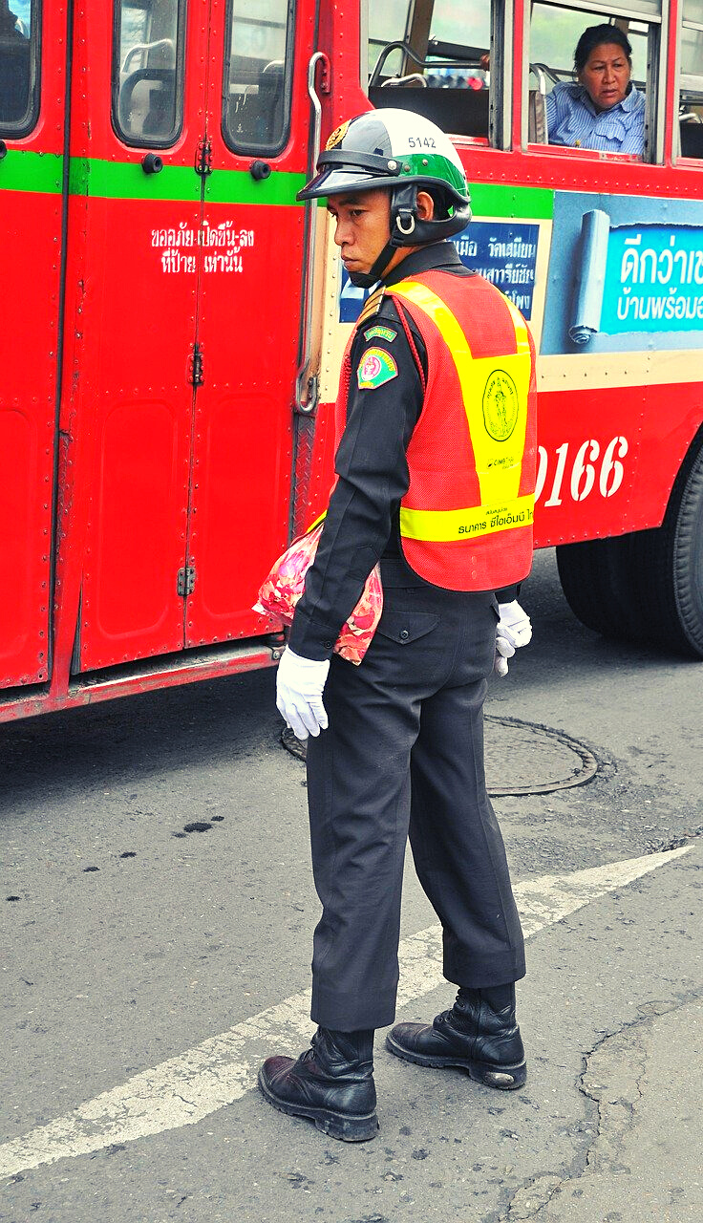
Getting people to "obey the rules" is a problem faced by all societies.
The mechanisms by which a society maintains order and cohesion are known as social control. These can vary markedly across cultures.
The purpose of social control is to establish norms and regulations – codified or otherwise - and to maintain conformity to those rules.
Did you know?

Slide 5
Social control may be exercised by the state and related apparatuses such as police, laws, courts, and formal education.
It may also be instituted via religious, spiritual, or moral codes which discourage "undesirable" or "deviant" behavior in other ways.
The means of enforcing social control can be either formal or informal.

Slide 6
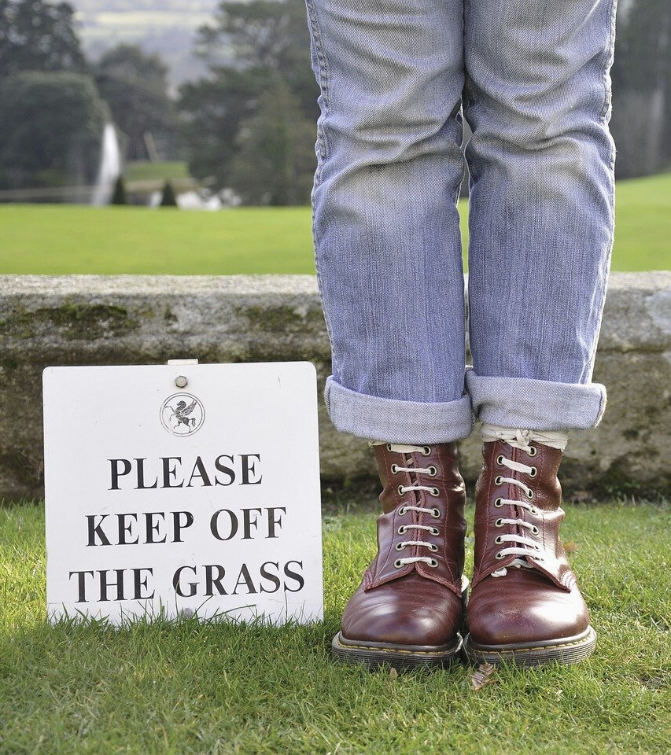
FORMAL VS. INFORMAL
Laws imposed by governments, such as state sanctions regarding crime and punishment, are formal aspects of social control.
Informal means of control are guided by common belief systems that regulate both individual and group behaviors. For example, gossip, public opinion, and ostracism act to normalize what is seen as acceptable or unacceptable.

Slide 7
eHRAF Workbook
ACTIVITY

Slide 8
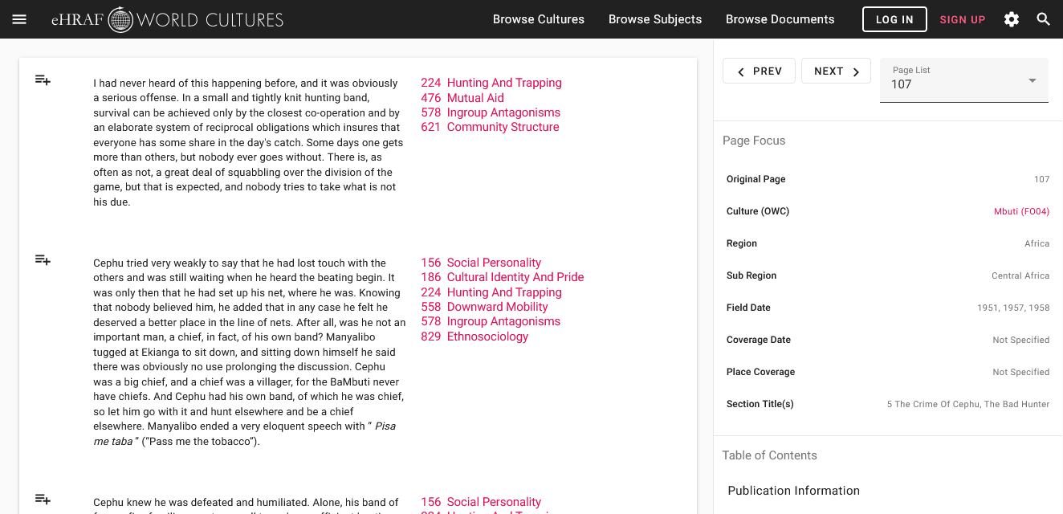
To read pages in eHRAF:
INSTRUCTIONS
First, follow the permalinks provided in the activities below to get to the relevant documents.
For example:
🌐 https://ehrafworldcultures.yale.edu/document?id=fo04-003
Then, use the Page List dropdown menu to navigate to the required page(s).

Slide 9
Finding pages without permalinks
INSTRUCTIONS
Follow these steps if you are having trouble with permalinks from off campus while using a proxy or VPN service, or if you have been provided with a HRAF-issued username and password.
Sign in via your library proxy or VPN, or using the HRAF-issued credentials.
Go to the Browse Documents tab.
Enter the author's name or document title into Search Document List box.
Click on the required title to access the document, then select the page number from the Page List dropdown menu as shown above.

Slide 10
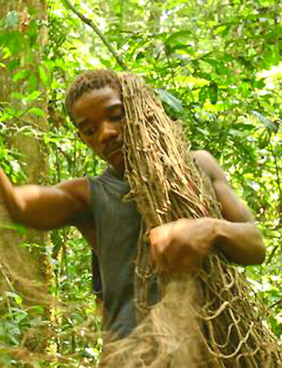
QUESTION 1
In eHRAF World Cultures, read the passages indicated, then answer the questions.
The Mbuti (FO04) of Central Africa do not
have any formal mechanisms of social control, so how do they achieve it?
Read pp. 107-109 of Turnbull's The Forest People
🌐https://ehrafworldcultures.yale.edu/document?id=fo04-003

Slide 11
QUESTION 2
The threat of sorcery is a central aspect of social control among the Ojibwa (NG06). Describe how this fear appears to work.
Read pp. 93-95 of Hallowell's The Ojibwa of Berens River
🌐https://ehrafworldcultures.yale.edu/document?id=ng06-058
Contrast the Ojibwa's use of sorcery with that of the Ganda (FK07) of eastern Africa.
Read pp. 252-253 of Mair's An African People in the 20th Century.
🌐https://ehrafworldcultures.yale.edu/document?id=fk07-001

Slide 12
QUESTION 3
The Kanuri (MS14) have higher levels of authority to resolve disputes. Explain how their system works, focusing on at least 2 aspects (e.g. legal or political) of control.
Read pp. 20-22 of Cohen's The Kanuri of Bornu, and "The Village Area" on pp. 94-96.
🌐https://ehrafworldcultures.yale.edu/document?id=ms14-001

Slide 13
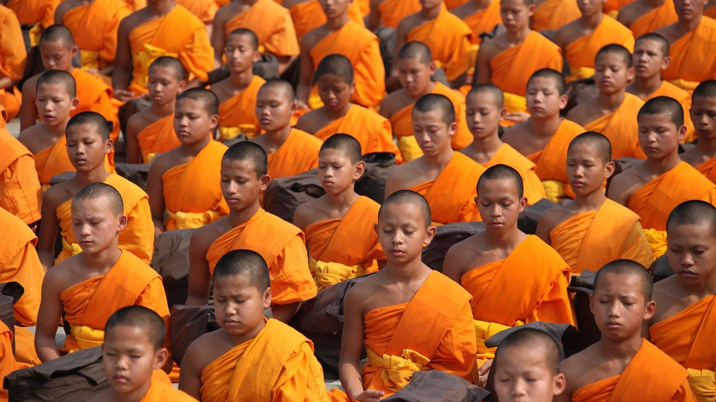
RULES ACROSS CULTURES
search and discover

Slide 14
Social Control & Society
Conduct your own search in eHRAF Advanced Search to find out more about how different cultures instill rules and order their societies.

Slide 15
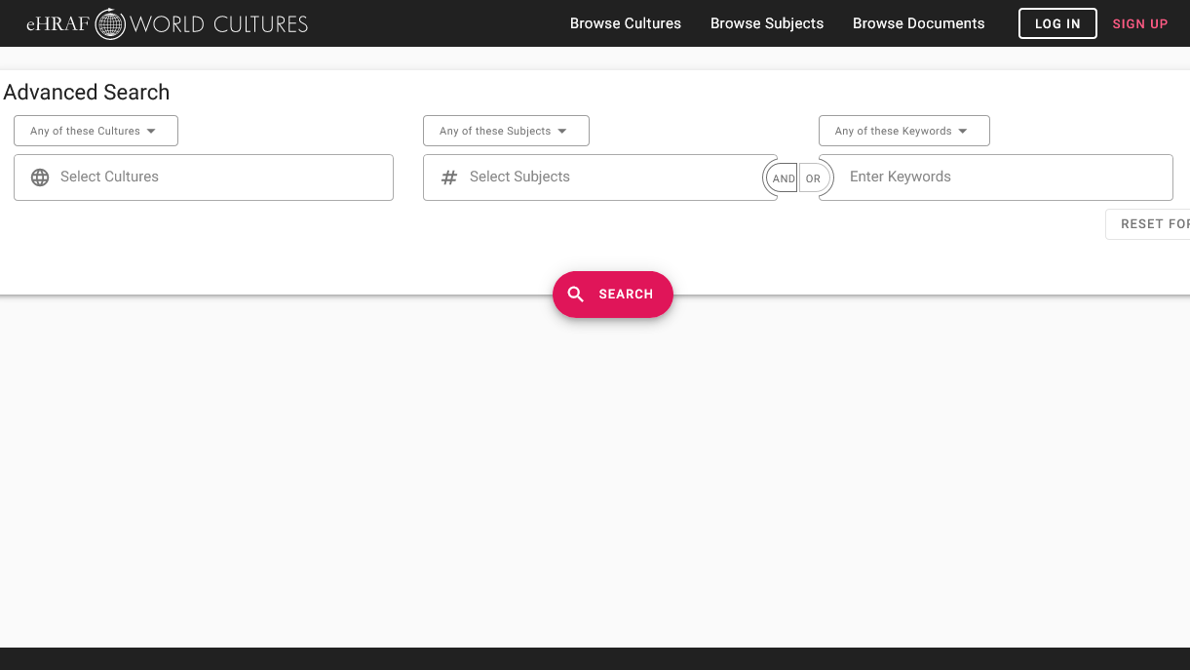
ADVANCED SEARCH
Add cultures:
Select as many cultures as you like, or search the entire collection
Add subjects:
Social Control (626),
Judicial Authority (692) or choose your own
You may also enter keywords of your choice such as "rule*" or "order"

Slide 16
COMPARE AND CONTRAST
summarize your findings

Slide 17
Compare and contrast the various systems of social control covered in this activity.
Do they share any similarities?
What other ways are "the rules" enforced?
What did you find?
What type of social controls do you think are most effective? Why?
Compare the mechanisms for social control you found in other cultures with your own. What differences stand out to you?

Slide 18
1. This activity was adapted from "Exercise X. Rules", by Carol R. Ember, in Teaching eHRAF.
2. Cohen, Ronald. 1967. “The Kanuri of Bornu.” In Case Studies in Cultural Anthropology, x, 115. New York: Holt, Rinehart and Winston, Inc. https://ehrafworldcultures.yale.edu/document?id=ms14-001.
3. Hallowell, A. Irving, and Jennifer S. H. Brown. 1991. “The Ojibwa of Berens River, Manitoba: Ethnography into History.” In Case Studies in Cultural Anthropology, xx, 128. Fort Worth: Harcourt Brace Jovanovich College Publishers. https://ehrafworldcultures.yale.edu/document?id=ng06-058.
References
4. Mair, Lucy Philip. 1934. An African People in the Twentieth Century. London: Routledge & Sons. https://ehrafworldcultures.yale.edu/document?id=fk07-001.
5. Turnbull, Colin M. 1962. The Forest People. New York, N.Y.: Simon and Schuster. https://ehrafworldcultures.yale.edu/document?id=fo04-003.

Slide 19
Mohammed Mustapha Aliyu, CC BY SA 4.0 - Traditional Kanuri dancers north east Nigeria - https://commons.wikimedia.org/wiki/File:Traditional_Kanuri_dancers_north_east_Nigeria.jpg
Radio Okapi, CC BY SA 2.0 - Chasseur pygmé bambuti, près d'Epulu, 2005 - https://www.flickr.com/photos/radiookapi/4442806755/
Image Credits

Slide 20
Social
Control
in eHRAF World Cultures
Produced by
Human Relations Area Files
at Yale University
An eHRAF Workbook Activity
hraf.yale.edu

