Slide 1
An eHRAF Workbook Activity
Anthropology:
The Four Fields
in eHRAF World Cultures
Human Relations Area Files
at Yale University

Slide 2
In this activity
We will learn about the four fields of anthropology:
Archaeology
Cultural Anthropology
Linguistic Anthropology
Biological Anthropology
We will also conduct research using eHRAF World Cultures.
Topics We'll Cover

Slide 3
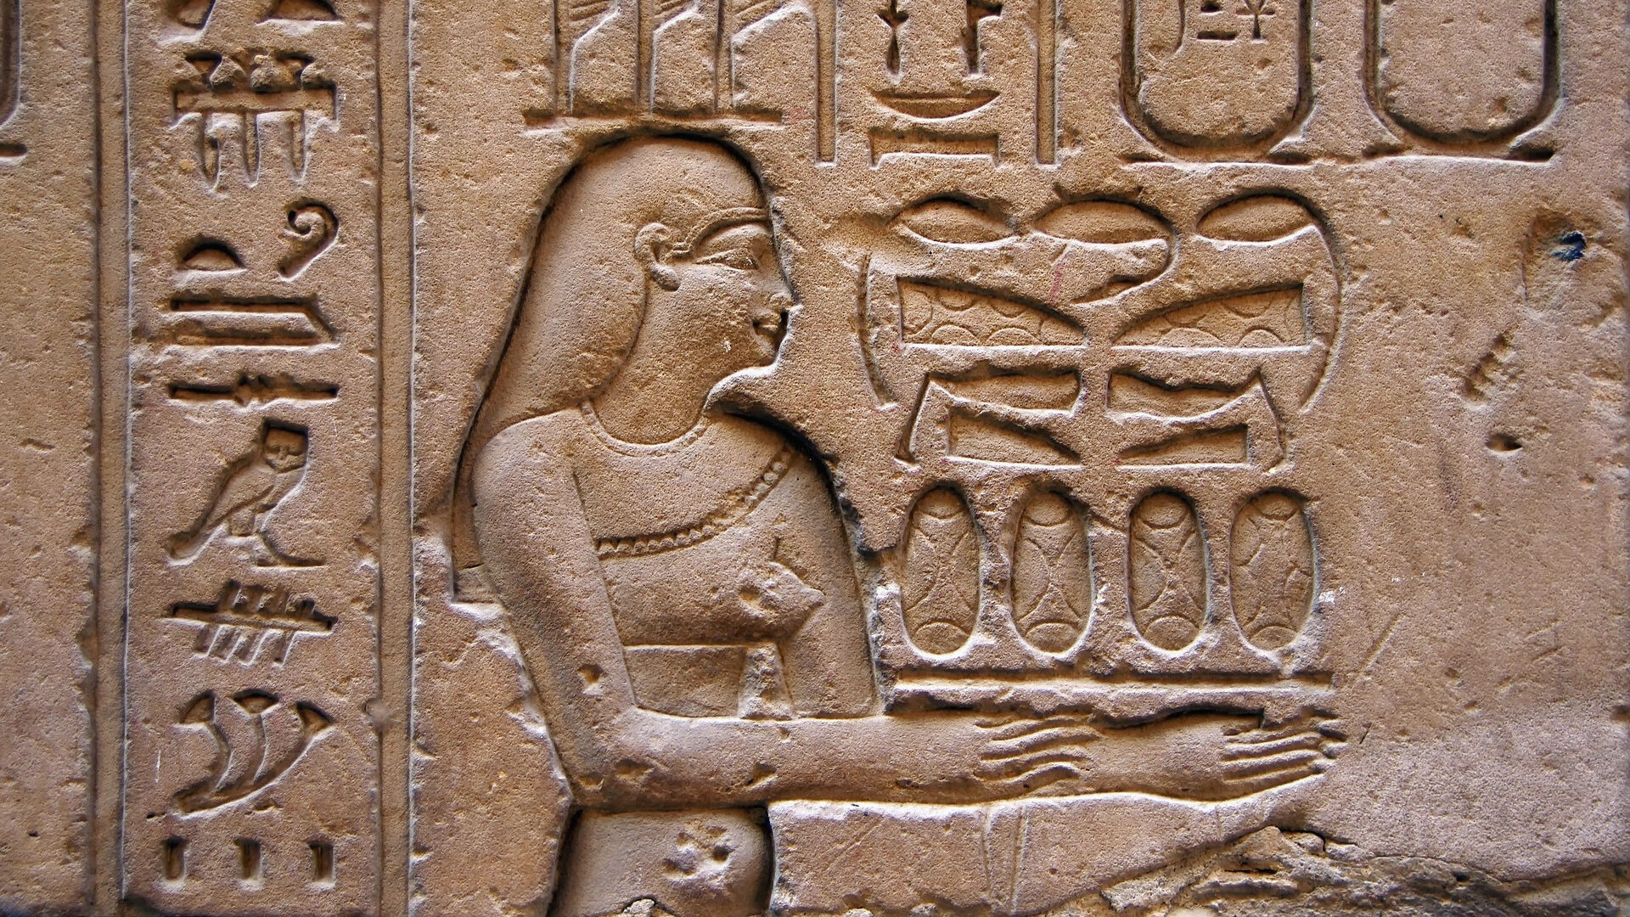
THE FOUR FIELDS

Slide 4
Anthropology
The first three fields - archaeology, linguistics, and cultural anthropology (also called ethnology) - all deal with culture.
This makes these three fields somewhat distinct from biological anthropology, which primarily deals with physical features such as anatomy, physiology, and genetics.

Slide 5
Archaeology
Archaeologists study culture of the past primarily by analyzing the material remains of sites of human occupation.
The time range for archaeological research ranges from prehistorical archaeology (time periods prior to written records) to historical archaeology (time periods with written records).

Slide 6
Cultural Anthropology
Cultural anthropologists are interested in understanding the social and cultural life of diverse peoples around the world.
One of the primary methods of investigation is ethnographic fieldwork, living among the people studied.
In contrast to archaeology, which focuses on the past, cultural anthropology is focused on the recent past and present.

Slide 7
Linguistic Anthropology
Linguistic anthropologists study language, communication, and patterns of speaking.
They are interested in the origins of languages, how they have diverged and changed over time, and how languages vary in the present day.

Slide 8
Biological Anthropology
Biological anthropologists concentrate on humans as biological organisms.
They seek to understand how humans evolved, and they are interested in explaining the biological similarities and differences that are found among humans across the world.

Slide 9
eHRAF WORLD CULTURES

Slide 10
The eHRAF World Cultures database is primarily about cultural anthropology: cultural and social life in the recent present. It also contains information about the other subfields: archaeology, linguistics, and biological anthropology.
The eHRAF Archaeology database is devoted to reconstruction of culture prior to extensive written records.

Slide 11
Outline of Cultural Material (OCM)
The Outline of Cultural Materials (OCM) is a vast subject index designed to cover all aspects of cultural and social life.
It was first developed in the 1930s by George Peter Murdock and colleagues at Yale's Institute of Human Relations and has been revised ever since.

Slide 12
Outline of Cultural Materials (OCM)
The OCM is an ethnographic classification system on human behavior, social life and customs, and material culture.
In the eHRAF databases, these subjects categories have been use to index each and every paragraph.
This tagging system means that you can search across all of our collections to find the exact paragraph-level content you need.

Slide 13
OCM SUBJECTS
On the following slides, you will find some suggested OCM subjects which may be helpful when searching for information related to the four fields.

Slide 14
ARCHAEOLOGY
Archaeology (brief descriptions)
USE: Prehistory (172)
Archaeology (general Information)
USE: Archaeological measures, techniques, and analyses (910)
Archaeological excavation methods
USE: Archaeological excavation methods (1210)
FOUR FIELDS

Slide 15
CULTURAL ANTHROPOLOGY
Culture characterizations
USE: Ethos (181)
Culture (ideas about)
USE: Ethnosociology (829)
Psychology (ideas about)
USE: Ethnopsychology (828)
FOUR FIELDS

Slide 16
LINGUISTIC ANTHROPOLOGY
Linguistic stylistics
USE: Sociolinguistics (195)
Linguistic symbolism
USE: Semantics (196)
Linguistic identification
USE: Linguistic identification (197)
FOUR FIELDS

Slide 17
PHYSICAL ANTHROPOLOGY
Ontogenetic data
USE: Ontogenetic data (145)
Food (nutritional values)
USE: Nutrition (146)
Physiology (data about)
USE: Physiological data (147)
FOUR FIELDS

Slide 18
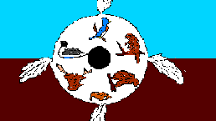
CASE STUDY:
The OJIBWA (NG06)

Slide 19
Ojibwa (NG06)
The Ojibwa comprise numerous communities ranging mainly from southern and northwestern Ontario, northern Michigan and Wisconsin, and Minnesota, to North Dakota and southern and central Manitoba and Saskatchewan. The most usual explanation of the name, "Ojibwa", relates it to a root meaning "puckered up", a reference to a distinct style of moccasin.

Slide 20
This screenshot shows how the paragraph from Vennum (1988: 76) on the Ojibwa (NG06) appears in eHRAF World Cultures. Read the text to discover a perspective from archaeology about the society.

Slide 21
SAMPLE ANALYSIS
Vennum looks at the role wild rice played and continues to play in the life of the Ojibway people. Archaeological evidence is presented showing that the practice of rice as a mortuary offering is ancient.
ARCHAEOLOGY
Reagan in 1924 mentioned that Nett Lake Ojibway threw a package of wild rice into the grave to provide sustenance for the deceased. Sister M. Inez Hilger reported that a Red Lake man was buried in 1930 wearing full ceremonial regalia, including moccasins and feather bonnet; with him were dried meat, berries, a frying pan, and wild rice. At Mille Lacs the deceased was dressed in new or clean clothes; two bags made from flour sacks or muslin, one containing tools, such as a jackknife, the other food, such as wild rice, were laid near the body during the wake and later interred with it. Nett Lake Indians in 1947 took the first rice of the new harvest, cooked it in a small pot, and hung it on the gravepost so the spirit of the rice would assist the deceased. Such practices are ancient; rice grains have been recovered as part of a mortuary offering in Michigan, dated by archaeologists at 400–600 B.C (Vennum 1988: 76).

Slide 22
This screenshot shows how the paragraph from Buffalohead (1983: 244) on the Ojibwa (NG06) appears in eHRAF World Cultures. Read the text to discover a perspective from cultural anthropology about the society. Note that gender is the topic explored.

Slide 23
SAMPLE ANALYSIS
This book presents a critical evaluation of women's status and roles in Ojibwa society.
CULTURAL ANTHROPOLOGY
IN EXPLORING women's status in hunting societies beyond fleeting impressions and commonly accepted stereotypes, a new image of Ojibway women begins to emerge. This image speaks of dynamic and resourceful women whose contributions encompassed traditionally defined female roles and reached beyond them into nearly every facet of life. Women were in a very real sense economic providers. They worked alone and in groups to construct the lodges, collect the firewood, make the clothing, and produce a substantial portion of the food supply. Credit for these contributions has for too long been hidden in the sources because historians and ethnologists presumed women's work to be supplementary and secondary to the primary hunting role of men. Furthermore, continued references to women's ownership and distribution rights, to their products, and to their strong voice in determining how male-acquired resources should be distributed suggest that the products of women's work were appreciated by the Ojibway themselves (Buffalohead 1982: 244).

Slide 24
This screenshot shows how the paragraph from White (1982: 62) on the Ojibwa (NG06) appears in eHRAF World Cultures. Read the text to discover a perspective from linguistic anthropology about the society.

Slide 25
SAMPLE ANALYSIS
This book explores the various ways in which gift-giving functions in Ojibwa society. The paragraph below discusses the language of the Ojibway and the meanings given to various words.
LINGUISTIC ANTHROPOLOGY
Crucial to certain kinds of gift giving and their meaning in the idiom of kinship was a concept that has been translated as “pity” or “charity.” These words occur not only in transcripts of Ojibway meetings with traders and European diplomats but also in more modern ethnographic texts. Landes wrote that “In Ojibwa idiom, to ‘pity’ another is to adopt him and care for him as a parent or grandparent cares for a child.” To give someone a gift with no thought of an immediate return was to “pity” him and thus in a sense to adopt him. This idea was applied not only to relationships between persons but also to those between humans and supernatural beings (White 1982: 62).

Slide 26
This screenshot shows how the paragraph from Hallowell (1976: 395) on the Ojibwa (NG06) appears in eHRAF World Cultures. Read the text to discover a perspective from biological anthropology about the society.

Slide 27
SAMPLE ANALYSIS
In this paragraph, the author states that, "We cannot dissociate the persistence of hominid populations, viewed biologically, from the distinctive mode of adaptation which characterized them."
BIOLOGICAL ANTHROPOLOGY
Instead of considering systems of primitive medicine chiefly with respect to their degree of effectiveness in curing the ills of the human organism, we might ask: What potential relations can we see between Man's confrontation with sickness, the development of systems of medicine, and the functioning of a cultural mode of adaptation? For, once this mode of adaptation had become an integral part of the evolution of the hominids, socio-cultural systems became the matrix of Man's survival. We cannot dissociate the persistence of hominid populations, viewed biologically, from the distinctive mode of adaptation which characterized them (Hallowell 1976: 395-396).

Slide 28
eHRAF Workbook
ACTIVITY
The Four Fields
In this activity, you will ual relations across the globe.

Slide 29
eHRAF Research
Use eHRAF to research additional cultures that are of interest to you.
Specifically look for information which is archaeological, biological, cultural, and linguistic.
Make sure to keep track of the sources you find.

Slide 30
Essay Assignment
Write a short paper (2-4 pages) in which you discuss your findings.
Were you able to find information related to all 4 fields of anthropology?
If you were an anthropologist, would you specialize in 1 of the 4 fields?
What interests you about that particular field of anthropology?

Slide 31
Buffalohead, Priscilla K. 1983. “Farmers, Warriors, Traders: A Fresh Look at Ojibway Women.” Minnesota History Vol. 48 (no. 6): 236–44. https://ehrafworldcultures-yale-edu.yale.idm.oclc.org/document?id=ng06-028.
Hallowell, A. Irving (Alfred Irving). 1976. “Ojibwa World View and Disease.” In Contributions to Anthropology: Selected Papers of A. Irving Hallowell, 391–448. Chicago: University of Chicago Press. https://ehrafworldcultures.yale.edu/document?id=ng06-077.
References
Vennum, Thomas. 1988. Wild Rice and the Ojibway People. St. Paul: Minnesota Historical Society Press. https://ehrafworldcultures.yale.edu/document?id=ng06-042.
White, Bruce M. 1982. “‘Give Us a Little Milk’: The Social and Cultural Meanings of Gift Giving in the Lake Superior Fur Trade.” Minnesota History Vol. 48 (no. 2): 60–71. https://ehrafworldcultures.yale.edu/document?id=ng06-043.

Slide 32
Ojibwa moccasins, c. 1890 - Bata Shoe Museum by Daderot / CC0 via Wikimedia Commons:
https://commons.wikimedia.org/wiki/File:Ojibwa_moccasins,_c._1890_-_Bata_Shoe_Museum_-_DSC00691.JPG
Temagama Ojibwa (public domain) via Wikimedia Commons: https://commons.wikimedia.org/wiki/File:Temagama_Ojibwa.png
Image Credits

Slide 33
Anthropology:
The Four Fields
in eHRAF World Cultures
Produced by
Human Relations Area Files
at Yale University
An eHRAF Workbook Activity
hraf.yale.edu

