Slide 1
An eHRAF Workbook Activity
Understanding Culture
in eHRAF World Cultures
Human Relations Area Files
at Yale University

Slide 2
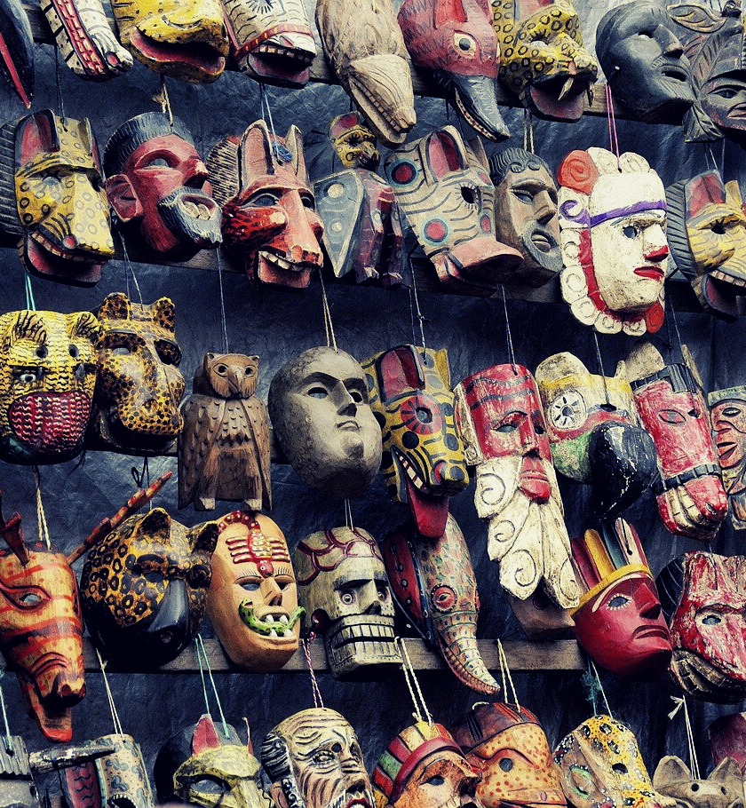
In this activity
Understand the concept of culture
Define ethnocentrism and cultural relativism
Learn how culture is shared and can change over time
Compare and contrast different cultures, including your own
Topics We'll Cover

Slide 3
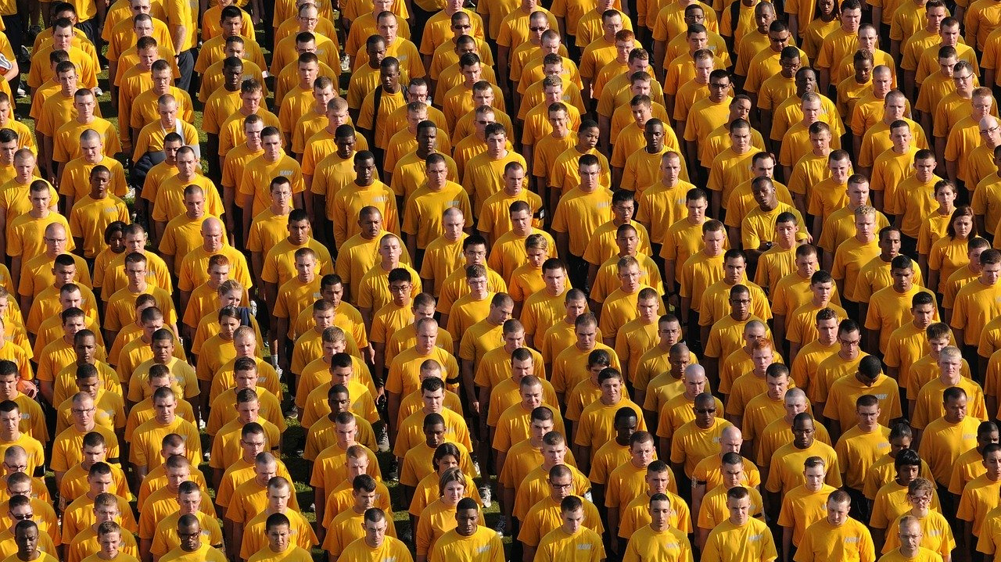
WHAT IS CULTURE?

Slide 4
Culture represents shared norms, values, ideas and patterns of learned behavior.
Because culture is learned, it is always changing. When people respond to environmental changes as well as social ones, culture changes as people try to adapt to new circumstances. It is also imbued with symbolic meaning, such as through language.
An individual may belong to overlapping cultural spheres at any one time.
Did you know?

Slide 5
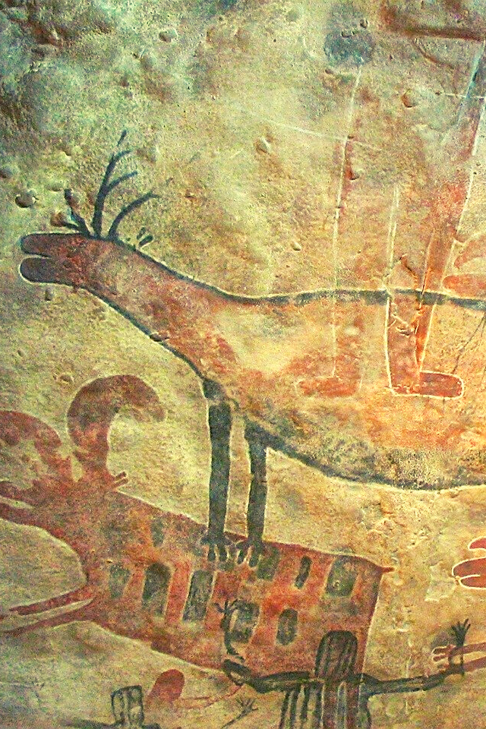
Many people trace their cultural foundations through kinship and the family. Additional cultural identities can be based on ethnicity, nationality, language, religion, occupation, gender, or age, or a combination of these.
Traditionally, anthropologists focused on the culture of bounded societies, often defined by common language and geography. More recently, other types of cultures have been recognized, such as an immigrant community in a city, a business corporation, or a transnational diaspora.

Slide 6
ETHNOCENTRISM
Ethnocentrism is when a person believes that his or her own cultural values and ideals are the best and most valid way to behave. Because we each grow up surrounded by familiar practices, or people who mostly act like we do, it is not unusual to find some ethnocentrism in all cultures around the world. However, extreme ethnocentrism and intolerance of others is the basis for racism, xenophobia, and ethnic conflict, among other forms of hatred or violence.

Slide 7
CULTURAL RELATIVISM
Cultural relativism is the idea that other people’s lives, values, and beliefs should be respected and understood on their own terms rather than based on how closely they might match up to an outside observer’s own cultural standards.
This approach requires one to suspend judgement about practices that may seem unusual or even “wrong” at first glance, and to attempt to look at the world through the eyes of another. Anthropologists try to understand the conditions that might explain the cultural behavior.

Slide 8
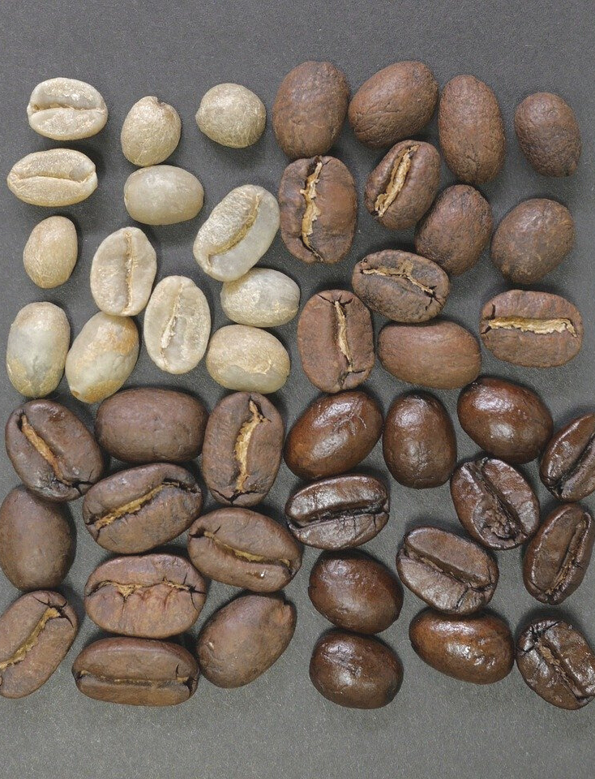
CULTURAL RELATIVISM
For cultural relativists, no single culture is superior or inferior to another. While cultural relativism represents the opposite of ethnocentrism, in its most extreme form, absolute relativism suggests that there is no way to judge any human behavior outside of its cultural context. This can similarly be used to justify atrocities or human rights violations.
It is by exposure to other ways of life that people can begin to challenge the assumption that their culture is the “best” or only way to live.

Slide 9
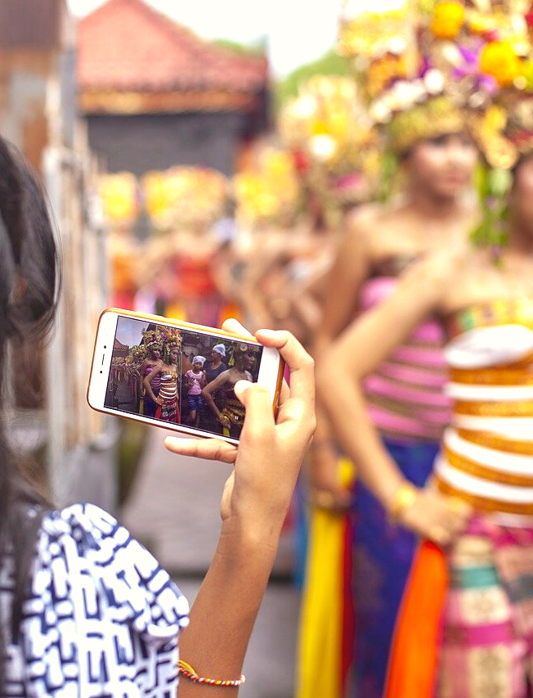
CULTURAL DIFFUSION
Anthropologists combat ethnocentric ideas by living among other communities. Through ethnography, they show that it is possible to learn and adapt to different cultures and their distinct ways of living, and that all cultures share important similarities as well as differences. Anthropology teaches us that all cultural groups are constantly learning and adopting ideas from one another.
Cultural diffusion – or the spread of cultural beliefs, practices, and material artifacts across populations – leads to the sharing of thoughts and behaviors between groups.

Slide 10
DISCUSSION QUESTIONS
What are some cultural traits?
How do we know if two individuals have a shared culture?
Is culture static? Why or why not?
Can cultural practices be deemed objectively “good” or “bad”?
What are some cases of extreme ethnocentrism and extreme relativism?
Can you think of any examples of cultural diffusion?

Slide 11
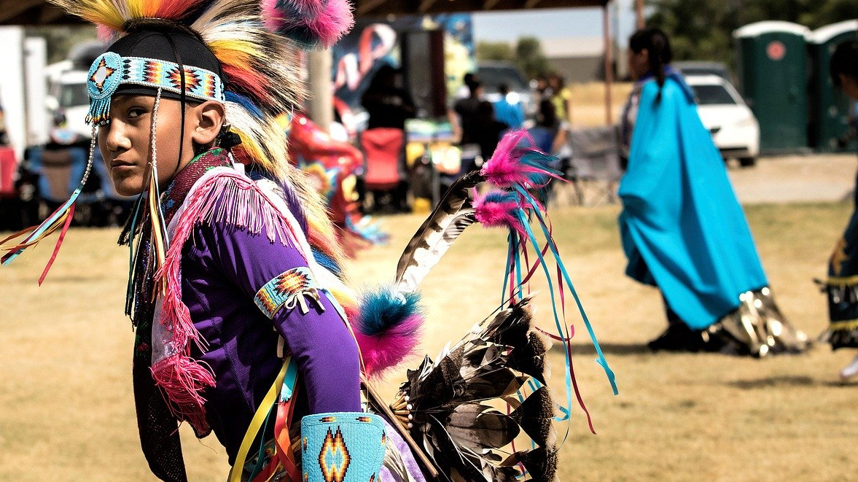
ACTIVITY 1
Cultural Comparison

Slide 12
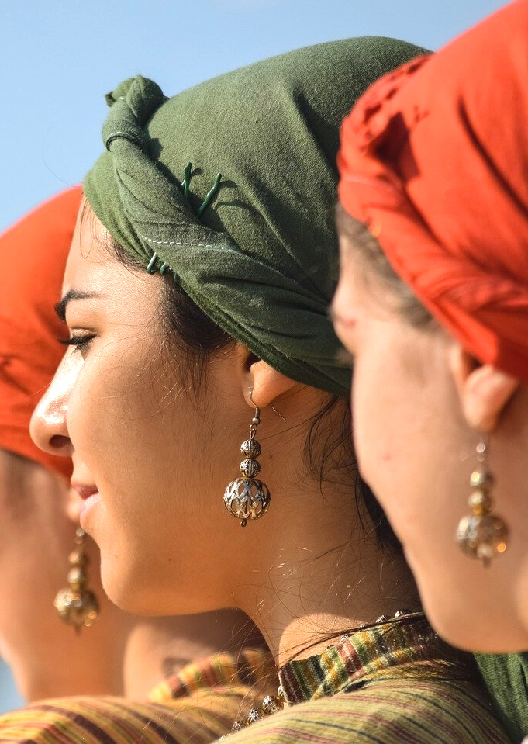
Using Culture Summaries in eHRAF World Cultures, compare and contrast 2-3 aspects of culture across 3 societies from different world regions in eHRAF.
Go to Browse Cultures to select 3 cultures from different regions of the world as shown in the instructions below.
Then, read the culture summaries for your selected cultures.
Focus on 2-3 aspects of the culture summary, such as kinship, marriage, economics, politics, social stratification or religious beliefs.

Slide 13
Culture Summaries
A brief overview for societies in eHRAF World Cultures is provided in the form of Culture Summaries.
The format, general outline, and headings are the same for each summary. You will find a basic overview about the culture, such as its economy, history, environment, and sociopolitical organization.
eHRAF
World
Cultures
To find a culture summary, go to the Browse Cultures tab. Enter the culture name into the box, then click to expand the result. Click on Full Profile to reach the Culture Profile, then access the Culture Summary via the Summary tab.

Slide 14
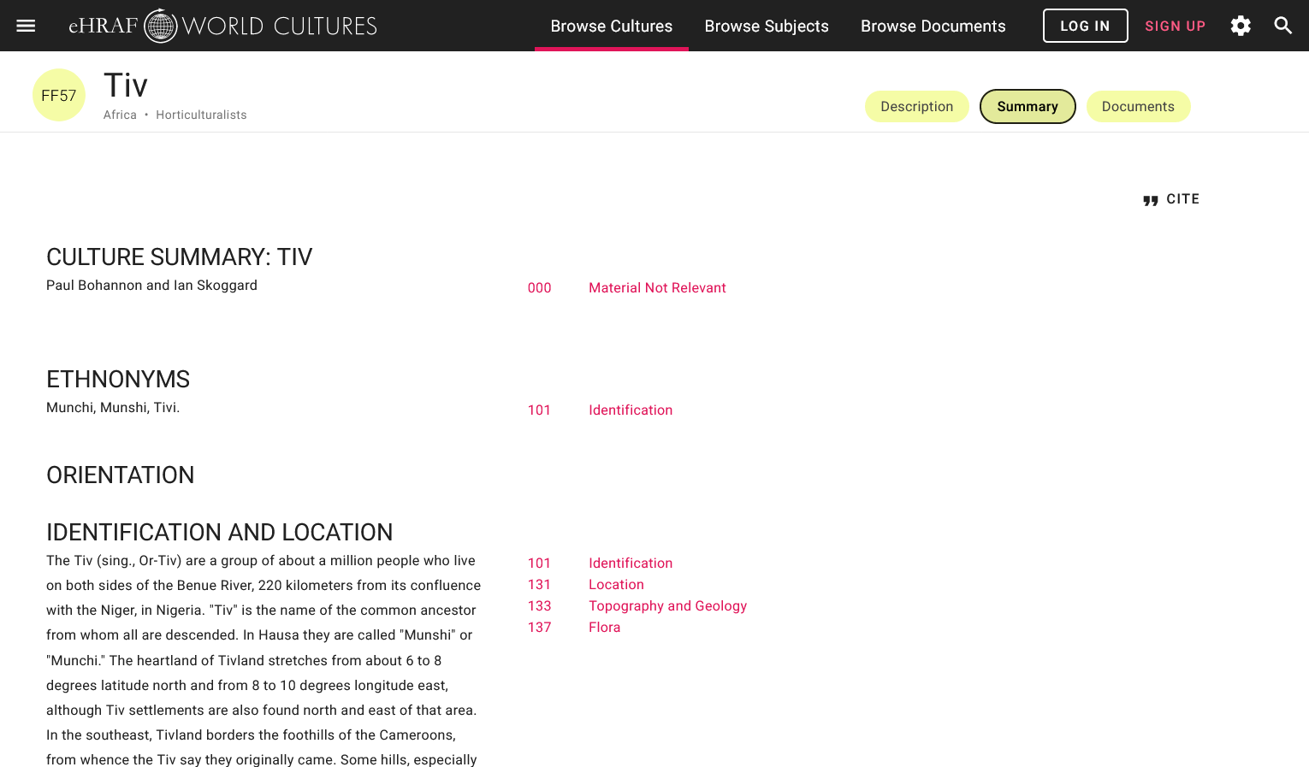
FIND CULTURE SUMMARIES

Slide 15
Create a table like the one below to record a summary of your findings for each culture.
List the culture name, OWC, and geographic location at the top of each column, and the topics you have chosen to the left of each row.
Fill in the table using the information you have read in the eHRAF culture summaries.
The sample table below has been filled in with one example.

Slide 16
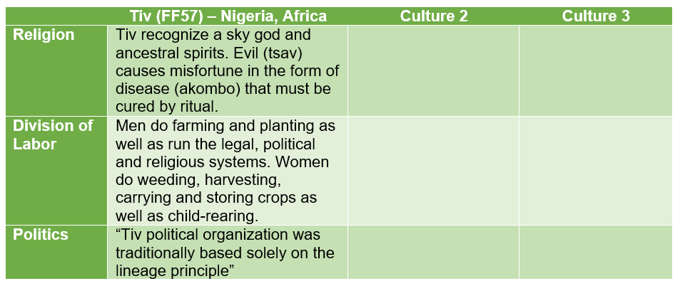
SAMPLE TABLE

Slide 17
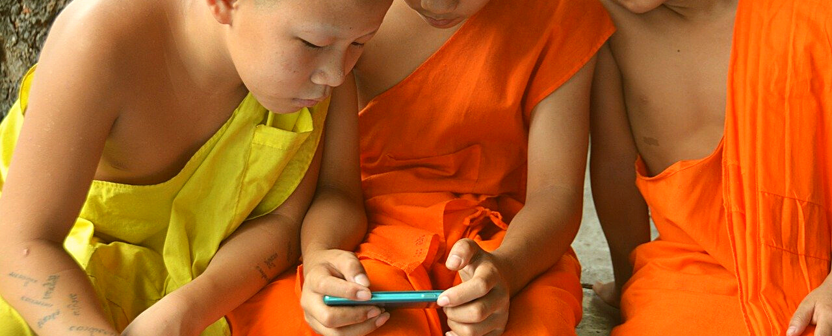
Compare & Contrast
Once your table is complete, compare your chosen aspects of culture across your selected regions. What similarities and differences have you found?
Then, compare what you found to what life is like in your own culture. Have you found any more similarities or differences?

Slide 18
ACTIVITY 2
Group Discussion

Slide 19
GROUP DISCUSSION QUESTIONS
Share your answers with one or more classmates. Compare your cultural findings from eHRAF as well as and the key aspects of the culture(s) that you belong to.
What culture or cultures do you identify with?
What are the features of your culture that differentiate it from others?
Do you and your classmate(s) share common cultural traits? List as many as you can think of.
Have you discovered any cultural traits that may be human universals (in other words, common across all cultures)?

Slide 20
1. This activity is based on Introducing Culture, by Francine Barone, in Teaching eHRAF. https://hraf.yale.edu/teach-ehraf/introducing-culture/
2. Bohannan, Paul. 1998. “Culture Summary: Tiv.” New Haven, Conn.: HRAF. https://ehrafworldcultures.yale.edu/document?id=ff57-000.
References

Slide 21
Understanding Culture
in eHRAF World Cultures
Produced by
Human Relations Area Files
at Yale University
An eHRAF Workbook Activity
hraf.yale.edu

